Slide 1
CAWT – Overview of packages
Microsoft Office packages
CawtExcel
Microsoft Excel
CawtOutlook
Microsoft Outlook
CawtPpt
Microsoft PowerPoint
CawtWord
Microsoft Word
CawtEarth
Google Earth
CawtExplorer
MS Internet Explorer
CawtOcr
MS Document Imaging
CawtMatlab
MathWorks Matlab
CawtCore
Basic Automation
Twapi
Tcl Windows API extension

Slide 2
Module excelCsv – Procedure overview
CSV
File
ReadCsvFile
Matrix
(List of lists)
Excel
Worksheet
Excel
File
WriteCsvFile
SetMatrixValues
OpenWorkbook
CSV
String
CsvStringToMatrix
GetMatrixValues
SaveAs
MatrixToCsvString
SaveAsCsv

Slide 3
Module excelTablelist – Procedure overview
Tablelist
Excel
Worksheet
GetTablelistValues
Matrix
(List of lists)
SetMatrixValues
SetTablelistValues
GetMatrixValues
TablelistToWorksheet
WorksheetToTablelist

Slide 4
Module excelMatlabFile – Procedure overview
Matlab
File
Excel
Worksheet
Excel
File
ReadMatlabFile
Matrix
(List of lists)
SetMatrixValues
OpenWorkbook
WriteMatlabFile
GetMatrixValues
SaveAs
MatlabFileToWorksheet
WorksheetToMatlabFile
MatlabFileToExcelFile
ExcelFileToMatlabFile

Slide 5
Module excelWord – Procedure overview
Word Table
Excel
Worksheet
Word::GetMatrixValues
Matrix
(List of lists)
SetMatrixValues
Word::SetMatrixValues
GetMatrixValues
WordTableToWorksheet
WorksheetToWordTable

Slide 6
Module excelImgRaw – Procedure overview
RawImage
File
Excel
Worksheet
Excel
File
ReadRawImageFile
Matrix
(List of lists)
SetMatrixValues
OpenWorkbook
WriteRawImageFile
GetMatrixValues
SaveAs
RawImageFileToWorksheet
WorksheetToRawImageFile
RawImageFileToExcelFile
ExcelFileToRawImageFile

Slide 7
Module excelMediaWiki – Procedure overview
MediaWiki
File
Excel
Worksheet
Excel
File
ReadMediaWikiFile
Matrix
(List of lists)
SetMatrixValues
OpenWorkbook
WriteMediaWikiFile
GetMatrixValues
SaveAs
MediaWikiFileToWorksheet
WorksheetToMediaWikiFile
MediaWikiFileToExcelFile
ExcelFileToMediaWikiFile

Slide 8
Module excelWikit – Procedure overview
Wikit
File
Excel
Worksheet
Excel
File
ReadWikitFile
Matrix
(List of lists)
SetMatrixValues
OpenWorkbook
WriteWikitFile
GetMatrixValues
SaveAs
WikitFileToWorksheet
WorksheetToWikitFile
WikitFileToExcelFile
ExcelFileToWikitFile

Slide 9
Module excelHtml – Procedure overview
HTML
File
Excel
Worksheet
Excel
File
Matrix
(List of lists)
SetMatrixValues
OpenWorkbook
WriteHtmlFile
GetMatrixValues
SaveAs
WorksheetToHtmlFile
ExcelFileToHtmlFile

Slide 10
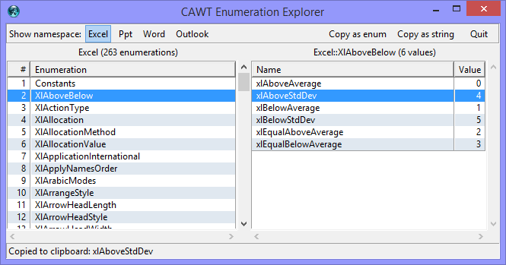

Slide 11
Input
Tcl Scripts
Output
UserManual Template
CawtManualTemplate.doc
User Manual
CawtManual-VERSION.doc
UserManual Pictures
CawtFigures.ppt
Gen. UserManual Doc.
genCawtDoc.tcl
User Manual
CawtManual-VERSION.pdf
CAWT Source
Tcl Files
%VERSION%
%DATE%
%YEAR%
%FIGURE Figure-01%
%TABLE Excel%
%TABLE TestPrograms%
CAWT Reference
HTML Files

