Slide 1

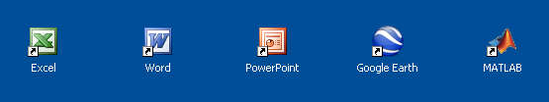
CAWT – COM Automation With Tcl
A Work-In-Progress report
by Paul Obermeier
CAWT
=
+
European Tcl/Tk User Meeting 2012, Munich

Slide 2
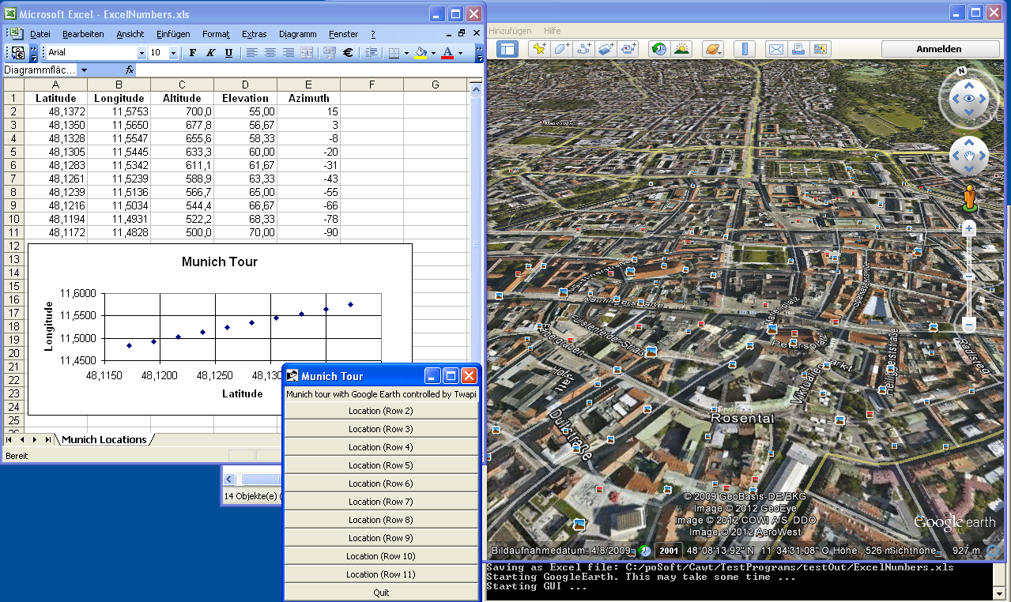
CAWT – What it is good for?
High-level Tcl interface for scripting Windows applications having a COM interface:
Excel
Word
PowerPoint
GoogleEarth
Matlab

Slide 3
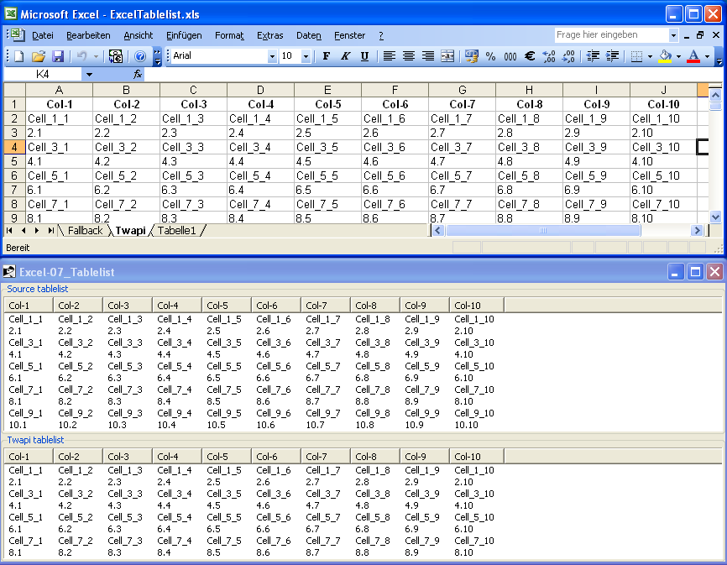
CAWT – What it is good for?
Exchange of tabular data:
Excel tables
Word tables
Tablelist
Raw images
Matlab MAT-files
CSV files
MediaWiki tables

Slide 4
CAWT - History
2008/09/11 TcomExcel 0.1 Initial release. Support for Excel 2000 and 2003.
2009/09/19 TcomExcel 0.2 Extended functionality. Added support for Excel 2007.
2010/10/29 TcomExcel 0.3 Bug fixes and extended test programs.
2011/01/13 TcomExcel 0.3.1 Extended functionality. Added support for Excel 2010.
2011/04/05 TcomExcel 0.3.2 Extended functionality.
2011/07/17 TcomOffice 0.4.0 Renaming of extension to TcomOffice.
New module TcomWord for Word automation.
2011/08/28 TcomOffice 0.4.1 Extended functionality.
2012/01/21 TcomOffice 0.5a3 Alpha release: Use Twapi for COM access instead of Tcom.
Tcom has no 64-bit support. No active development.
2012/??/?? CAWT 1.0 Yet another rename. No Tcom anymore.
Twapi developer Ashok Nadkarni extends and refactors COM
support in Twapi (currently at version 4.0a2)
Added (minimal) support for PowerPoint, GoogleEarth, Matlab.

Slide 5
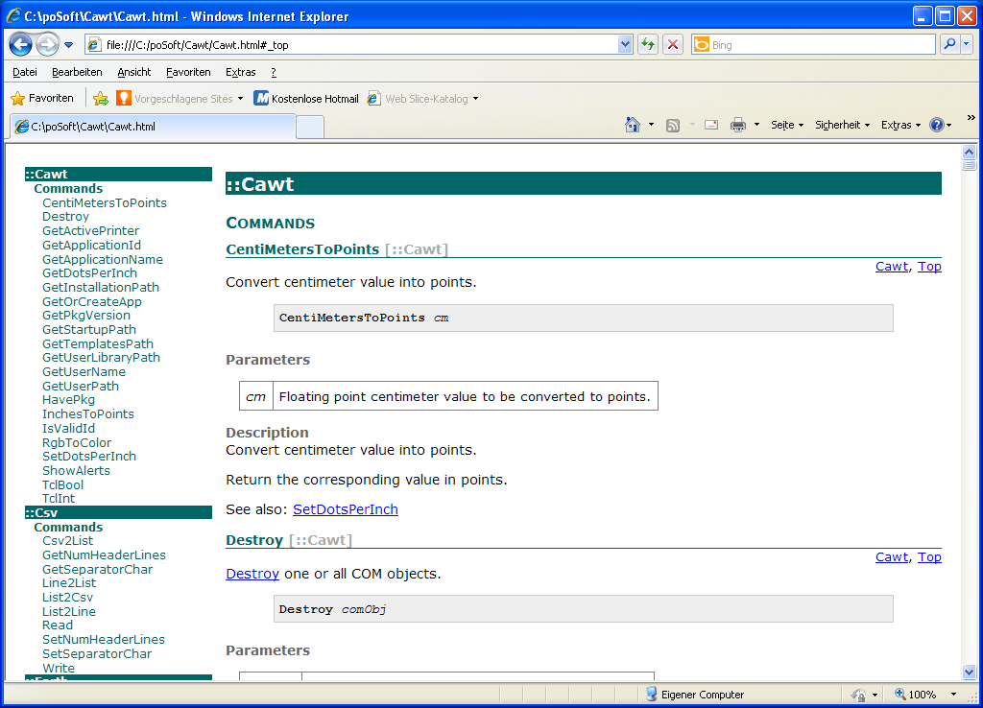
CAWT – Current Work
Refactoring to eliminate duplicate code (using common namespace Cawt).
Add inline documentation (will be converted to HTML with ruff)
Improve insertion/extraction speed of large Excel data due to new Value2 function in Twapi version 4.
Speed comparison (3 tables with 100x10 cells):
SetCellValue (visible): 8400 ms
SetCellValue (hidden): 7200 ms
Using clipboard (visible): 150 ms
Using clipboard (hidden): 110 ms
Using Value2 (visible): 45 ms
Using Value2 (hidden): 45 ms

Slide 6
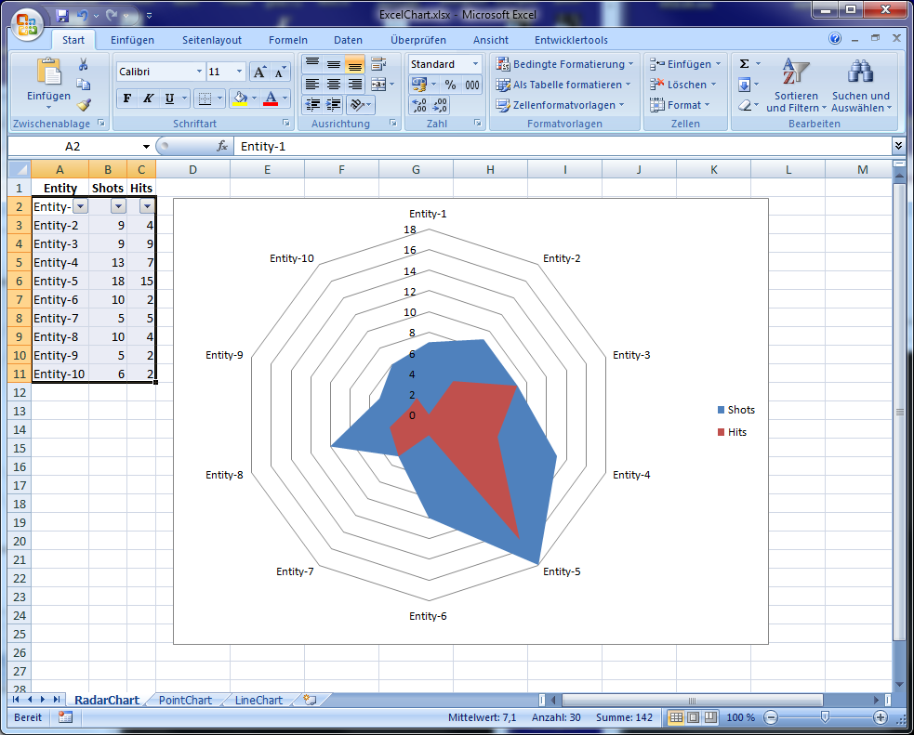
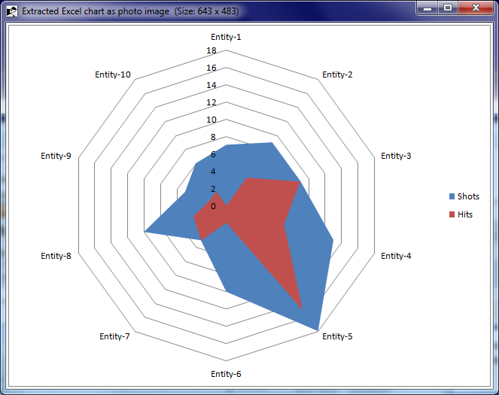
CAWT – Examples
CAWT comes with lots of test programs showing usage examples.
Screenshot of an Excel workbook consisting of 3 worksheets with 3 different chart types generated by a Tcl script.
The Excel chart was copied to the Windows clipboard with the Twapi extension and pasted into a photo image with the help of the tkImg extension.

