Slide 1





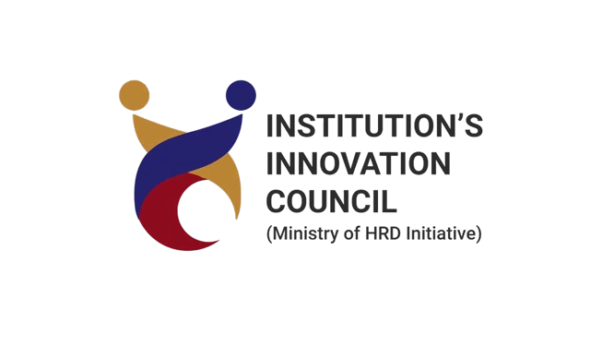
Round 1 Idea Submission
[Tech Titus]
Vedant Borle
Arjun Dudile
Digvijay Bhongale
Theme: Environmental Impact
Problem Statement: Integrated Medication Adherence and Management Platform

Slide 2
[Tech Titus]
IDEA TITLE
Integrated Medication Adherence and Management Platform
Objectives Of This Project:
Personalized Medication And Dosage Recommendations From EHR Data
Optimizing Therapeutic Outcomes
Improving Treatment Precision
Reducing Trial-and-error
Solution to the Problem:
Personalized Recommendations
Efficient Predictions
Seamless Integration
Enhanced Accuracy
Dosage Timers
Dosage Control
Innovation:
Alerts On Dosage Amount/Limit And Timings
Personalised Drug Interaction Model
Integration With Wearable Data

Slide 3

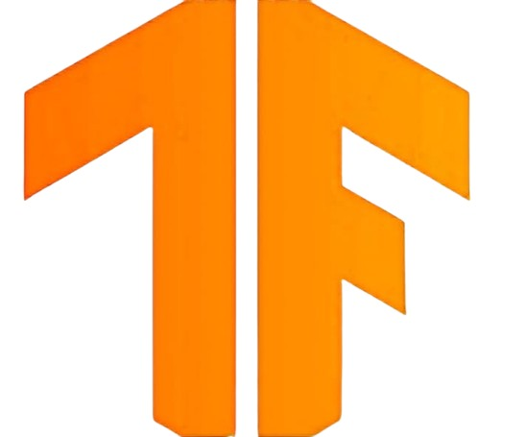
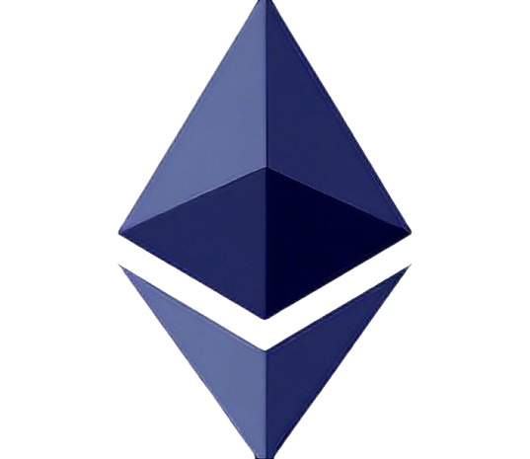

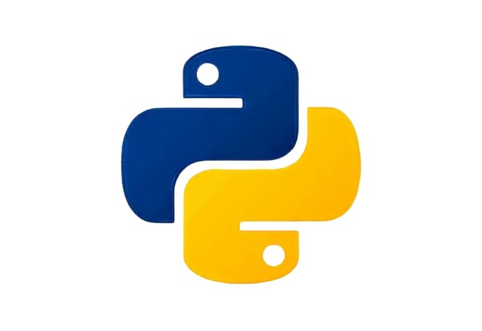
[Tech Titus]
TECHNICAL APPROACH
Predicting Non-adherence Risk: Decision Trees, Random Forests, SVM
Analyzing Patient Data: Clustering, CNN, RNN, Anomaly Detection.
Optimizing Dosage And Timing: Simulated Annealing, Genetic Algorithm
NLP In Communication: NLP Models (GPT-3), Named Entity Recognition (NER)
Python – Machine Learning, AI, Data Processing.
Hugging Face Transformers – For API Natural Language Processing Tasks
Javascript, React & Node.Js – For Web Interface
Firebase Authentication - For User Account Management And Authentication

Slide 4
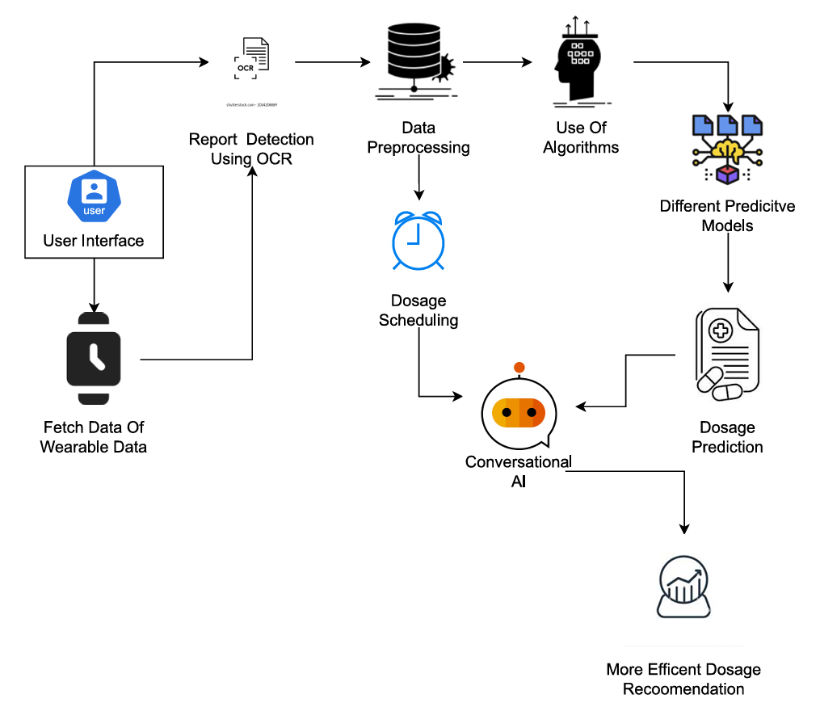
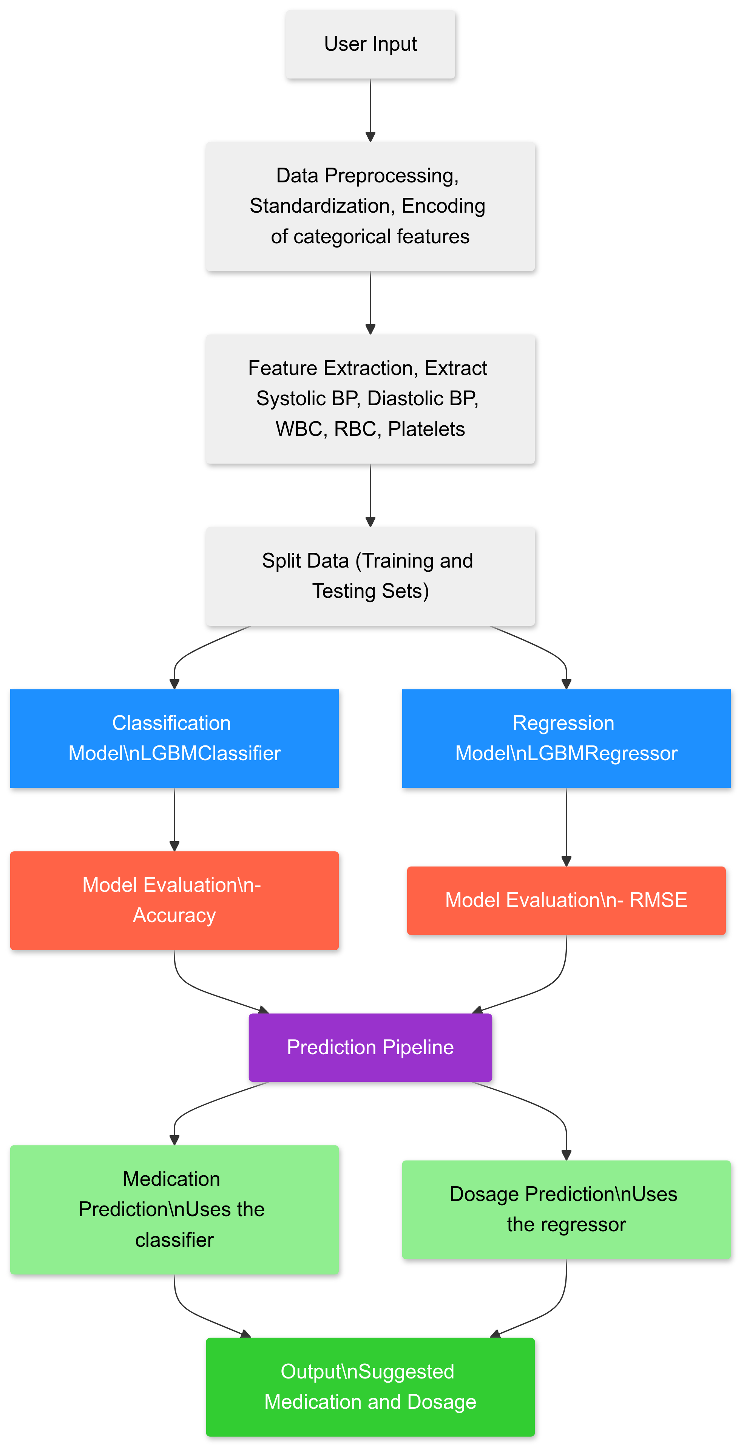
[Tech-Titus]
METHODOLOGY

Slide 5
[Tech Titus]
FEASIBILITY AND VIABILITY
Feasibility:
Data Availability: Real-world Data Integration Can Be Addressed
Integration: Compatible With EHR Systems, Facilitating Seamless Adoption
Scalability: Designed To Scale With Additional Real Patient Data
Real-time Processing: Capable Of Processing Data In Real-time, Enhancing Decision-making Speed.
Scalable Infrastructure: Supports Cloud-based Or On-premises Deployment Options
Viability:
Development Costs: Utilizes Open-source Tools And Libraries, Reducing Initial Development Expenses.
Market Demand: Addresses A Growing Need For Ai-driven Healthcare Solutions.
Scalability: Can Be Scaled To Handle Larger Datasets And More Complex Models
Cost-efficiency: Uses Cost-effective ML Frameworks And Cloud Services, Making It Financially Viable
Regulatory Compliance: Ensuring Legal And Ethical Use.

Slide 6
[Tech Titus]
IMPACT AND BENEFITS
Impacts On Target Audience:
Reduced Side Effects
Cost Savings
Patient’s Trust
Reduced Hospital Readmissions
Better Medication Adherence
Benefits For Patients:
Personalized Treatment
Fewer Side Effects
Faster Recovery
Enhanced Engagement
Benefits For Healthcare Providers:
Improved Decision-making
Cost Savings
Reduced Errors
Better Eye On Patients Health
Modes Of Usage:
Freemium Model
Subscription Model
Per-Usage Pricing

Slide 7
[Tech-Titus]
CONCLUSION
The AI-powered solution is going to revolutionize personalized health care by optimizing medications and dosages in ways that will improve patient outcomes, enhancing the efficiency of clinicians, hence, permitting data-driven, precision medical care.
Personalized Healthcare: Offers personalized medication and dosage advice based on the individual patient data.
Scalable/Flexible: Able to scale up with real-world data over time. Long-term adaptability with the EHR system easily possible.
Future Potency: Has the potential for improvement, with more sophisticated AI models, to then be clinically validated and used more broadly.
Broad Impact: Improvement in health outcomes of the patients and the providers, with simplification of care provided.

Slide 8
[Tech Titus]
IMPORTANT RULES AND INSTRUCTIONS
THANK YOU

