Slide 1
Predicting Non-Motorized Severe Crash Occurrence in Incidents Involving Vehicle-Pedestrian/Cyclist
Team – Sia Mwende & Digvijay Bhagat

Slide 2
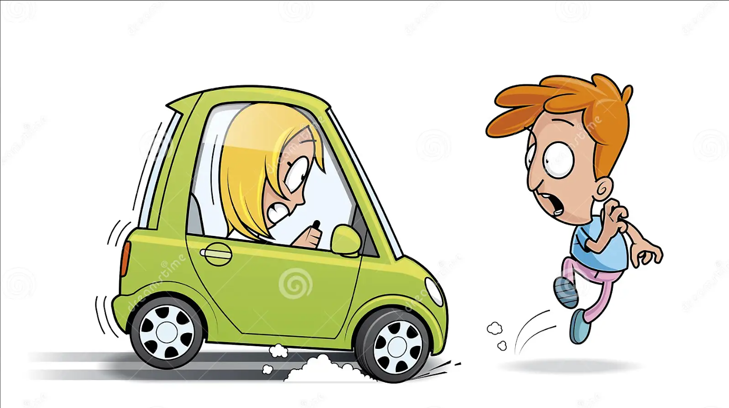
Introduction
The motivation behind this study is by an increasing interest in non-motorized transportation safety in U.S. cities.
It emphasizes the economic, environmental, and health benefits of non-motorized travel while addressing safety concerns.
The specific study mentioned aims to predict severe crashes, contributing to improved safety for non-motorized transportation.

Slide 3
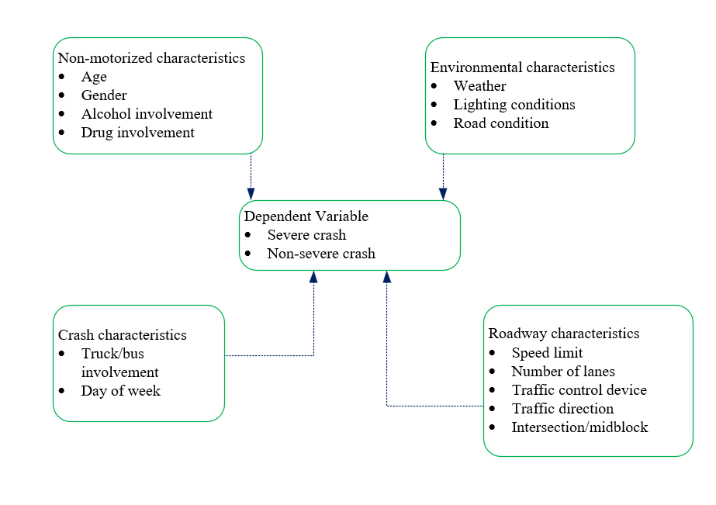
Data Used
Pedestrian and cyclist crashes in Michigan from 2009 to 2021.
51,914 observations were used.
1 binary target variable and 16 predictor variable.

Slide 4
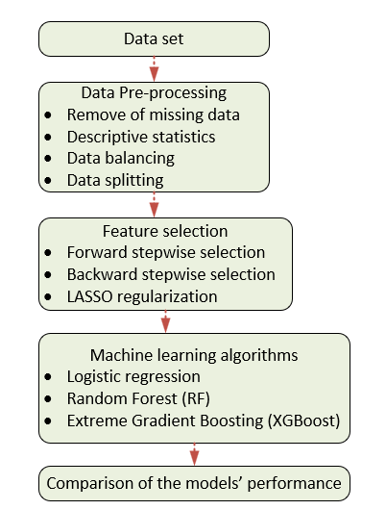
Methodology
Overview structure of the data analysis

Slide 5
Descriptive Statistics
 | Non-severe Injury |  | Severe Injury
Variable | Count | Percent | Count | Percent
Day of the week
Weekday | 33700 | 79% | 6755 | 73%
Weekend | 8997 | 21% | 2462 | 27%
Weather
Clear/Cloudy | 37584 | 88% | 7880 | 86%
Other | 5085 | 12% | 1333 | 14%
Lighting Condition
Dark | 11076 | 26% | 4412 | 48%
Dawn Dusk | 1988 | 5% | 405 | 4%
Daylight | 29453 | 69% | 4372 | 48%
Alcohol
No | 40434 | 95% | 7553 | 82%
Yes | 2263 | 5% | 1664 | 18%
Drug
No | 42412 | 99% | 8633 | 94%
Yes | 285 | 1% | 584 | 6%
 | Non-severe Injury |  | Severe Injury
Variable | Count | Percent | Count | Percent
Location
Midblock | 19949 | 47% | 5594 | 61%
Intersection | 22748 | 53% | 3623 | 39%
Direction of traffic
Non traffic | 3570 | 9% | 627 | 7%
Divided | 5319 | 13% | 1665 | 18%
Not physically separated | 32892 | 79% | 6760 | 75%
Gender
Female | 13267 | 32% | 2841 | 31%
Male | 28400 | 68% | 6314 | 69%
Age
Young | 12673 | 30% | 1997 | 22%
Adult | 22224 | 52% | 5444 | 59%
Elder | 7800 | 18% | 1776 | 19%
Speed limit (mph)
0-25 | 18197 | 43% | 2249 | 24%
Missing data were removed.
Variables such as dark conditions, alcohol and midblock location have higher proportion of severe crashes compared to non-severe crashes

Slide 6
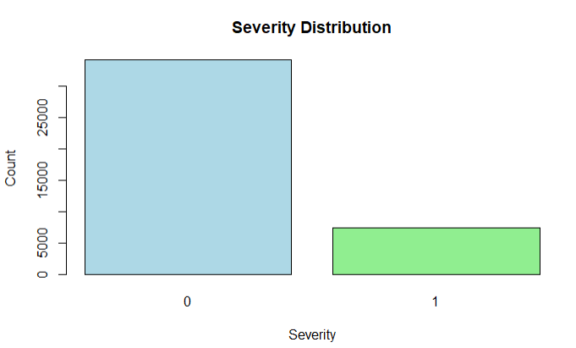
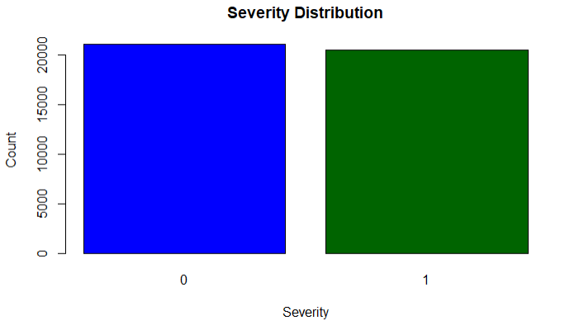
Data Pre-processing
Before
After
The data set was split into train data (80%) and test data (20%)
Data was balanced by oversampling using the ROSE package in R for training data

Slide 7
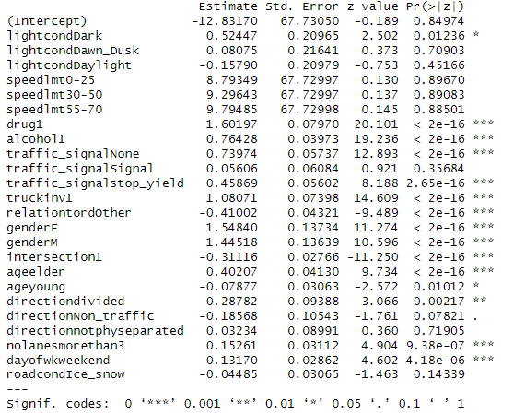
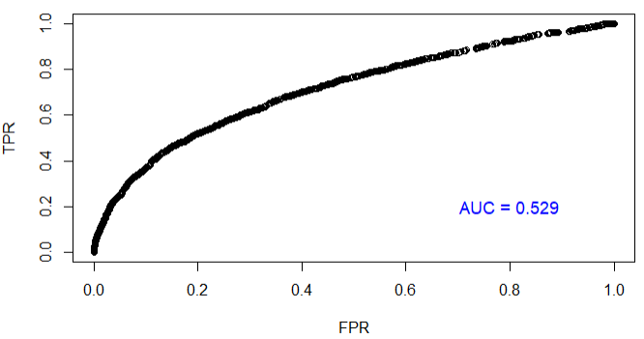
Feature Selection
Forward and Backward Stepwise selection
LASSO regularization
Both forward and backward yielded the same variables with similar lowest AIC. Only one variable (weather) was removed.
LASSO regularization didn’t perform well hence variables were not adopted (AIC=0.53)

Slide 8
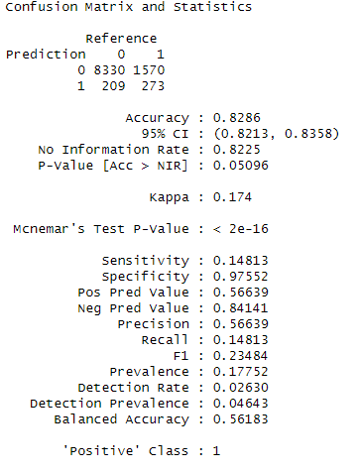
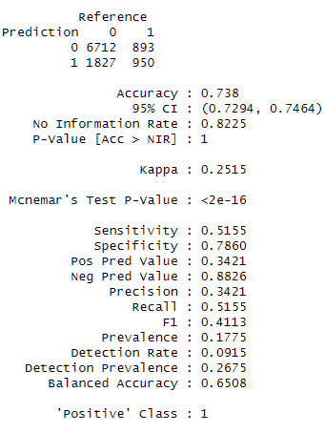
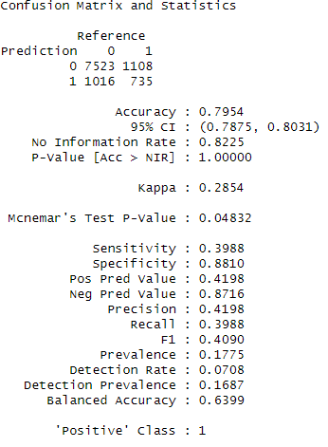
Machine Learning Methods
Logistic Regression, Random Forest and XGBoost

Slide 9
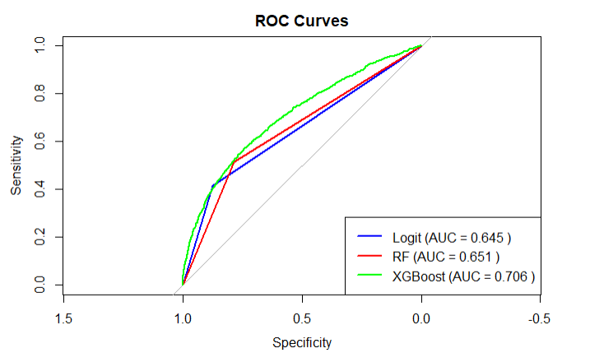
Models Evaluation Performance
The AUROC for the XGBoost classifier is higher than that of the logistic regression and RF classifier on the test dataset.

Slide 10
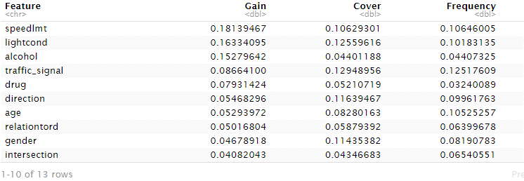
Feature Importance
Results show that factors such as speed limit of the road, alcohol involvement, lighting conditions are the most important variables in predicting non-motorized severe crash.

Slide 11
Conclusion
In recent years, there has been an increasing amount of interest in non-motorized safety in U.S. cities
Three machine learning algorithms were used to predict non-motorized severe crash occurrence in incidents involving vehicle-pedestrian/cyclist
XGBoost outperformed LR and Random Forest.
Speed limit of the road, alcohol involvement, and lighting conditions are the most important variables to consider when improving the safety of non-motorized traffic.

Slide 12
Thank you!

