Slide 1

Phishing Sites Prediction
Name Roll No.
Digvijay Patil 77

Slide 2

Contents
Introduction
Problem Statement
Flowchart
Proposed methodology
Literature review and state of the Art technology/Method
Objectives of Project
Domain Technology and Tools/ software's used
Work done till now
Outcome
Reference

Slide 3
Introduction
Phishing :- It is a act of attempting to acquire credential information such as username, password, credit card details and OTP and so on as trustworthy entity in an electronic communication
Clone phishing
In clone phishing, phishing attackers create clone site of any bank, university and so on after that they share their URLs which are also not easily predictable or detectable.
Email phishing
Most phishing messages are delivered by email, and are not personalized or targeted to a specific individual or company–this is termed "bulk" phishing
In India, It is a cyber crime. If anyone is found while doing this malpractice then the criminal will be punished for imprisonment of 5 years or more and penalty of 5 lakhs or more under section 43 Information Technology Act, 2000.
Punishment is dependent on the seriousness of crime.

Slide 4
Problem statement
Problem :- We don’t know that the links which are attached with the e-mails and messages which we get randomly are secure or not and it may contain spyware or malware which can be automatically downloaded into our system. It may also contain phishing sites.
Solution :- We are designing a webapp which will predict the link or URL is phishing or not or safe or not.

Slide 5

Flowchart of Project :-
Collection of Data
Split the Data Into Train and Test set
Build The Model
Train the Model
Results
Deploy The Model
Import Links To Prediction

Slide 6
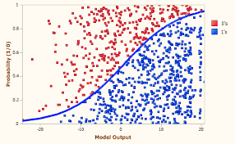
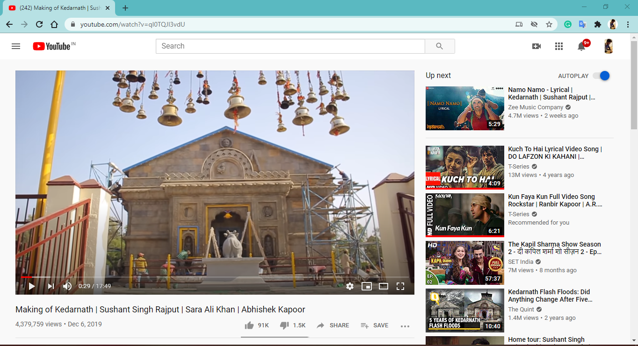
Methodology (How it actually Works)
Pulling
Fit data
Converting
Tokenizes
Transforms
text
Results

Slide 7
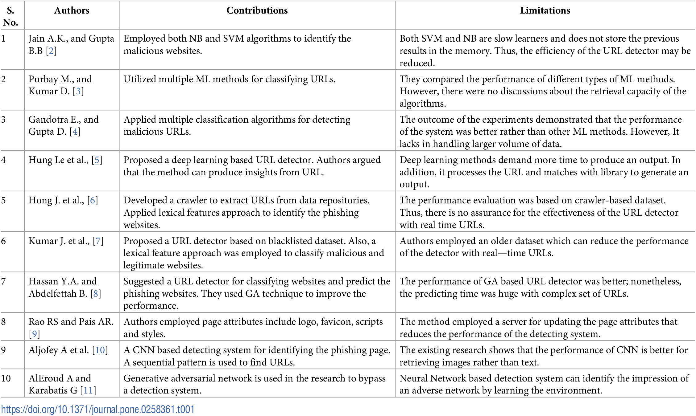
Literature review
2017
2018
2019
2020
2016

Slide 8
Literature review
2015
2019
2005
2006

Slide 9

objectives
It will help us to detect phishing sites and phishing attacks.
It can avoid financial loses of people due to phishing as well as spyware.
It will save some amount of money and time of many users.
It decreases the work of cyber crime police cops.
The user has to enter link of any site then it will be able to easily predict its type.

Slide 10



Domain Technology and Tools / software's used
Domain :- Cyber Security
Tools / Languages used for project :-
Backend development
Python
Jupyter Notebook
Anaconda Spider
Frontend Development
HTML
CSS
Visual Studio Code
Technology :- AI-ML

Slide 11
references
I. Androutsopoulos, J. Koutsias, K. Chandrinos, G. Paliouras, and C. Spyropoulos. An evaluation of naive bayesian anti-spam filtering. In Proc. of the workshop on Machine Learning in the New Information Age, 2000.
I. Androutsopoulos, J. Koutsias, K. V. Chandrinos, and C. D. Spyropoulos. An experimental comparison of naive bayesian and keyword-based anti-spam filtering with personal e-mail messages. In SIGIR '00: Proceedings of the 23rd annual international ACM SIGIR conference on Research and development in information retrieval, pages 160--167, New York, NY, USA, 2000. ACM Press.
Anti-Phishing Working Group. http://www.antiphishing.org/.
M. W. Berry, editor. Survey of Text Mining: Clustering, Classification, and Retrieval. Springer, 2004.
L. Breiman. Random forests. Machine Learning, 45(1):5--32, October 2001.
L. Breiman, J. Friedman, C. J. Stone, and R. A. Olshen. Classification and Regression Trees. Chapman &amp; Hall/CRC, 1984.

Slide 12
Distribution
Name | Roll No. | Distribution
Digvijay | 77 | Backend
Advait | 14 | Frontend
Momin | 63 | Testing models and Documentation

Slide 13
Outcome
To appear for Conference Paper Competition

Slide 14

Thank You !

