Slide 1
Discovering Googles DDSP
Approaching Neural Synthesis
Filip Plavsic, Nico Previtali
Notes:
In the following slides we want to present you our little journey through the ddsp library which is optimized for sound procession by neural networks
Differentiable Digital Signal Processing

Slide 2
Why DDSP ?
DDSP is the state of the art library when working with artificial intelligence and procession of audio and offers a lot of possibilities.
Older audio synthesis networks such as WaveGAN or GANSynth lack the combination of expressive features and efficiency in training, that DDSP offers.

Slide 3
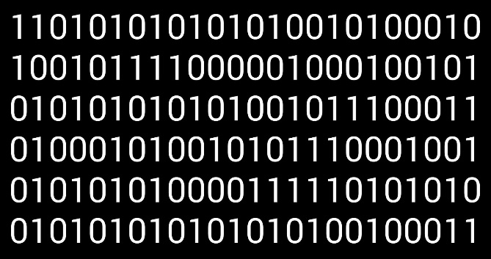

Challenge
One song of 3 minutes = 1 Million time steps BUT relevant information is much less!
How do represent sound in a natural and efficient way ?
?!

Slide 4
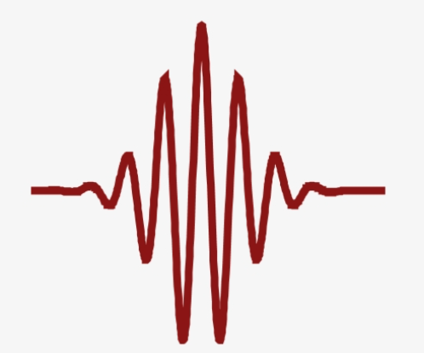
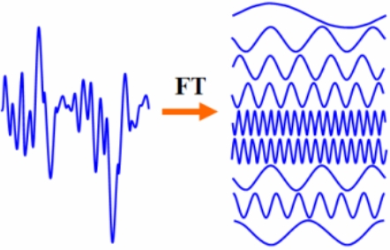
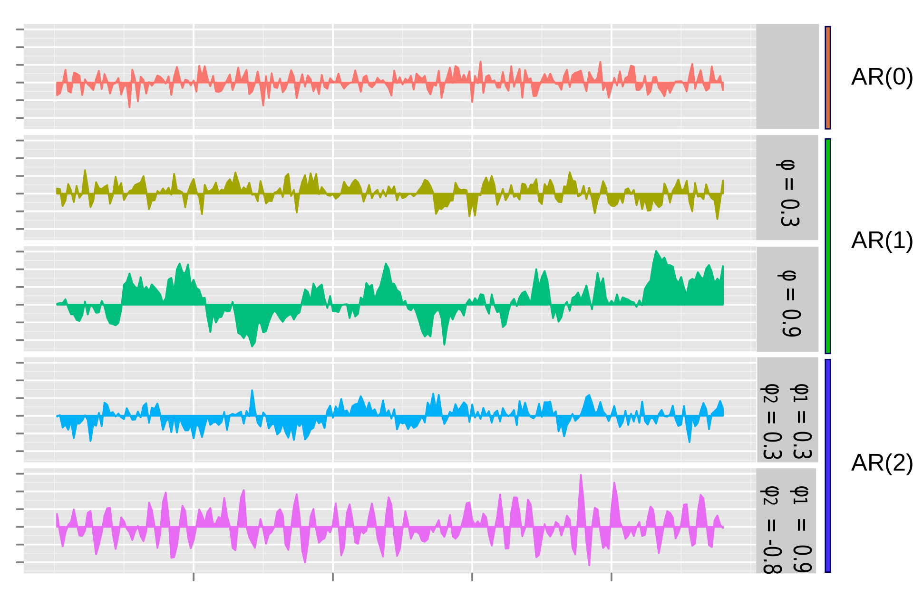
Conventional Representations of Sound
Wavepackets
Fast Fourier Transformation
Autoregressive Interpolation
Notes:
Learn all the waveform packets

Slide 5
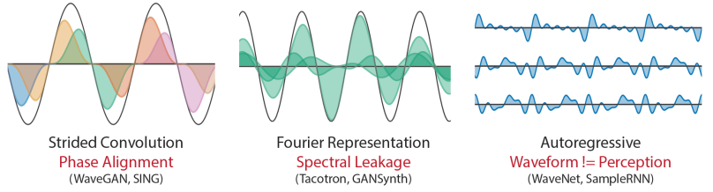
Bias
Conventional feature representations lead to many overlaps and waveforms do not align with our perception
Notes:
Representations not free of bias
Strided Convolution: Waves represented as overlapping frames, whereas in reality sound moves in different phases and would have to be aligned precisely between two fixed frames
Fourier Representation: Same problem, wavepackaets are represented in frames which would have to be aligned perfectly, which can be very complicated
Auto.Interp. : sample by sample, still not aligned with our hearing perception (look different but sound the same and therefore lead to different error in the neural network even though they should not)
We need something inbetween: sample by sample, but still in line with our perception
Hard to work on block
Phase Alignment
Phases of different simultaneous frequencies have to be aligned precisely else they cancel each other out or become to loud which leads to an overall bad mix.
Fourier based Models
Another widely used method was to just learn all the waveform packages, decompose them into sine and cosine waves and finally recreate the soundwave out of the Fourier waves. However, the waveforms overlap and therefore this procedure is inprecise and inefficient.
Autogenerative Models
Autogenerative models try to mitigate these problems by constructing the waveform sample by sample so they do not suffer from the same bias the wave packets. Still, the waveform shapes do not perfectly correlate with human perception because of teacher enforcing / exposure bias during network training. For example the waveforms on the right sound the same for humans but cause different perceptual losses for the model. Moreover they need alot of data to work.

Slide 6
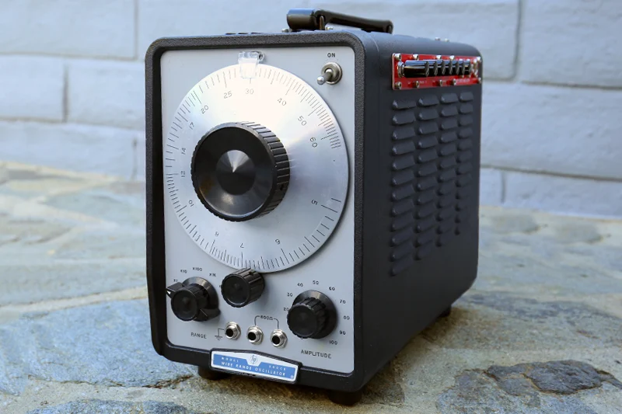
Back to the Roots: Oscillation based Models
Not a new idea, first electronic oscillator dates back to a 1912 radio
Notes:
New: incorporate this knowledge into neural networks

Slide 7
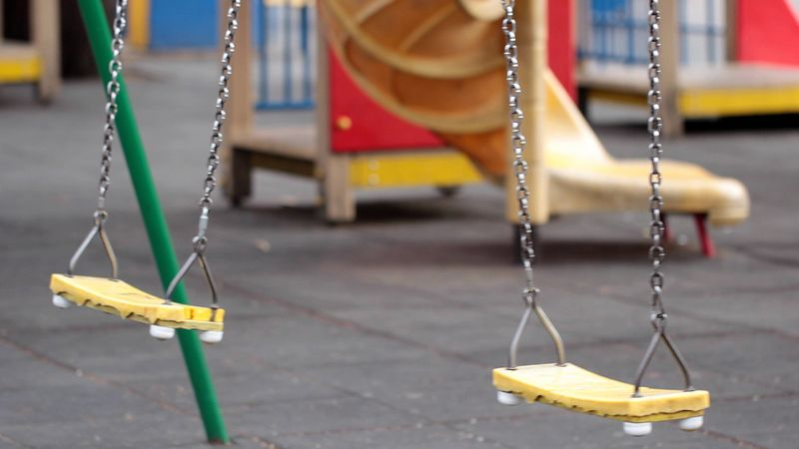
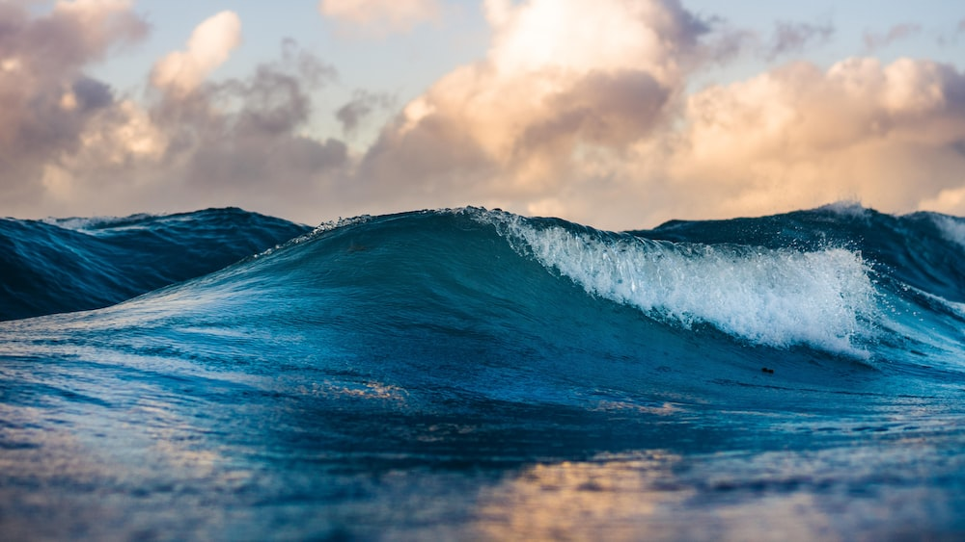
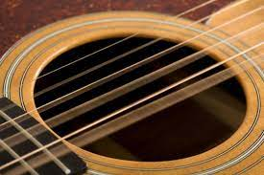
Oscillation
Oscillation is defined as the process of repeating variations of any quantity or measure about its equilibrium value in time
Most of the things in nature oscillate (vibrate) at a characteristic (natural) frequency or frequencies. Some familiar examples are the motions of the pendulum of a clock and playground swing, up and down motion of small boats, ocean waves, and motion of the string or reeds on musical instruments
Notes:
Not a new idea, first electronic oscillator dates back to a 1912 radio
New: incorporate this knowledge into neural networks

Slide 8
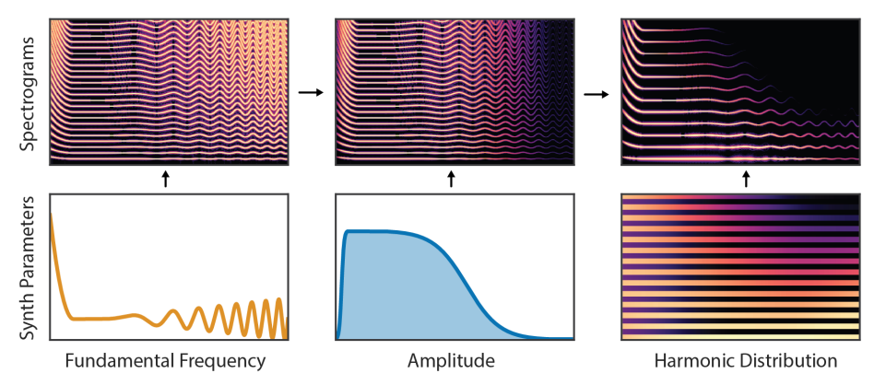
Frequencies and Amplitudes
selective & precise features which go hand with our perception and are easily modifiable

Slide 9
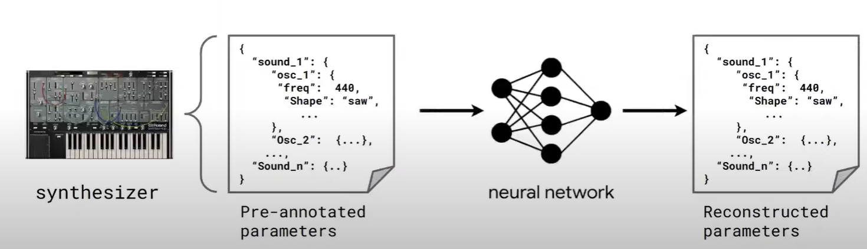
Learning Sound as Synthesizer Parameters
Notes:
Rather than predicting the waveforms or Fourier coefficients those models directly generates the oscillations.
These “analysis/synthesis” models use expert knowledge and hand-tuned heuristics to extract synthesis parameters (analysis) that are interpretable (loudness in dB and frequencies in Hz) and can be used by the generative algorithm (synthesis)

Slide 10
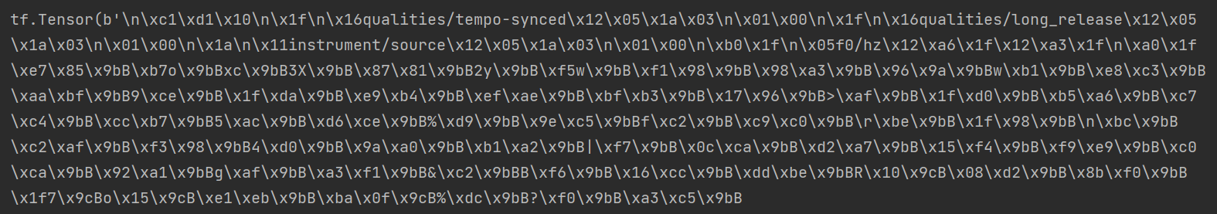
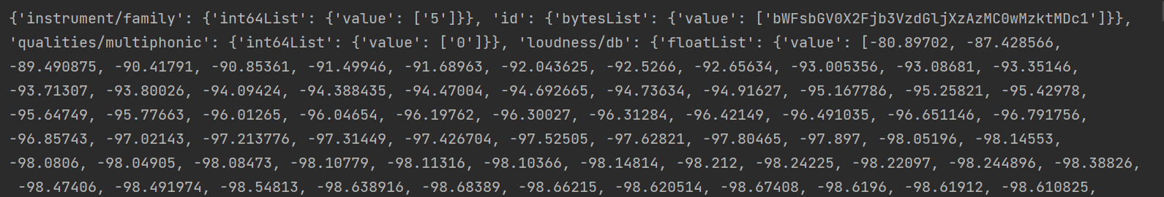
Dataset & Data Structure
We downloaded the TensorFlow dataset NSYNTH GAN subset which consists of around 16 gigabyte of sound samples stored as TFR files
We had to sort all files by instrument label (took around 7 hours) and deleted the objects continuously to prevent memory errors
JSON parsing
Notes:
Took time (around 6 hours) to sort
Memory problems in the beginning

Slide 11
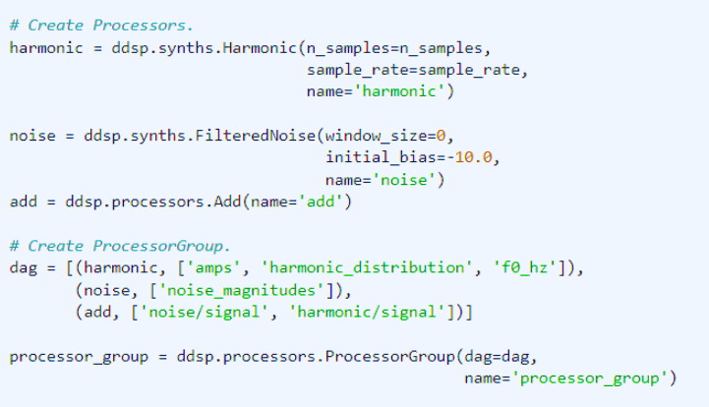
Neural Networks in DDSP
DDSP library offers differentiable synth layers whose parameters can be learned fast by backpropagation to digitally recreate a sound
Synth Layers
Notes:
Deep, specialized structures to learn sound ==> more selective & faster than conventional methods

Slide 12
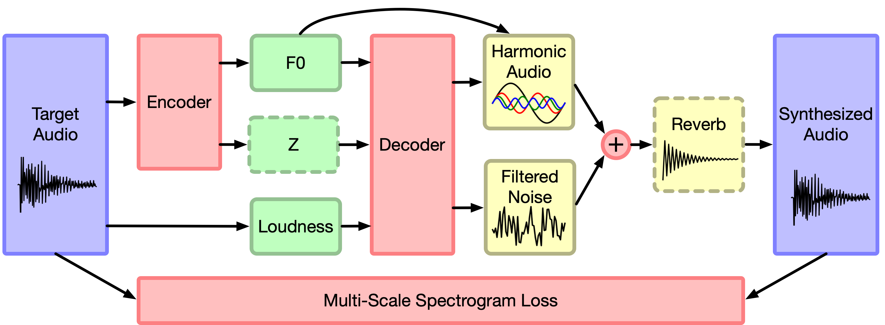
Training
Add
Notes:
1: audio input (as wave or already processed)
2: encode/analyse the relevant features (f0, amplitude)
3: synthesise the sound
4: calculate loss
5: adjust the parameters
6: repeat

Slide 13
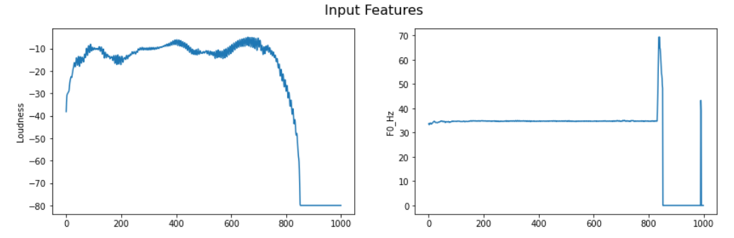
Results after 300 Training Steps (~ 5 Minutes)
Input Audio after Preprocession
Notes:
Fast training leads to quick feedback and allows you to adjust the parameters in time (more like an instrument) opposed to waiting for 16 hours till training finishes and you can finally do something

Slide 14
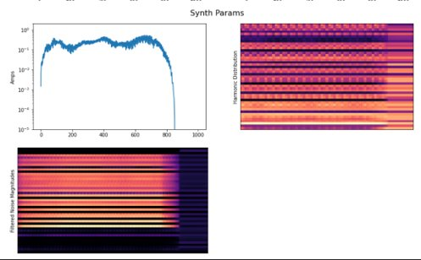
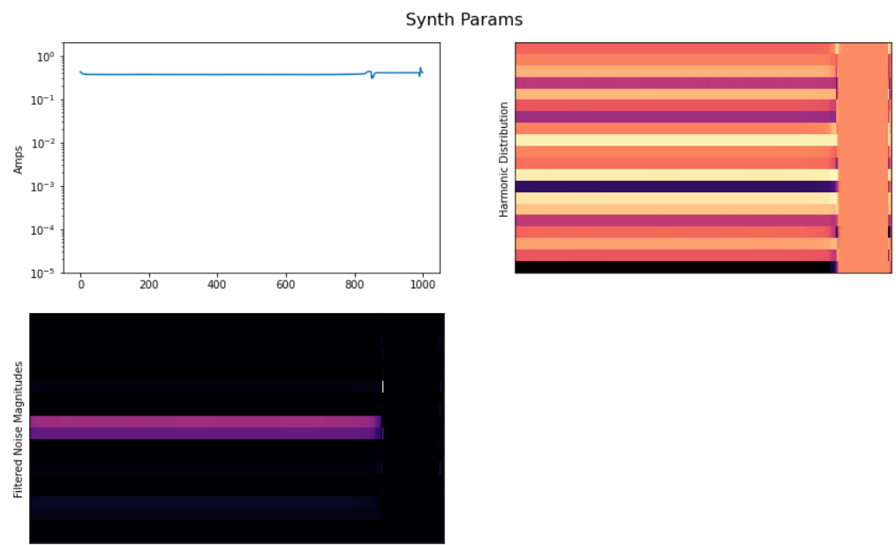
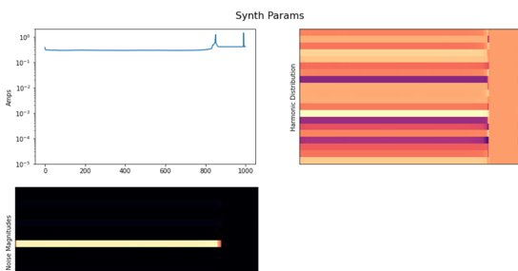
Harmonic Synthesizer
Sinusoid Synthesizer
Wavetable Synthesizer
Notes:
We tried out 3 different synths (=layers)
Harmonic Synthesizer: biggest harmonic spectrum (visible by more horizontal lines)

Slide 15
Learnings, difficulties and last steps
We underestimated the acquisition of the data a bit and did not expect to receive files in the TFRecords format. It took some time to get used to that
DDSP is deep and it feels as if we´ve only scratched the surface yet but is what makes it interesting !
Longer training would be our last step if time allows it. That would lead to a more precise resynthesis of the audio and if we manage to save our model in Google Cloud Storage we could integrate it into further DDSP notebooks such as Timbre Transfer or training one´s own VST that could be used with music softwares such as Ableton.

Slide 16
Thanks for your attention !

