Slide 1
Internship Overview
By: Lee Yen Foong Ernest
VNI CE

Slide 2
Contents
Planning
Requirements
Development
Testing
Challenges
Key Takeaways
Decoder tool

Slide 3
Definition of terms
RoB (RecordOnBehavior) - any abnormal vehicle behavior are recorded
RoB SSR (Snapshot record) - contains information related to the RoB
DTC (Diagnostic Trouble Code) - information notified from the DCM
Remote DTC - information notified from the Electronic control unit (ECU)

Slide 4
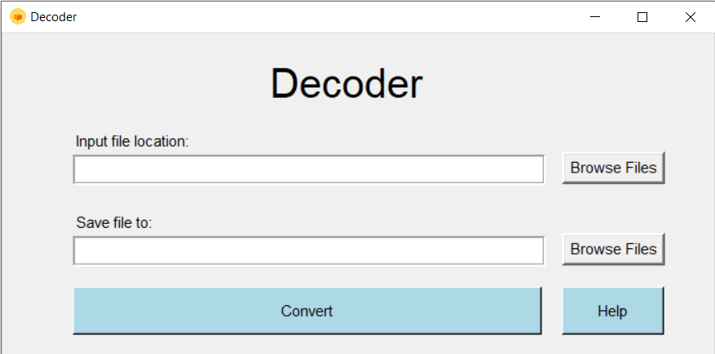
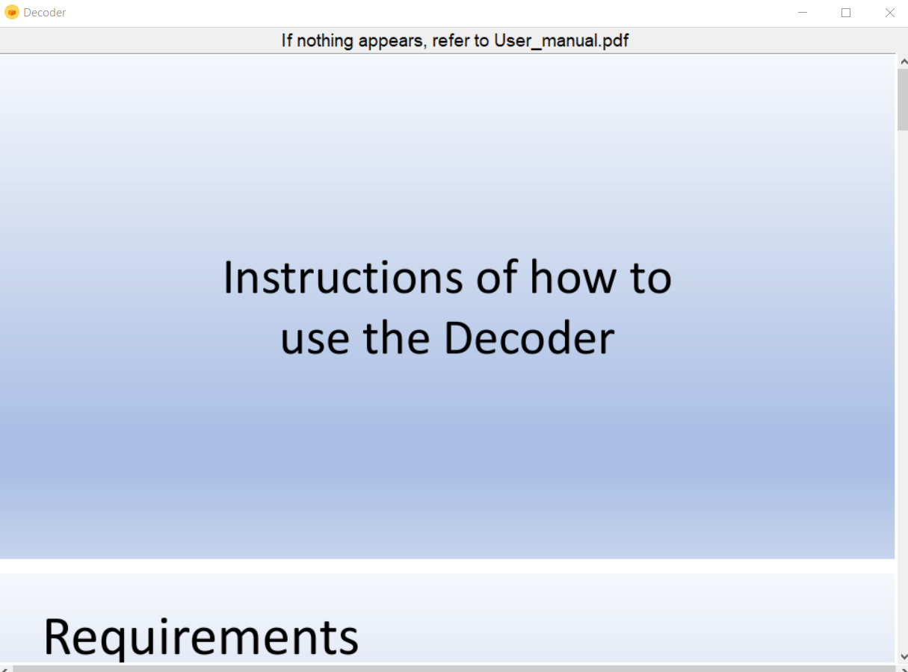
Decoder Tool
Purpose
To convert RoB/DTC and Remote DTC data into a readable Excel file format
Automate and speed-up process and make it easy to interpret the data
In case a customer issue is reported, the developer can easily acquire the RoB/DTC information needed (such as the detection date and time) that will help in the analysis of the issue. In case the issue is not captured by the provided logs, this can be easily detected with the help of the decoder tool.
User interface
Input
RoB/DTC – text file
Remote DTC – excel file
Output
Decoded RoB/DTC info and decoded ECU info for remote DTC in an Excel file

Slide 5

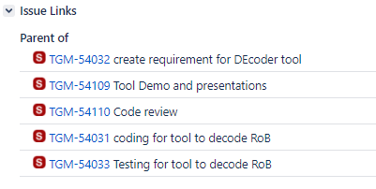
Planning
Epic created for tracking purposes:
All Stories and sub-tasks for the stories created and linked to the epic:
The stories are tracked on the JIRA dashboard during daily Stand-up, Ernest is part of the DSU daily.
Source code of the tool is added to the repository: https://buic-scm-sgp.contiwan.com:8443/2731684
Bi-monthly presentation of the progress on tool organized. Demo of the tool usage was presented to System Test team as well.
Exe of the tool will be updated on Toyota sharepoint and link will be shared with all stakeholders.
What next: To maintain the Epic and reuse the code if improvements or new features are needed.

Slide 6
Requirements
Objectives
Understand and define requirements for the input file and data formats for RoB/DTC and Remote DTC from Toyota DCM requirements
Define preconditions, scope and limitations of the tool
Define the error handling for the tool
Defined Requirements
Input file is expected to be Text file or Excel file
Tool would not work if format of data is incorrect
Tool would prompt user to re-enter information if it is wrong

Slide 7
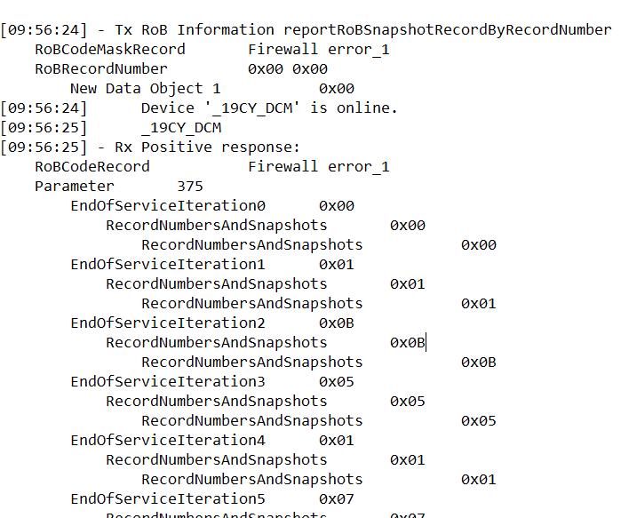
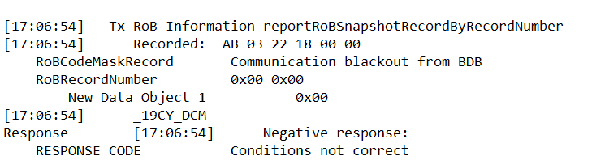
Development (RoB)
Programming Language: Python on Pycharm.
Required Data
RoB name
Response types:
Positive
Negative
RoB/DTC Data will be decoded if response is positive
Response Code
1
0x05
0x01
0x07
0x00
0x07
0x00
0x00
0x56
0xB8
0x01
0x05
0x02
2a
3
2b
4

Slide 8
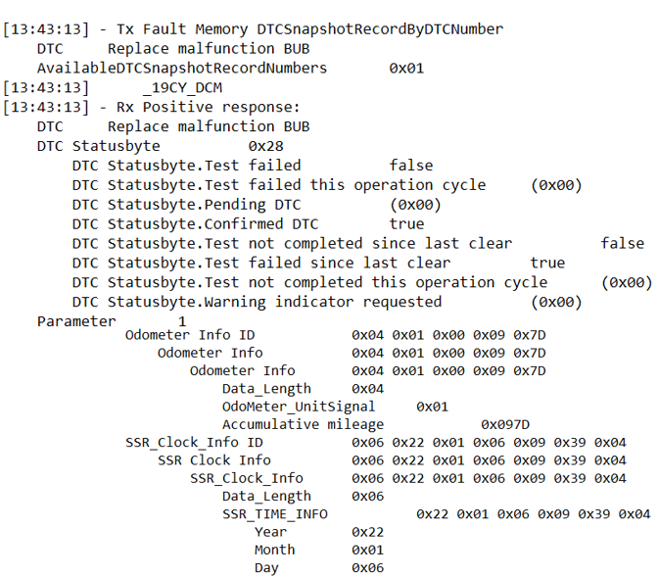
Development Continued (DTC)
Required data
DTC name
DTC statusbyte
DTC statusbyte confirmed
Time information

Slide 9
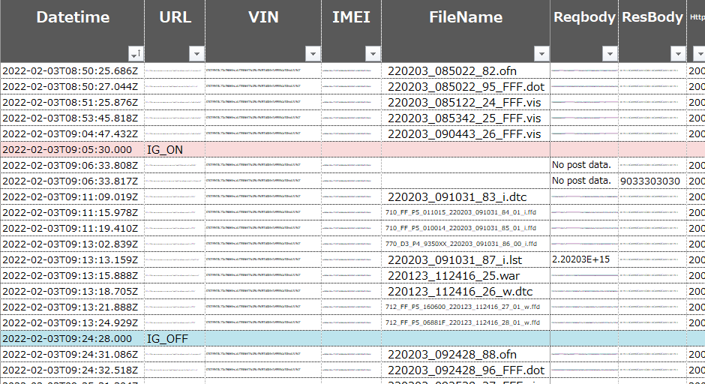
Development Continued (Remote DTC)
Find all .dtc files under filename
Refer to next column to find data and decode it

Slide 10
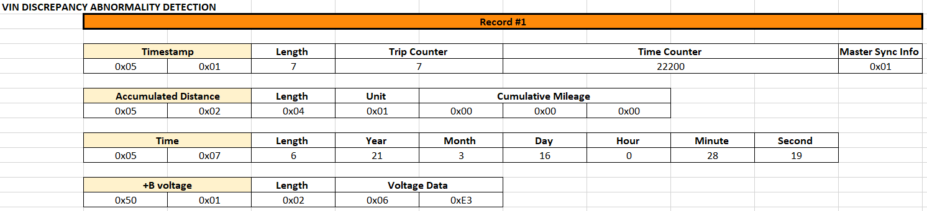
RoB Output
Positive Response
Contain RoB information divided in 3 parts: RoB name, instance number and the data.
Negative Response
Negative response may indicate that the RoB\DTC information cannot be acquired by the diagnostic request due to invalid format or condition.
This will be collated and put at the bottom of the file.

Slide 11
DTC Output
Contain DTC information: DTC name, DTC Statusbyte, DTC Statusbyte Confirmed, Time information

Slide 12
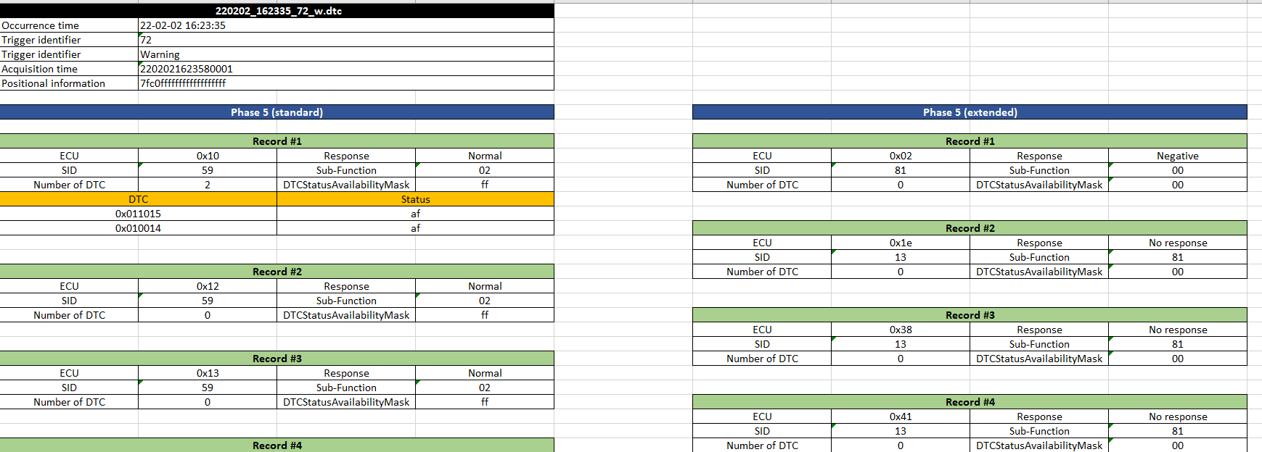
Remote DTC Output
Contain ECU information which includes the response, SID, sub-function, DTC name and DTC status availability mask

Slide 13
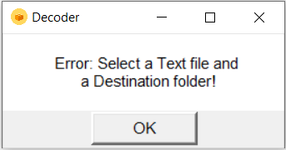
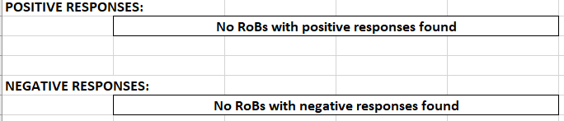
Error handling scenarios
User does not put in Input file and Destination folder
→ Error: Select a Text file and a Destination folder!
User does not put in Input file
→ Error: Select a Text file or Excel file!
User does not put in Destination folder
→ Error: Select a Destination folder!
Folder not accessible
→ Error : Select another Destination folder!
No RoBs in Input file

Slide 14
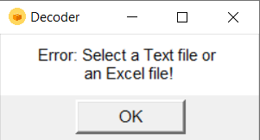
Software Testing
Ensuring all test cases passed based on the input file provided
Eg Input file contains positive RoB responses only
Rx EndOfServiceIteration0 0x00
Rx RecordNumbersAndSnapshots 0x00
Rx RecordNumbersAndSnapshots 0x00
Rx EndOfServiceIteration1 0x01
Rx RecordNumbersAndSnapshots 0x01 →
Rx RecordNumbersAndSnapshots 0x01
Rx EndOfServiceIteration2 0x04
Rx RecordNumbersAndSnapshots 0x04
Rx RecordNumbersAndSnapshots 0x04
Eg No input file was selected →

Slide 15
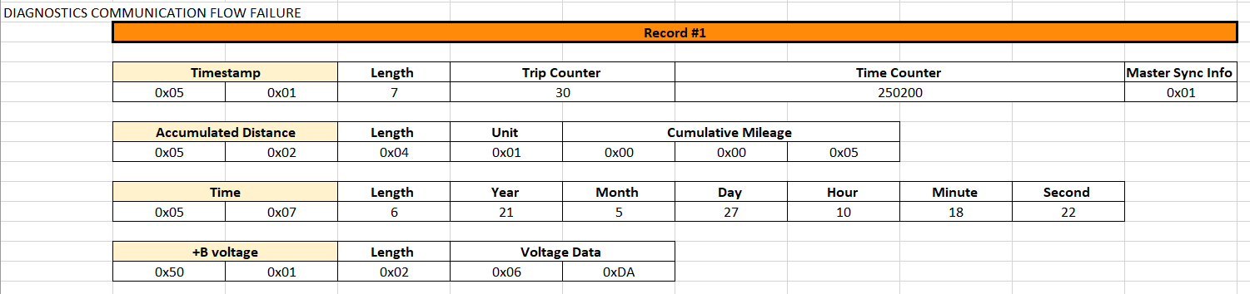
Challenges
Formatting
Ensuring length, row, columns positioning are all correct
Merging the tool into one to decode RoB/DTC and Remote DTC
Ensuring no variables overlap when combining

Slide 16
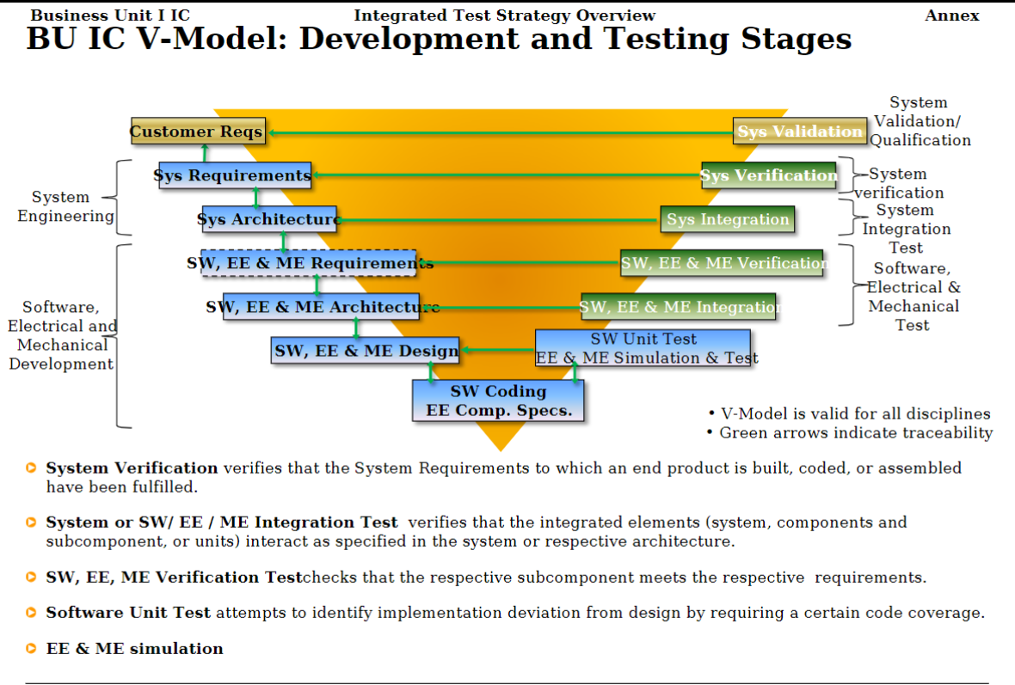
Key takeaways
Learnt about Software development lifecycle
Requirements → Development → Testing
Understood Agile scrum methodology being a part of daily processes.
Sprints (2-weeks)
Daily Stand-Ups
Learnt to use the below tools:
Jira for Tracking progress
Gerrit and Code-Collaborator for code reviews

Slide 17
Thank you

