Slide 1

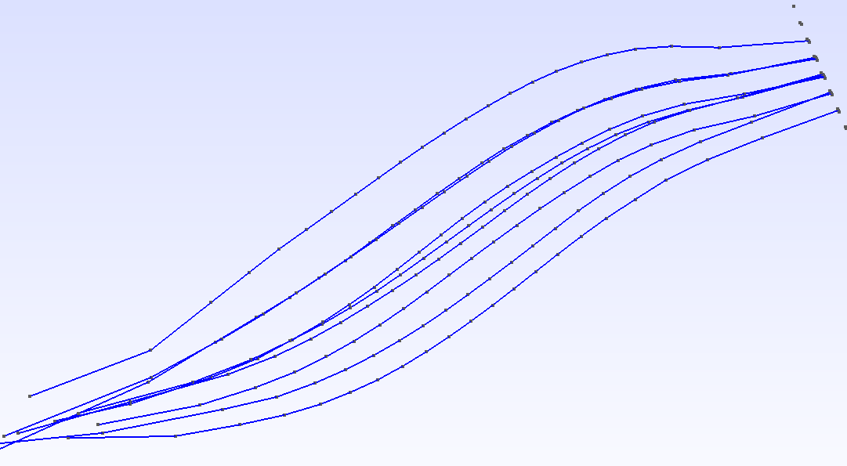
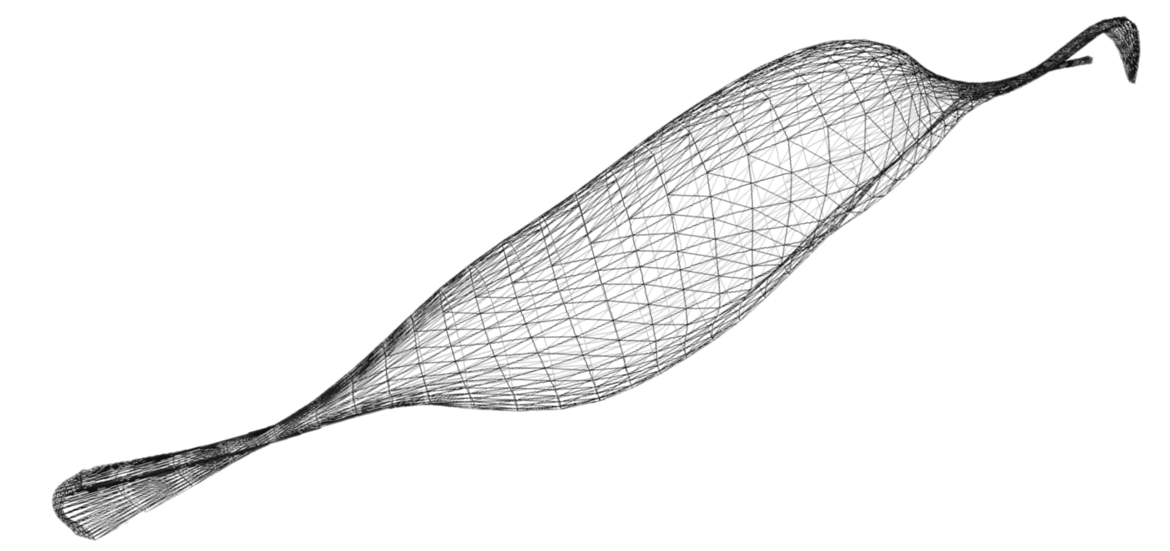
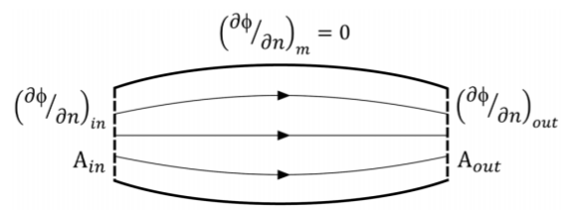
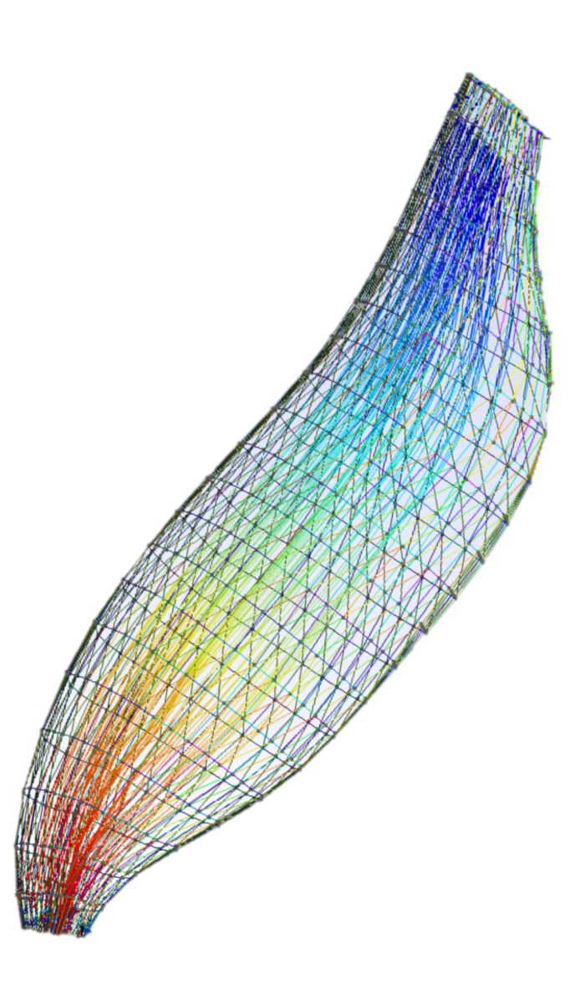
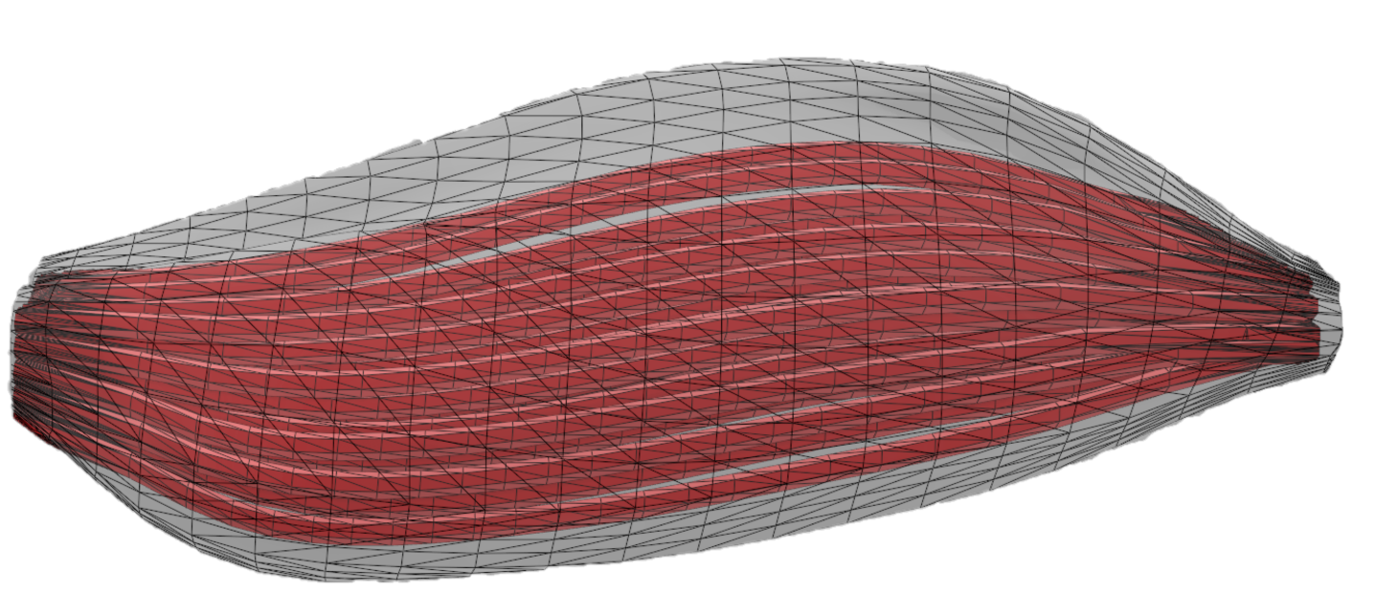
Simulation großer Systeme – SGS
www.ipvs.uni-stuttgart.de
Jan Kusterer
Niven Ratnamaheson
Raimund Rolfs
Tobias Walter
Generating and
Visualizing Muscular
Fascicle
Arrangements
Calculating Arrangement of muscular fascicles using Laplacian vector field simulation and Dirichlet + Neumann boundary condition
Creating a reliable, semi-autonomous procedure
3D-meshing and Simulation using Gmsh
Visualization of generated fascicles
Variable amount of generated fascicles
Introduction
In biomechanical simulations it is important to acquire an adequate representation of the muscle fibers. It’s impossible to obtain these fibers from a simple CT-scan and in order to simplify the problem we calculate the trajectories of the fascicles instead of the muscle fibers. This can be achieved by using a Laplacian vector field with Dirichlet and Neumann boundary conditions.
CT-scan of the musculus biceps brachii
Laplacian Vector Field
Dirichlet boundary
Neumann boundary
Calculates stream, given an
inflow and outflow
Choi and Blemker already showed 2013 that the muscle fascicles can be reconstructed using a Laplacian vector field simulation. After solving the Laplacian potential flow (ΔΦ=0), the fibers are obtained by tracing streamlines through the volume. Because of that, we use the meshing program Gmsh and its build-in solver GetDP. It is a three-dimensional finite-element mesh generator. The simulation of electric potential in a dielectric volume implements the Laplace equation and the two boundaries and thus is a perfect fit for our conditions.
Gmsh features
GUI, own scripting language
Automation: loops conditionals, user-defined macros and external system calls
Compiling without the GUI and use directly from the command line
Pre- and postprocessing
Built-in solver
Free software
After the postprocessing we get the trajectories of the fascicles. These however aren’t in a suitable file-format and thus we have to process the data with our python-script.
The resulting fascicles are set for presentation as shown in our pictures (e.g. 3D-visualization).
Generated fascicles without the muscle volume
CT-scan
Starts with a hollow CT-scan of the muscle
If necessary repair the surface of the volume
compute in- and outflow for the Laplacian vector field
compute streamlines using these vector field
convert result to a mesh-file
Visualization
Repair
Horizontal Cut
Reclassify
Shell Script
merge the fascicles mesh with the muscle
3D-printing
Execute the shell script
Cut the model on a horizontal plane on the upper and the lower end
Reclassify the model with a threshold of 0°
Postprocessed streamlines (fascicles) in Gmsh
www.uni-stuttgart.de
Completed generation of the muscle including volumes for the fascicles

