Slide 1

BCR Business Card Reader
Made by Easy Money Team
Team member:
Laith Abuhannun
Phyo Zay Thit Andrew Chen
Zhengyi Duan

Slide 2
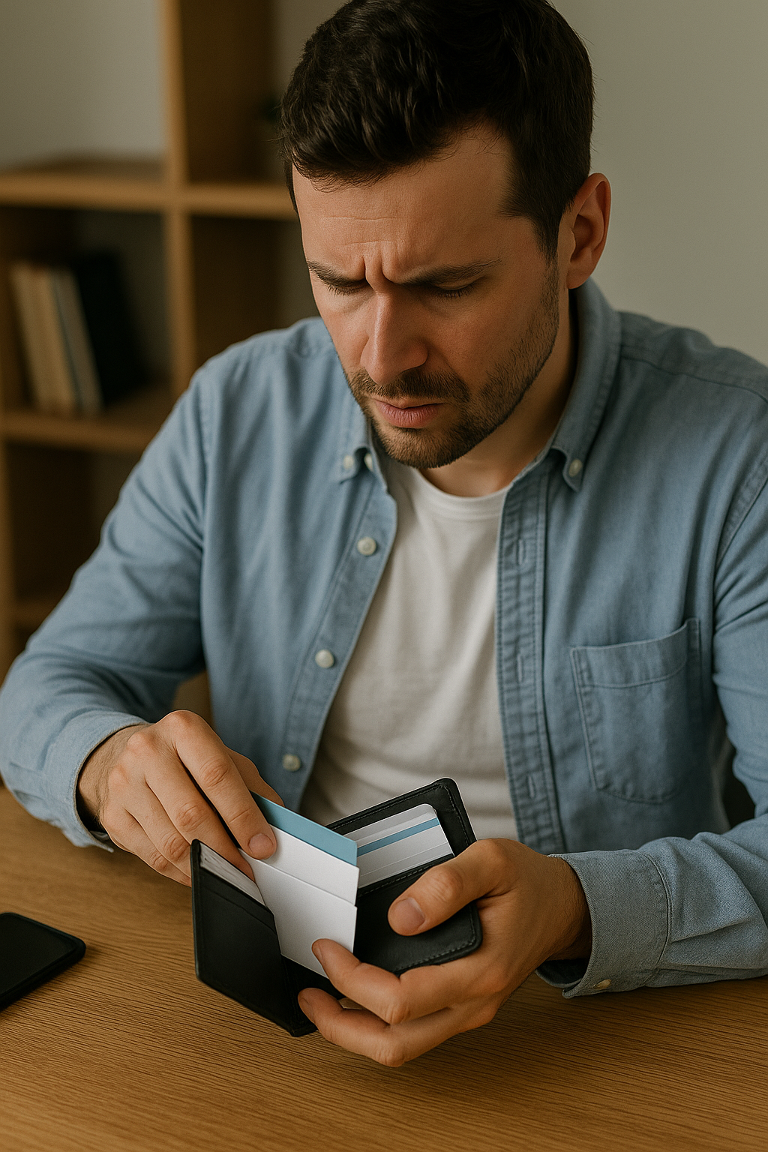
Networking is vital, but managing all those physical business cards can be a chaotic challenge.
Time-Consuming Manual Entry
Prone to Errors
Physical Clutter & Loss Risk
Limited Accessibility
Outdated Information

Slide 3
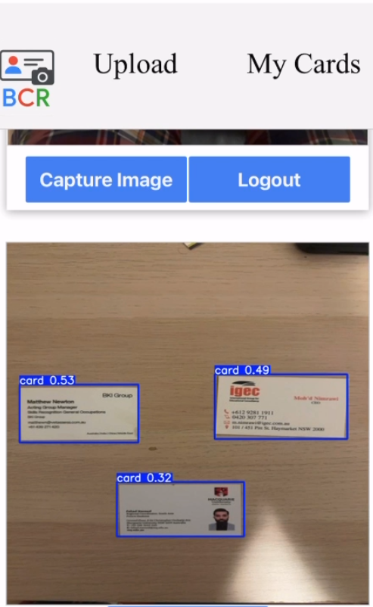
How BCR Solves It:
1. Instant Capture: Use your device's camera to log business cards.
Our system smartly detects one or even multiple cards in a single shot.

Slide 4
How BCR Solves It:
1. Instant Capture:
CNN Architecture | Train Accuracy |  |  | Validation Accuracy |  |  | Test Accuracy
 | mAP@0.5 | MAP@0.5:0.9 | MAP@0.75 | mAP@0.5 | MAP@0.5:0.9 | MAP@0.75 | mAP@0.5 | MAP@0.5:0.9 | MAP@0.75
CNN-1 | 0.9937 | 0.9584 | 0.9937 | 0.8014 | 0.7600 | 0.8014 | 0.8019 | 0.7600 | 0.8014
CNN-2 | 0.991 | 0.9449 | 0.9911 | 0.7761 | 0.7382 | 0.7761 | 0.8381 | 0.7791 | 0.8381
CNN-3 | 0.7876 | 0.7332 | 0.7876 | 0.8276 | 0.7457 | 0.8151 | 0.6696 | 0.5733 | 0.6402
We explored different YOLO model setups to find the best:
Optimized Model (Our Choice): This final setup, with higher resolution processing and fine-tuning, dramatically improved our ability to detect cards, especially smaller ones or multiple cards in a complex scene. It made detection more sensitive and accurate.

Slide 5
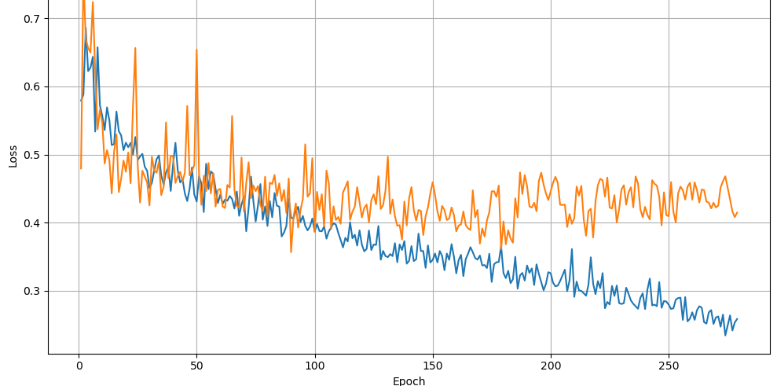
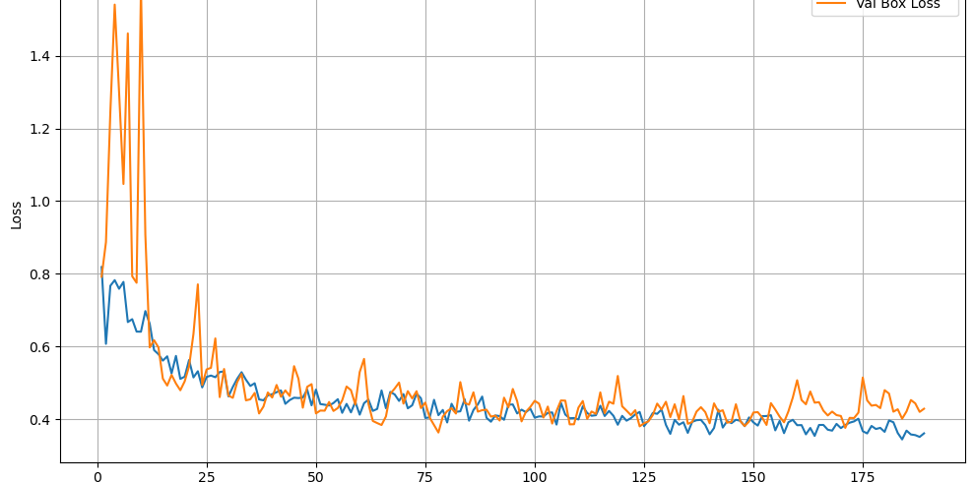
How BCR Solves It:
CNN1
1. Instant Capture:
CNN2
CNN – 1:
CSPDarknet backbone for yolo 8n + 640x640 (baseline) + 0.6 confidence
CNN - 2:
CSPDarknet backbone for yolo 8n+ augmentation +640x640 + 0.6 confidence
CNN -3:
CSPDarknet backbone for yolo 8s+ 1024x1024 + 0.5 confidence + augmentation
CNN3
We choose that

Slide 6
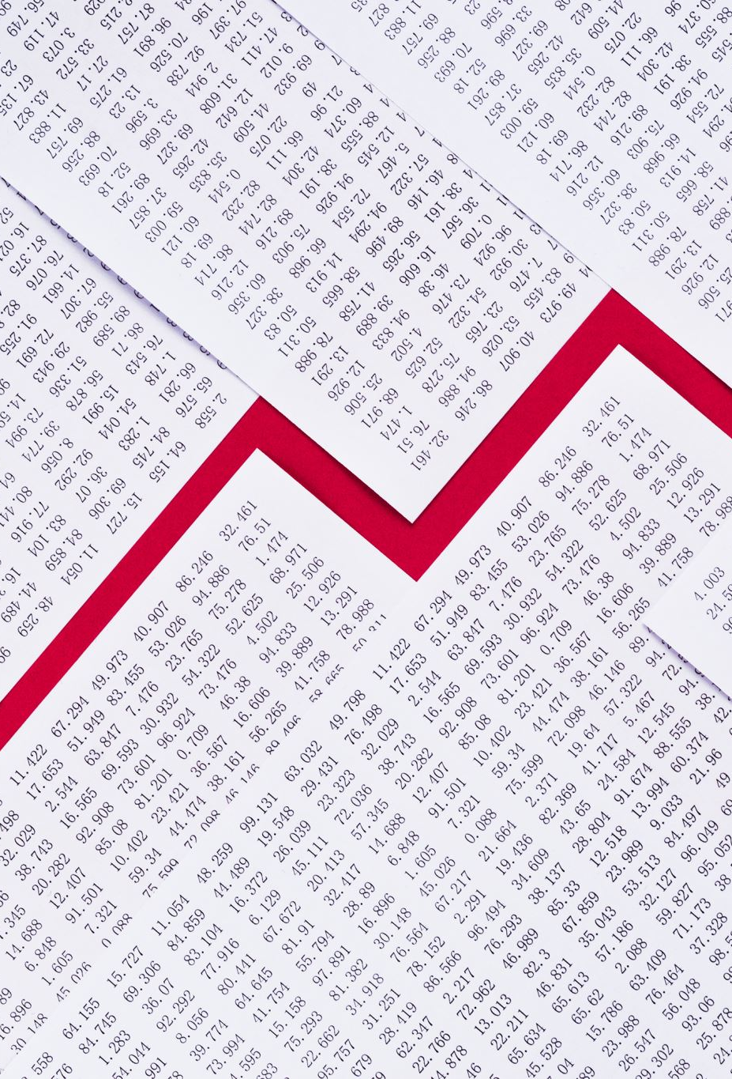
Results

Slide 7
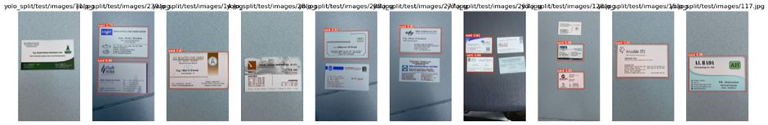
CNN-1

Slide 8
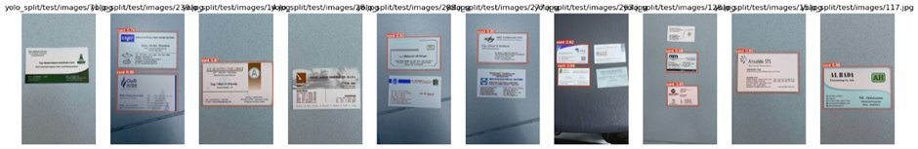
CNN-2

Slide 9
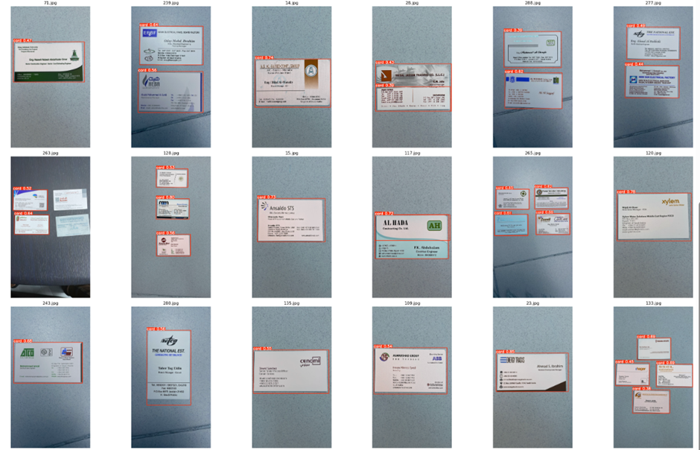
CNN-3 (Final model)

Slide 10
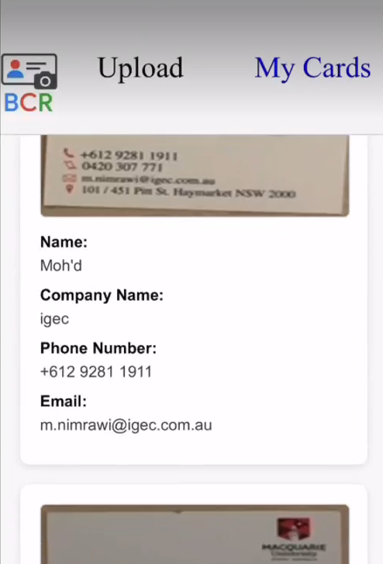
How BCR Solves It:
2.AI-Powered Extraction:
Advanced Artificial Intelligence automatically identifies and extracts key information: Name, Company, Phone, and Email.

Slide 11
How BCR Solves It:
2.AI-Powered Extraction:
Choosing the Best AI for Extraction: We rigorously compared two main strategies:
Traditional OCR + Local AI (Ollama): A standard text recognition method paired with a smaller local language model.
Cloud-based Generative AI (OpenAI API): Leveraging a powerful, state-of-the-art AI service.

Slide 12
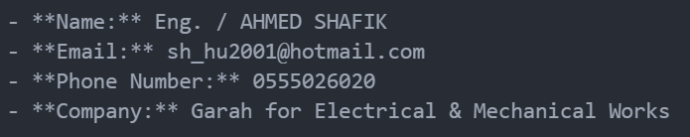
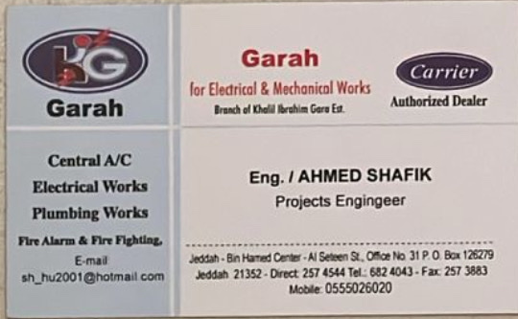
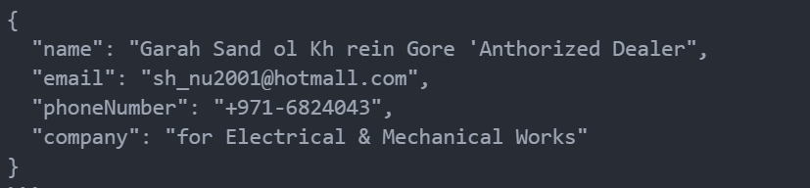
Better
How BCR Solves It:
OpenAI output
Ollama output

Slide 13
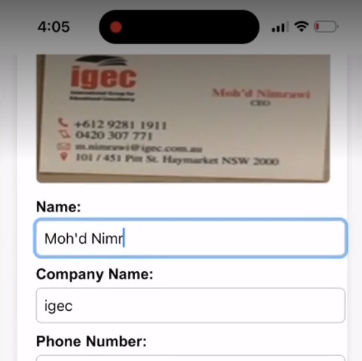
BCR: Your Smart Digital Business Card Wallet
3. Easy Editing & Personalization

Slide 14
BCR: Your Smart Digital Business Card Wallet
Your Private Digital wallet

Slide 15
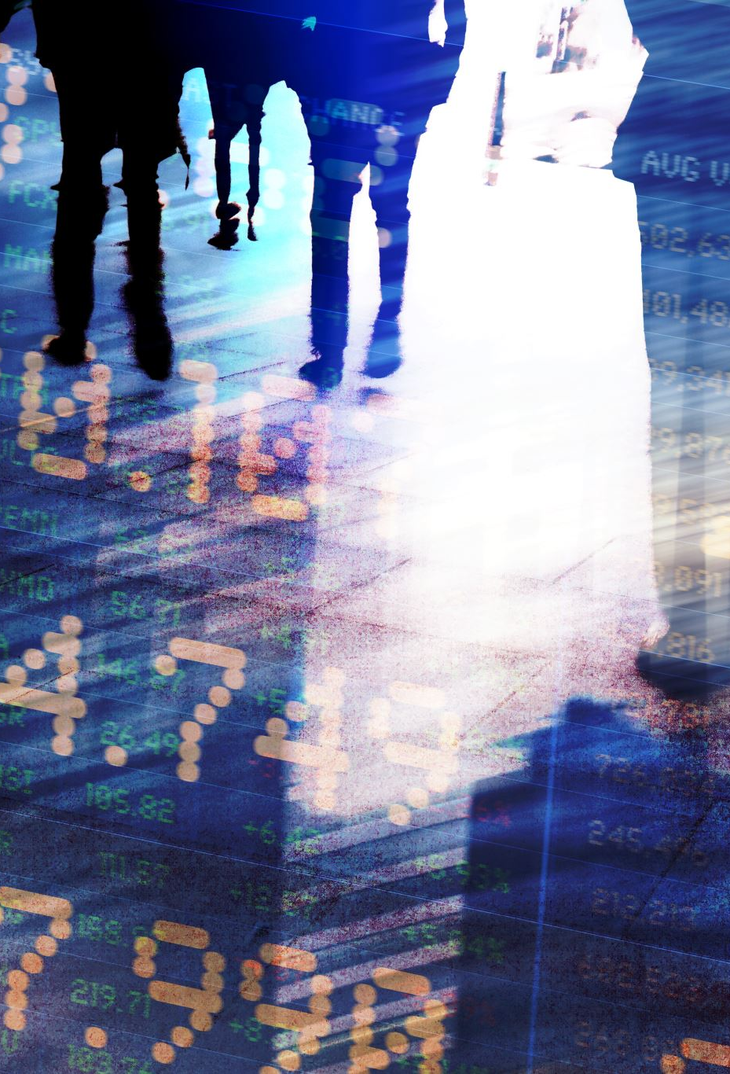
Unlocking Potential: Business Opportunity & Beyond
Business Opportunity:
Vast Market
Problem-Solution Fit
Efficiency & Productivity
ScalabilityMonetization Potential
Future Vision:
To become the go-to digital solution for seamless business card management.
Moving towards even smarter AI that understands complex layouts and multiple languages with near-perfect accuracy.
Integrating BCR into broader professional ecosystems for true end-to-end networking solutions.

