Slide 1

CRUD Web Application By Using Docker & Kubernetes
Cloud-ready Student Management System
By – DIYA DIWAKAR

Slide 2

Project Overview
Built a full-stack CRUD student management web app, containerized with Docker and orchestrated on Kubernetes. Demonstrates portability, reproducible deployments, and basic scaling for internship-level DevOps exposure.

Slide 3

Problem Statement
Inconsistent deployments across environments causing runtime errors
Manual server management and fragile setup scripts
Limited scalability for sudden load
Difficulty shipping reproducible dev/test/production artifacts

Slide 4

Project Objectives
Build
Containerize
Implement CRUD endpoints and a responsive frontend using Flask + HTML/CSS/JS.
Create a reproducible Docker image with a small, single-file SQLite DB for demo.
Orchestrate
Prepare
Deploy on Kubernetes with a Deployment and NodePort Service for external access.
Document steps and demonstrate local cluster testing (Docker Desktop).

Slide 5
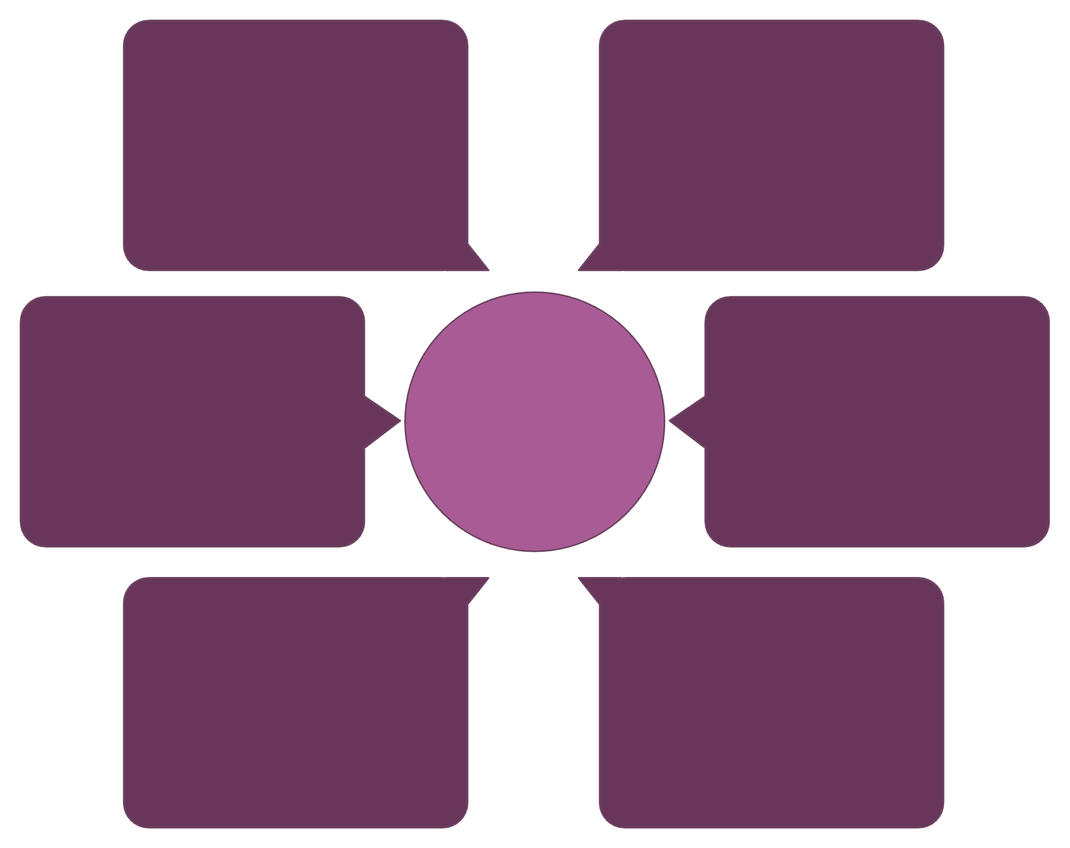
System Architecture
SQLite file
Browser
Single-instance persistent DB
Client sends HTTP request
Docker Container (Flask)
Browser to SQLite Flow
NodePort Service
Handles request logic
Exposes cluster port
Pod
Deployment
Schedules container instance
Manages replica set
This architecture shows the runtime path for requests and the components responsible for orchestration, exposure, and persistence (single-file SQLite for demo purposes).

Slide 6
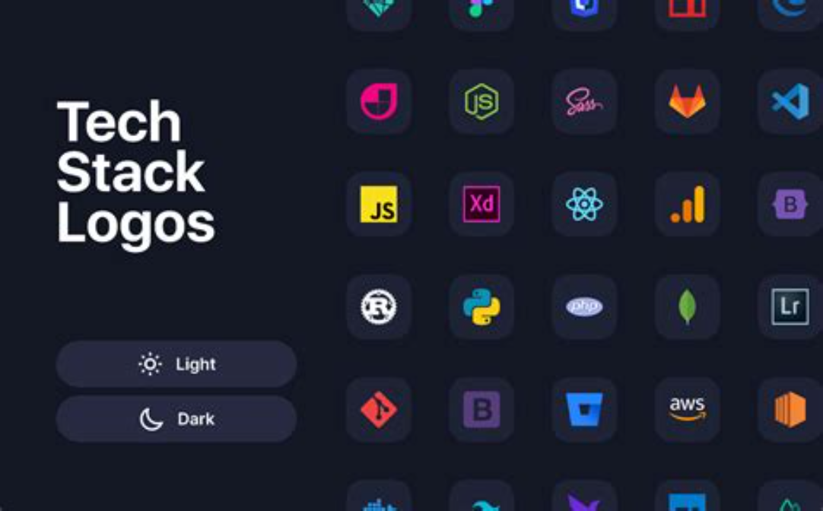
Technology Stack
Backend: Python Flask — lightweight REST + templates
Frontend: HTML/CSS/JS — simple responsive UI
DB: SQLite — file-based, suitable for demo
Containers: Docker — Dockerfile for image build
Orchestration: Kubernetes — Deployment + Service (NodePort)
Local cluster: Docker Desktop (single-node)

Slide 7
Implementation Steps
01
02
1. App Development
2. Docker
Implemented CRUD routes, templates, and server-side validation in Flask.
Wrote Dockerfile, created image, and tested container locally.
03
04
3. K8s Manifests
4. Deploy & Verify
Created deployment.yaml and service.yaml with containerPort 5000 and NodePort mapping.
Applied manifests, confirmed Pod and Service status, and accessed the app via NodePort / port-forward for demos.

Slide 8
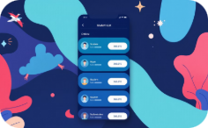
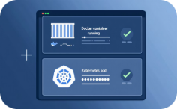

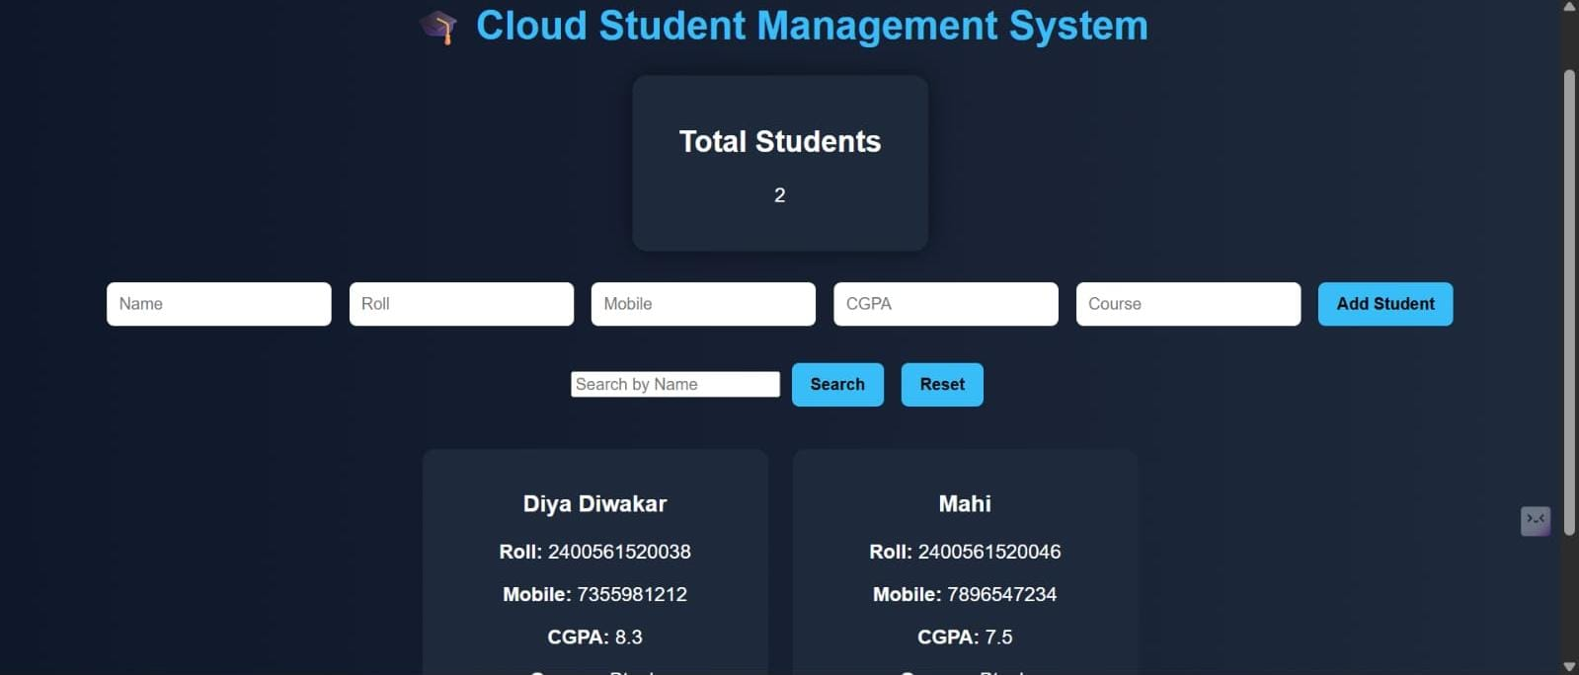
Features & Demo Output
Add Student
View & Delete
Runtime Status
Form validates input and inserts a record into the SQLite DB via Flask endpoint.
Docker image runs in a Pod; kubectl shows Pod/Service up. Use port-forward or NodePort to access externally.
List view shows students; delete action removes row and updates UI without full reload.

Slide 9
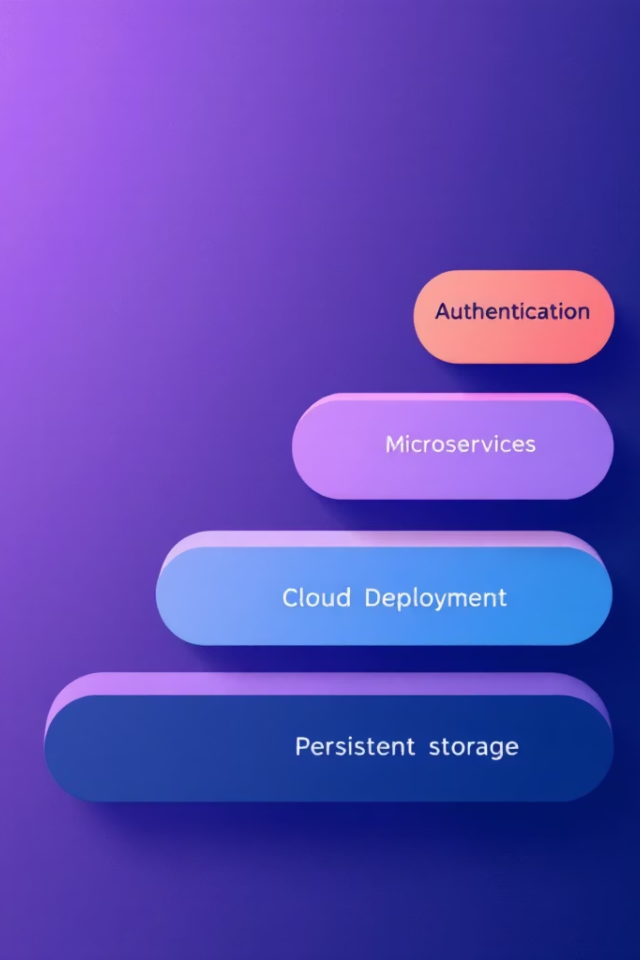
Conclusion & Next Steps
Summary: Successfully containerized a Flask CRUD app and deployed it to Kubernetes (local cluster), validating orchestration and exposure via NodePort. The demo proves portability and basic scaling concepts.
Immediate Next
Medium Term
Introduce persistent volumes and move DB to managed service (RDS / Cloud SQL).
Add authentication, config with Secrets, and CI/CD pipeline for automated builds and deployments.
Long Term
Refactor into microservices, deploy to cloud provider (AWS/GCP), and enable autoscaling with metrics.

