Slide 1
New Joiner Onboarding - Batch 7
Prepared by Neha Kulkarni, HR

Slide 2
Joiner details
Name | PAN | Mobile
Amit Kumar Verma | BXQPV4821K | 9876501234
Sneha Iyer | CKLPI7310M | 9123456780
Notes:
Call Amit on +91 98765 43210 before Monday. His Aadhaar is 7260 1815 9082.

Slide 3
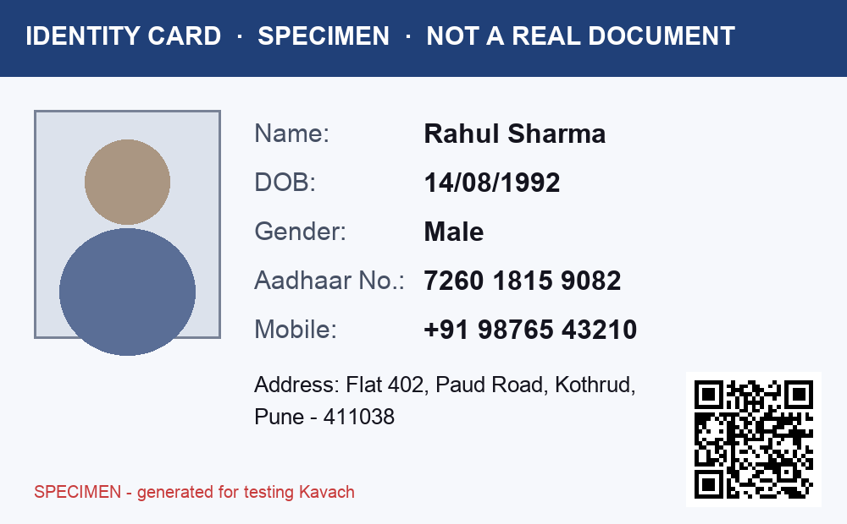
ID proof received

Slide 4
संपर्क
मेरा नाम सुनीता पाटिल है।
Email: sunita.patil@example.com

