Slide 1


IAM

Slide 2


Index
What is IAM?
IAM Features
Understanding How IAM Works

Slide 3
What is IAM ?
AWS Identity and Access Management (IAM) is a web service that helps you securely control access to AWS resources. You use IAM to control who is authenticated (signed in) and authorized (has permissions) to use resources.
When you first create an AWS account, you begin with a single sign-in identity that has complete access to all AWS services and resources in the account. This identity is called the AWS account root user and is accessed by signing in with the email address and password that you used to create the account. We strongly recommend that you do not use the root user for your everyday tasks, even the administrative ones. Instead, adhere to the best practice of using the root user only to create your first IAM user. Then securely lock away the root user credentials and use them to perform only a few account and service management tasks.

Slide 4
IAM Features
Shared access to your AWS account
You can grant other people permission to administer and use resources in your AWS account without having to share your password or access key.
Granular permissions
You can grant different permissions to different people for different resources. For example, you might allow some users complete access to Amazon Elastic Compute Cloud (Amazon EC2), Amazon Simple Storage Service (Amazon S3), Amazon DynamoDB, Amazon Redshift, and other AWS services. For other users, you can allow read-only access to just some S3 buckets, or permission to administer just some EC2 instances, or to access your billing information but nothing else.
Secure access to AWS resources for applications that run on Amazon EC2
You can use IAM features to securely provide credentials for applications that run on EC2 instances. These credentials provide permissions for your application to access other AWS resources.

Slide 5
Multi-factor authentication (MFA)
You can add two-factor authentication to your account and to individual users for extra security. With MFA you or your users must provide not only a password or access key to work with your account, but also a code from a specially configured device.
Identity federation
You can allow users who already have passwords elsewhere—for example, in your corporate network or with an internet identity provider—to get temporary access to your AWS account.
Identity information for assurance
If you use AWS CloudTrail, you receive log records that include information about those who made requests for resources in your account. That information is based on IAM identities.
Free to use
AWS Identity and Access Management (IAM) and AWS Security Token Service (AWS STS) are features of your AWS account offered at no additional charge. You are charged only when you access other AWS services using your IAM users or AWS STS temporary security credentials. For information about the pricing of other AWS products.

Slide 6
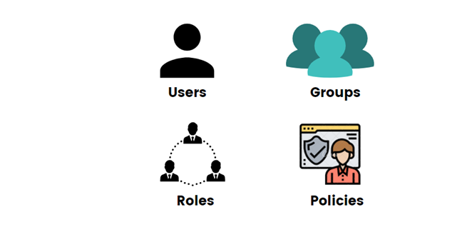
Understanding How IAM Works
In order to know how AWS IAM works, you must be familiar with the four basic concepts, which can be defined as

Slide 7
Users: Users are identifiable individuals, and with IAM, you can give each one login and password so they can access the AWS console on their own. However, they’ll have a restricted set of permissions that you specify. Users have secret keys and secret access keys, which are used as inputs in your application-level code when setting up clients.
Groups: Then there are groups, which essentially apply to a collection of users that share a mutual interest. Permissions are different for different groups. Specific users of a group are subject to the same permissions and policies that are defined for the group as a whole.
Roles: Then we have roles, which are similar to user accounts in AWS. We attach policies to roles as we do for the users. In AWS IAM, we provide the access permissions to roles instead of a user. If an instance wants to access an AWS account, we’ll make it a role so that it can access the account without a login id and password. Roles can also be used by an AWS service to access another VM.
Policies: Finally, there are policies, which is an AWS object that determines the permissions of identity or resource when it is connected with it. When an IAM principal (user or role) makes a request, AWS evaluates these policies. They come in two variations: allow or deny. The policy permissions decide whether the request is allowed or denied.

