Slide 1
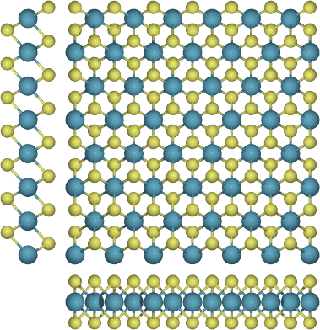
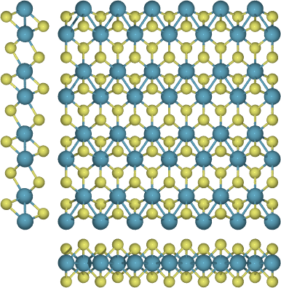
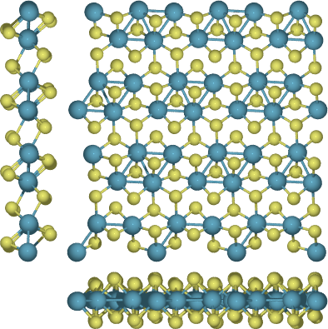
T-ReS₂
Excluded region
Pareto optimal
HOF
T’-ReS₂
T’’-ReS₂
Number of atoms

