Slide 1
Mycar Dream Assignment SUBMISSION
Name : Dijender Saini
Roll Number : DDA1610016

Slide 2
Business Requirement & Constraints
To estimate mileage of a car based on the given features.
Business Constraints:
The model should not contain more than 5 variables.
According to the business needs, set the VIF to 2.
The model should be highly predictive in nature i.e it should show 80% (R squared) of accuracy.

Slide 3
Problem Solving Methodology
Understand Requirements and Constraints
Examine Data/Understand Format
Data Preparation
Variables Formatting
Data Cleaning
Variables Transformation
Divide Entire Dataset Into Training and Testing sets
Model Meets Requirements and Constraints
Apply the Model on Test Dataset
Develop Model Using Training Dataset
Y
Model Meets Requirements and Constraints
Accept the Model
N
Y
Analyze How to Refine the Model
N

Slide 4
Data Dictionary
Variables | Description
Mpg | Mileage per gallon (continuous variable)
Cylinders | Number of cylinders in car (multi-valued discrete)
Displacement | Volume of fuel inside the engine i.e size of engine (continuous )
Horsepower | picks up of the car (continuous)
Weight | Weight of car (continuous)
Acceleration | Acceleration of car (continuous)
Model year | Year when the car launched (multi-valued discrete)
Origin | Origin of car (multi-valued discrete)
Car name | Name of car company (unique for each instance)

Slide 5
Data Cleansing/Preparation Activities
Check for missing values
No missing values were found
Variable formatting
Change factor variables to factors
Change Origin and Cylinders to factor variables
Change non-factor variables to appropriate type
Change Horsepower to numeric from factor
Outlier Treatment
Outlier found only in Acceleration variable
Capped outliers on upper side to Upper Hinge + 1.5X IQR
Capped outliers on lower side to Lower Hinge - 1.5X IQR

Slide 6
Data Cleansing/Preparation Activities
Feature Extraction/Standardization
Car Company Name feature extracted from car name
Standardized
Binning/Bucketing
Model year is bucketed/binned into these categorical values
2005orEarlier
Between2006-2008
Between2009-2012
2013orLater
Creation of Dummy Variables
Car Company
Cylinders
Car Model Year(Bucketed)
Origin

Slide 7
Training and Test Data Sets
Entire data set divided into Training and Test data sets
Ratio of division
70% Training data
30 % Test data

Slide 8
Modelling Process
Modelling is done using the training data set
All variables used in creation of first model using lm function in R
Resulting model fed to stepAIC function for model refinement.
Model obtained after refinement by stepAIC
lm(formula = MPG ~ Weight + Acceleration + Cylinders4 + Cylinders5 +
Cylinders6 + Cylinders8 + carModelBin2013orLater + carModelBinBetween2006.2008 +
carModelBinBetween2009.2012 + carCompanycadillac + carCompanydatsun +
carCompanyfiat + carCompanyhonda + carCompanymazda + carCompanymercedes +
carCompanyoldsmobile + carCompanyplymouth + carCompanypontiac +
carCompanyrenault + carCompanytriumph + carCompanyvolkswagen,
data = carmileage.train)
Number of variables: 21
R-squared value: 0.8598

Slide 9
Model Refinement
Model refined by using p-Value(relevance) of the variables and their collinearity
summary(model) is used for examining the p-Value
vif(model) is used to see the multi collinearity of the variables
Keep business constraints in mind at all times

Slide 10
Final Model
Final model arrived at after 19 refinements
Final model
lm(formula = MPG ~ Weight +
carModelBin2013orLater +
carModelBinBetween2006.2008 +
carModelBinBetween2009.2012,
data = carmileage.train)
Number of variables: 4
R-Squared value: 0.8258
Regression formula:
EstimatedMpg = 48.0014310 + (-0.0065884*Weight) + (-7.5540290*carModelBin2013orLater)
+ (-4.2541915*carModelBinBetween2006.2008)
+ (-7.1354110*carModelBinBetween2009.2012)

Slide 11
Examination of Model Against Constraints
Constraint#1: The model should not contain more than 5 variables.
Result: Model contains 4 variables
Constraint#2: According to the business needs, set the VIF to 2.
Result: VIF of all variables is less than 2 as seen in the result below
Constraint#3: The model should be highly predictive in nature i.e it should show 80% (R squared) of accuracy.
Result: Model has R-square value of 0.8258. Which means model shows 82.5% accuracy on the training dataset for predicting MPG of a car.
Weight | carModelBin2013orLater | carModelBinBetween2006.2008 | carModelBinBetween2009.2012
1.12321 | 1.704937 | 1.634272 | 1.832217

Slide 12
Examination of Model Against Test dataset
Manual calculation of R-Squared value
Apply regression model to calculate estimated MPG
EstimatedMpg = 48.0014310 + (-0.0065884*Weight) + (-7.5540290*carModelBin2013orLater)
+ (-4.2541915*carModelBinBetween2006.2008)
+ (-7.1354110*carModelBinBetween2009.2012)
Calculate Error Square and Sum of Squares using the estimated and actual MPG values
Calculate R-Square :
1-(Sum of Error Square/Sum of Sum of Squares)
Result : R-Square: 0.8114772(81.1% accuracy)
Correlation between actual MPG and Estimated MPG: 0.900

Slide 13
Examination of Model Against Test dataset
Using R function lm on the test data using variables in the model
lm(formula = MPG ~ Weight +
carModelBin2013orLater +
carModelBinBetween2006.2008 +
carModelBinBetween2009.2012,
data = carmileage.test)
Summary function yields the details of the model
Result : R-Square: 0.811(81.1% accuracy)
VIF values :
Weight | carModelBin2013orLater | carModelBinBetween2006.2008 | carModelBinBetween2009.2012
1.14858 | 1.621131 | 1.659832 | 1.812924

Slide 14
Examination of Model Against Constraints for Test Data
Constraint#1: The model should not contain more than 5 variables.
Result: Model contains 4 variables
Constraint#2: According to the business needs, set the VIF to 2.
Result: VIF of all variables is less than 2 as seen in the result below
Constraint#3: The model should be highly predictive in nature i.e it should show 80% (R squared) of accuracy.
Result: Model has R-square value of 0.811. Which means model shows 81.1% accuracy on the test dataset for predicting MPG of a car.
Weight | carModelBin2013orLater | carModelBinBetween2006.2008 | carModelBinBetween2009.2012
1.14858 | 1.621131 | 1.659832 | 1.812924

Slide 15
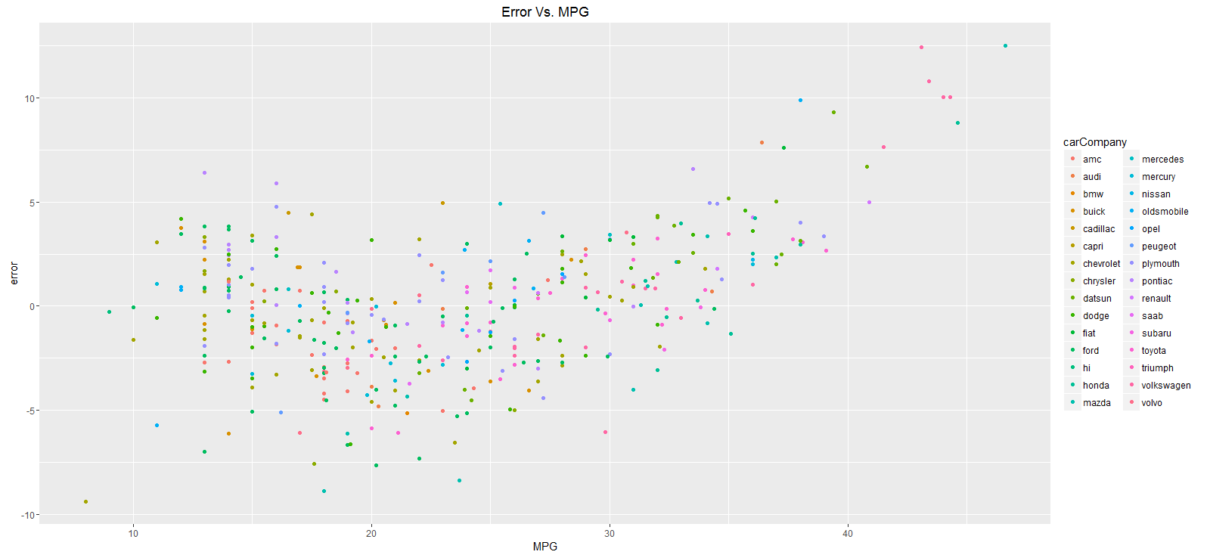
Plotting Error(MPG-Estimated MPG) Vs. MPG

Slide 16
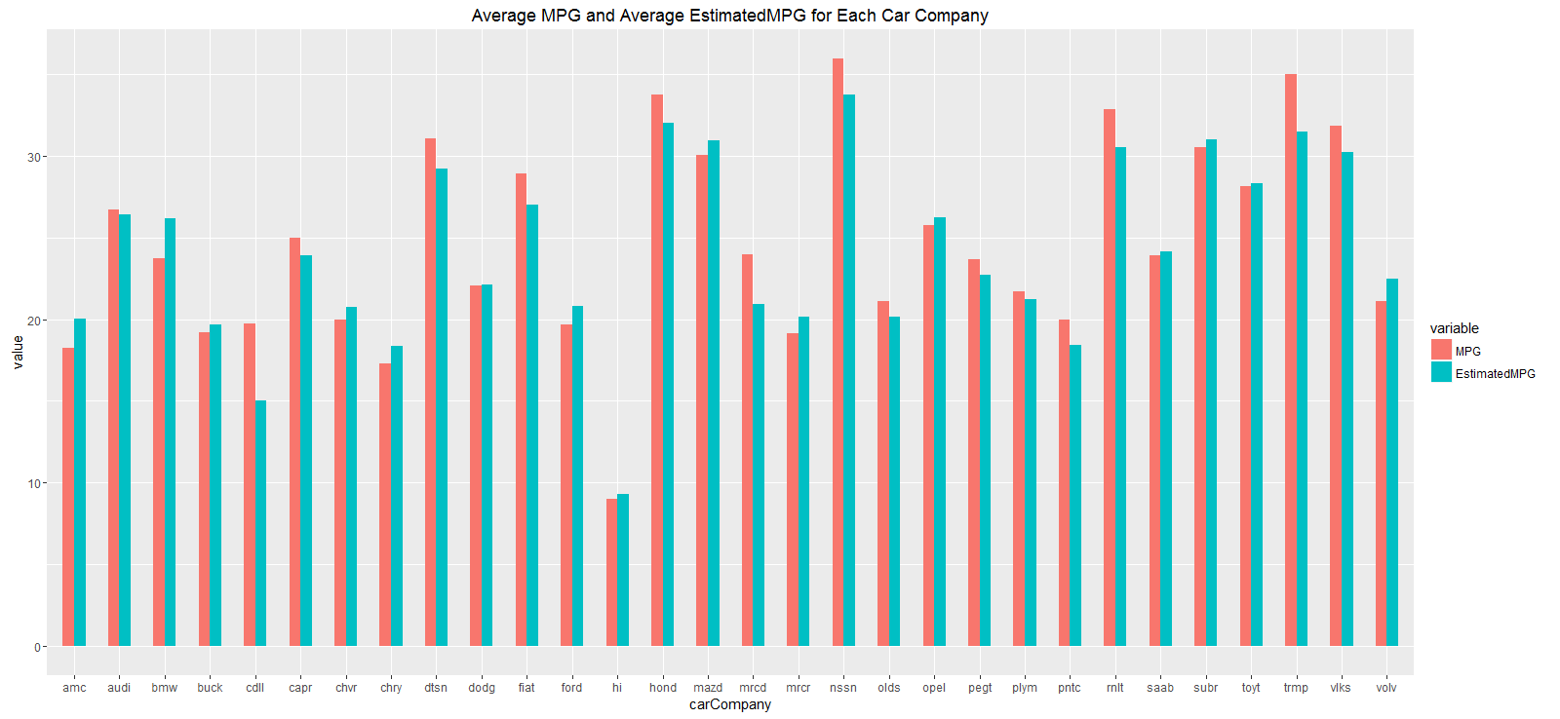
Plotting MPG Vs. EstimatedMPG For Each Car Company

Slide 17
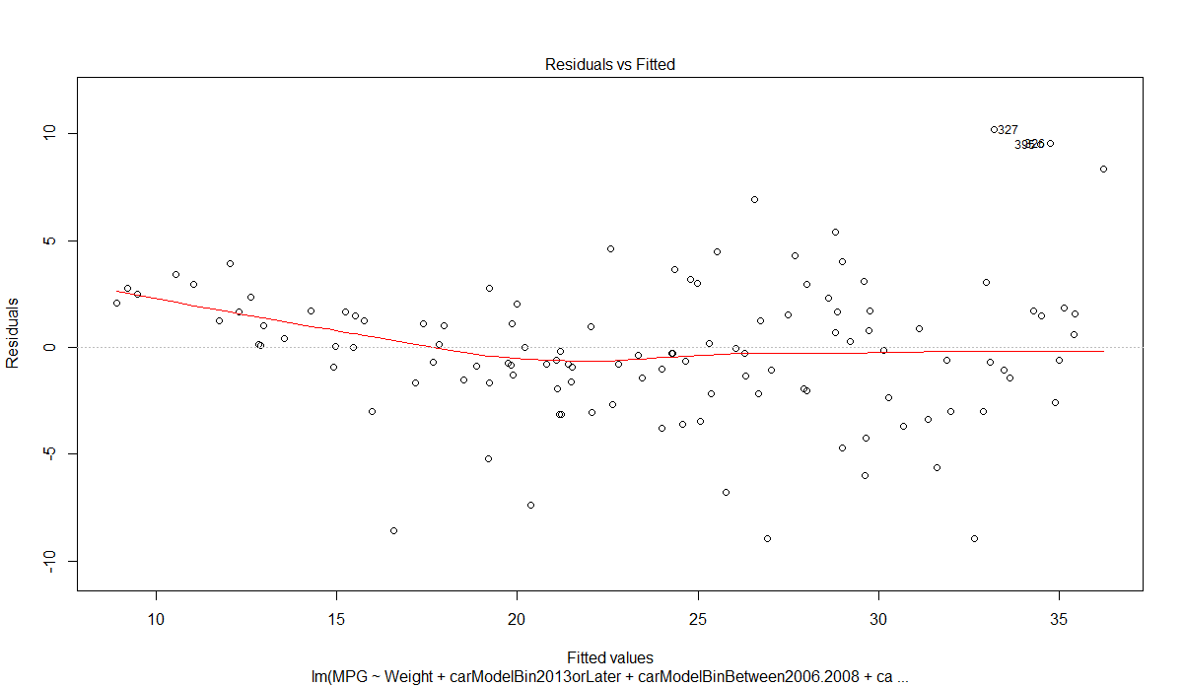
Model plot -1 From Test Dataset

Slide 18
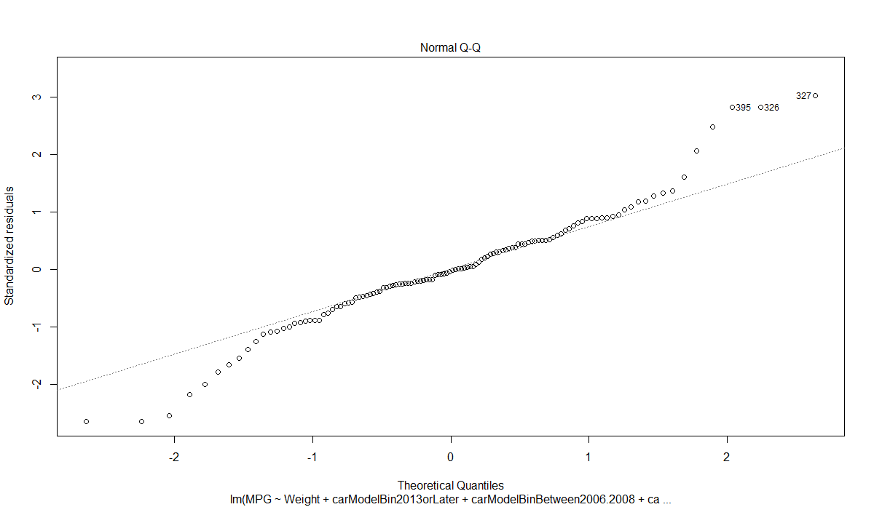
Model plot - 2 From Test Dataset

Slide 19
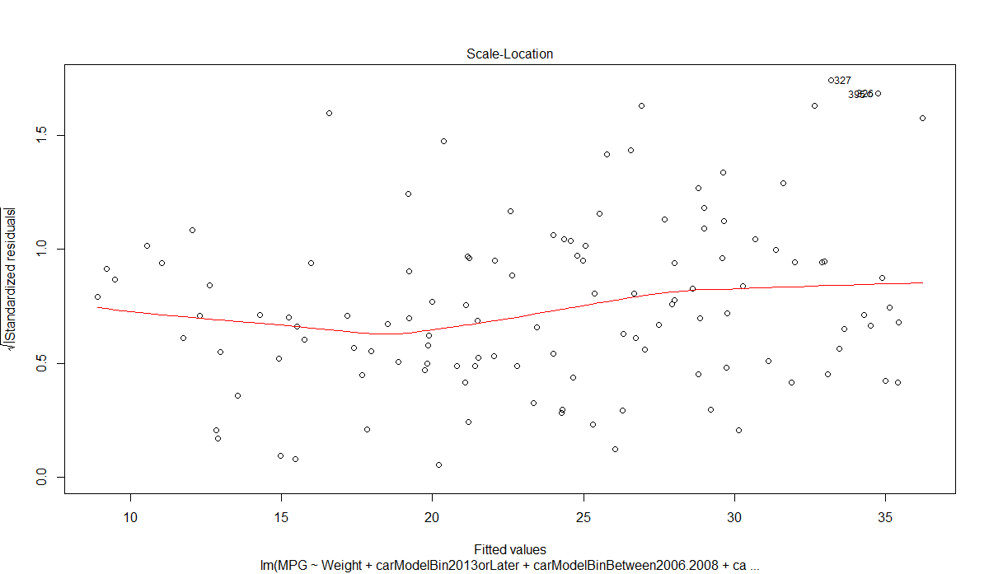
Model plot - 3 From Test Dataset

Slide 20
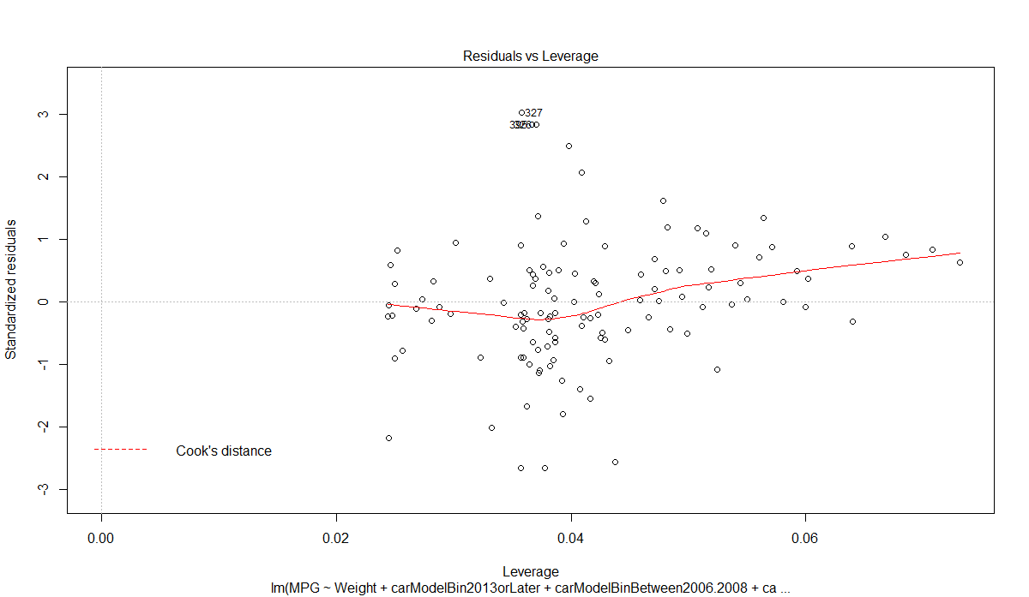
Model plot - 4 From Test Dataset

Slide 21
Conclusion
The model below estimates the MPG of a car with accuracy of more than 80% and therefore it is accepted.
EstimatedMpg = 48.0014310 +
(-0.0065884*Weight) +
(-7.5540290*carModelBin2013orLater) +
(-4.2541915*carModelBinBetween2006.2008)+
(-7.1354110*carModelBinBetween2009.2012)

