Slide 1

The Shortest Path Problem
Diksha Chottani
Grant Hartley
Zoe Ellis

Slide 2
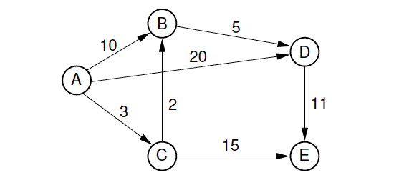
Shortest Path Problem: Details
When discussing the Shortest Path Problem in relation to graph theory:
It is a problem in which the solution lies in determining the path between 2 vertices such that the sum of the weights of its edges is minimized

Slide 3
Shortest Path Algorithms: Dijkstra's algorithm
There are a variety of algorithms for solving the Shortest Path Problem.
In particular, we will be focusing on Dijkstra's algorithm.
Dijkstra's Algorithm: Makes use of breadth-first search to find the shortest path between 2 vertices. It can only be applied when using
non-negative edge weights.
Time Complexity: O(n^2)

Slide 4
Shortest Path Application: Parking Lots and Space Availability

Slide 5
Objective and Requirements
The Program will then determine the closest available parking spot
User is prompted to select desired parking lot.
The program will retrieve the vacancy data from that particular lot
When considering the layout of a specific parking lot, we are able to determine the closest available parking spot in that particular lot using Dijkstra's algorithm.
The project is intended to run through the utilization of a database that contains viable information drawn from the details of each parking lot in a given location

Slide 6
Front-End & Back-End Application
When the user selects the desired parking lot, the front-end application will call the back-end.
This part of the application will read in a set of data that is dependent on the choice of the user.
The data set will be read into a graph
The function that determines the closest vacancy will be called utilizing Dijkstra's algorithm.
This solution will then be returned to the front-end application for display.

Slide 7
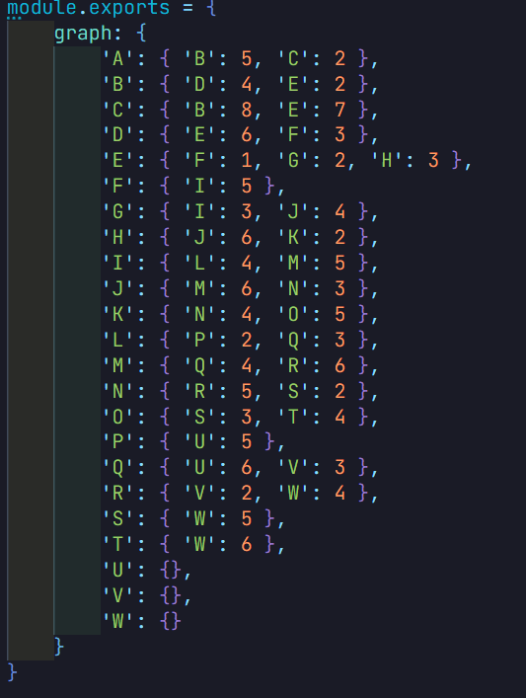
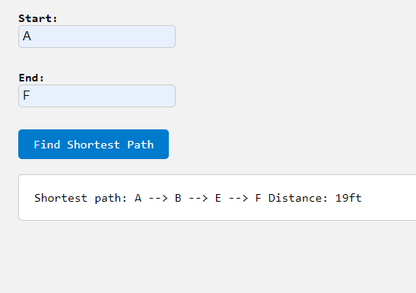
Program Execution:

Slide 8
References:
https://en.wikipedia.org/wiki/Shortest_path_problem#Algorithms
https://brilliant.org/wiki/shortest-path-algorithms/

