Slide 1
Intermediary Systems: A Survey
Marios Dikaiakos
Dept. of Computer Science
University of Cyprus
3rd Anwire Workshop on Adaptable Service Provision
18th November 2003, Paris

Slide 2
Outline
Introduction.
Classifying Intermediaries.
A survey of Intermediary Systems.
Summary and Conclusions.

Slide 3
Definition
Software entities that intervene in the client-server exchanges taking place at the application layer of the Internet.
Deployed on hosts of the wireline and wireless network, along the route taken by client requests and server replies through the network (content path).
From simple relaying and caching to more complex transformations involving the modification of requests and replies, and the creation of content.
Extend the functionality and application performance offered by the network to its end-users, without violating the end-to-end principles of Internet design.
Provide a “reusable and expandable set of services and functions, commonly needed by many applications to function well in a networked environment” [Middleware].

Slide 4
Motivation
Intermediaries are important:
  A useful abstraction for designing and studying emerging software infrastructures for the Internet services.
  Will permeate the Internet because of the increasing demand for scalability, high-availability, personalization, localization, and ubiquity.
Our goals:
  Provide an survey of a wide range of intermediary systems and identify common characteristics and functional properties.
  Examine the requirements and identify key components of intermediary systems.
  Define a framework for comparing, modeling, and designing intermediaries.

Slide 5
“End-to-end” principles and the Web
End-to-end arguments in system design:
  Application-level functions usually cannot, and preferably should not, be built into the lower levels of a system.
  Functionality can completely and correctly be implemented only with the knowledge and the help of the applications standing at the endpoints of the communication system. Providing that functionality as a feature of communication systems is not possible [Saltzer et al., ACM Trans. Comput. Syst., Vol. 2, No. 4, 1984]
The system architecture of the World-Wide Web is based on end-to-end principles: functionality and complexity are put at Web clients and Web servers.

Slide 6
Departing from e2e
Excessive loads of Web traffic: large latencies, overloaded Web servers.
Wireless connectivity and mobile services: disconnected operation, content and service adaptation.
More demanding applications: streaming media with stringent bandwidth requirements.
Need for service differentiation: added-value, different service-levels, personalization, context and location awareness.
Less sophisticated users: delegating configuration, protection, and control to a common point, part of the application execution context.
Diversity of terminal devices: Support for wireless, mobility and ubiquity.
Operation in an untrustworthy world.

Slide 7
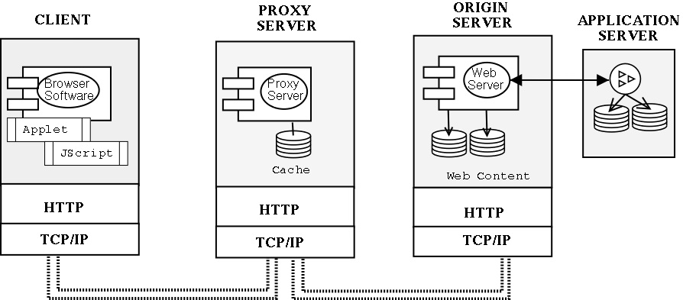
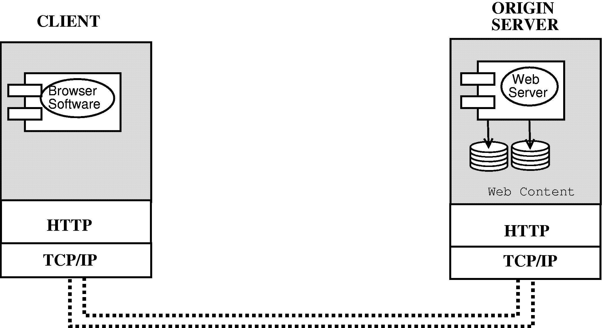
Extending the edges

Slide 8
Dynamic content management
Web pages as collections of:
  Dynamic information fragments extracted from back-end applications and databases (WebSphere).
  XML fragments derived through queries to back-end databases (Weave).
High-level abstractions for Web-site structure:
  Object Dependence Graphs persistent data-structures (IBM’s WebSphere).
  OO Declarative programs (WeaveL language, INRIA’s Weave project).
Run-time policies for update propagation and consistency with back-end systems specified via:
  Trigger monitors integrated with ODG’s (WebSphere)
  Declarative specification languages (WeavePRL).
Run-time adaptability - flexibility to choose at run-time which codes to invoke is provided by the Accessible Business Rules framework which contain run-time decision points (WebSphere).

Slide 9
Proxies and Content-Distribution Networks
Proxy caches reduce response times, server loads, HTTP traffic.
Organized as hierarchical and co-operative caching infrastructures.
Content Distribution Networks: belong to one administrative entity and comprise geographically distributed collections of cooperating edge proxies.
Edge
Servers

Slide 10
Beyond Web proxies
We examine intermediaries that extend the paradigm of typical Web intermediaries along three dimensions:
The functionality provided by an intermediary beyond proxying and content caching: capabilities, services, policies.
The system architecture of an intermediary, describing its composition in terms of components, the division of roles and functions between them, their inter-relationships, their placement across the network and their ownership.
The interaction between intermediaries and their counterparts, described in terms of communication patterns, supported protocols, access models.

Slide 11
Functionality
Customization: restructuring the presentation of content according to user-preferences, terminal-device capabilities, context of use, location, etc.
Filtering: semantic analysis of content retrieved from origin servers; pertinent to intelligent techniques for service personalization and localization, protection from viruses, indecent content, etc.
Annotation: generation and dissemination of additional information and meta-information (summaries, keywords, highlights, ad banners).
Transcoding: transformation from one format to another, to enable presentation in different terminals and to optimize transportation across wireless links.
Protocol Translation between wireless and wireline protocols.
Content creation: produced from application code off-loaded, cached and executed on intermediaries, or from the aggregation of content retrieved from multiple origin servers.

Slide 12
System Architecture
Structure: centralized/tightly integrated versus distributed intermediaries.
Deployment: near origin server, near client, in the network, in the intranet.
Ownership: client device, ISP, intermediary service provider, CDN, content provider, enterprise intranet, etc.
Complexity: special purpose, “light” components vs. components with complex functionality (caching, versioning, indexing, profiling).
Support for configurability and programmability:
  Configuration parameters: determine the set of operations to be invoked in a given context; hard-wired or extracted from meta-data files
  Generic execution environments: supporting the dynamic off-loading of intermediary entities into the infrastructure (JVM, Mobile agents, Jini); provide APIs, libraries, patterns for programming new services.
  Compositional frameworks: providing components used as building blocks for defining new services according to higher-level programming models.

Slide 13
Interaction
Communication mode: synchronous (on-demand) versus asynchronous.
Access model: push (server-initiated) versus pull (client-initiated).
Protocol support: HTTP, stripped-down HTTP, SMTP, NNTP, WAP.
Supported media: wireline versus wireless.

Slide 14
Classifying Intermediaries
We examine three categories of intermediary systems (based on their functionality and focus):
  Notification intermediaries (aka information-dissemination systems): driven by end-user profiles, operate asynchronously, even when an end-user is disconnected.
  Intermediaries for wireless and mobile services.
  Intermediary infrastructures: overlay networks extending the support of the core network for the development and deployment of new services.

Slide 15
Notification Intermediaries
Monitor content in origin Web servers on behalf of subscribed users.
Evaluate the relevance of changes with respect to stored user profiles (long-term, continuously evaluated queries).
Notify subscribers accordingly (push or pull).
Provide support for filtering, annotation and aggregation of content.
Examples of notification Systems:
  SIFT (Stanford Univ.) - for Usenet News; information-retrieval style profiles
  AIDE (AT&T Research) - for the Web; emphasis on versioning and differencing of Web pages.
  Grand Central Station (IBM) - for the Web, Usenet news, email; boolean-structured predicated language for profile specification; combined with Web casting dissemination.
  FIGI (Univ. Cyprus) - for the Web, Usenet news, email; XML profiles; mobile-agent based architecture, dissemination with mobile agents, email, and SMS.

Slide 16
Intermediaries for Mobility & Wireless: Requirements
Optimize client-server communication over the wireless medium.
Support personal, physical, and service mobility.
Support both synchronous and asynchronous interaction, coping with frequent disconnections.
Support seamless access from a variety of devices.
Adapt content to terminals of different type.
Support the provision of content in multiple formats (HTML, WML, XML) to the same device over the same link.
Adapt content to situational and personal preferences (personalization, localization, context-awareness).
Guarantee high availability, robustness, and performance scalability.

Slide 17
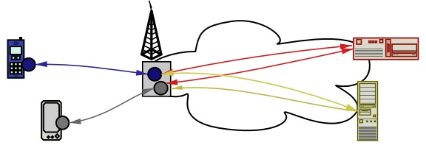
Distributed agent-based approaches
Deploy special-purpose, “light” components (“agents”) on the wireline network and/or the mobile hosts.
These agents collaboratively mediate the communication between origin servers and mobile terminals.

Slide 18
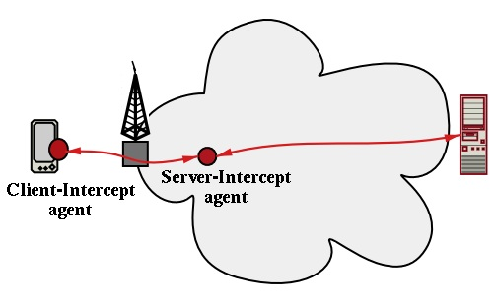
IBM’s WebExpress
By IBM [Housel, Samaras, Linguist, 1998].
Supports wireless WWW access.
Provides HTTP optimization over wireless channel, header caching, disconnection management.

Slide 19
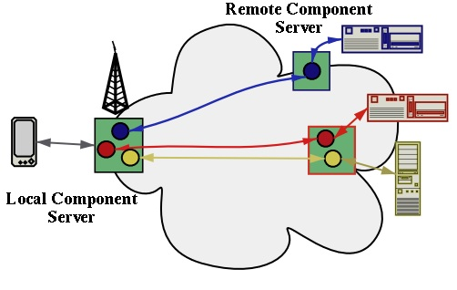
Web Stream Customizers
Steinberg & Pasquale (WWW 2003). Provides redirection of HTTP traffic, protocol and content adaptation, compression and caching.
Local Component Server attached to client; hosts multiple local components (one per origin server).
Remote Component Server attached to origin server; hosts multiple remote components (one per client).

Slide 20
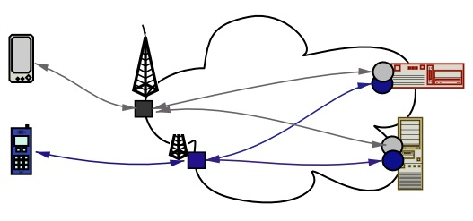
End-to-end solutions
Origin servers store content in multiple formats compatible with various wireless clients or adapt it on-the-fly according to client, connection, or end-user profiles.
However: adapted content or adaptation software has to be inserted at each origin server (and updated as new terminals and protocols become available).

Slide 21
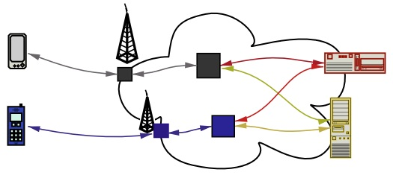
Proxy-based solutions
Deploy powerful adaptation intermediaries in the net, to act as delegates for a specific family of devices.
Can be combined with end-to-end solutions.

Slide 22
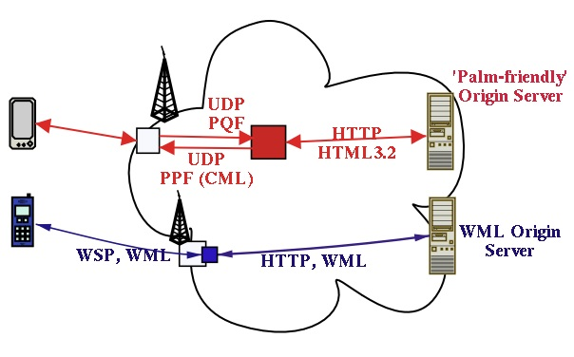
WAP Gateways and Web Clippings
Combine the end-to-end approach (“specialized” ends) with the proxy-based solution (proxy providing optimization of communication).
Provide translation between HTTP and wireless protocols, and lower-level optimizations for the provision of Web access over wireless devices.
Presume the publishing of content into specific formats (WML and HTML3.2, respectively).

Slide 23
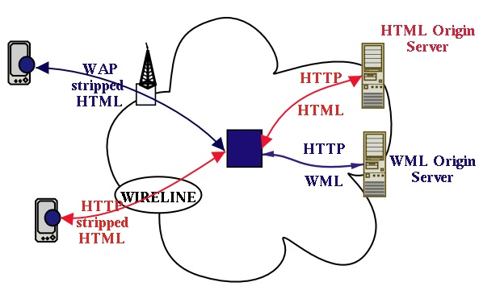
Handspring’s Blazer
Combination of a powerful adaptation proxy with a device-specific micro-browser.

Slide 24
Intermediary Infrastructures
Intermediary solutions need to support, additionally:
  Large numbers of simultaneous end-users.
  Big heterogeneity of terminal devices.
  High-throughput of requests for service.
  Bursty workloads.
  High-availability and incremental scalability in service provision.
  Ease in the definition and deployment of new services.
Requirements:
  To shift computation, storage and complexity from centralized proxies, terminals, mobile-base stations, into the networking infrastructure.
  Distributed, cooperating, network-centric components.
  Enhance the programmability or configurability of intermediary components.

Slide 25
Intermediary Infrastructures
Proposed approaches suggest a separation of concerns:
  Content presentation.
  Communication optimization.
  Aggregation of content.
  Orchestration of functions.
  Robust execution.
Solutions typically include some type of multi-tier architecture:
  Lower tiers provide the execution environments of intermediary services, offering support for load-balancing, high-availability, etc.
  Middle tiers provide mechanisms for specifying the orchestration of intermediary functions.
  Upper tiers provide support for adapting the content to particular terminal devices and network connections.

Slide 26
Examples of Intermediary Infrastructures
BARWAN project (UC/Berkeley): support service access from mobile clients roaming across heterogeneous wireless networks.
  Lower tier: Scalable Network Services
  Middle tier:TACC servers.
  Upper tier: handles presentation of data to various terminals.
  Compositional framework: inspired by UNIX pipes.
  Basic component: TACC workers,supporting basic functionalities (transformation, aggregation, customization, caching).
Ninja architecture: robust, Java-based infrastructure for Internet services
  Lower tier: Bases and vSpace execution environment.
  Middle tier: Active Proxies provide transformational support between services and clients.
  Upper tier: Units represent terminal devices in the infrastructure.
  Compositional framework: introduces a path abstraction, comprising operators and connectors, put together according to four patters (wrap, pipeline, combine, replicate).

Slide 27
Examples of Intermediary Infrastructures
WBI (Web Browser Intelligence, IBM Almaden): assembles complex intermediary systems from simpler components.
Compositional framework:
  Based on five building blocks: request editors [upper tier], generators [lower tier], document editors [middle tier], monitors and autonomous functions [logging and book-keeping functions].
  These are composed into information streams, packaged as WBI plugins, and connecting origin servers with terminal devices.
  Multiple WBI plugins can be composed into WBI services.
  Composition of WBI plugins can be dynamic, using a rule-based approach.
iMobile (ATT research):
  iProxy: programmable proxy server designed to host agents and services in Java.
  Programming abstractions: devlets, applets, infolets.

Slide 28
Infrastructures for Dynamic Content
Intermediary infrastructures presented earlier, do not support the retrieval, execution, and caching of service code from dynamic-content providers to the intermediary infrastructure.
In that context, several issues need to be addressed:
  Specification and composition of intermediary services out of code components retrieved dynamically from service providers.
  Consistency maintenance, security management, and resource management.
Approaches in that direction focus on a three-tier architecture of a service, comprising: presentation, business logic and database tiers:
  Active Cache system [Univ. Wisconsin].
  Websphere Edge Services (IBM)
  EdgeSuite CDN (Akamai) - based on the ESI specification of W3C.
  IETF’s Open Pluggable Edge Services (OPES) working group.

Slide 29
Conclusions
Existing intermediaries lack the semantics and the system support to be used as open and dynamic overlay networks.
Recent intermediary infrastructures offer some support for composability of services and for hosting code retrieved from remote providers.
Many challenges still exist:
  Programmability support: need for programming models, languages, APIs, generic compositional frameworks, execution environments, well-defined interfaces.
  Extended Communication support: mechanisms for specifying and standardizing richer interaction semantics between intermediary components.
  Adaptability: system support for dynamic adaptation, in terms of performance and context monitors, execution environments for execution-state migration, etc.
  Support from Middleware: explicit description and management of adaptation conditions, resource availability; standardization of services for data management, for policy implementation.

