Slide 1
Searching the Grid
Marios Dikaiakos
Dept. of Computer Science
University of Cyprus

Slide 2

In collaboration with..
Dr. Rizos Sakellariou
Dept. of Computer Science
University of Manchester
Prof. Yannis Ioannidis
Dept. of Informatics & Telecommunications
University of Athens
Wei Xing
  Dept. of Computer Science
  University of Cyprus
Partly supported by

Slide 3
Outline
Context
Information on the Grid: Approaches & Limitations
Searching the Web and the Grid
Summary and Conclusions

Slide 4
Future Scenarios for the Grid
A wide-scale, distributed computing infrastructure to support resource sharing and coordinated problem solving in dynamic, multi-institutional Virtual Organizations.
Future scenarios and the Grid (grand?) vision:
  Simplified access to any resources, for anyone, anywhere, anytime.
  A space of services & service economies.
  Seamless support for collaborative work of distributed teams.
  Monitoring and steering through wireless devices.
  Numerous application areas: Computational Sciences, Health Care, Societal Problems, Distance learning and education.

Slide 5
Future Scenarios for the Grid
Computational Grid: Provides the raw computing power, high speed bandwidth interconnection and associate data storage.
Data & Information Grid: Allows easily accessible connections to major sources of information and tools for its analysis and visualisation.
Knowledge & Semantic grid: Gives added value to the information; provides intelligent guidance for decision-makers; facilitates the generation, diffusion and support of knowledge.

Slide 6
Future Scenarios for the Grid
The Grid as a Wide-Scale Distributed System:
  Millions of resources of different kinds.
  Services and Policies in place.
  Relationships (permanent and transient) between organizations, software, data, services, applications…
  Different middleware platforms.
  Common (?) protocols, standards and API’s.
The hope is that Grid will grow larger and will reach an acceptance as wide as the Web.

Slide 7
Problem Statement: Searching the Grid
How are individuals and organizations going to harness the capabilities of a fully deployed Grid, with a massive and ever-expanding base of computing and storage nodes, network resources, and a huge corpus of available programs, services, and data?

Slide 8
Problem Statement: Searching the Grid
How are individuals and organizations going to harness the capabilities of a fully deployed Grid, with a massive and ever-expanding base of computing and storage nodes, network resources, and a huge corpus of available programs, services, and data?
To this end, users need to identify “resources” that are:
  Interesting (discovery)
  Relevant (classification)
  Accessible and available under known policies of use, cost (inquiry)

Slide 9
Problem Statement: Searching the Grid
How are individuals and organizations going to harness the capabilities of a fully deployed Grid, with a massive and ever-expanding base of computing and storage nodes, network resources, and a huge corpus of available programs, services, and data?
To this end, users need to identify “resources” that are:
  Interesting (discovery)
  Relevant (classification)
  Accessible and available under known policies of use, cost (inquiry)
Emphasis on “summary” information, in terms of granularity and timing.

Slide 10
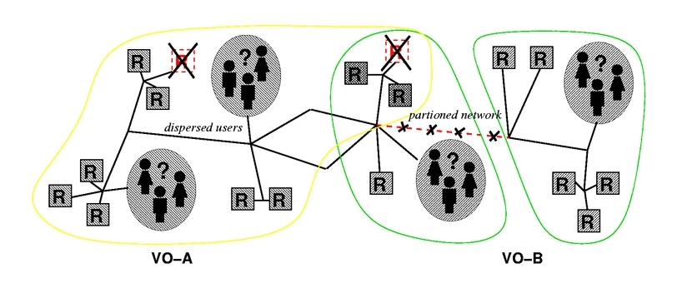

The Grid Information Problem
Computing, Storage, Network Resources
Software and Data-sets
Policies
Relationships
Best-practices

Slide 11
Outline
Context
Information on the Grid: Approaches & Limitations
Searching the Web and the Grid
Summary and Conclusions

Slide 12
Grid Information Services
Established to help users answer questions on the status of individual resources and the Grid.
Support the discovery and ongoing monitoring of the existence and characteristics of resources, services, computations and other entities of value to the Grid.
Examples:
  GLOBUS, EDG: Metacomputing Directory Service (MDS)
  UNICORE Gateway and Network Job Supervisor (NJS)
  Relational Grid Monitoring Architecture (R-GMA)
  Condor Matchmaker

Slide 13
Metacomputing Directory Service (MDS)
Distributed Directory approach: collection of LDAP servers.
Simple LDAP Information Schemas describe resource information.
Servers:
  Grid Resource Information Server (GRIS): Running on each resource and supplying information about it. Supports multiple resources as well.
  Grid Index Information Server (GIIS): Collect information from multiple GRIS servers. Support particular queries for information spread across multiple GRIS servers.
Protocols (LDAP based) for:
  Discovery and Inquiry (GRIP).
  “Soft-state” Registration (GRRP).

Slide 14
MDS: Grid Information Services in Globus
Users
GRIP
GIIS
GRIP
GRRP
GRRP
Discovery/
Inquiry/
Retrieval
GIIS
GIIS
GIIS
GRIP
GRRP
GRRP
GRRP
GRRP
GRIS
GRIS
GRIS
GRIS
Info. Retrieval
LDIF
LDIF
LDIF
LDIF
“Info.
Providers”
“Info.
Provider”
“Info.
Providers”
“Info.
Providers”
Resources

Slide 15
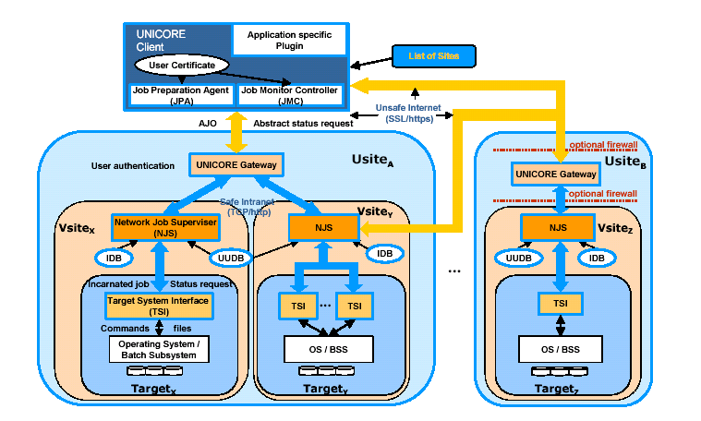
UNICORE Gateway and NJS

Slide 16
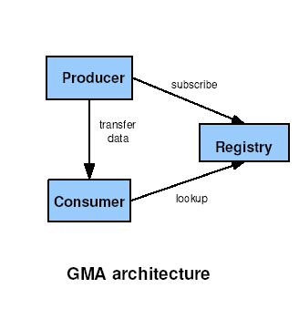
Relational Grid Monitoring Architecture
Application
Consumer
Servlet
Consumer
API
Registry
Service
Registry API
Producer
API
Producer
Servlet
Sensor Code

Slide 17
What information is out there?
Applications:
  Descriptions.
  I/O requirements.
  Meta-Data
  Worklfows
Virtual Organizations:
  Resources
  Policies
  People
Resource Specifications:
  Descriptions & Types
  Names
  Capacity
  Configuration
Resource status
  Resource use.
  Availability.
  Monitoring data.
Summary & Statistics
  Logs.
  Associations.
  Statistics of use.
Software:
  Codes
  Specs
  Location
Data-sets:
  Data
  Metadata
  Replicas
Services:
  Interface
  Metadata

Slide 18
Resource Specification info. (examples)
Source | Information provided | Schema | System
Info. Provider (Unix sys-call) | Mds-computer-platform Mds-Cpu-model Mds-Host-hn | Hierarchical | MDS-Globus LDAP
Info. Provider (Unix sys-call) Static info. | GlueCEName GlueHostName GlueHostArchitecture GlueHostProcessorClockSpeed GlueSEAccessProtocolType GlueCESEBindGroup GlueHostFileLatency | Hierarchical | MDS-EDG LDAP
Sensors (Unix sys call) | StorageElementProtocol NetworkTCPThroughput NetworkRTT | Relational | RGMA-EDG HTTP

Slide 19
Resource status information (examples)
Source | Information provided | Schema | System
Info. Provider (Unix sys-call) | Mds-Memory-Ram-freeMB Mds-FS-Total-freeMB cpuload5 | Hierarchical | MDS-Globus LDAP
Info. Provider (Unix sys-call) | GlueCEStateRunningJobs GlueCEJobLocalID GlueHostProcessorLoadLast1Min | Hierarchical | MDS-EDG LDAP
Sensors (Unix sys call) | StorageElementStatus NetworkUDPPacketLoss NetworkFileTransferThroughput | Relational | RGMA-EDG HTTP
Condor’s Sensor modules | DiskSpace MemoryUsed SystemLoad | ClassAds | Hawkeye Condor
NWS probes Traceroute | End-to-end bandwidth End-to-end latency End-to-end path | XML | GridLab’s TopoMon GMA arch.

Slide 20
VO information (examples)
Source | Information provided | Schema | System
Static info. | Cert (info. About local certificate policy) MdsHostContact | Hierarchical | MDS-Globus LDAP
Static info. | GlueCEPolicyMaxWallClockTime GlueCEPolicyMaxCPUTime GlueSAPolicyMaxFileSize | Hierarchical | MDS-EDG LDAP

Slide 21
Software & Dataset information (examples)
Source | Information provided | Schema | System
Info. Provider | Mds-Application-Group-config Mds-Application-name Mds-Application-location Mds-Application-info | Hierarchical | MDS-Globus LDAP
Info. Provider | GlueSLFileName GlueSLFileSize GlueSLFilePath | Hierarchical | MDS-EDG LDAP
GDMP producer | ExportCatalogue | RGMA | Replica Catalogue Service GDMP-EDG

Slide 22
Application & Logging Information
Source | Information provided | Schema | System
TRIANA | Worklow information & Metadata | XML | TRIANA - GridLab
Condor submission | DAGMan input file (DAG specification and metadata) | Condor-specific | Condor meta-scheduler
Workload Management System | BrokerInfo file | Hierarchical | Resource Broker (EDG) LDAP
LDAP queries to JSS, RB. | Logging information Bookkeeping information (transient) UserID, JobID, Job State, JobDescription, etc | Attribute=value | LB Server (EDG) Events, exported API for queries

Slide 23
Limitations of Current Approaches
Remarks extracted from the description of a Grid-application development effort:
  “Jobs typically need to access hundreds of files, and each site has a different subset of the files.”
  “Our data system knows what portion of a user's data may be at each site, but does not know how to submit grid jobs.”
  “Our job submission system required users to choose grid sites and gave them no assistance in choosing.”
  “…jobs requesting thousands of files and sites having hundreds of thousands of files are not uncommon in production.”
  “…it would not be scalable to explicitly publish all the properties of jobs and resources in ...”

Slide 24
Limitations of Current Approaches
Scalability in the context of Millions of Resources:
  Infrastructure intrusiveness.
  Resource Discovery, Retrieval and Classification.

Slide 25
Limitations of Current Approaches
Scalability in the context of Millions of Resources:
  Infrastructure intrusiveness.
  Resource Discovery, Retrieval and Classification.
Expressiveness of Data Models in terms of:
  Types of captured information.
  Expressing semantic relationships between represented entities.
  Amenability to Indexing, Query Optimization.

Slide 26
Limitations of Current Approaches
Scalability in the context of Millions of Resources:
  Infrastructure intrusiveness.
  Resource Discovery, Retrieval and Classification.
Expressiveness of Data Models in terms of:
  Types of captured information.
  Expressing semantic relationships between represented entities.
  Amenability to Indexing, Query Optimization.
Complexity:
  Different protocols for discovery & inquiry, registration, invocation.
  Lack of interoperability between different platforms.
  Information Standardization.

Slide 27
Limitations of Current Approaches
Scalability in the context of Millions of Resources:
  Infrastructure intrusiveness.
  Resource Discovery, Retrieval and Classification.
Expressiveness of Data Models in terms of:
  Types of captured information.
  Expressing semantic relationships between represented entities.
  Amenability to Indexing, Query Optimization.
Complexity:
  Different protocols for discovery & inquiry, registration, invocation.
  Lack of interoperability between different platforms.
  Information Standardization.
Missing Functionalities:
  Transient and Historical information.
  Policies.
  Complex Queries.

Slide 28
Outline
Context
Information on the Grid: Approaches & Limitations
Searching the Web and the Grid
Summary and Conclusions

Slide 29

Searching the Grid
A problem of federation:
  Wrap
  Extract
  Integrate
  Monitor
  Query
Very large number of sources.
Independent.
Various, partly unknown, semantics.
No common schema.
Subject to change, birth or silence.

Slide 30
Searching the Grid: Possible Approaches
The “warehouse” approach:
  “Wrap” the various sources to extract their information.
  Store data in a warehouse.
  Monitor sources and propagate updates to the warehouse.
  Ask queries to the warehouse.
The “mediator” approach:
  Ask queries each time a user is looking for information.
  How do you ask different sources?

Slide 31
A Similar Problem…
The problem of Information retrieval on the World-Wide Web has been addressed by Search Engines.
Successful Search Engines:
  Identify interesting resources using one protocol for discovery and retrieval (HTTP with DNS support and URI conventions).
  Conduct extensive indexing to facilitate queries.
  Mine semantic relationships and implicit rules capturing the degree of relevance of resources.
  Provide simple end-user interfaces.
  Absence of registration; minimal intervention to resources.

Slide 32
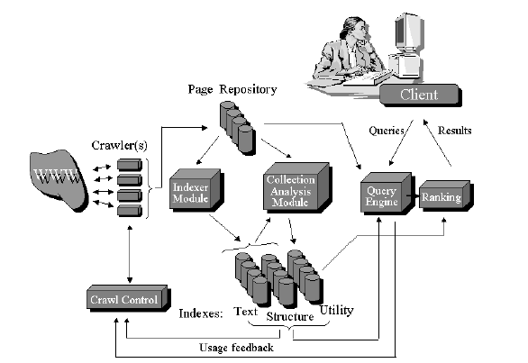
The Architecture of Search Engines
Source: Brin & Page

Slide 33
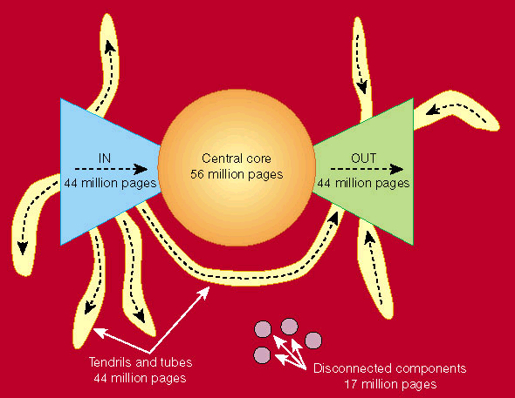
Web Structure
Source: A. Broder et al “Graph Structure in the Web,” (9th WWW Conference, 2000)

Slide 34
Requirements for Searching the Grid
Global/Common naming scheme for Grid entities.
Resolution mechanism for discovery and retrieval of entity-related information/meta-data.
Type and representation of retrieved entity-related information.
Mining and representation of relationships and summary data.
Complexity of queries and query interpretation.

Slide 35
Towards a Grid Search Engine (GRISEN)
Based on the notion of “grid entity,” which represents various (permanent or transient) resources on the Grid: computational, storage, and network; services, software and datasets; workflows and VO’s; “best practices”; policies for use, pricing, QoS etc.
Grid entities:
  Capture characteristics of Grid-architecture components.
  Have a common naming scheme.
  Can be described by metadata using a common hierarchical data model (RDF or XML).
  Have their metadata published in “proxies.”

Slide 36
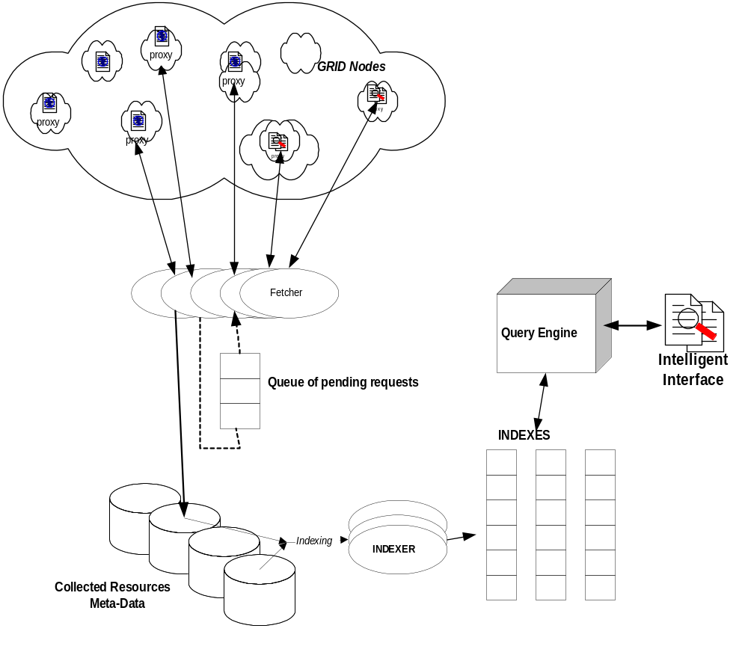
A Reference Architecture for GRISEN

Slide 37
A Reference Architecture for GRISEN
Proxies distributed throughout the Grid, running query mechanisms to extract information and integrate entity metadata.

Slide 38
A Reference Architecture for GRISEN
Proxies distributed throughout the Grid, running query mechanisms to extract information and integrate entity metadata.
A distributed “crawler” that discovers and accesses proxies to retrieve metadata for the underlying Grid resources, and transform them into the GRISEN data-model.

Slide 39
A Reference Architecture for GRISEN
Proxies distributed throughout the Grid, running query mechanisms to extract information and integrate entity metadata.
A distributed “crawler” that discovers and accesses proxies to retrieve metadata for the underlying Grid resources, and transform them into the GRISEN data-model.
The indexer, which processes collected metadata, using information retrieval and data mining techniques to create indexes that can be used for resolving user queries.

Slide 40
A Reference Architecture for GRISEN
Proxies distributed throughout the Grid, running query mechanisms to extract information and integrate entity metadata.
A distributed “crawler” that discovers and accesses proxies to retrieve metadata for the underlying Grid resources, and transform them into the GRISEN data-model.
The indexer, which processes collected metadata, using information retrieval and data mining techniques to create indexes that can be used for resolving user queries.
The query engine, which recognizes the query language of GRISEN and processes queries coming from the user-interface of the search engine.

Slide 41
A Reference Architecture for GRISEN
Proxies distributed throughout the Grid, running query mechanisms to extract information and integrate entity metadata.
A distributed “crawler” that discovers and accesses proxies to retrieve metadata for the underlying Grid resources, and transform them into the GRISEN data-model.
The indexer, which processes collected metadata, using information retrieval and data mining techniques to create indexes that can be used for resolving user queries.
The query engine, which recognizes the query language of GRISEN and processes queries coming from the user-interface of the search engine.
The intelligent-agent interface that helps users issue complicated queries when looking for combined resources requiring the joining of many relations.

Slide 42
Research Issues
Metadata consolidation.
Proxy Discovery.
Metadata Retrieval and Integration.
Management of data.
Query mechanisms and interface.
Notes:
Metadata consolidation
This issue refers to the extraction to the proxy of metadata describing the resources of a Grid node.
Metadata must comply with a common data model to be defined in GRISEN.
A specification of the proxy structure and interface to the Grid node are required; this interface must be compliant with the enquiry protocols implemented by various Grid platforms, different types of nodes, etc.
A proxy can be many things: a simple index of local resources created by the Grid node, published on a Web server and accessed via HTTP; a daemon running on a network port of the node, awaiting for requests complying to a platform-specific protocol; a mobile agent launched by GRISEN and parked at a node hosting a directory of resources and running periodic queries to extract meta-information.
Besides supporting the protocols of acknowledged Grid platforms like Globus or Unicore, GRISEN proposes a minimalist approach for defining, naming, addressing, and implementing proxies.
Proxy Discovery
GRISEN must implement efficient mechanisms for discovery of Grid-resource descriptions throughout Internet.
As a first step to facilitate the discovery process, GRISEN will explore naming schemes that can be adopted to identify proxies and Grid resources.
Different approaches need to be studied and compared. For example: (i) periodic “crawling” of the Grid for the discovery of “passive” proxies, or (ii) updates of GRISEN structures by “active” proxies whenever meta-data change. For the effective discovery of proxies in the presence of hundreds of thousands of Grid nodes on Internet, it is important to define and exploit the semantic and administrative “relationships” that will be established between Grid resources (represented graphically as the grey area in Figure 6.2), as users exploit the benefits of the Grid and form dynamic Virtual Organizations, using multiple Grid nodes to solve a problem, coupling different codes, etc.
Retrieval of metadata: Upon discovery of a proxy, GRISEN must retrieve and store its meta-data for further processing. This simple task must be highly efficient and scalable with respect to the size of the Grid. Moreover, it is critical to incorporate proper scheduling, replacement and garbage-collection mechanisms in order to monitor and follow the rate of change of resources, to maintain the freshness of collected metadata, to achieve the prompt disposal of obsolete resources, etc.
Organization and management of data, query mechanisms and interface: Collected metadata must be analysed with techniques combining information-retrieval and data-mining algorithms to build proper indexes that will enable the extrapolation of semantic relationships between resources and the effective execution of user queries. A query language will be developed. Given that the expected difficulty of queries ranges from that of very small inquiries to requests requiring complicated joins, an intelligent-agent interface is required to help users formulate queries to the GRISEN data model, and into efficient computation thereof.

Slide 43
Implementation
VO1
VO2

Slide 44
Conclusions
Motivation stems from the need to provide effective information services to the users of the envisaged massive Grids.
Working towards:
  The provision of a high-level, platform-independent, user-oriented tool that can be used to retrieve a variety of Grid resource-related information in a large and heterogeneous Grid setting.
  The standardization of different approaches to represent resources in the Grid and their relationships, thereby enhancing the understanding of Grids.
  The development of appropriate data management techniques to cope with a large diversity of grid-related information.

Slide 45
Grid Activities in Cyprus
Focused around the University of Cyprus.
Funded by European Commission through IST-FP5.
Currently, three running projects:
  BioGrid
  CrossGrid
  SeLeNe

Slide 46
Grid Projects in Cyprus
BioGrid (September 2002 / 24 months)
  Development of a research infrastructure for large genomics and proteomics databases applications.
  Globus
CrossGrid (March 2002 / 36 months)
  Grid Infrastructure for Interactive applications.
  EDG/CG
SeLeNe (November 2002 / 12 months)
  Feasibility study of using Semantic Web technology for dynamically integrating metadata from heterogeneous and autonomous educational resources.

Slide 47
CyGrid
An activity funded in the context of the CrossGrid project.
Goal:
  Establish the local node of the pan-european CrossGrid testbed.
  Establish a Certification Authority for Cyrpus.
  Promote the uptake of Grid technologies in Cyprus and the deployment of new applications on the CyGrid testbed.

Slide 48
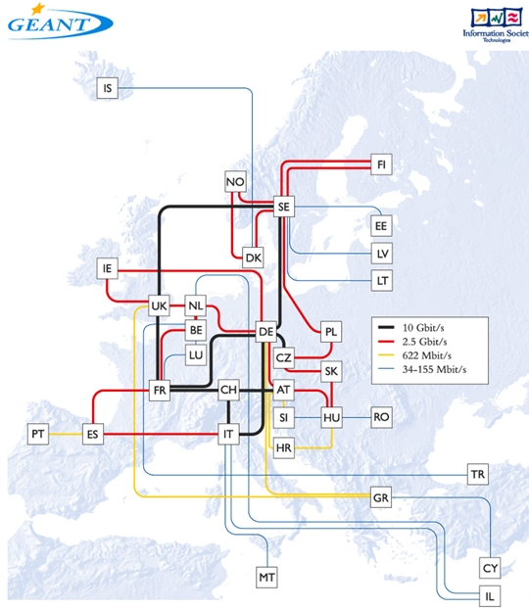
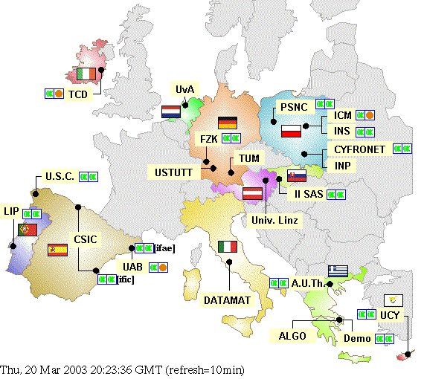
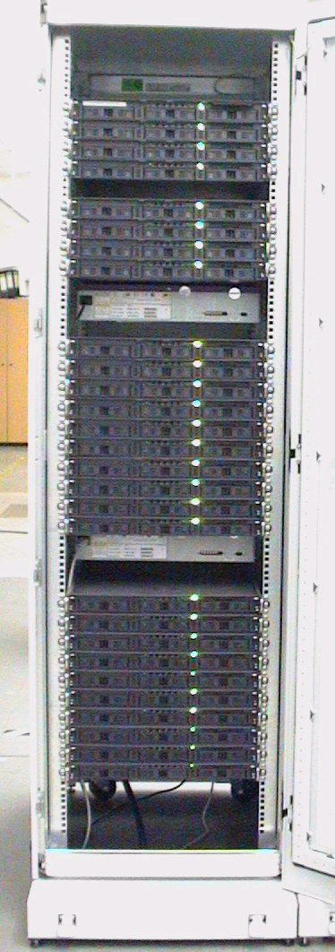
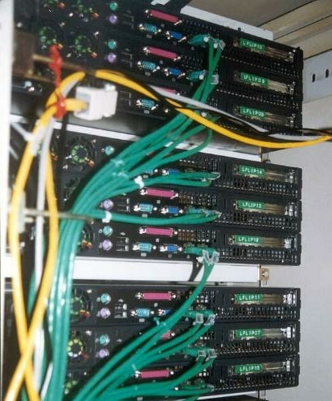
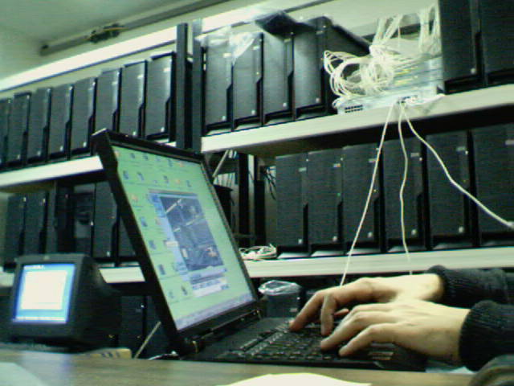
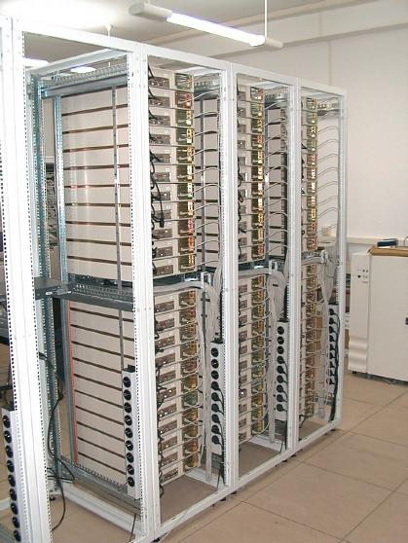
  What is the “CrossGrid testbed” ?
    A collection of distributed computing
    resources
    Supporting a “Grid environment”
  Objectives
    Development, Testing and validation
    Emphasis on interoperability
    with EU-DataGrid (EDG)
    Extension of GRID across Europe

Slide 49
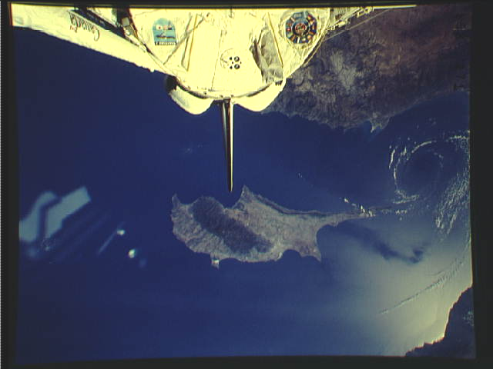
THANK YOU

Slide 50
Searching the Grid: Possible Approaches
The “warehouse” approach

