Slide 1
Topics: - Multilayer Neural Net Forward Propagation - Back propagation - Kullback-Leibler divergence

Slide 2
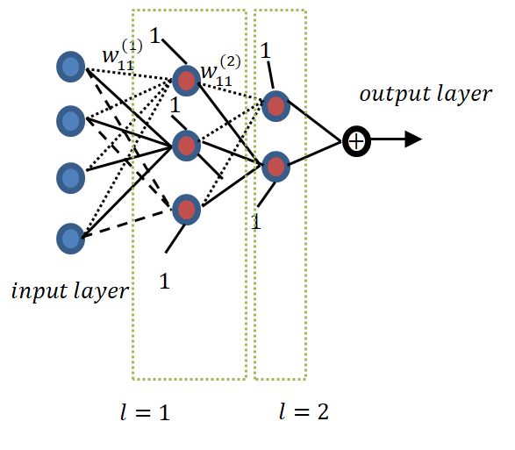
Multilayer Neural Network. How it looks

Slide 3
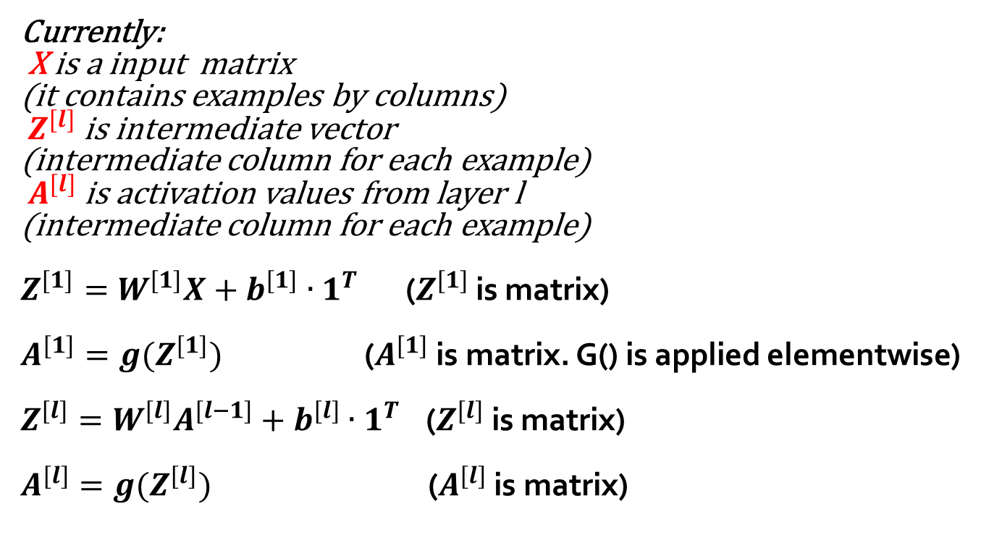
Multilayer Neural Network. Forward propagation.
Currently:
X is a input matrix
(it contains examples by columns)
$Z^{[l]}$ is intermediate vector
(intermediate column for each example)
$A^{[l]}$ is activation values from layer l
(intermediate column for each example)
$Z^{[1]}=W^{[1]}X+b^{[1]}∙1^{T}$ ($Z^{[1]}$ is matrix)
$A^{[1]}=g(Z^{[1]})$ ($A^{[1]}$ is matrix. G() is applied elementwise)
$Z^{[l]}=W^{[l]}A^{[l−1]}+b^{[l]}∙1^{T}$ ($Z^{[l]}$ is matrix)
$A^{[l]}=g(Z^{[l]})$ ($A^{[l]}$ is matrix)

Slide 4
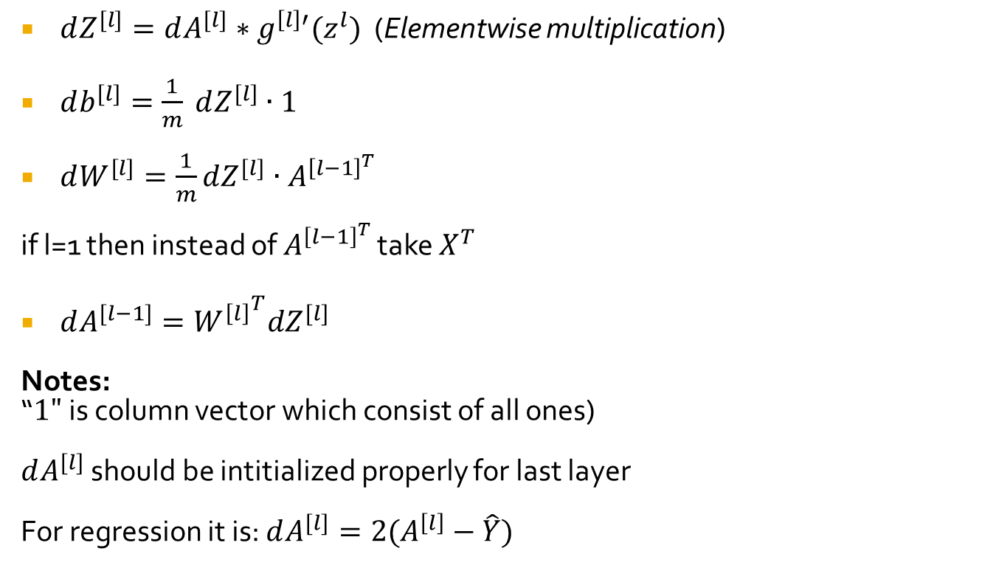
Equation to perform back-propagation for this notation
$dZ^{[l]}=dA^{[l]}∗g^{\left[l\right]′}(z^{l})$ (Elementwise multiplication)
$db^{[l]}=\frac{1}{m} dZ^{[l]}∙1$
$dW^{[l]}=\frac{1}{m}dZ^{[l]}∙A^{{\left[l−1\right]}^{T}}$
if l=1 then instead of $A^{{\left[l−1\right]}^{T}}$ take $X^{T}$
$dA^{[l−1]}={W^{\left[l\right]}}^{T}dZ^{[l]}$
Notes:
“$1"$ is column vector which consist of all ones)
$dA^{[l]}$ should be intitialized properly for last layer
For regression it is: $dA^{[l]}=2(A^{\left[l\right]}−\hat{Y})$

Slide 5
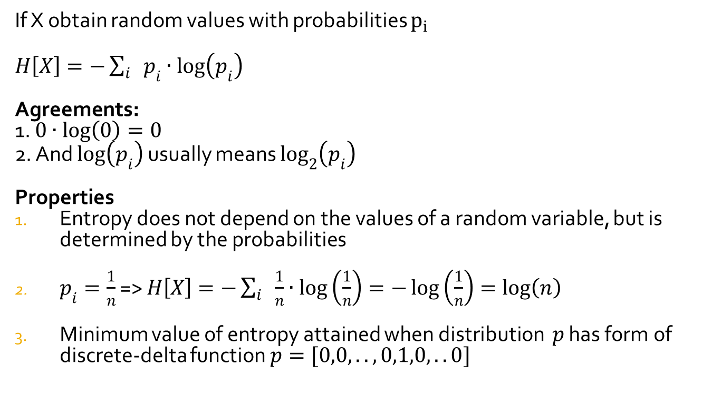
About Entropy
If X obtain random values with probabilities $p_{i}$
$H\left[X\right]=−\sum_{i}{p_{i}∙\log\left(p_{i}\right)}$
Agreements:
1. $0∙\log\left(0\right)=0$
2. And $\log\left(p_{i}\right)$ usually means $\log_{2}\left(p_{i}\right)$
Properties
Entropy does not depend on the values of a random variable, but is determined by the probabilities
$p_{i}=\frac{1}{n}$ => $H\left[X\right]=−\sum_{i}{\frac{1}{n}∙\log\left(\frac{1}{n}\right)}=−\log\left(\frac{1}{n}\right)=log\left(n\right)$
Minimum value of entropy attained when distribution $p$ has form of discrete-delta function $p=[0,0,..,0,1,0,..0]$

Slide 6
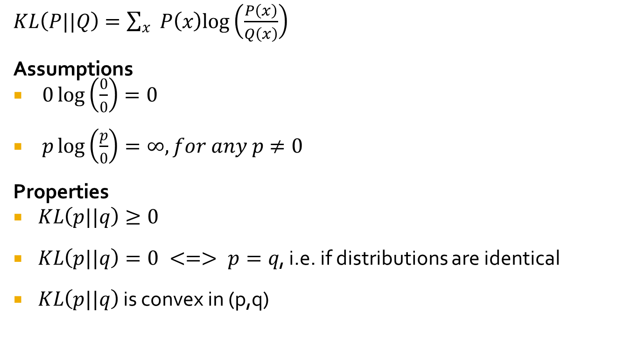
Kullback-Leibler (KL) divergence or relative entropy
$KL\left(P||Q\right)=\sum_{x}{P\left(x\right)log\left(\frac{P\left(x\right)}{Q\left(x\right)}\right)}$
Assumptions
$0\log\left(\frac{0}{0}\right)=0$
$p\log\left(\frac{p}{0}\right)=∞,for any p≠0$
Properties
$KL\left(p||q\right)≥0$
$KL\left(p||q\right)=0 <=> p=q$, i.e. if distributions are identical
$KL\left(p||q\right)$ is convex in (p,q)

Slide 7
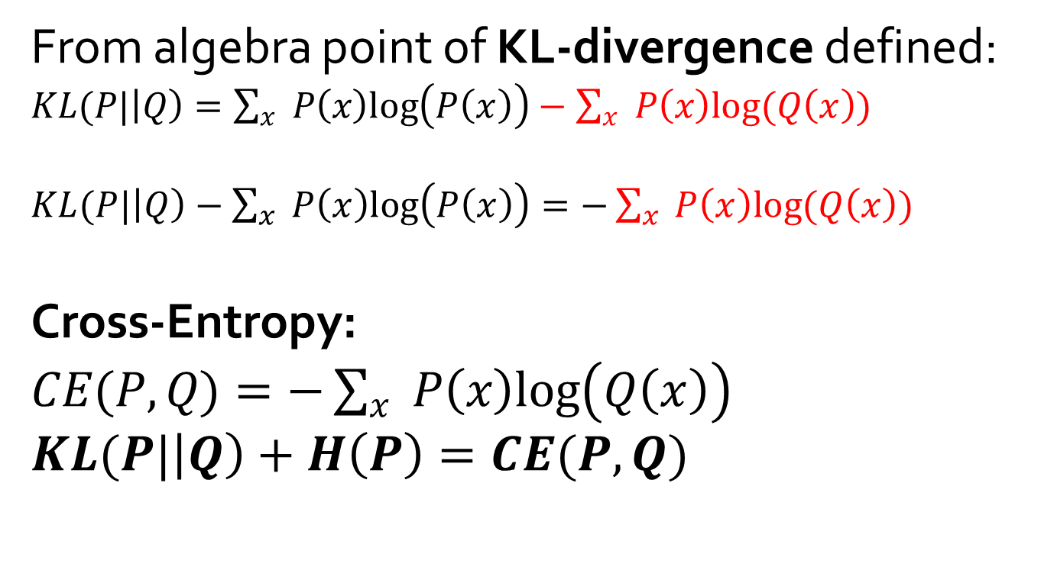
About CE (Cross-Entropy)
From algebra point of KL-divergence defined:
$KL(P|\left|Q\right)=\sum_{x}{P\left(x\right)log\left(P\left(x\right)\right)}−\sum_{x}{P\left(x\right)log(Q\left(x\right))}$
$KL(P|\left|Q\right)−\sum_{x}{P\left(x\right)log\left(P\left(x\right)\right)}=−\sum_{x}{P\left(x\right)log(Q\left(x\right))}$
Cross-Entropy:
$CE(P,Q)=−\sum_{x}{P\left(x\right)log\left(Q\left(x\right)\right)}$
$KL(P|\left|Q\right)+H\left(P\right)=CE(P,Q)$

Slide 8
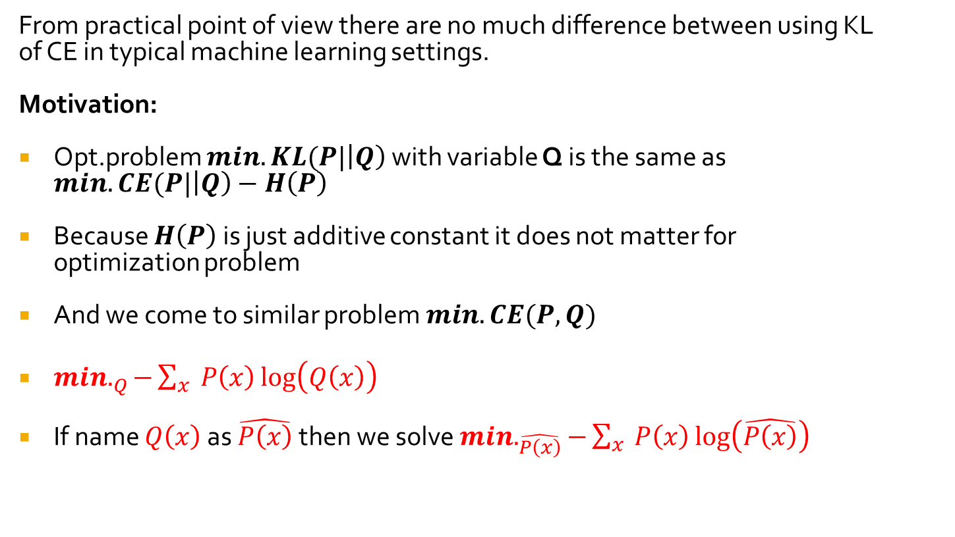
About CE (Cross-Entropy) application for classification loss
From practical point of view there are no much difference between using KL of CE in typical machine learning settings.
Motivation:
Opt.problem $min.KL(P|\left|Q\right)$ with variable Q is the same as $min.CE(P|\left|Q\right)−H\left(P\right)$
Because $H\left(P\right)$ is just additive constant it does not matter for optimization problem
And we come to similar problem $min.CE(P,Q)$
$min._{Q}−\sum_{x}{P\left(x\right)\log\left(Q\left(x\right)\right)}$
If name $Q\left(x\right)$ as $\hat{P\left(x\right)}$ then we solve $min._{\hat{P\left(x\right)}}−\sum_{x}{P\left(x\right)\log\left(\hat{P\left(x\right)}\right)}$

Slide 9
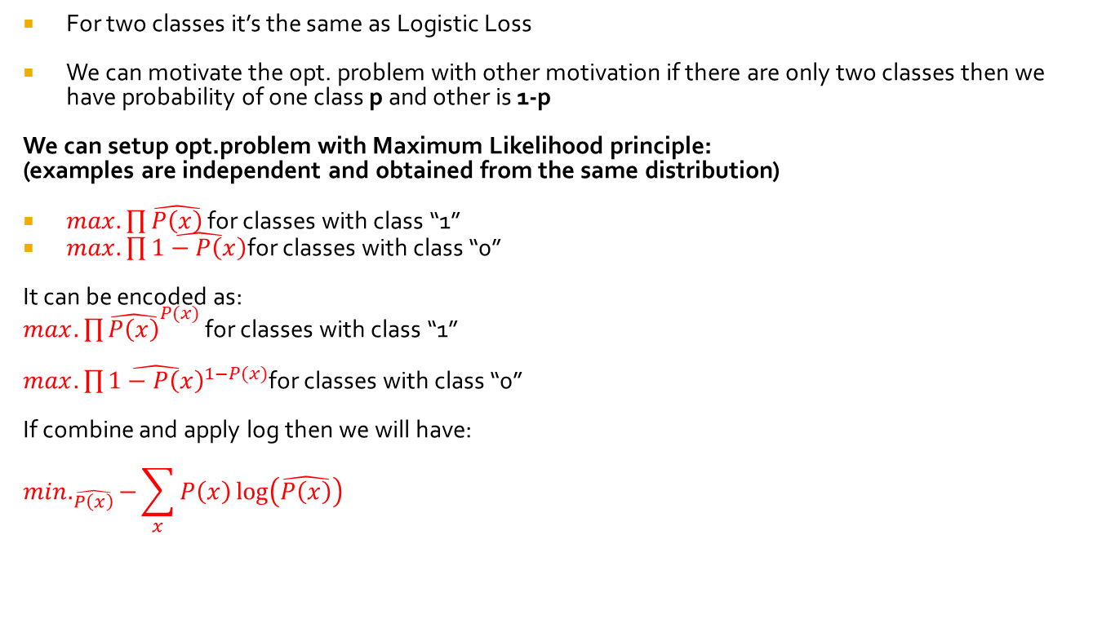
Motivation of the logistic loss from from ML principle
For two classes it’s the same as Logistic Loss
We can motivate the opt. problem with other motivation if there are only two classes then we have probability of one class p and other is 1-p
We can setup opt.problem with Maximum Likelihood principle:
(examples are independent and obtained from the same distribution)
$max.\prod{\hat{P\left(x\right)}}$ for classes with class “1”
$max.\prod{\hat{1−P\left(x\right)}}$for classes with class “0”
It can be encoded as:
$max.{\prod{\hat{P\left(x\right)}}}^{P(x)}$ for classes with class “1”
$max.\prod{{\hat{1−P\left(x\right)}}^{1−P(x)}}$for classes with class “0”
If combine and apply log then we will have:
$$min._{\hat{P\left(x\right)}}−\sum_{x}{P\left(x\right)\log\left(\hat{P\left(x\right)}\right)}$$

