Slide 1
Topics: - …

Slide 2
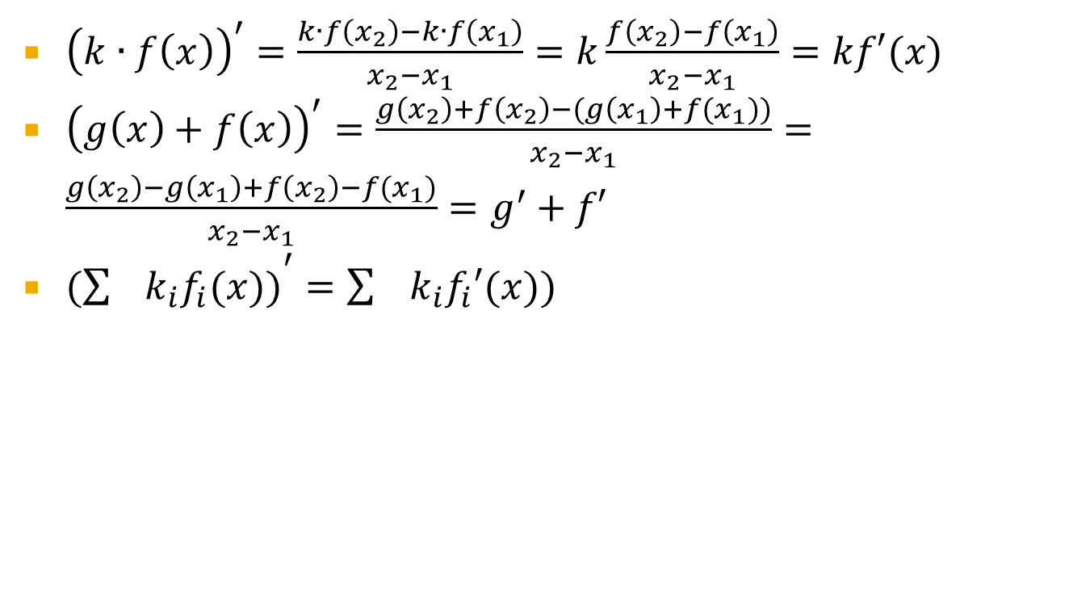
Derivative properties
${\left(k∙f\left(x\right)\right)}^{′}=\frac{k∙f\left(x_{2}\right)−k∙f\left(x_{1}\right)}{x_{2}−x_{1}}=k\frac{f\left(x_{2}\right)−f\left(x_{1}\right)}{x_{2}−x_{1}}=kf′(x)$
${\left(g\left(x\right)+f\left(x\right)\right)}^{′}=\frac{g\left(x_{2}\right)+f\left(x_{2}\right)−(g\left(x_{1}\right)+f(x_{1}))}{x_{2}−x_{1}}=\frac{g\left(x_{2}\right)−g\left(x_{1}\right)+f\left(x_{2}\right)−f(x_{1})}{x_{2}−x_{1}}=g^{′}+f′$
$({\sum{k_{i}f_{i}(x))}}^{′}=\sum{k_{i}f_{i}′(x))}$

Slide 3
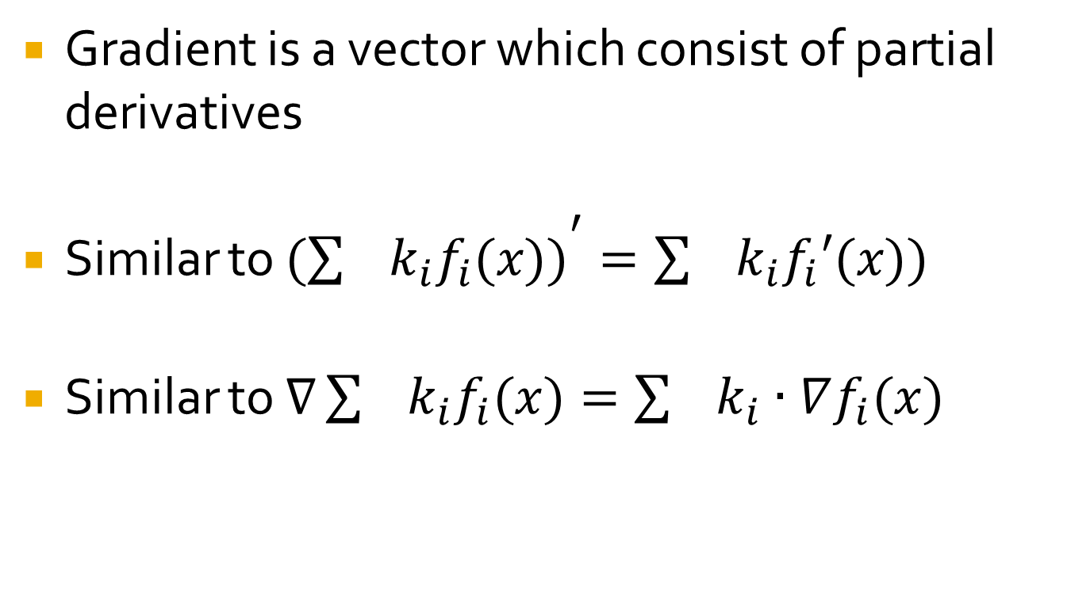
Gradient Properties
Gradient is a vector which consist of partial derivatives
Similar to $({\sum{k_{i}f_{i}(x))}}^{′}=\sum{k_{i}f_{i}′(x))}$
Similar to $∇\sum{k_{i}f_{i}(x)}=\sum{k_{i}∙∇f_{i}(x)}$

Slide 4
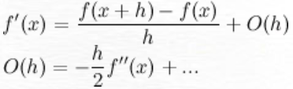
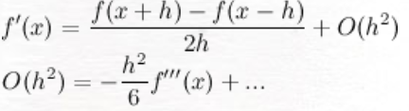
How numerially evaluate derivative?
Approach (1) for first derivative
Approach (2) for first derivative

Slide 5
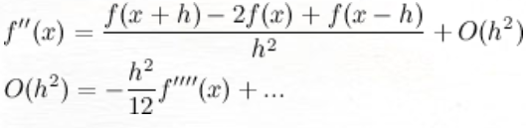
How numerially second derivative?
Numerically we can evaluate second derivative in the following way:

Slide 6
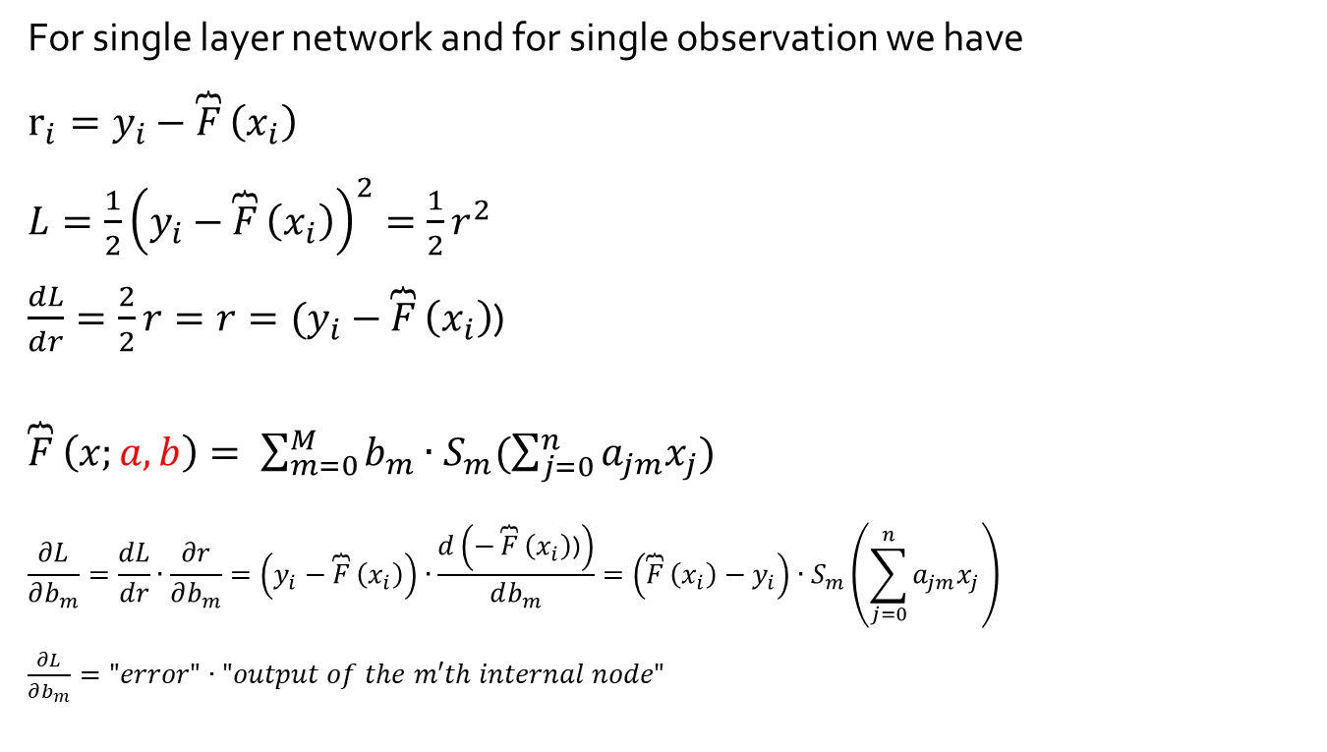
Derivative to compute partial derivatives
For single layer network and for single observation we have
$r_{i}=y_{i}−\overbrace{F}\left(x_{i}\right)$
$L=\frac{1}{2}{\left(y_{i}−\overbrace{F}\left(x_{i}\right)\right)}^{2}=\frac{1}{2}r^{2}$
$\frac{dL}{dr}=\frac{2}{2}r=r=(y_{i}−\overbrace{F}\left(x_{i}\right)$)
$\overbrace{F}\left(x;a,b\right)= \sum_{m=0}^{M}{b_{m}∙S_{m}(\sum_{j=0}^{n}{a_{jm}x_{j}})}$
$$\frac{∂L}{∂b_{m}}=\frac{dL}{dr}∙\frac{∂r}{∂b_{m}}=\left(y_{i}−\overbrace{F}\left(x_{i}\right)\right)∙\frac{d\left(−\overbrace{F}\left(x_{i}\right)\text{)}\right)}{db_{m}}=\left(\overbrace{F}\left(x_{i}\right)−y_{i}\right)∙S_{m}\left(\sum_{j=0}^{n}{a_{jm}x_{j}}\right)$$
$\frac{∂L}{∂b_{m}}="error"∙"output of the m′th internal node"$

Slide 7
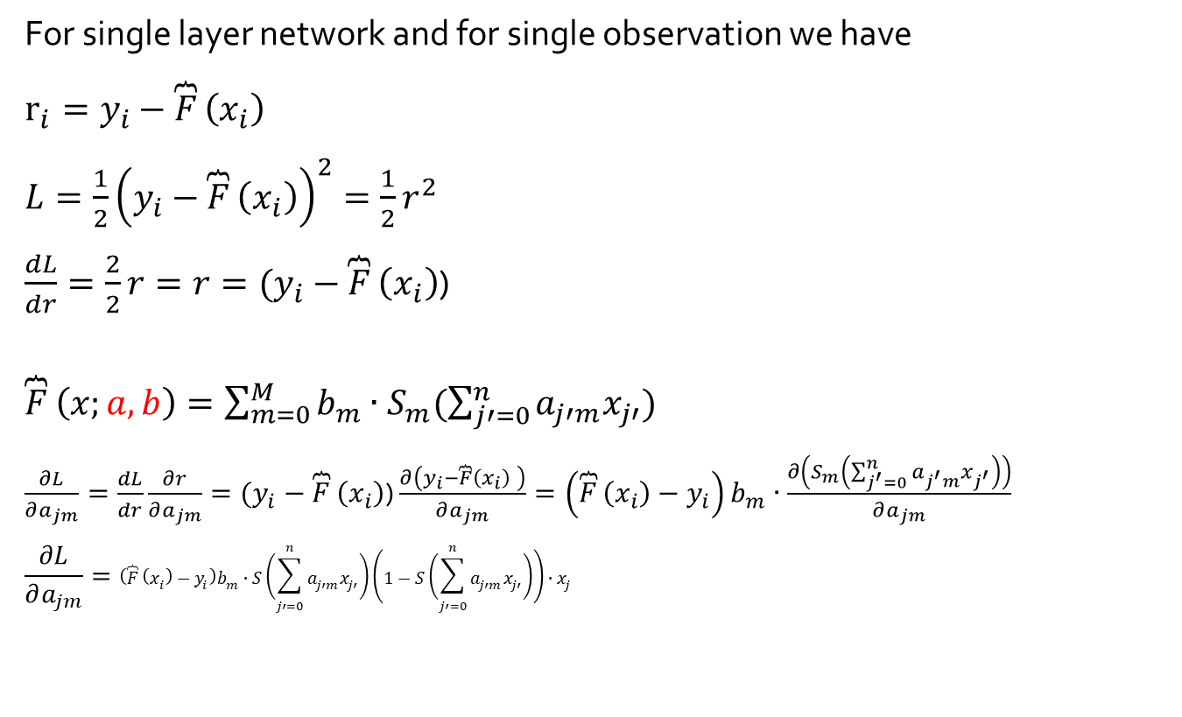
Derivative to compute partial derivatives
For single layer network and for single observation we have
$r_{i}=y_{i}−\overbrace{F}\left(x_{i}\right)$
$L=\frac{1}{2}{\left(y_{i}−\overbrace{F}\left(x_{i}\right)\right)}^{2}=\frac{1}{2}r^{2}$
$\frac{dL}{dr}=\frac{2}{2}r=r=(y_{i}−\overbrace{F}\left(x_{i}\right)$)
$\overbrace{F}\left(x;a,b\right)=\sum_{m=0}^{M}{b_{m}∙S_{m}(\sum_{j′=0}^{n}{a_{j′m}x_{j′}})}$
$\frac{∂L}{∂a_{jm}}=\frac{dL}{dr}\frac{∂r}{∂a_{jm}}=(y_{i}−\overbrace{F}\left(x_{i}\right)\text{)}$ $\frac{∂\left(y_{i}−\overbrace{F}\left(x_{i}\right) \right)}{∂a_{jm}}=\left(\overbrace{F}\left(x_{i}\right)−y_{i}\right)b_{m}∙\frac{∂\left(S_{m}\left(\sum_{j^{′}=0}^{n}{a_{j^{′}m}x_{j^{′}}}\right)\right)}{∂a_{jm}}$
$$\frac{∂L}{∂a_{jm}}=\left(\overbrace{F}\left(x_{i}\right)−y_{i}\right)b_{m}∙S\left(\sum_{j′=0}^{n}{a_{j′m}x_{j′}}\right)\left(1−S\left(\sum_{j′=0}^{n}{a_{j′m}x_{j′}}\right)\right)∙x_{j}$$

Slide 8

Our Prediction Schema
$\overbrace{F}\left(x;a,b\right)=\sum_{m=0}^{M}{b_{m}∙S_{m}(\sum_{j=0}^{n}{a_{jm}x_{j}})}$
$S_{0}(z)=1$ always
${S(z)}^{′}=S(z)(1−S(z))$

Slide 9
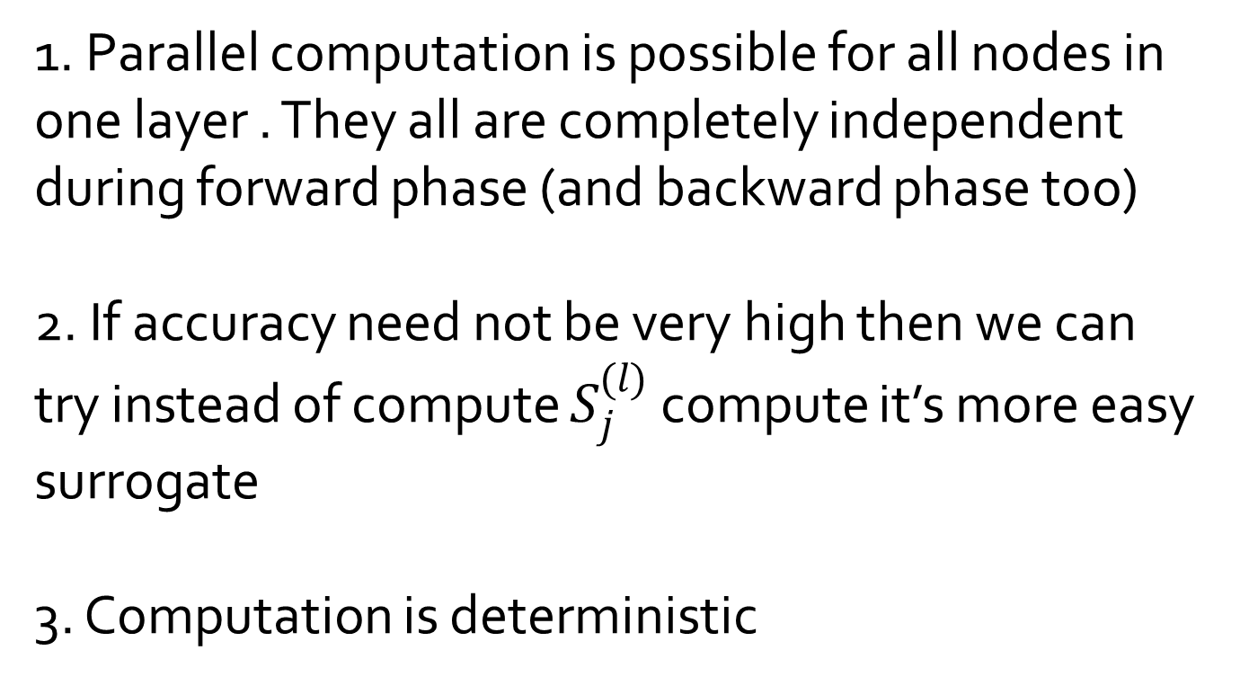
Remarks about computation
1. Parallel computation is possible for all nodes in one layer . They all are completely independent during forward phase (and backward phase too)
2. If accuracy need not be very high then we can try instead of compute $S_{j}^{(l)}$ compute it’s more easy surrogate
3. Computation is deterministic

Slide 10
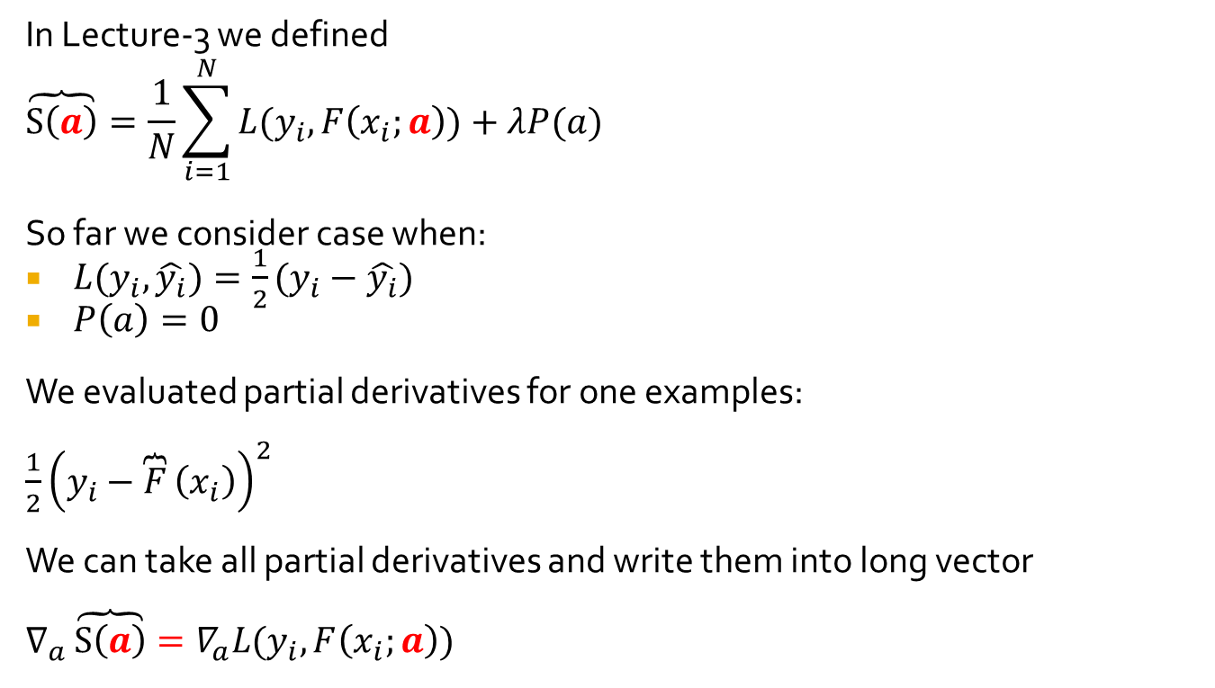
What we evaluated so far?
In Lecture-3 we defined
$$\overbrace{S\left(a\right)}=\frac{1}{N}\sum_{i=1}^{N}{L(y_{i},F\left(x_{i};a\right))}+λP(a)$$
So far we consider case when:
$L(y_{i},\hat{y_{i}})=\frac{1}{2}(y_{i}−\hat{y_{i}})$
$P\left(a\right)=0$
We evaluated partial derivatives for one examples:
$\frac{1}{2}{\left(y_{i}−\overbrace{F}\left(x_{i}\right)\right)}^{2}$
We can take all partial derivatives and write them into long vector
$∇_{a}\overbrace{S\left(a\right)}=∇_{a}L(y_{i},F\left(x_{i};a\right))$

Slide 11
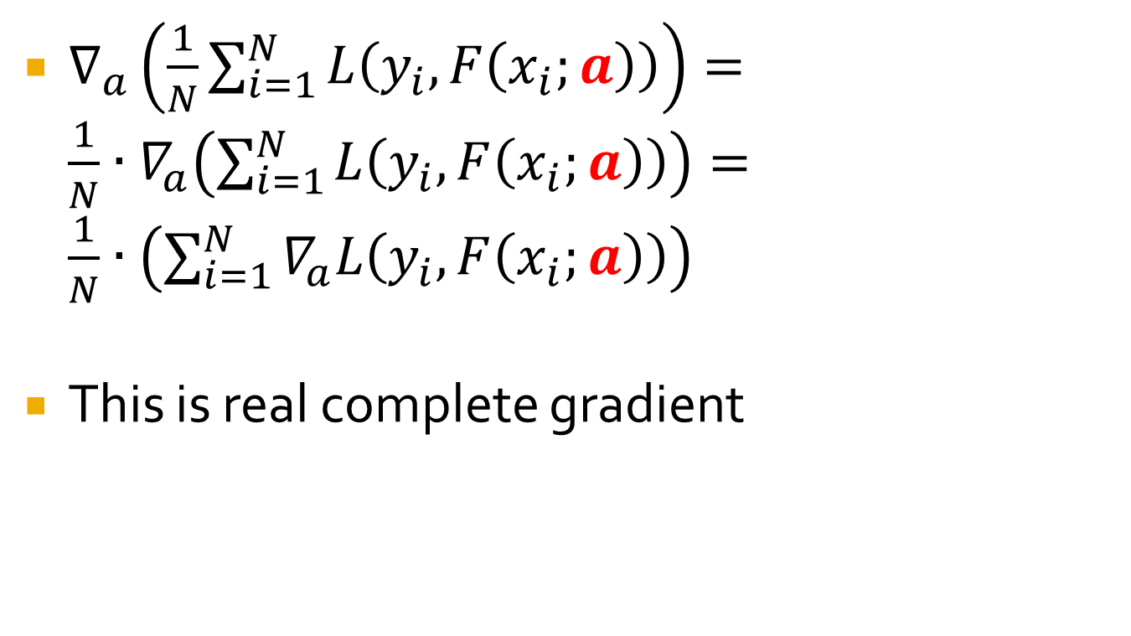
What about complete gradient?
$∇_{a}\left(\frac{1}{N}\sum_{i=1}^{N}{L\left(y_{i},F\left(x_{i};a\right)\right)}\right)=\frac{1}{N}∙∇_{a}\left(\sum_{i=1}^{N}{L\left(y_{i},F\left(x_{i};a\right)\right)}\right)=\frac{1}{N}∙\left(\sum_{i=1}^{N}{∇_{a}L\left(y_{i},F\left(x_{i};a\right)\right)}\right)$
This is real complete gradient

Slide 12
What is mini-batch
Lets’ evaluate gradient not for complete loss function, which is objective to minimize
Evaluate it via compute it for each observation
Or for some subset.
In this case it’s mini-batch
Whole pass over the complete available data is called “epoc”. Does not matter what algorithm we use

Slide 13
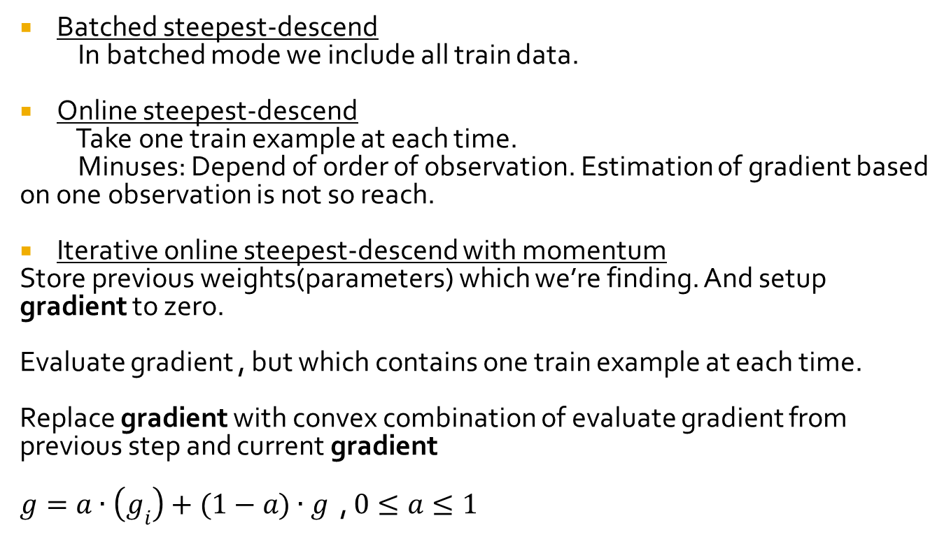
Variants of gradient descend algorithms
Batched steepest-descend
In batched mode we include all train data.
Online steepest-descend
Take one train example at each time.
Minuses: Depend of order of observation. Estimation of gradient based on one observation is not so reach.
Iterative online steepest-descend with momentum
Store previous weights(parameters) which we’re finding. And setup gradient to zero.
Evaluate gradient , but which contains one train example at each time.
Replace gradient with convex combination of evaluate gradient from previous step and current gradient
$g=a∙\left(g_{i}\right)+(1−a)∙g$ , $0≤a≤1$

