Slide 1
Topics: - Our prediction schema - K-fold cross-validation - Forward and Backward phase - Chain Rule (on board) - Derivation how compute partial derivatives for quadratic Loss - Source code with which you figure out “What it do?”

Slide 2
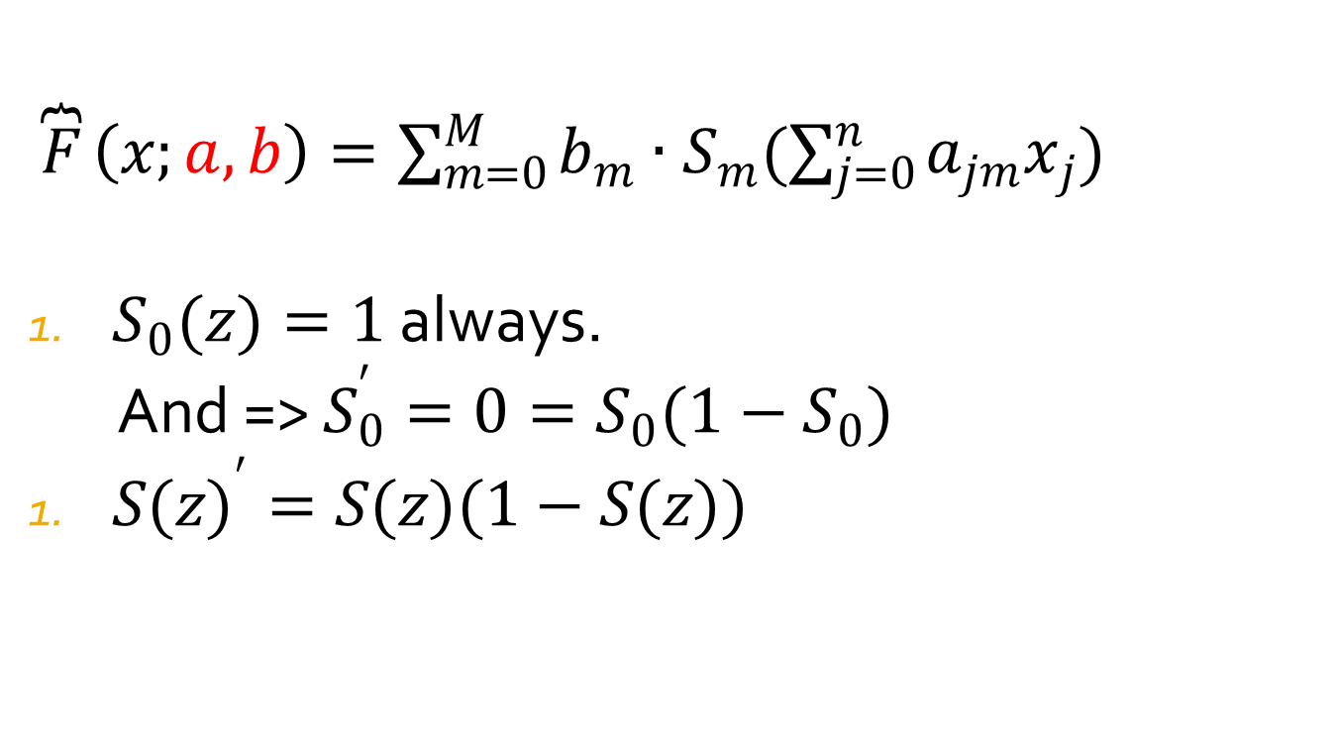
Our Prediction Schema
$\overbrace{F}\left(x;a,b\right)=\sum_{m=0}^{M}{b_{m}∙S_{m}(\sum_{j=0}^{n}{a_{jm}x_{j}})}$
$S_{0}(z)=1$ always.
And => $S_{0}^{′}=0=S_{0}(1−S_{0})$
${S(z)}^{′}=S(z)(1−S(z))$

Slide 3
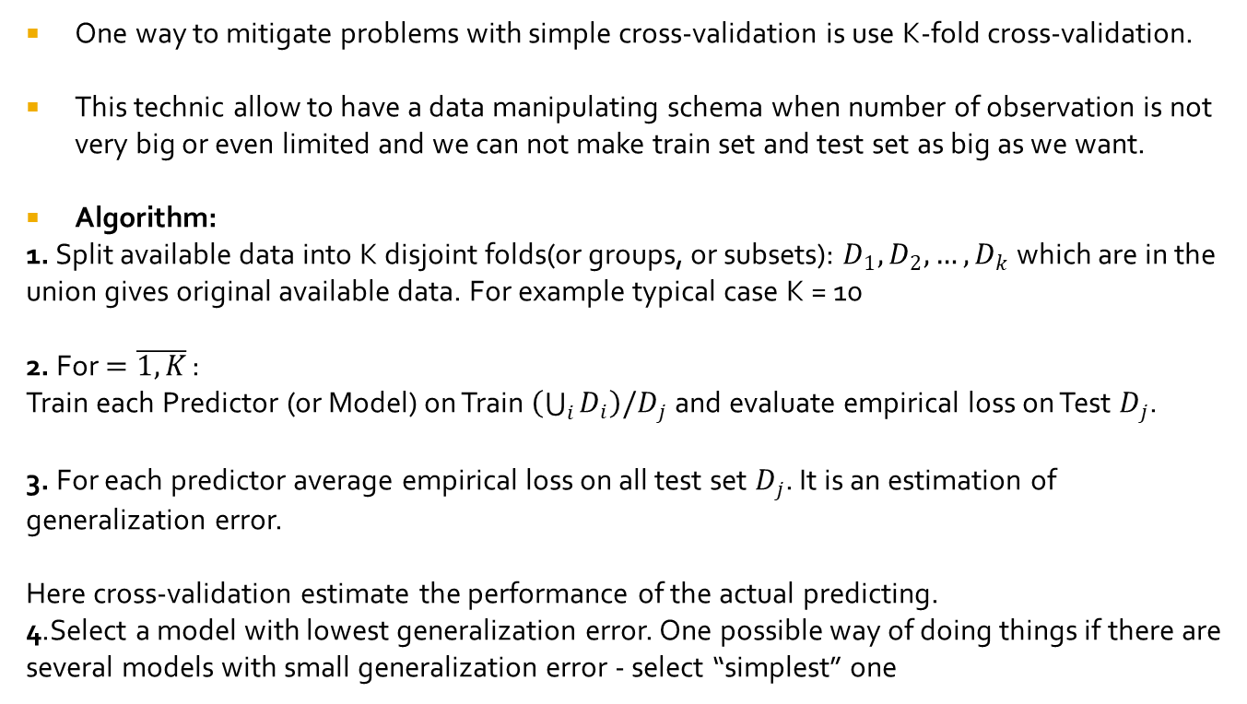
K fold cross-validation
One way to mitigate problems with simple cross-validation is use K-fold cross-validation.
This technic allow to have a data manipulating schema when number of observation is not very big or even limited and we can not make train set and test set as big as we want.
Algorithm:
1. Split available data into K disjoint folds(or groups, or subsets): $D_{1},D_{2},…,D_{k}$ which are in the union gives original available data. For example typical case K = 10
2. For $=\overline{1,K}$ :
Train each Predictor (or Model) on Train $\left(\bigcup_{i}{D_{i}}\right)/D_{j}$ and evaluate empirical loss on Test $D_{j}$.
3. For each predictor average empirical loss on all test set $D_{j}$. It is an estimation of generalization error.
Here cross-validation estimate the performance of the actual predicting.
4.Select a model with lowest generalization error. One possible way of doing things if there are several models with small generalization error - select “simplest” one

Slide 4
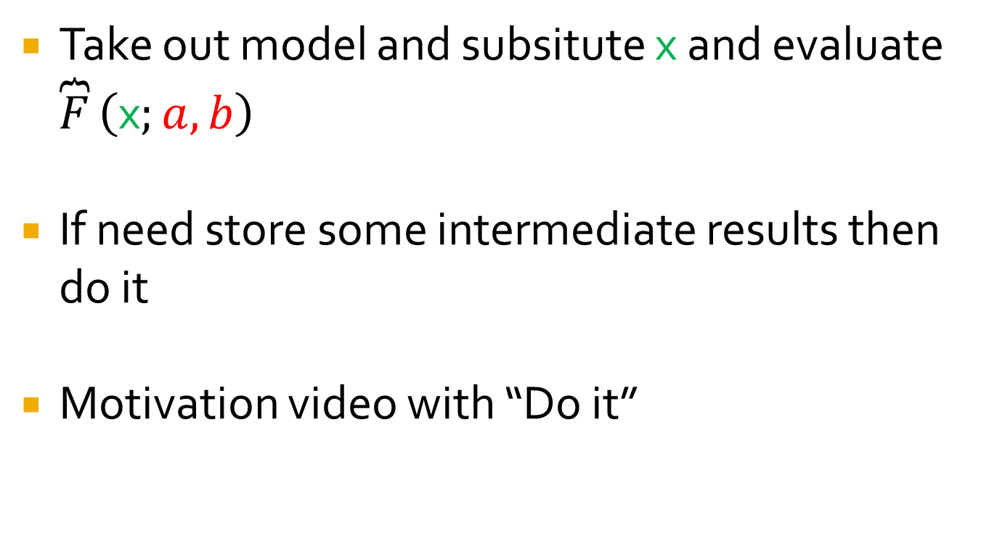
What is forward propagation?
Take out model and subsitute x and evaluate $\overbrace{F}\left(\text{x};a,b\right)$
If need store some intermediate results then do it
Motivation video with “Do it”

Slide 5
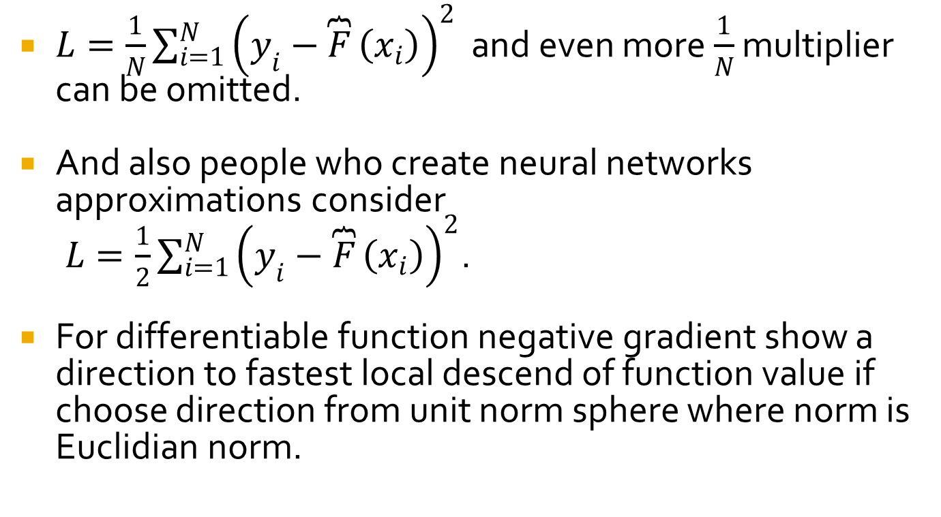
Loss function for regression for NN
$L=\frac{1}{N}\sum_{i=1}^{N}{{\left(y_{i}−\overbrace{F}\left(x_{i}\right)\right)}^{2}}$ and even more $\frac{1}{N}$ multiplier can be omitted.
And also people who create neural networks approximations consider
$L=\frac{1}{2}\sum_{i=1}^{N}{{\left(y_{i}−\overbrace{F}\left(x_{i}\right)\right)}^{2}}$.
For differentiable function negative gradient show a direction to fastest local descend of function value if choose direction from unit norm sphere where norm is Euclidian norm.

Slide 6
Chain Rule
In board discuss Chain Rule
Gradients
Linearity of apply derivative
Difference between Gradient and Jacobian

Slide 7
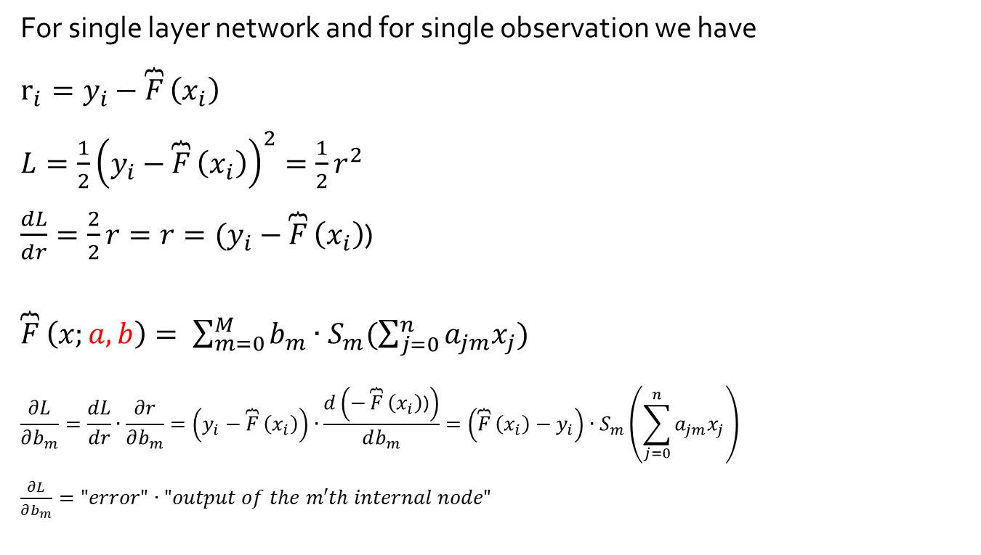
Derivative to compute partial derivatives
For single layer network and for single observation we have
$r_{i}=y_{i}−\overbrace{F}\left(x_{i}\right)$
$L=\frac{1}{2}{\left(y_{i}−\overbrace{F}\left(x_{i}\right)\right)}^{2}=\frac{1}{2}r^{2}$
$\frac{dL}{dr}=\frac{2}{2}r=r=(y_{i}−\overbrace{F}\left(x_{i}\right)$)
$\overbrace{F}\left(x;a,b\right)= \sum_{m=0}^{M}{b_{m}∙S_{m}(\sum_{j=0}^{n}{a_{jm}x_{j}})}$
$$\frac{∂L}{∂b_{m}}=\frac{dL}{dr}∙\frac{∂r}{∂b_{m}}=\left(y_{i}−\overbrace{F}\left(x_{i}\right)\right)∙\frac{d\left(−\overbrace{F}\left(x_{i}\right)\text{)}\right)}{db_{m}}=\left(\overbrace{F}\left(x_{i}\right)−y_{i}\right)∙S_{m}\left(\sum_{j=0}^{n}{a_{jm}x_{j}}\right)$$
$\frac{∂L}{∂b_{m}}="error"∙"output of the m′th internal node"$

Slide 8
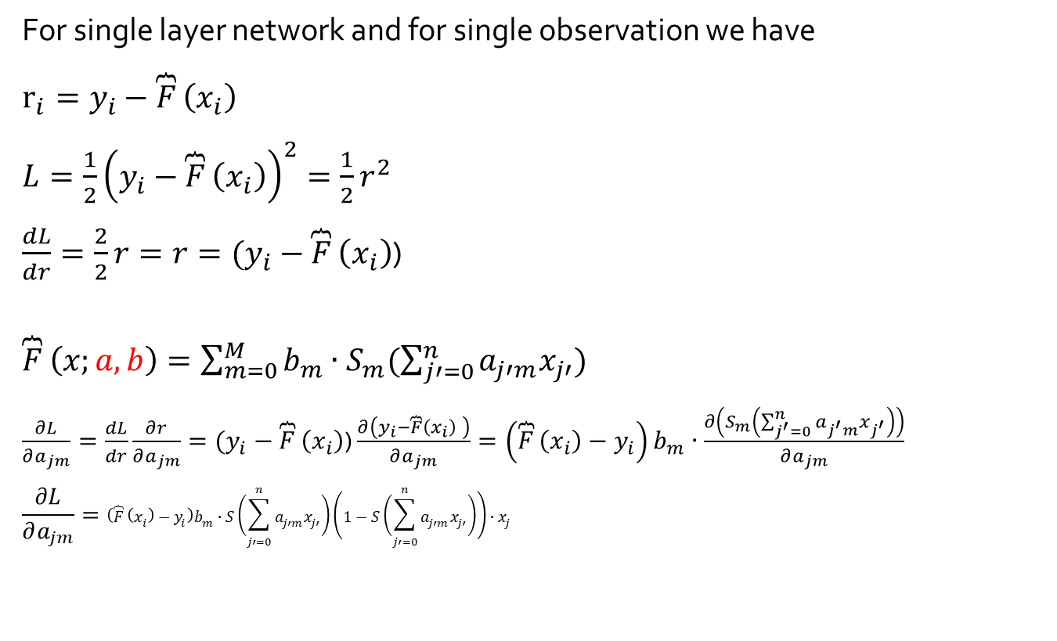
Derivative to compute partial derivatives
For single layer network and for single observation we have
$r_{i}=y_{i}−\overbrace{F}\left(x_{i}\right)$
$L=\frac{1}{2}{\left(y_{i}−\overbrace{F}\left(x_{i}\right)\right)}^{2}=\frac{1}{2}r^{2}$
$\frac{dL}{dr}=\frac{2}{2}r=r=(y_{i}−\overbrace{F}\left(x_{i}\right)$)
$\overbrace{F}\left(x;a,b\right)=\sum_{m=0}^{M}{b_{m}∙S_{m}(\sum_{j′=0}^{n}{a_{j′m}x_{j′}})}$
$\frac{∂L}{∂a_{jm}}=\frac{dL}{dr}\frac{∂r}{∂a_{jm}}=(y_{i}−\overbrace{F}\left(x_{i}\right)\text{)}$ $\frac{∂\left(y_{i}−\overbrace{F}\left(x_{i}\right) \right)}{∂a_{jm}}=\left(\overbrace{F}\left(x_{i}\right)−y_{i}\right)b_{m}∙\frac{∂\left(S_{m}\left(\sum_{j^{′}=0}^{n}{a_{j^{′}m}x_{j^{′}}}\right)\right)}{∂a_{jm}}$
$$\frac{∂L}{∂a_{jm}}=\left(\overbrace{F}\left(x_{i}\right)−y_{i}\right)b_{m}∙S\left(\sum_{j′=0}^{n}{a_{j′m}x_{j′}}\right)\left(1−S\left(\sum_{j′=0}^{n}{a_{j′m}x_{j′}}\right)\right)∙x_{j}$$

Slide 9
Practice
L4_single_nn_compute_gradient_of_loss.py
- Read it and fill comments (In Russian on English)

