Slide 1
Topics: - …

Slide 2
How measure errors. Terminology.
Quanity in which you interesting in and try to find via some approach. Let's say it’s x
Real best Qunaity that you should obtain is x*. Let’s assume it’s unique
You don't know it because it's true answer and not known
Really you can not measure |x-x*| because you don't know x*. If you know x* there is no real reason to setup such problem at all.
What you can measure is Quanity |f(x)-f(x*)|
Quanity |x-x*| in English literature called backward error
Quanity |f(x)-f(x*)| in English literature t's called forward error

Slide 3
Meaning of terminology
https://youtu.be/Ib18ONxvz2Y?list=PLrX-Xj1yIkS-PcenrKFF3XocjxayjPgHE&t=229
03:55
“Имена не дают знаний, это только какие-то имена. Что мой отец забыл мне сказать, что имена нужны если ты хочешь с кем-то поговорить” – Ричард Фейнман

Slide 4
Forward and backward error
Everything from previous slides are names.
Real meaning
|f(x)-f(x*)| can be (typically) measured
|x-x*| can not be (typically) measured.

Slide 5
Absolute error and relative error
math.abs(1-3*(4/3.0-1)) is absolute Error
math.abs(1-3*(4/3.0-1))/1.0 is relative Error
Hint
You can use this expression to evaluate what is a typical error in computations with real number in your computer or programming language

Slide 6
What we can do ?
If Aggregate different areas then there are 5 ways:
A. Nothing. Just stop algorithm when |f(x)-f(x*)| < tolerance. It is some criteria, but really alone it say nothing. Really we hope that when "f(x)-f(x*)" is small then x is near x*
It's in fact definition of well-condition problems "if small forward error implies small backward error" then problem is well-conditioned.
B. Sometimes from forward error you can obtain bound in backward error.
C. Sometimes you can derive bound on x-x* a solution which depends on uknown constants. Carefull analyze should be done how this numbers can be replaced with exact numbers.
D. It's more lile exception, but amazingly sometimes people derive different bound which does not depend in any unknown constants.
E. If problem can be solved exactly in integer arithmetic then everything then typically the solution is exact

Slide 7
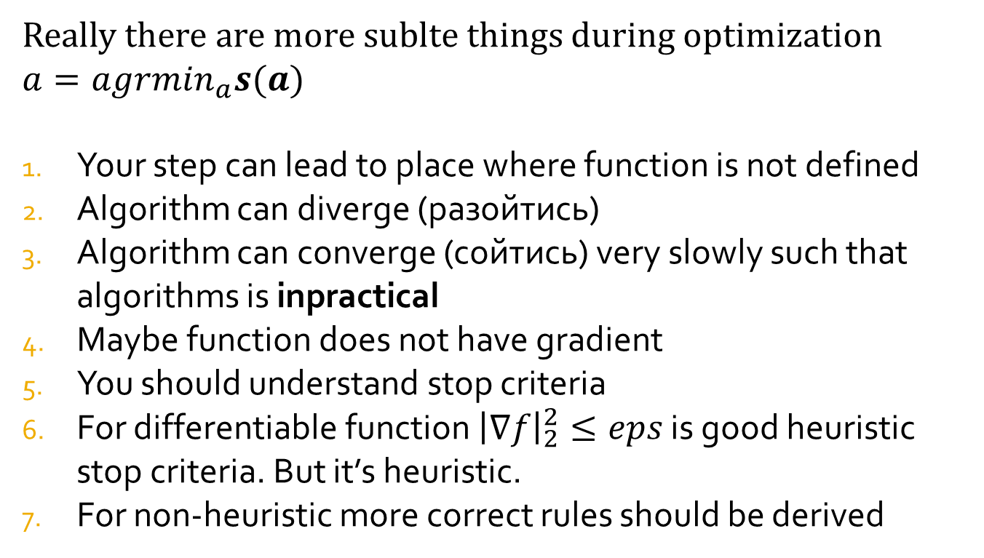
Subtle thing around unconstrained
Really there are more sublte things during optimization
$a=agrmin_{a}s(a)$
Your step can lead to place where function is not defined
Algorithm can diverge (разойтись)
Algorithm can converge (сойтись) very slowly such that algorithms is inpractical
Maybe function does not have gradient
You should understand stop criteria
For differentiable function ${\left|∇f\right|}_{2}^{2}≤eps$ is good heuristic stop criteria. But it’s heuristic.
For non-heuristic more correct rules should be derived

Slide 8
Variants of gradient descend algorithms
Batched steepest-descend
Online steepest-descend
Iterative online steepest-descend with momentum

Slide 9
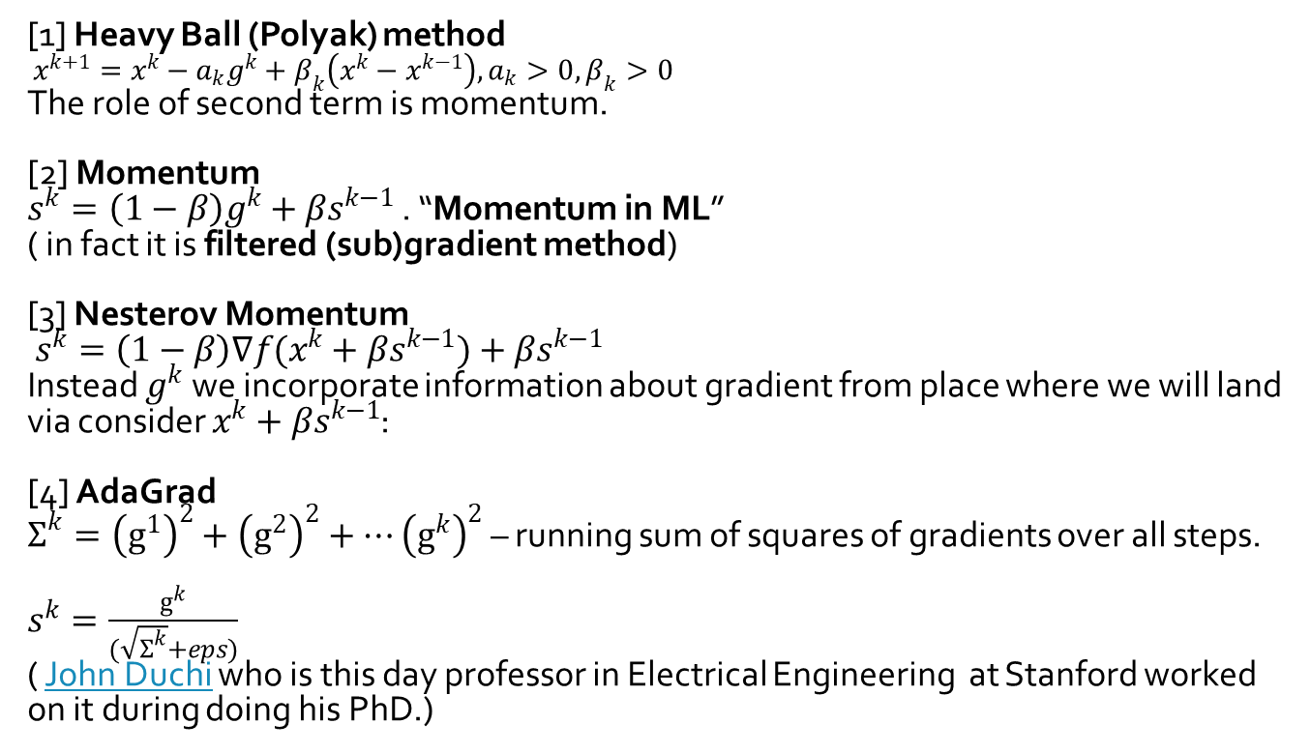
Fast First order methods
[1] Heavy Ball (Polyak) method
$x^{k+1}=x^{k}−a_{k}g^{k}+β_{k}\left(x^{k}−x^{k−1}\right),a_{k}>0,β_{k}>0$
The role of second term is momentum.
[2] Momentum
$s^{k}=\left(1−β\right)g^{k}+βs^{k−1}$ . “Momentum in ML”
( in fact it is filtered (sub)gradient method)
[3] Nesterov Momentum
$s^{k}=\left(1−β\right)∇f(x^{k}+βs^{k−1})+βs^{k−1}$
Instead $g^{k}$ we incorporate information about gradient from place where we will land via consider $x^{k}+βs^{k−1}$:
[4] AdaGrad
$Σ^{k}={\left(g^{1}\right)}^{2}+{\left(g^{2}\right)}^{2}+…{\left(g^{k}\right)}^{2}$ – running sum of squares of gradients over all steps.
$s^{k}=\frac{g^{k}}{(\sqrt{Σ^{k}}+eps)}$
( John Duchi who is this day professor in Electrical Engineering at Stanford worked on it during doing his PhD.)

Slide 10
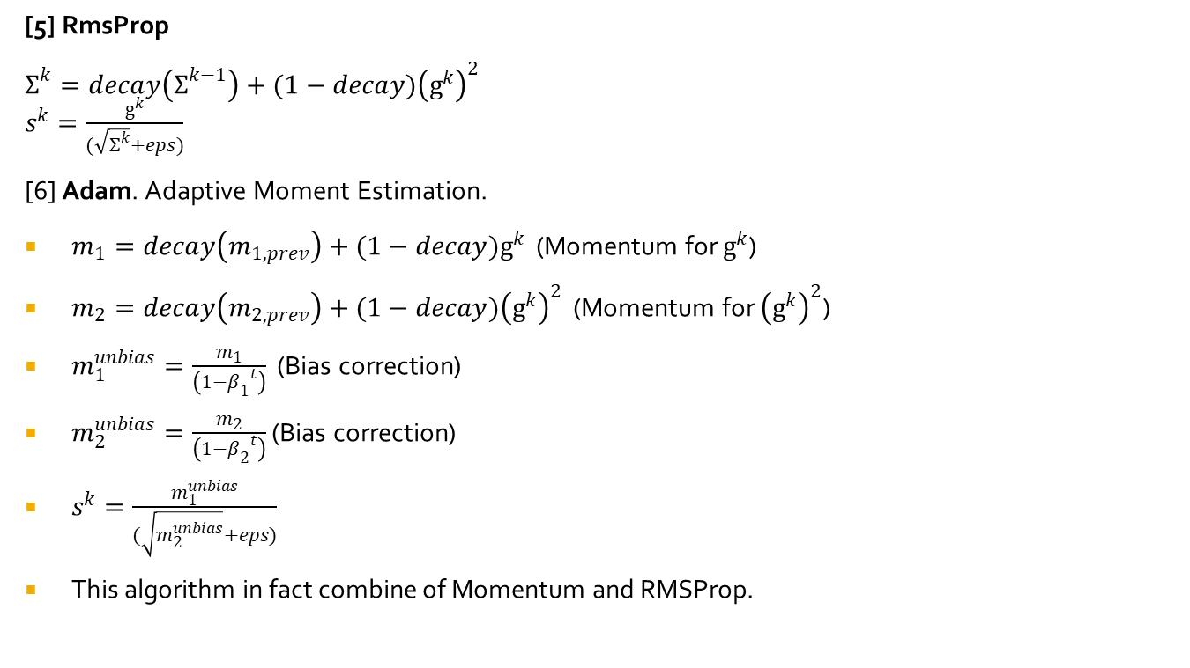
Fast First order methods
[5] RmsProp
$Σ^{k}=decay\left(Σ^{k−1}\right)+(1−decay){\left(g^{k}\right)}^{2}$
$s^{k}=\frac{g^{k}}{(\sqrt{Σ^{k}}+eps)}$
[6] Adam. Adaptive Moment Estimation.
$m_{1}=decay\left(m_{1,prev}\right)+(1−decay)g^{k}$ (Momentum for $g^{k}$)
$m_{2}=decay\left(m_{2,prev}\right)+(1−decay){\left(g^{k}\right)}^{2}$ (Momentum for ${\left(g^{k}\right)}^{2}$)
$m_{1}^{unbias}=\frac{m_{1}}{\left(1−{β_{1}}^{t}\right)}$ (Bias correction)
$m_{2}^{unbias}=\frac{m_{2}}{\left(1−{β_{2}}^{t}\right)}$ (Bias correction)
$s^{k}=\frac{m_{1}^{unbias}}{(\sqrt{m_{2}^{unbias}}+eps)}$
This algorithm in fact combine of Momentum and RMSProp.

Slide 11
Regularization Strategies
Early stopping. Dividing learn set into learn/dev set (90%/10%). Idea to stop when validation goes up.
Drop out. During forward and backward propagate half of the network nodes output is setuped to zero
Drop connect. During forward and backward some weights are setuped to zero and just update anothers.
Extra regularization with extra term
L2 norm square in objective with all parameters

Slide 12
Pros and cons of Single Layer NN
Pros
Single layer neural net is general in terms that they can approximate continuous function via appending extra units in hidden layer.
Theorem said that you should have no deep layers if number of data is infinite, but it’s not infinite.
Result weights depends on anything because arised optimization problem is non-convex.
Applied to many complex problems
It’s possible to be employed for work on this field. Create big market for predictive models
.
Cons
Many tunable parameters: topology of network, gradient momentum, learning rate, type of transfer function, and etc.
Training very slow.
Produce black-box models which are not easy to intepretate even people working on it right now.
Degree of success depend on skill of engineer, they are not out-of-shelve.

