Slide 1
OSCAR on PS3
DongInn Kim
October 24, 2007
Open Systems Lab
Notes:
Here is what I have.
OSCAR on PS3.

Slide 2
Overview
Introduction
What is in PS3?
Purpose of having PS3 cluster
Deploying OSCAR on PS3
Kboot + SIS
OSCAR implementation overview
Current status / Future work
Notes:
Setting up a cluster is such a mess. It is a lot work for the system administrator or for anyone who want to build a cluster with their own purpose. Even worse, maintaining a cluster is a big headache because we are not installing/updating programs to the one machine but to all the machines in a cluster.
We need a program to make this kind of works easier. That’s why OSCAR was born for this.
My talk is not only about OSCAR but I would like to more focus on OSCAR configuration on PS3.
So, here is how I am going to talk about this.
I will finish my talk with the current OSCAR status and Future work.

Slide 3
Introduction
Open Source Cluster Application Resources
Software stack to ease deployment of Linux cluster
Project started around year 2000 - 2001
Open Source, core members from Academia/Research and Industry
191,000 + downloads from SourceForge
Notes:
It is such a nice toolkit which makes it very easy to setup/maintain a Linux cluster.
It includes many useful Open Source Cluster packages. For the MPI libraries, we have Open MPI, LAM/MPI, MPICH and For the Resource Manager, Torque and Sun Grid Engine. I will talk more about OSCAR packages later.
The OSCAR core developers consist of the people who are from Academia/Research and Industry.
The number of the actual downloads would be much bigger than this.

Slide 4
Mostly written in perl
1278 files, 485 directories in trunk
GPL license
Mature and well-established codebase
Timely updated documentation
Well-commented source code
Notes:
OSCAR is written mostly in Perl. Some codes are written in shell script and Python.
We try to update the OSCAR documents as often as possible to make it more useful for users.
The source code is extremely well commented so that a new OSCAR developer can catch up with the current code bases without a big hassle.

Slide 5
OSCAR core members
Intel
NEC
Louisiana Tech University
The University of Texas
Oak Ridge National Laboratory
Indiana University /
Pervasive Technology Labs

Slide 6
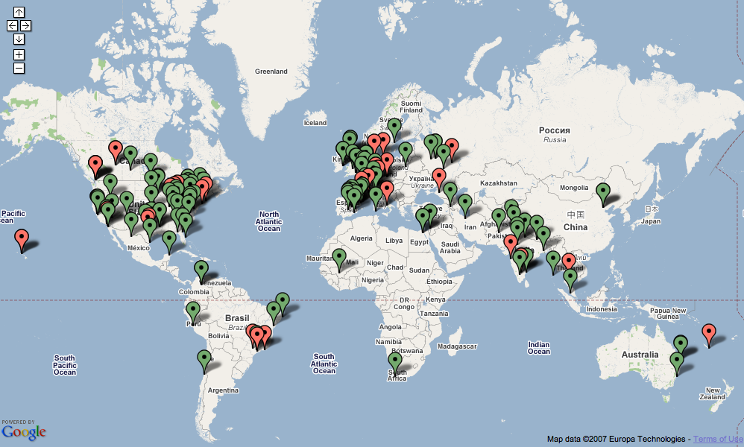
Who uses OSCAR
Notes:
As you can see, many oscar clusters are used on many countries around the world. Most OSCAR clusters are built on North America. Some of them are in Europe and some in Asia. A little bit in South America and Africa.
Unfortunately, Korea does not have OSCAR cluster yet but I believe that they have some. Just they did not register their cluster for the OSCAR website.

Slide 7
OSCAR Features
Linux distribution agnostic
Flexible, modular, customizable
Image-based
Supports heterogeneous cluster configurations
Virtual console
Notes:
Basically we can support all deb and RPM based Linux distros but we can not really tell that we officially support all these kinds of distros.
This is not because OSCAR framework can not support some specific Linux distros but because we do not have enough man-power to follow up with all the problems of various Linux distros.
We have supported RHEL, Fedora Core, SuSE, Mandriva, and Debian. Fortunately, we were able to support YDL5.0 by taking my OSCAR adventure on PS3.
We do not install systems on the client nodes one by one. We build an image for client nodes. It has almost everything about a client node. Once the image is ready, we spread it out to the client nodes and then finish up the cluster installation.
Since we use an image-based provision solution, it is possible to build a heterogeneous cluster with oscar.
For example, I have built RHEL5 image for A group of client nodes and I have another image, FC7 image for B group of client nodes. And once these OSCAR images are ready, I spread the RHEL5 image to the A group and FC7 image to the B group. All images are transferred via rsync.
Virtual console is such a nice tool to monitor how the client nodes are imaged. This is one of the SIS application.

Slide 8
OSCAR Components
Deployment / Provisioning
  System Installation Suite
  (SystemInstaller, SystemImager, SystemConfigurator)
Infrastructure
  OSCAR Database API (ODA)
  OSCAR Package Downloader (OPD)
  Yume (enhanced Yum), Rapt(for debian)
Resource Manager / Scheduler
  TORQUE
  Sun Grid Engine (SGE)
Parallel Libraries
  MPI: Open MPI, LAM/MPI, MPICH
  PVM
Notes:
As I mentioned before, these are the OSCAR packages in the Default package set.
We don’t have to talk all the details about the packages but I would like to talk more about SIS later.

Slide 9
OSCAR Components (continued)
Administration
  C3 / SC3
  OPIUM / Sync_files
  Switcher
Monitoring
  Ganglia
Security
  Pfilter
Third-party add-on packages
Notes:
C3: Cluster Command and Control.
OPIUM: OSCAR Password Installer and User Management
All these packages are ready to use. You don’t have to worry about manually installing/configuring these packages.
In order to make OSCAR more powerful and useful, we strongly recommend the OSCAR community contribute to build the OSCAR packages that they want to add so that the other users can share the packages without having to do the same stuff over and over.

Slide 10
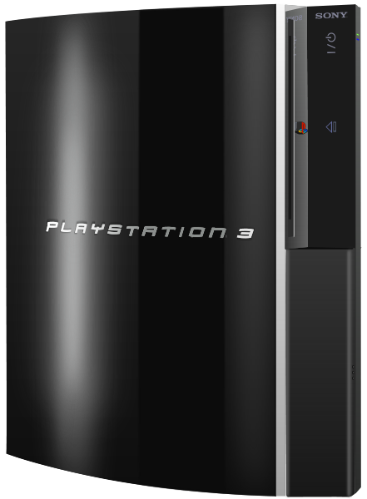
What is in PS3?
3.2GHz Cell Processor
Power PC-base core
7 x SPE @3.2GHz
7 x 128b 128 SIMD GPRs
7 x 256KB SRAM for SPE
218 GFLOPS of total
floating point performance
256MB XDR Main RAM
256MB GDDR3 VRAM
60GB HDD
Notes:
Honestly before I started my OSCAR adventure on PS3, I did not even know what PS3 looks like and what is in it. I just thought that it is a nice game player.
Finally I found what it looks like and what is in it.
SPE: Synergistic Processing Elements
*Each chip includes 8 SPEs, but one is disabled to improve yields and reduce costs
For more detail, http://www.ps3source.net/content/view/17/33/

Slide 11
Purpose of having PS3 cluster
Light weight but powerful cluster
New research approach to get the full performance of SPU
New support of YDL5.0 and PPC64
Utilizing CorePy to the PS3 cluster
Notes:
Why do I want to have a PS3 cluster?
I guess that we don’t need a big reason for this but it was a nice adventure and worth to try it.
CorePy is a python library which one the OSL students made for utilizing the full performance of cell core chips on PS3.
So, it is a good thing to do.

Slide 12

Deploying OSCAR on PS3

Slide 13
Requirements
OSCAR 5.1
2 x PS3 machines or more
USB Key
OtherOS Installer
HDMI - DVI connector
YDL 5.0 (PPC) DVD
USB Keyboard and USB mouse
Network
Notes:
Before we start, we need these things prepared.
We have to download YDL 5.0 for Power PC and then make it to DVD.
All I want from here is all the PS3 machines should be able to get the internet connection.

Slide 14
Step 1. Install YDL5.0 on a PS3
Download the OtherOS installer specially built for OSCAR
Save it to the USB key (FAT format)
Power on PS3 on the game mode
  Settings Menu -> System Settings -> A partition setting for hard disk: custom
    60GB = 10GB(Game) + 50GB(Linux)
  Settings Menu -> System Settings -> Install Other OS
  Click on OK to start the installation
  Settings -> System Settings -> Default System and select "Other OS”
Notes:
10GB is already assigned to the Game OS and we can not change this size but the rest of HDD. So, for the maximum, we can set 50GB for the linux partition on my PS3 machine.
Click on OK to start the installation. This will install the kboot image to the PS3.

Slide 15
Step 1. Install YDL5.0 on a PS3
Insert YDL5.0 DVD
Restart PS3 to boot with Other OS
Type in “install” at the kboot prompt
Do the YDL5.0 installation
Notes:
# When the PS3 starts, you will be greeted with the kboot message for the YDL 5 installer.
# You can only install via a DVD, CDs aren't supported!
# When the installation starts, one Hard Disk will be recognised - sda Linux.

Slide 16
Step 2. Install OSCAR
Once YDL5.0 is fully installed and up, download OSCAR 5.1
Follow the ordinary OSCAR installation instruction
At the OSCAR installation step 6. “Setup Networking…”, prepare PS3 client nodes to boot up with OtherOS
Finish up the OSCAR installation
Notes:
This is the only different part from the normal oscar installation process.
Like we just did on the PS3 head node.
Step 6. “Setup Networking…” which spreads out the oscarimage to the client nodes.

Slide 17
Kboot + SIS
Special therapy of OSCAR on PS3
Kboot does what PXEboot is supposed to do on X86 machines
SIS could support PPC or PPC64
Notes:
This is a secret therapy of the OSCAR installation on PS3.
At the normal OSCAR installation, we use PXEboot for the netboot but PXEboot is not available on PS3 but kboot is.

Slide 18
Kboot
A boot loader based on Kexec
Navigate with automounting
Access (read) files on the network
  HTTP, FTP, TFTP
Command execution
Network configuration
Outbound and inbound SSH
Timeouts, startup message, root device, initrd
Notes:
Before we jump into how kboot was used to replace PXEboot, let me talk a little bit about kboot.

Slide 19
Kboot
How PXEboot works?
  The PXE-booting host initiates a PXE boot by issuing a broadcast
  A DHCP server authoritative for the network responds.
  The PXE-booting host downloads the NBP via tftp.
  The pxelinux.0 binary starts running on the PXE-booting host.
  The pxelinux.0 binary then evaluates the configuration file.
  Using the downloaded kernel and initrd, the pxelinux.0 binary boots the kernel with the kernel command line found in the configuration file downloaded in step 3.
Notes:
I would like to remind how PXEboot works.
1) The PXE-booting host initiates a PXE boot by issuing a broadcast.
2) A DHCP server authoritative for the network responds. Assuming PXE is properly set up, the DHPC server provides either a fixed or pool-based IP address and prepares the tftp download a Network Boot Program (NBP). The pxelinux.0 binary is the pxelinux NBP.
3) The PXE-booting host downloads the NBP via tftp.
4) The pxelinux.0 binary starts running on the PXE-booting host. Its first request is for a configuration file; it asks for various names in turn, accepting the first one the tftp server finds.
5) The pxelinux.0 binary then evaluates the configuration file. For a network boot, the pxelinux.0 binary will download a kernel and optional initrd via tftp.
6) Using the downloaded kernel and initrd, the pxelinux.0 binary boots the kernel with the kernel command line found in the configuration file downloaded in step 3.

Slide 20
How kboot replaces PXEboot?
A client node initiates a kboot by issuing a broadcast
A DHCP server authoritative for the network responds
kboot triggers the download of kernel of SIS image server with the kboot.conf file via tftp
When a client node boots up with the SIS kernel, it is imaged with the oscarimage of OSCAR server node via rsync/multicasting/bittorrent
Once a client node is imaged, it does not re-image and boots up with its own OS
Notes:
DHCP server provides a proper IP to the right client node.
Kboot starts to download the kernel of SIS image server by evaluating the kboot.conf via tftp.

Slide 21
SIS
SystemImager + SystemInstaller + SystemConfigurator
SystemConfigurator has not been fully updated to support PPC64
Need to update oscar systemimage manually since SystemConfigurator does not know how to deal with oscarimage:/etc/systemconfig/systemconfig.conf

Slide 22
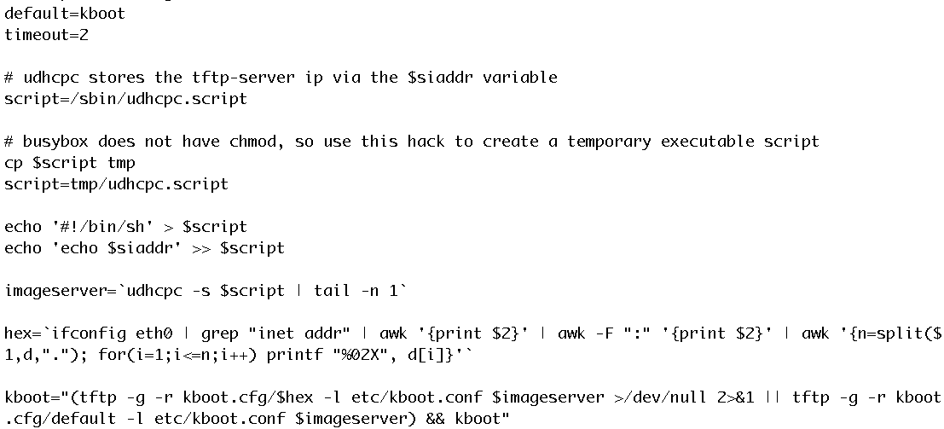
Kboot
kboot.conf
Notes:
OSCAR server knows what IP each client node has. The hex values are generated based on the IP address. The hex values for all the client nodes are saved on the oscar server.
If the hex value is the same as the one in OSCAR server, boot up with the installed OS. Otherwise, start to download SIS kernel from OSCAR server and then image the client node.
The secret file with the file name of the hex value will overwrite the current kboot.conf on the client node. Then another kboot runs with the overwritten kboot.conf.

Slide 23
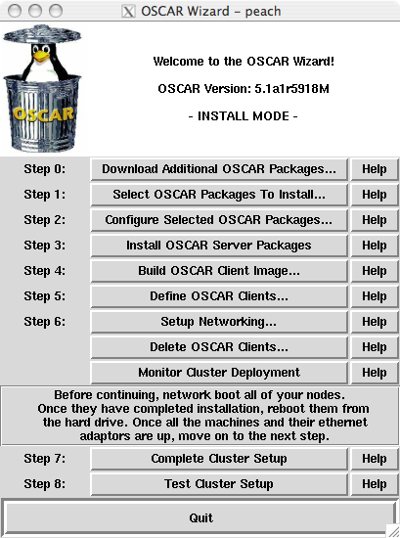

OSCAR implementation overview

Slide 24
Current Status / Future work
OSCAR Releases
  Last official release is 5.0, released on 12 November, 2006
  Last unofficial release is 5.0.1, released in April, 2007
  Official release 5.1 will be released on 11 November, 2007
Notes:
We have never released an official OSCAR version since 5.0 because we moved to the big changes on the OSCAR frame work and we could not really clean up the mess before we let our baby out of the door.
The unofficial version 5.0.1 was released with some updated packages and with lots of bugs fixed.

Slide 25
Current Status / Future work
OSCAR 5.1 Highlights
  Support Power PC and Power PC64
  ODA (Database) enhancements
  Support SUSE, Debian, Yellow Dog Linux
  Various software package updates
  New OSCAR Package (OPKG) structure
  Merge the several official OSCAR web sites to the one
Notes:
So that OSCAR users do not need to download the oscar package tarballs from the oscar website but they can just download any packages from yum / deb repositories as they wish.
There are more complicated things to explain how to make the OSCAR packages available on the yum/deb repository but this is not our topic here now.

Slide 26
OSCAR Resources
Official website: http://svn.oscar.openclustergroup.org
SVN repository: http://svn.oscar.openclustergroup.org/oscar
Sourceforge Website: http://www.sf.net/projects/oscar
Notes:
Here is what we have for the OSCAR resources.

Slide 27
Questions?

