Slide 1
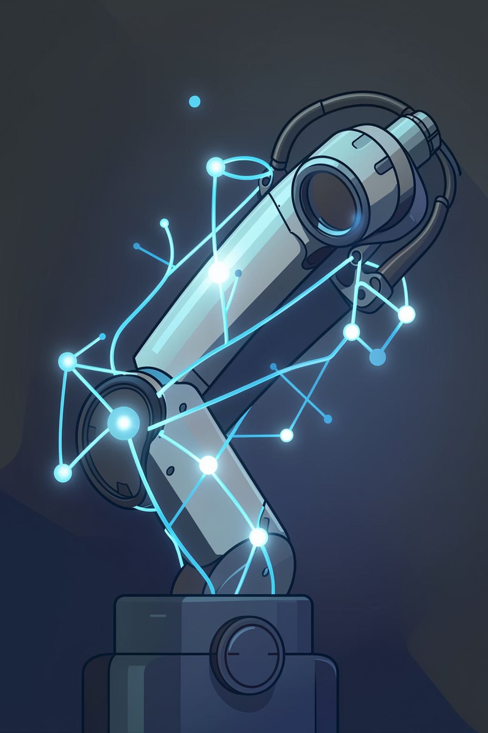
MSc ROBOTICS · CASE STUDY · TH DEGGENDORF
EEG-Based Brain–Computer Interface for Assistive Robotic Arm Control
A non-invasive system that turns imagined movement into real robot motion — decoding motor-imagery EEG with CSP + SVM and driving a UR5e manipulator in ROS 2 / Gazebo.
Team Prajwal Dikonda · Nishant Shetty · Papiha Dhavan
Supervisor Prof. Dr.-Ing. Hamidreza Heidari
Analytical review — with independently reproduced results and an honest critique
Notes:
Welcome. This is a review of our EEG-BCI project, but with something extra: I re-ran the real training myself, so the results here are verified, and I'll be honest about where the reports run ahead of the code.

Slide 2
What we'll walk through
01
The problem & why it matters
02
How a brain talks to a machine
Who this helps, and the goals we set ourselves
BCIs, motor imagery, and the EEG rhythms we ride on
03
What the literature taught us
04
The system, end to end
20 papers, and the five gaps that shaped our design
Architecture, dataset, signal processing, features
05
Decoding & moving the arm
06
Does it actually work?
SVM classification, ROS 2, MoveIt 2 and Gazebo
Reproduced accuracy and an honest KPI scorecard
07
Where it falls short
08
How we'd take it further
Doc-vs-code gaps, data leakage, unmeasured latency
Concrete fixes and a research roadmap
Notes:
Here's the shape of the talk — from the human problem, through how the system works, to whether it delivers and how we'd improve it.

Slide 3
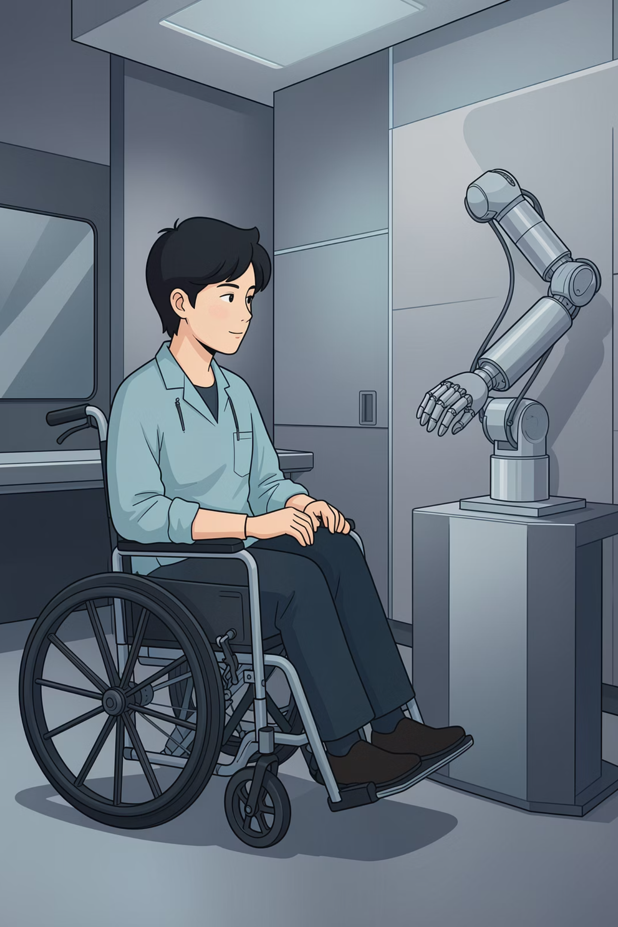
Why this project matters
Every year, stroke alone changes millions of lives — and the mind is usually still fully there.
15M
strokes worldwide, every single year
~5M
survivors left with permanent disability
100%
of them keep their cognition — the intent is intact
Here's the heart of it: someone can know exactly what they want to do — reach for a glass, press a button — and simply have no muscular pathway left to do it. A Brain–Computer Interface listens to the brain directly and hands that intention to a robot arm, giving back a slice of everyday independence. The catch we set out to solve: most systems that do this need costly lab hardware, long calibration, and heavy compute.
02
Notes:
The stakes are personal. Cognition intact, body unable to follow. A BCI restores the link — and our whole design is about making that link affordable and deployable.

Slide 4
What we set out to achieve
Our objectives
How we'd know it worked
→
Build a motor-imagery decoding pipeline that's genuinely modular — every stage swappable
≥ 75%
Classification accuracy the model should clearly beat guessing
→
Choose methods that are light enough to run in real time on an ordinary laptop, no GPU
≤ 500 ms
End-to-end latency fast enough to feel connected to the arm
→
Prove the whole thing in simulation first, before anything touches real hardware
≥ 80%
Command success rate commands land reliably, not occasionally
→
Turn decoded thoughts into 4–5 practical arm commands
→
Anchor every single design choice to something in the literature, not a hunch
4–5
Distinct arm movements enough vocabulary to be useful
03
Notes:
Five objectives, four numbers to hit. Each KPI isn't arbitrary — they trace back to benchmarks in Lotte 2018, Blankertz 2007 and Abiri 2019.

Slide 5
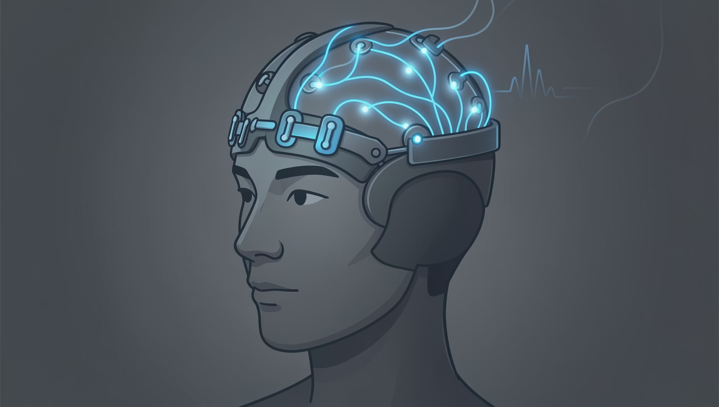
How a brain talks to a machine
What a BCI actually is. Think of it as a translator. It reads the brain's electrical activity, works out what the person intends, and passes that on as a command — no nerves or muscles in the loop at all.
Why we read from the scalp. You can tap the brain three ways — and it's a trade-off between signal quality and how invasive you're willing to be.
Invasive
Semi-invasive
Non-invasive — EEG
Electrodes implanted in cortex
ECoG on the brain's surface
Sensors sit on the scalp
Sharpest signal — but surgery, and real risk
Strong signal, still needs an operation
Safe, cheap, portable. Our choice.
04
Notes:
A BCI is a translator from intention to command. We use non-invasive EEG — noisier than implants, but safe, affordable and the standard for assistive work.

Slide 6
The trick: imagined movement
Here's the neat part. You don't have to move at all. Just vividly imagining moving your left hand lights up the sensorimotor cortex in a specific, repeatable way — the brain rehearses the action even when the muscles stay still.
The EEG rhythms — and the two that matter to us
Band | Range | What it reflects
Delta | 0.5–4 Hz | Deep sleep
Theta | 4–8 Hz | Drowsiness
Alpha | 8–13 Hz | Relaxed — carries MI (ERD)
Beta | 13–30 Hz | Active focus — carries MI (ERS)
Gamma | >30 Hz | High-level processing
→
ERD — during the imagined move, rhythmic power drops.
→
ERS — once you stop, it rebounds back up.
→
These swings live in the alpha & beta bands — and they're different enough between actions to tell apart.
What the cortex does
Imagine LEFT hand
→ ERD over the RIGHT cortex
Everything downstream — filtering, features, the classifier — is tuned to the 8–30 Hz window where motor imagery lives.
Imagine RIGHT hand
→ ERD over the LEFT cortex
Imagine feet
→ desynchronisation at the midline
05
Notes:
Motor imagery gives us repeatable ERD/ERS signatures in alpha and beta. That 8–30 Hz band is the target for the whole pipeline.

Slide 7
What the literature taught us
We read 20 peer-reviewed works (2000–2025). Six of them did the most to shape our thinking.
1
Wolpaw et al. (2002)
2
Pfurtscheller & da Silva (1999)
The founding proof that EEG can drive devices in real time.
Pinned down the ERD/ERS neurophysiology.
→ So motor imagery is a solid basis to build on
→ Tells us which bands to trust
3
Ramoser et al. (2000)
4
Lotte et al. (2018)
Introduced CSP spatial filtering.
10-year review: SVM shines on small datasets.
→ Became our main feature method
→ Why we chose SVM
5
Roy et al. (2019)
6
Blankertz et al. (2007)
Deep learning is powerful — but data- and compute-hungry.
Single short epochs are enough to classify.
→ Why we didn't go deep (yet)
→ Makes the 500 ms goal realistic
06
Notes:
Six anchor papers. The point isn't the citations — it's that every one maps to a decision we made.

Slide 8
Choosing the classifier
We compared the field honestly — accuracy is only half the story when you need real-time control.
Approach | Type | Typical accuracy | Compute | Real-time?
SVM (RBF kernel) | Classical ML | 75–85% | Low | Excellent
Logistic Regression | Classical ML | 70–80% | Very low | Excellent
LDA | Classical ML | 70–78% | Very low | Excellent
CNN | Deep learning | 80–90% | High | Moderate
RNN / LSTM | Deep learning | 78–88% | Very high | Poor
Riemannian geometry | Geometric ML | 80–87% | Moderate | Good
Our call
SVM with an RBF kernel wins on fit, not just score.
→
Strong on the small datasets EEG actually gives you
→
Fast enough for real-time control
→
No GPU — runs on a normal laptop
→
Deep learning parked for later: too hungry for now
07
Notes:
Deep nets edge out on raw accuracy, but they need data and GPUs we don't have. For this scope, SVM is simply the smarter fit.

Slide 9
The five gaps we tried to close
Reading the field, the same shortcomings kept coming up. Each one pointed straight at a design decision.
GAP 1
Everyone leans on expensive lab hardware
→ We use free, public datasets instead
GAP 2
Simulation validation is often skipped
→ We validate the whole thing in sim, documented
GAP 3
Systems are welded together, hard to change
→ We built independent, swappable ROS 2 modules
GAP 4
Latency is rarely actually reported
→ We set out to measure it against 500 ms
GAP 5
Most demos manage only 2–3 commands
→ We aim for 4–5 useful directions
08
Notes:
Five recurring gaps, five deliberate responses. This mapping is the backbone of our justification.

Slide 10
The system, end to end
EEG → filtering → CSP → SVM → ROS 2 / MoveIt 2 → Gazebo (UR5e). Five stages, each one testable on its own.
1
→
2
→
3
→
4
→
5
→
6
EEG input
Preprocessing
Features
Classify
Command
Move
A public BCI IV-2a recording — 22 channels at 250 Hz
Band-pass to 8–30 Hz, then cut into 0–4 s epochs
CSP finds the spatial patterns that separate classes
SVM decides — and only speaks up when it's confident
The label becomes a robot pose, sent over ROS 2
MoveIt 2 plans it; the UR5e executes in Gazebo
Because the stages are independent, any one can be upgraded without rebuilding the rest — that's the modularity gap answered directly.
09
Notes:
The core architecture. A heads-up for later: in the final code the feature path is CSP only — the ICA and PSD stages are described but not wired in.

Slide 11
The data we learned from
BCI Competition IV — Dataset 2a. The most-used motor-imagery benchmark there is.
4
22
250 Hz
9
classes
channels
sampling
subjects
left hand · right hand · feet · tongue
EEG, plus 3 EOG for artefacts
fine enough for MI rhythms
288 trials each per session
Why this one
One honest caveat
→
It's the field's common yardstick — so our numbers can be compared to everyone else's
The final code actually trains and tests on just one subject (A01). Cross-subject generalisation is described in the report, but it isn't implemented — so the numbers are single-person.
→
Every trial is cleanly labelled, which makes supervised training and cross-validation straightforward
→
It's public and standardised — full reproducibility, and it sidesteps the pricey-hardware gap entirely
10
Notes:
A strong, standard benchmark. But be clear-eyed: only subject A01 is used in the code, so results are single-subject.

Slide 12
Cleaning the signal
Raw EEG is tiny (10–100 µV) and swamped by blinks, muscle twitches and mains hum. Here's the gap between the plan and the code.
What the report describes
What the code actually runs
✓
Butterworth band-pass, 8–30 Hz — keeps the MI rhythms
✓
Band-pass 8–30 Hz — done
✓
50 Hz notch filter — kills mains hum
✓
Epoching 0–4 s — done
✗
Notch filter — not in the run path
✓
ICA artefact removal — strips out eye & muscle noise
✗
ICA removal — not in the run path
✓
±100 µV epoch rejection — drops the ugliest segments
✗
±100 µV rejection — not in the run path
✓
Epoch segmentation, 2–4 s — locked to the imagery cue
✗
Normalisation — not in the run path
So in practice, only the band-pass and epoching happen. The richer cleaning is written up but never actually wired in — the first of several gaps we'll come back to.
✓
Per-channel normalisation — evens out drift
11
Notes:
This is the first honesty slide. The documented pipeline is rich; the executed one is band-pass plus epoching. Worth being upfront about.

Slide 13
Making the decision — safely
The SVM decides which movement was imagined. But a good BCI also knows when to stay quiet.
The SVM, in plain terms
The safety catch
It draws the widest possible boundary between classes, and the RBF kernel lets that boundary curve — so it can separate patterns that aren't neatly linear.
Not every guess deserves to move a robot. We only act on confident ones.
if P(class) ≥ 0.70 → move else → hold still (treat as Rest)
K(xᵢ,xⱼ) = exp(−γ ‖xᵢ − xⱼ‖²)
→
Four classes handled one-vs-rest, with probability estimates
→
Ambiguous epochs get ignored, not acted on
→
CSP and SVM live in one scikit-learn pipeline — so no test data ever leaks into training
→
Threshold is 0.70 in the final node (the reports say 0.65 — a small inconsistency)
→
Robust on little data, GPU-free, quick to answer
→
Backed by a 2.5 s cooldown and duplicate-command suppression
13
Notes:
SVM in a leakage-safe pipeline, plus a confidence gate and cooldown so a shaky read never jerks the arm.

Slide 14
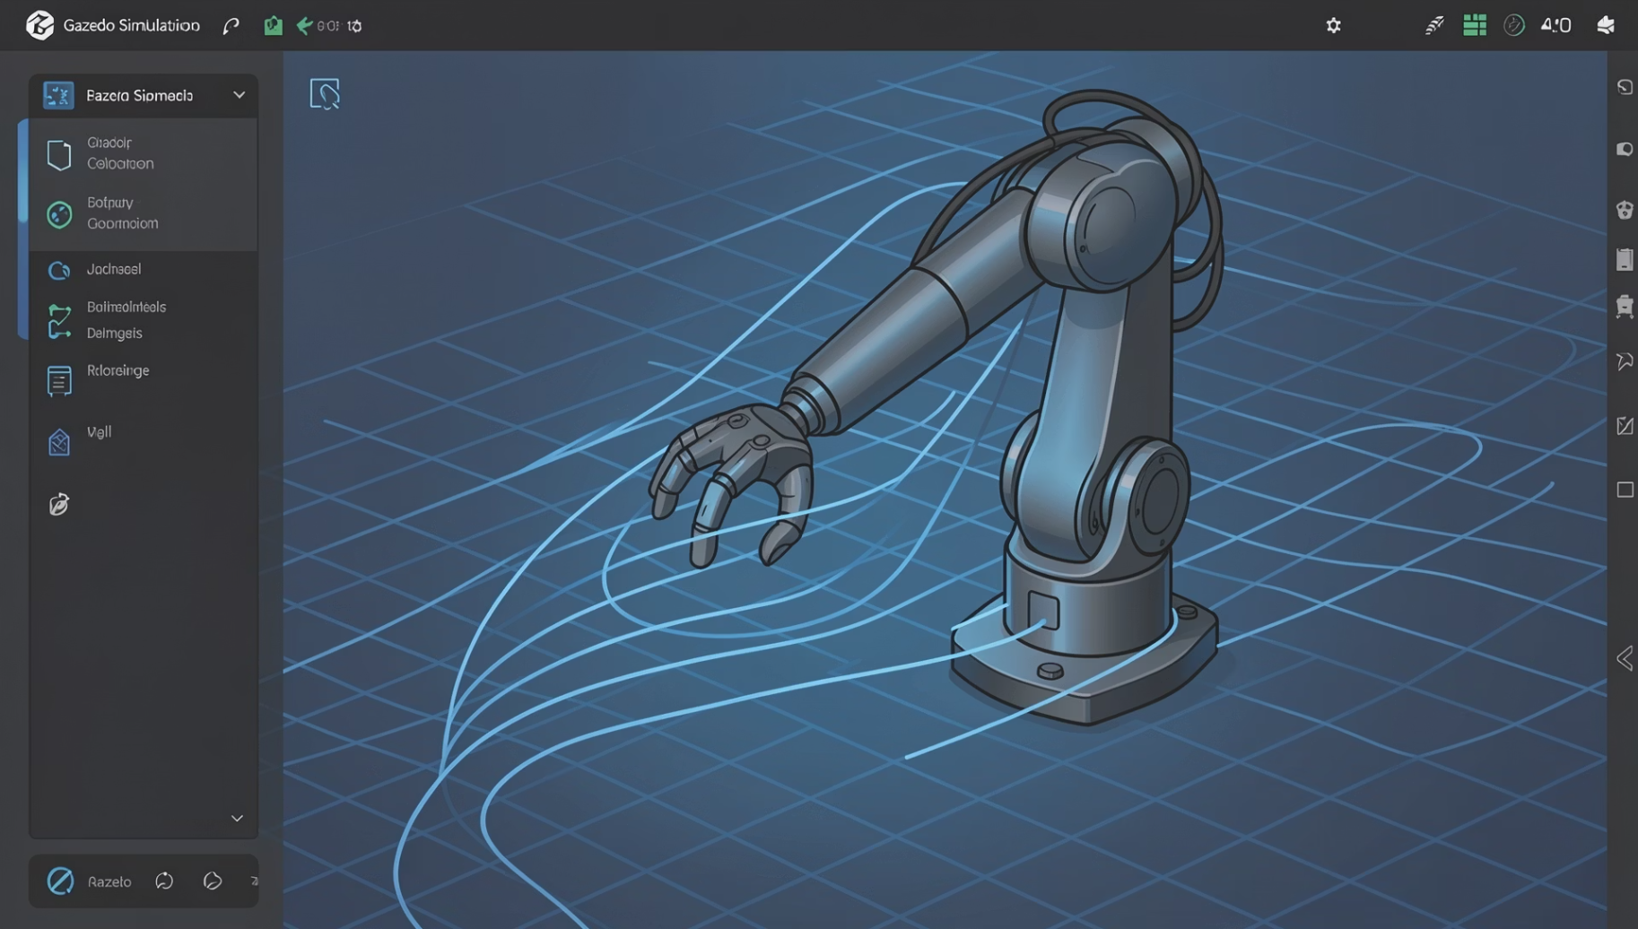
From command to motion
Three small ROS 2 programs pass the baton: one decodes, one translates to a pose, one makes the arm move.
1
EEG Predictor loads the model, publishes /eeg_command
2
Robot Controller turns a command into a UR5e joint pose
3
MoveIt 2 + Gazebo plans the path and executes it safely
Why UR5e + Gazebo
What each imagined action does
A real 6-DOF arm with native ROS 2 and MoveIt 2 support, in a physics simulator with proper collision checking. Best of all: a misread command in sim can't hurt anyone.
Imagined (event) | Command | The UR5e…
Left hand (769) | LEFT | rotates its base left
Right hand (770) | RIGHT | rotates its base right
Feet (771) | FORWARD | reaches forward
Tongue (772) | HOME | returns to its home pose
14
Notes:
A genuinely working ROS 2 / MoveIt 2 / Gazebo stack driving a UR5e. Note the sim platform migrated from PyBullet in the early phase to Gazebo in the final one.

Slide 15
And plenty that's genuinely strong
For all the caveats, this project earns real credit where it counts.
✓ Grounded in the literature
✓ The core result is verified
20 correctly-cited works, and every design choice traces to a source or a gap.
CSP + SVM really does hit ~75% cross-validated on a standard benchmark.
✓ It's a real, working system
✓ Clean ML hygiene
A functioning ROS 2 / MoveIt 2 / Gazebo stack driving a UR5e — not just slides.
CSP sits inside the scikit-learn pipeline, so there's no train/test leakage.
✓ Safety was designed in
✓ Simulation-first discipline
Confidence gating, a cooldown and duplicate suppression on every command.
Full validation in sim before hardware — best practice, and zero physical risk.
18
Notes:
The credit side: strong scholarship, a verified result, a working robotics integration, and good hygiene and safety thinking.

Slide 16
Selected references
Wolpaw, J. R. et al. (2002). Brain–computer interfaces for communication and control. Clin. Neurophysiol., 113(6).
Pfurtscheller, G. & Lopes da Silva, F. H. (1999). Event-related EEG/MEG synchronization & desynchronization. Clin. Neurophysiol., 110(11).
Ramoser, H. et al. (2000). Optimal spatial filtering of single-trial EEG. IEEE Trans. Rehab. Eng., 8(4).
Lotte, F. et al. (2018). A review of classification algorithms for EEG-based BCIs: a 10-year update. J. Neural Eng., 15(3).
Roy, Y. et al. (2019). Deep learning-based EEG analysis: a systematic review. J. Neural Eng., 16(5).
Blankertz, B. et al. (2007). The non-invasive Berlin Brain–Computer Interface. NeuroImage, 37(2).
Abiri, R. et al. (2019). A comprehensive review of EEG-based BCI paradigms. J. Neural Eng., 16(1).
Padfield, N. et al. (2019). EEG-based BCIs using motor imagery: techniques & challenges. Sensors, 19(6).
Ang, K. K. et al. (2012). Filter Bank CSP on BCI Competition IV Datasets 2a/2b. Front. Neurosci.
Tangermann, M. et al. (2012). Review of the BCI Competition IV. Front. Neurosci., 6, 55.
Welch, P. D. (1967). Use of the FFT for estimation of power spectra. IEEE Trans. Audio Electroacoust., 15(2).
Nicolas-Alonso, L. F. & Gomez-Gil, J. (2012). Brain–computer interfaces, a review. Sensors, 12(2).
Full 20-reference IEEE list is in the project's bibliography report. Results reproduced with MNE-Python + scikit-learn.
21
Notes:
Selected references; the full list is in the bibliography report. Reproduction used MNE-Python and scikit-learn.

