Slide 1

End-to-End Brain-Computer Interface: From GDF Headers to UR5e Robot Actuation
A Closed-Loop Machine Learning & ROS2/Gazebo Control Pipeline

Slide 2
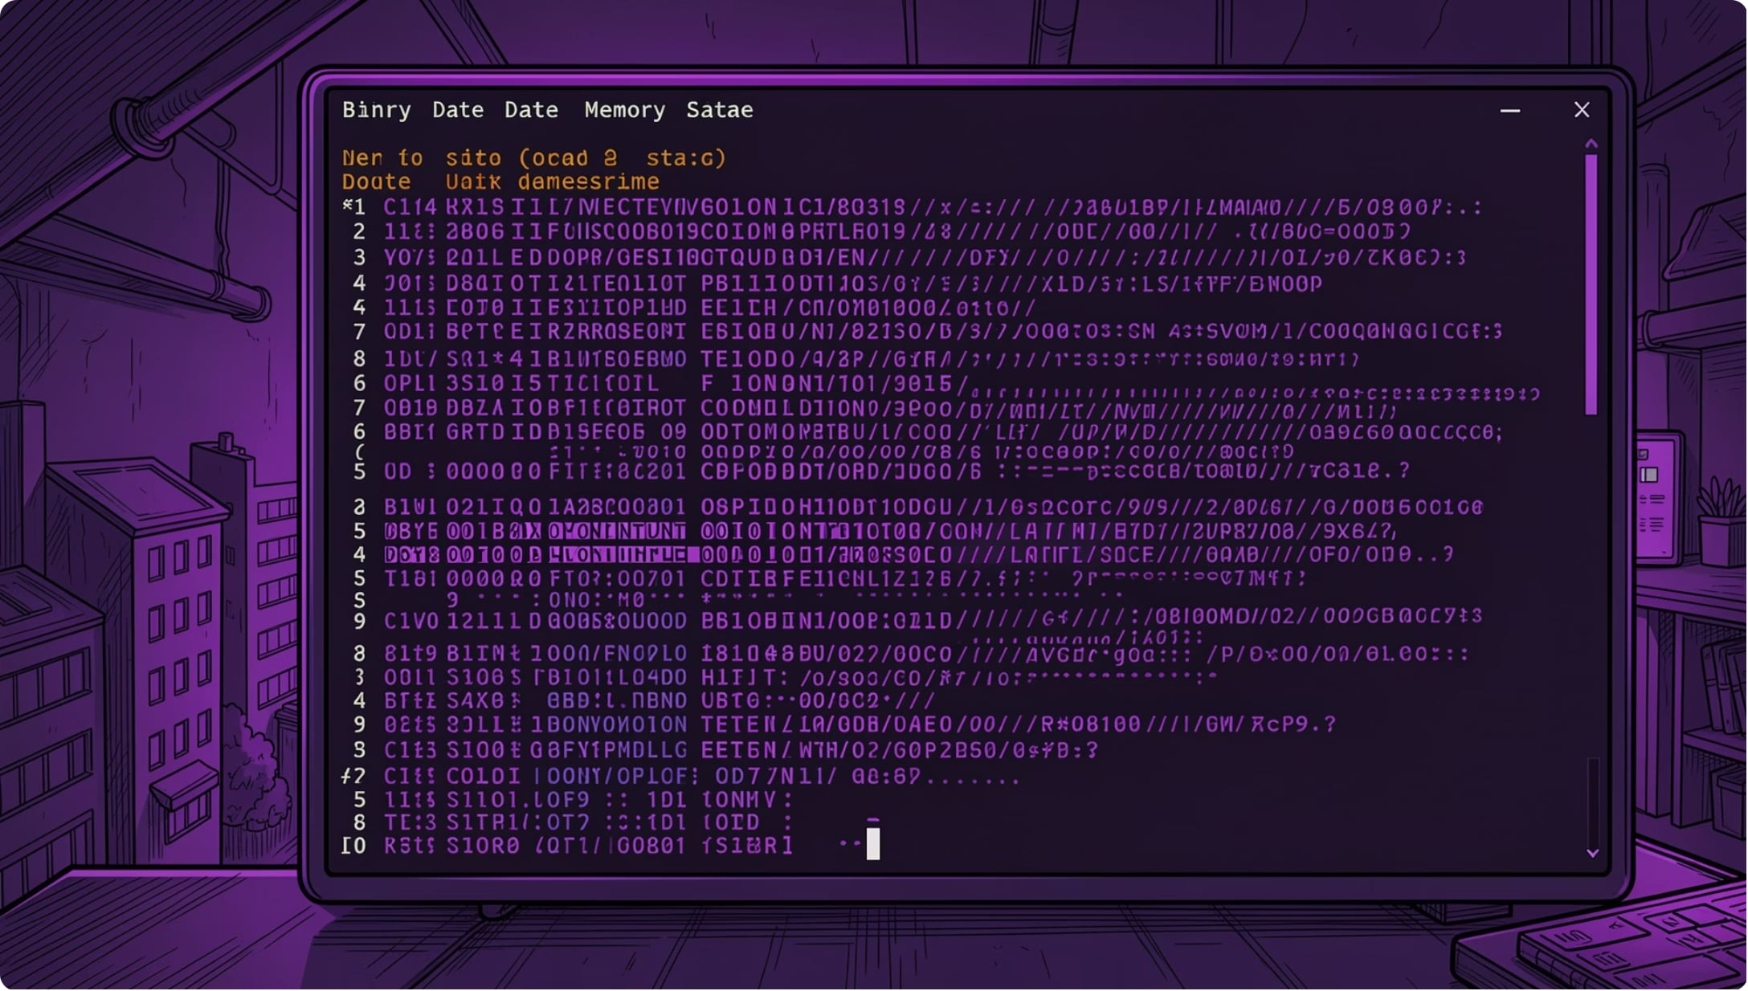
DATA INGESTION
Inside the General Data Format (GDF)
Fixed Header
MNE reads the binary header to extract sampling frequency (250 Hz) and channel count (25 channels), mapping raw streams to memory-resident NumPy arrays.
Event Table
Embedded at the data stream's end, this table holds sample offsets (when) and event codes (what) — the ground-truth anchors for epoch extraction.

Slide 3
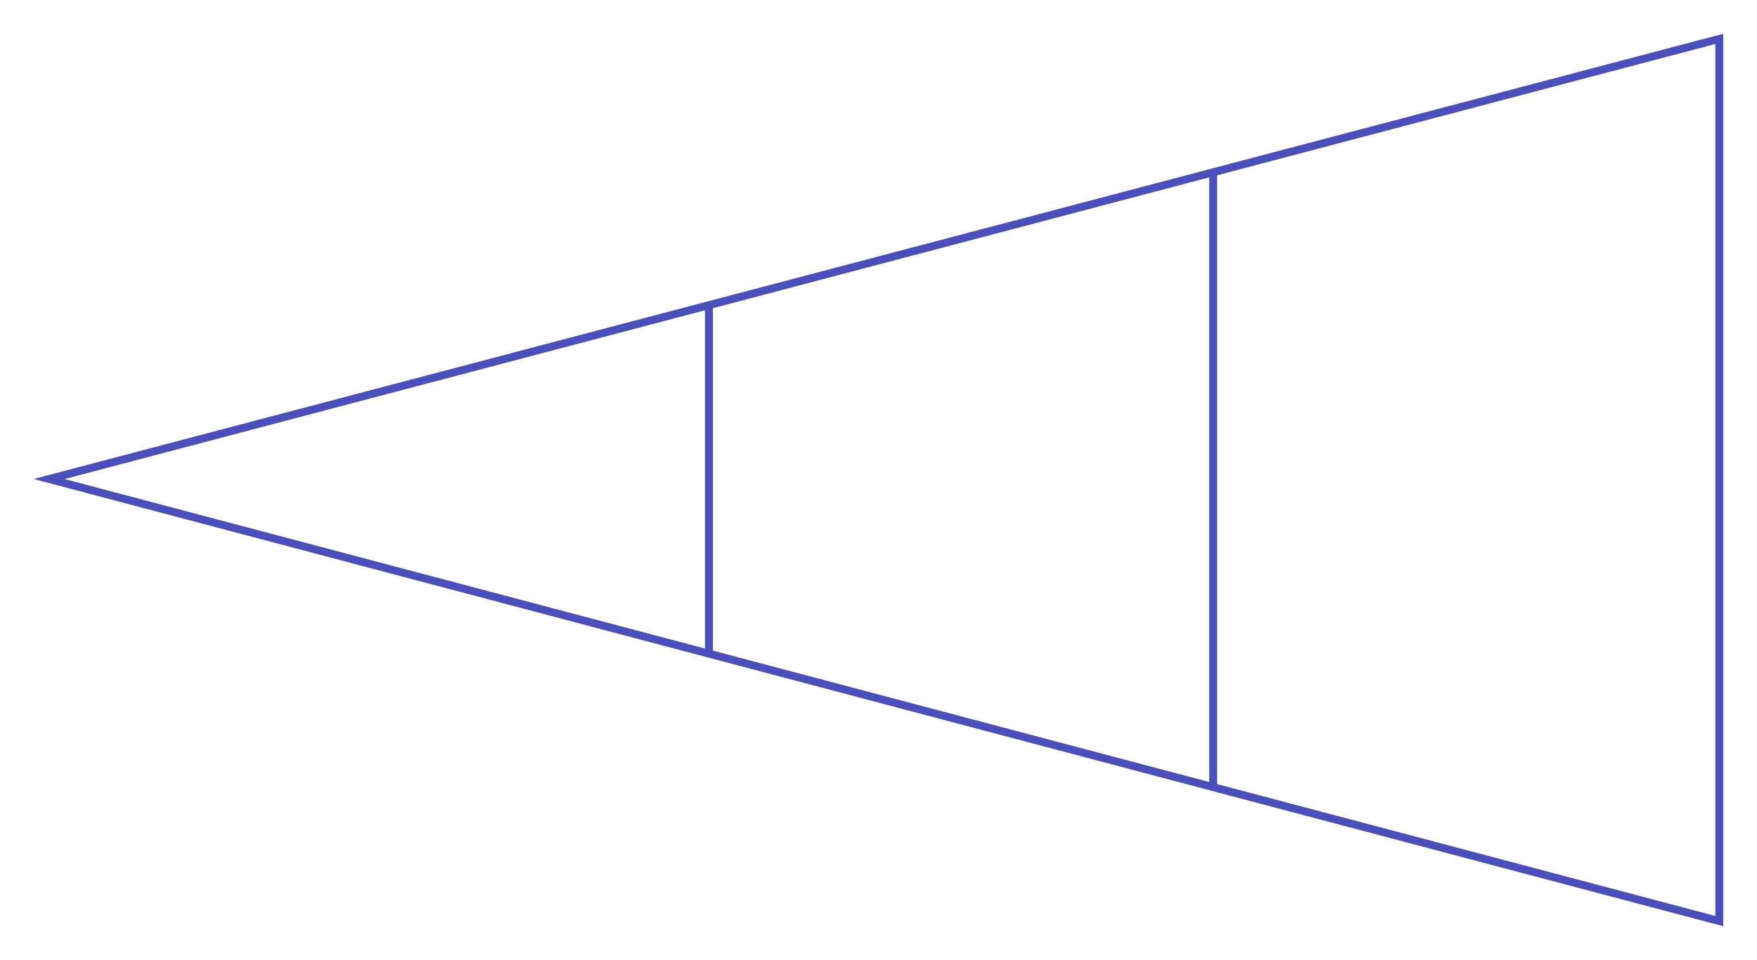
PREPROCESSING
From Continuous Data to 3D Epoch Tensors
Event Mapping
Tensor Assembly
Window Slicing
The script performs explicit event-code remapping, slices a 4-second window (tmin=0.0 to tmax=4.0s) at each event offset — yielding exactly 1,001 time samples per trial at 250 Hz — and assembles the result into a 3D tensor of shape (Trials, 25, 1001).

Slide 4
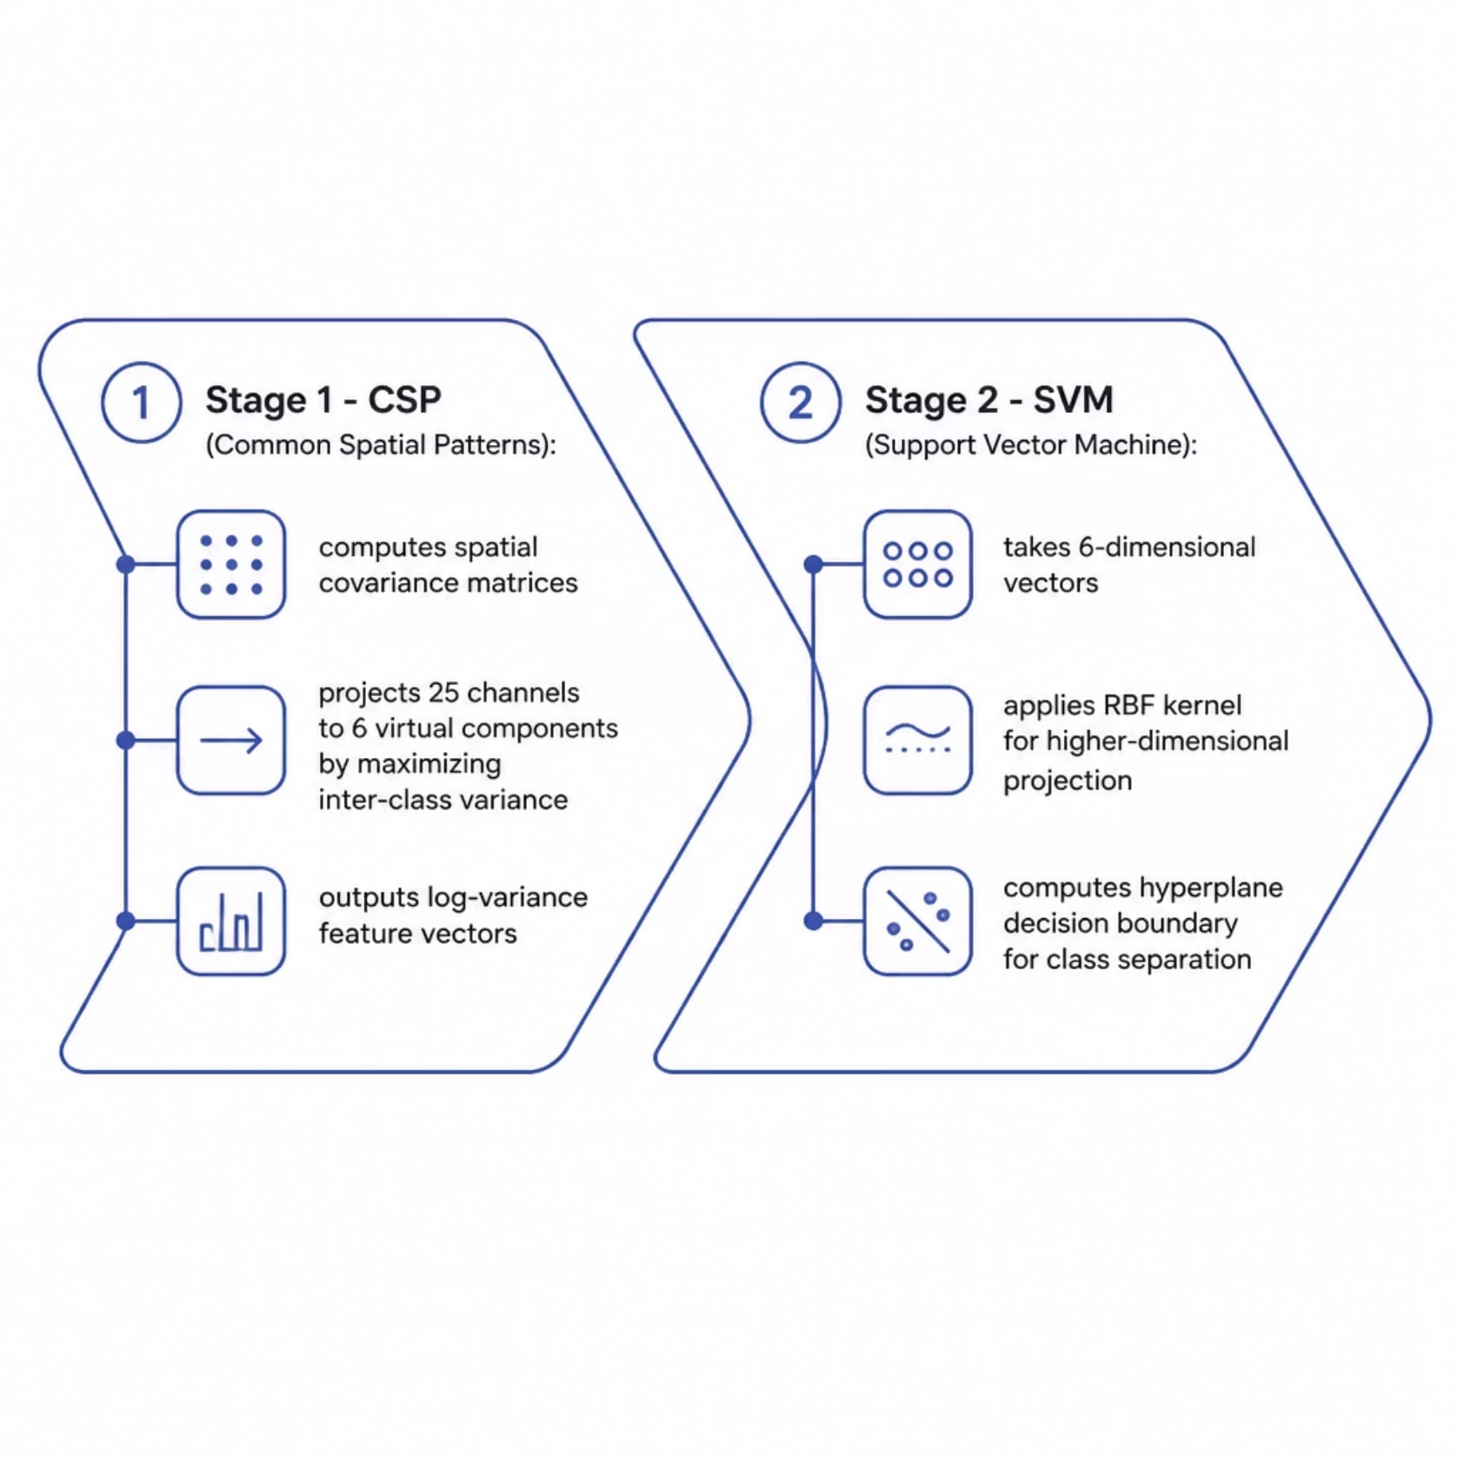
MACHINE LEARNING
The Scikit-Learn Pipeline: CSP + SVM
Stage 1 — CSP
Computes spatial covariance matrices and projects 25 channels → 6 virtual components (n_components=6) by maximizing inter-class variance, outputting flat log-variance feature vectors.
Stage 2 — SVM
Accepts 6-D vectors, applies an RBF kernel for higher-dimensional projection, and computes a hyperplane decision boundary to separate motor imagery classes.

Slide 5
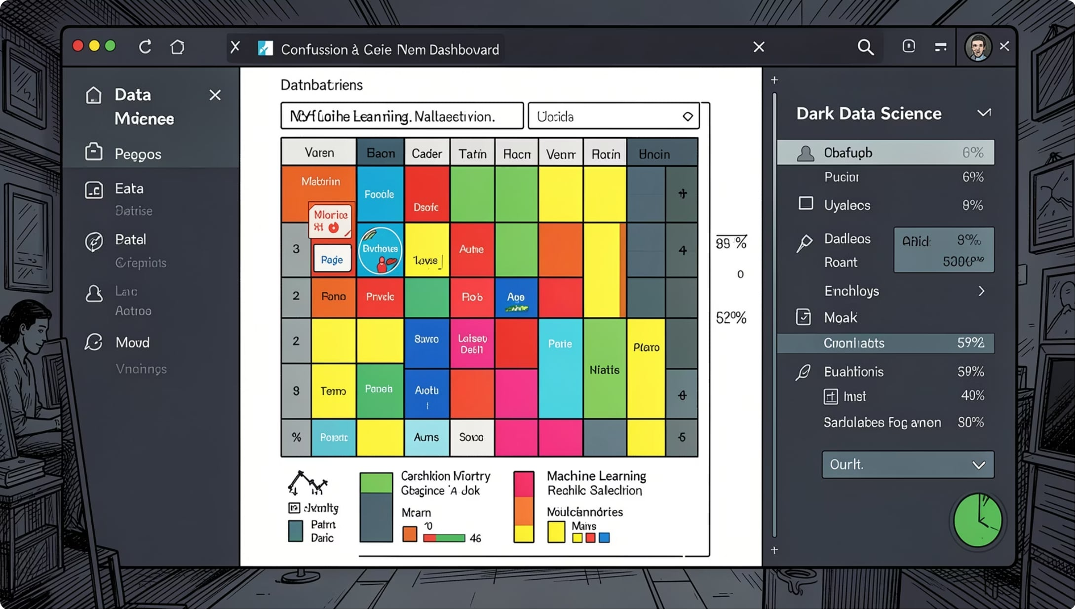
VALIDATION
Stratified Validation and Inference Testing
The Invisible Wall
A stratified 80/20 split isolates 20% of trials. Stratification guarantees identical class ratios in both sets, preventing evaluation bias.
Inference Pipeline
Test trials pass through the fitted CSP filters and are scored against the SVM boundary to generate predicted labels.
Scoring
Accuracy is computed by matching predictions against header-extracted ground truth — no external labels.

Slide 6
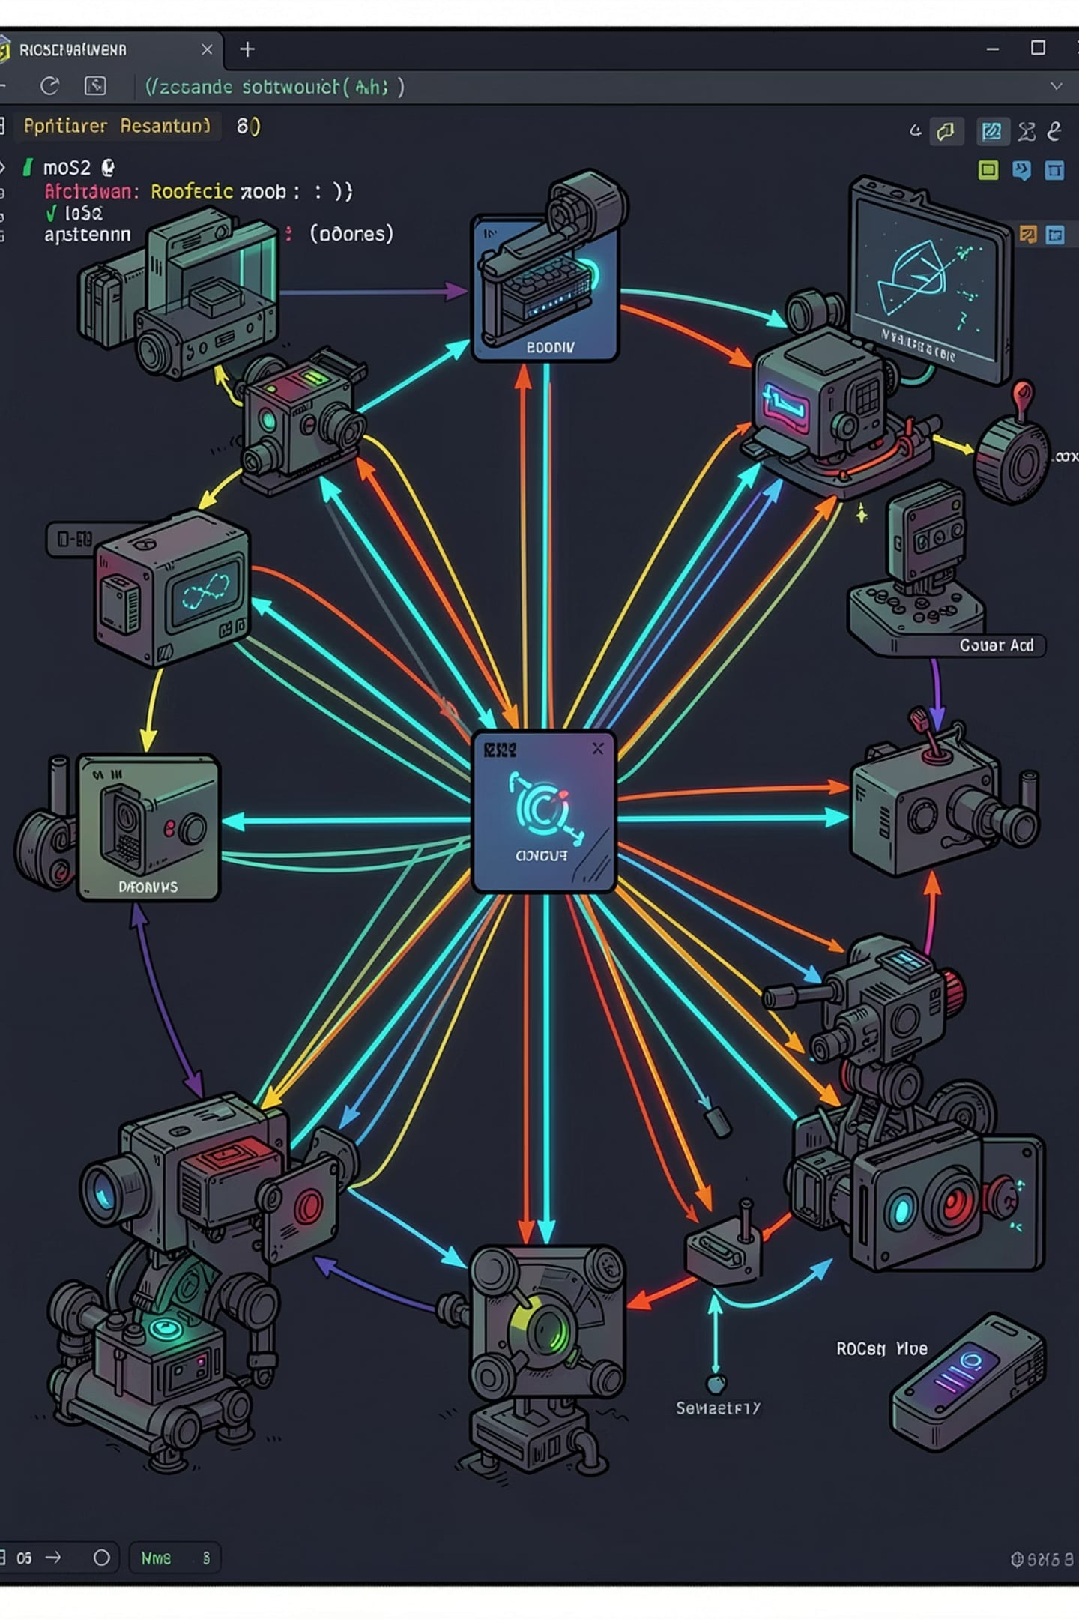
ROS2 INTEGRATION
Real-Time Prediction & Command Stream
Simulation Loop
Confidence Gate
A 3-second timer callback steps through trial matrices, simulating live BCI inference cadence.
predict_proba extracts confidence scores. Trials below 0.70 threshold are rejected to suppress false actuation.
Command Publishing
Mapped predictions convert to layout-safe strings — LEFT, RIGHT, FORWARD, HOME — published onto /eeg_command.

Slide 7
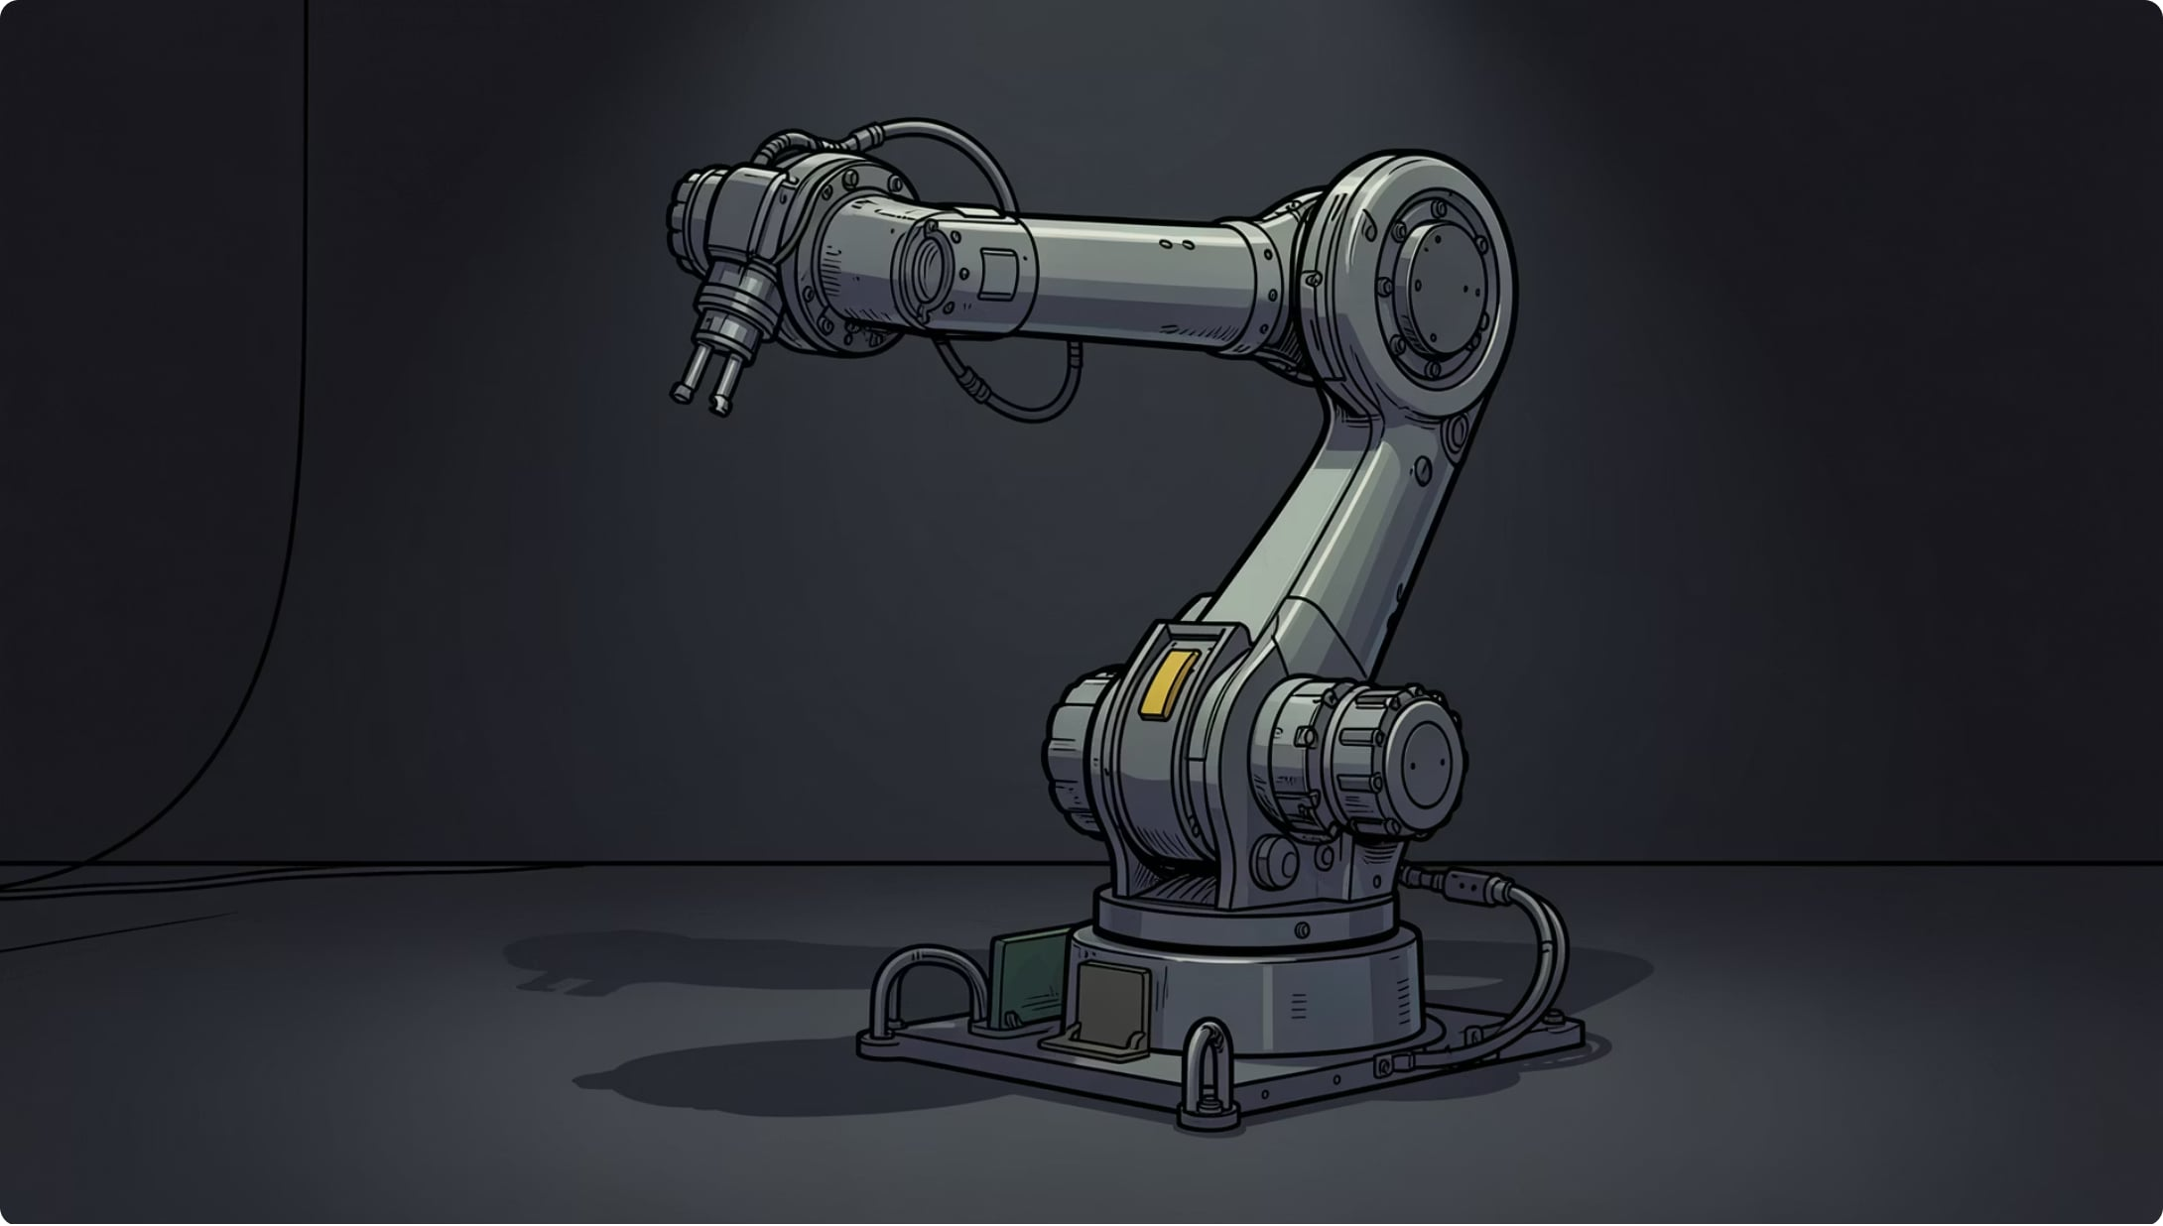
ROBOTICS
Decoupling and Actuating Physical Poses in Gazebo
Async Subscription & Cooldown
Subscribes to /eeg_command, drops duplicates, and enforces a 2.5-second execution cooldown for mechanical safety.
Configuration Dictionary
String tokens map to 6-element joint vectors containing exact radian positions for all 6 DOF of the UR5e.
Action Client Execution
Dispatches a 3-second trajectory point via FollowJointTrajectory Action Server to /joint_trajectory_controller/follow_joint_trajectory.

Slide 8
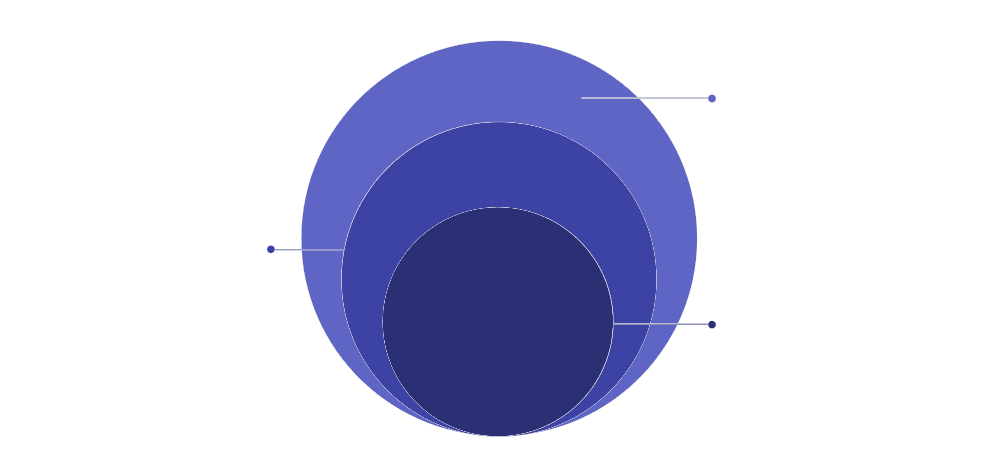
LOW-LEVEL ARCHITECTURE
The Internal Hardware Abstraction & Physics Execution
Open Dynamics Engine
ODE computes torques, friction, and dynamics
gazebo_ros2_control
Virtual hardware bridge between ROS2 and simulator
ros2_control
Interpolates 3s goals to 1ms quintic steps
The ros2_control framework interpolates goals into 1 ms step commands via quintic polynomials. The gazebo_ros2_control plugin bridges ROS2 to the simulator, while the Open Dynamics Engine (ODE) computes real-world torque, friction, and rigid-body dynamics to actuate the UR5e model.

