Slide 1

Nishant shetty
09/07/2026
End-to-End Motor Imagery BCI
Translating Biological Intent into Robotic Action

Slide 2
02
1. Introduction and Motivation
Neuroscience and Signal Processing
Classification and Robot Control
Testing, Data, and Results
Agenda

Slide 3
Introduction and Motivation
03

Slide 4
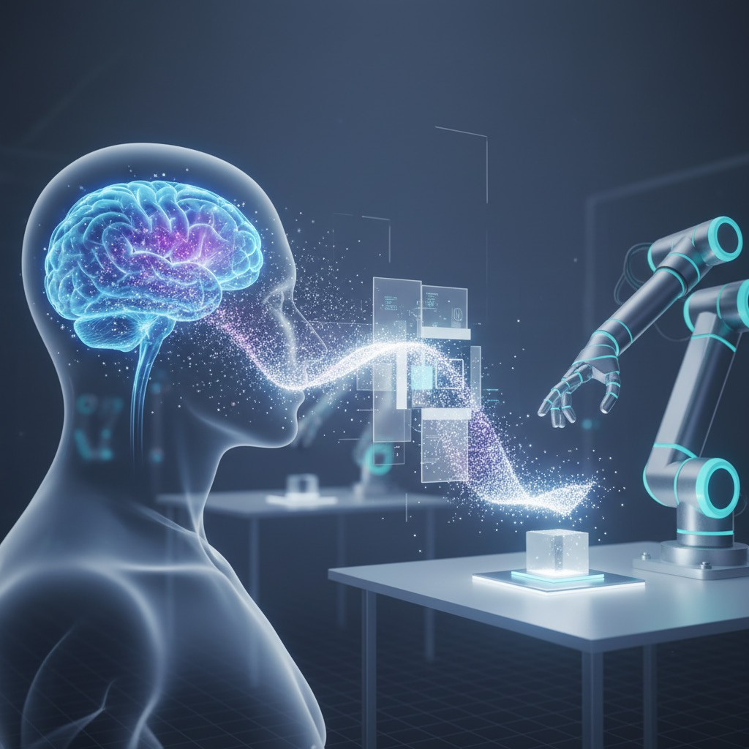
Thought to Robot Motion
INTRODUCTION AND MOTIVATION
04
What the system does
It turns imagined movement into motion commands for a UR5e cobot.
End-to-end ﬂow
Brain signals are processed, classified, and converted into robot actions.
Where it runs today
In ROS and Gazebo, the robot responds to intent inside simulation.

Slide 5


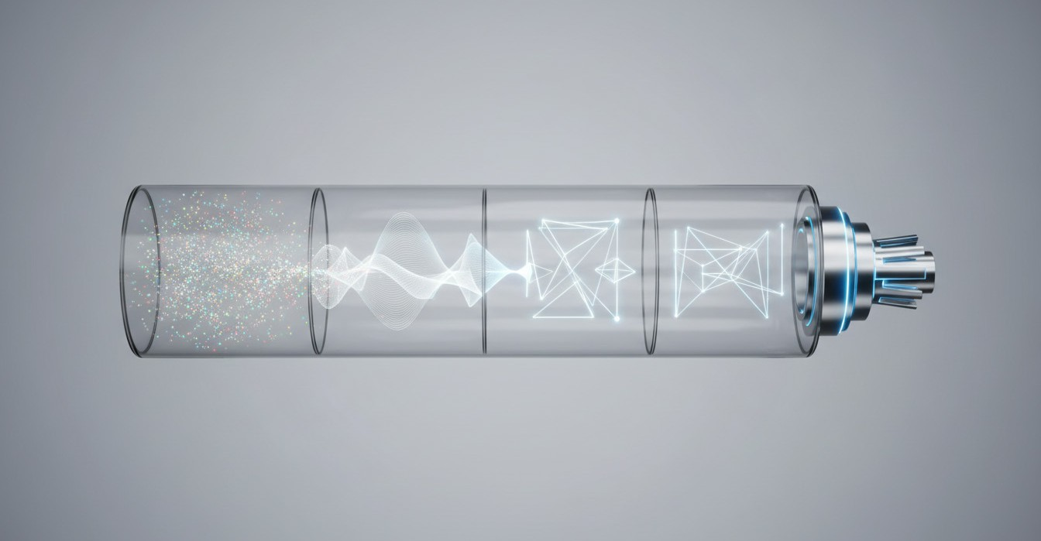
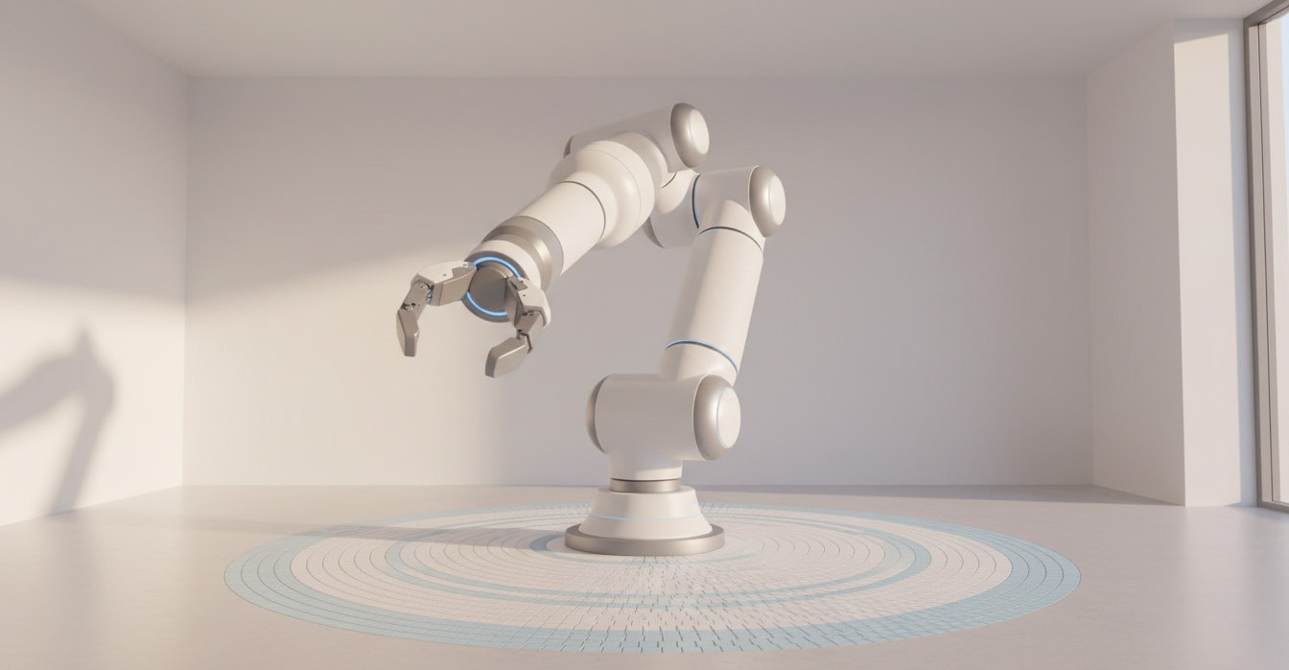
Why It Matters
INTRODUCTION AND MOTIVATION
05
Hands-free, intent-driven control
It turns imagined movement into robot commands, without controllers.
This shows how brain signals can become direct, usable actions.
A clear 4-step pipeline
Signals are captured, key patterns are extracted, then classified.
The final output is a safe actuation command for the robot.
Why it matters to everyone
It demonstrates how BCIs can guide real machines in practice.
It frames a future of accessible interaction beyond mouse and touch.

Slide 6
Neuroscience and Signal Processing
06

Slide 7
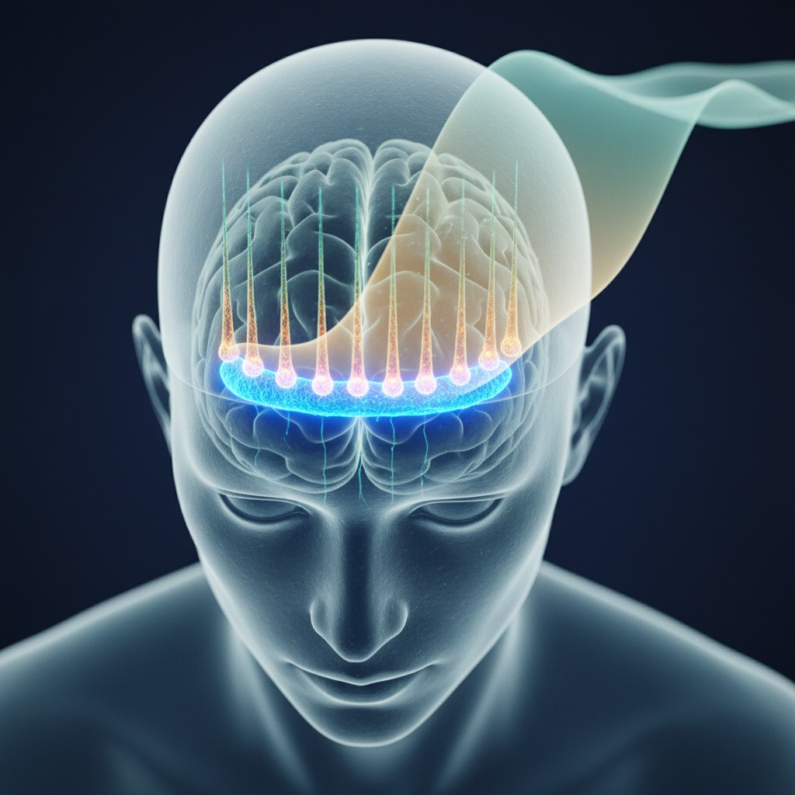
Motor Intent in M1
NEUROSCIENCE AND SIGNAL PROCESSING
07
Origin of motor intent
Movement planning begins in the primary motor cortex (frontal lobe).
Different regions correspond to different parts of the body.
Neurons that scale up
Pyramidal neurons align similarly, like tiny vertical dipoles.
When many fire together, their voltages add into a larger signal.
What EEG can capture
EEG senses the summed activity across thousands of neurons at once.
This macroscopic pattern becomes the input used by our BCI pipeline.

Slide 8
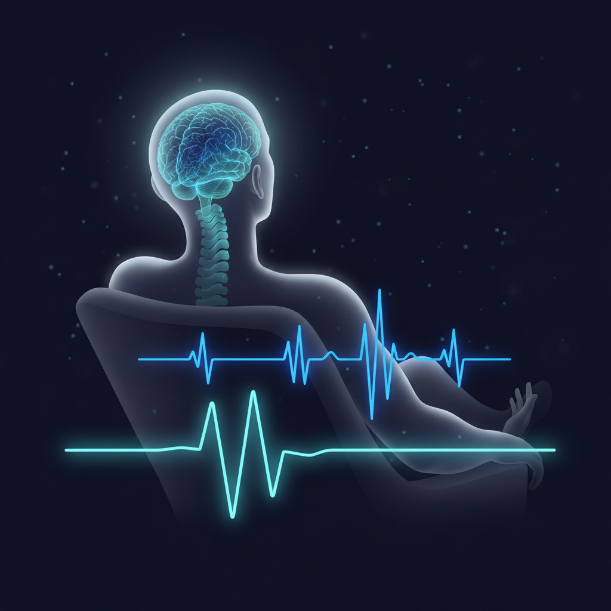
Resting motor rhythms
NEUROSCIENCE AND SIGNAL PROCESSING
08
Sensorimotor baseline
When you rest, motor areas produce steady, repeating EEG rhythms.
This “idling” pattern is the reference state for later comparisons.
Two key rhythm bands
Mu rhythm sits around 8–13 Hz and reﬂects motor-system standby.
Beta rhythm spans 13–30 Hz and is also strong during rest.
Why it matters
Imagined movement is detected as a drop from this baseline power.

Slide 9
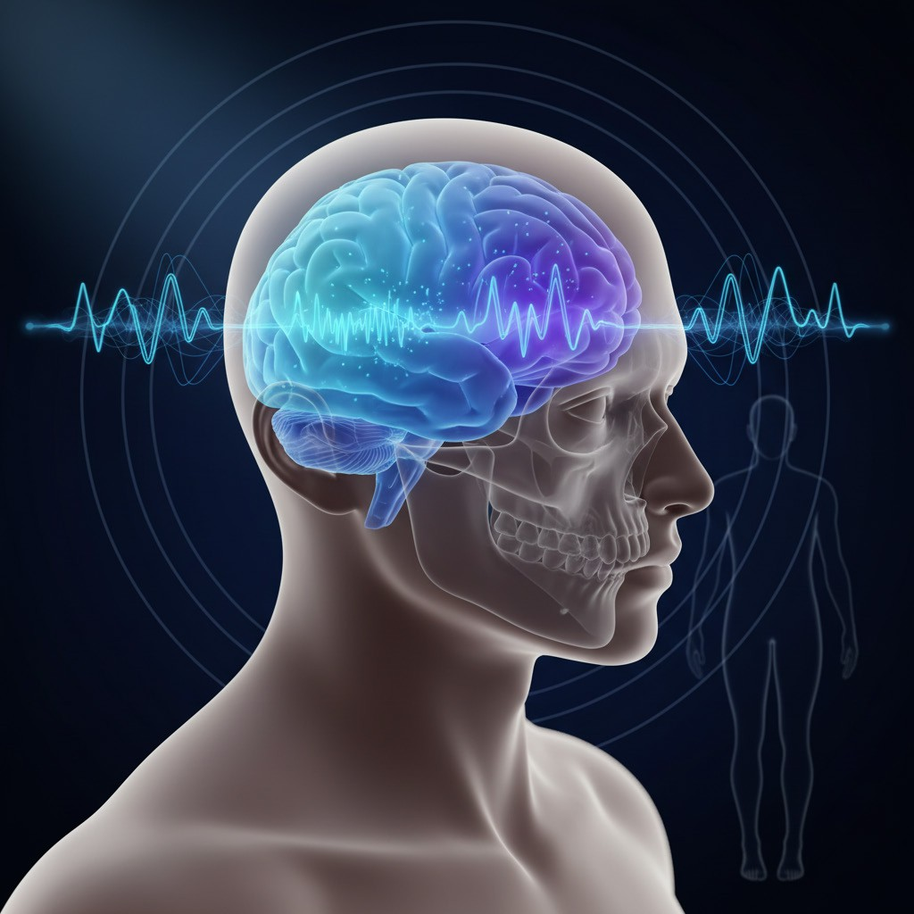
Contralateral ERD Signal
NEUROSCIENCE AND SIGNAL PROCESSING
09
Contralateral brain control
Left hemisphere activity typically relates to right-side intention, and vice versa.
Imagery breaks the resting pattern
When you imagine movement, the usual steady rhythm becomes less synchronized.
A measurable power drop appears
Local signal energy decreases near motor areas during imagined action.
Key clue the model learns
This event-related desynchronization (ERD) helps separate intent classes reliably.

Slide 10
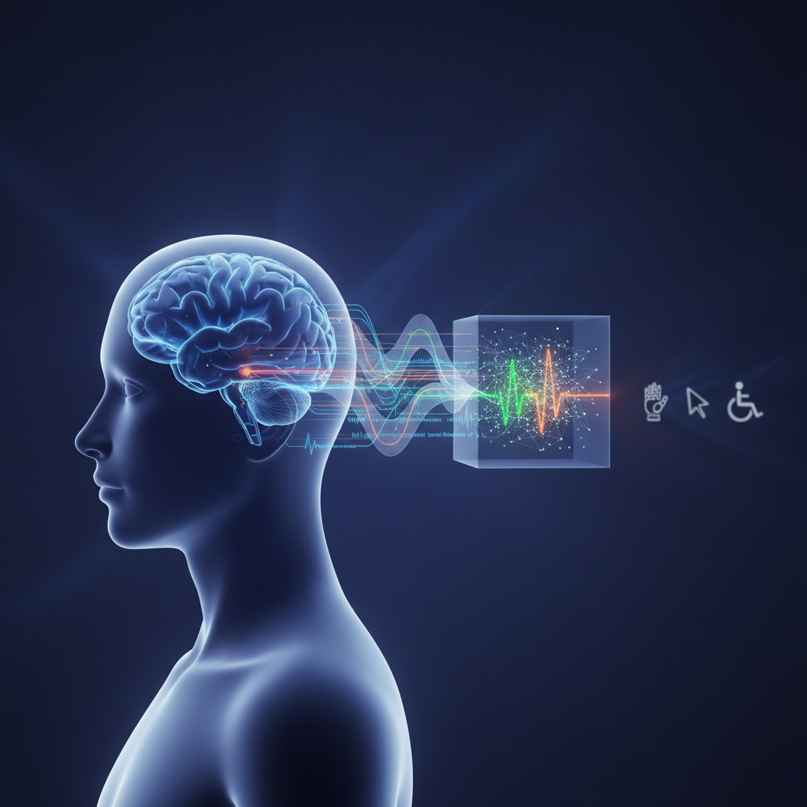
Teaching biology to code
NEUROSCIENCE AND SIGNAL PROCESSING
10
From signals to meaning
Software receives only time-series voltages, not human intention.
Learning is needed to connect patterns with imagined movement.
Supervised learning setup
We label examples by motor imagery class, then train a model.
Training teaches the system what ERD-like changes look like.
Working in real-world noise
The model must recognize intent even when signals drift and vary.
Output becomes reliable class predictions that can drive control.

Slide 11
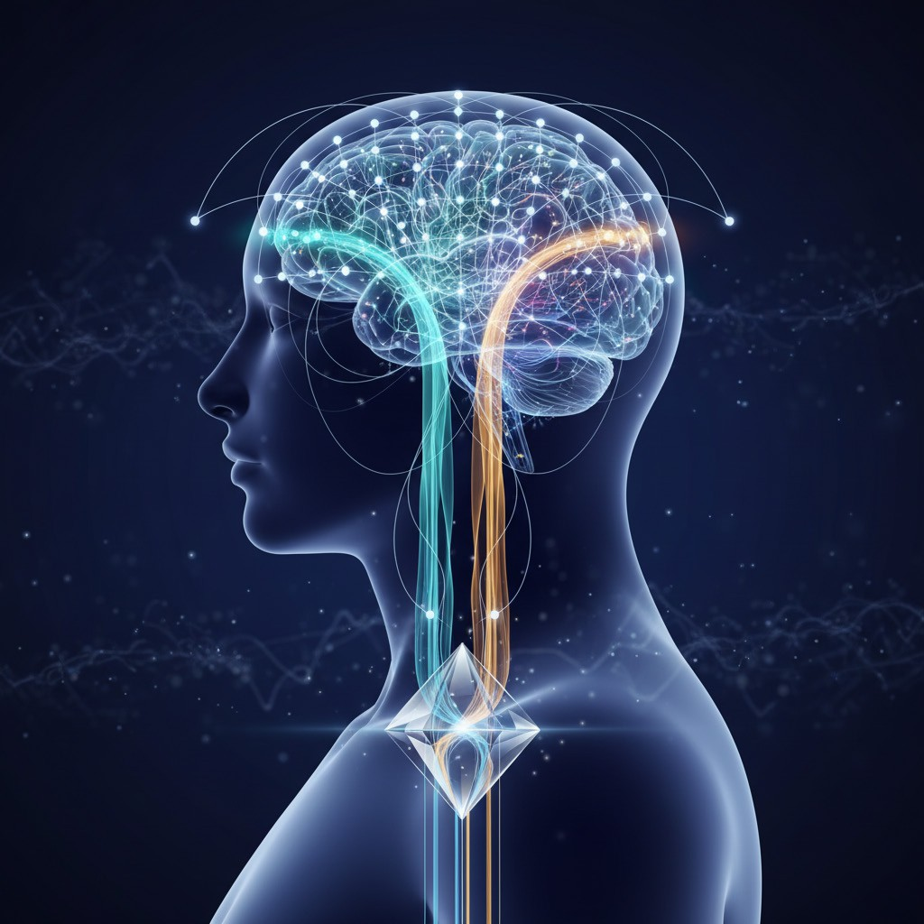
CSP: Where activity lives
NEUROSCIENCE AND SIGNAL PROCESSING
11
What CSP does
It learns spatial filters by comparing patterns across all EEG channels.
It re-weights electrodes so informative regions contribute more to features.
Why it helps motor imagery
It amplifies left-versus-right hemisphere differences tied to imagined movement.
It suppresses shared background activity that can mask class-specific signals.
Practical takeaway
CSP highlights where scalp activity is most useful before classification.

Slide 12
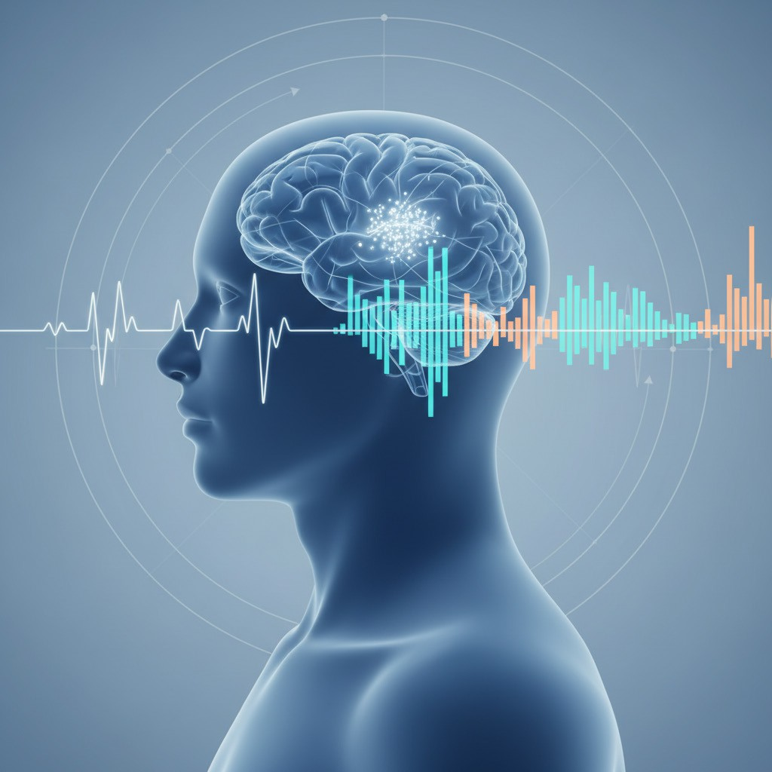
Tracking EEG Power Shifts
NEUROSCIENCE AND SIGNAL PROCESSING
12
PSD turns EEG into a frequency map
It shows how much signal power exists at each frequency.
This makes subtle rhythm changes easier to spot than raw waves.
Welch + FFT focus on key bands
Welch’s method stabilizes estimates by averaging short time windows.
FFT reveals the spectrum, highlighting the 8–30 Hz region.
What we expect during motor imagery
A drop in power indicates ERD in mu and beta rhythms.
Those frequency features feed the classifier for intent prediction.

Slide 13
Classification and Robot Control
13

Slide 14
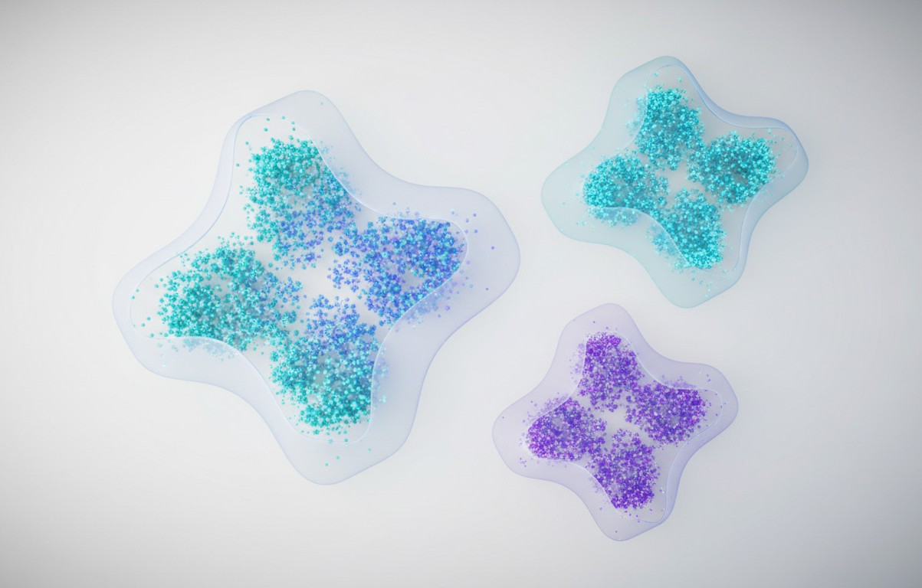

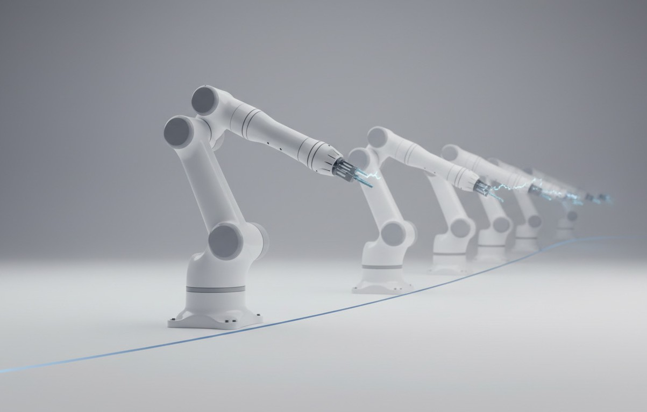
SVM + Confidence Gate
CLASSIFICATION AND ROBOT CONTROL
14
Separating intent patterns
An RBF SVM draws ﬂexible boundaries between movement-intent clusters.
This turns extracted features into a single predicted class label.
Confidence-gated commands
Only send robot actions when confidence is at least 65%.
Lower-confidence outputs are treated as uncertain and ignored.
Why it matters in practice
The threshold reduces twitchy switching between classes over time.
This supports safer, steadier behavior during real robot control.

Slide 15
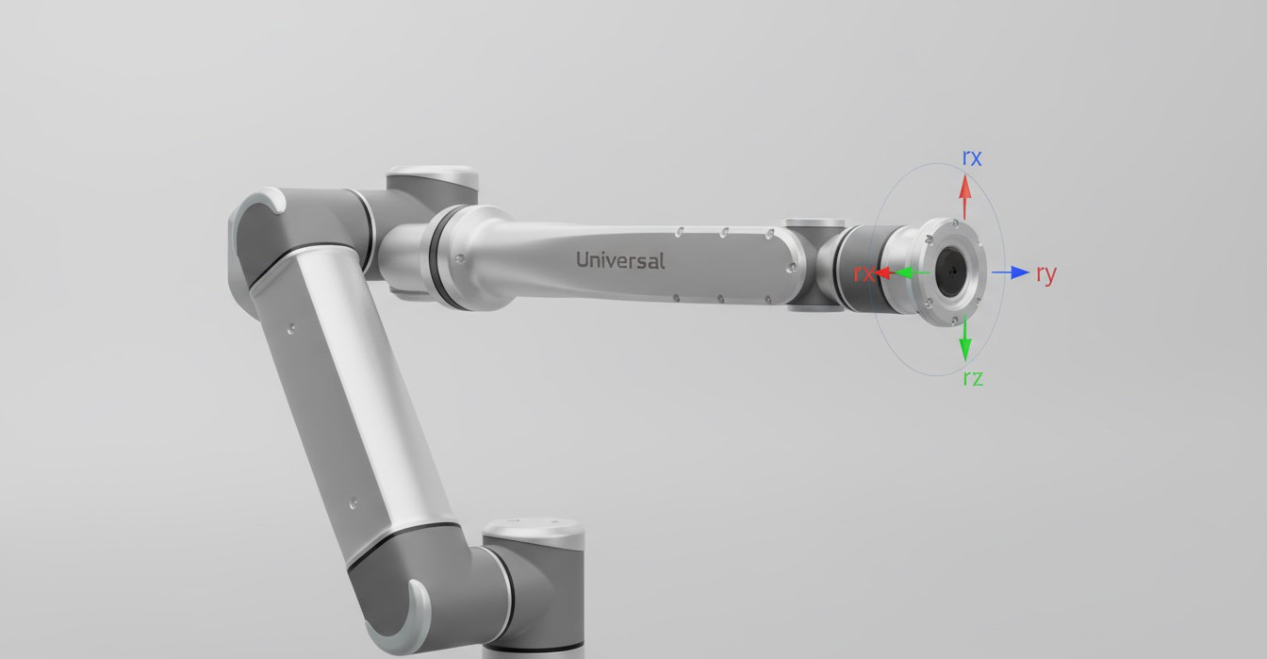
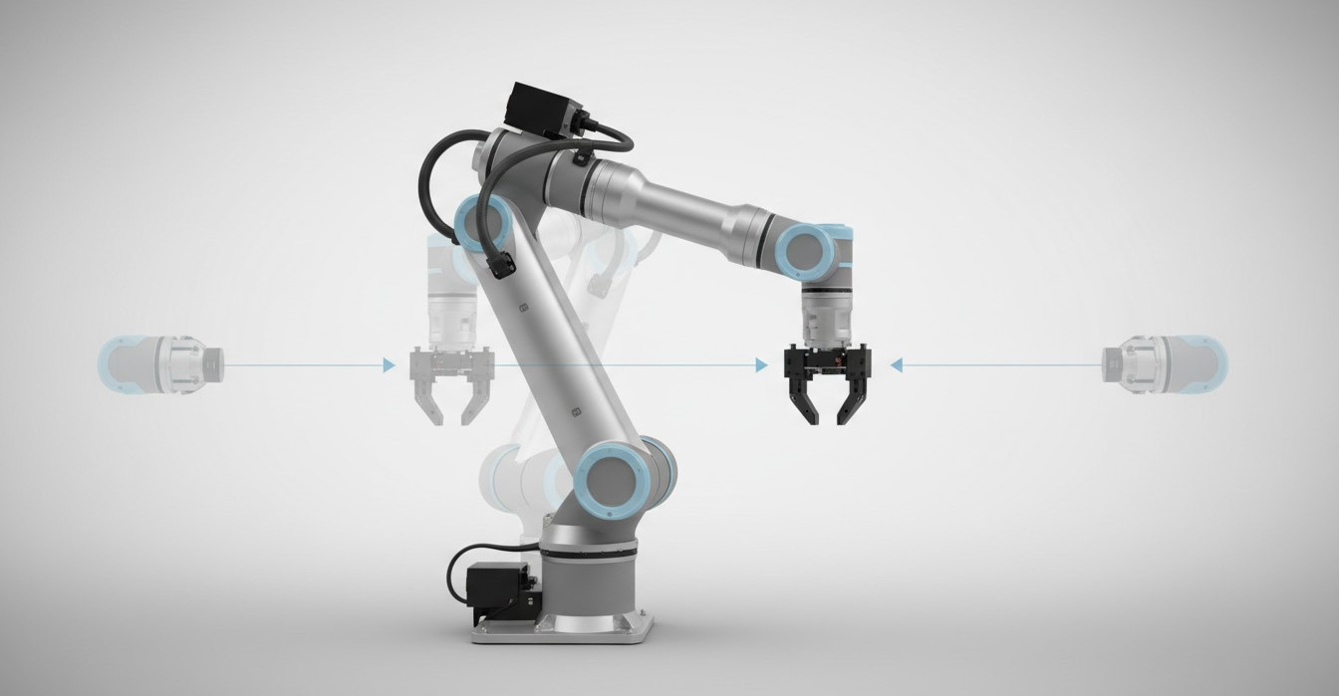
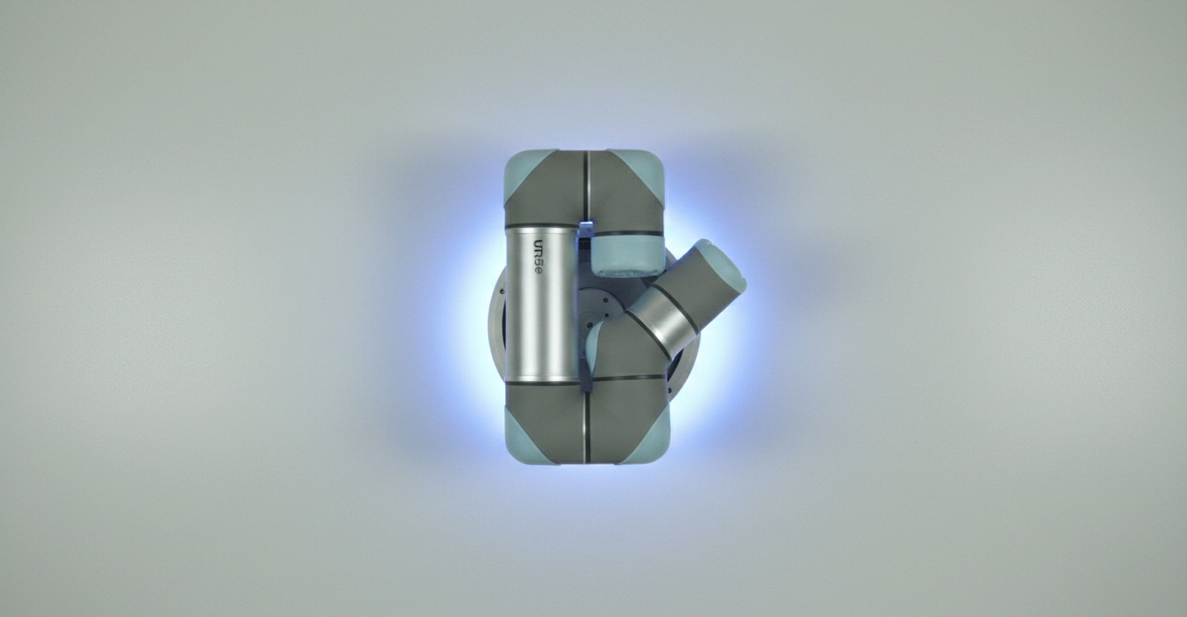
CLASSIFICATION AND ROBOT CONTROL
15
UR5e Motion Mapping
Robot command format
Each prediction becomes a UR5e pose command: [x, y, z, rx, ry, rz].
Pose targets are predefined so motions look smooth and repeatable.
Intent-to-direction mapping
LEFT_HAND and RIGHT_HAND shift the arm left or right.
FEET and TONGUE drive the end-effector front or back.
Safe default behavior
BASELINE always sends the robot back to HOME.

Slide 16
Testing, Data, and Results
16

Slide 17
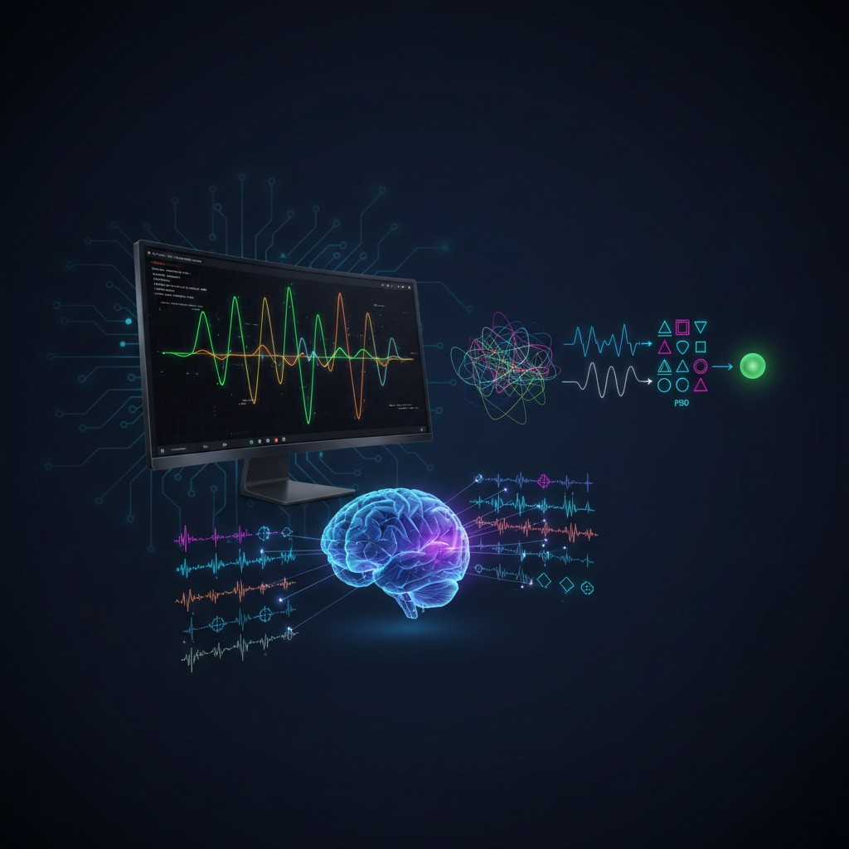
BCI Pipeline Simulation
TESTING, DATA, AND RESULTS
17
Why we simulated
With no EEG headset available, we validated the pipeline in Python.
How we generated signals
Synthetic motor-rhythm sine waves were embedded in 25-channel noise.
What this proved
CSP, PSD, and SVM produced stable, end-to-end control outputs.

Slide 18
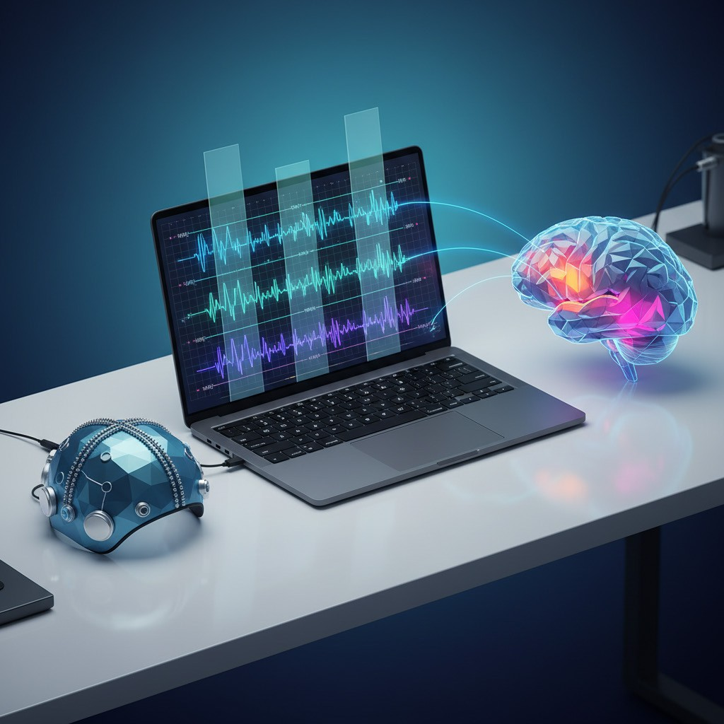
Real Clinical Data Input
TESTING, DATA, AND RESULTS
18
Clinical benchmark dataset
We used Subject 1 training data from BCI Competition IV-2a.
Clean trial labeling
Embedded digital event markers split recordings into labeled imagery segments.
This produced 288 motor-imagery trials ready for model training.
Apples-to-apples comparison
Trials were exported as a 25-channel CSV matching our simulation format.
That kept preprocessing consistent for a fair simulation-versus-real test.

Slide 19
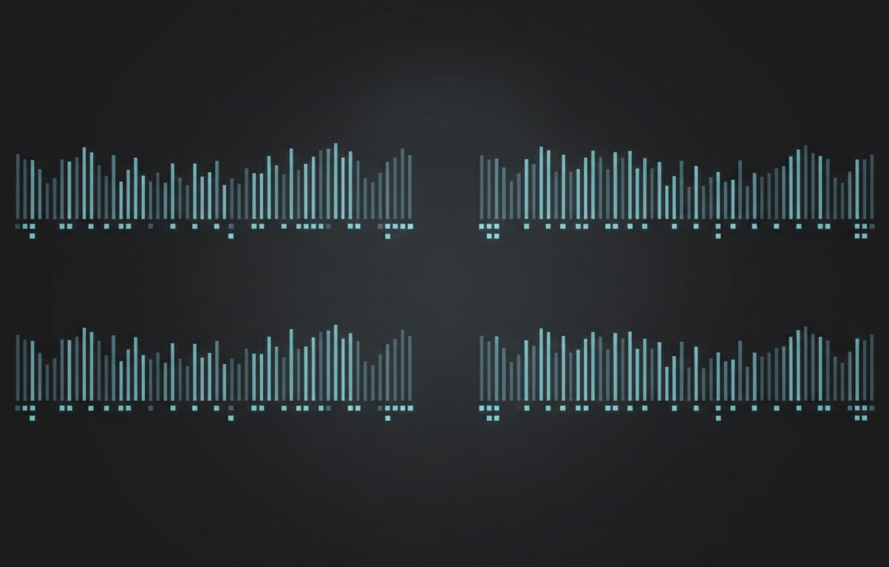
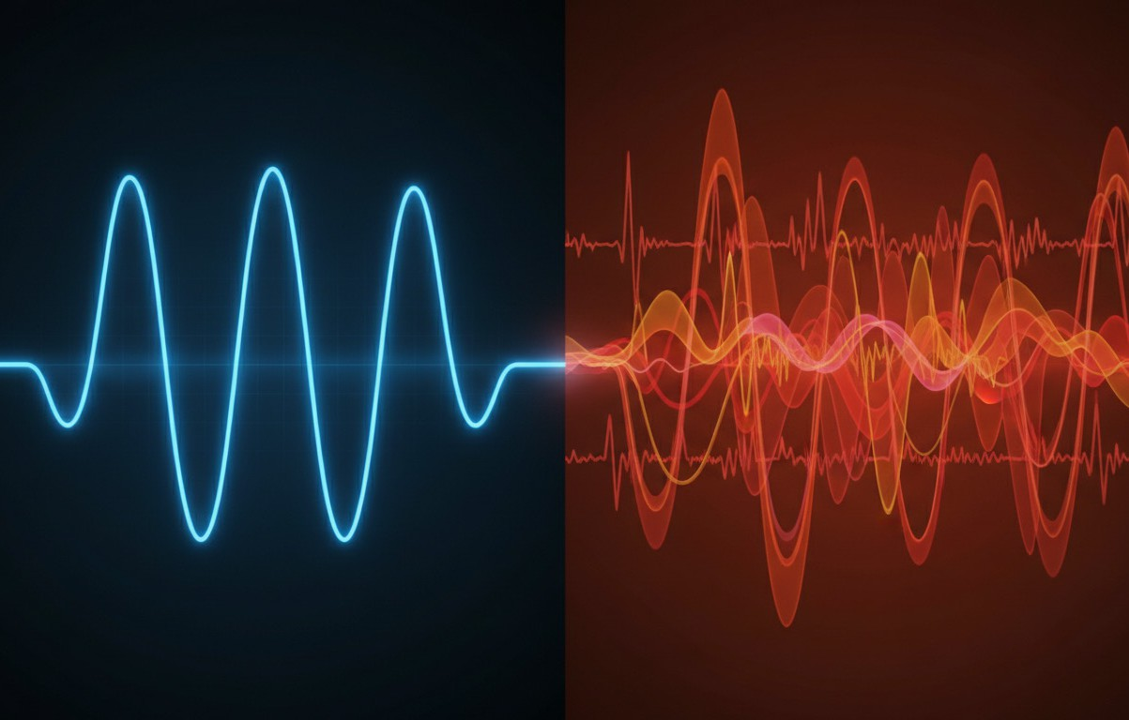
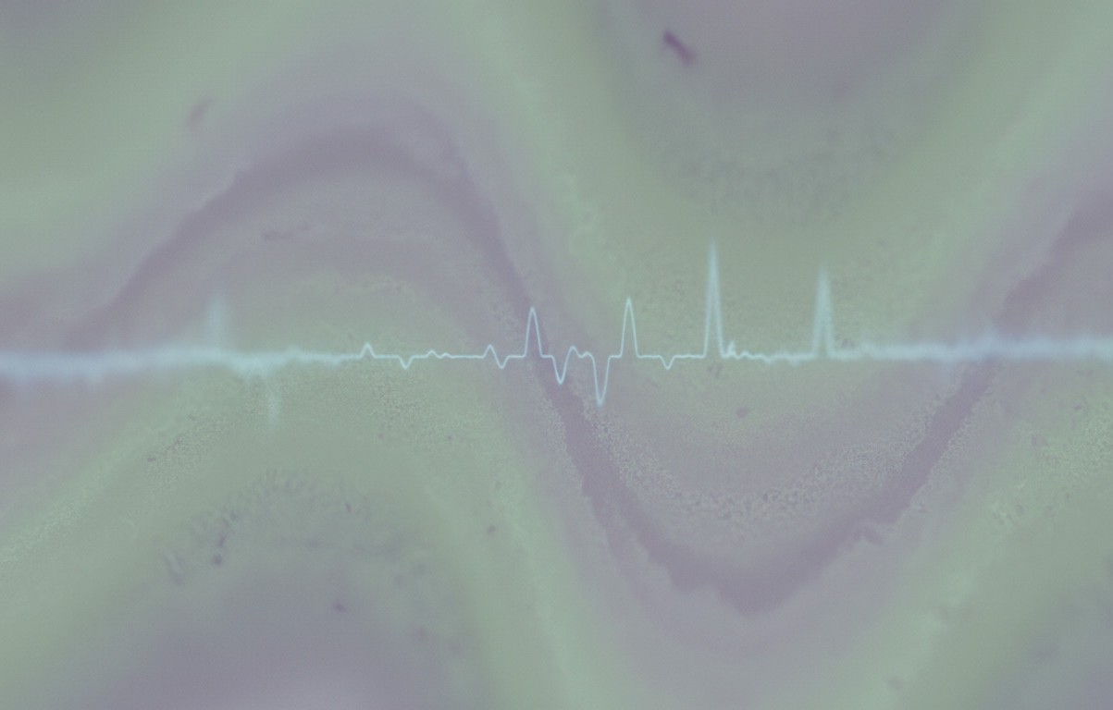
Sim vs Real EEG
TESTING, DATA, AND RESULTS
19
Same structure, fair comparison
Both streams use 250 Hz, 25 channels, and four motor classes.
Clean math vs messy biology
Simulation is smooth and predictable, so patterns stand out clearly.
Real EEG adds blinks, heartbeat, breathing, and 50 Hz power noise.
Why accuracy drops in real data
ERD changes are subtle and get buried in natural variability.

Slide 20
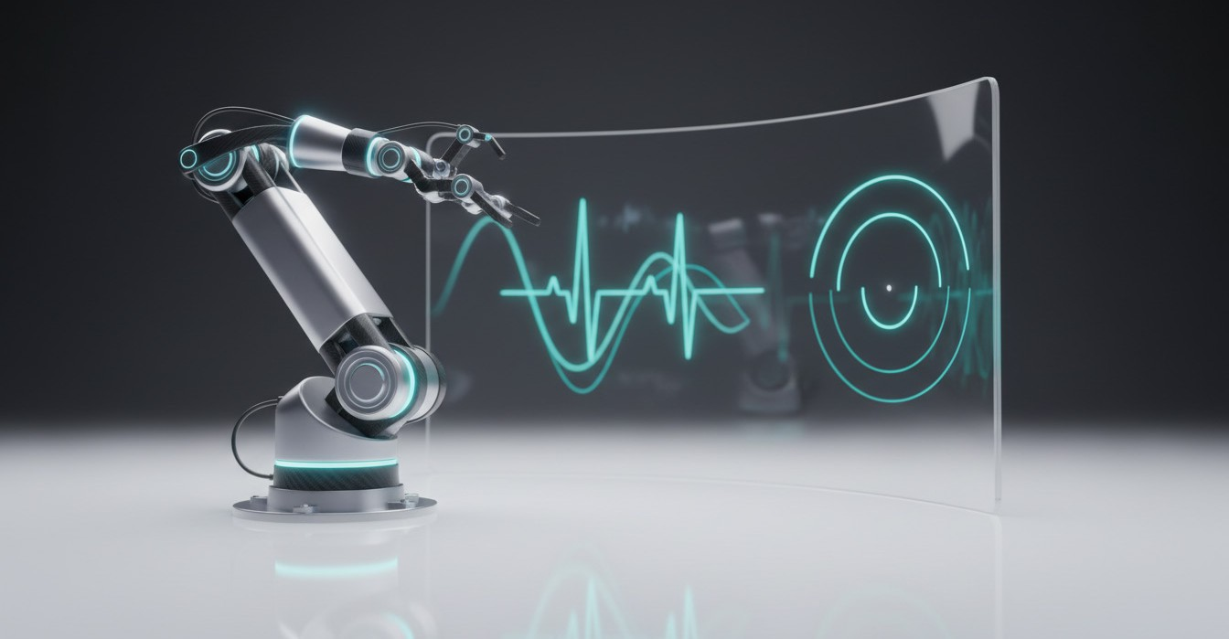
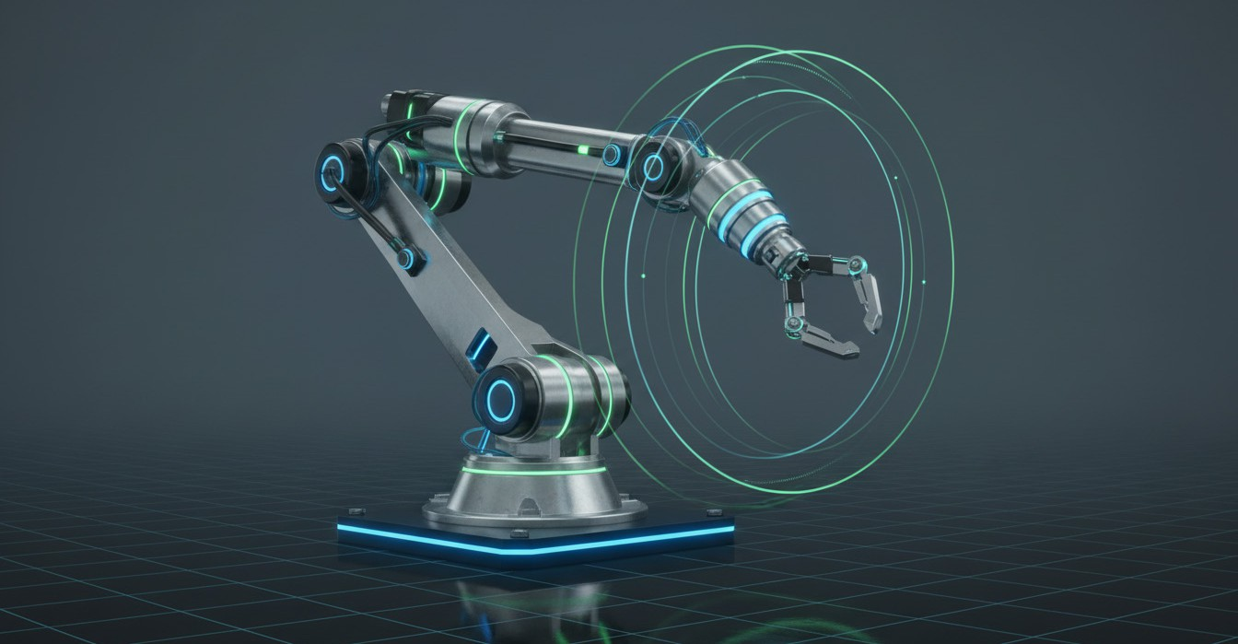

TESTING, DATA, AND RESULTS
20
Outcome & Next Steps
End-to-end system delivered
EEG intent classification is fully linked to UR5e actuation.
ROS/Gazebo provides a complete, repeatable closed-loop demo environment.
Proof of concept validated
Simulation runs reliably, showing clear intent-to-motion behavior.
Confidence gating reduces uncertain commands and stabilizes control.
Next: real-world robustness
Improve performance under non-stationary clinical EEG noise and artifacts.
Retune features and models to better expose subtle ERD patterns.

