Slide 1
PostgreSQL Join Methods

Slide 2
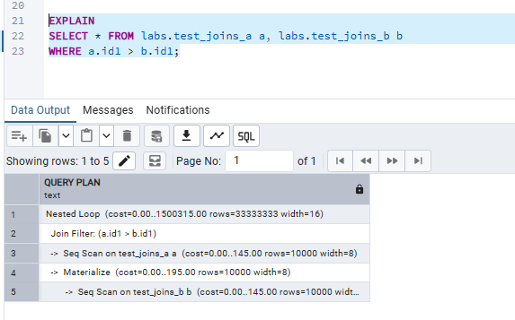
1. JOIN METHODS
1.1. TASK 1: NESTED LOOP JOIN
The optimizer chose a Nested Loop Join because the join is a comparison condition. Nested Loop can handle any join condition by comparing each row of the outer table with each row of the inner table. In contrast, Hash Join is optimized for equality joins, while Merge Join is optimized for equality joins on sorted data. Both Hash Join and Merge Join are generally more efficient for large tables. PostgreSQL uses After scanning test_joins_b, PostgreSQL materializes its rows in memory so they can be reused efficiently during the nested loop instead of scanning the table repeatedly

Slide 3
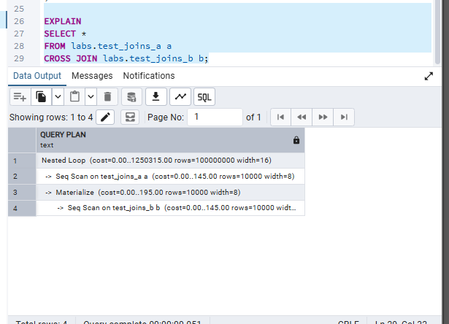
The optimizer chose a Nested Loop Join because a CROSS JOIN produces every possible combination of rows from both tables. This matches the logic of a Nested Loop, which compares each row of one table with every row of the other table.

Slide 4
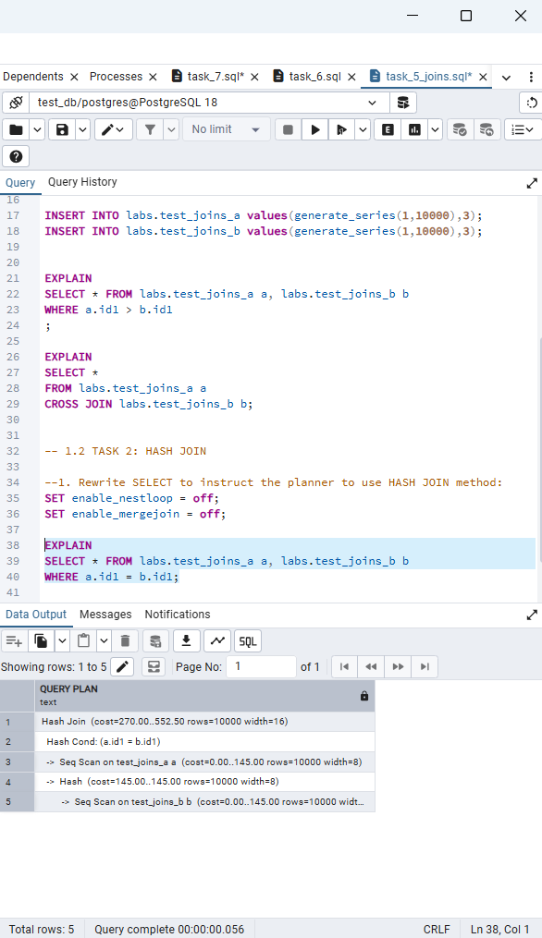
1.2 TASK 2: HASH JOIN
1.2 TASK 2: HASH JOIN
1. Rewrite SELECT to instruct the planner to use HASH JOIN method:
To implement hash join:
I changed WHERE a.id1 > b.id1; to WHERE a.id1 = b.id1; Since Hash Join cannot handle comparison condition.
SET enable_nestloop = off;
SET enable_mergejoin = off;
Here is what happened:
As we can see from screenshot: Hash Join is used.
Sequential scan is used for both tables.
PostgreSQL builds a hash table from labs.test_joins_b instead of materializing it.

Slide 5
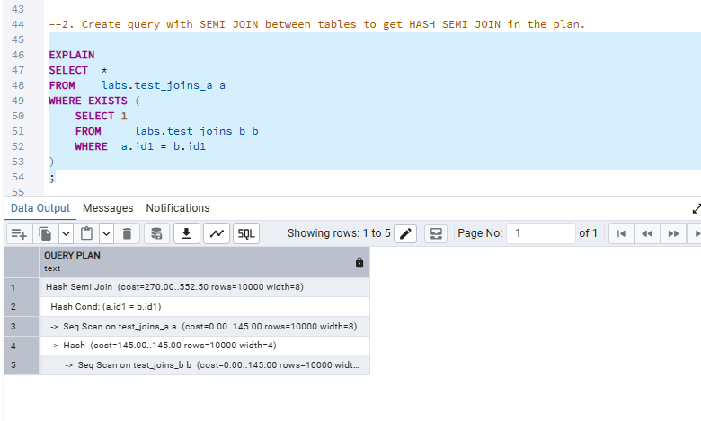
2. Create query with SEMI JOIN between tables to get HASH SEMI JOIN in the plan.
To get Hash Semi join:
SET enable_nestloop = off;
SET enable_mergejoin = off;
Plan description:
Seq Scan on both tables
Creating hash table for labs.test_joins_b
Hash condition
Hash Semi Join checks whether a matching row exists in labs.test_joins_b and returns only the rows from labs.test_joins_a.

Slide 6
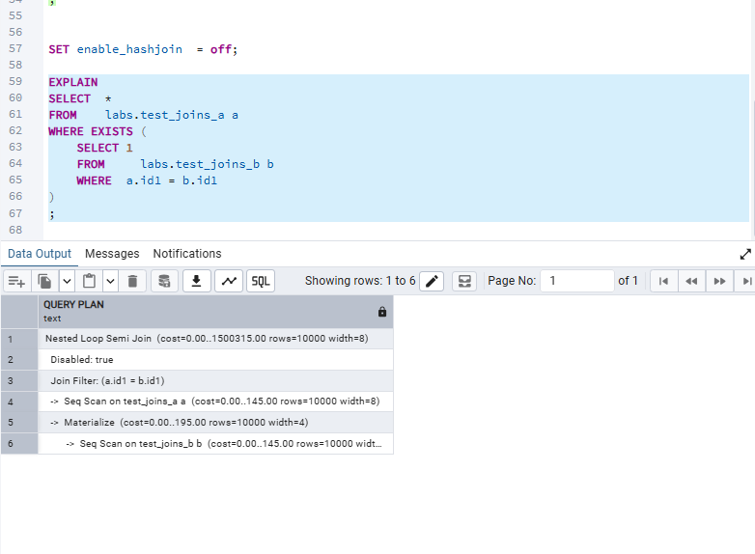
3. Set enable_hashjoin to off and recheck plan. Switch on enable_hashjoin.
After enabling hash join off:
PostgreSQL cannot use a Hash Semi Join because Hash Join is disabled
Instead, it chooses a Nested Loop Semi Join.
Both tables are still read using Sequential Scans.
Instead of building a hash table from labs.test_joins_b, PostgreSQL materializes it in memory so it can be reused during the nested loop without scanning the table repeatedly.
The join is performed using the condition a.id1 = b.id1.

Slide 7
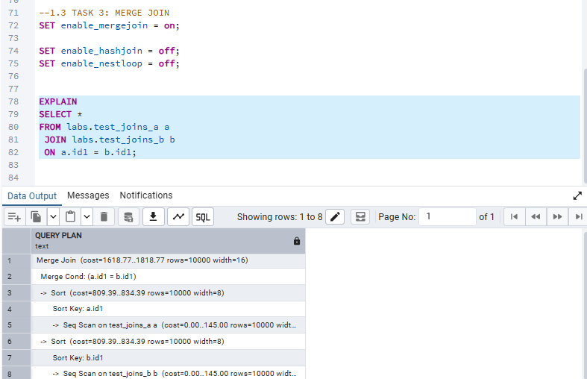
1.3 TASK 3: MERGE JOIN
Used seq scan for both tables,
Columns b.id1 and a.id1 are sorted since for merge join columns must be sorted . And Merge join is used.

Slide 8
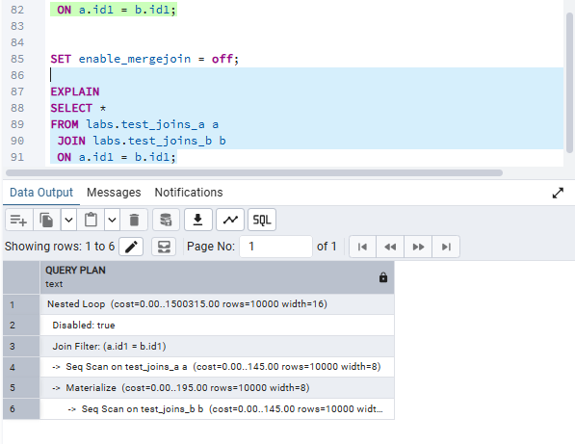
2. Set enable_mergejoin to off and recheck plan. Switch on enable_mergejoin.
After merge join seet off Nested loop join is used

Slide 9
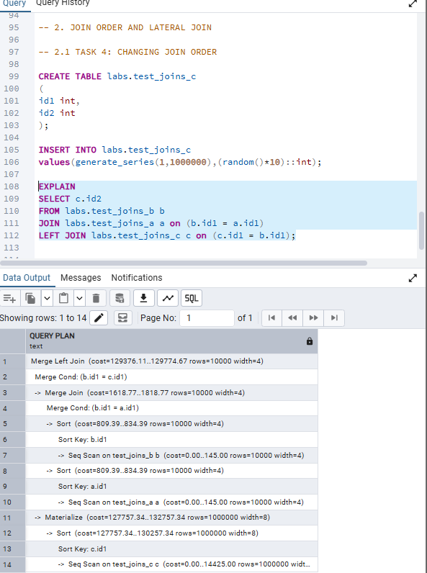
2. Check the plan. Describe the order of tables joining:
PostgreSQL first joins labs.test_joins_b with labs.test_joins_a using a Merge Join. Then it joins the result with labs.test_joins_c using a Merge Left Join.

Slide 10
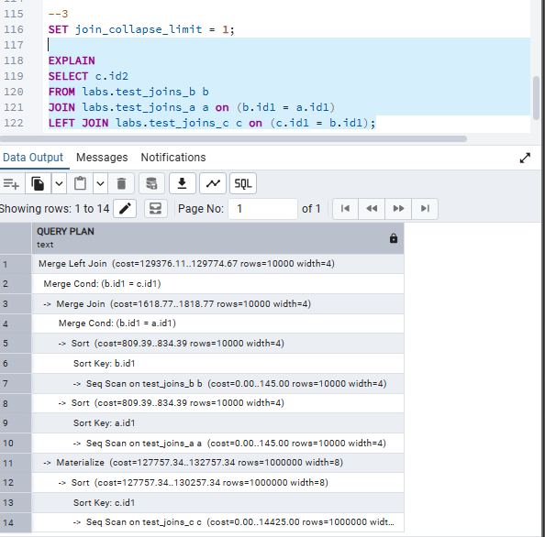
3. Set join_collapse_limit = 1 and recreate plan for query above. Describe changes if any. Return join_collapse_limit = 8.
join_collapse_limit = 1 forces PostgreSQL to follow the join order written in the query instead of reordering the joins. In this case, the execution plan did not change because PostgreSQL was already using the same join order.

