Slide 1
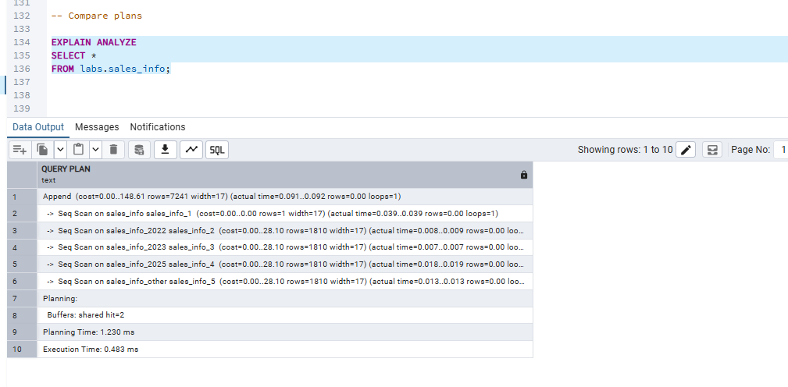
1.1 TASK 1: USE INHERITANCE
PostgreSQL uses an Append node to combine data from all inherited partitions. Because no WHERE condition is specified, a sequential scan is performed on every partition. The query finishes with an execution time of about 0.48 ms.

Slide 2
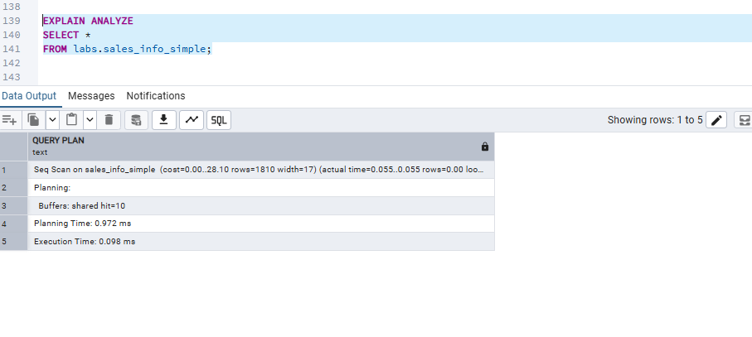
Unlike the partitioned table, sales_info_simple uses a single Sequential Scan because there are no partitions to combine. PostgreSQL reads only one table instead of performing an Append operation over multiple child tables.

Slide 3
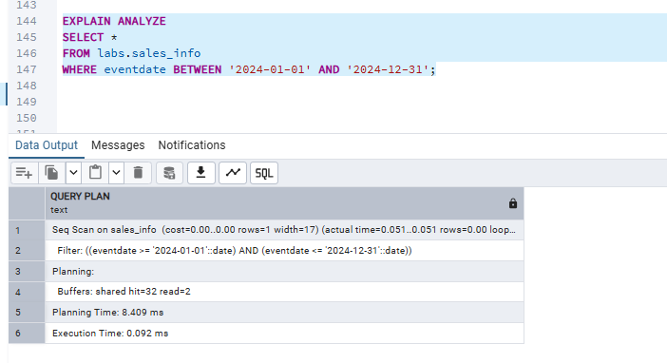
The execution plan shows a Sequential Scan with a date filter. PostgreSQL reads only the partition containing data for the specified date range, demonstrating partition pruning, which improves query performance. The execution time is approximately 0.09 ms.

Slide 4
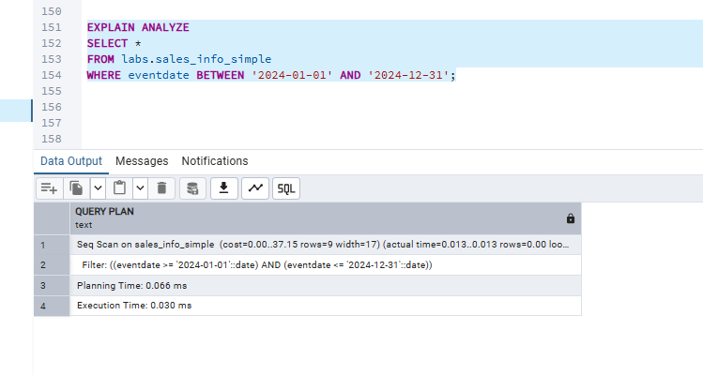
Unlike the partitioned table, sales_info_simple has no partitions, so PostgreSQL performs a Sequential Scan on the entire table and then applies the date filter. No partition pruning is possible because all data is stored in a single table.

Slide 5
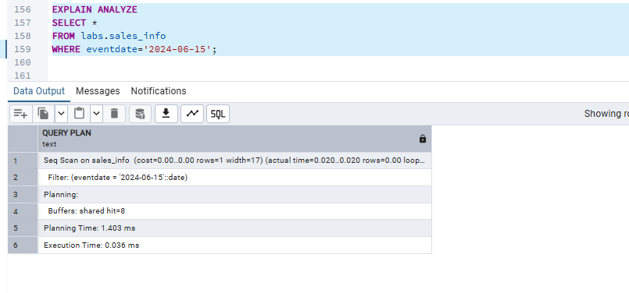
The execution plan shows a Sequential Scan with an exact date filter. PostgreSQL scans only the relevant partition for the specified date, demonstrating partition pruning and reducing unnecessary data scanning. Execution time is about 0.04 ms.

Slide 6
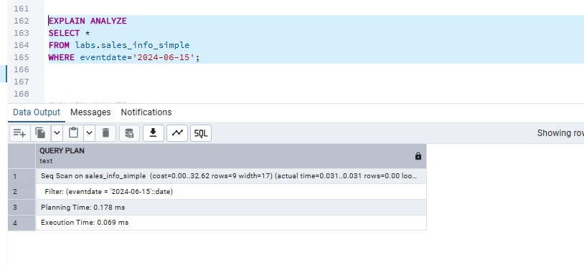
The execution plan shows a Sequential Scan on the non-partitioned table with an exact date filter. Unlike the partitioned table, PostgreSQL cannot use partition pruning, so it searches the whole table before returning the matching rows. The execution time is about 0.07 ms.

Slide 7
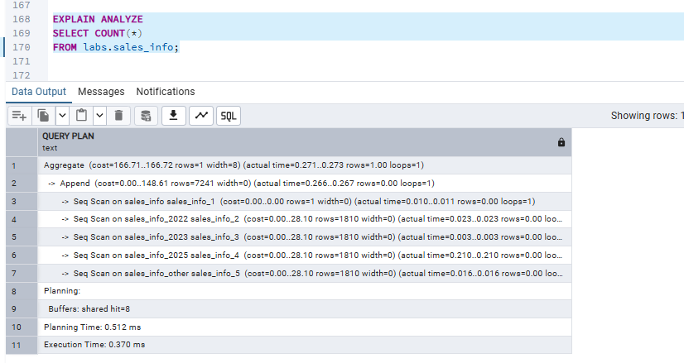
The execution plan uses an Aggregate node to calculate COUNT(*). PostgreSQL scans all partitions using an Append operation because the query counts every row in the partitioned table. The execution time is about 0.37 ms.

Slide 8
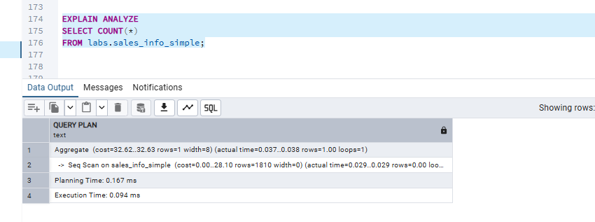
The execution plan uses an Aggregate node to calculate the total row count. Unlike the partitioned table, PostgreSQL scans only the single sales_info_simple table because there are no partitions to combine. The execution time is about 0.09 ms.

Slide 9
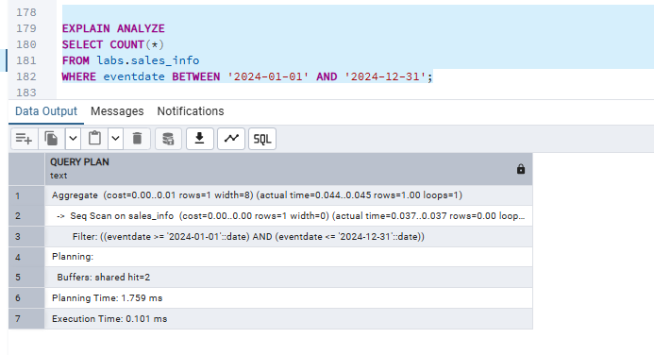
The execution plan shows an Aggregate node with a Sequential Scan and a date filter. PostgreSQL scans only the relevant partition for the specified date range and then calculates the total number of matching rows. The execution time is about 0.10 ms.

Slide 10
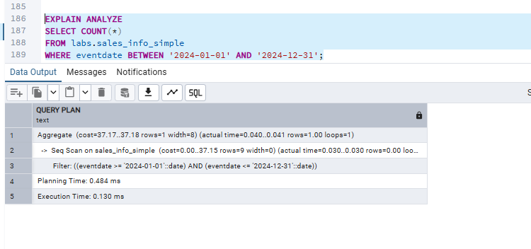
The execution plan shows an Aggregate node with a Sequential Scan on sales_info_simple. Because the table is not partitioned, PostgreSQL scans the whole table and applies the date filter before calculating the count. Unlike the partitioned table, partition pruning is not available, so the entire table must be examined. The execution time is about 0.13 ms.

Slide 11
The comparison shows that both tables return the same results, but their execution plans are different. The partitioned table uses Append and partition pruning, so only the necessary partition is scanned for queries with date conditions. The non-partitioned table always performs a Sequential Scan on the whole table. For COUNT(*) queries, PostgreSQL uses an Aggregate operation in both tables. Overall, partitioning helps improve the performance of queries that filter data by date.

Slide 12
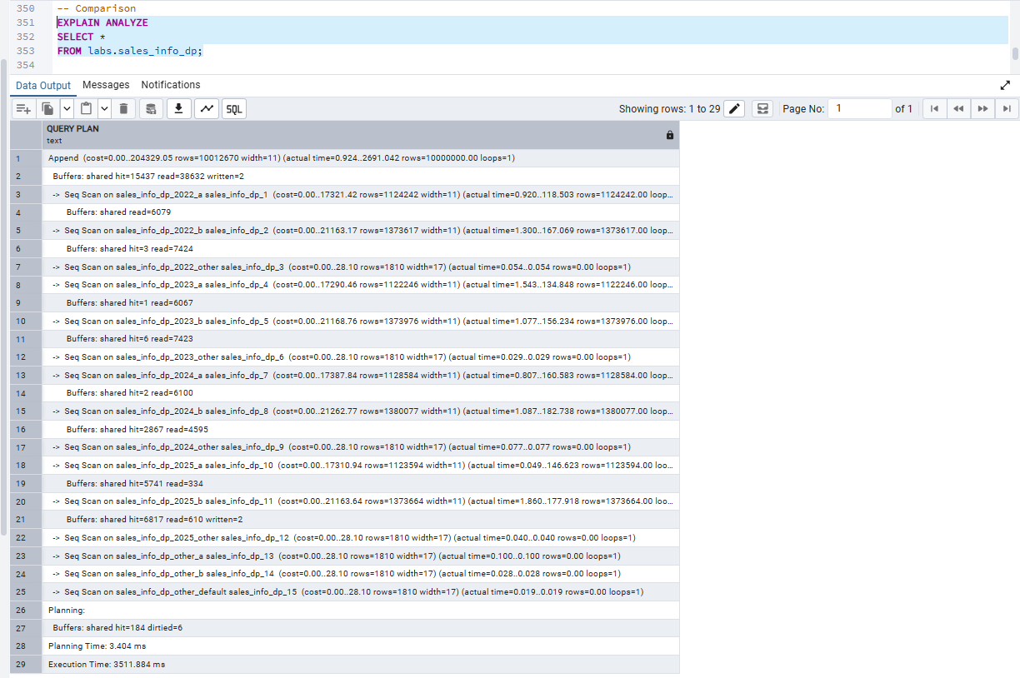
TASK2: USE DECLARATIVE PARTITIONING
The execution plan shows an Append node because the table is partitioned into multiple range and list partitions. As there is no filter, PostgreSQL scans all partitions and combines the results. The execution time is about 3511.88 ms.

Slide 13
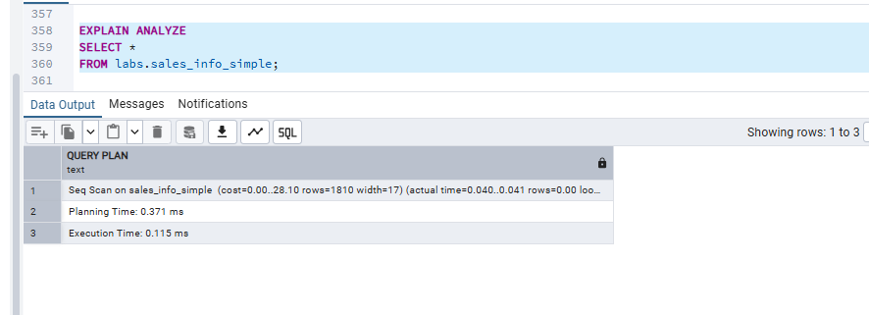
Unlike sales_info_dp, which uses an Append operation to scan multiple partitions, sales_info_simple performs a single Sequential Scan because all data is stored in one table. The execution time is about 0.12 ms.

Slide 14
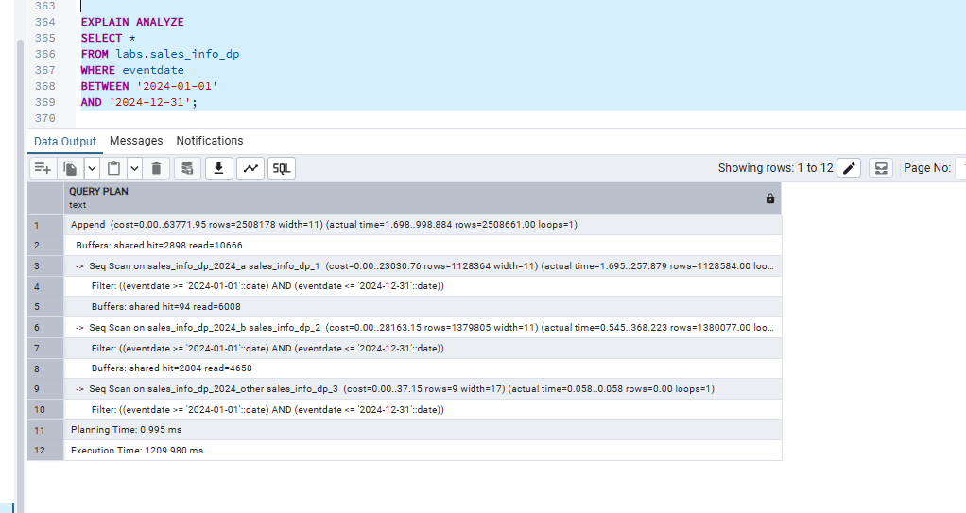
The execution plan shows an Append node with Sequential Scans on the 2024 subpartitions. PostgreSQL uses partition pruning to read only the partitions for the specified date range, improving query performance. The execution time is about 1209.98 ms.

Slide 15
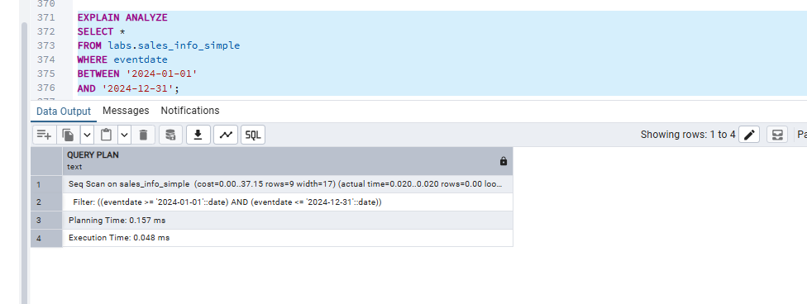
The execution plan shows a Sequential Scan with a date filter. Unlike the partitioned table (sales_info_dp), sales_info_simple cannot use partition pruning, so PostgreSQL scans the entire table before applying the filter. The execution time is about 0.05 ms.

Slide 16
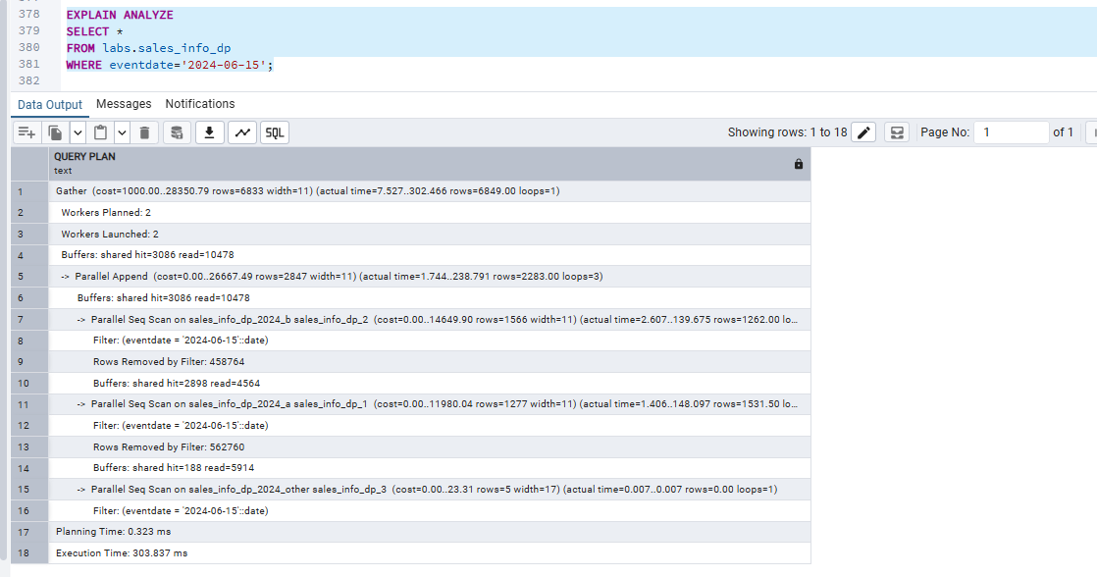
The execution plan shows a Gather node with Parallel Seq Scans. PostgreSQL scans only the 2024 partitions because of the date filter and uses multiple workers to speed up the query. The execution time is about 303.84 ms.

Slide 17
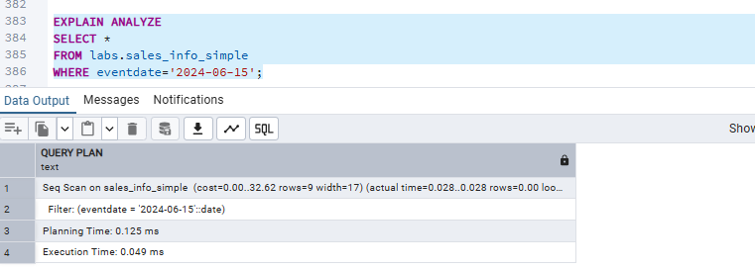
The execution plan shows a Sequential Scan on the sales_info_simple table with an exact date filter. Unlike the partitioned table, PostgreSQL cannot use partition pruning or parallel scanning, so it scans the whole table before applying the filter. The execution time is about 0.05 ms.

Slide 18
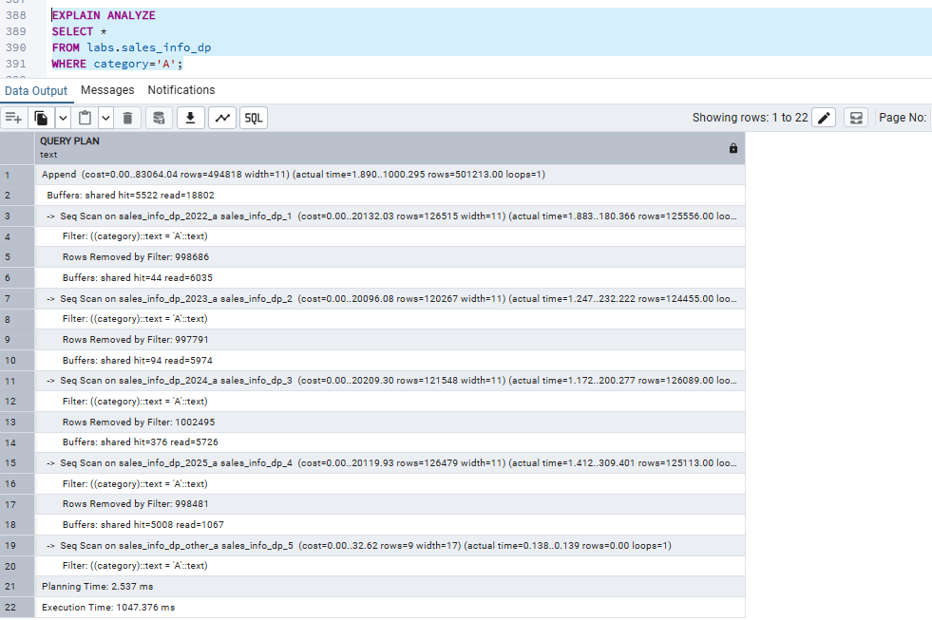
The execution plan shows an Append node with Sequential Scans on the _a list partitions of each year. Because the table is partitioned by category, PostgreSQL scans only the partitions that can contain category 'A', skipping the other category partitions. The execution time is about 1047.38 ms.

Slide 19
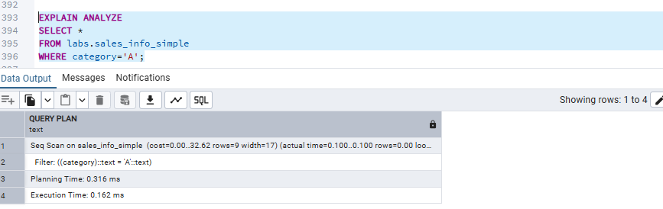
The execution plan shows a Sequential Scan on the sales_info_simple table with the category filter. Unlike the partitioned table (sales_info_dp), PostgreSQL cannot use list partitioning, so it scans the whole table instead of only the relevant category partition. The execution time is about 0.16 ms.

Slide 20
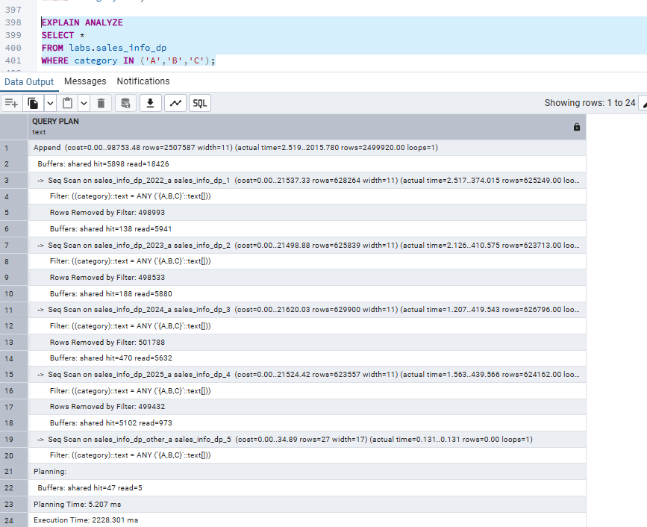
The execution plan shows an Append node with Sequential Scans on the _a list partitions. PostgreSQL scans only the partitions that contain categories A, B, and C, reducing the number of partitions that need to be read. The execution time is about 2228.30 ms.

Slide 21
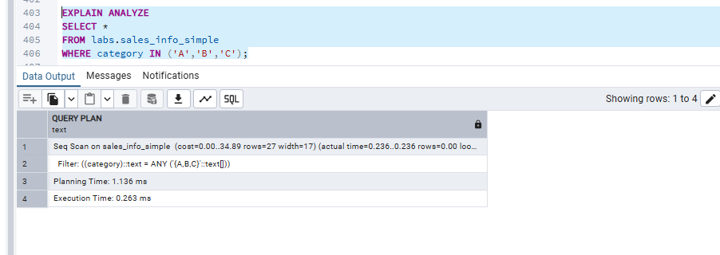
The execution plan shows a Sequential Scan on the sales_info_simple table with the category list filter. Unlike the partitioned table (sales_info_dp), PostgreSQL cannot use list partition pruning, so it scans the whole table before applying the filter. The execution time is about 0.26 ms.

Slide 22
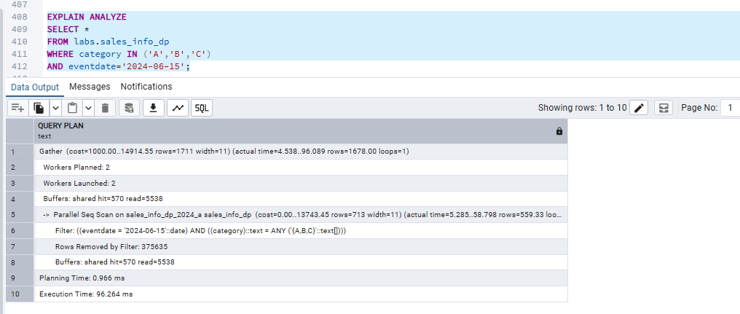
The execution plan shows a Gather node with Parallel Sequential Scans. PostgreSQL scans only the 2024 _a partition because of the date and category filters. This demonstrates range and list partition pruning, making the query more efficient. The execution time is about 96.26 ms.

Slide 23
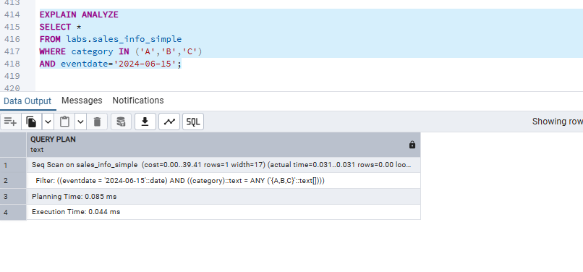
The execution plan shows a Sequential Scan on the sales_info_simple table with both the category and date filters. Unlike the partitioned table (sales_info_dp), PostgreSQL cannot use range or list partition pruning, so it scans the entire table before applying the filters. The execution time is about 0.04 ms.

