Slide 1
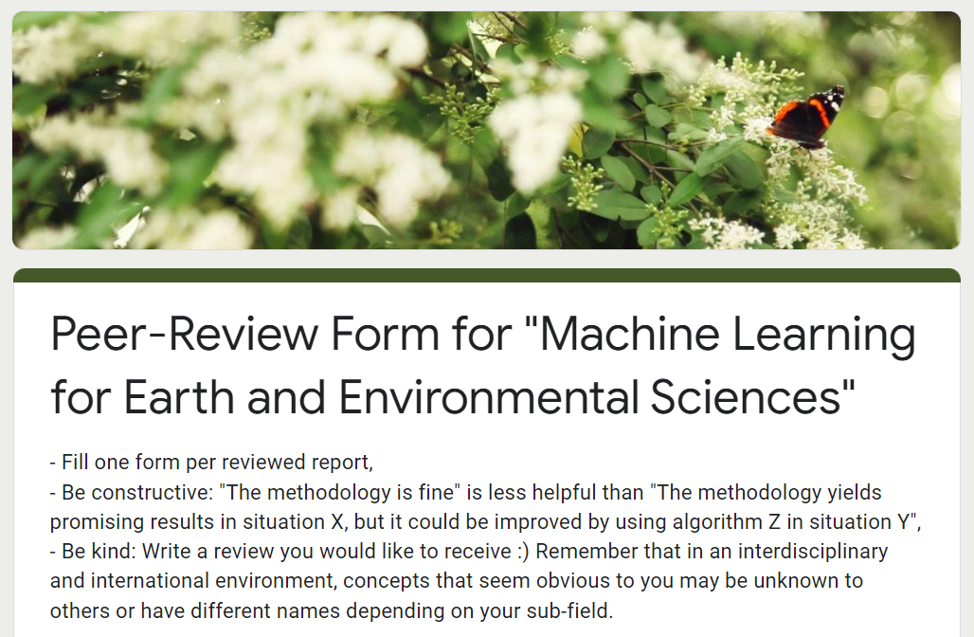
In-Class Peer-Review (Today)
You should have received 3 drafts to review by email
Up to 10% bonus points per peer-review submitted by tonight.
Once submitted, you should automatically receive a copy. You can go back & edit your review if necessary.

Slide 2
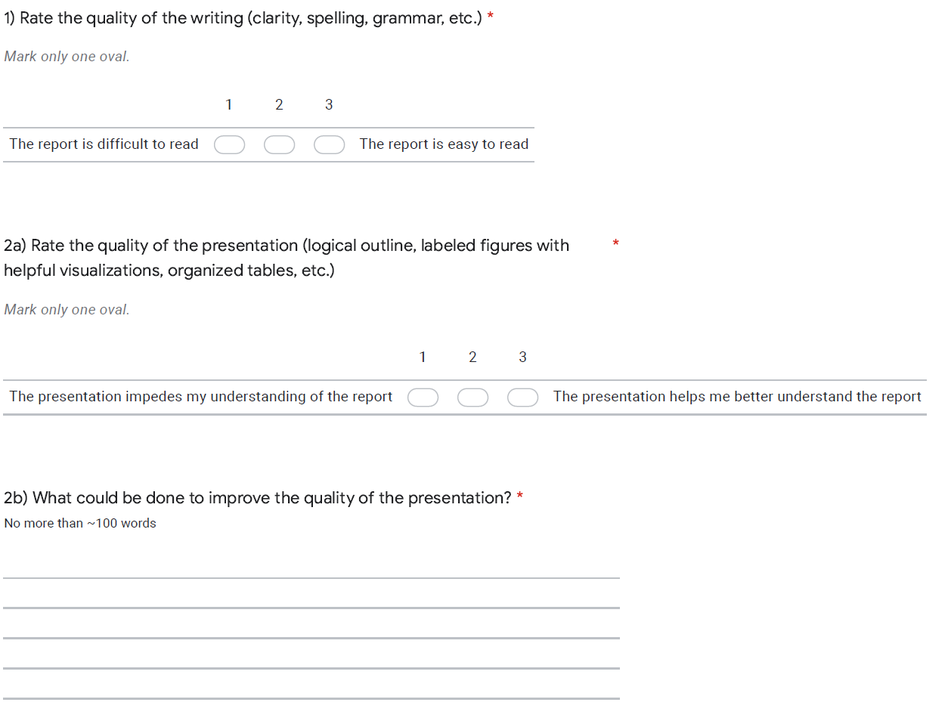
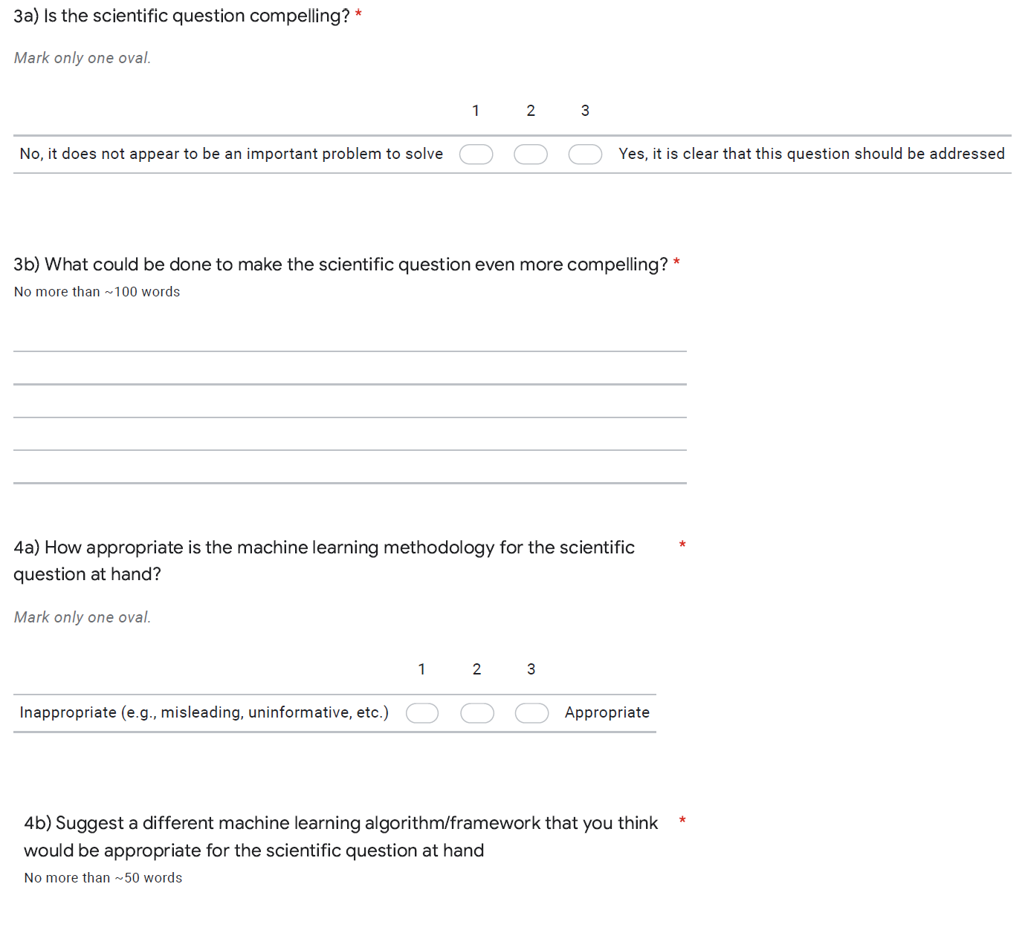
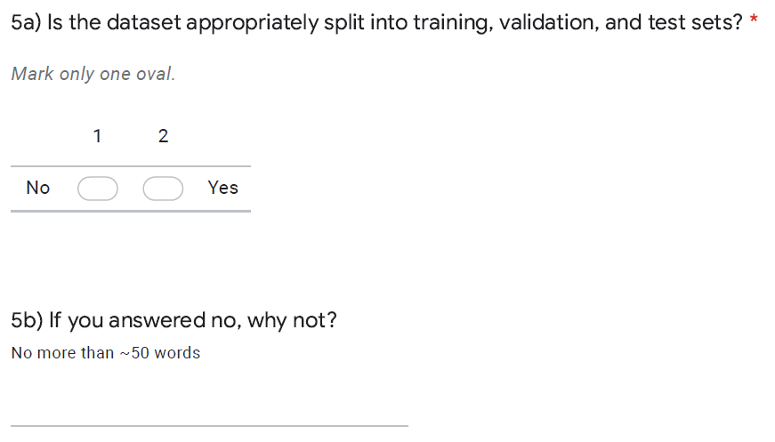

Slide 3
