Slide 1
GraphLink
Parallel Implementation of Graph Algorithms

Slide 2
Motivation
Graph clustering algorithms:
For small graphs, will work fine, but for large graphs - computationally expensive
Have applications in myriad fields like social network analysis, bioinformatics, and machine learning
Parallelization:
Can speed up the execution and improve the performance of these algorithms
Algorithms executed parallely by utilizing GPU

Slide 3
Intro
Implemented a library similar to iGraph library (Open source) with the functionality to execute the graph clustering algorithms parallely
Implemented using C++ as well as Python programming language
Leveraged CUDA for GPU programming. CUDA is a parallel computing platform provided by NVIDIA for general computing on GPUs
CPU vs GPU - few 10 threads can be executed at a time parallely in CPU whereas thousands of threads can be executed parallely at a time on GPU

Slide 4
graphMAZE
A library we implemented that consists of parallel algorithms for graphs by utilizing GPU
With the help of CUDA programming in python, we were able to implement parallel k-means algorithm as well as embedding algorithm through deepwalk
Time complexity of traditional k-means algorithm is O(n*d*k*i) but through parallelization it comes around O(d*k*i)
Embedding algorithm still performs better on CPU since the gensim library implementation performs CPU parallelization very well

Slide 5
Pseudocode
Initialize centroids randomly
Repeat until maximum iterations reached:
a. Assign each data point to the nearest centroid using a CUDA kernel that runs in parallel on the GPU
b. Update the centroids based on the new assignments using another CUDA kernel that runs in parallel on the GPU
c. Copy the updated centroids and cluster assignments from the GPU memory to the CPU memory
d. Set the previous assignments to the new ones and go back to step 2a

Slide 6
Dataset
Nodes: 4039
Edges: 176468
Facebook

Slide 7
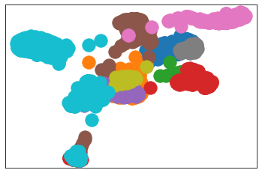
Cluster Visualization - Facebook dataset

Slide 8
30x
With the help of gpu capable of running 1024 threads in parallel, we achieved 30 times better speed efficiency on average

Slide 9
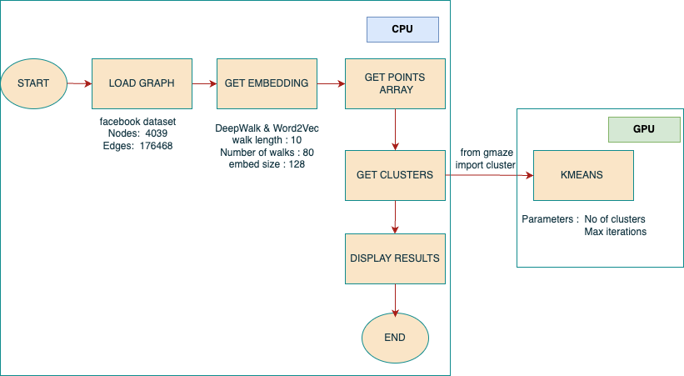
Implementation Details

Slide 10
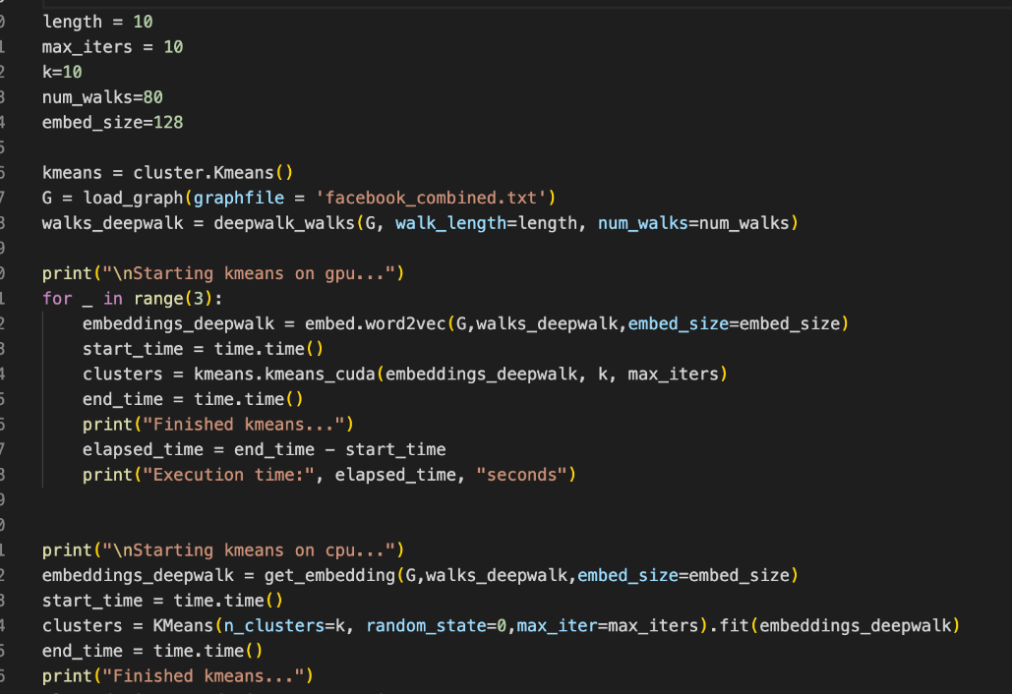
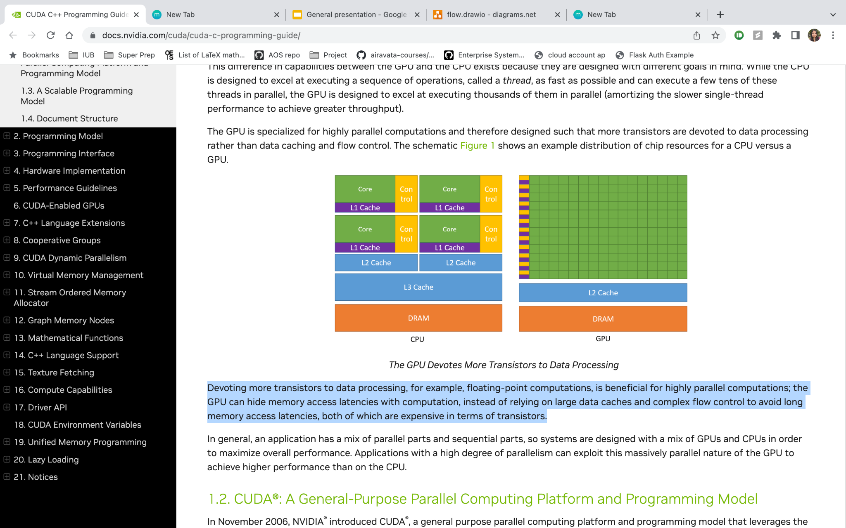
Behind the scenes : CPU vs GPU
Traditional Kmeans :
clusters = KMeans(n_clusters=k, random_state=0,max_iter=max_iters).fit(embeddings_deepwalk)
Parallelized Kmeans from our gmaze library :
from gmaze import cluster
kmeans = cluster.Kmeans()
clusters = kmeans.kmeans_cuda(embeddings_deepwalk, k, max_iters)
GPU : More memory is devoted to data processing rather than caching unlike in CPU

Slide 11
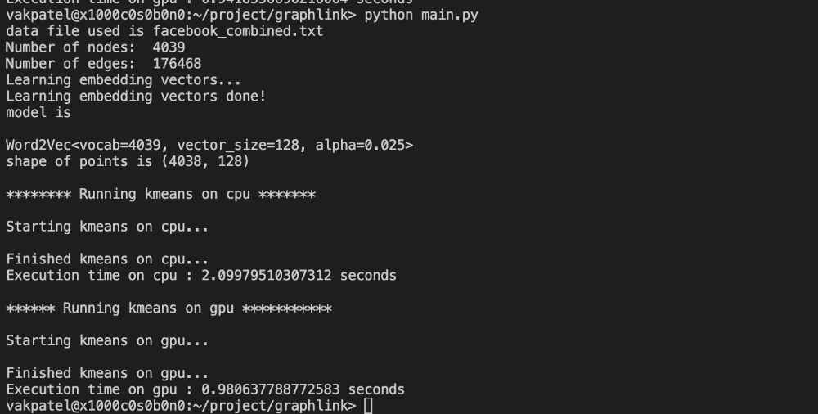
Output :
Significant difference in execution time of
running kmeans on CPU and GPU
with number of clusters : 99 , max iterations : 10

Slide 12
Why use our library
The main advantage of making use of our parallel implementation of kmeans algorithm on GPU is that on an average it provides comparable results to that of the traditional kmeans algorithm but at significantly higher speeds on average.
To get an idea about the speed difference between the traditional kmeans approach and our parallel implementation of kmeans algorithm on GPU we did some performance comparison tests on different kmeans parameters for the facebook dataset. We got the following results

Slide 13
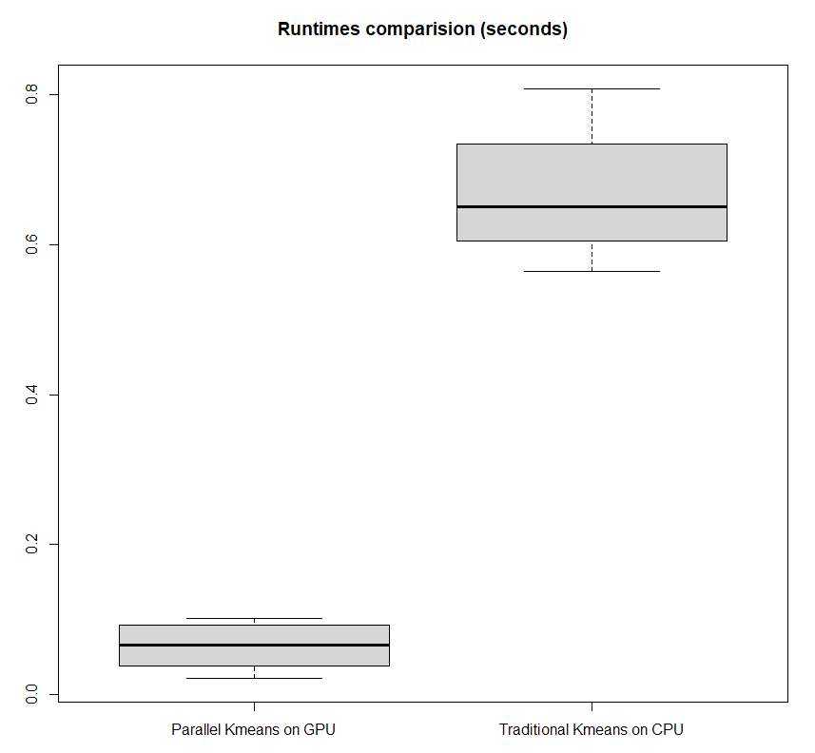
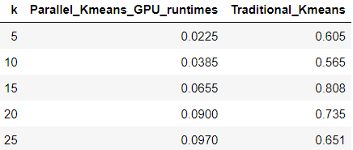
Performance Comparison - K
We tried executing the kmeans algorithm and the parallel kmeans algorithm for different k values of 5,10,15,20,25 on the facebook graph dataset and we got the following running times for these values. The average runtimes for different k values are

Slide 14
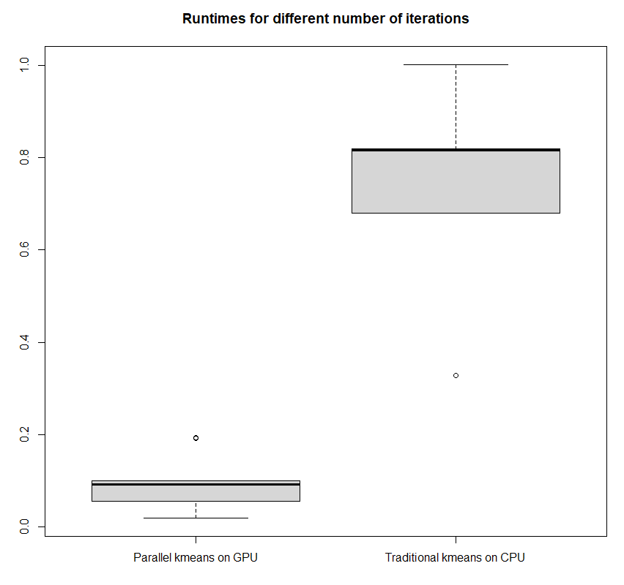
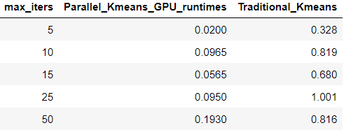
Performance Comparison - MAX ITERATIONS
We tested the kmeans algorithm and the parallel kmeans algorithm for different maximum iteration values of 5,10,15,25,50 on the facebook graph dataset and we got the following running times for these values. The average runtimes for different maximum iteration values are

Slide 15
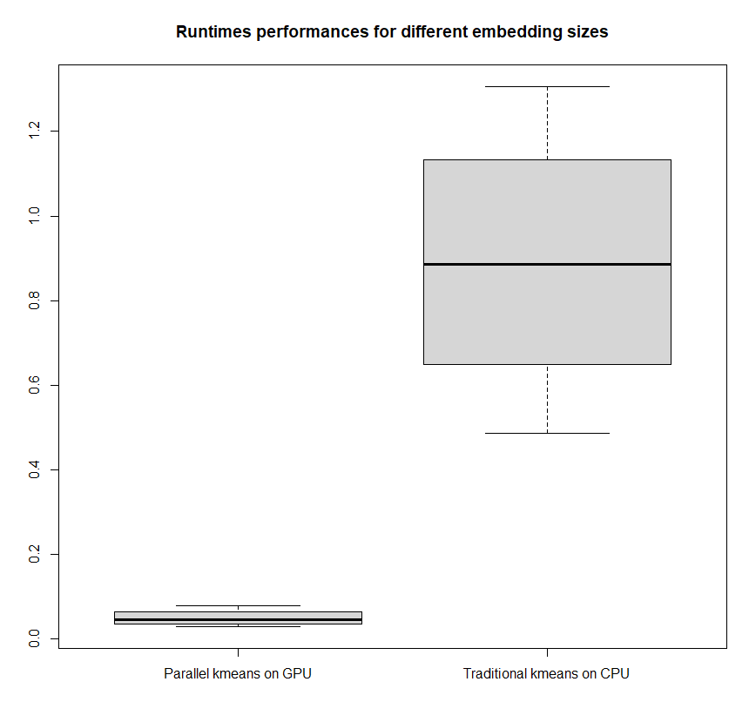
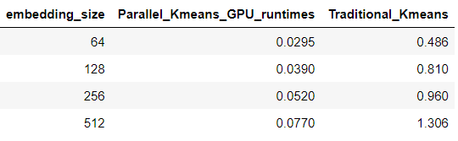
Performance Comparison - EMBEDDING SIZE
We tested the kmeans algorithm and the parallel kmeans algorithm for different embedding size values of 64,128,256,512 on the facebook graph dataset and we got the following running times for these values. The average runtimes for different embedding size values are:

Slide 16
Applications
The algorithm which has been developed can have many applications for example it can be used in big data analysis when dealing with massive datasets, parallel k-means clustering can reduce computation time and improve scalability.
Clustering gene expression data or identifying protein families based on sequence similarity
Parallel k-means clustering can be used to cluster users based on their behavior or interests, enabling personalized recommendations or targeted advertising. In our use case we tested out our parallel kmeans with facebook data in order to perform clustering.

Slide 17
Thank You !
You can install the wheel package from - https://github.iu.edu/manaagra/graphlink/blob/master/graphmaze/dist/gmaze-0.1.0-py3-none-any.whl

