Slide 1
Data Loading
-Diksha Garg

Slide 2
Accessing CMS Data
Using SQL server management studio, logged in using following information:
Server name: sdtqjk71tc.database.windows.net,1433
Login: BDR
Password: P@ssw0rd

Slide 3
For CMS data access, my system’s IP-address was added by Deepa.
Using the data available, following query is used to retrieve information:
Select top 10 * from DE1_0_2008_to_2010_Carrier_Claims_Sample_2A

Slide 4
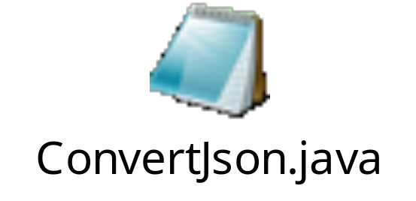
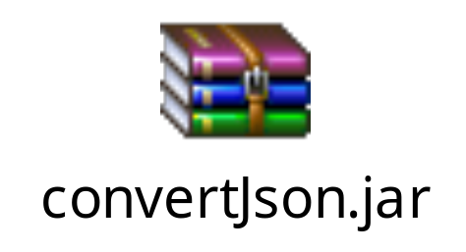
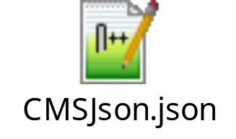
Java code for JSON
The data from SQL was converted in to json using following code.
The CMSJson.json file having the output and Kafka setup is transferred to VM provided using WinSCP.

Slide 5

Using Kafka
With reference to kafka documentation, installed kafka on VM, following steps were followed:

Slide 6
Using following script, convertJson.jar output is send to kafka queue:
Producer:
bin/kafka-console-producer.sh --broker-list localhost:9092 --topic test < CMSJson.json
Consumer:
bin/kafka-console-consumer.sh --zookeeper localhost:2181 --topic test --from-beginning
The JSON output is displayed.

Slide 7
End of Assignment.

