Slide 1
Chapter 3
What Do Samples Tell Us?
Lecture Slides

Slide 2
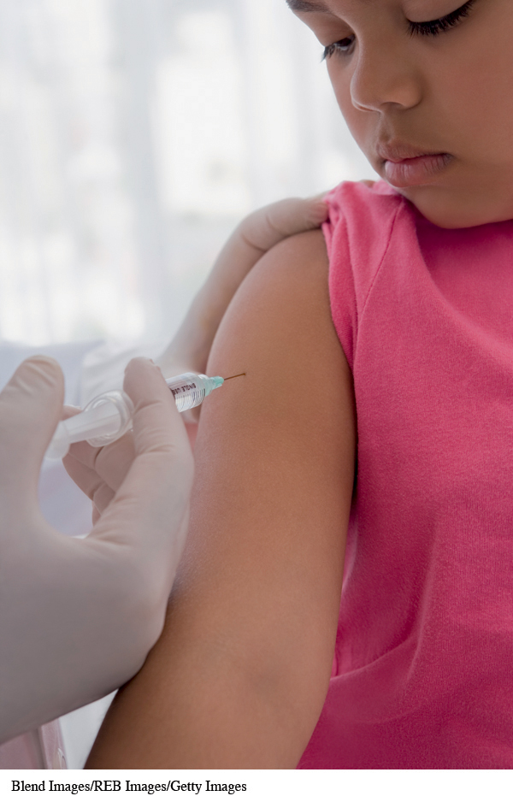
Case Study
According to the Centers for Disease Control and Prevention (CDC), there were 173 cases of measles reported between June 1 and May 29, 2015.
About 87% of the cases were related to 5 outbreaks during the same time period.

Slide 3
Case Study
The CDC also reported that the “United States experienced a record number of measles cases during 2014, with 668 cases from 27 states reported to CDC’s National Center for Immunization and Respiratory Diseases (NCIRD).”

Slide 4
Case Study
This is the greatest number of cases since measles elimination was documented in the United States in 2000.
According to the same report by the CDC, “the majority of people who got measles were unvaccinated.”
Vaccinating children against diseases like measles is controversial.

Slide 5
Case Study
A Gallup poll conducted February 28–March 1, 2015, asked the following question:
“How important is it that parents get their children vaccinated—extremely important, very important, somewhat important, or not at all important?”
They found that 54% of respondents said, “extremely important” (down from 64% who responded to a similar Gallup Poll in 2001).
Can we trust this conclusion?

Slide 6
Case Study
Reading further, we find that Gallup talked with 1015 randomly selected adults to reach these conclusions.
The U.S. Census Bureau said that there were about 258 million adults in the United States in 2013.
How can 1015 people tell us about the opinions of 258 million people?
Is the 54% who feel that it is extremely important, in fact, the majority of Americans who feel this way? By the end of this chapter you will learn the answers to these questions.

Slide 7
Parameters and Statistics
A parameter is a number that describes the
population.
A parameter is a fixed number, but in practice we don’t know its value.
A statistic is a number that describes the sample.
The value of a statistic is known when we have taken a sample, but it can change from sample to sample.
We often use a statistic to estimate an unknown parameter.

Slide 8
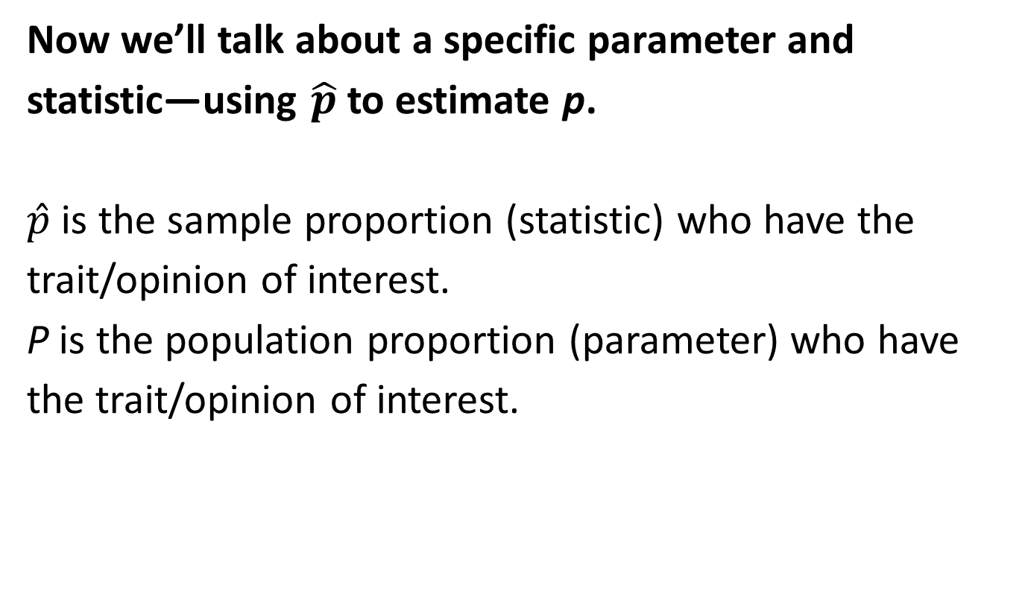
Proportions
Now we’ll talk about a specific parameter and statistic—using $\hat{p}$ to estimate p.
$\hat{p}$ is the sample proportion (statistic) who have the trait/opinion of interest.
P is the population proportion (parameter) who have the trait/opinion of interest.

Slide 9
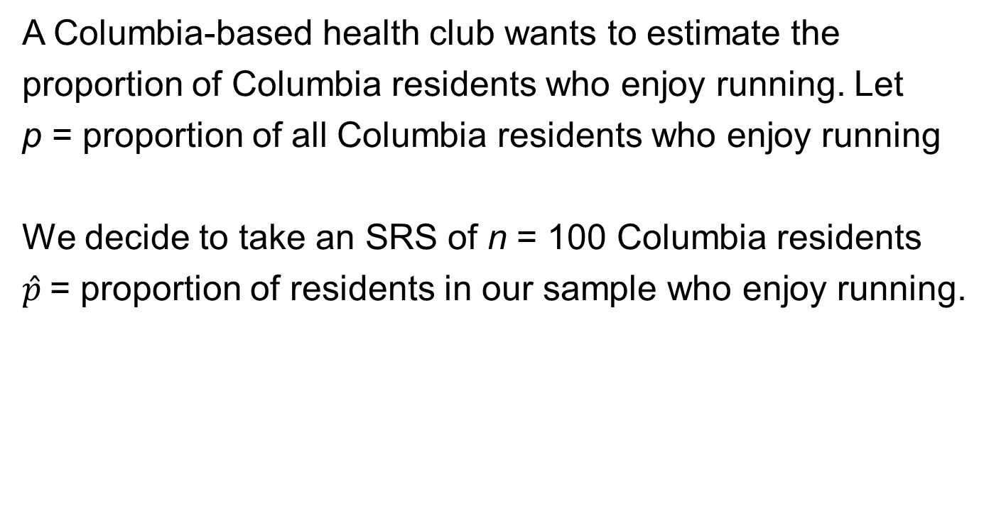
Proportions
A Columbia-based health club wants to estimate the
proportion of Columbia residents who enjoy running. Let
p = proportion of all Columbia residents who enjoy running
We decide to take an SRS of n = 100 Columbia residents
$\hat{p}$= proportion of residents in our sample who enjoy running.

Slide 10
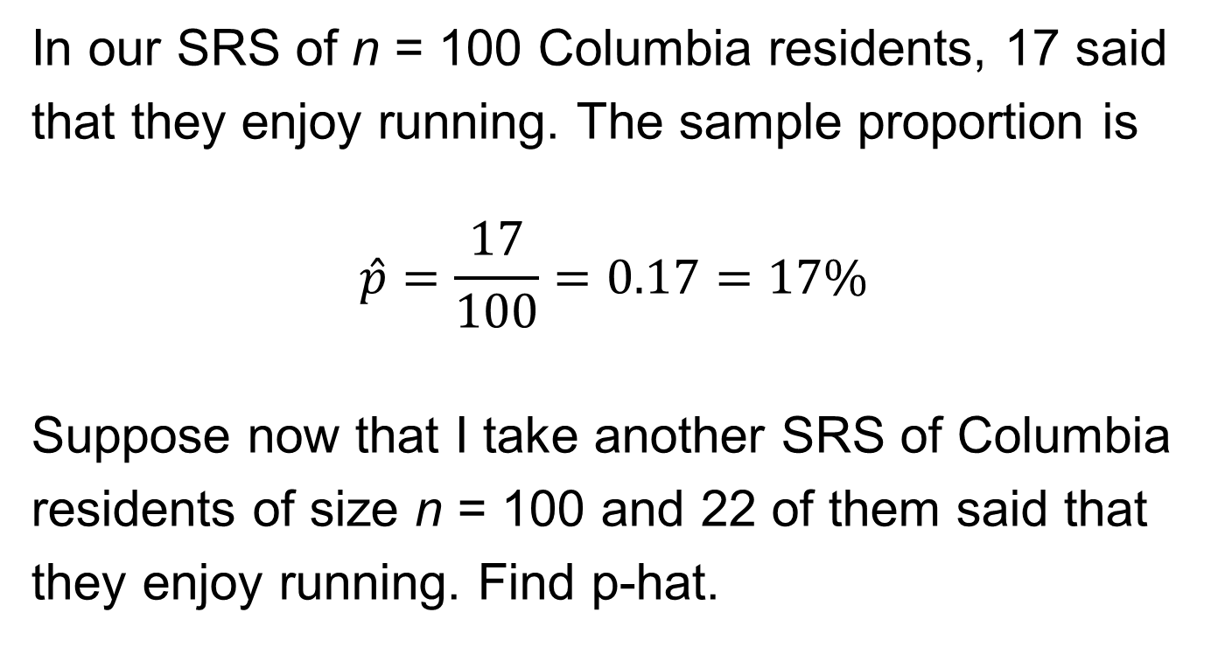
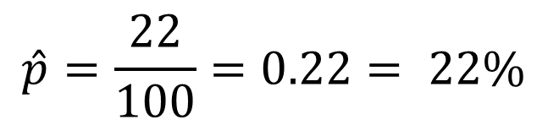
Proportions
In our SRS of n = 100 Columbia residents, 17 said
that they enjoy running. The sample proportion is
$$\hat{p}=\frac{17}{100}=0.17=17\%$$
Suppose now that I take another SRS of Columbia
residents of size n = 100 and 22 of them said that
they enjoy running. Find p-hat.
$$\hat{p}=\frac{22}{100}=0.22= 22\%$$

Slide 11
Sampling Variability
Notice that we have two samples from the same population and our sample proportions are different from each other.
Question: Are statistics from the different samples (but drawn from the same population) going to be exactly the same? No!
Question: Is our statistic, calculated from any one sample, going to exactly match the population parameter it is attempting to estimate? No!

Slide 12
Sampling Variability
The fact that our statistics will not be the same from sample to sample is called sampling variability (because all samples are going to be a little different from each other).
We hope that as long as we have a good sampling scheme, we will be estimating the population parameter fairly well when we take our one shot at estimating it.

Slide 13
Bias and Variability
Bias is consistent, repeated deviation of the
statistic from the parameter in the same
direction when we take many samples.
Variability describes how spread out the
values of the statistic are when we take many
samples.
Large variability means the result of
sampling is not repeatable. A good sampling
method has small bias and small variability.

Slide 14
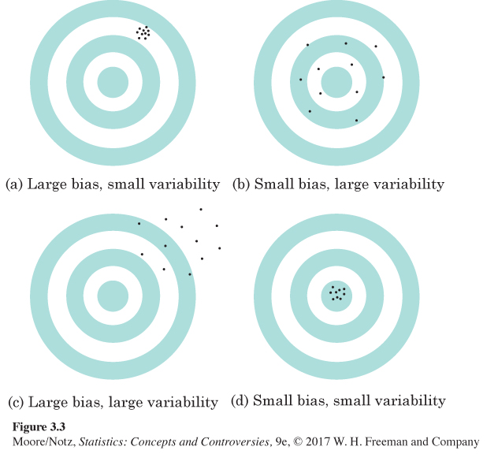
Bias and Variability

Slide 15
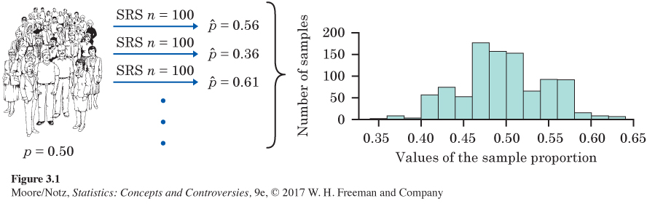
Variability of p-hat
1000 of size n = 100

Slide 16
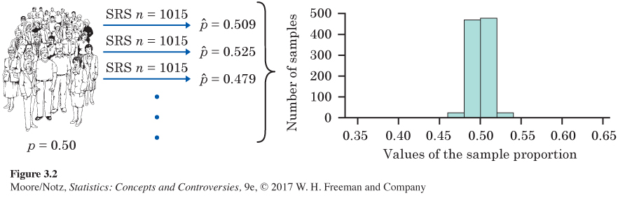
Variability of p-hat
1000 of size n = 1015
Notice that with larger samples (1015 vs. 100), there is a lot less variability, but the distribution is still centered at p = 0.50 (so p-hat is unbiased for p).

Slide 17
Reducing Bias and Variability
To reduce bias, use random sampling.
To reduce variability of your statistic when
sampling with a SRS, use a larger sample. You
can make the variability as small as you want by
taking a large enough sample.
Large random samples almost always give an
estimate that is close to the truth (population
parameter).

Slide 18
Example
Pewinternet.org, on November 30, 2012, in the report The Best (and Worst) of Mobile Connectivity, stated that 85% ± 2.4% of American adults own a cell phone.
Where does the plus or minus 2.4% come from?
This is called margin of error (MOE).

Slide 19
Margin of Error
The margin of error (MOE) is a value that
quantifies the uncertainty in our estimate.
When using the sample proportion to estimate the
population proportion, the MOE is a measure of
how close we believe the sample proportion is to
the population proportion.
We usually report this through a confidence
interval. (More on this coming soon.)

Slide 20
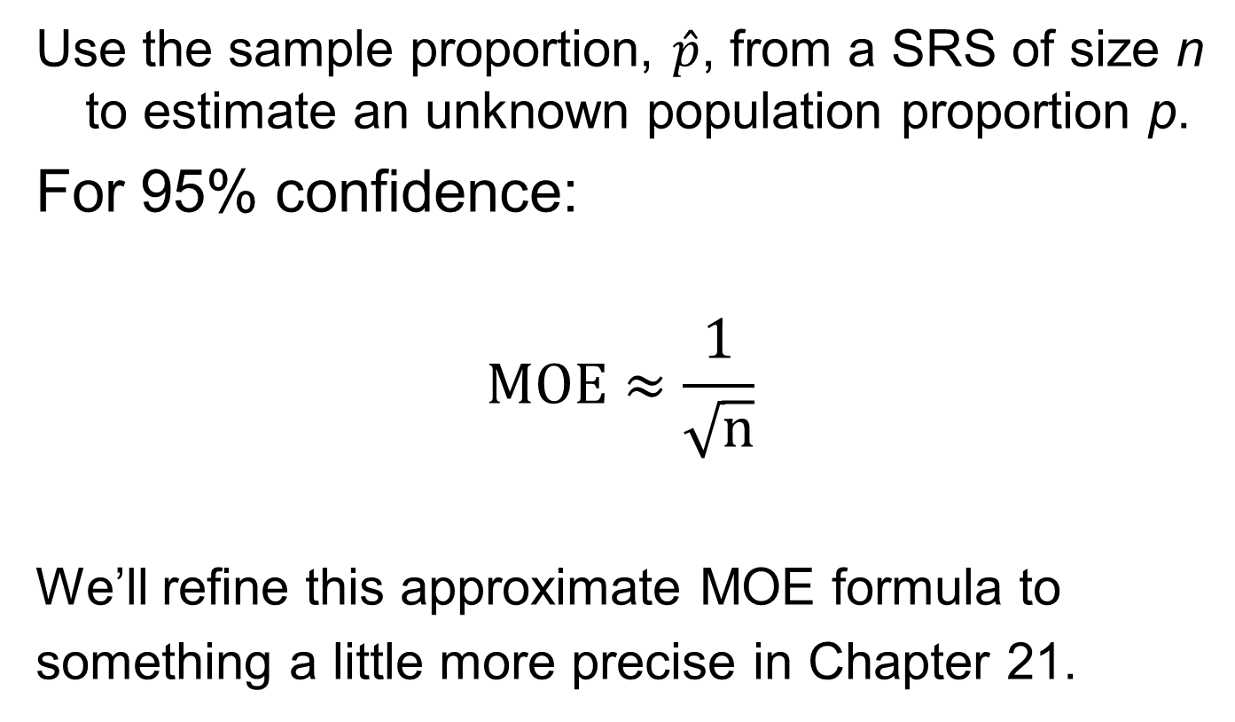
Calculating Margin of Error
Use the sample proportion, $\hat{p}$, from a SRS of size n to estimate an unknown population proportion p.
For 95% confidence:
$$MOE≈\frac{1}{\sqrt{n}}$$
We’ll refine this approximate MOE formula to
something a little more precise in Chapter 21.

Slide 21
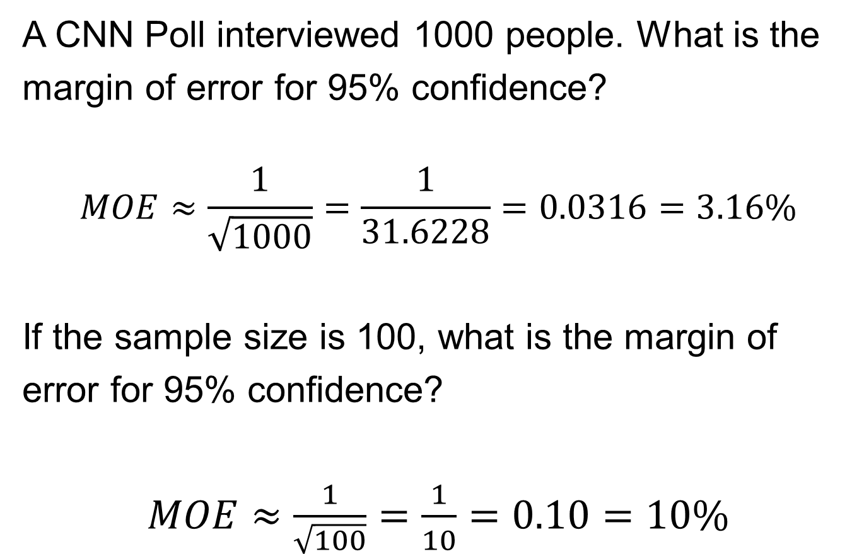
Example: Margin of Error
A CNN Poll interviewed 1000 people. What is the
margin of error for 95% confidence?
$$MOE≈\frac{1}{\sqrt{1000}}=\frac{1}{31.6228}=0.0316=3.16\%$$
If the sample size is 100, what is the margin of
error for 95% confidence?
$MOE≈\frac{1}{\sqrt{100}}=\frac{1}{10}=0.10=10\%$

Slide 22
MOE: What Is It?
“Margin of error plus or minus 4 percentage points” is shorthand for this statement:
If we took many samples using the same method we used to get this one sample, 95% of the samples would give a result within plus or minus 4 percentage points of the truth about the population.

Slide 23
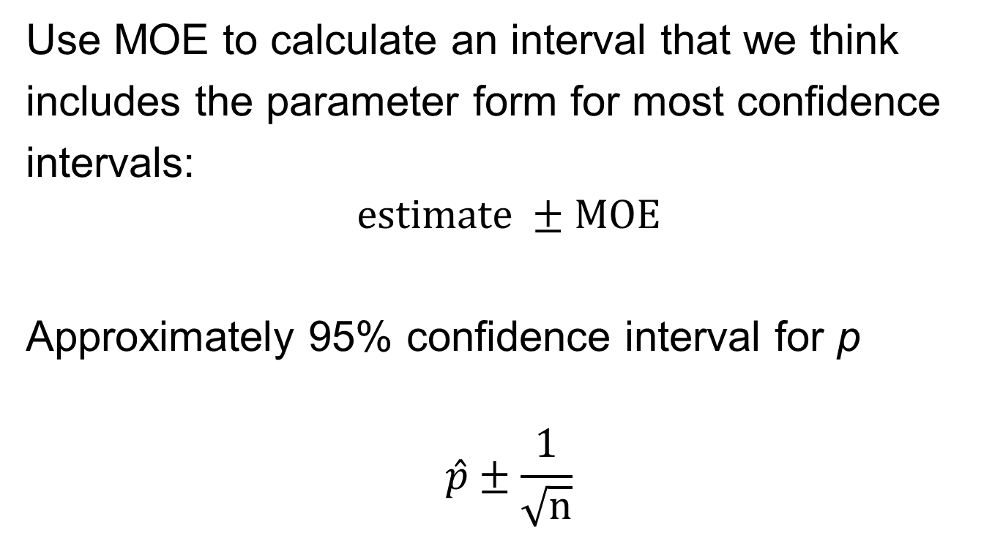
Confidence Interval
Use MOE to calculate an interval that we think
includes the parameter form for most confidence
intervals:
$$estimate ±MOE$$
Approximately 95% confidence interval for p
$$\hat{p}±\frac{1}{\sqrt{n}}$$

Slide 24
Confidence Statements
A confidence statement interprets a confidence
interval and has two parts: a margin of error and
a level of confidence.
Margin of error says how close the statistic lies to
the parameter.
Level of confidence says what percentage of all
possible samples results in a confidence interval,
which contains the true parameter.

Slide 25
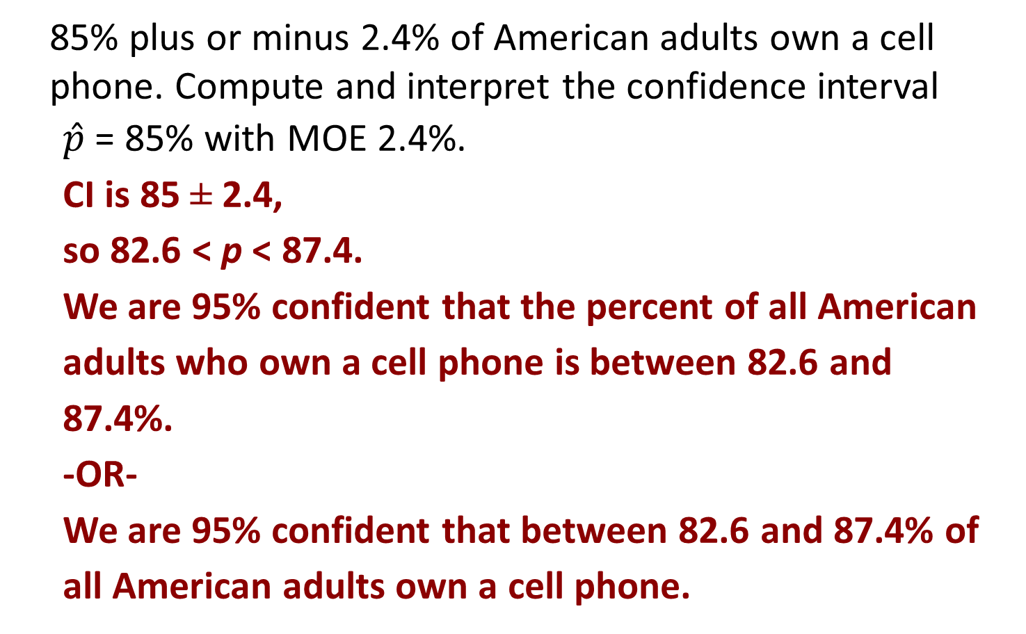
Example (cont’d)
85% plus or minus 2.4% of American adults own a cell phone. Compute and interpret the confidence interval
$\hat{p}$ = 85% with MOE 2.4%.
CI is 85 ± 2.4,
so 82.6 < p < 87.4.
We are 95% confident that the percent of all American adults who own a cell phone is between 82.6 and 87.4%.
-OR-
We are 95% confident that between 82.6 and 87.4% of all American adults own a cell phone.

Slide 26
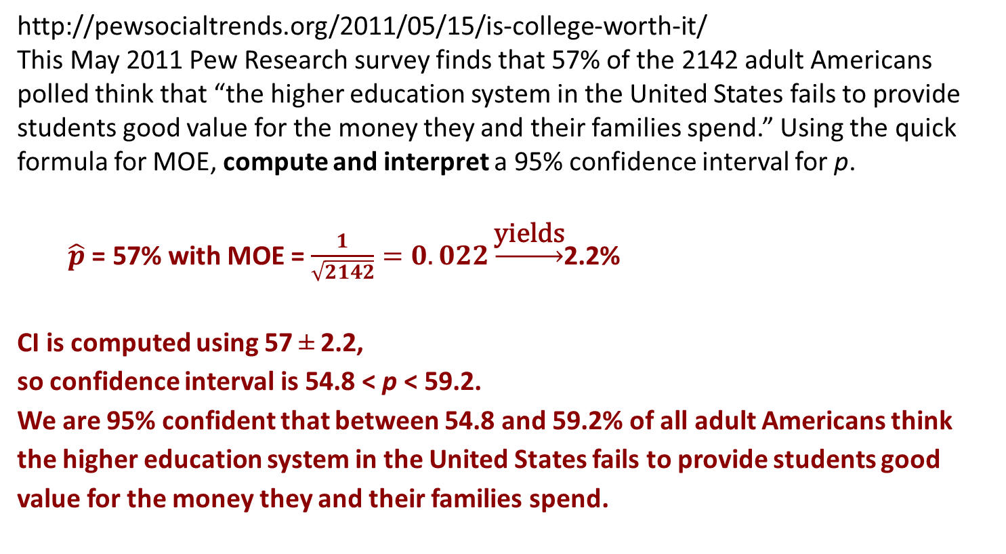
Example
http://pewsocialtrends.org/2011/05/15/is-college-worth-it/
This May 2011 Pew Research survey finds that 57% of the 2142 adult Americans polled think that “the higher education system in the United States fails to provide students good value for the money they and their families spend.” Using the quick formula for MOE, compute and interpret a 95% confidence interval for p.
$\hat{p}$ = 57% with MOE = $\frac{1}{\sqrt{2142}}=0.022\underset{→}{\text{yields}}$2.2%
CI is computed using 57 ± 2.2,
so confidence interval is 54.8 < p < 59.2.
We are 95% confident that between 54.8 and 59.2% of all adult Americans think the higher education system in the United States fails to provide students good value for the money they and their families spend.

Slide 27
Population Size Doesn’t Matter
The variability of a statistic from a SRS does not
depend on the size of the population as long as
the population is at least 100 times larger than the
sample.
Suppose we take a sample of size 2527 from a
population of 300,000. Then we take a sample of
2527 from a population of 1,000,000. Which
sample statistic has more variability?
Neither. Population size does not affect
variability of the statistic.

Slide 28
Statistics in Summary
The purpose of sampling is to use a sample to gain
information about a population. We often use a
sample statistic to estimate the value of a population
parameter.
One big idea: to describe how trustworthy a sample
is, ask, “What would happen if we took a large
number of samples from the same population?” If
almost all samples would give a result close to the
truth, we can trust our one sample even though we
can’t be certain that it is close to the truth.

Slide 29
Statistics in Summary
In planning a sample survey, first aim for small bias
by using random sampling and avoiding bad
sampling methods such as voluntary response. Next,
choose a large enough random sample to reduce the
variability of the result. Using a large random
sample guarantees that almost all samples will give
accurate results.

Slide 30
Statistics in Summary
To say how accurate our conclusions about the
population are, make a confidence statement.
News reports often mention only the margin of error.
Most often this margin of error is for 95%
confidence. That is, if we chose many samples, the
truth about the population would be within the margin
of error 95% of the time.

Slide 31
Statistics in Summary
We can roughly approximate the margin of error for
95% confidence based on a simple random sample
of size n by the formula 1/√n. As this formula
suggests, only the size of the sample, not the size of
the population, matters. This is true as long as the
population is much larger (at least 20 times larger)
than the sample.

