Slide 1
Chapter 10
Graphs, Good and Bad
Lecture Slides

Slide 2
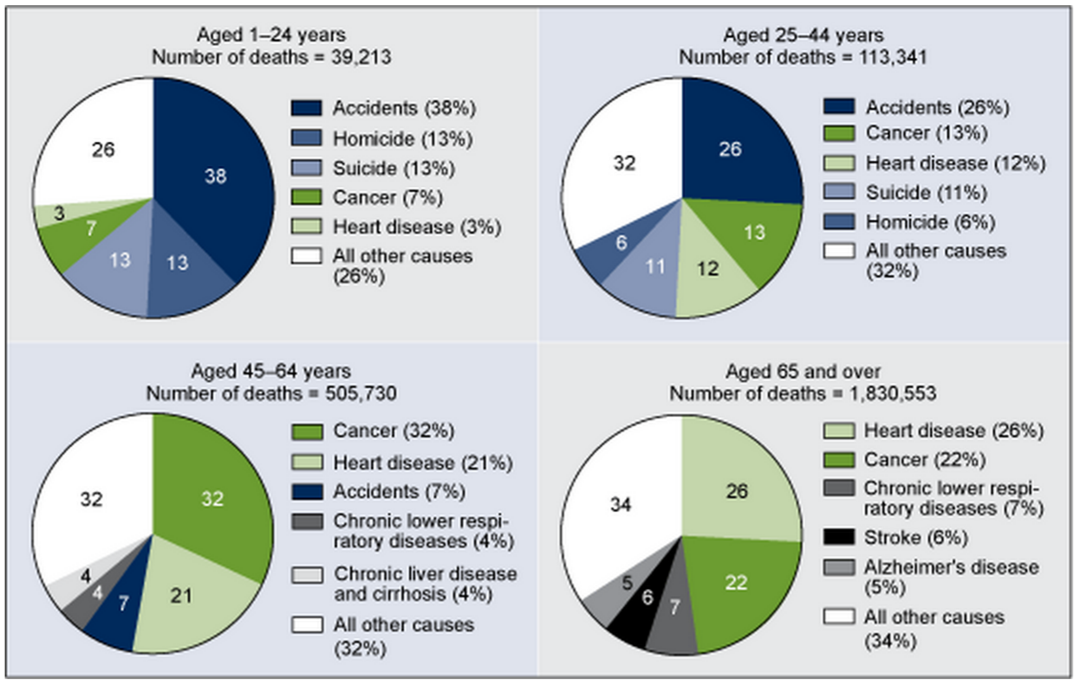
Case Study
In its March 2013 brief, “Death in the United States, 2011,” the National Center for Health Statistics (NCHS) produced the following figure:

Slide 3
Case Study
A clear graphical display can make it easy for policy and decision makers to decide how to allocate resources for prevention or intervention.
A quick glance at the pie chart for ages 1–24 shows that a large portion, 13% of deaths in that age range, are attributed to suicide.
A clear display of this staggering number makes a strong argument for allocation of resources.

Slide 4
Case Study
Tables and graphs help us see what the data say.
Not all tables and graphs do so accurately or clearly.
In this chapter you will learn some basic methods for displaying data and how to assess the quality of the graphics you see in the media.
By the end of the chapter you will be able to determine whether the side-by-side pie charts make a good or a bad graphic.

Slide 5
Types of Variables
When we think about graphs, it is helpful to distinguish between variables that place individuals into categories (such as gender, occupation, or education level) and those whose values have a meaningful numerical scale (such as height in centimeters or SAT scores).
A categorical variable places an individual into one of several groups or categories.
A quantitative variable takes numerical values for which arithmetic operations such as adding and averaging make sense.

Slide 6
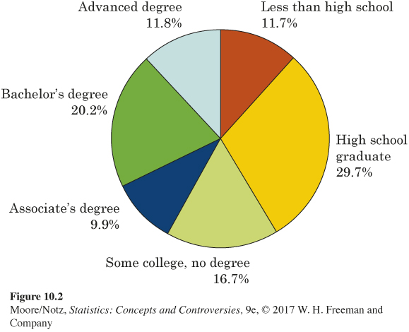
Pie Charts and Bar Graphs
“Level of education” is a categorical variable. There are six possible values of the variable from our previous example.
To picture this distribution in a graph, we might use a pie chart.

Slide 7
Pie Charts and Bar Graphs
Pie charts show how a whole is divided into parts.
To make a pie chart, draw a circle. The circle represents the whole.
Pie charts force us to see that the parts do make a whole. However, it is much easier for our eyes to compare the heights of the bars on a bar graph than it is to compare the size of angles on a pie chart.

Slide 8
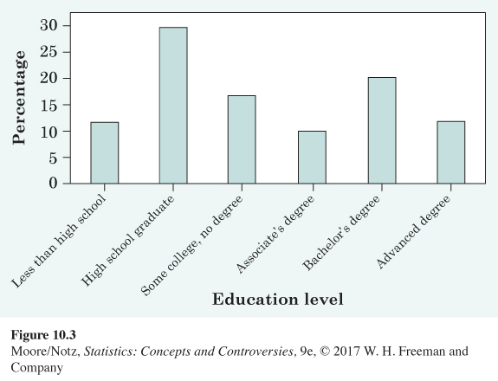
Pie Charts and Bar Graphs
The figure below is a bar graph of the same “education level” data.

Slide 9
Pie Charts and Bar Graphs
A bar graph displays a single number representing each category.
The height of each bar will represent that number.
On a bar graph, each bar has the same width. This is always the case with a bar graph. Also, there is a space between the bars.
The bars on a bar graph can be vertical or horizontal.
Bar graphs are better for making comparisons of the sizes of categories.

Slide 10
Pie Charts and Bar Graphs
Pie charts and bar graphs can both show the distribution (either counts or percentages) of a categorical variable such as level of education.
A pie chart usually displays the percentage for each category (rather than the count) and only works if you have all the categories (the percentages add to 100).
A bar graph can display an entire distribution or only a few categories. A bar graph can also compare the size of categories that are not parts of one whole. If you have one number to represent each category, you can use a bar graph.

Slide 11
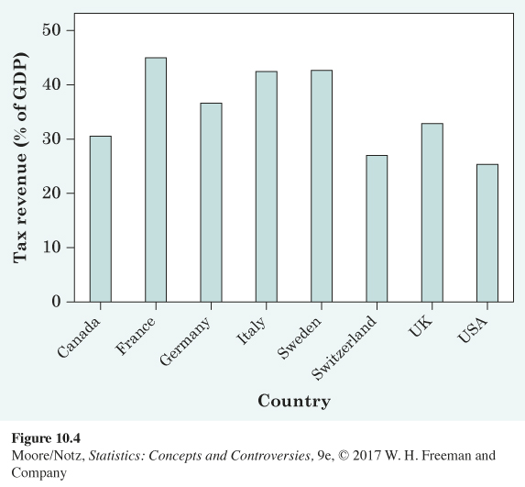
Example
Level of taxation in eight democratic nations by gross domestic product that is taken in taxes.
Notice that a pie chart is not possible for these data since we are displaying eight separate quantities, not the parts of a whole.

Slide 12
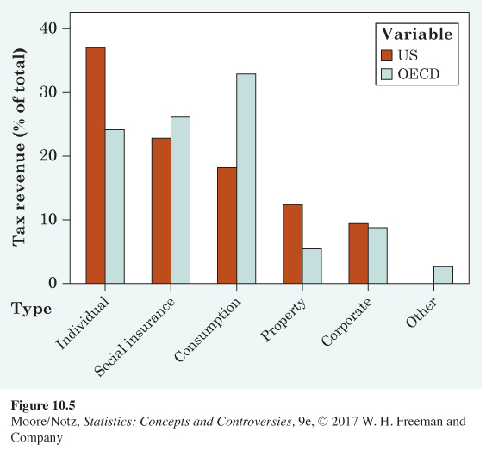
Example
A side-by-side bar graph is useful for making comparisons. It is now clear that the USA relies more heavily on individual income tax, while the other countries rely more heavily on consumption taxes.
Organization for Economic Cooperation and Development (OECD).

Slide 13
Change over Time: Line Graphs
Many quantitative variables are measured at intervals over time.
To display how a quantitative variable changes over time, make a line graph.
A line graph of a quantitative variable plots each observation against the time at which it was measured.
Always put time on the horizontal scale of your plot and the variable you are measuring on the vertical scale. Connect the data points by lines to display the change over time.

Slide 14
Change over Time: Line Graphs
When constructing a line graph, make sure to use equally spaced time intervals on the horizontal axis to avoid distortion.
Line graphs can also be used to show how a quantitative variable changes over time, broken down according to some other categorical variable.
When displaying several categories, use a separate line for each category.

Slide 15
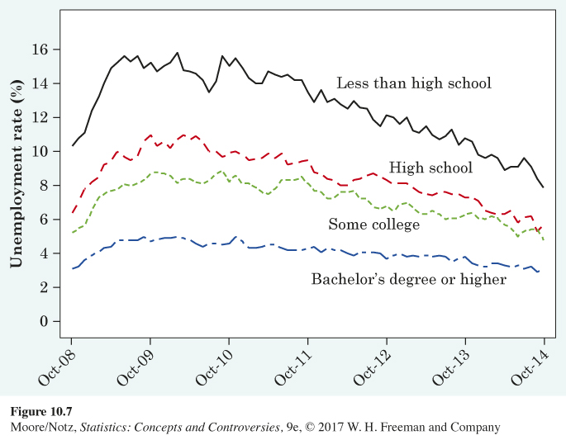
Example
How has unemployment changed over time?

Slide 16
Change over Time: Line Graphs
How should we describe patterns on a line graph?
First, look for an overall pattern. For example, a trend is a long-term upward or downward movement over time.
From the previous example, unemployment was at its highest for all education groups in 2009 and 2010, due to the Great Recession. Since then, the overall trend is showing a decrease in the unemployment rate for all education levels (each line is generally decreasing).

Slide 17
Change over Time: Line Graphs
Next, look for striking deviations from the overall pattern.
From the previous example, there is a noticeable increase from 2008 to the beginning of 2009. This was a side effect of the recession economy. Unemployment hovered around these record highs through 2010, when the rates finally started their decline to the current levels. There is a striking deviation (a drastic dip) in the unemployment rate for those with less than a high school degree around mid-2010.

Slide 18
Change over Time: Line Graphs
A pattern that repeats itself at known regular intervals of time is called seasonal variation.
Calculating the unemployment rate depends on the size of the workforce and the number of those in the workforce who are working. The unemployment rate rises every year in January as holiday sales jobs end and outdoor work slows in the North due to winter weather. This is regular and predictable. As such, the Bureau of Labor Statistics makes seasonal adjustments to the monthly unemployment rate before reporting it to the general public.

Slide 19
Watch Those Scales!
Because graphs speak so strongly, they can mislead the unwary.
The careful reader of a line graph looks closely at the scales marked off on the axes.

Slide 20
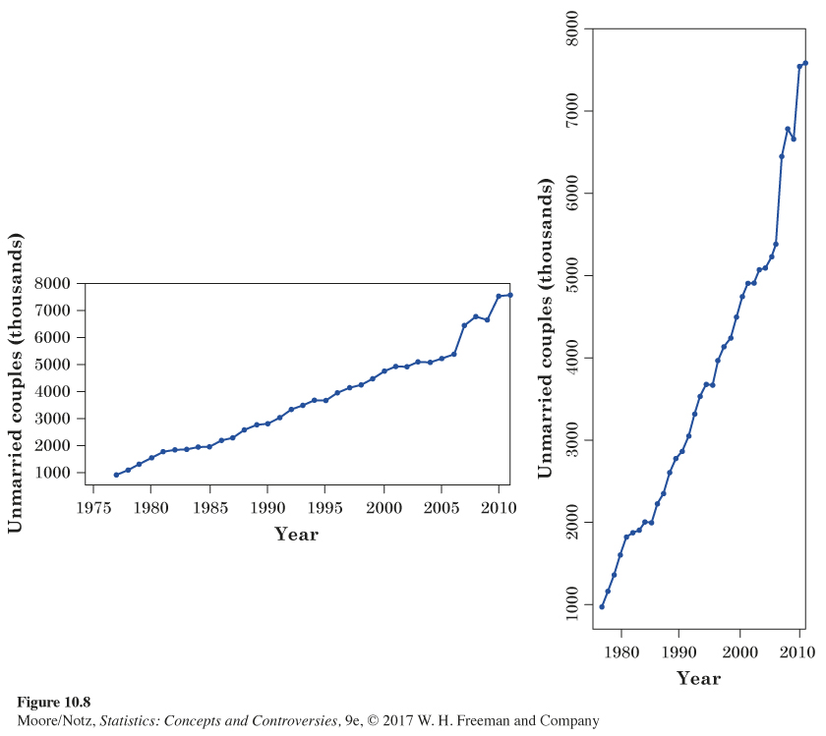
Example

Slide 21
Watch Those Scales!
Another important issue concerning scales is the following.
When examining the change in the price or value of an item over time, plotting the actual increase can be misleading.
It is often better to plot the percentage increase from the previous period.

Slide 22
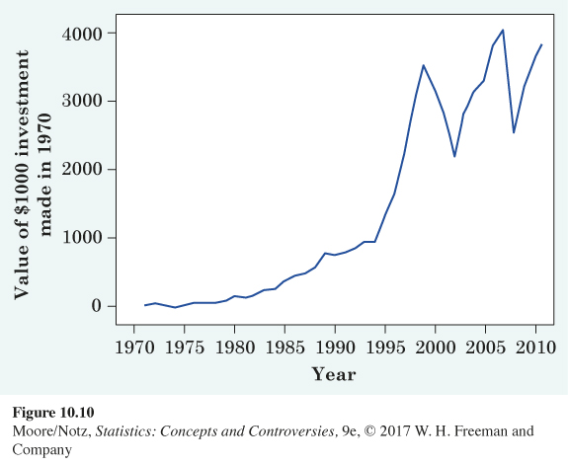
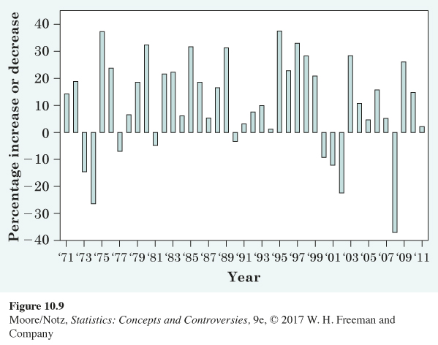
Example

Slide 23
Watch Those Scales!
Figure 10.10 gives the impression that increases between 1970 and 1980 were negligible but that increases between 1995 and 1999 were dramatic.
While it is true that the actual value of our investment increased much more between 1995 and 1999 than it did between 1970 and 1980, it would be incorrect to conclude that investments in general increased much more dramatically between 1995 and 1999 than in any of the years between 1970 and 1980.

Slide 24
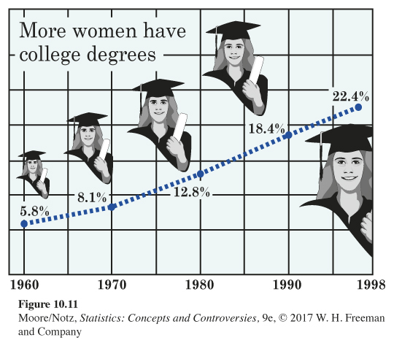
Example

Slide 25
Example
Figure 10.11 shows the rise in the percentage of women aged 25 years and over who have at least a bachelor’s degree.
Figure 10.11 isn’t simple. The artist couldn’t resist a nice background sketch and also cluttered the graph with grid lines. Grid lines on a graph serve no purpose.
Using pictures of the female graduate at each time point distorts the values in the same way as a pictogram.

Slide 26
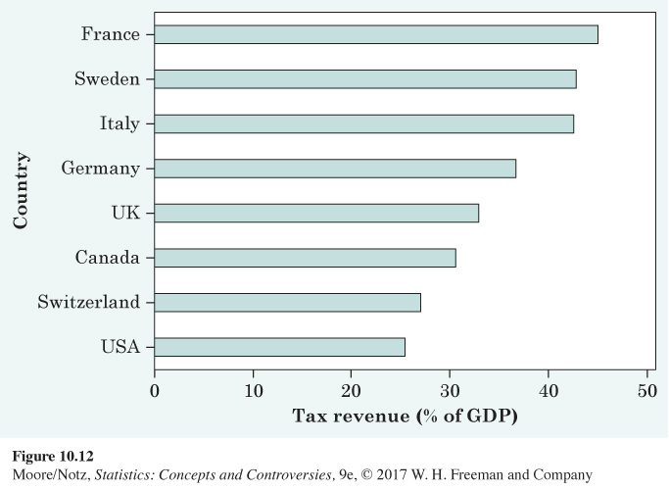
Example
The tax data displayed again….

Slide 27
Example
The first bar graph we saw displayed this tax data with the countries in alphabetical order.
Figure 10.12 rearranges the categories in order of the tax burdens. This simple change improves the graph by making it clearer where each country stands in the group of eight countries.
Figure 10.12 also demonstrates the ability to display a bar graph horizontally.

Slide 28
Statistics in Summary
To see what data say, start with graphs.
The choice of graph depends on the type of data. Do you have a categorical variable, such as level of education or occupation, which puts individuals into categories? Or do you have a quantitative variable measured in meaningful numerical units?
Check data presented in a table for roundoff errors.
The distribution of a variable tells us what values it takes and how often it takes those values.

Slide 29
Statistics in Summary
To display the distribution of a categorical variable, use a pie chart or a bar graph. Pie charts always show the parts of some whole, but bar graphs can compare any set of numbers measured in the same units. Bar graphs are better for comparisons. Bar graphs can be displayed vertically or horizontally.

Slide 30
Statistics in Summary
To show how a quantitative variable changes over time, use a line graph that plots values of the variable (vertical scale) against time (horizontal scale). If you have values of the variable for different categories, use a separate line for each category. Look for trends and seasonal variation in a line graph, and ask whether the data have been seasonally adjusted.

Slide 31
Statistics in Summary
Graphs can mislead the eye. Avoid pictograms that replace the bars of a bar graph by pictures whose height and width both change. Look at the scales of a line graph to see if they have been stretched or squeezed to create a particular impression. Avoid clutter that makes the data hard to see.

