Slide 1
Chapter 11
Displaying Distributions with Graphs
Lecture Slides

Slide 2
Case Study
Nutritionists tell us that a healthy diet should include 20 to 35 grams of fiber daily.
Cereal manufacturers advertise their products as “high-fiber.”
The food label on the side of a box of cereal (mandated by the Food and Drug Administration) provides information that allows the consumer to choose a healthy breakfast cereal.
You will find lots of different cereals displayed at the grocery store.

Slide 3
Case Study
You could examine all the boxes to see how much fiber each contains, but how do you make sense of all the numbers?
Is your favorite cereal, Wheaties, with three grams of dietary fiber, among those with the highest fiber content? How will you choose?
A histogram or stemplot could help. By the end of this chapter, you will know how to make a histogram and stemplot and know what to look for when you study one of these graphs.

Slide 4
Histograms
Categorical variables record group membership, such as the race of a college student.
What about quantitative variables such as the SAT scores of students admitted to a college?
These variables take so many values that a graph of the distribution is clearer if nearby values are grouped together. The commonest graph of the distribution of a quantitative variable is a histogram.

Slide 5
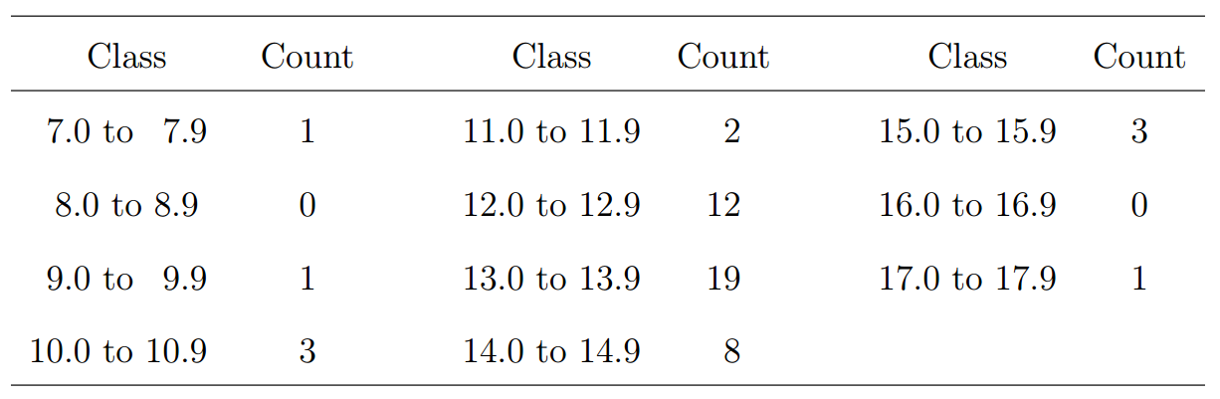
Example
Table 11.1 presents the percent of residents aged 65 years and over in each of the 50 states.
Step 1. Divide the range of the data into classes of equal width.

Slide 6
Example
Step 2. Count the number of individuals in each class. Here are the counts:

Slide 7
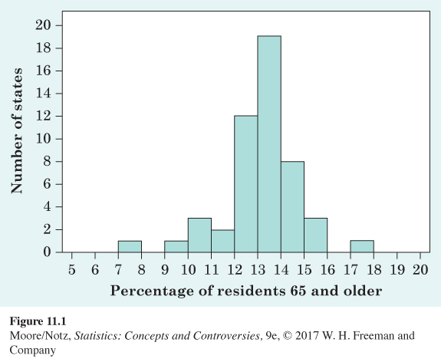
Example
Step 3. Draw the histogram. Mark on the horizontal axis the scale for the variable whose distribution you are displaying. The vertical axis contains the scale of counts. Each bar represents a class.

Slide 8
Histograms
The classes for a histogram should have equal widths. Choose the number of classes wisely.
Statistics software will choose the classes for you and may use slightly different rules than those we have discussed.
The computer’s choice is usually a good one, but you can change it if you want. When using statistical software, it is good practice to check which rules are used to determine the classes.

Slide 9
Interpreting Histograms
Making a statistical graph is not an end in itself. The purpose of the graph is to help us understand the data.
After you (or your computer) make a graph, always ask, “What do I see?” Here is a general strategy for looking at graphs.
In any graph of data, look for an overall pattern and also for striking deviations from that pattern.

Slide 10
Interpreting Histograms
An outlier in any graph of data is an individual observation that falls outside the overall pattern of the graph.
Whether an observation is an outlier is to some extent a matter of judgment, although statisticians have developed some objective criteria for identifying possible outliers.
Look for an explanation for outliers, either an error or the special nature of some observations.

Slide 11
Interpreting Histograms
To see the overall pattern of a histogram, ignore any outliers.
Here is a simple way to organize your thinking.
To describe the overall pattern of a distribution:
Describe the center and the variability.
Describe the shape of the histogram in a few words

Slide 12
Interpreting Histograms
We will learn how to describe center and variability numerically in Chapter 12.
For now, describe the center of a distribution by its midpoint, the value at roughly the middle of all the values in the distribution.
Describe the variability of a distribution by giving the smallest and largest values, ignoring any outliers.

Slide 13
Example
See Figure 11.1 to the right.
Shape: The distribution has a single peak. It is roughly symmetrical—that is, the pattern is similar on both sides of the peak.
Center: The midpoint of the distribution is close to the single peak, at about 13%.
Variability: The variability is about 9% to 18% if we ignore the outliers

Slide 14
Interpreting Histograms
Symmetrical and skewed distributions
A distribution is symmetrical if the right and left sides of the histogram are approximately mirror images of each other.
A distribution is skewed to the right if the right side of the histogram (containing the half of the observations with larger values) extends much farther out than the left side.
It is skewed to the left if the left side of the histogram extends much farther out than the right side.

Slide 15
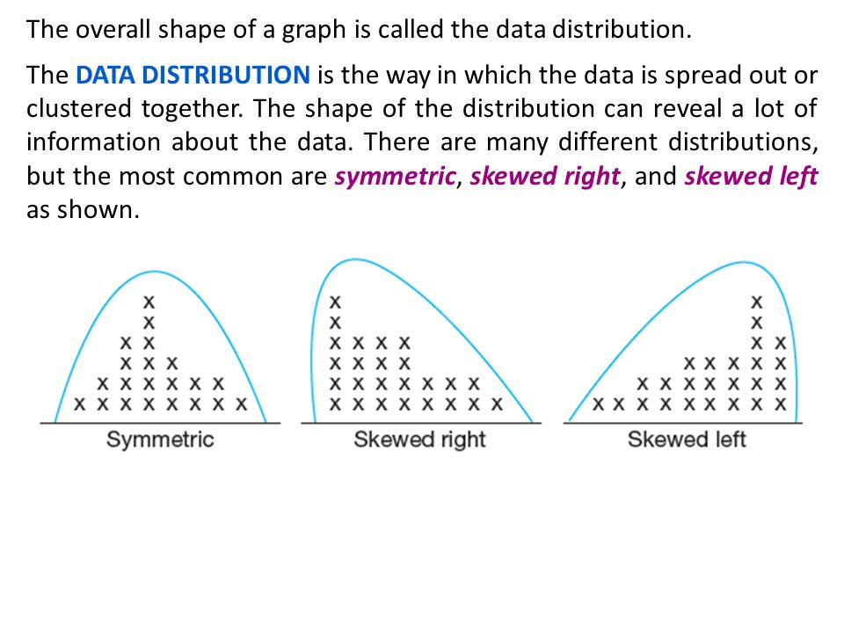
Interpreting Histograms

Slide 16
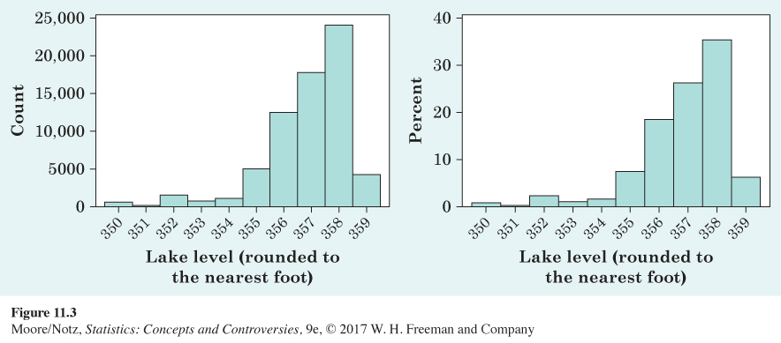
Interpreting Histograms
The histograms below were created using 67,810 hourly elevation levels for Lake Murray from November 1, 2007, through August 11, 2015. The two histograms of lake levels were made from the same data set and the histograms look identical in shape.

Slide 17
Interpreting Histograms
Let’s examine the difference in the two histograms.
The histogram on the left puts the count of observations on the y axis (this is called a frequency histogram), while the histogram on the right uses the percent of times the lake reaches a certain level (this is called a relative frequency histogram).

Slide 18
Stemplots
Histograms are not the only graphical display of distributions.
For small data sets, a stemplot (sometimes called a stem-and-leaf plot) is quicker to make and presents more detailed information

Slide 19
Stemplots
To make a stemplot:
Separate each observation into a stem consisting of all but the final (rightmost) digit and a leaf, the final digit. Stems may have as many digits as needed, but each leaf contains only a single digit. Do not include commas or decimal points with your leaves.
Write the stems in a vertical column with the smallest at the top, and draw a vertical line at the right of this column.
Write each leaf in the row to the right of its stem, in increasing order out from the stem.

Slide 20
Example
For the “65 and over” percentages in Table 11.1, the whole-number part of the observation is the stem, and the final digit (tenths) is the leaf. The Alabama entry, 13.8, has stem 13 and leaf 8.
Stems can have as many digits as needed, but each leaf must consist of only a single digit.

Slide 21
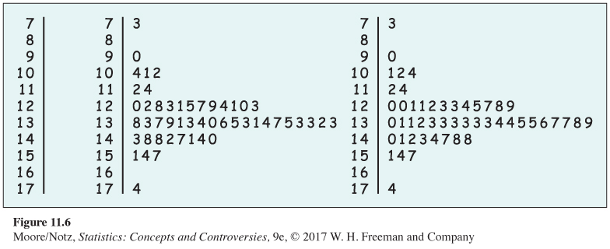
Example
Stemplot of the “65 and over” data.

Slide 22
Example
The chief advantage of a stemplot is that it displays the actual values of the observations.
Stemplots are faster to draw than histograms.
A stemplot requires that we use the first digit or digits as stems. This amounts to an automatic choice of classes and can give a poor picture of the distribution.
Stemplots do not work well with large data sets, because the stems then have too many leaves.

Slide 23
Statistics in Summary
The distribution of a variable tells us what values the variable takes and how often it takes each value.
To display the distribution of a quantitative variable, use a histogram or a stemplot. We usually favor stemplots when we have a small number of observations and histograms for larger data sets. Make sure to choose the appropriate number of classes so that the distribution shape is displayed accurately. For really large data sets, use a histogram of percents (relative frequency histogram).

Slide 24
Statistics in Summary
When you look at a graph, look for an overall pattern and for deviations from that pattern, such as outliers.
We can characterize the overall pattern of a histogram or stemplot by describing its shape, center, and variability. Some distributions have simple shapes such as symmetrical, skewed left, or skewed right, but others are too irregular to describe by a simple shape.

