Slide 1
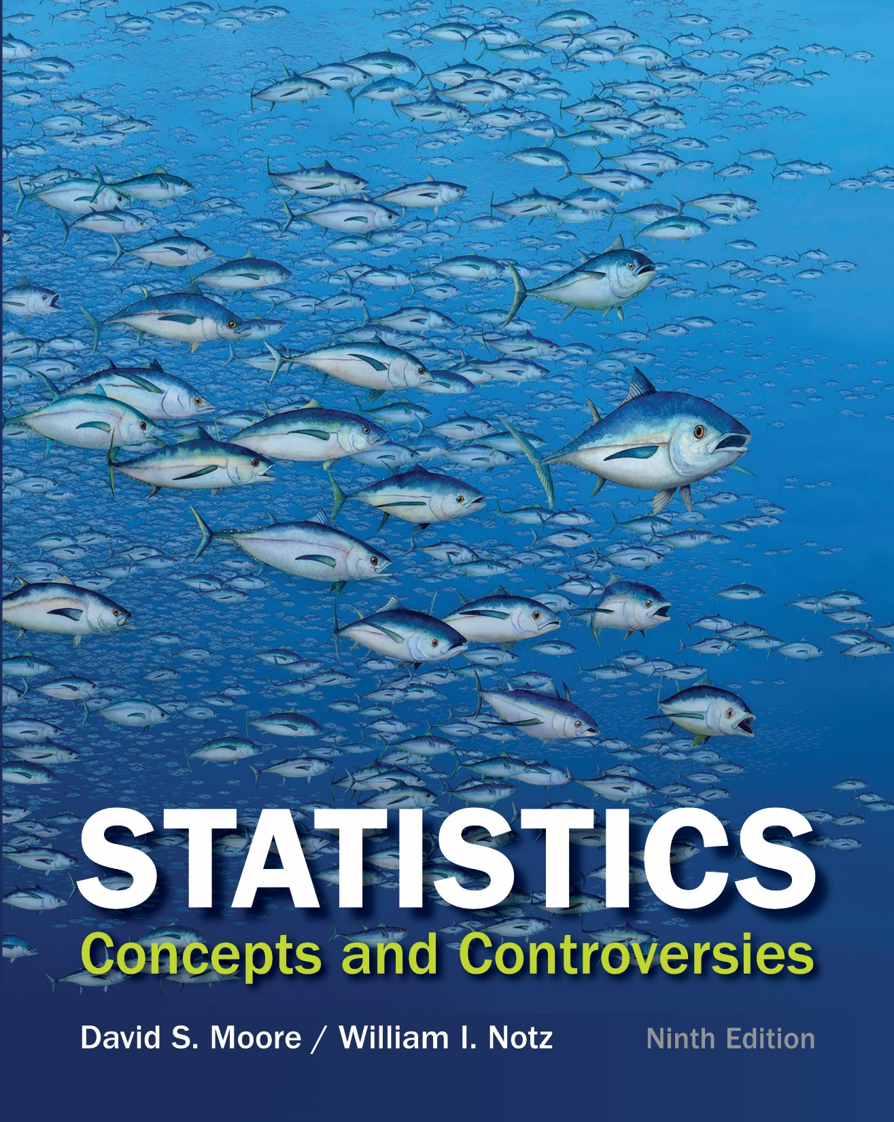
Chapter 14
Describing Relationships:
Scatterplots and Correlation
Lecture Slides

Slide 2
Case Study: Describing Relationships – Scatterplots and Correlation 1
The news media have a weakness for lists.
Best places to live
Best colleges
Healthiest foods
Worst-dressed women
A list of best or worst is sure to find a place in the news.

Slide 3
Case Study: Describing Relationships – Scatterplots and Correlation 2
When the state-by-state SAT scores come out each year, it’s therefore no surprise that we find news articles ranking the states from best (North Dakota in 2014) to worst (District of Columbia in 2014) according to the average SAT Mathematics score achieved by their high school seniors.
Such reports leave readers believing that schools in the District of Columbia must be much worse than those in North Dakota.

Slide 4
Case Study: Describing Relationships – Scatterplots and Correlation 3
The College Board, which sponsors the SAT exams, doesn’t like this practice at all.
“Comparing or ranking states on the basis of SAT scores alone is invalid and strongly discouraged by the College Board,” says the heading on their table of state average SAT scores.
To see why, let’s look at the data.

Slide 5
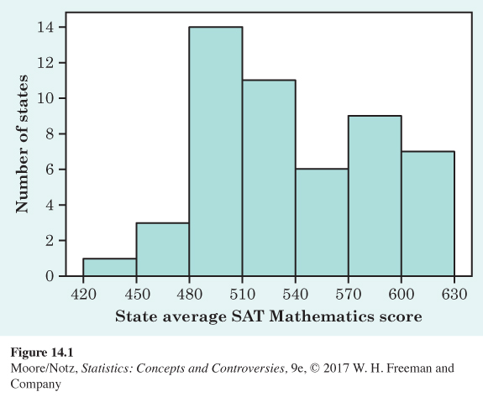
Case Study: Describing Relationships – Scatterplots and Correlation 4
Figure 14.1 shows the distribution of average scores on the SAT Mathematics exam for the 50 states and the District of Columbia. North Dakota leads at 620, and the District of Columbia trails at 438 on the SAT scale of 200 to 800.

Slide 6
Case Study: Describing Relationships – Scatterplots and Correlation 5
The distribution has an unusual shape: it has one clear peak and perhaps a second, small one. This may be a clue that the data mix two distinct groups. But we need to explore the data further to be sure that this is the case.

Slide 7
Case Study: Describing Relationships – Scatterplots and Correlation 6
In this chapter we will learn that to understand one variable, such as SAT scores, we must look at how it is related to other variables.
By the end of this chapter you will be able to use what you have learned to understand why Figure 14.1 has such an unusual shape and to appreciate why the College Board discourages ranking states on SAT scores alone.

Slide 8
Relationships among Variables 1
A medical study finds that short women are more likely to have heart attacks than women of average height, while tall women have the fewest heart attacks.
An insurance group reports that heavier cars are involved in fewer fatal accidents per 10,000 vehicles registered than are lighter cars.
These and many other statistical studies look at the relationship between two variables.
The relationship between two variables can be strongly influenced by other variables that are lurking in the background.

Slide 9
Relationships among Variables 2
To examine the relationship between two variables:
First plot the data, then add numerical summaries.
Look for overall patterns and deviations from those patterns.
When the overall pattern is quite regular, there is sometimes a way to describe it very briefly.

Slide 10
Example: The Big Bang 1
The big bang theory holds that the universe began with a big bang and matter expanded outward, as an inflating balloon does.
If this theory is correct, galaxies farthest away from the origin of the bang must be moving faster than those closest to the origin.
This also means that galaxies close to Earth must be moving at a similar speed to that of Earth, and galaxies far from Earth must be moving at very different speeds from that of Earth. Hence, relative to Earth, the farther away a galaxy is, the faster it appears to be moving away from Earth.

Slide 11
Example: The Big Bang 2
The recession velocity of an object is the speed at which an object is moving away from an observer.
In 1929 Edwin Hubble investigated the relationship between the distance from Earth and the recession velocity of galaxies.
Using data he had collected, he estimated the distance from Earth to 24 galaxies, in megaparsecs.
The recession velocities of the galaxies were also measured, in kilometers per second.

Slide 12
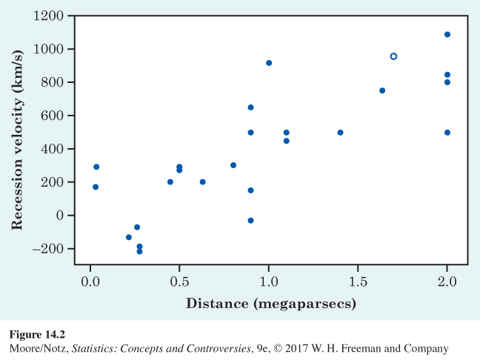
Example: The Big Bang 3
Figure 14.2 is a scatterplot that shows how recession velocity is related to distance from Earth.
“Distance from Earth” is the explanatory variable.
“Recession velocity” is the response variable.

Slide 13
Example: The Big Bang 4
Each point represents one galaxy. The point with a different plotting symbol represents a galaxy that is 1.7 megaparsecs from Earth and has a recession velocity of 960 kilometers per second.
As distance from Earth goes up, recession velocity goes up.

Slide 14
Example: The Big Bang 5
Hubble’s discovery turned out to be one of the most important discoveries in all of astronomy.
The data helped establish Hubble’s law, which is recession velocity = H₀ × distance, where H₀ is the value known as the Hubble constant.
Hubble’s law says that the apparent recession velocities of galaxies are directly proportional to their distances. This relationship is the key evidence for the idea of the expanding universe, as suggested by the big bang theory.

Slide 15
Scatterplots
A scatterplot shows the relationship between two quantitative variables measured on the same individuals. The values of one variable appear on the horizontal axis, and the values of the other variable appear on the vertical axis. Each individual in the data appears as the point in the plot fixed by the values of both variables for that individual.
Always plot the explanatory variable, if there is one, on the horizontal axis (the x axis) of a scatterplot.
If there is no explanatory-response distinction, either variable can go on the horizontal axis.

Slide 16
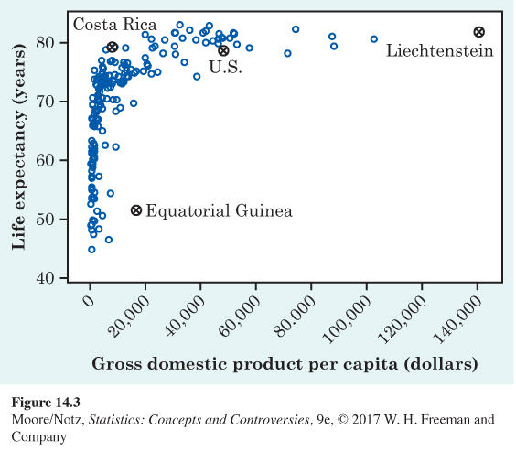
Example: Health and wealth 1
Figure 14.3 is a scatterplot of data from the World Bank for 2010.
The individuals are all the world’s nations for which data are available.
The explanatory variable is the gross domestic product (GDP) per capita.
The response variable is life expectancy at birth.

Slide 17
Example: Health and wealth 2
Life expectancy tends to rise very quickly as GDP increases and then levels off.
People in very rich countries such as the United States typically live no longer than people in poorer, but not extremely poor, nations. Some of these countries, such as Costa Rica, do almost as well as the United States.

Slide 18
Example: Health and wealth 3
Two nations are outliers.
In Equatorial Guinea, life expectancies are similar to those of its neighbors, but its GDP is higher.
Equatorial Guinea produces oil. It may be that income from mineral exports goes mainly to a few people, pulling up GDP per capita without affecting income or life expectancy of ordinary citizens.

Slide 19
Example: Health and wealth 4
The other outlier is Liechtenstein, a tiny nation bordering Switzerland and Austria.
Liechtenstein has a strong financial sector and is considered a tax haven.

Slide 20
Interpreting Scatterplots 1
In any graph of data, look for the overall pattern and for striking deviations from that pattern.
You can describe the overall pattern of a scatterplot by the direction, form, and strength of the relationship.
An important kind of deviation is an outlier, an individual value that falls outside the overall pattern of the relationship.

Slide 21
Interpreting Scatterplots 2
Two variables are positively associated when above-average values of one tend to accompany above-average values of the other and below-average values also tend to occur together. The scatterplot slopes upward as we move from left to right.
Two variables are negatively associated when above-average values of one tend to accompany below-average values of the other, and vice versa. The scatterplot slopes downward from left to right.

Slide 22
Example: Scatterplots 1
The form on Figure 14.2 is roughly a straight line. This is not a strong linear relationship.
There is a positive association.

Slide 23
Example: Scatterplots 2
The form on Figure 14.3 is curved. This is not a strong relationship.
There is a positive association.

Slide 24
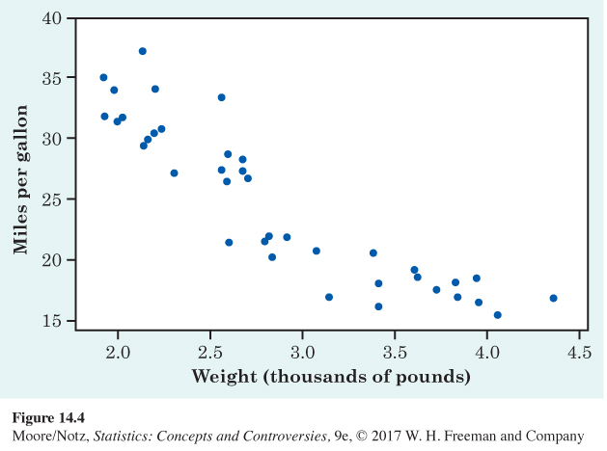
Example: Scatterplots 3
The form on Figure 14.4 is a moderately strong, slightly curved relationship.
There is a negative association between gas mileage and engine size.

Slide 25
Correlation 1
A scatterplot displays the direction, form, and strength of the relationship between two variables.
Straight-line relations are particularly important because a straight line is a simple pattern that is quite common.
A straight-line relation is strong if the points lie close to a straight line, and weak if they are widely scattered about a line.

Slide 26
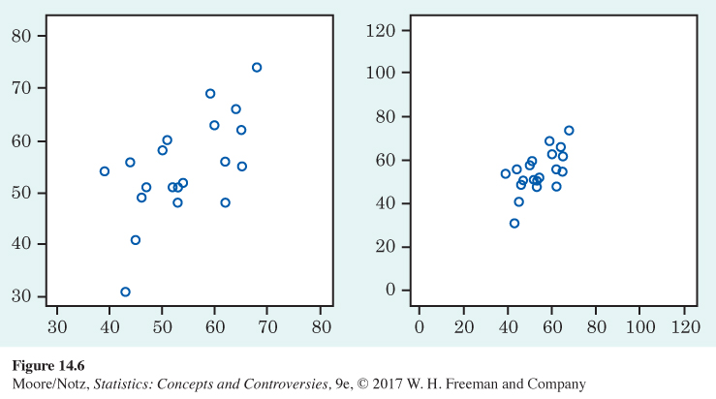
Correlation 2
The two scatterplots in Figure 14.6 depict the same data. The right-hand plot seems to show a stronger straight-line relationship. Our eyes can be fooled by changing the plotting scales or the amount of blank space around the cloud of points in a scatterplot. We need to follow our strategy for data analysis by using a numerical measure to supplement the graph.

Slide 27
Correlation 3
The correlation describes the direction and strength of a straight-line relationship between two quantitative variables. Correlation is usually written as r.
Calculating a correlation takes a bit of work. We usually calculate r using a calculator or software.

Slide 28
Understanding Correlation 1
Positive r indicates positive association between the variables, and negative r indicates negative association.
The correlation r always falls between −1 and 1. Values of r near 0 indicate a very weak straight-line relationship. The strength of the relationship increases as r moves away from 0 toward either −1 or 1. Values of r close to −1 or 1 indicate that the points lie close to a straight line. The extreme values r = −1 and r = 1 occur only when the points in a scatterplot lie exactly along a straight line.

Slide 29
Understanding Correlation 2
Because r uses the standard scores for the observations in its calculation, the correlation does not change when we change the units of measurement of x, y, or both.
The correlation between two variables has no unit of measurement; it is just a number between −1 and 1.
Correlation ignores the distinction between explanatory and response variables. If we reverse our choice of which variable to call x and which to call y, the correlation does not change.

Slide 30
Understanding Correlation 3
Correlation measures the strength of only straight-line association between two variables. Correlation does not describe curved relationships between variables, no matter how strong they are.
The correlation is strongly affected by a few outlying observations. Use r with caution when outliers appear in the scatterplot.

Slide 31
Understanding Correlation 4
Correlation measures the strength and direction of a straight-line relationship between two quantitative variables.
Correlation is not a complete description of two-variable data, even when there is a straight-line relationship between the variables. You should give the means and standard deviations of both x and y along with the correlation. Because the formula for correlation uses the means and standard deviations, these measures are the proper choice to accompany a correlation.

Slide 32
Statistics in Summary 1
A scatterplot is a graph of the relationship between two quantitative variables. If you have an explanatory and a response variable, put the explanatory variable on the x (horizontal) axis of the scatterplot.
When you examine a scatterplot, look for the direction, form, and strength of the relationship and also for possible outliers.
If there is a clear direction, is it positive (the scatterplot slopes upward from left to right) or negative (the plot slopes downward)?

Slide 33
Statistics in Summary 2
Is the form straight or curved? Are there clusters of observations? Is the relationship strong (a tight pattern in the plot) or weak (the points scatter widely)?
The correlation r measures the direction and strength of a straight-line relationship between two quantitative variables.
Correlation is a number between −1 and 1. The r shows whether the association is positive or negative. Its value gets closer to −1 or 1 as the points cluster more tightly around a straight line. The extreme values −1 and 1 occur only when the scatterplot shows a perfectly straight line.

