Slide 1


Bank of Baroda Hackathon - 2022
Technology Partner
Your Team Name : SDGR
Your team bio :
We are a team of highly motivated developers, aiming on creating projects that would benefit the society as a whole.
Date : 22 August 2022

Slide 2
Problem Statement
The clearing process at the banks involves handling lots of checks. Numerous technological checks including:
Some of the stages are laborious and need human involvement to be finished. The existing procedure necessitates a significant investment in human resources and takes longer to complete.
By solving this problem statement we can have a better way of processing cheques, a more safer way which is beneficial for both bank and customer.
Signature Verification
Fraud Detection

Slide 3



User Segment
The user segment would mostly be concentrated on banking industry. Focusing on those banks having heavy cheque transactions.
Why?
01
02
03
Reduces Human Labour
Faster and Secure Transactions
Fraudulent Cheque Detection

Slide 4
Previous Works
Automated Cheque Processing (ACP) by Central Bank of Belize
Using ACP by Central Bank of Belize deposited cheques can be cleared by the end of the next day if deposited by afternoon. A digital image of the cheque would be created and this image along with other information like MICR band, etc would be sent to the other bank. This will eliminate the need for handling of the physical document.
Automated Inward Cheque Processing by Arya.ai
With the use of six distinct AI models for the various variables, including Date, MICR, Amount in words and numbers, Account Number, and Signature extraction and verification, Arya's module automates the procedure. Each model is trained in such away to attain high precision results.
Cheque Processing by OpenSys
The solution by OpenSys provides entire cheque processing system, also called as Cheque Truncation System, using various image scanning techniques and also provides service for fraud detection.

Slide 5
Azure tools or resources
Azure OCR
Printed and handwritten text will be extracted from photos and documents with mixed linguistic and writing styles using Azure OCR. This tool will be used to extract data from the digital image of the cheque like, MICR Code, Cheque Number, Name, etc.
Azure SQL Database
A managed cloud database offered as part of Microsoft Azure is the Azure SQL Database. Data from OCR will be stored using this tool. The data saved would have high-tech security as a result.
Computer Vision Azure
Developers get access to cutting-edge methods for processing photos and retrieving data thanks to the cloud-based Computer Vision API. Using this programme, several picture pre-processing techniques will be applied to a cheque image.
Microsoft Cognitive Toolkit
The Microsoft Cognitive Framework (CNTK) is an open-source deep learning toolkit for distributed commercial applications. A directed graph is used to represent neural networks as a sequence of computational operations. We will mostly be using this tool for comparing signatures.

Slide 6
Workflow for Traditional Cheque Processing
Customer presents a Cheque of "Bank B" to "Bank A"
"Bank A" justifies and presents the cheque to the clearing house to check
Clearing House justifies the cheque, then inform "Bank B"
The Unpaid/Rejected Cheque is returned to customer
Red Signal is sent to “Bank A”
If “Bank B” declines the cheque
“Bank B” justifies the cheque again, and check with the particulars and accordingly respond by either Accepting or Declining the Cheque
Customer Account is credited with Cheque Amount
Green Signal is sent to “Bank A”
If “Bank B” accepts the cheque

Slide 7
Our Solution
OCR Model
Data Entry
Fraud Detection
Image
Verification
Transaction
Received from user through frontend
Detect texts in bilingual (English/Hindi) using Azure OCR
Store data in Azure SQL Database for advanced security
Detect later-edited texts in cheque intimating fraud using Computer Vision Azure
Signature Verification using Microsoft Cognitive Toolkit
Amount Debit and Credit in respective account
A/c Balance Verification
Image Pre-processing for better prediction
Date Verification
Scalability
The program would be deployed on Flask/Django/React for better and easier User Experience.
This program would be able to process faster than traditional methods
This might revolutionize Cheque Processing Process.

Slide 8
Key Differentiators & Adoption Plan
Unlike competitors, our program would provide full-proof solution to cheque processing, starting from scanning the cheque image to transferring the funds from one account to another (Imitated by SQL databases)
The program would ensure data privacy and security as the data extracted from cheques would be stored in SQL Databases
Most of the cheque processing programs don’t focus on the fraudulent detection factor, in our program we would not only verify the signature but also create a model for identifying different handwriting on the same cheque that would be indicating frauds.
For current usage, the model would be deployed on Flask/Django/React. Allowing users to seamlessly use the following program.

Slide 9
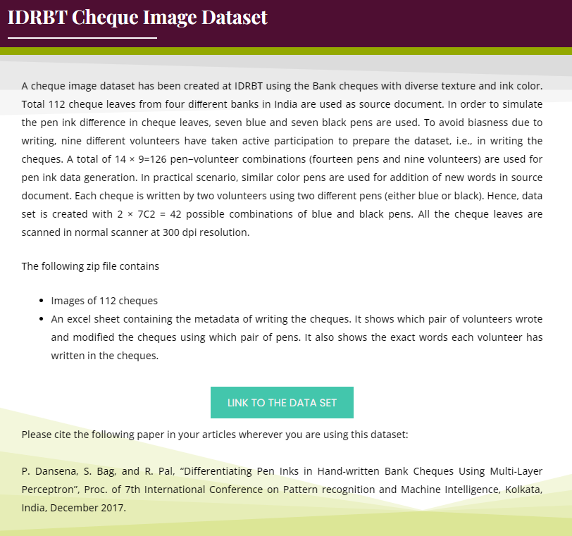
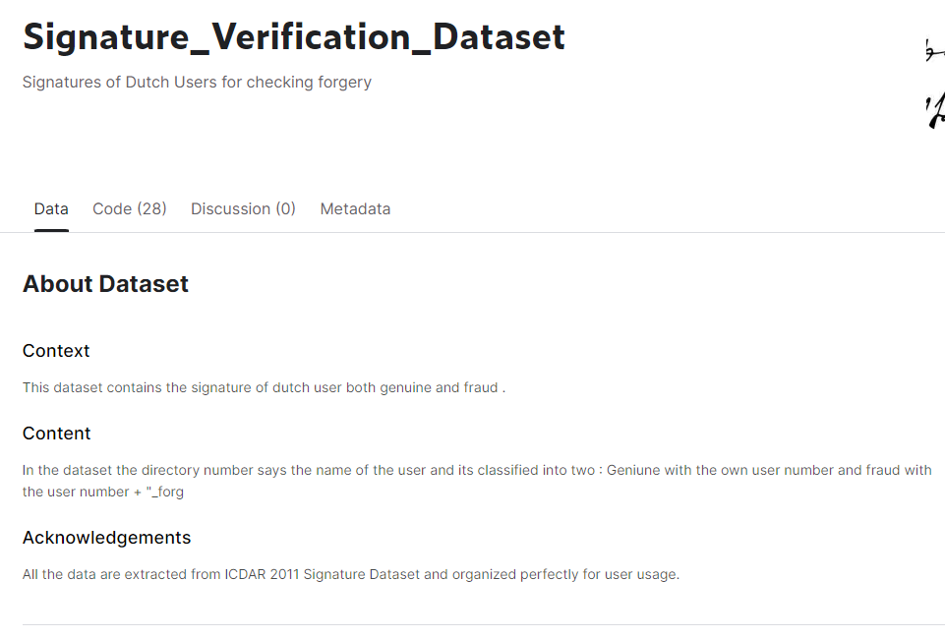
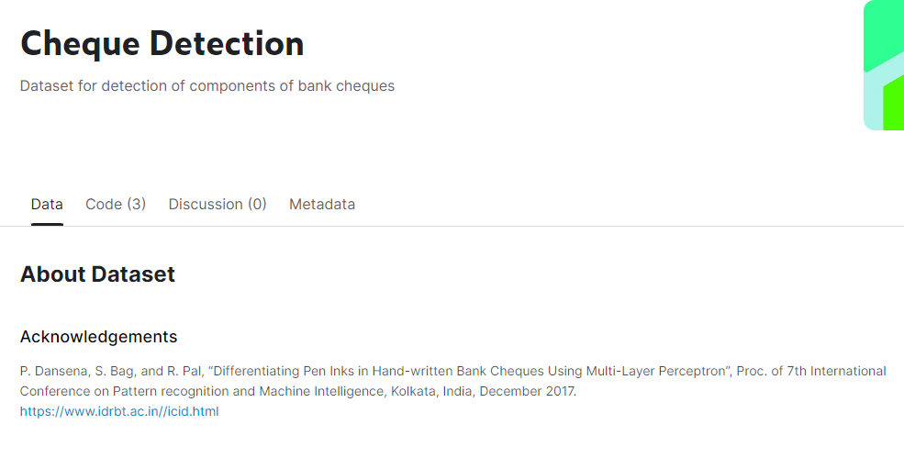
GitHub Repository Link & supporting diagrams, screenshots, if any
GitHub Repository Link : PayCheck : Automated Cheque Processing
Data Sources:
Kaggle Dataset 1 Signature Detection
Kaggle Dataset 2 Cheque Image Dataset
IDRBT Cheque Image Dataset

Slide 10
Thank You
Team member names
Rithuraj Nambiar
Saksham Gupta
Garima Khare
Diksha Bhambri

