Slide 1


Slide 2

GROUP MEMBERS NAME
MADHURA PATIL
DIKSHA GUPTA
PRAKRUTI PANDYA
GROUP NO.
5
NANDINI GUPTA
SUBHADIP GHOSH
SARVESH JATHAR
PAVADA ANJI
SUNIL KUMAR
SK. AKHIL

Slide 3
WHAT IS CROWDFUNDING ?
Crowdfunding is a way of raising money by collecting small amounts from a large number of people, usually through the internet.
It helps individuals, start-ups, or creators to fund their projects, products, or ideas.

Slide 4




FAMOUS CROWDFUNDINGS WEBSITES

Slide 5
Kickstarter helps people raise money for creative projects like tech products, art, games, music, and more.
People who support a project are called backers.
In return, they might get rewards or early access to the product once it’s made.

Slide 6
MODULE WISE
DASHBOARDS

Slide 7
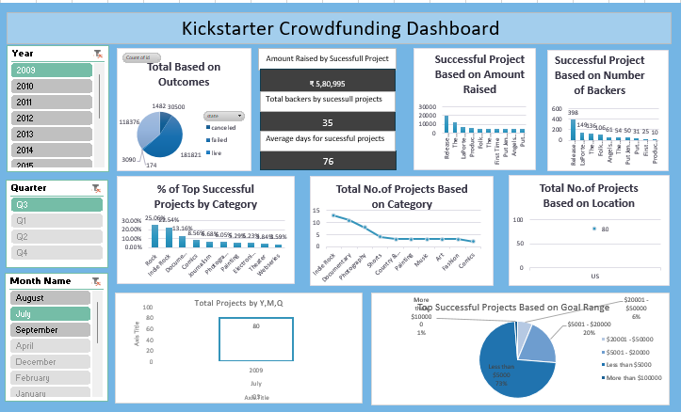
EXCEL DASHBOARD

Slide 8
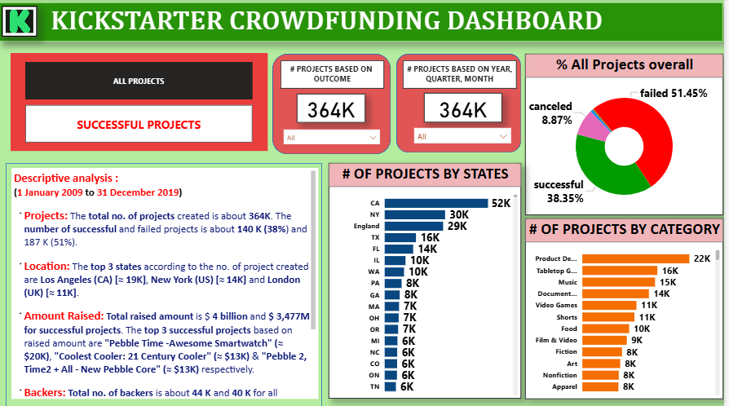
POWER BI DASHBOARD

Slide 9
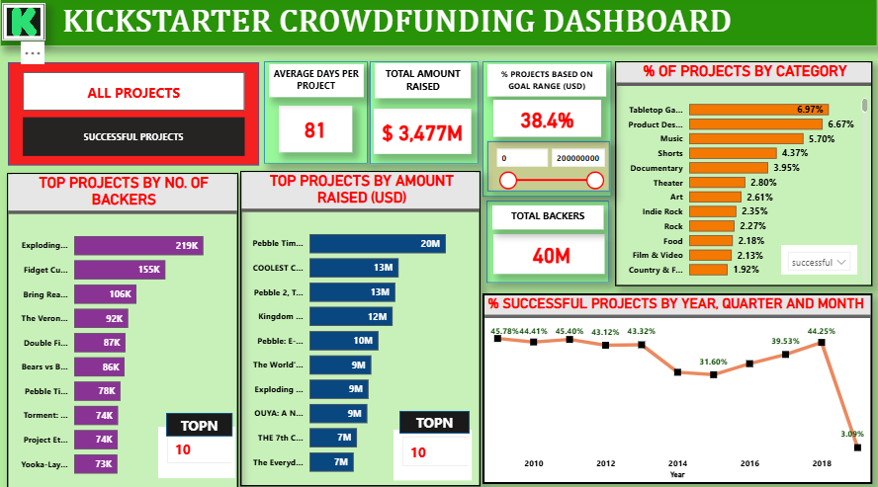
POWER BI DASHBOARD

Slide 10
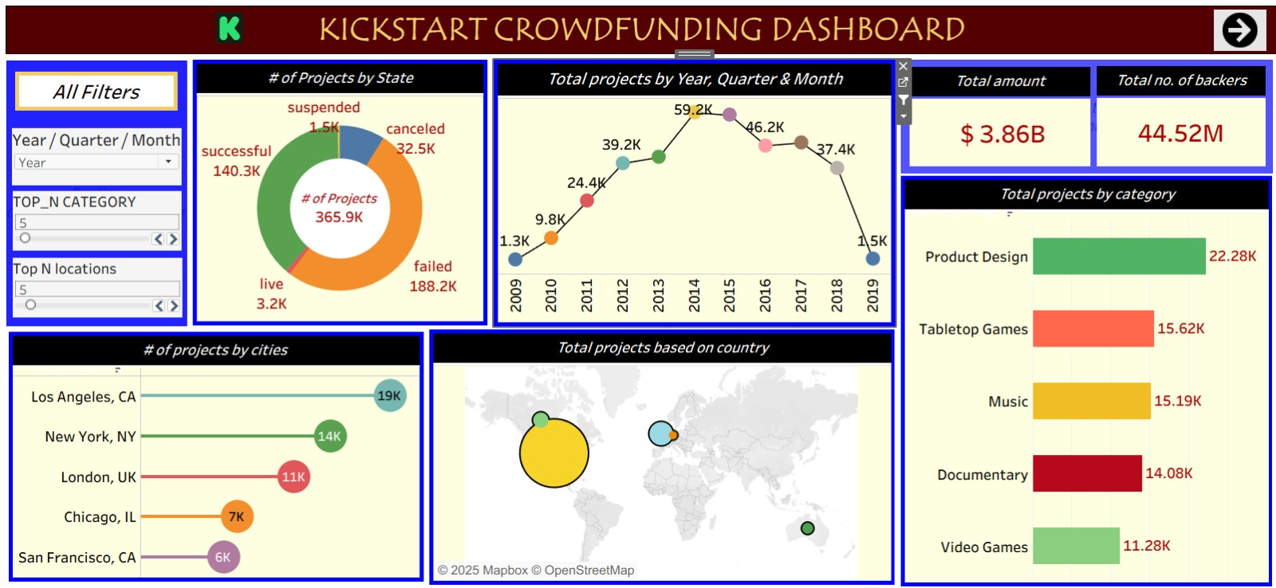
TABLEAU DASHBOARD

Slide 11
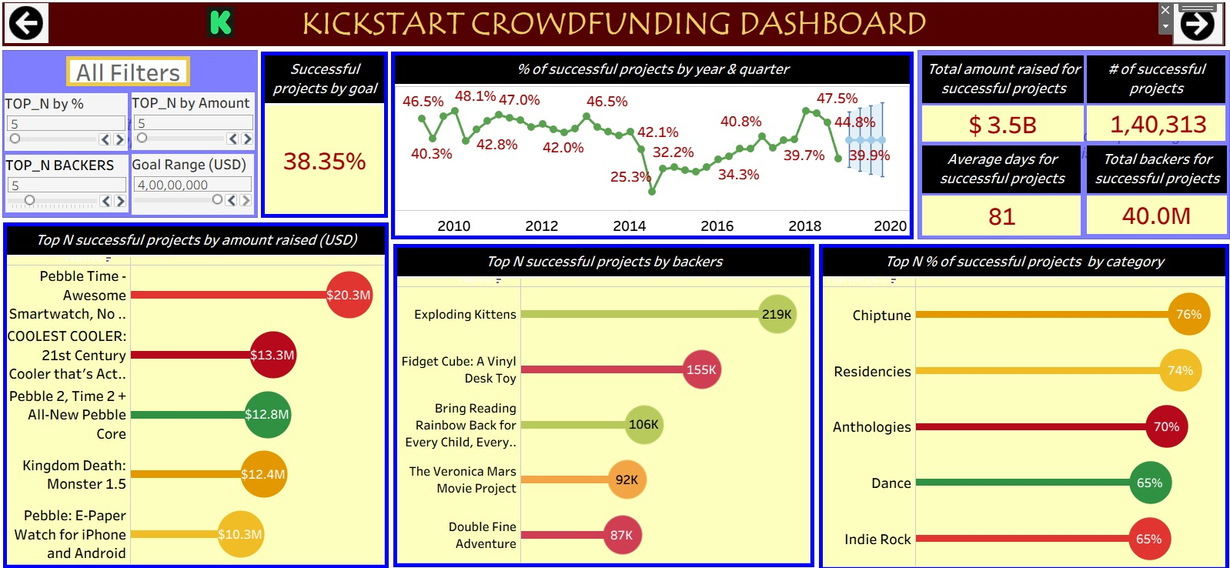
TABLEAU DASHBOARD

Slide 12
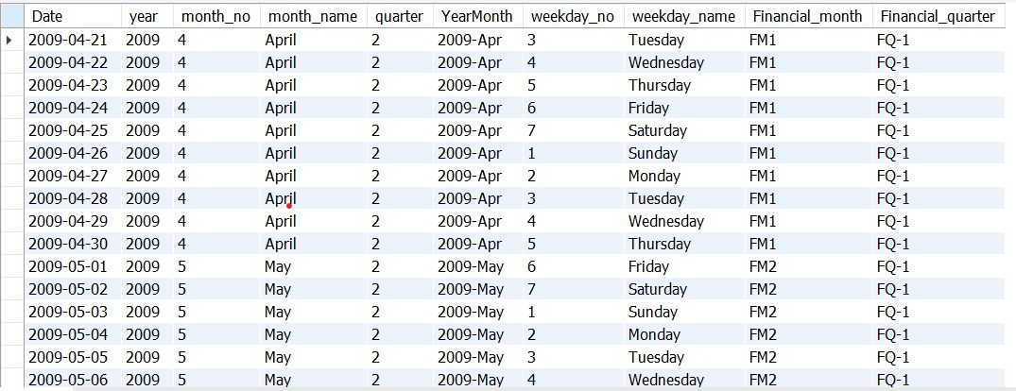
SQL
Build a Calendar Table using the Date Column Created Date ( Which has Dates from Minimum Dates and Maximum Dates) Add all the below Columns in the Calendar Table using the Formulas.
A.Year, B.Monthno, C.Monthfullname, D.Quarter(Q1,Q2,Q3,Q4) , E. YearMonth ( YYYY-MMM) , F. Weekdayno , G.Weekdayname , H.FinancialMOnth ( April = FM1, May= FM2 &. March = FM12), I. Financial Quarter ( Quarters based on Financial Month FQ-1 . FQ-2..)

Slide 13
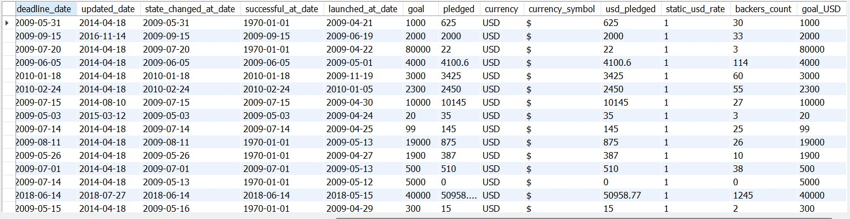
SQL
Convert the Goal amount into USD using the Static USD Rate.

Slide 14
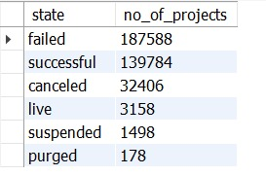
SQL
Projects Overview KPI : Total Number of Projects based on outcome

Slide 15
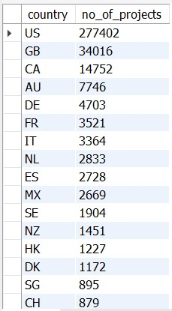
SQL
Projects Overview KPI : Total Number of Projects based on Locations

Slide 16
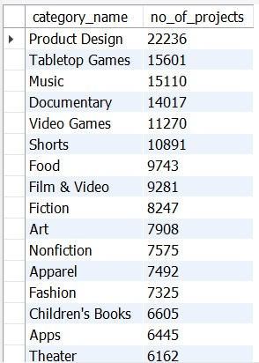
SQL
Projects Overview KPI : Total Number of Projects based on Category

Slide 17
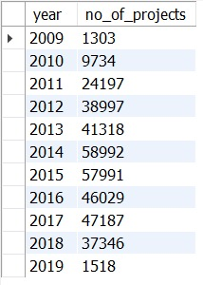
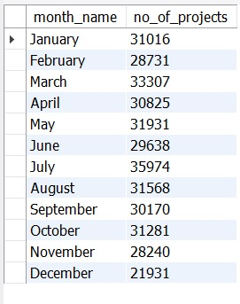
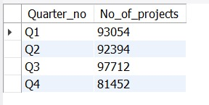
SQL
Projects Overview KPI : Total Number of Projects created by Year
Projects Overview KPI : Total Number of Projects created by month
Projects Overview KPI : Total Number of Projects created by Quarter

Slide 18



SQL
Amount Raised for successful projects:
Number of backers for successful projects:
Average number of days for successful projects:

Slide 19
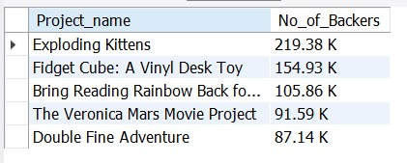
SQL
Top Successful Projects : Based on Number of Backers

Slide 20
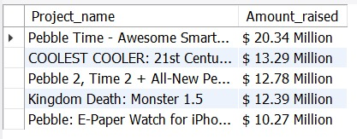
SQL
Top Successful Projects : Based on Amount Raised

Slide 21

SQL
Percentage of Successful Projects overall

Slide 22
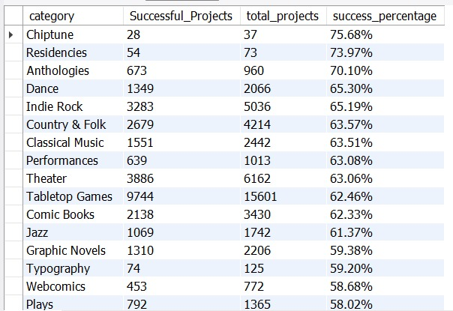
SQL
Percentage of Successful Projects by Category

Slide 23
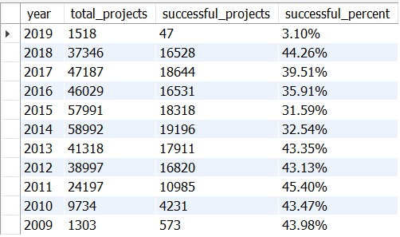
SQL
Percentage of Successful Projects by Year

Slide 24
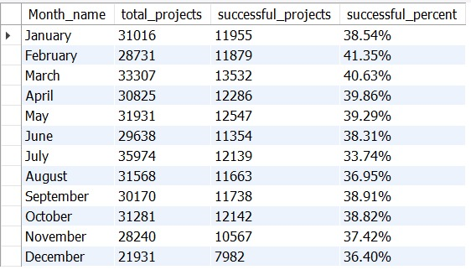
SQL
Percentage of Successful Projects by Month

Slide 25
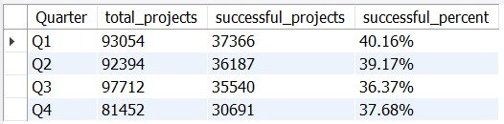
SQL
Percentage of Successful Projects by Quarter

Slide 26

SQL
Percentage of Successful projects by Goal Range ( decide the range as per your need ) where goal range is from 0 to 100000 USD

Slide 27

CONCLUSION

Slide 28
The total number of projects created is approximately 364K.
The top 3 countries according to the number of project created are The USA 266K, England 32k and Canada 13K.
The total raised amount is $ 3.8 billion and $ 3.4 billion for all projects and successful projects respectively.
The total number of backers is 44 Million and 40 Million for all projects and successful projects respectively.

Slide 29
THANK YOU

