Slide 1

Groups, Sets and Parameters in Tableau
-Diksha Gupta

Slide 2
Introduction
Tableau is a powerful data visualization tool used to transform raw data into insightful visuals or dashboards.
We’ll explore three key Tableau concepts :
• Groups
• Sets
• Parameters

Slide 3
What Are Groups ?
In Tableau groups are a way to categorize dimensions based on specific conditions or characteristics.
They simplify data by merging similar items.
Groups are useful for organizing and analyzing related data points.
It Simplify filtering and analysis.
Types of groups in Tableau :
Dimension Groups: Group dimensions based on specific attributes or conditions.
Measure Groups: Group measures based on specific conditions or ranges.

Slide 4
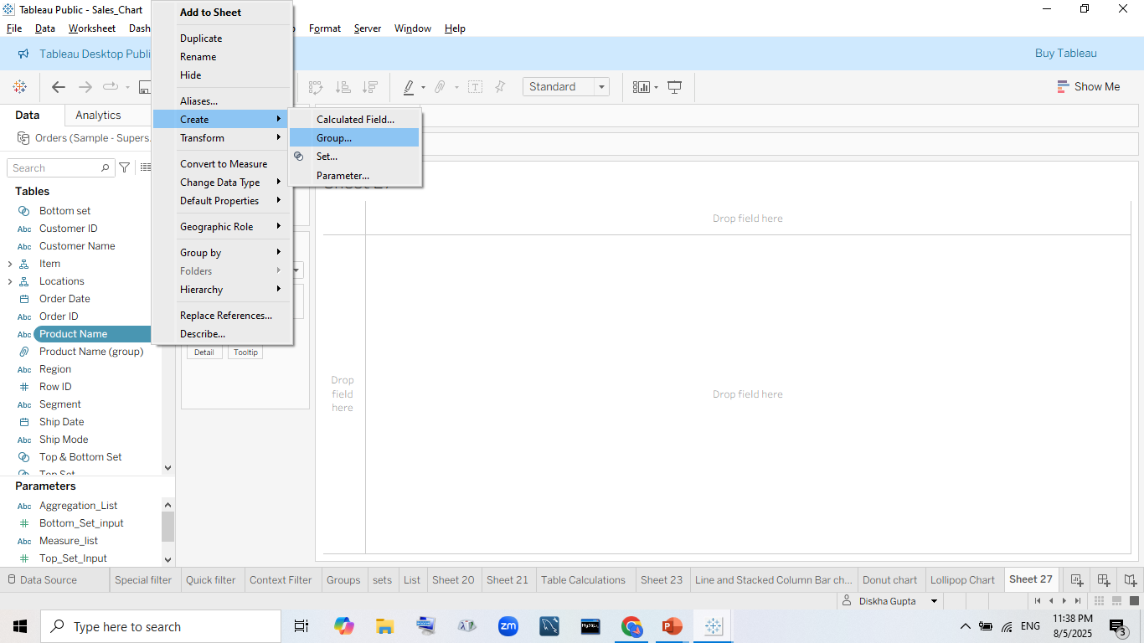
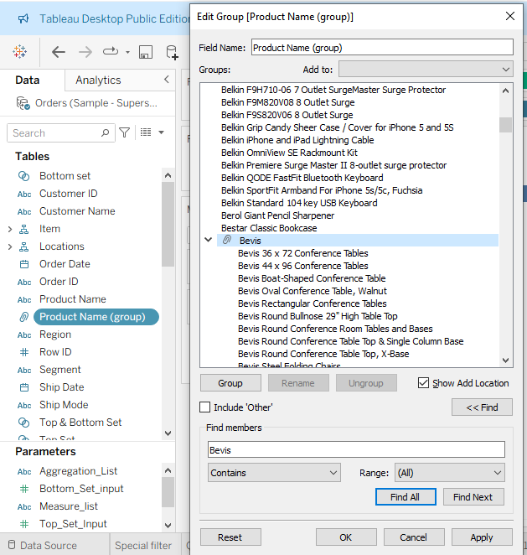
Creating Groups in Tableau

Slide 5
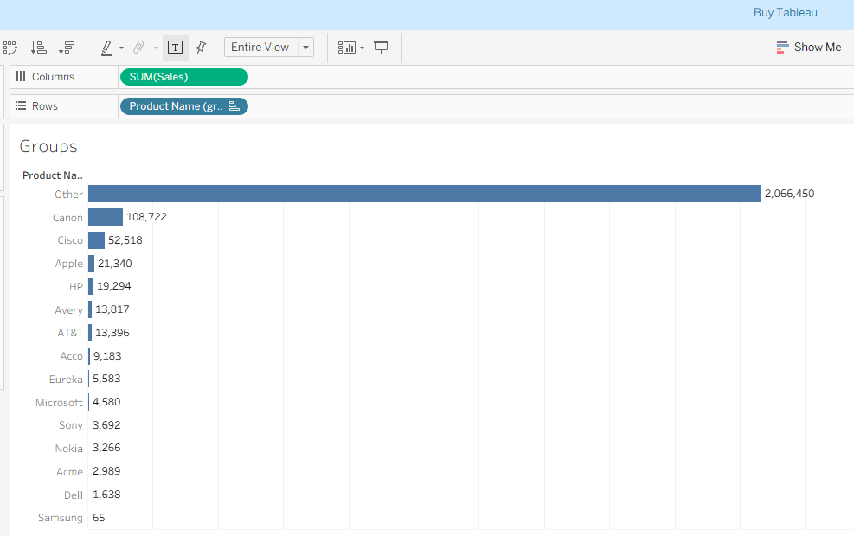
Output :

Slide 6
What Are Sets ?
In Tableau , a set is a custom field that defined a sub-group of databased on specific or selection.
Types of set in Tableau :
Fixed set ( Manual Set)
Dynamic set (Computer set)
Use cases of set :
Highlight or compare a specific group against the rest.
Create calculated field on set membership.
Filter views dynamically using set actions.
Create complex dashboards with interactions.

Slide 7
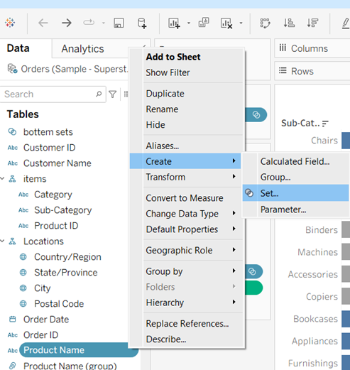
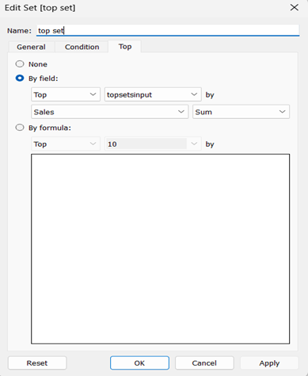
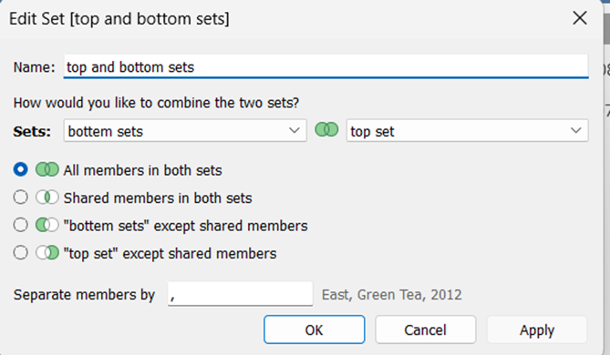
Creating Sets in Tableau

Slide 8
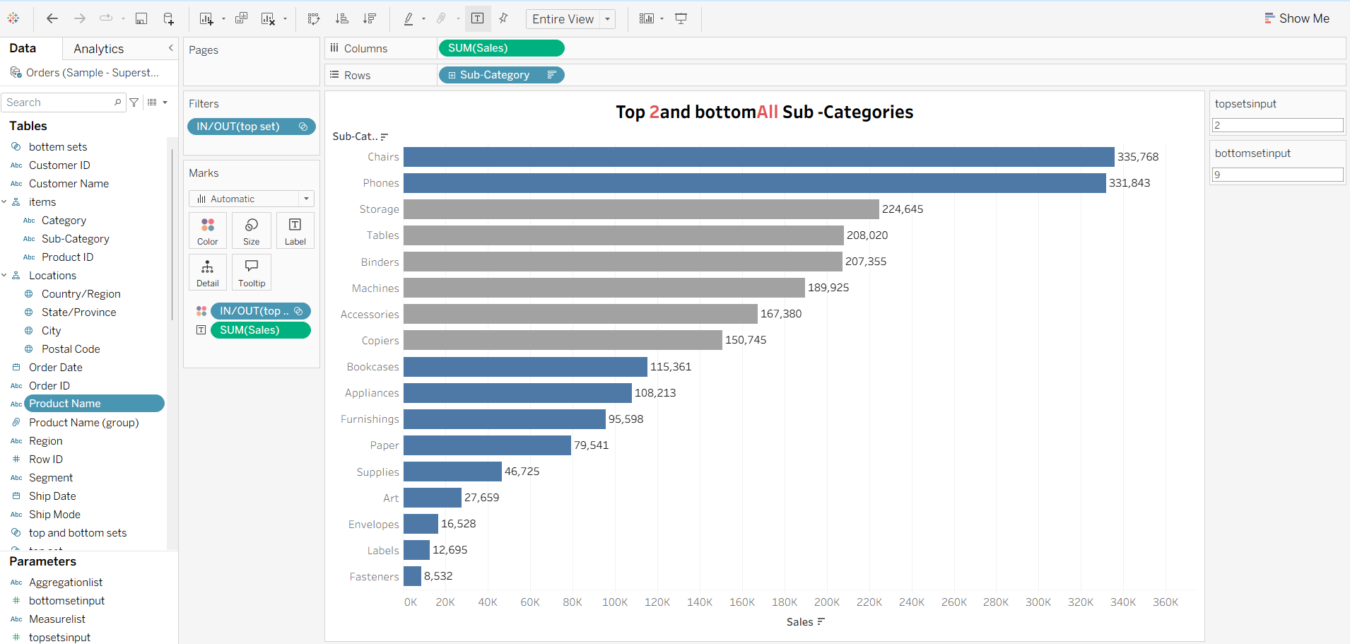
Output :

Slide 9
What Are Parameters ?
In Tableau, a parameter is a dynamic input that allows users to change the values used in a visualization, calculation, or filter interactively.
Types of Parameters in Tableau :
Based on Data types
Based on Functionality
Use cases of Parameters :
Create what-if analysis
Toggle between measures/dimensions
Control Top N filters
Choose a value for reference lines

Slide 10
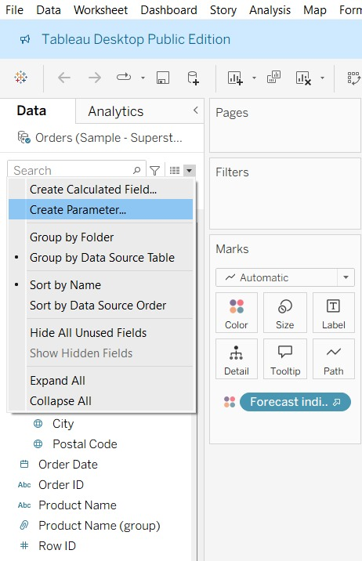
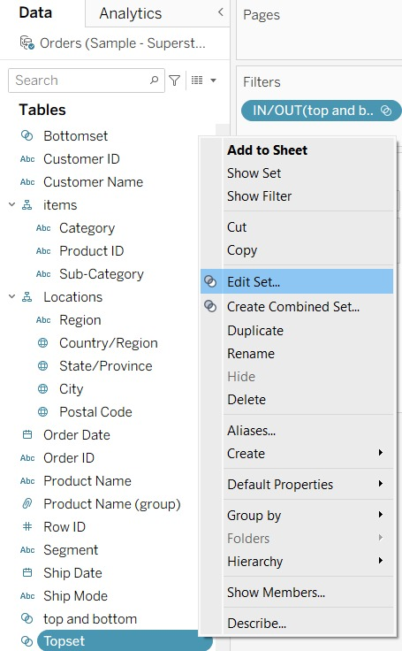
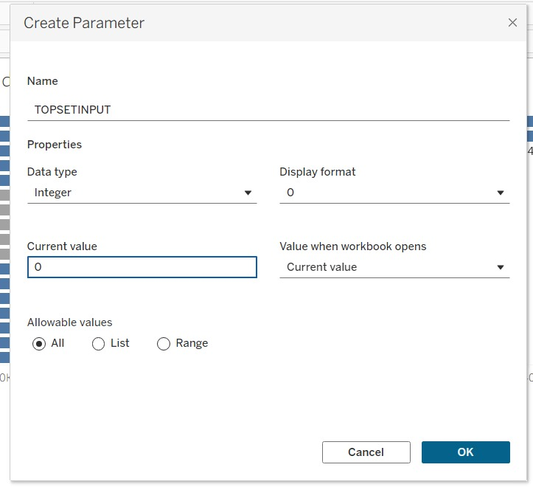
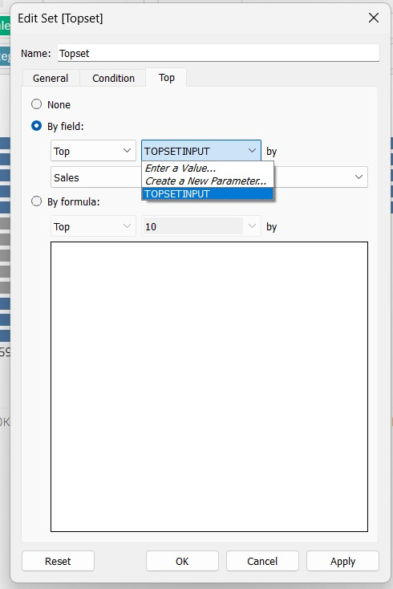
Creating Parameters in Tableau

Slide 11

Conclusion
Groups help you organize and simplify data by combining similar members.
Sets let you compare and analyze specific subsets dynamically.
Parameters add interactivity and flexibility to dashboards, enabling “what-if” analysis and user control.
Together, these features make Tableau dashboards more powerful, customizable, and insightful.

Slide 12
Thank You

