Slide 1

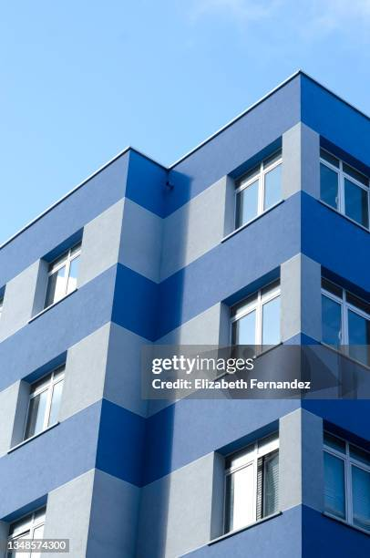

Property Prices Analysis
Presented by: Diksha Kulkarni

Slide 2

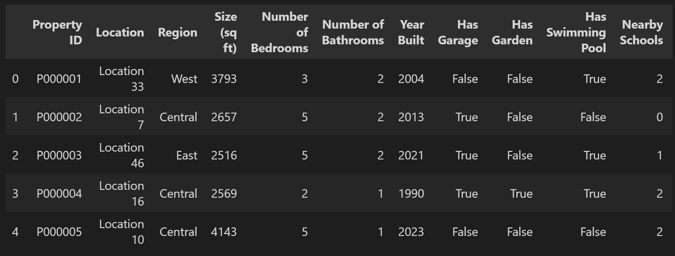
Overview of Dataset
01
.

Slide 3
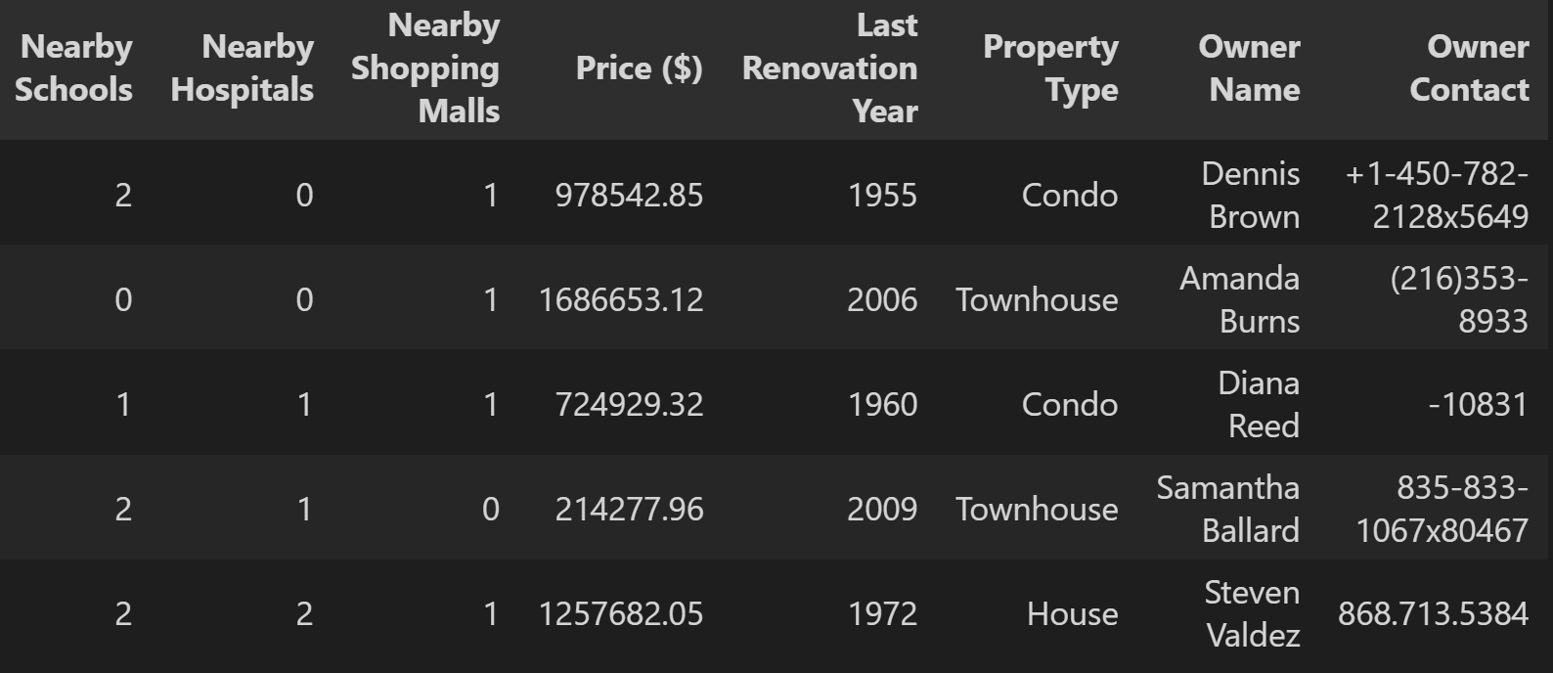
overview of Dataset
A picture is worth a thousand words

Slide 4
About The Dataset
The dataset contains 100,000 real estate records with 18 attributes, including property details (Property ID, Property Type, Location, Region), structural features (Size (sq ft), Bedrooms, Bathrooms, Year Built, Last Renovation Year), and amenities (Has Garage, Has Garden, Has Swimming Pool). It also includes financial (Price ($)) and owner details (Owner Name, Owner Contact). Nearby infrastructure is covered with Nearby Schools, Nearby Hospitals, and Nearby Shopping Malls. There are no missing values, but inconsistencies exist in renovation years and contact formats. This dataset can help analyze pricing trends, regional variations, feature influence, and the impact of nearby facilities on property values.
The dataset contains 100,000 real estate records with 18 attributes, including property details (Property ID, Property Type, Location, Region), structural features (Size (sq ft), Bedrooms, Bathrooms, Year Built, Last Renovation Year), and amenities (Has Garage, Has Garden, Has Swimming Pool). It also includes financial (Price ($)) and owner details (Owner Name, Owner Contact). Nearby infrastructure is covered with Nearby Schools, Nearby Hospitals, and Nearby Shopping Malls. There are no missing values, but inconsistencies exist in renovation years and contact formats. This dataset can help analyze pricing trends, regional variations, feature influence, and the impact of nearby facilities on property values.

Slide 5
Objectives
Understanding Property Price Influences – Identifying the key factors (location, amenities, infrastructure) that impact property prices.
Investment Decision-Making – Evaluating which locations and property types offer the best returns for buyers and investors.
Market Trends & Customer Preferences – Analyzing why apartments are the most preferred property type and how property size affects customer choices.
High-Value & Low-Demand Regions – Exploring why certain locations have high property prices and why some regions (like the East) have fewer properties.
Business Strategy for Real Estate Development – Providing insights for developers on where to invest, which property types to prioritize, and how to maximize property value.

Slide 6
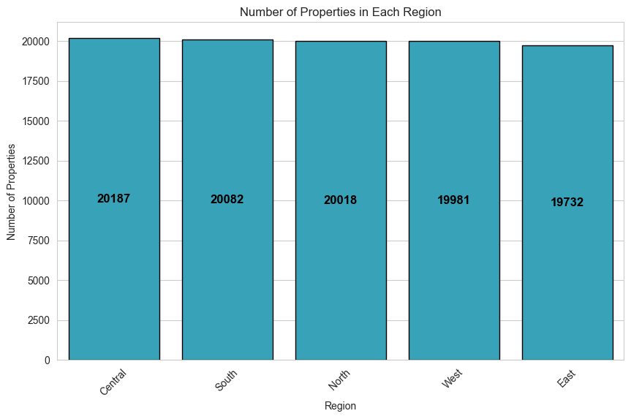
Analysis: 1
Regionwise Analysis of Properties
Topic 1
Observation : Central Region has most number of properties than other regions.

Slide 7
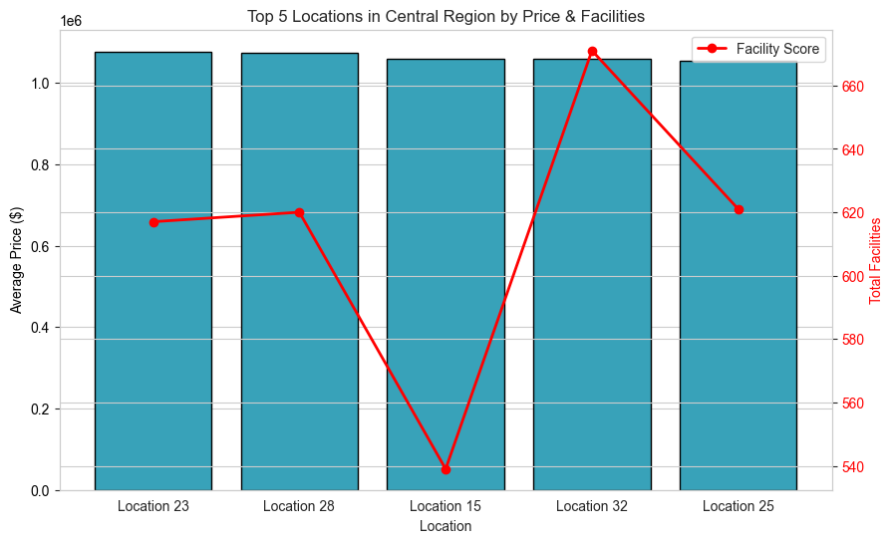
Analysis: 1.1
Analysis of Central Region Showing Maximum Properties by Count and has Maximum Amenities as well as less average price than top 5 locations
Topic 1
Presentations are communication tools that can be used as speeches, reports, and more.
Observation:-Get the top 5 Locations from the Central Region by their Facalities Available so investors can know about which location is better

Slide 8
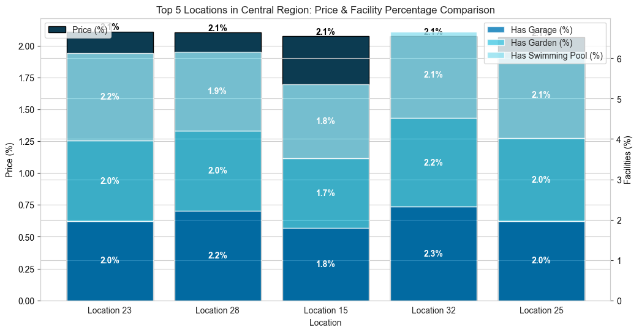
Analysis: 1.2
Comparison of Price and Facalities Available in central Region of top 5 properties
Observation:- Among the top 5 locations, Location 32 has the highest facility percentage and price, while Location 15 has the lowest facility percentage despite having a competitive price.

Slide 9
Question 1: Should buyers consider purchasing properties in Location 32 ?

Slide 10
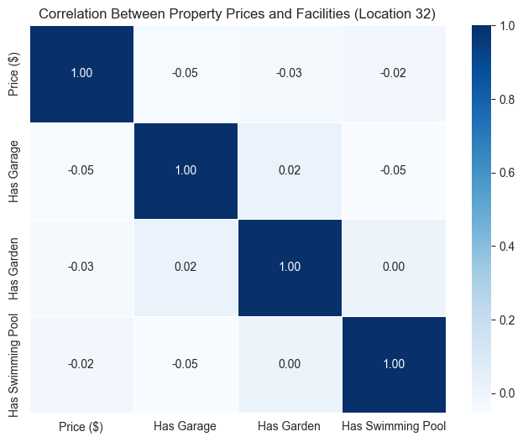
Step 1:- The Location 32 is High Facalities as well as high Price is there Correlation Between Property Prices and Facalities Available
Observation:- The heatmap for Location 32 shows weak or almost no correlation between property prices and available facilities (garage, garden, swimming pool), suggesting that facility availability does not significantly impact property prices in this location.

Slide 11
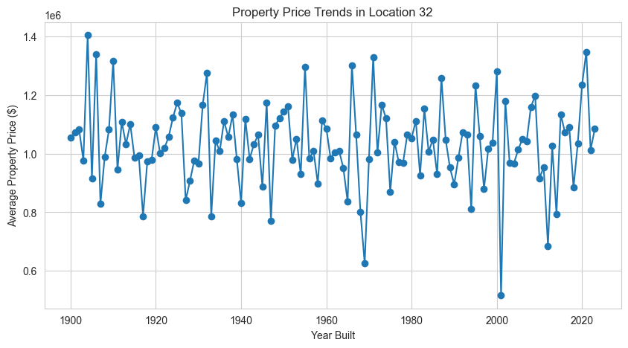
Step 2:- How have property prices in Location 32 changed over the years based on the year the properties were built?
Observation:- Property prices in Location 32 fluctuate across different construction years, with peaks in both older (pre-1920) and newer (post-2000) properties.
Mid-century properties (1950-1990) show relatively stable prices with moderate variations.

Slide 12
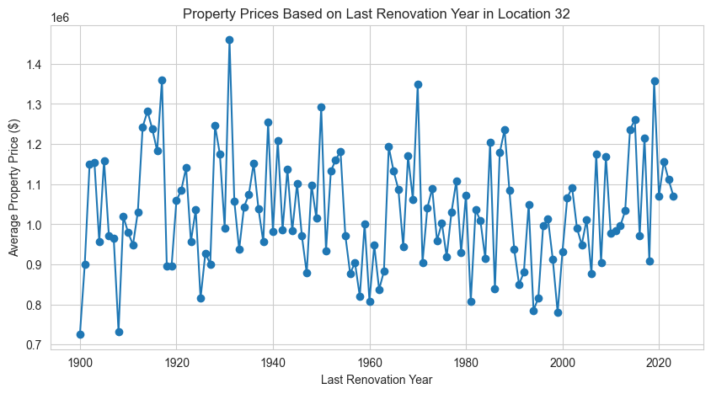
Step 3:-How do property prices in Location 32 vary based on the last renovation year?
Observation:- Properties renovated in the 2000s and 2020s tend to have higher prices, indicating a preference for modernized homes.
Some older renovations (early 1900s) still hold high value, suggesting historical properties may retain demand.
Prices fluctuate across different renovation periods, with dips observed around the 1950s-1970s and late 1990s.

Slide 13
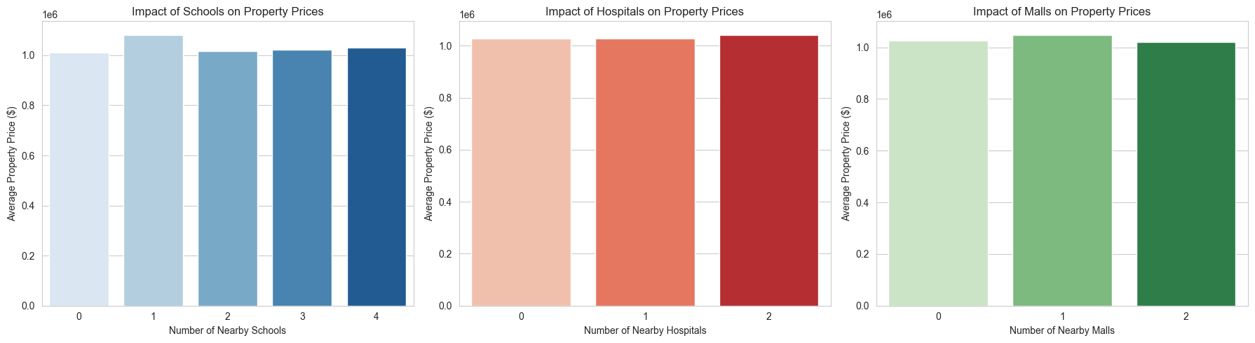
Step 4:-How do the number of nearby schools, hospitals, and shopping malls impact the average property price in Location 32?
Observation:- Properties near one school or one mall have the highest prices, while additional schools or malls show diminishing returns. Hospitals have a neutral to slight positive impact on property prices.

Slide 14
Conclusion
Investment Strategy for Location 32
Best Investment: Properties built pre-1920 or post-2000, especially if renovated in the 2000s or 2020s.
Good Locations: Near a single school or mall.
⚠️ Avoid: Paying extra for properties just because they have a pool, garage, or multiple nearby schools/malls.
⚠️ Caution: Properties with outdated renovations (1950-1970 & late 1990s) may have lower value appreciation.
👉 Final Verdict: Invest in well-renovated historical or modern properties near a single school or mall for the best returns.

Slide 15
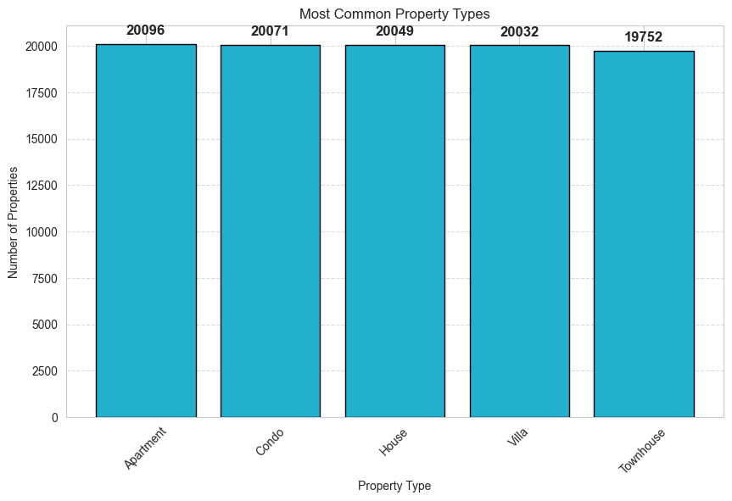
Analysis :2
Most Common Property type by their count from every location
observation: Count of Apartment is greater than other properties hence Customers invests most of in Apartment

Slide 16
Question 2: "Why do clients prefer apartments over other property types despite the availability of condos, houses, villas, and townhouses?" ?

Slide 17
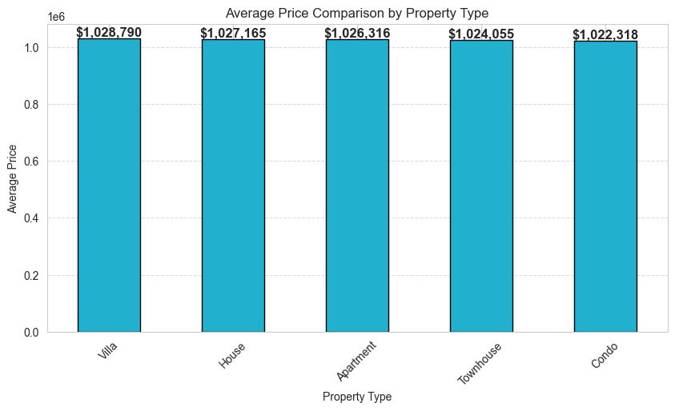
Step 1:- How do the average prices of apartments compare to condos, houses, villas, and townhouses?
Observation:- Apartments offer a competitive price advantage compared to villas and houses while maintaining high demand, making them a cost-effective yet desirable option for buyers. Their affordability, combined with modern amenities and strategic locations, drives customer preference.

Slide 18
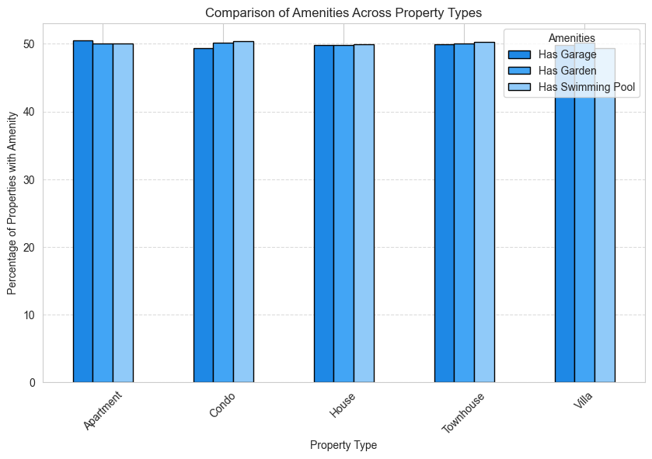
Step 2:- Do apartments provide more or better amenities compared to other property types?
Observation:- Apartments offer amenities comparable to other property types, with a balanced distribution of garages, gardens, and swimming pools, making them an attractive choice for buyers seeking convenience and modern facilities.

Slide 19
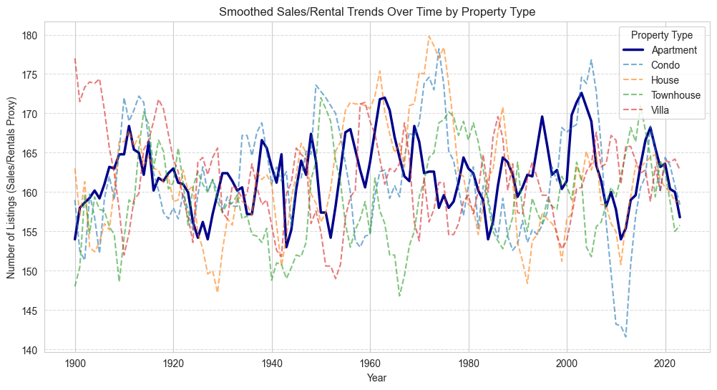
Step 3:- Which property type has the highest number of sales or rentals over time, and how does it compare to other options?
Observation:- Apartments have consistently higher sales/rental activity compared to other property types, showing a more stable trend over time, while other property types exhibit greater fluctuations.

Slide 20
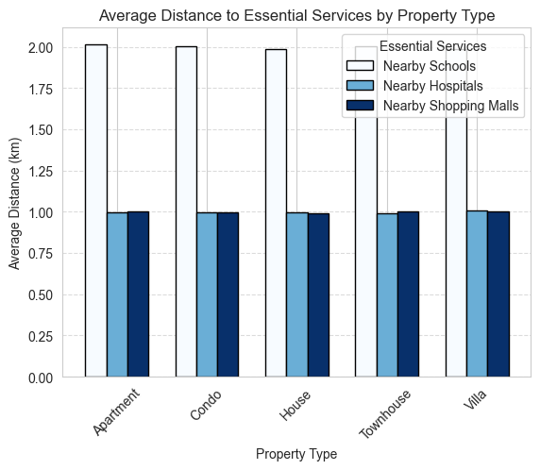
Step 4:- Are apartments located closer to essential services (schools, hospitals, workplaces, public transport) compared to other property types?
Observation:- Apartments have consistently higher sales/rental activity compared to other property types, showing a more stable trend over time, while other property types exhibit greater fluctuations.

Slide 21
Conclusion
Affordability & High Demand – Apartments offer a cost-effective option while maintaining strong buyer demand compared to villas and houses.
Prime Location & Accessibility – They are usually closer to essential services like schools, hospitals, and shopping malls, enhancing convenience.
Modern Amenities & Low Maintenance – Apartments provide amenities like swimming pools and gardens with shared maintenance, reducing individual upkeep costs.
Security & Investment Stability – Gated communities and high resale value make apartments a safer and more reliable investment choice.

Slide 22
Question 3: "How does property size influence customer preference for apartments over other property types?"

Slide 23
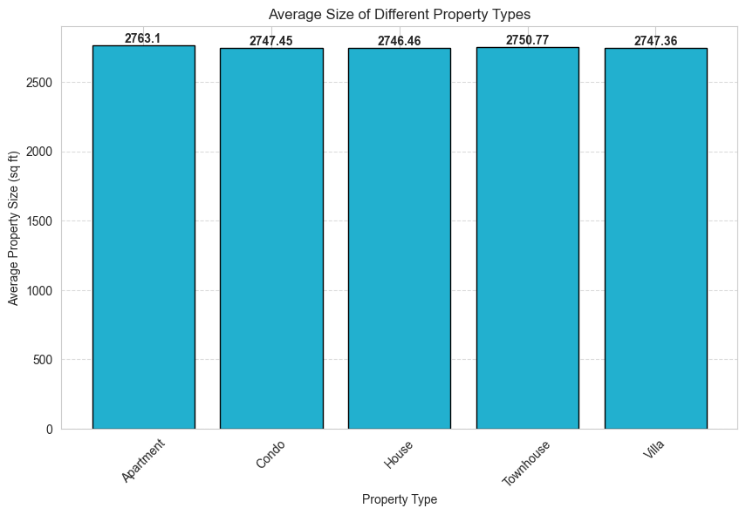
Analysis :333333three
Step 1:- What is the average size of different property types?
Observation:- The average property size across all property types is quite similar, indicating that size alone may not be a key differentiator influencing customer preference for apartments over other property types. Other factors like affordability, amenities, and location may play a more significant role.

Slide 24
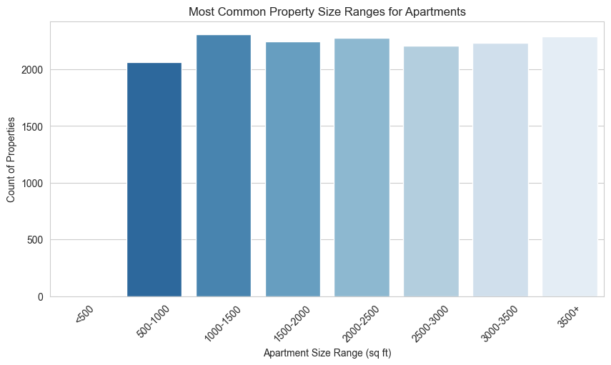
Step 2:- What is the most common property size range for apartments?
Observation:- The most common apartment sizes fall between 500-1000 sq ft and 1000-1500 sq ft, indicating a higher availability of mid-sized apartments in the market.

Slide 25
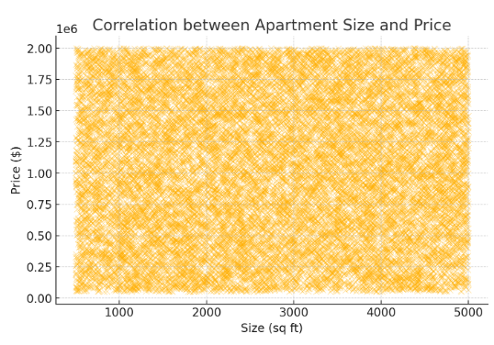
Step 3:- how price and size of apartments correlaetate with each other?
Observation:- The data points are widely scattered, indicating no strong correlation between size and price.
Prices do not consistently increase with size—suggesting that other factors like location, demand, and amenities play a bigger role in determining apartment prices.

Slide 26
Conclusion
Apartment sizes are mostly in the 500-1500 sq ft range, and property size alone may not drive customer preference—factors like affordability, amenities, and location likely play a bigger role.

Slide 27

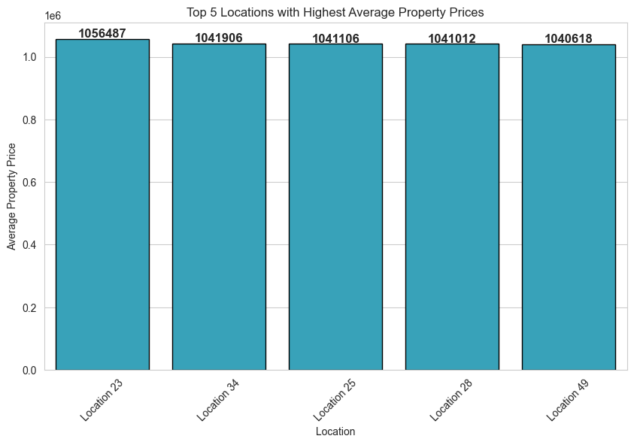
Analysis 4:
Analysis of Top 5 Locations with highest Property Price
observation: Location 23 has propertes with highest average price.

Slide 28
Question 4: "What factors make these locations have the highest average property prices, and how do they compare in terms of amenities, demand, and neighborhood characteristics?"

Slide 29
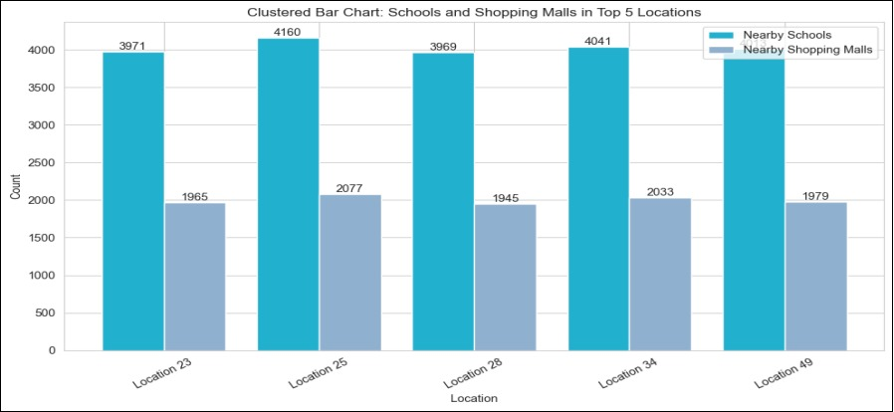
Step 1:-Does the last renovation year significantly impact property prices in the top 5 high-value locations, or are other factors like location and demand more influential?
Observation:- Locations with a higher number of nearby schools and shopping malls, like Location 25 and Location 34, tend to have higher property prices, suggesting that accessibility to education and retail services significantly impacts demand and real estate value.

Slide 30
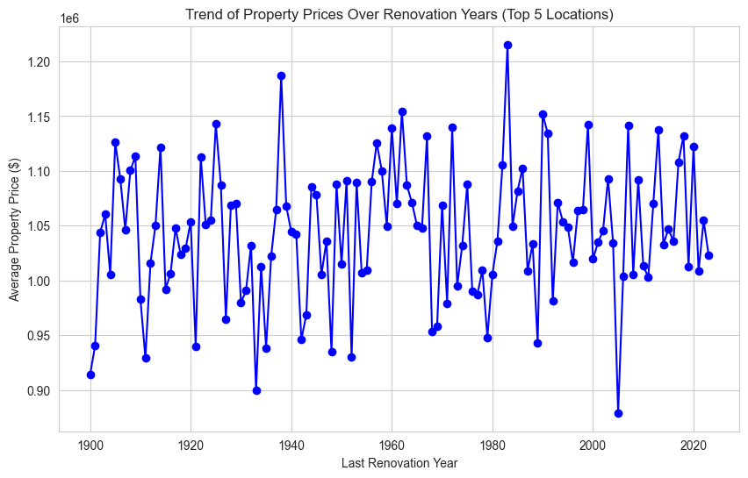
Step 2:- Does the last renovation year significantly impact property prices in the top 5 high-value locations, or are other factors like location and demand more influential?
Observation:- Renovation year alone is not a strong indicator of property price.
Other factors like demand, location, and amenities likely have a greater impact.

Slide 31
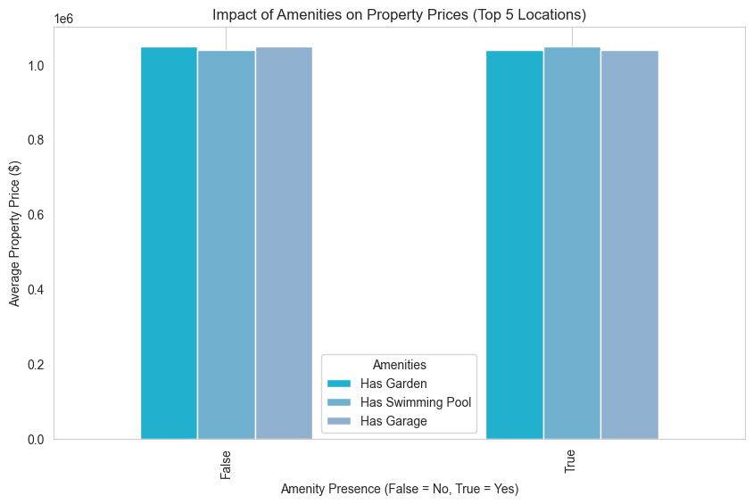
Step 3:- Do buyers prioritize location and demand over additional property features like a garage or a swimming pool?
Observation:- The impact of amenities on property prices is minimal, suggesting that location and demand play a more significant role in determining property value.

Slide 32
Conclusion
Minimal Impact of Amenities: Gardens, swimming pools, and garages do not significantly influence property prices.
Stronger Role of Location & Demand: Property value is more affected by location and market demand.
Limited Effect of Renovation Year: Renovation year alone is not a strong determinant of price.
Importance of Accessibility: Locations with more schools and shopping malls (e.g., Location 25 & 34) tend to have higher property prices, indicating accessibility drives real estate value.
4o

Slide 33
Question 5: ""Why does the East region have the lowest number of properties compared to other regions?" "

Slide 34
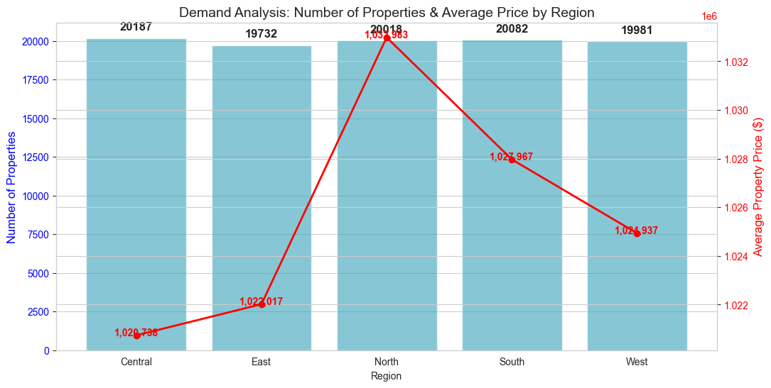
Step 1:- "Why does the East region have fewer properties compared to other regions, and how does demand (reflected in price) influence this?"
Observation:- The East region has fewer properties and a lower average price, suggesting lower demand, possibly due to fewer amenities or less infrastructure development.

Slide 35
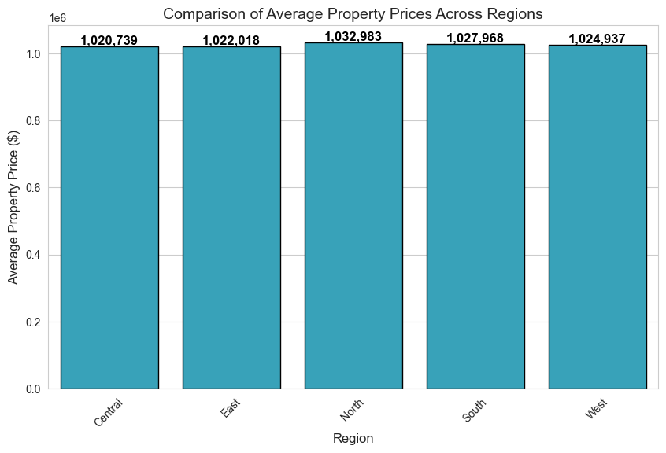
Step 2:- "Does property price influence the number of properties in different regions?"
Observation:- The East region has fewer properties and lower average prices, indicating lower demand, possibly due to lack of infrastructure or investment interest.

Slide 36
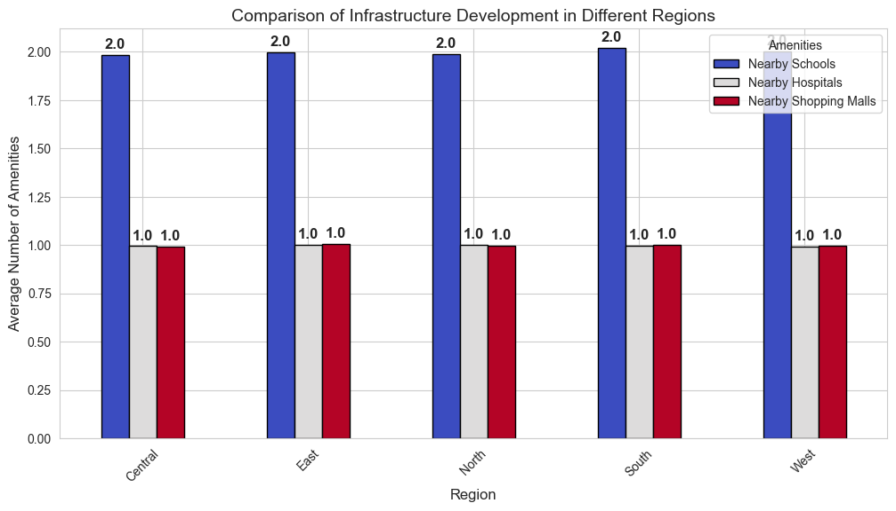
Step 3:- Does the East region have fewer properties due to a lack of essential infrastructure like schools, hospitals, and shopping malls?
Observation:- The East region has the same level of infrastructure as other regions, indicating that factors other than amenities, such as land availability or demand, might contribute to the lower number of properties.

Slide 37
Conclusion
The East region has fewer properties and lower average prices, indicating lower demand in the real estate market.
The lower demand may be driven by limited infrastructure development, lower investment interest, or land availability issues.
From a customer perspective, the lower property prices could present an affordable investment opportunity if future development occurs.
From a business perspective, real estate developers and investors should assess potential growth opportunities by improving infrastructure and amenities to attract buyers.

Slide 38
FInal Conclusion
Key Investment Factors – Location, affordability, and demand drive property investments more than size or amenities.
Apartment Preference – Apartments dominate the market due to affordability, prime locations, and modern facilities.
Impact of Infrastructure – Proximity to schools, malls, and hospitals increases property value more than amenities.
Investment in Location 32 – Best returns come from well-renovated historical or modern properties near key services.
Growth Potential in the East – Low property numbers due to weak demand, but future growth is possible with better infrastructure.
Business Strategy – Developers should prioritize strategic location selection and infrastructure improvement to attract buyers.

Slide 39


