Slide 1

STOCK PRICE TREND ANALYSIS
Presented By Diksha Kulkarni

Slide 2

Description of project
This project involves analyzing stock market data to gain insights into market performance, company growth, stock price volatility, trading behavior, and sector trends. Using datasets that include company information, stock price data, trade details, and trader demographics, the project aims to identify valuable patterns and correlations that can assist in investment decision-making. By applying SQL queries and data analysis techniques, the goal is to provide actionable insights for investors, stakeholders, and business analysts looking to understand the dynamics of the stock market.

Slide 3

Objectives:-
Assess Market Trends: Identify top-performing sectors, companies, and stocks by market capitalization and trading volume.
Evaluate Stock Price Movements: Analyze stock price volatility and trends, helping to understand market risk and opportunities.
Examine Trader Behavior: Investigate the correlation between trader demographics (age, gender, location) and their trading patterns, such as trade frequency and value.
Uncover Investment Opportunities: Explore sectors and companies with the potential for growth based on historical performance and trading activity.
Provide Business Insights: Deliver actionable insights that help stakeholders make informed decisions in terms of stock investments and trading strategies.

Slide 4
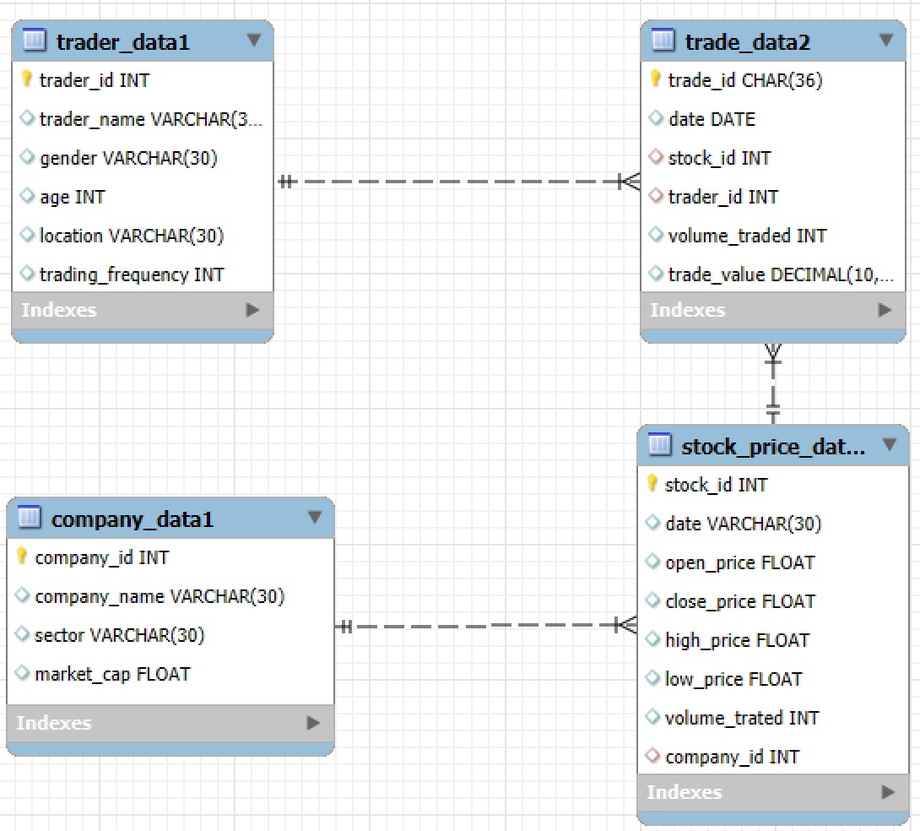
About Datasets
This project uses four integrated datasets to analyze stock market dynamics. The company_data file (500 rows × 5 columns) holds company-level info like ID, name, sector, and market cap. stock_price_data (50,000 rows × 7 columns) logs daily stock performance and links to companies via company_id. trade_data (200,000 rows × 6 columns) tracks trade transactions, connected to both stock_price_data via stock_id and trader_data via trader_id. The trader_data file (10,000 rows × 5 columns) stores trader demographics and behavior. These relational datasets enable powerful insights into company trends, stock performance, and trader activity.

Slide 5
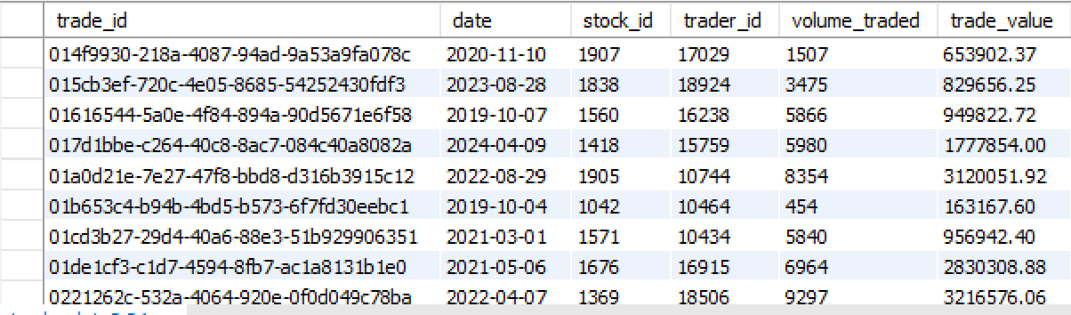
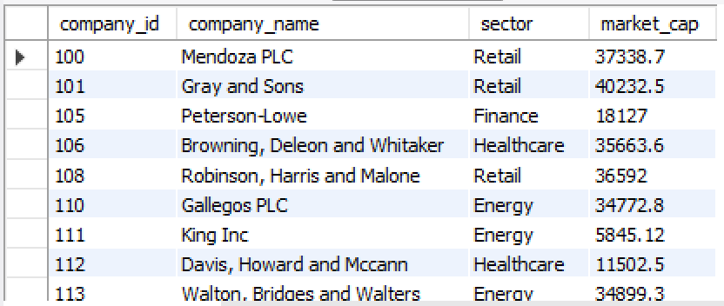
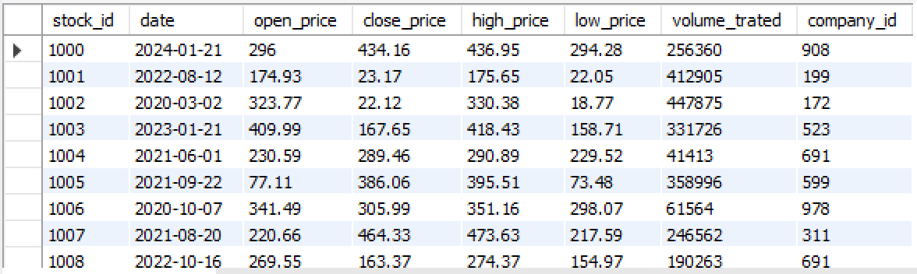
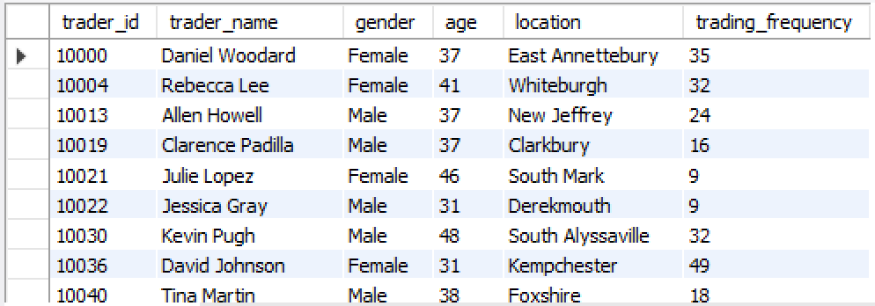
Overview of Datasets

Slide 6
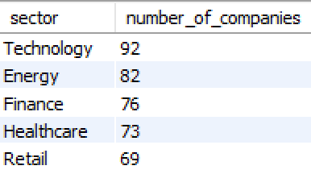
Analysis: 1
Which sector has the most listed companies?
Query:-
Output:-
Conclusion:-
The Technology sector has the highest number of listed companies, showing it’s a fast-growing and popular area for business and investment.

Slide 7
Why are more companies listed under the Technology sector compared to other sectors, and what business or market factors—like growth potential, investor interest, and trading activity—make the tech sector more attractive for public listings?
Question No:-1

Slide 8
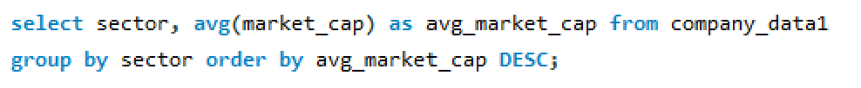
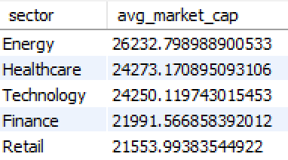
Step 1:What is the average market capitalization of technology companies compared to other sectors?
Result :-
Conclusion:- From a business perspective, the strong average market capitalization in the Technology sector indicates high investor confidence and growth potential, encouraging more companies to list there.

Slide 9

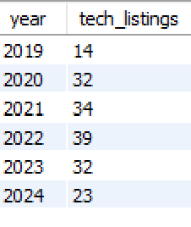
Step 2: How has the number of new tech companies changed over the years?
Result:-
Conclusion:- From 2019 to 2022, tech company listings steadily increased, indicating strong growth and investor interest. However, the decline in 2023 and 2024 suggests a market slowdown, requiring businesses to focus on innovation and strategic positioning.

Slide 10
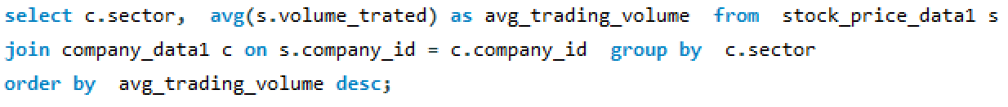
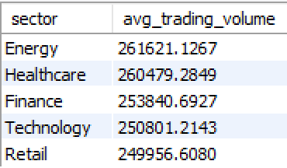
Step 3:- Do tech companies have higher trading volumes on average?
Conclusion:- technology companies do not have the highest average trading volume. The Energy sector shows the highest average trading volume, followed by Healthcare and Finance. Therefore, from a business perspective, focusing solely on the technology sector might not capture the highest trading activity in the market.

Slide 11
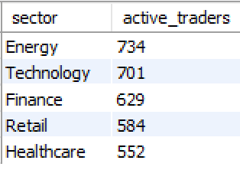
Step 4:-Which sectors have the highest number of active traders involved?
Conclusion:- The Energy sector attracts the highest number of active traders, suggesting significant speculative interest and liquidity in this area. While Technology has a substantial number of listed companies, the higher trader activity in Energy indicates potentially more short-term trading opportunities or volatility that draws in active participants.

Slide 12
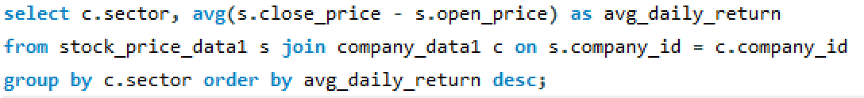
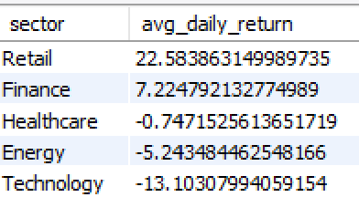
Step 5:- How does the performance of tech companies compare to others?
Conclusion:- Based on the average daily return, technology companies have underperformed compared to other sectors in this analysis. The Retail and Finance sectors show positive average daily returns, while Technology, along with Energy and Healthcare, exhibits negative returns, indicating an average daily decrease in stock price.

Slide 13
Conclusion
Easy to Start New Tech Companies: Lower costs mean more startups, increasing the pool of potential listed companies. (Relates to high number of companies)
Focus on Future Growth (Not Just Now): Investors and companies prioritize long-term potential and innovation over current trading or short-term returns. (Explains why high listing despite current underperformance)
Many Different Tech Areas: The wide variety of tech industries leads to a constant flow of new, specialized companies going public. (Supports high number of companies)
Strong VC Funding Leads to IPOs: Venture capital actively pushes tech startups towards IPOs, increasing listings. (Explains the continuous supply of new tech listings)

Slide 14
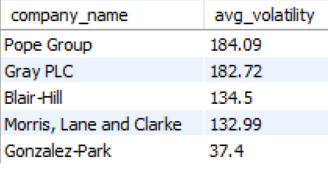
Analysis: 2
Among top 5 companies, which one shows the highest average stock volatility?
Query:-
Output:-
Conclusion:- From a business perspective, among the top 5 companies by market capitalization, Pope Group exhibits the highest average stock volatility. This suggests potentially higher risk but also greater short-term trading opportunities associated with Pope Group's stock compared to its peers.

Slide 15
Question No:-2
Should we invest in Pope Group, Gray PLC, Blair-Hill, Morris, Lane and Clarke, or Gonzalez-Park based on how their stock prices change (volatility) and other important factors for businesses and customers?

Slide 16
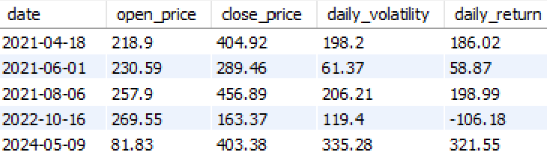
Step 1:- Is the high price volatility of Pope Group a sign of high risk or high potential reward for investors?
Conclusion:- From a business perspective, Pope Group's stock exhibits significant daily volatility and large swings in daily returns, indicating a potentially higher risk investment. However, these substantial price movements also present opportunities for short-term gains for investors with a higher risk tolerance and active trading strategies.

Slide 17

Step 2:- Are the companies with less volatile stock (like Gonzalez-Park) potentially safer but offer less exciting returns for investors?
Conclusion:- From a business standpoint, Gonzalez-Park demonstrates significantly lower average stock volatility compared to Pope Group, suggesting a potentially safer investment with more predictable price movements. However, its lower average daily return also implies potentially less opportunity for rapid, high gains compared to more volatile stocks.

Slide 18
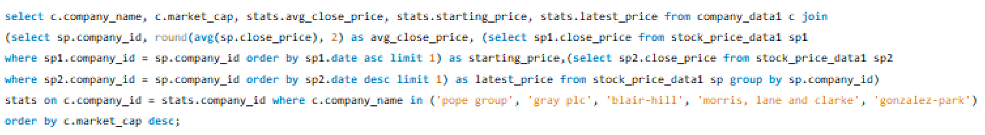
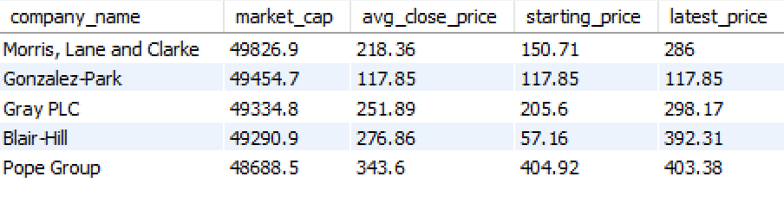
Step 3:- Are the companies with less volatile stock (like Gonzalez-Park) potentially safer but offer less exciting returns for investors?
Conclusion:- Gonzalez-Park's stock price doesn't change much. This might mean it's a safer investment, but it probably won't grow super fast.
Blair-Hill and Morris, Lane and Clarke have stock prices that go up a lot. This could mean they are growing faster, even if their prices are a bit more unpredictable.

Slide 19
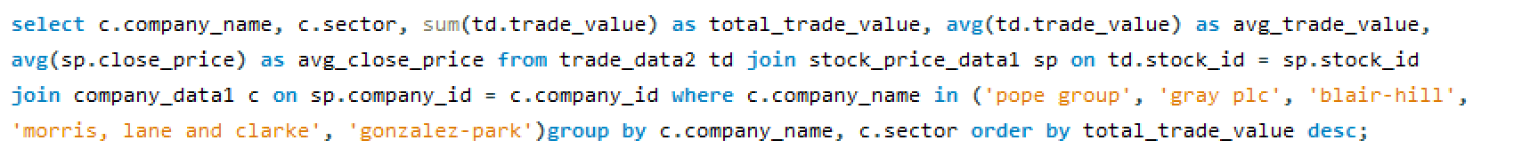
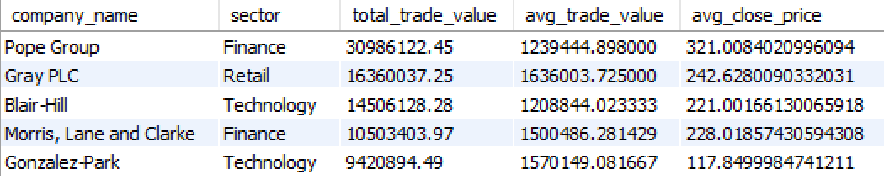
Step 4:- Do these companies provide valuable products or services that customers need, which would support the companies' stability and attractiveness to investors?
Conclusion:- particularly for Pope Group (Finance) and Gray PLC (Retail), suggest significant market activity and demand for their offerings. This strong trade volume and average close price indicate investor interest and likely reflects the perceived value of their products or services to customers, supporting the companies' stability.

Slide 20
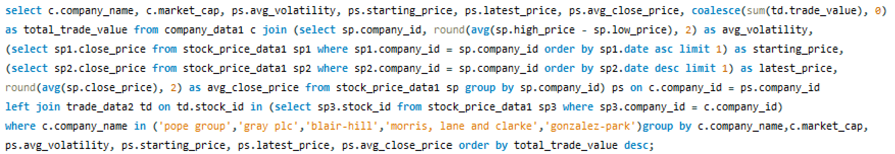
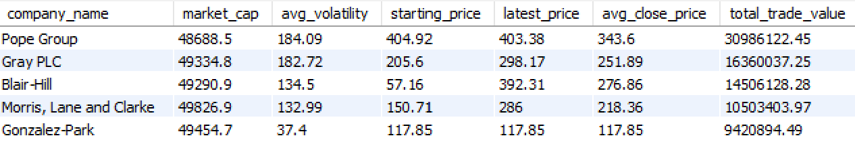
Step 5:- Considering potential gains and losses, do any of these companies align with the investment goals and risk tolerance of businesses or individual customers?
Conclusion:- Higher price swings (Pope, Gray) mean higher risk, but bigger potential profits. Lower swings (Gonzalez-Park) mean lower risk, but smaller potential profits. Choose based on your risk comfort.

Slide 21
Conclusion
High Risk/Reward: Pope Group & Gray PLC have big price swings, meaning big potential gains (or losses).
Low Risk/Reward: Gonzalez-Park has stable prices, safer but likely slower growth.
Growth Potential: Blair-Hill & Morris, Lane and Clarke show price increases, suggesting faster growth but maybe more price jumps.
Customer Demand: Pope Group & Gray PLC have a lot of trading, suggesting people want what they offer.
Your Choice: Invest based on how much risk you're comfortable with and how big you want your potential returns to be.

Slide 22
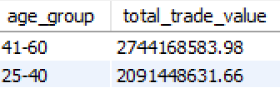
Analysis: 3
Which age group trades the most in terms of total trade value?
Query:-
Output:-
Conclusion:- The 41-60 age group accounts for the highest total trade value, indicating this demographic represents a significant portion of the investment capital and trading activity in the market. Businesses offering financial products and services should likely tailor their strategies and offerings to cater to the preferences and needs of this substantial age segment.

Slide 23
Since the 41–60 age group has a higher total trade value than the 25–40 group, how can businesses and financial institutions use the data (like age, location, and trading frequency) to understand why this is happening and use that knowledge to grow their business and attract more traders from both groups?
Question:-3

Slide 24
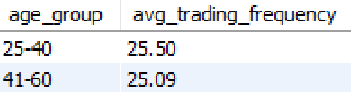
Step 1:- Do 41–60-year-olds trade more frequently than 25–40-year-olds?
Conclusion:- From a business view, the 41–60 age group trades less often but spends more per trade. This means marketing to them should focus on premium services, while for 25–40, it should encourage more frequent trading.

Slide 25
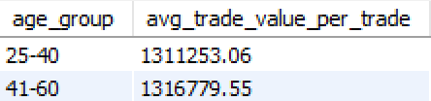
Step 2:- Is the average trade value per transaction higher for the 41–60 age group?
Conclusion:- The 41–60 age group has a slightly higher average trade value per transaction than the 25–40 group. This suggests they make larger investments per trade, indicating greater risk tolerance or financial capacity—businesses can target them with premium investment plans, while encouraging higher frequency trading in younger groups.

Slide 26
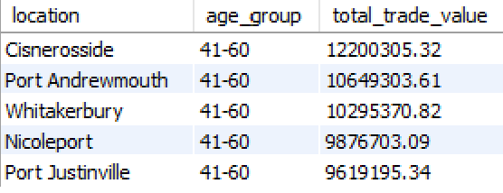
Step 3:- Are there specific locations where 41–60 traders dominate and invest more?
Conclusion:- The 41–60 age group invests the most in locations like Cisnerosside and Port Andrewmouth. These areas show strong trading potential among older investors, making them ideal targets for premium financial services, advisory offerings, or regional marketing campaigns.

Slide 27
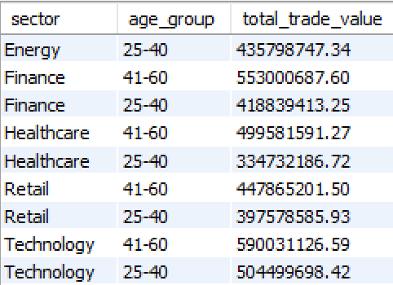
Step 4:- Which sectors or companies do 41–60 age group invest in more compared to 25–40?
Conclusion:- The 41–60 age group invests more in key sectors like Finance, Healthcare, Retail, and Technology compared to the 25–40 group. This highlights a strong preference for stable, essential industries—businesses can tailor premium investment products and sector-focused campaigns to attract and retain these high-value investors.

Slide 28
Conclusion
Older Investors (41-60): Focus on stable sectors like Finance and Healthcare, offering premium products and advisory services. Target regions like Cisnerosside and Port Andrewmouth where they trade more.
Younger Investors (25-40): Encourage more frequent trading with incentives and educational tools, as they trade often but in smaller amounts.
Tailored Marketing: Create separate strategies for each group—premium services for older investors and frequent trading rewards for younger ones.

Slide 29
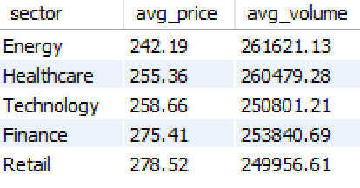
Analysis: 4
Which sector has the lowest average stock price and lowest trade volume?
Query:-
Output:-
Conclusion:- The Energy sector has the lowest stock price and fewer trades, which makes it a good option for new or budget-conscious investors. Businesses can use this insight to promote affordable investment plans and attract more people to start investing in this sector.

Slide 30
How can businesses make use of the affordability and low trading activity of the Energy sector to attract new or budget-conscious investors?
Question:-4

Slide 31
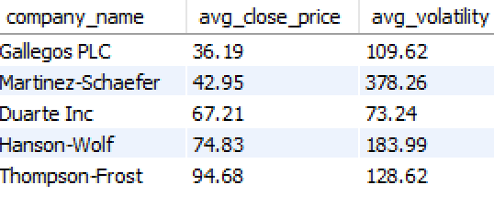
Step 1:- what factors make the energy sector appealing for first-time or low-budget investors?
Conclusion:- Several companies in the Energy sector offer low average stock prices (e.g., Gallegos PLC at $36.19), making them attractive for first-time or budget-conscious investors. Some also show low volatility (like Duarte Inc), indicating lower risk—businesses can use this to design affordable, beginner-friendly investment products to grow their investor base.

Slide 32
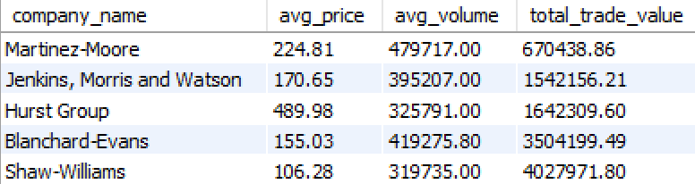
Step 2:- why is the trading volume low despite the low stock price?
Conclusion:- Despite low stock prices for some energy companies, trading volumes remain low due to limited investor interest or lack of market confidence. This suggests that price alone isn't driving demand—other factors like company performance, market perception, or sector trends may be influencing trading activity.

Slide 33
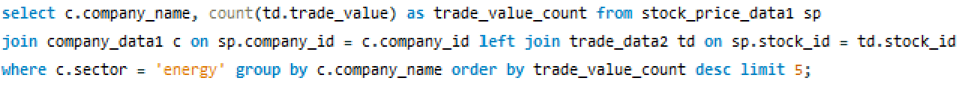
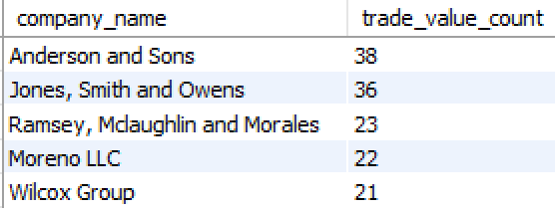
Step 3:- how can targeted marketing or investment education increase interest in the energy sector?
Conclusion:- The low number of trade transactions for energy companies highlights a gap in investor engagement. Targeted marketing campaigns and investment education initiatives could raise awareness, improve investor confidence, and stimulate trading activity within the sector.

Slide 34
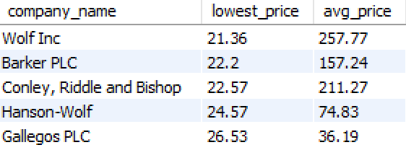
Step 4:- what kind of investment products or plans can be built around the energy sector to engage new investors?
Conclusion:- Several energy companies have historically low stock prices, making them attractive entry points for new investors. Designing affordable, beginner-friendly investment products like sector-based ETFs or SIPs can help engage risk-tolerant individuals and promote long-term participation in the energy sector.

Slide 35
Conclusion
Promote Low Prices:
Some energy stocks are cheap (like Gallegos PLC), which is great for beginners or people with smaller budgets.
Highlight Low Risk:
Some companies have stable prices (like Duarte Inc), which means less risk—this can be appealing to cautious investors.
Educate Investors:
Many people may not be investing because they don’t understand the sector. Simple education and guidance can help build their confidence.
Run Smart Marketing Campaigns:
Marketing can help change how people see the energy sector and show them it’s a good investment choice.
Offer Easy Investment Options:
Create simple products like low-cost plans or energy-focused investment packages to make it easier for new investors to get started.

Slide 36
Final Conclusion
Tech Sector Growth = More Listings:
The technology sector continues to attract public listings because it’s easier and cheaper to start tech companies, there's strong investor interest, and venture capital supports frequent IPOs.
Different Investors Need Different Offers:
Not all investors want the same thing—some prefer high-growth, high-risk stocks (like Pope Group), while others go for safer, stable investments (like Gonzalez-Park). Businesses should offer a mix of options to appeal to both.
Age Influences Investment Behavior:
Older investors (41–60) invest larger amounts in stable sectors, while younger ones (25–40) trade more often but with smaller amounts. Businesses can grow by offering tailored products and communication for each age group.
Energy Sector Has Untapped Potential:
Energy stocks are affordable and low-risk, making them perfect for new or budget-conscious investors. But they’re overlooked due to low awareness. With better education, marketing, and beginner-friendly plans, businesses can unlock this opportunity.

