Slide 1

Department of Electronics and Communication Engineering
MINOR PROJECT
Design and development of ECU system using CAN bus protocol for automotive applications
SL.NO. | NAME | USN | ROLL NO.
01 | Basavaraj Ishwar Mujagoni | 02FE22BEC015 | 17
02 | Diksha Dilip Nalawade | 02FE22BEC025 | 25
03 | Rahul Kundaragi | 02FE22BEC062 | 60
04 | Preeti Anand Paschapuri | 02FE22BEC053 | 51
Under the Guidance of
Dr. Vijay Rayar

Slide 2
Gantt Chart
Phases | Week1 | Week2 | Week3 | Week4 | Week5 | Week6 | Week7 | Week8 | Week9 | Week10
Project Design
Component Selection
Hands-on Training with Tools
Simulation Design
Complete Hardware Model
Test and debug

Slide 3
WBS(Work Breakdown Structure)
Design and development of ECU system using CAN bus protocol for automotive applications
Problem statement
Deciding the type of ECU
Listing required Peripherals, i.e., in Perception, CAN protocol and Actuation unit
Lidar/Camera for Obstacle detection using
Bot motor direction control for actuation
Suitable module for CAN comm. between ECUs
Display for infotainment
Arduino IDE for ESP32 in Perception ECU and STM32 Nucleo in Actuation ECU
Communication between devices using MCP2515 CAN transceiver module
Software simulation of the Total design using
Lidar module data is sent through CAN bus and direction control of motors and infotainment display
Project Design
Component Selection
Hands on Training with tools
Simulation Design
Complete Hardware model

Slide 4
Input Specification
A suitable Lidar module TF-Luna module is used for Obstacle detection
The TF-Luna module is interfaced with ESP32 using Arduino IDE
The input data is then transmitted using MCP2515 CAN transceiver to the transceiver of output unit.

Slide 5
Output specification
The input data is received on the output side via the 2nd MCP2515 CAN Transceiver.
Based on the Obstacle detected information the vehicle direction is controlled
Suitable information is display on the OLED display for infotainment services

Slide 6
Functional Block Diagram
Motors direction control
TF-Luna Obstacle Detection
ESP32
MCP2515
CAN transceiver
CAN BUS
MCP2515
CAN transceiver
STM32 Nucleo
Infotainment OLED display

Slide 7
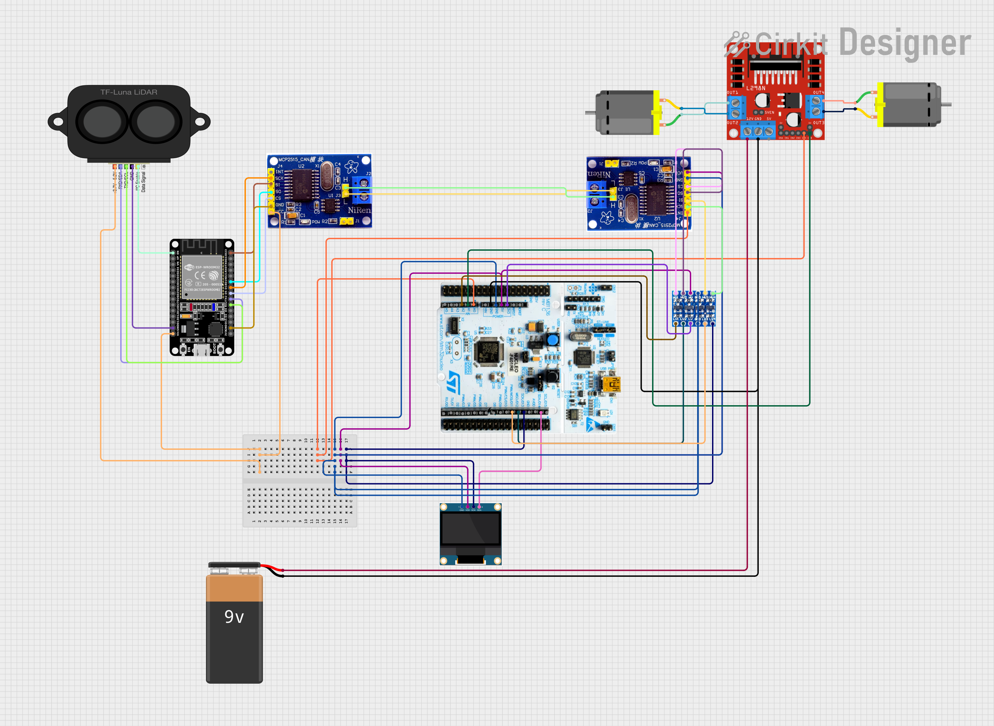
Software Simulation

Slide 8
Thank you

