Slide 1
Spot The Scam
Fraudulent Job Posting Detector
Alice Karakachian, David Pu, David Nguyen,
Sai Ananya Channamsetti, Lakshmi Gayathri Divakaruni

Slide 2
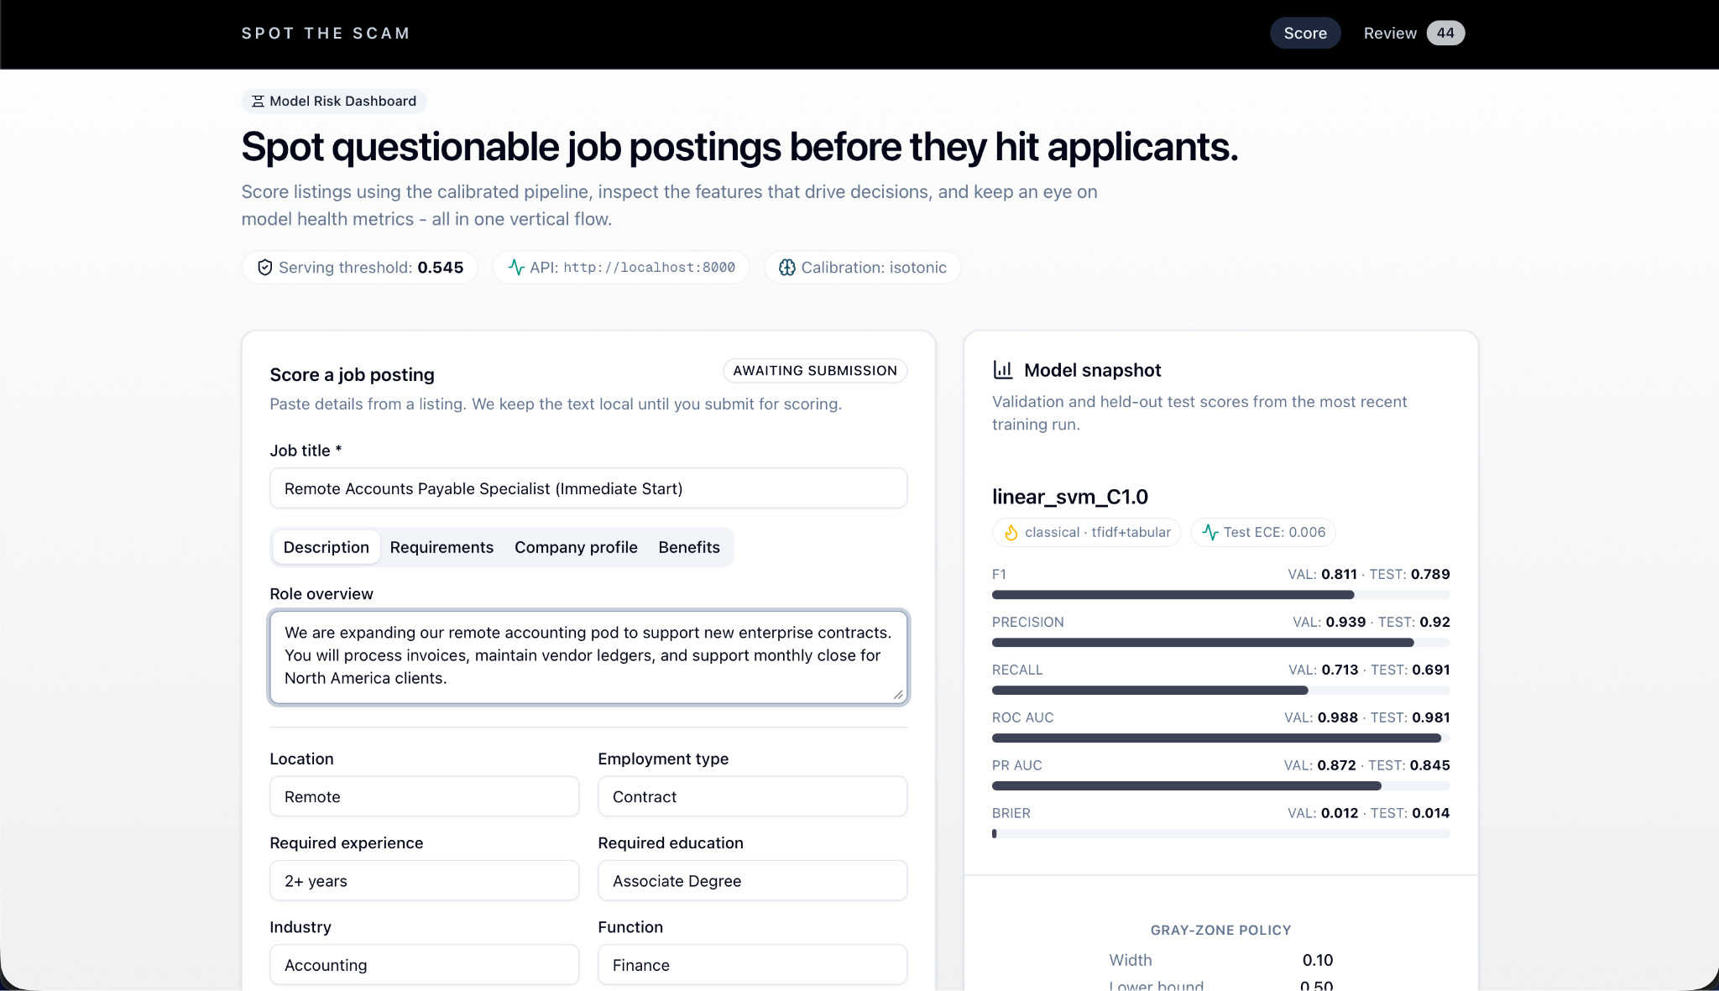
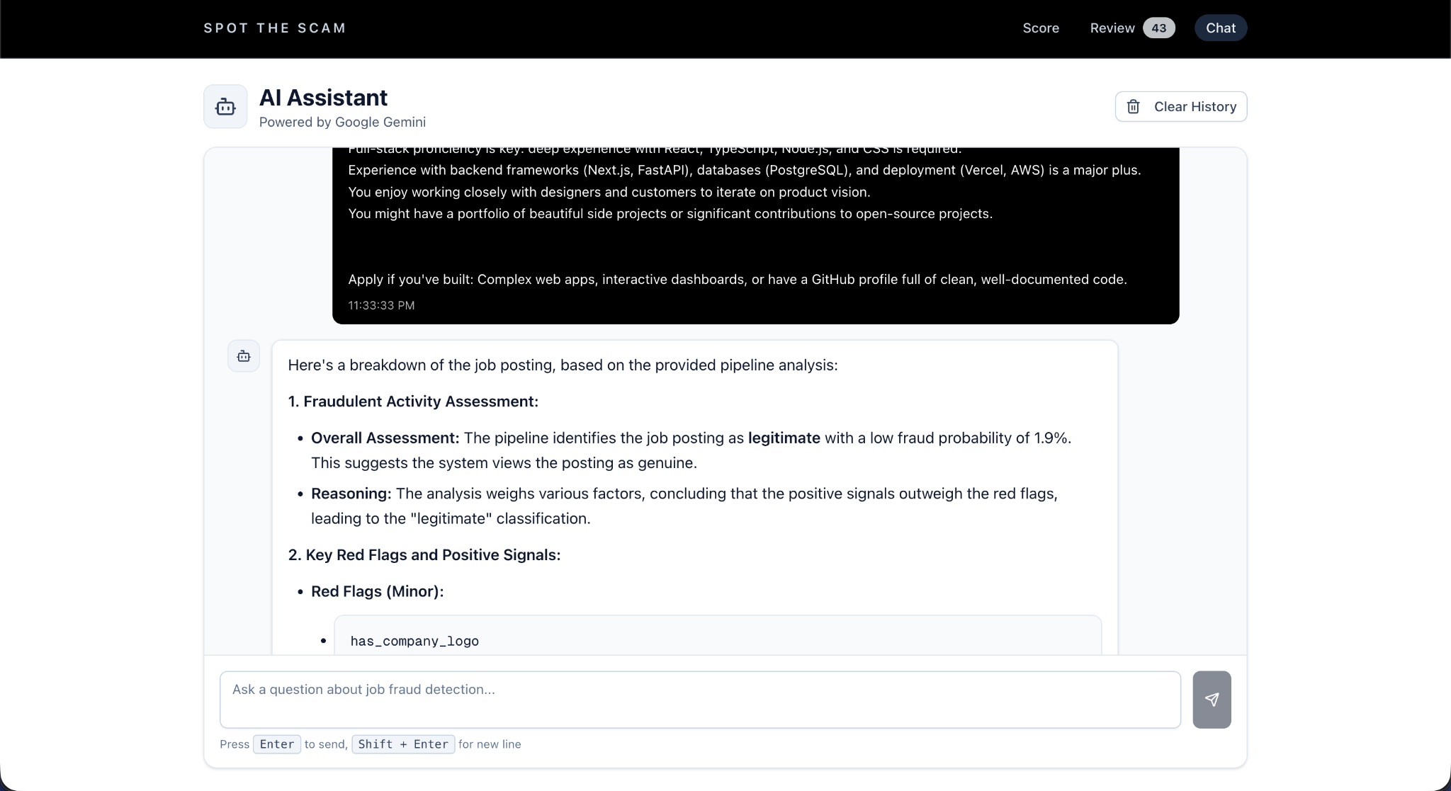
Introduction
The Problem:
Technology has increased accessibility to information about employment opportunities
However, with this, there has also been an increase in fraudulent job postings
Collecting personal information, trying to take job seekers’ money through upfront fees
Our project:
Aim: Improve the accuracy of the identification of fraudulent job postings
Our solution: full-stack application that applies both classical and transformer models to this modern problem
Notes:
Speaker notes:
Many AI/ML methods have been developed so far to identify fake job postings which show promising results
However certain ambiguous or poorly formatted job descriptions still present challenges for accurate identification

Slide 3
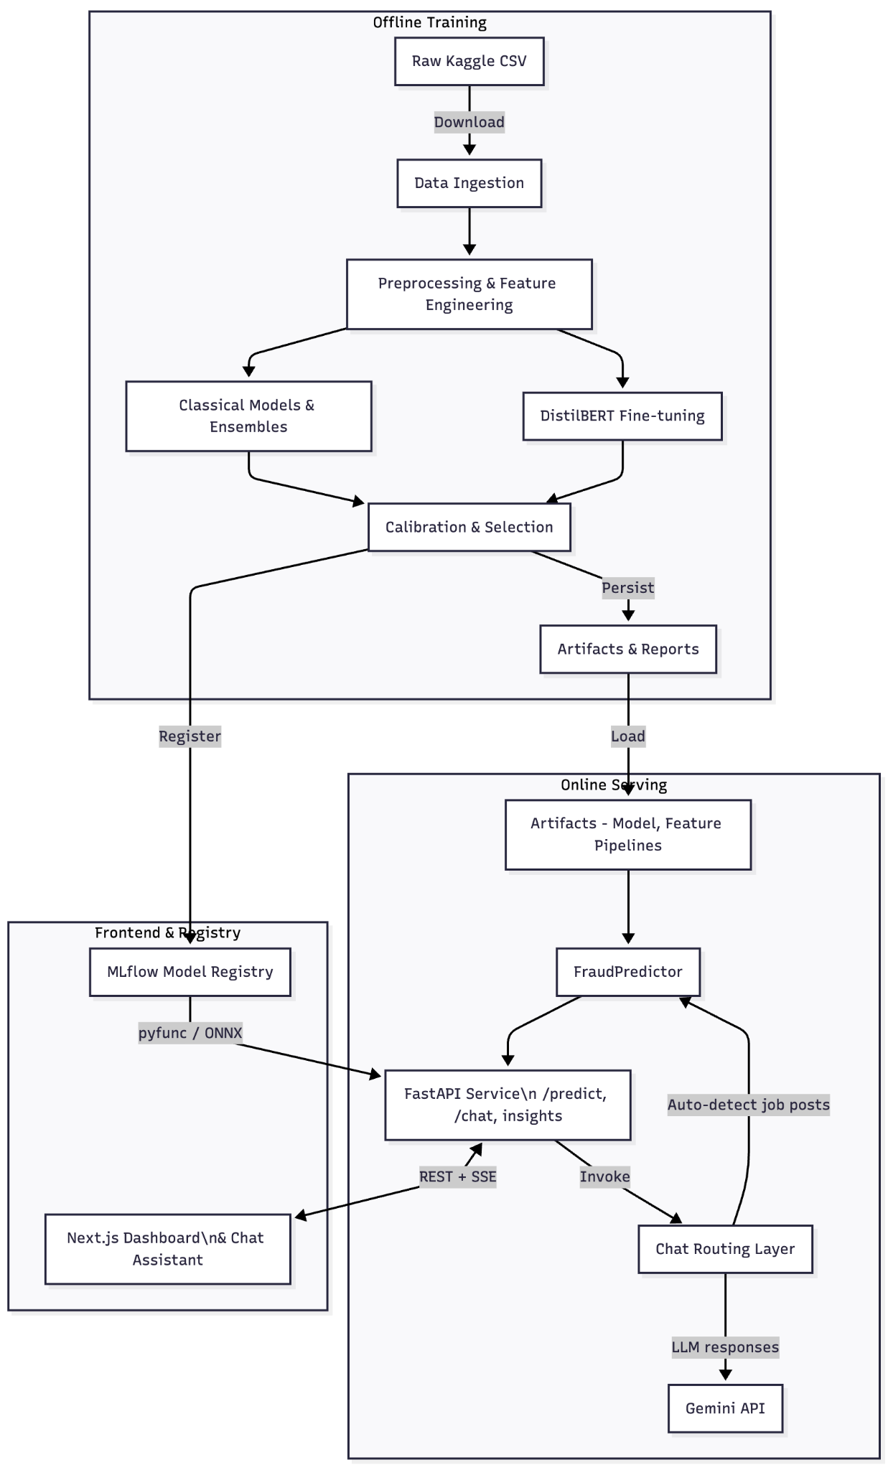
Methods
Kaggle job-post datasets merged. Used 70/15/15 split for model training, validation, and testing.
Classical models: Logistic Regression, Linear SVM, LightGBM, XGBoost
Transformer model: fine-tuned DistilBERT classifier
All candidates tuned and ranked by validation F1; best calibrated model evaluated on test
Gemini API chatbot wraps the model using conversation history, job fields, and model outputs to produce natural language responses
Notes:
First, we combined the two raw Kaggle job-posting datasets and merge relevant text columns into a single feature called text_all.
On top of this, we train several classical models - logistic regression, linear SVM, LightGBM, and XGBoost - as well as a fine-tuned DistilBERT classifier with the training set. FYI, we used 70% of the samples for model training, 15% for validation, and 15% for testing.
All candidates are then hyperparameter-tuned, calibrated where needed, and compared on a held-out validation set using their F1 scores.
The best-performing calibrated model is then frozen and evaluated once on the test data.
Finally, we plug that model into a Gemini-based chatbot, which uses the conversation context plus job fields and model scores to explain whether a posting looks suspicious in natural language.
Here is a flow chart outlining the full lifecycle of the training pipeline, from raw data ingestion, preprocessing and model training to model testing, validation, and serving.

Slide 4
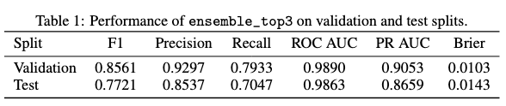
Results
Validation winner: calibrated classical ensemble ensemble_top3, selected over transformer baselines by validation F1
Generalizes well: strong F1 on validation and test with high ROC/PR AUC and low Brier (see table)
Notes:
Model comparison & selection: We trained multiple classical and transformer models on validation data. The ensemble_top3 model achieved the highest validation F1 and was locked in for a single test run.
So, what is ensemble_top3? The idea behind this is that we combined the top 3 models into a single one by averaging their probability predictions - which is like getting multiple expert opinions from multiple models. This thus reduces individual model weaknesses and improves robustness and generalization.
Strong generalization: Modest F1 drop from validation to test shows the model doesn't overfit the training data. The model also maintains a good precision >0.85 (which signals accurate fraud flags) and recall >0.70 (which means it catches most fraud) on unseen data.
High-quality probabilities: High ROC/PR AUC scores also show that the model ranks examples excellently. Low Brier scores further confirm that probability estimates are well-calibrated and trustworthy for production use.
→ Thus, the balanced precision/recall trade-off and calibrated probabilities make this model reliable for real-world deployment where users need accurate risk scores, and not just binary decisions.

Slide 5
References
[1] Sultana Umme Habiba, Md Khairul Islam, and Farzana Tasnim. A comparative study on fake job post prediction using different data mining techniques. In 2021 2nd international conference on robotics, electrical and signal processing techniques (ICREST), pages 543–546. IEEE, 2021.
[2] Vijay Madaan, Neha Sharma, Raghubeer Singh Bangari, and Srinivas Aluvala. Fraudulent job posting detection using logistic regression. In 2024 International Conference on Information Science and Communications Technologies (ICISCT), pages 1–6. IEEE, 2024.
[3] Gayathri Malaichamy, Cristina Hava Muntean, and Anderson Augusto Simiscuka. Online job posting authenticity prediction with machine and deep learning: Performance comparison between n-gram and tf-idf. In International Conference on Deep Learning Theory and Applications, pages 143–162. Springer, 2024.
[4] K Ramakrishna Reddy, G Indrani, N Pavan Kumar, and K Vamshi Krishna. Fake job posting detection using machine learning algorithms. In 2025 4th International Conference on Innovative Mechanisms for Industry Applications (ICIMIA), pages 822–827. IEEE, 2025.
[5] K. Suparna and R. Anil Kumar. A comparative study on fake job post prediction using different datamining techniques. International Journal of Information Technology and Computer Engineering, 12(3):317–323, 2024

Slide 6

GitHub Repo
Thank you!

