Slide 1
Resolve IT Smart Grievance and Feedback Management System R.S.DIKSHA

Slide 2

TOOLS AND TECH STACK USED IN PROJECT
LANGUAGES IN FRONTEND :
Html, CSS, JAVASCRIPT
BACKEND:
JAVA SPRINGBOOT
For designing:
ADOBE EXPRESS
FOR UI/UX DESIGN:
CANVA, FIGMA, ADOBE EXPRESS
DATABASE:
MySQL
REPOSITORY:
GIT AND GITHUB

Slide 3
Completed the tasks for Sprint 3
A fully functional STAFF DASHBOARD
Page for selecting the type of grievances
Submit page for feedback and complaints
DATABASE INTEGRATION AND VALUES ADDITION
Backend integration WITH FRONTEND
IMPROVE BACKEND CODE QUALITY

Slide 4
Feature Document
Feature No. | Feature | Description | Status | Further Plans
1 | User Login | Permits the user to login into their dashboard | Completed | Verification through bill id
2 | Admin Login | Allows the Admin to login into the dashboard | Completed | Creating a crew login page
3 | User Dashboard | The User can view their history and register complaints in this page | Completed | Making the page completely functional
4 | Profile and Logout Page | The user can view their profile details and logout | Completed | Adding and editing profile details
5 | Admin Dashboard | Admin views and allocates to departments | Completed | Making a working page

Slide 5
Feature Document for Sprint 2
Feature No. | Feature | Description | Status | Further Plans
1 | Database using MySQL | Designed and created MySQL tables for users, complaints and admin & feedback | Completed | Might Require Improvisation in future
2 | Backend codes | Core backend layers including Controllers, Services, DAOs, Models | Completed | Improve performance
3 | Setting Up of the Backend | Configured Spring Boot project structure & dependencies | Completed | Add more features
4 | Authentication and Authorization | Secure login for User and Admin roles | Completed | Role-based restrictions for staff
5 | JWT Token Generation | Added JWT-based authentication to generate secure access tokens | Completed | Implement refresh tokens

Slide 6
Feature Document for Sprint 3
Feature No. | Feature | Description | Status | Further Plans
1 | User Dashboard Functional | A fully functional dashboard for the user dashboard | Completed | Improvisation
2 | Staff Dashboard | Staff dashboard which is fully functional | Completed | Improvisation
3 | Staff Dashboard Functional | The dashboard with fully functional | Completed | Improvisation
4 | Feedback Page | User Interface that gets feedback | Completed | Improvisation
5 | Integration to Backend | When the User Logs in the details in Database | Completed | Improvisation

Slide 7
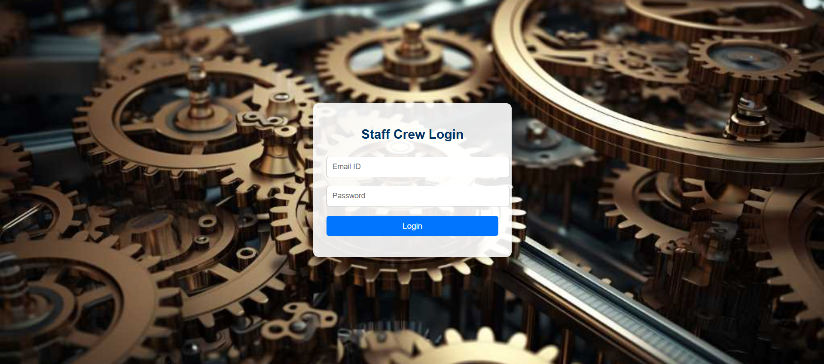

Slide 8
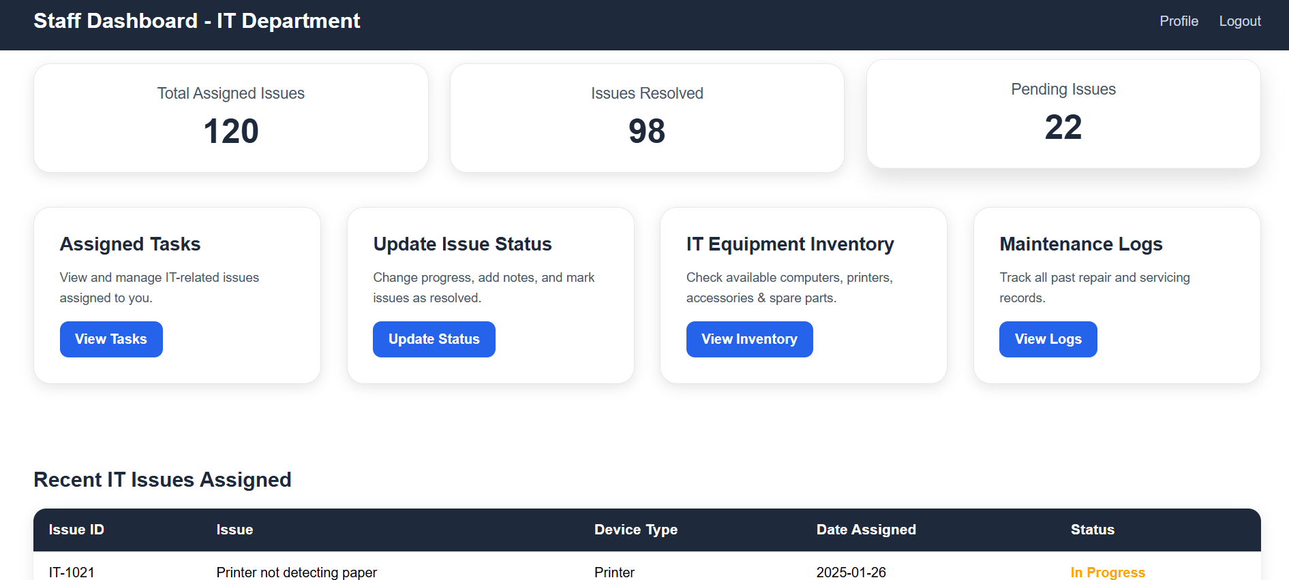

Slide 9
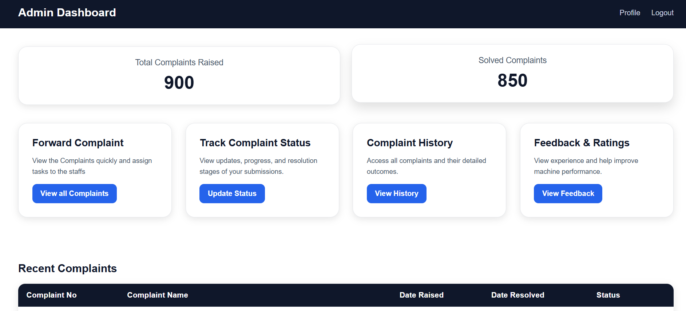

Slide 10
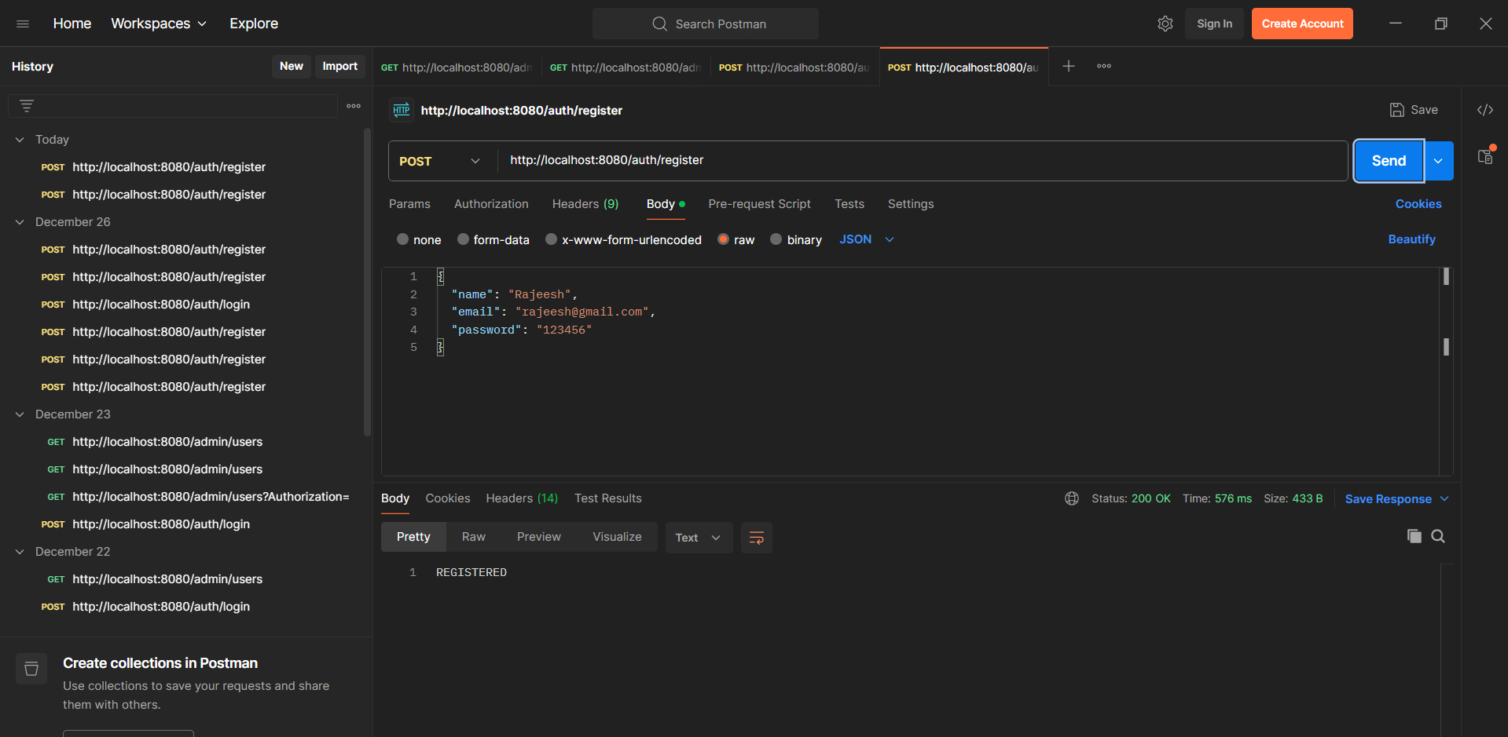

Slide 11
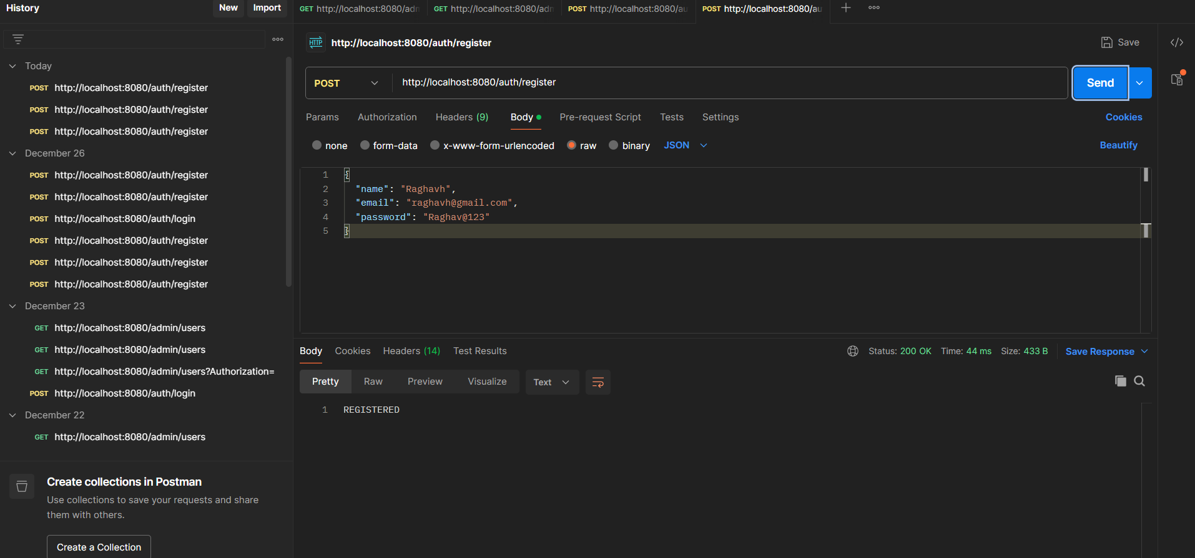

Slide 12
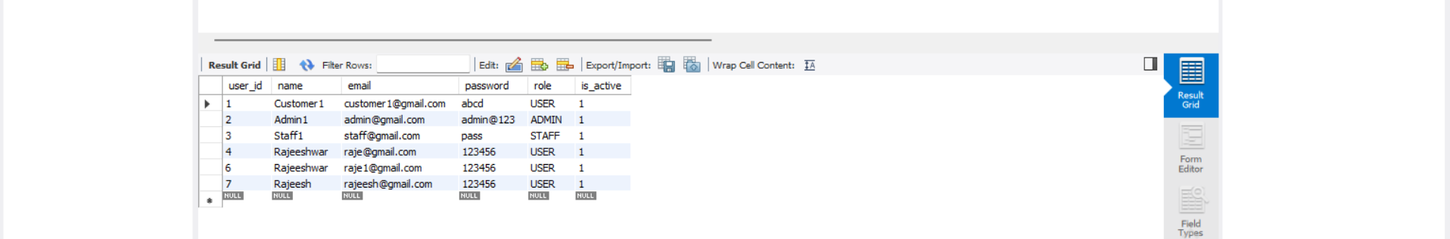

Slide 13
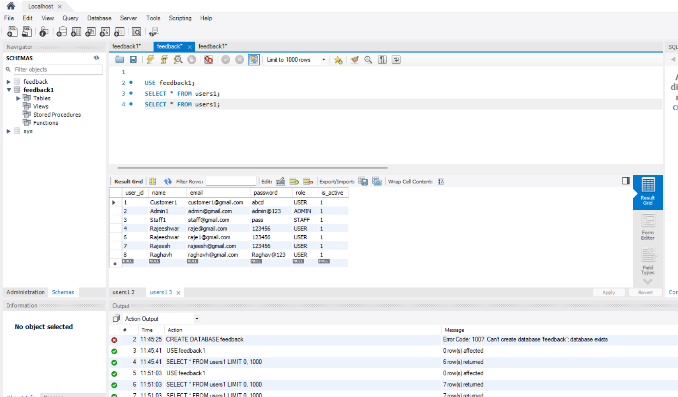

Slide 14
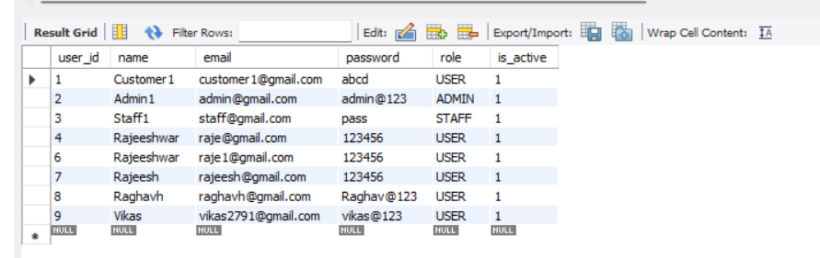

Slide 15
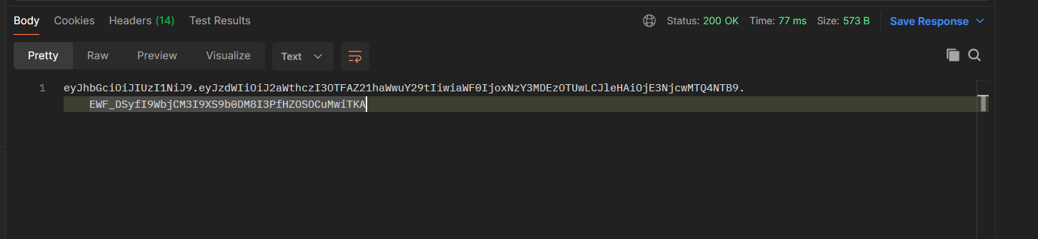

Slide 16
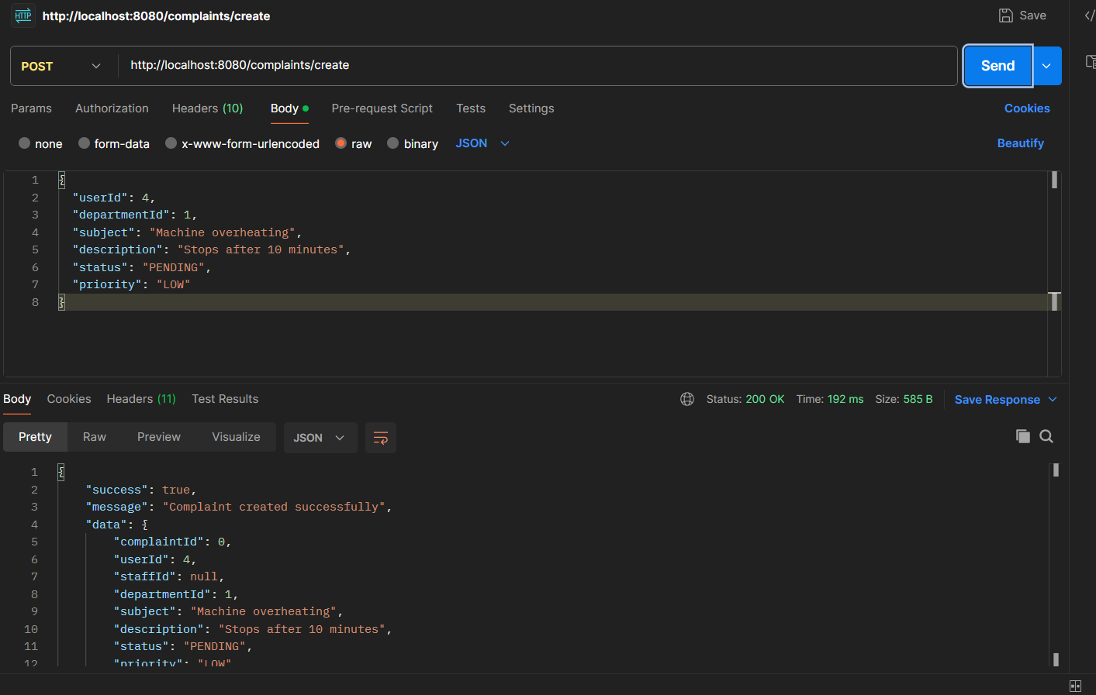

Slide 17
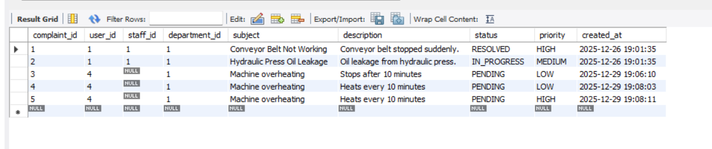

Slide 18
Sprint 3 Analysis and Requirements
DATABASE USING MYSQL
Designed and created MySQL tables for users, complaints and admin & feedback
BACKEND STRUCTURE
Configured Spring Boot project structure & dependencies
AUTHORIZATION
Secure login for User and Admin roles
BACKEND CODES USING JAVA
Core backend layers including Controllers, Services, DAOs, Models
TOKEN GENERATION
Added JWT-based authentication to generate secure access tokens
VERIFICATION USING POSTMAN
Using postman for ensuring the access

Slide 19
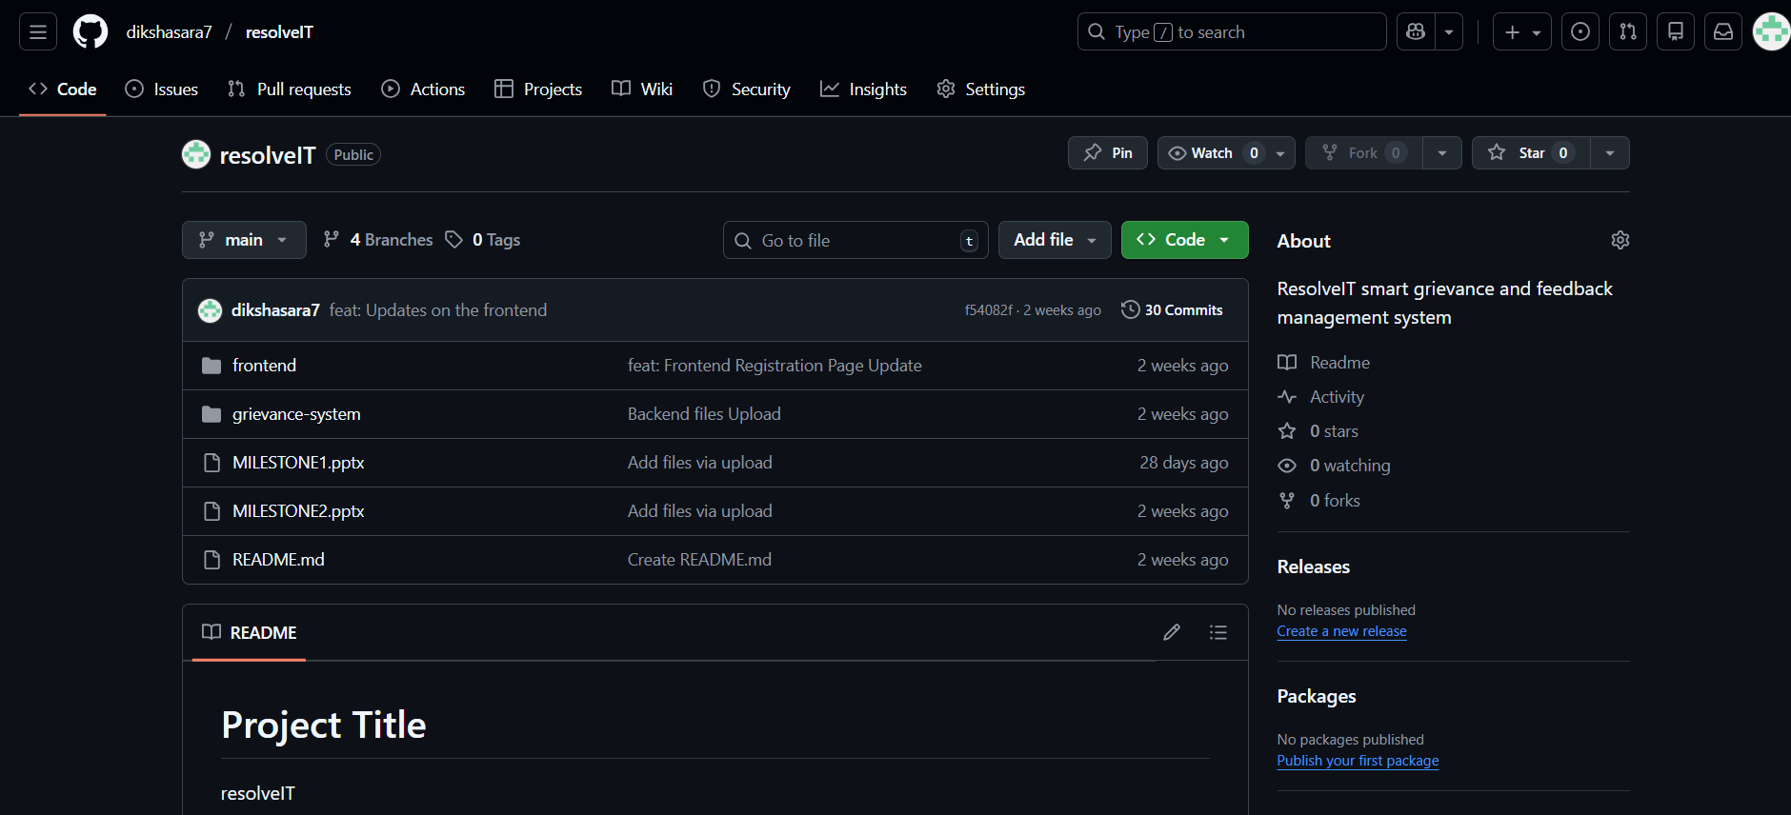
Current Github

Slide 20
GITHUB

Slide 21
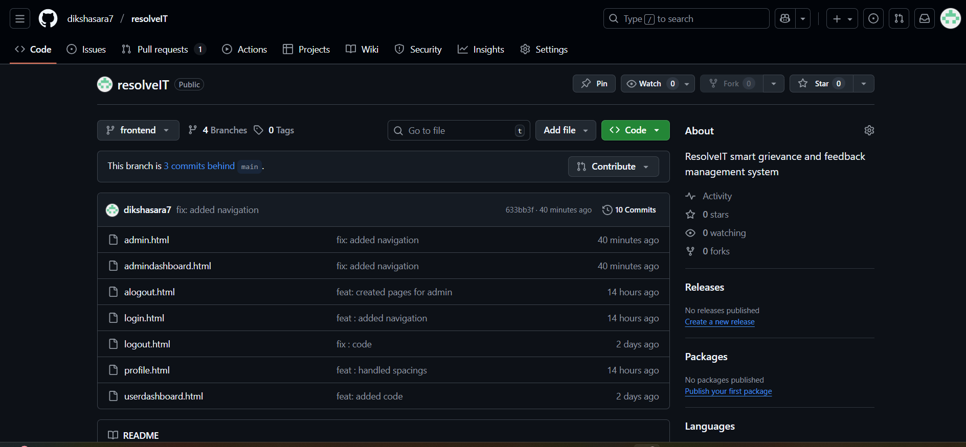
Git hub for Frontend

Slide 22
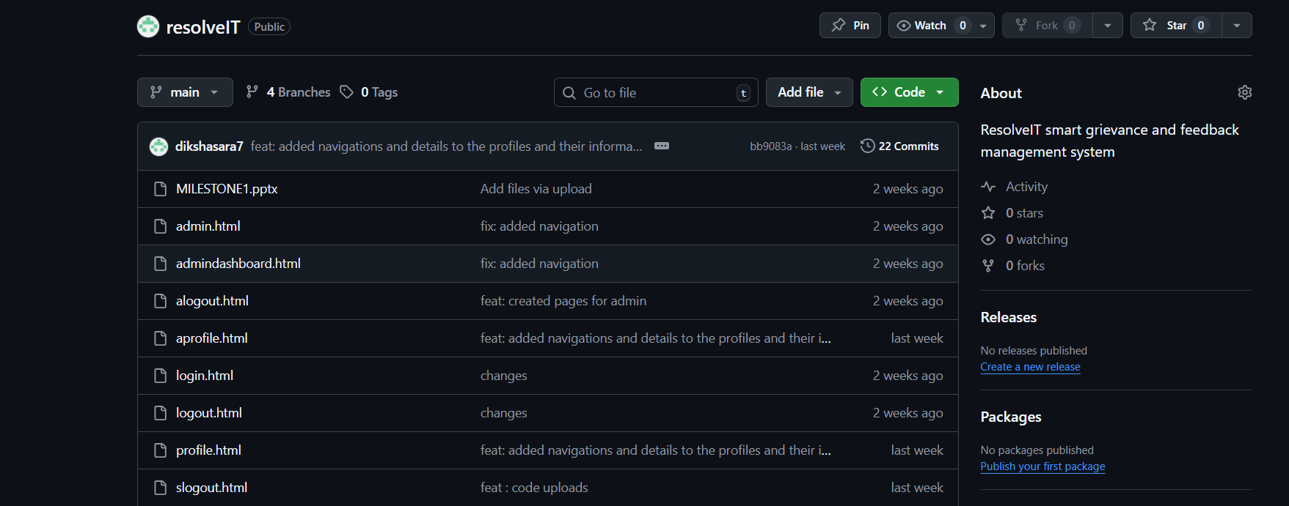
Git hub Sprint 1

Slide 23
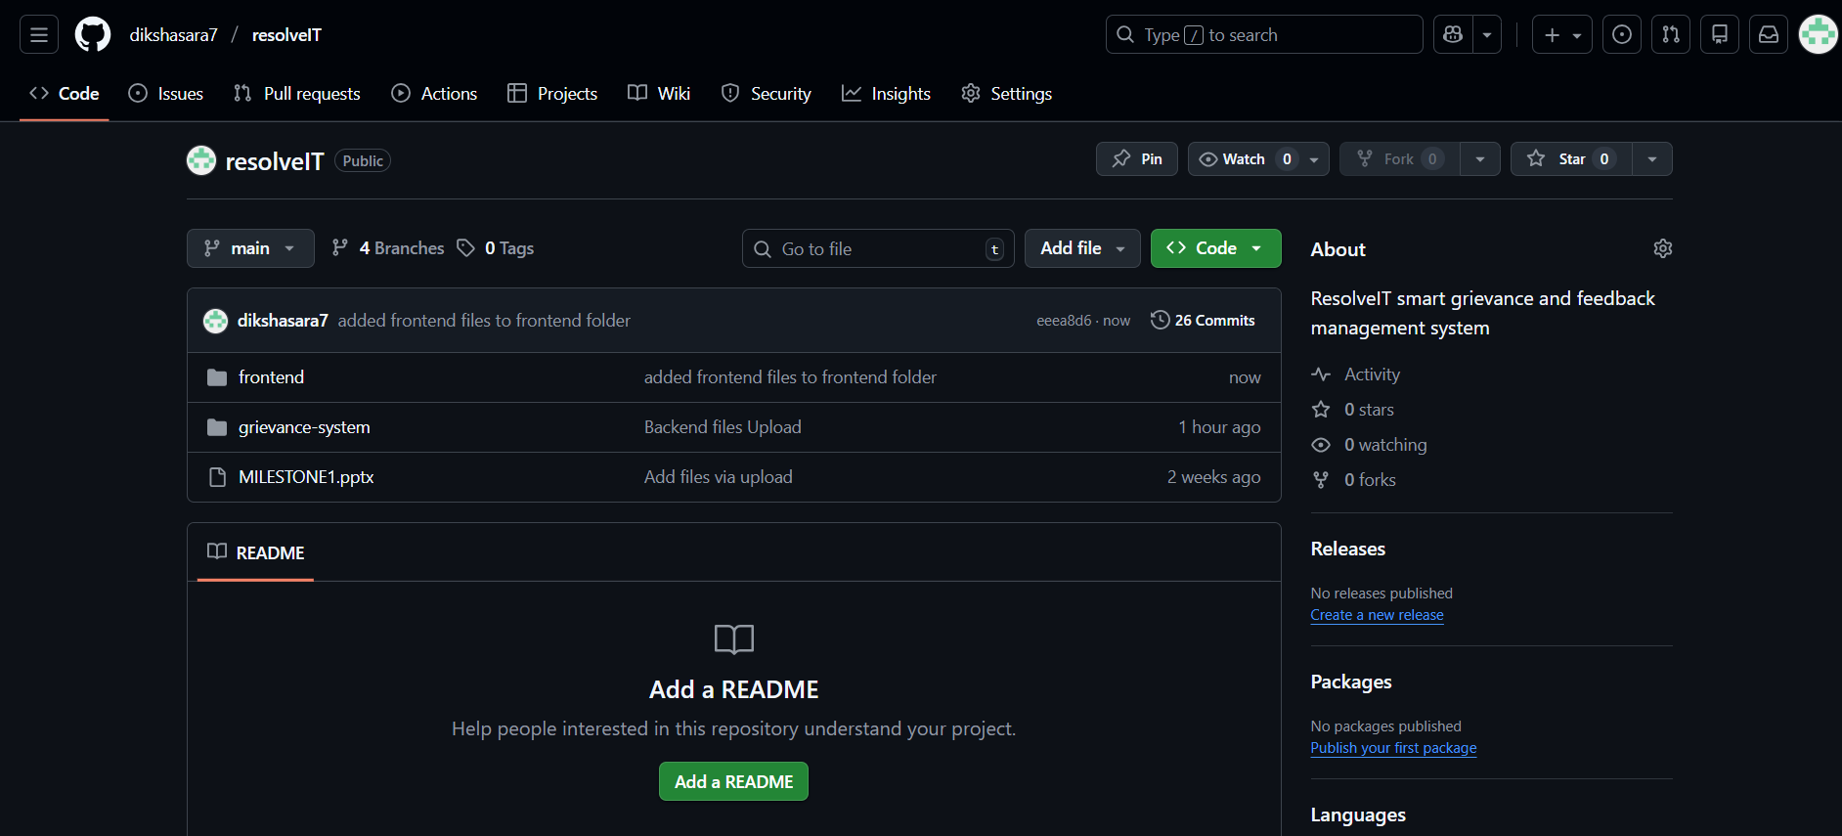
Folder Wise Organized

