Slide 1

Resolve IT Smart Grievance and Feedback Management System
Name: R.S.DIKSHA

Slide 2
Resolve IT Smart Grievance and Feedback Management System
PROCESS ONE: USER REGISTRATION AND LOGIN SYSTEM
PROCESS two: GRIEVANCES SELECTION AND SUBMISSION
PROCESS three: Complaint submission page
PROCESS four: Complaint transfer to respective departments
PROCESS five: RESOLVING THE COMPLAINT
PROCESS six: COLLECTING FEEDBACK

Slide 3
PROBLEM STATEMENT
KEY ISSUES THAT LEAD TO THE PROJECT DESIGN
Grievances and feedback management features are often overlooked in many commercial websites, resulting in poor handling of customer issues and service dissatisfaction. For machinery purchases in particular, customers frequently face problems or require support, yet there is no dedicated platform to report issues, track resolutions, or share feedback. This lack of a structured system creates delays, confusion, and loss of trust.

Slide 4
OBJECTIVE
THE OBJECTIVE OF THE PROJECT
A dedicated grievances and feedback management system for machinery buyers becomes essential to ensure timely support, transparent communication, and improved customer experience. Building a Smart Grievances System for a Company that works on Machineries for various Offices, Vehicles, Homes and Industries are quite challenging to manage where a feedback system would help it be more organized.

Slide 5
Feature Document
Feature No. | Feature | Description | Status | Further Plans
1 | User Login | Permits the user to login into their dashboard | Completed | Verification through bill id
2 | Admin Login | Allows the Admin to login into the dashboard | Completed | Creating a crew login page
3 | User Dashboard | The User can view their history and register complaints in this page | Completed | Making the page completely functional
4 | Profile and Logout Page | The user can view their profile details and logout | Completed | Adding and editing profile details
5 | Admin Dashboard | Admin views and allocates to departments | In Progress | Making a working page

Slide 6
Feature Document for Sprint 2
Feature No. | Feature | Description | Status | Further Plans
1 | Database using MySQL | Designed and created MySQL tables for users, complaints and admin & feedback | Completed | Might Require Improvisation in future
2 | Backend codes | Core backend layers including Controllers, Services, DAOs, Models | Completed | Improve performance
3 | Setting Up of the Backend | Configured Spring Boot project structure & dependencies | Completed | Add more features
4 | Authentication and Authorization | Secure login for User and Admin roles | Completed | Role-based restrictions for staff
5 | JWT Token Generation | Added JWT-based authentication to generate secure access tokens | Completed | Implement refresh tokens

Slide 7
Feature Document for Sprint 3
Feature No. | Feature | Description | Status | Further Plans
1 | User Dashboard Functional | A fully functional dashboard for the user dashboard | Completed | Improvisation
2 | Staff Dashboard | Staff dashboard which is fully functional | Completed | Improvisation
3 | Staff Dashboard Functional | The dashboard with fully functional | Completed | Improvisation
4 | Feedback Page | User Interface that gets feedback | Completed | Improvisation
5 | Integration to Backend | When the User Logs in the details in Database | Completed | Improvisation

Slide 8

TOOLS AND TECH STACK USED IN PROJECT
LANGUAGES IN FRONTEND :
Html, CSS, JAVASCRIPT
BACKEND:
JAVA SPRINGBOOT
For designing:
ADOBE EXPRESS
FOR UI/UX DESIGN:
CANVA, FIGMA, ADOBE EXPRESS
DATABASE:
MySQL
REPOSITORY:
GIT AND GITHUB

Slide 9
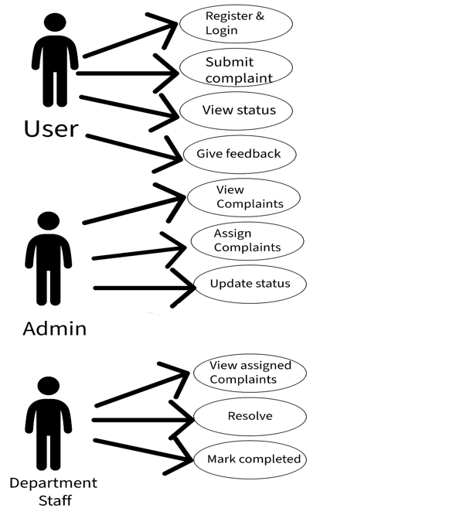
USE CASE DIAGRAM WITH 3 ACTORS

Slide 10
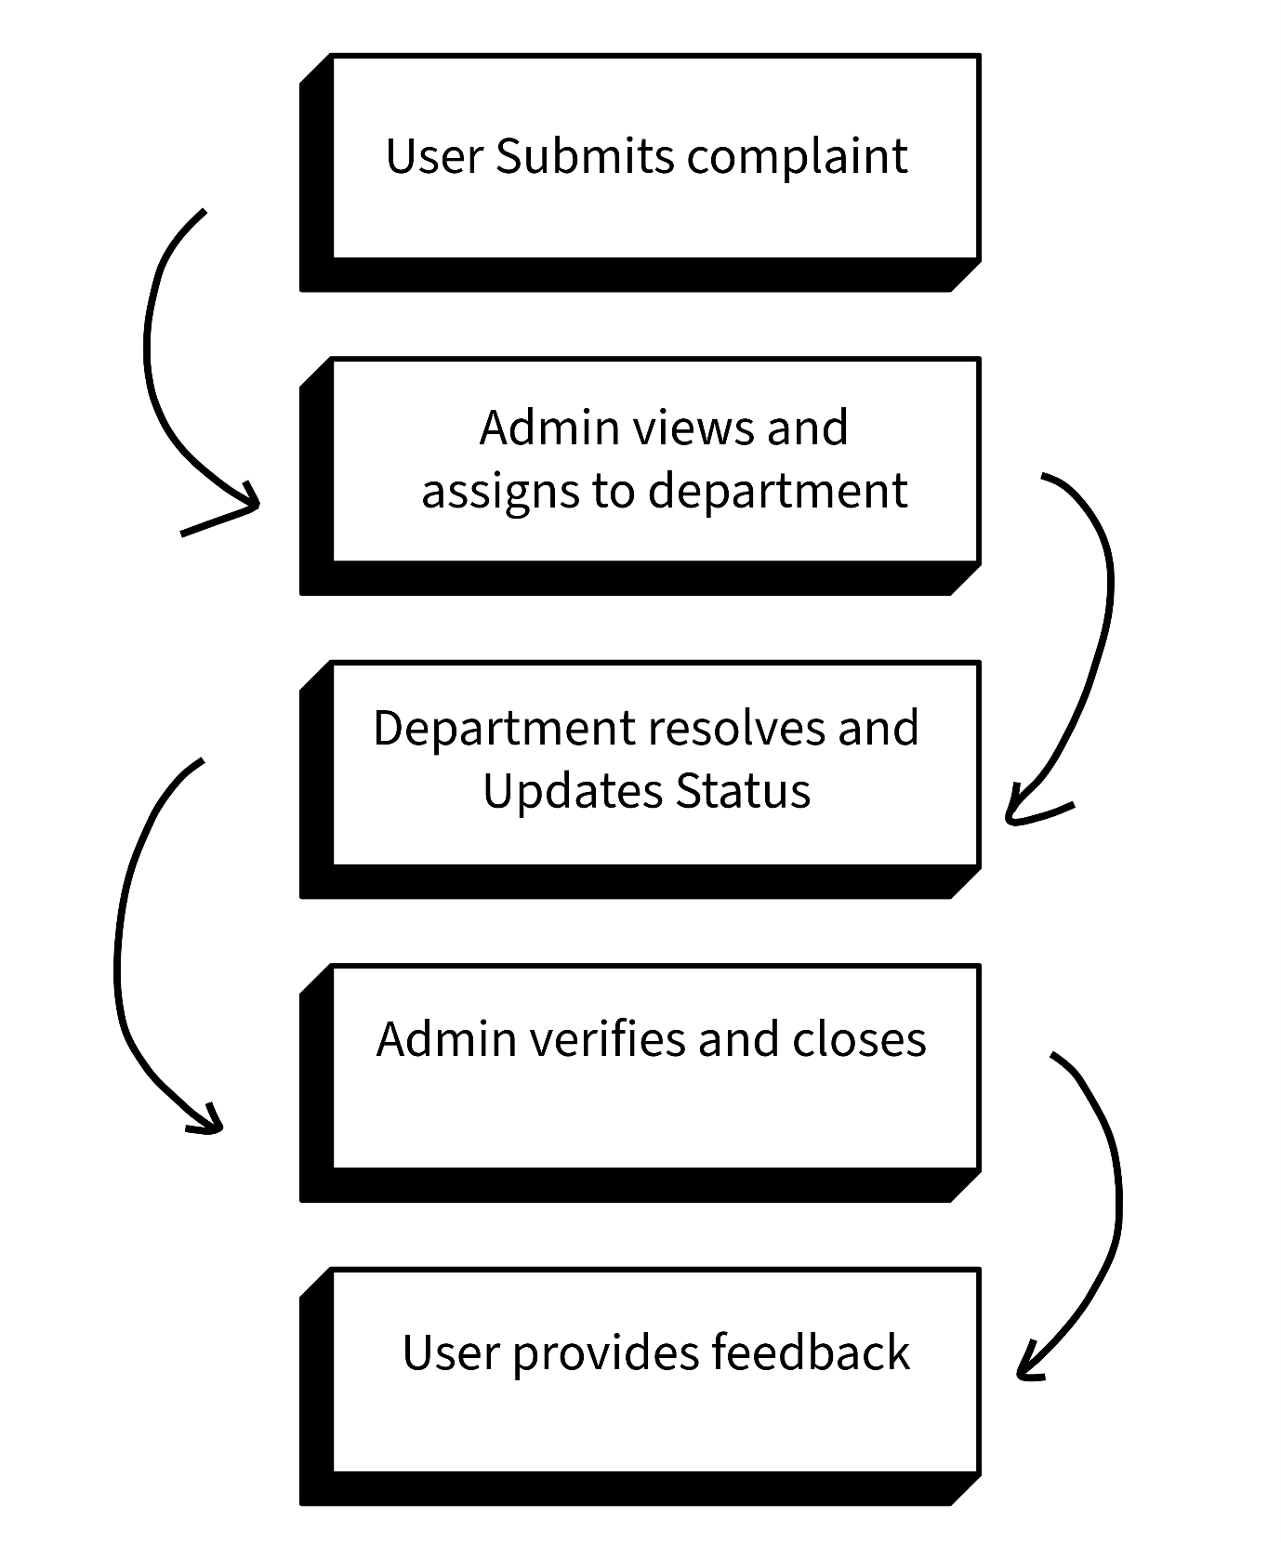
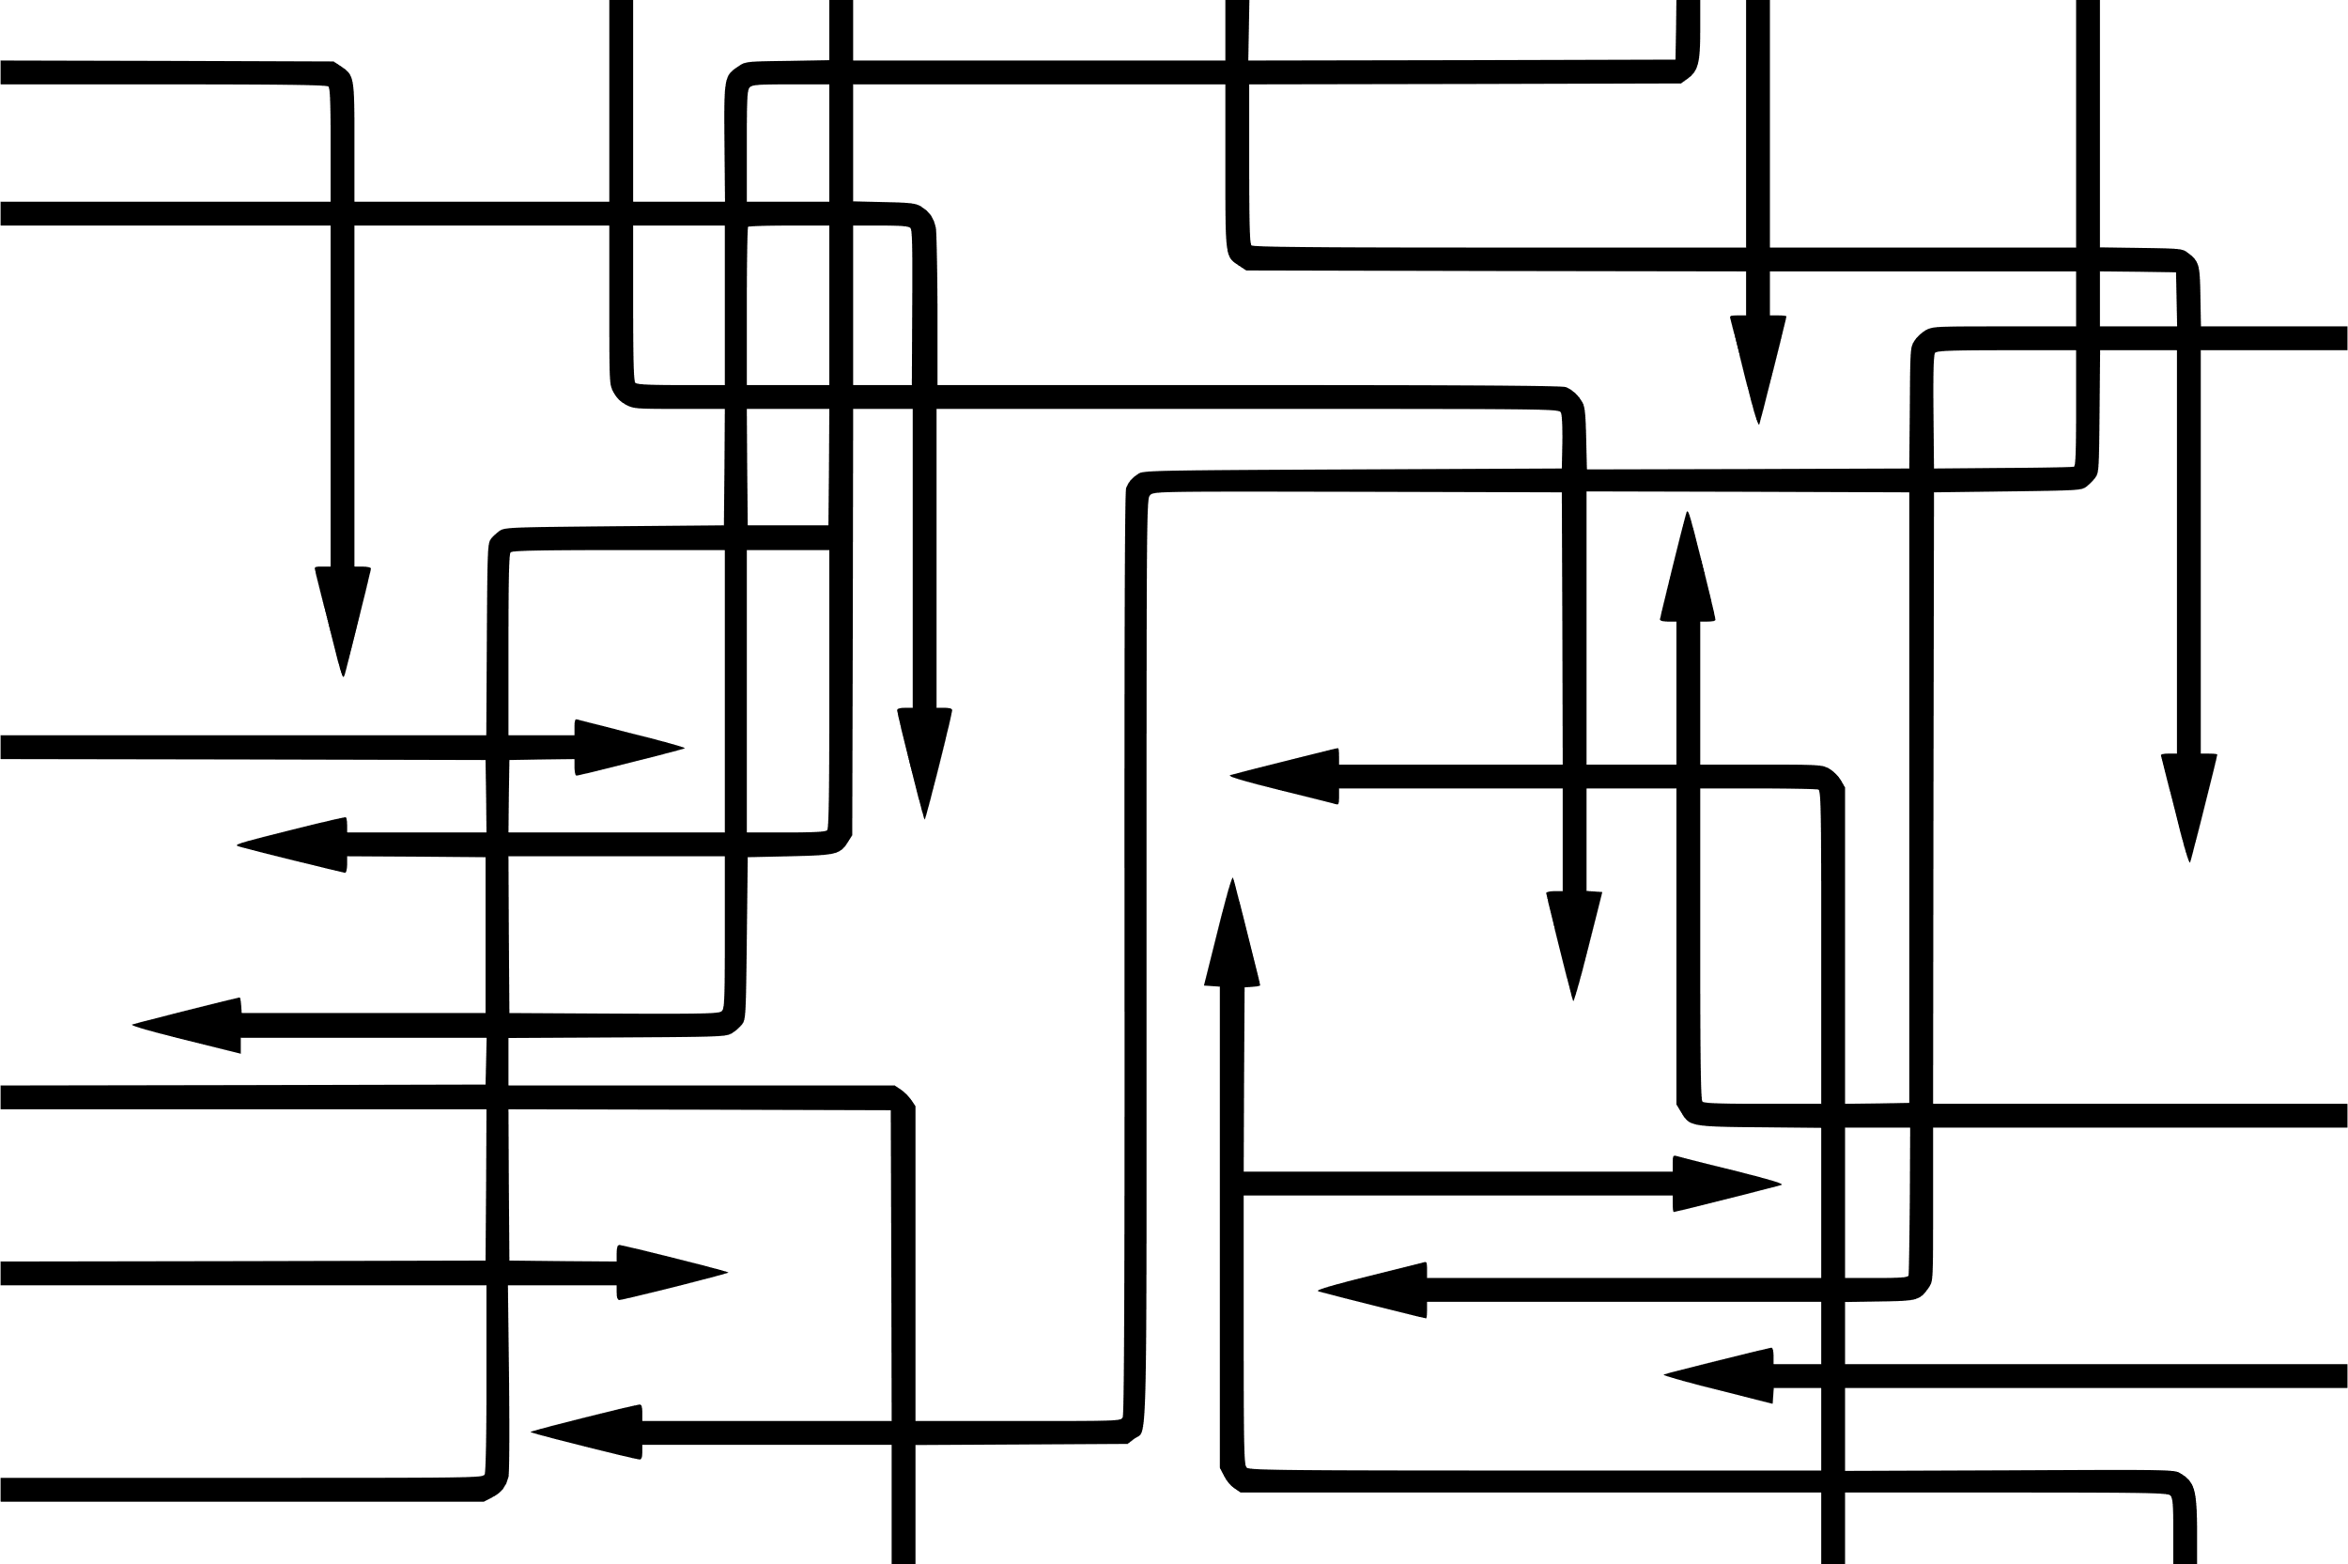
WORK FLOW DIAGRAM

Slide 11
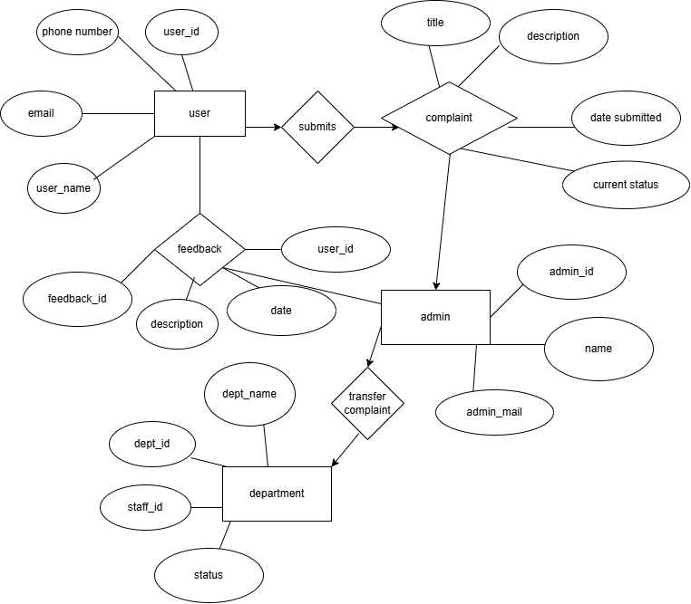
ER DIAGRAM DIAGRAM

Slide 12
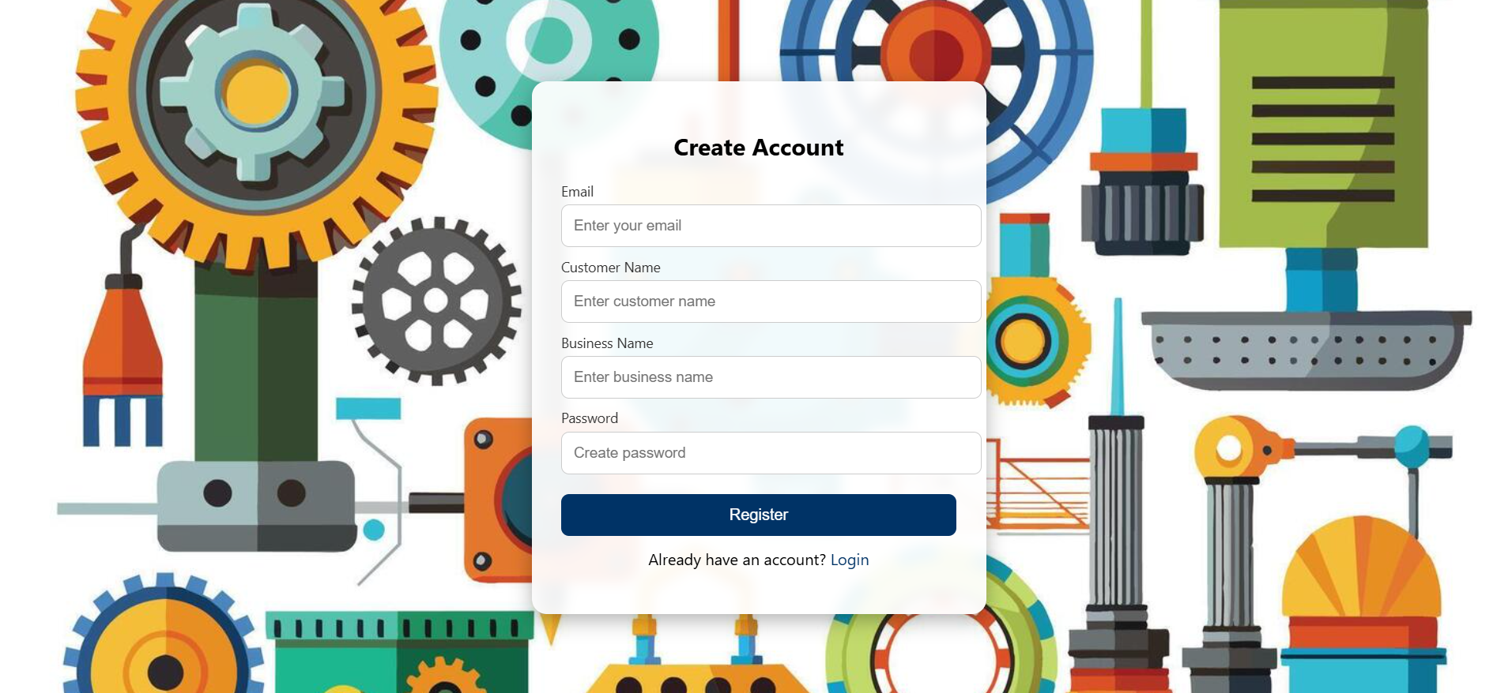
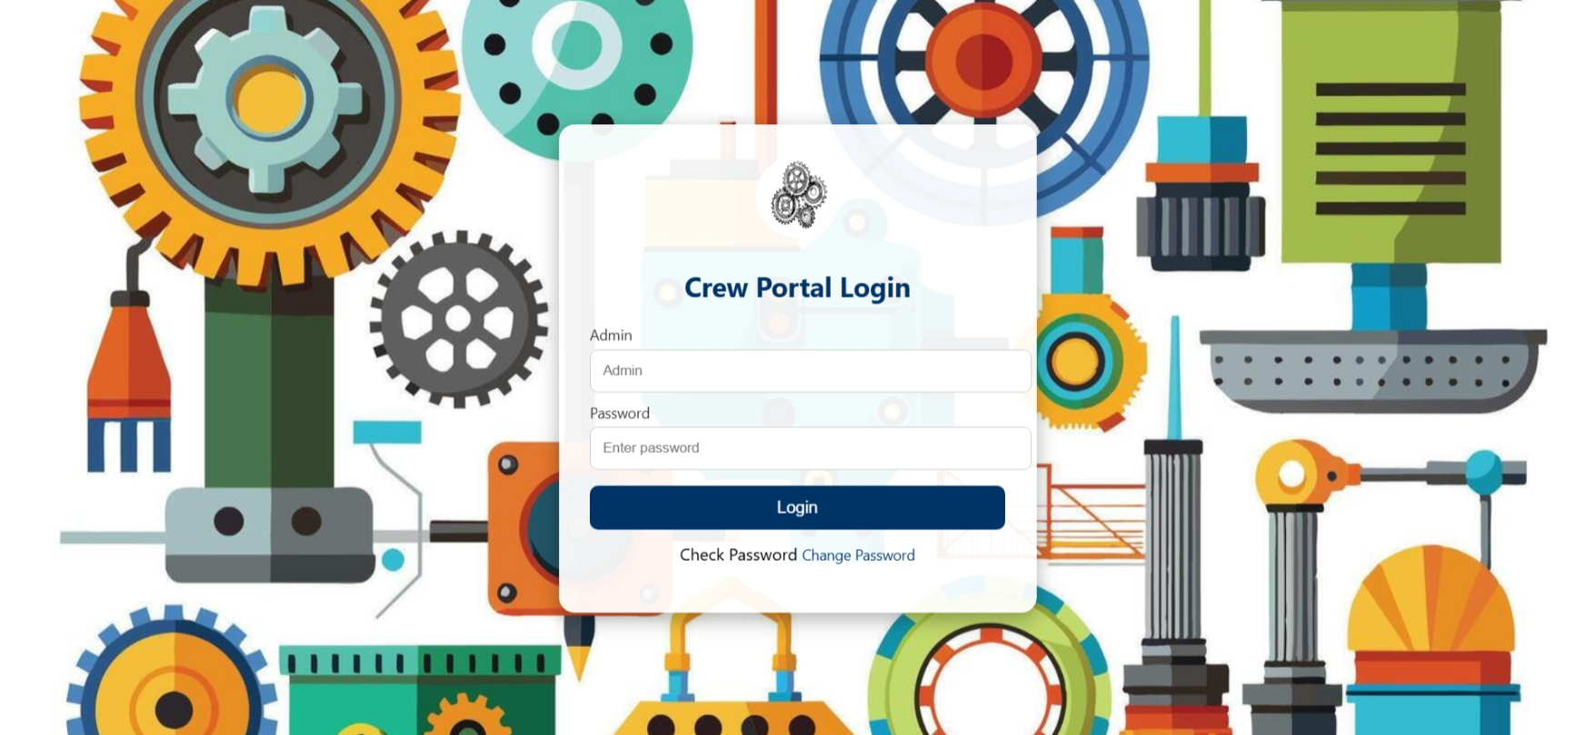
UI/UX DESIGNS

Slide 13
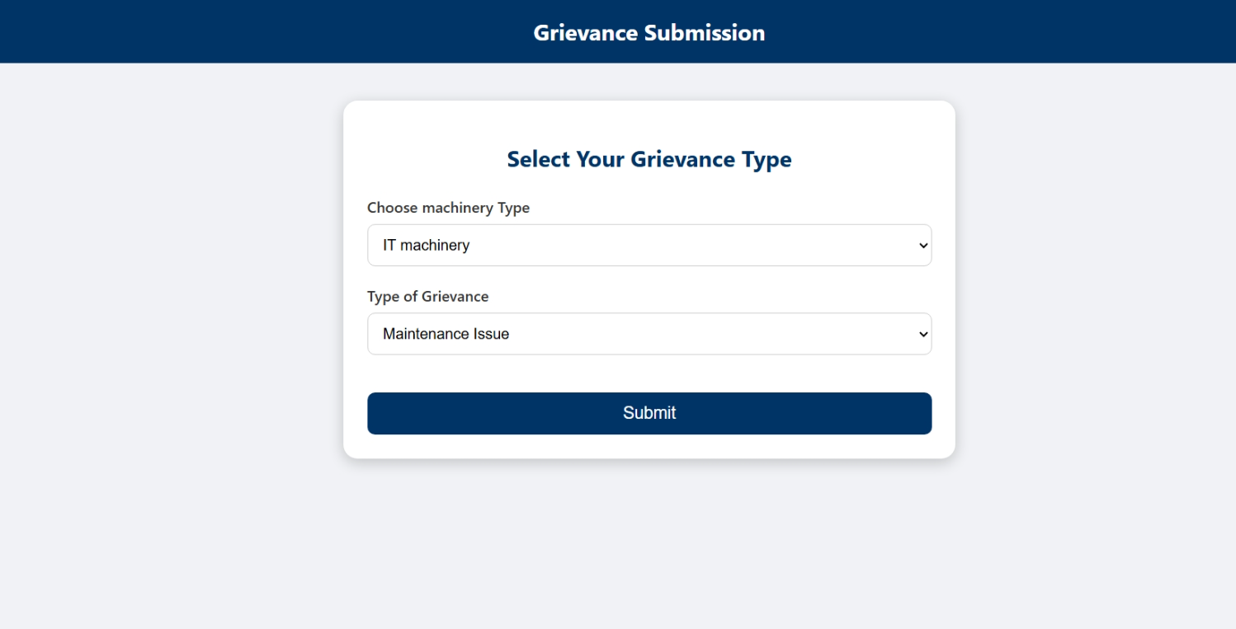
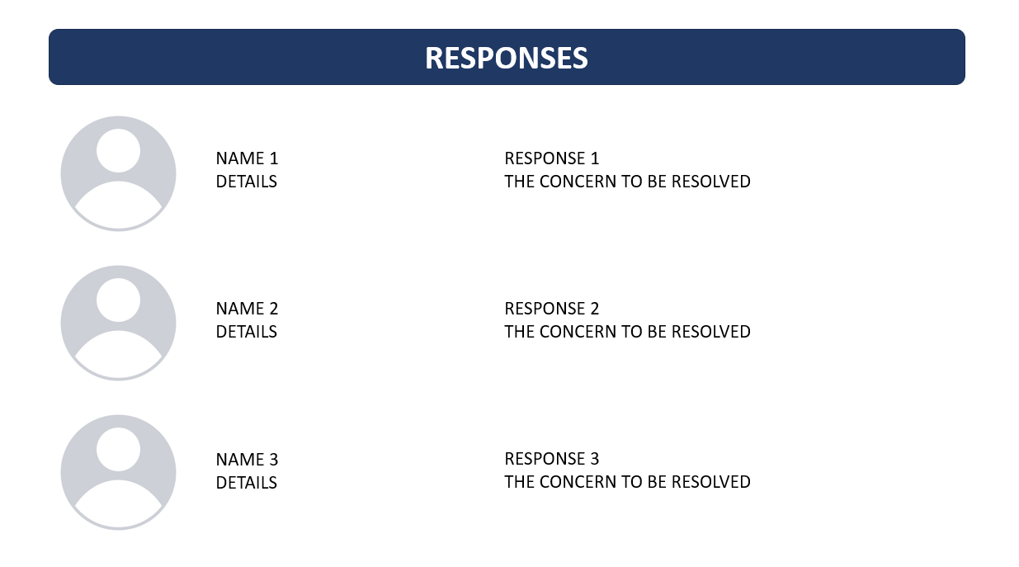
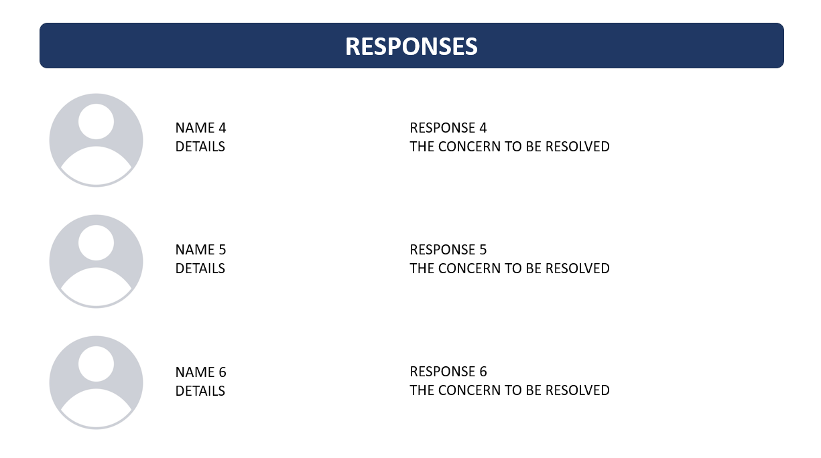
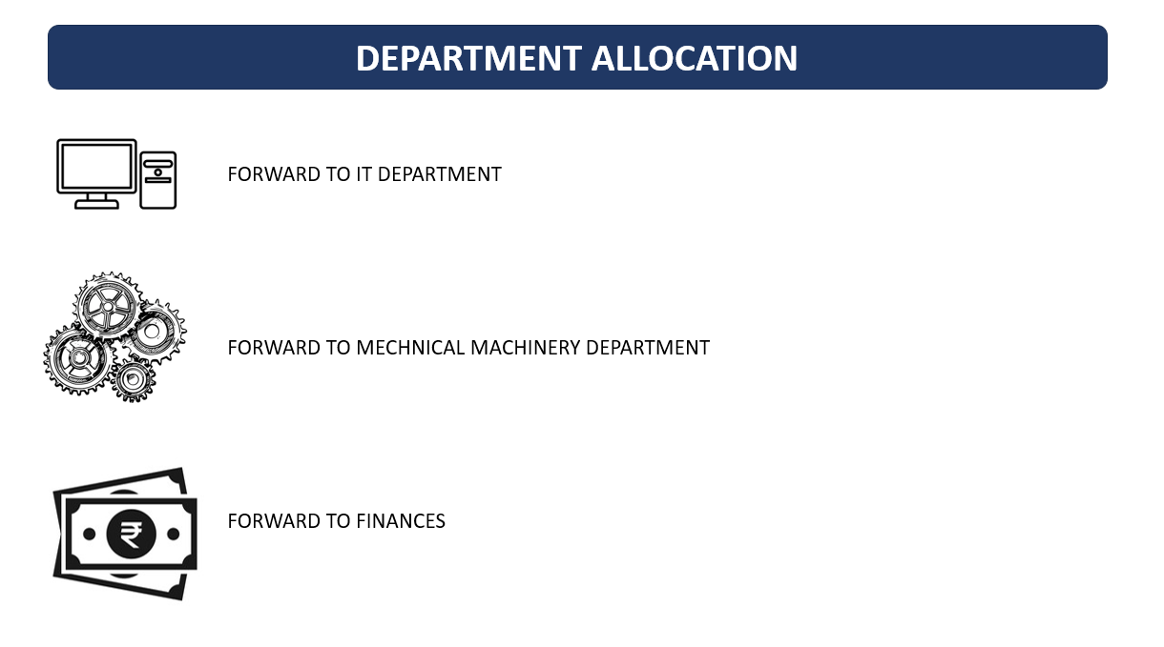

Slide 14
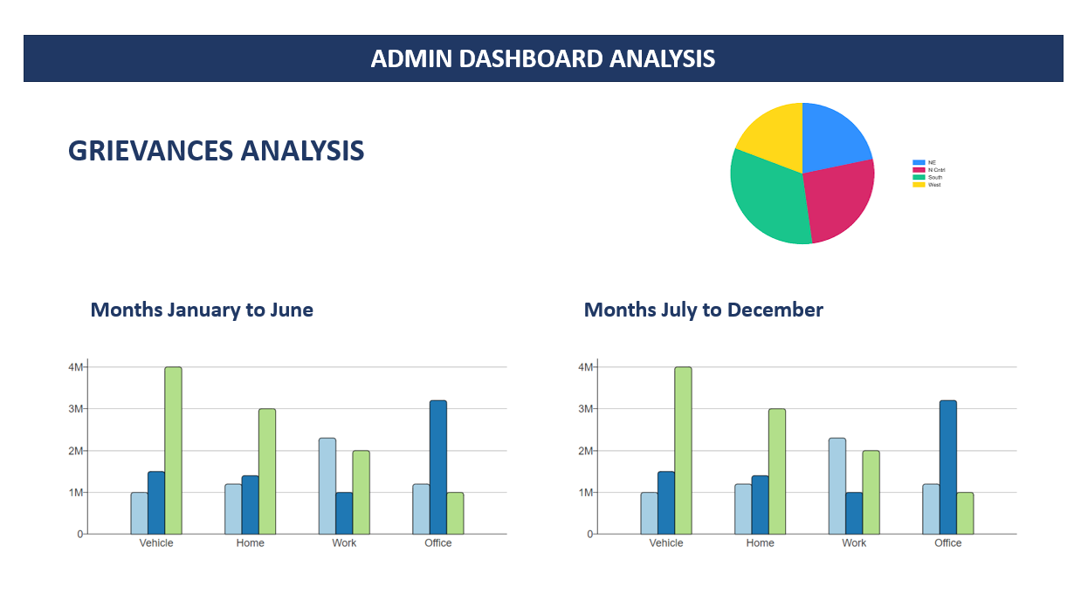

Slide 15
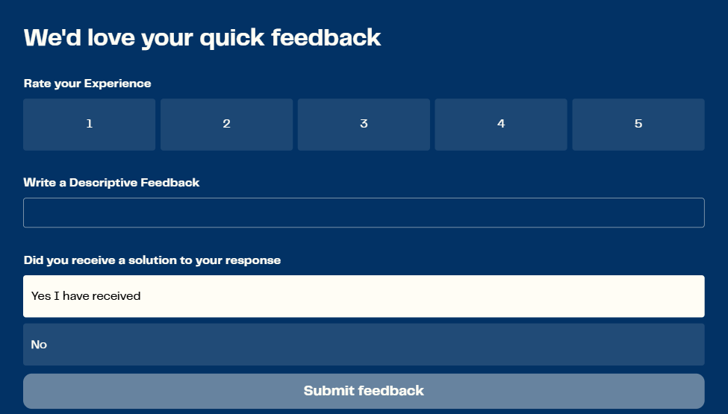

Slide 16
Sprint Analysis and Requirements
USER LOGIN
When the email and password are entered takes the user to the user dashboard
ADMIN LOGIN
For the admin login page where it takes the admin to an admin dashboard where the department allocations are proceeded with
USER DASHBOARD
The user dashboard is the page where the user interface and user experience design must be taken into at most consideration to make the process a cakewalk for the user
PROFILE PAGE
Shows the user details with read only options not editable currently the ability to edit will be added in future sprint
LOGOUT PAGE
Shows that the user has logged out also redirects to the login page when the user intends to login
ADMIN DASHBOARD
The admin dashboard allows the admin to view complaints as well as forward the grievances to the respected departments and view the feedback

Slide 17
Sprint 2 Analysis and Requirements
DATABASE USING MYSQL
Designed and created MySQL tables for users, complaints and admin & feedback
BACKEND STRUCTURE
Configured Spring Boot project structure & dependencies
AUTHORIZATION
Secure login for User and Admin roles
BACKEND CODES USING JAVA
Core backend layers including Controllers, Services, DAOs, Models
TOKEN GENERATION
Added JWT-based authentication to generate secure access tokens
VERIFICATION USING POSTMAN
Using postman for ensuring the access

Slide 18
Sprint 3 Analysis and Requirements
DATABASE USING MYSQL
Designed and created MySQL tables for users, complaints and admin & feedback
BACKEND STRUCTURE
Configured Spring Boot project structure & dependencies
AUTHORIZATION
Secure login for User and Admin roles
BACKEND CODES USING JAVA
Core backend layers including Controllers, Services, DAOs, Models
TOKEN GENERATION
Added JWT-based authentication to generate secure access tokens
VERIFICATION USING POSTMAN
Using postman for ensuring the access

Slide 19

Frontend Screenshots

Slide 20

Registration Page

Slide 21
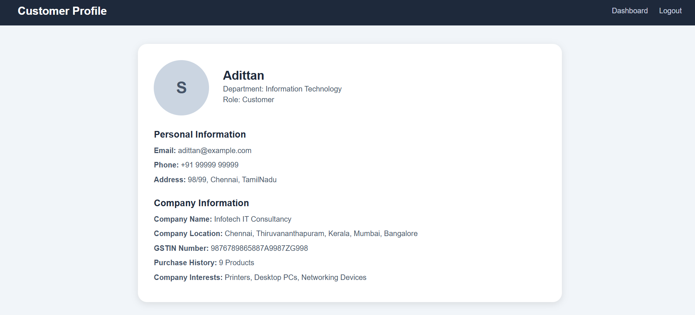
Profile Page

Slide 22
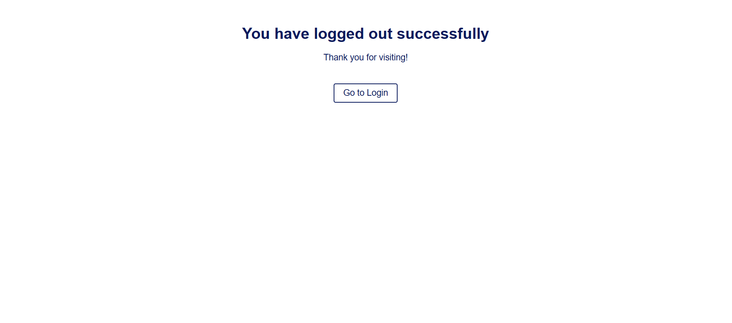
Logout Page

Slide 23
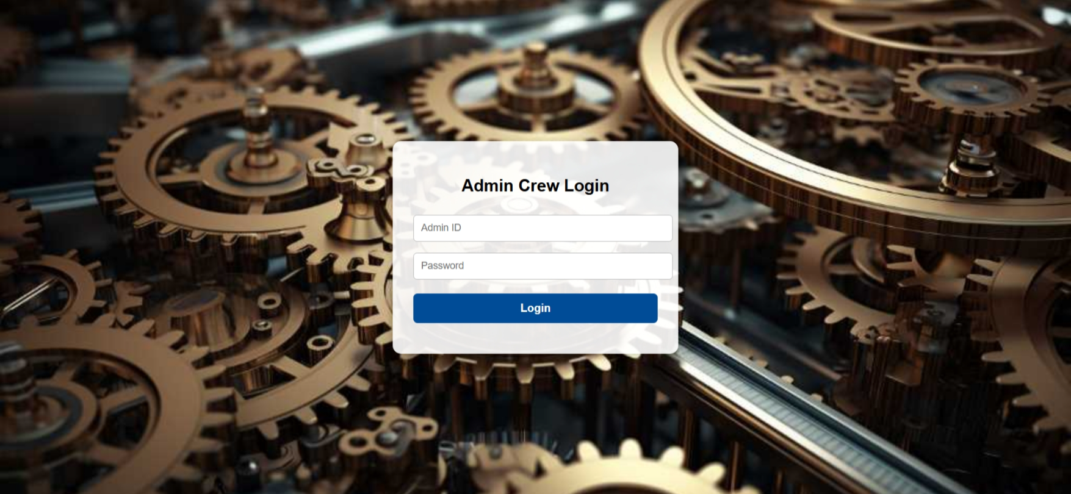

Slide 24
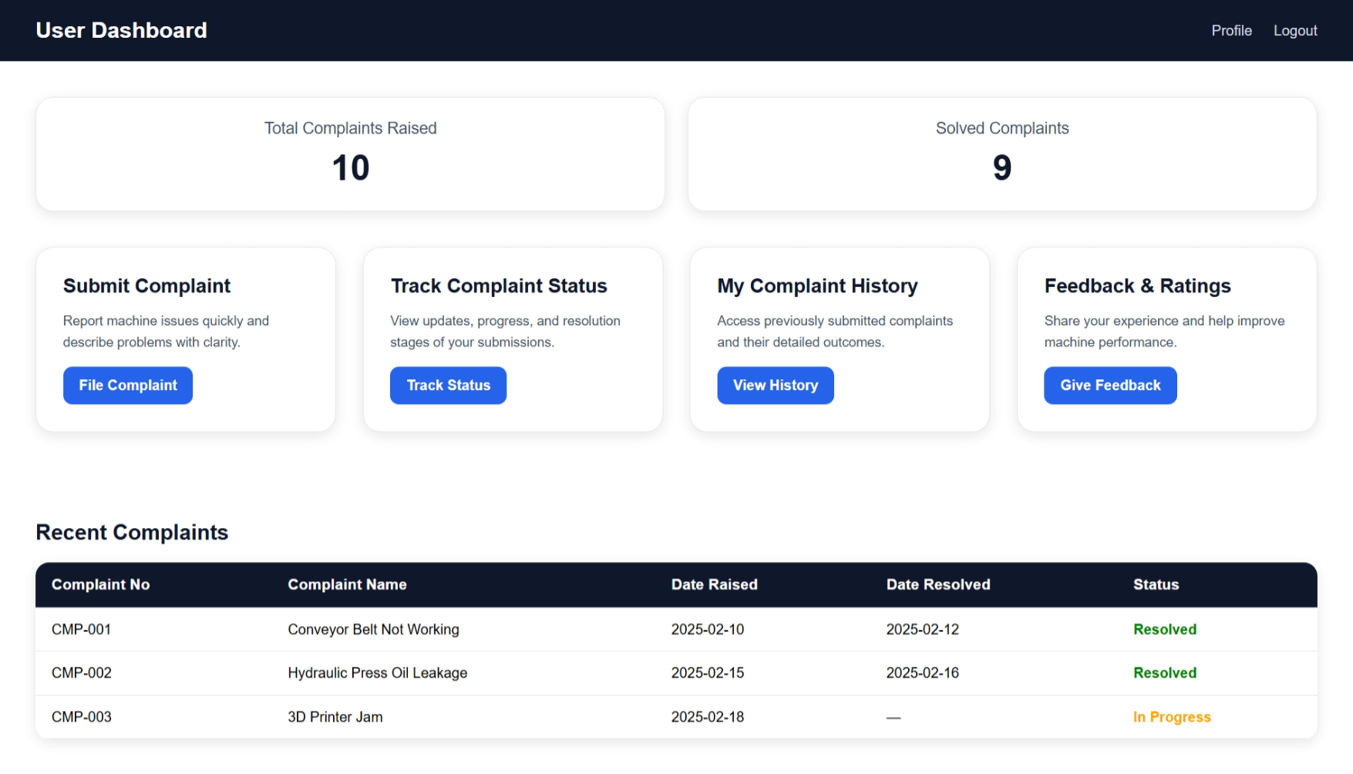

Slide 25
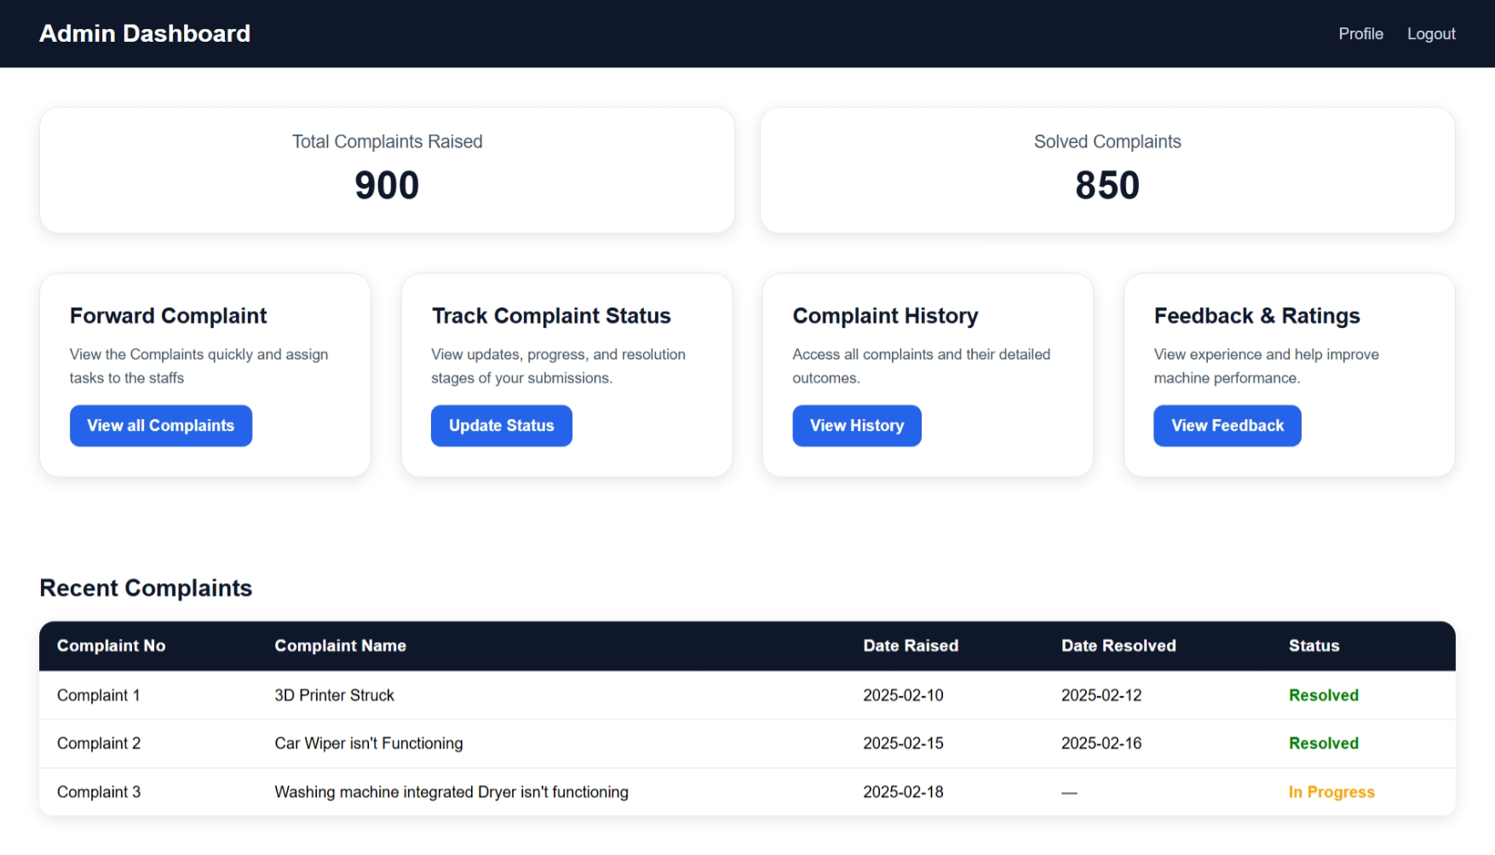

Slide 26





Advantages
MONEY
PEOPLE
DATA
TIME EFFECTIVE
EFFORTS
SINCE THE COMMUNICATION IS DONE ONLINE THE CUSTOMER DOESN’T HAVE TO MAKE CALLS OR VISIT THE COMPANY FREQUENTLY SAVING THEIR MONEY.
THE DATA GETS STORED PERMANENTLY AND CAN BE VIEWED AT ANYTIME FROM ANYWHERE BY BOTH CUSTOMERS AND THE OWNER
THE CUSTOMER SATISFACTION AND TRUST OF THE COMPANIES AND DEALERS ARE TAKEN CARE OF BY TIMELY SOLUTIONS
DEMANDS MINIMAL EFFORTS FROM BOTH THE PARTIES AS IT IS COMPLETELY ONLINE WEBSITE BASED SERVICE
SAVES THE TIME OF CUSTOMER AND USER MAINTAINING LOYALTY AMONGST CUSTOMERS

Slide 27
FUTURE ENHANCEMENTS
2
AI BASED CATEGORIZATION
1
chatbot
3
ai based segregation
4
AUTOMATIC ALLOCATION OF TECHNICIANS
6
VOICE BASED FEEDBACK AND RESPONSE DETECTION
5
LOCATION TRACKING OF TECHNICIANS

Slide 28
DAY WISE WORK
UNDERSTANDING THE ISSUE AND FEATURES
USER DASHBOARD
DAY 12
TABLES AND
ER DIAGRAM
DAY 5
TOPIC SPECIFIC UI/UX PAGES
DAY 8 & 9
DAY 1 - 3
LOGOUT PAGE AND PROFILE PAGE
DAY 13 & 14
USE CASE AND WORKFLOW DIAGRAM
DAY 4
UI/UX DESIGN FOR PAGES
DAY 6 & 7
LOGIN PAGES FOR ADMIN & USER
DAY 10 & 11

Slide 29
DAY WISE WORK Sprint 2
UNDERSTANDING THE WORKING OF SQL WORKBENCH
Writing code
DAY 23
Backend in vs code (which didn’t work)
DAY 19
Understanding the working and folders with code
DAY 21
DAY 15-17
Coding for the backend
DAY 24
DATABASE CREATION
DAY 18
Backend using IntelliJ
DAY 20
Writing codes for backend
DAY 22

Slide 30
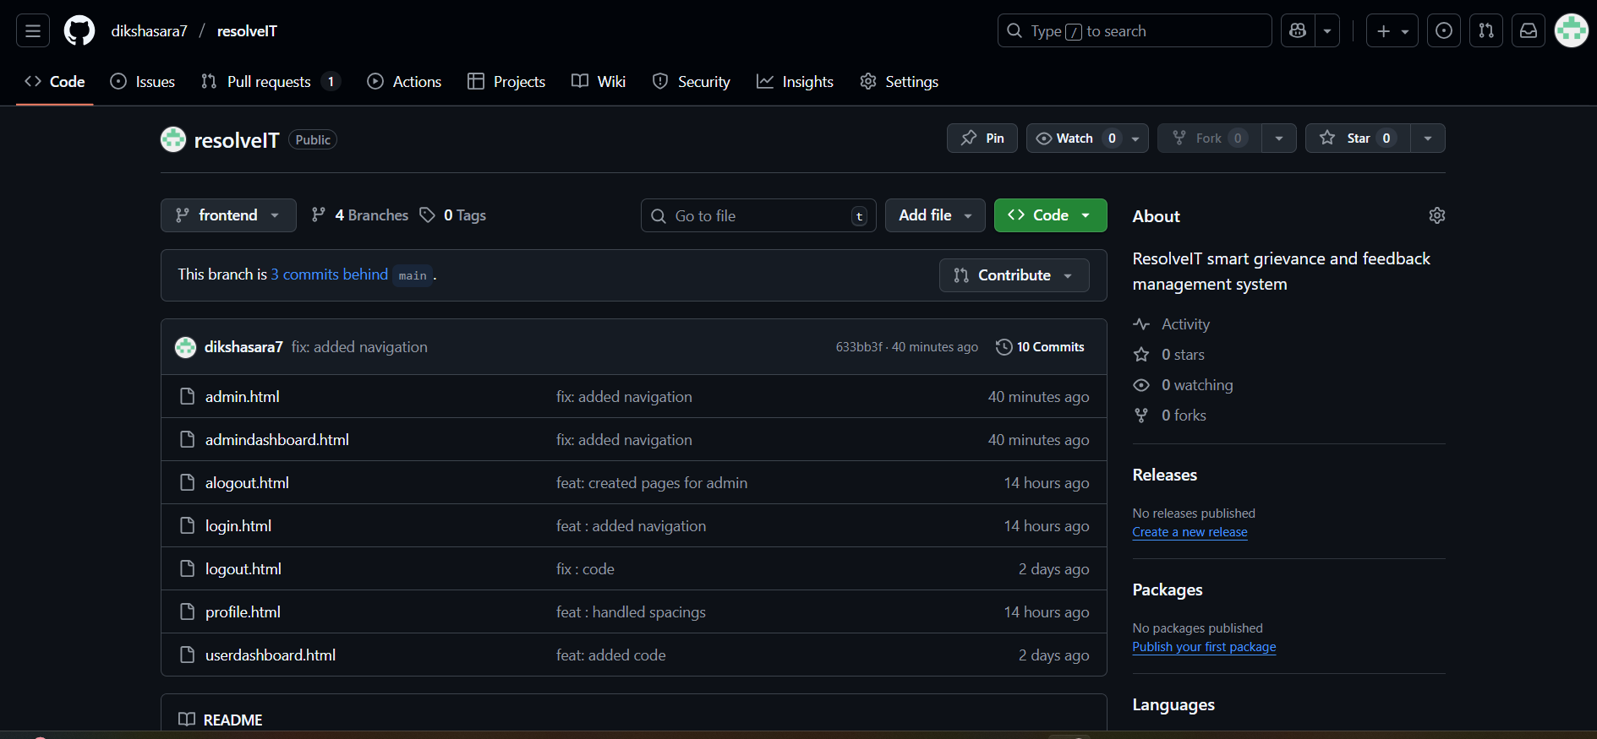
Git and GitHub

Slide 31
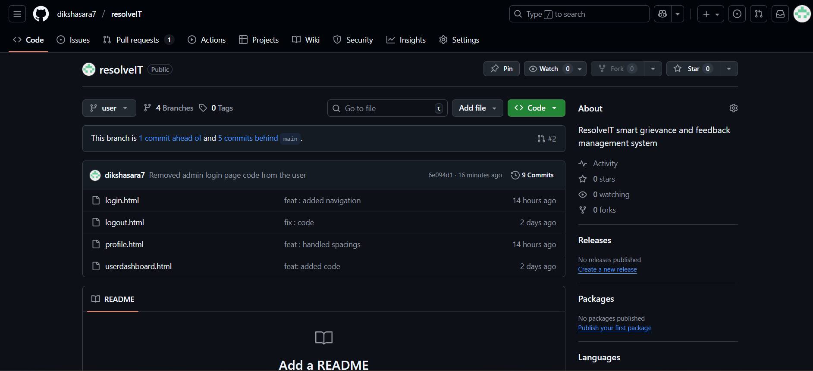
User Branch

Slide 32
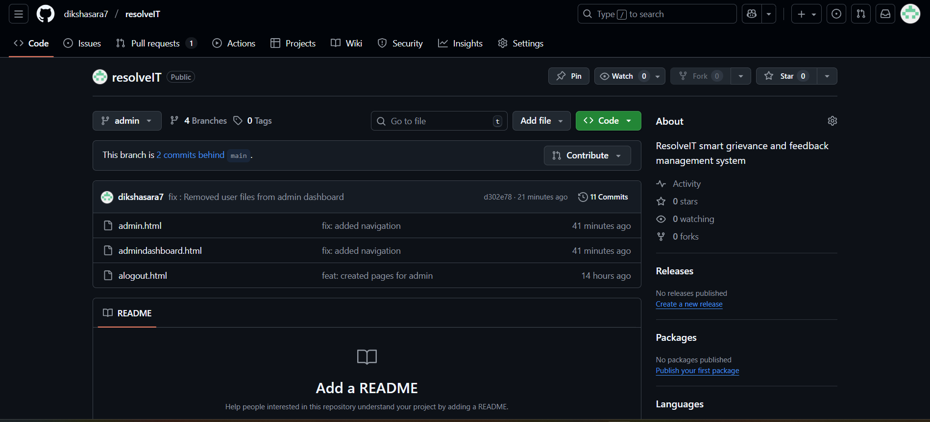
Admin Branch

Slide 33
User Dashboard

Slide 34
Profile Page

Slide 35
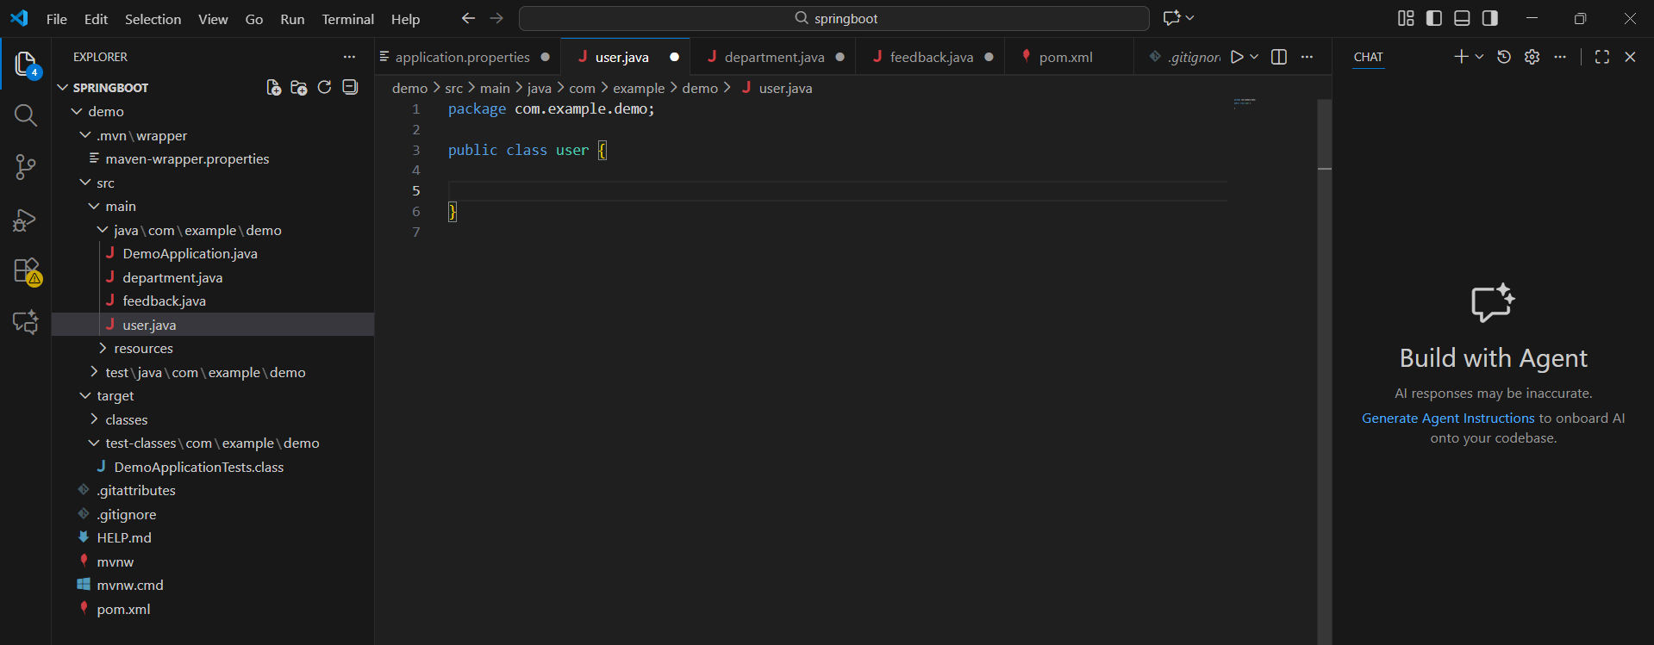
Backend in VS Code

Slide 36
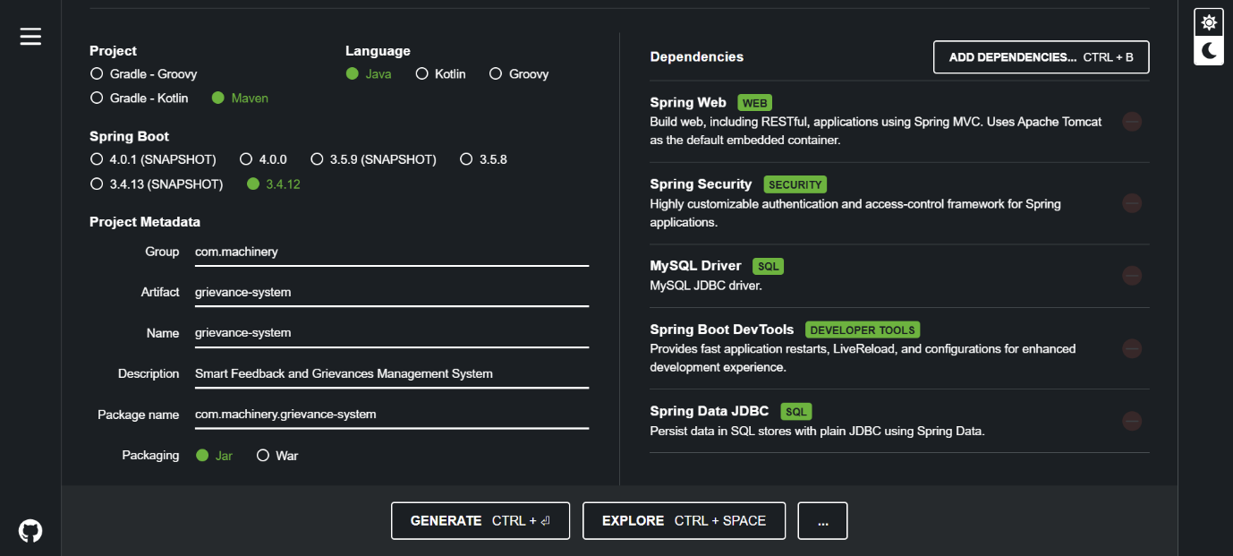
Spring Initializer

Slide 37
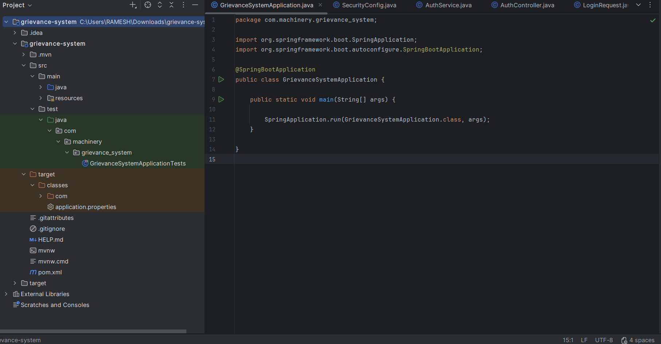
Backend architecture

Slide 38
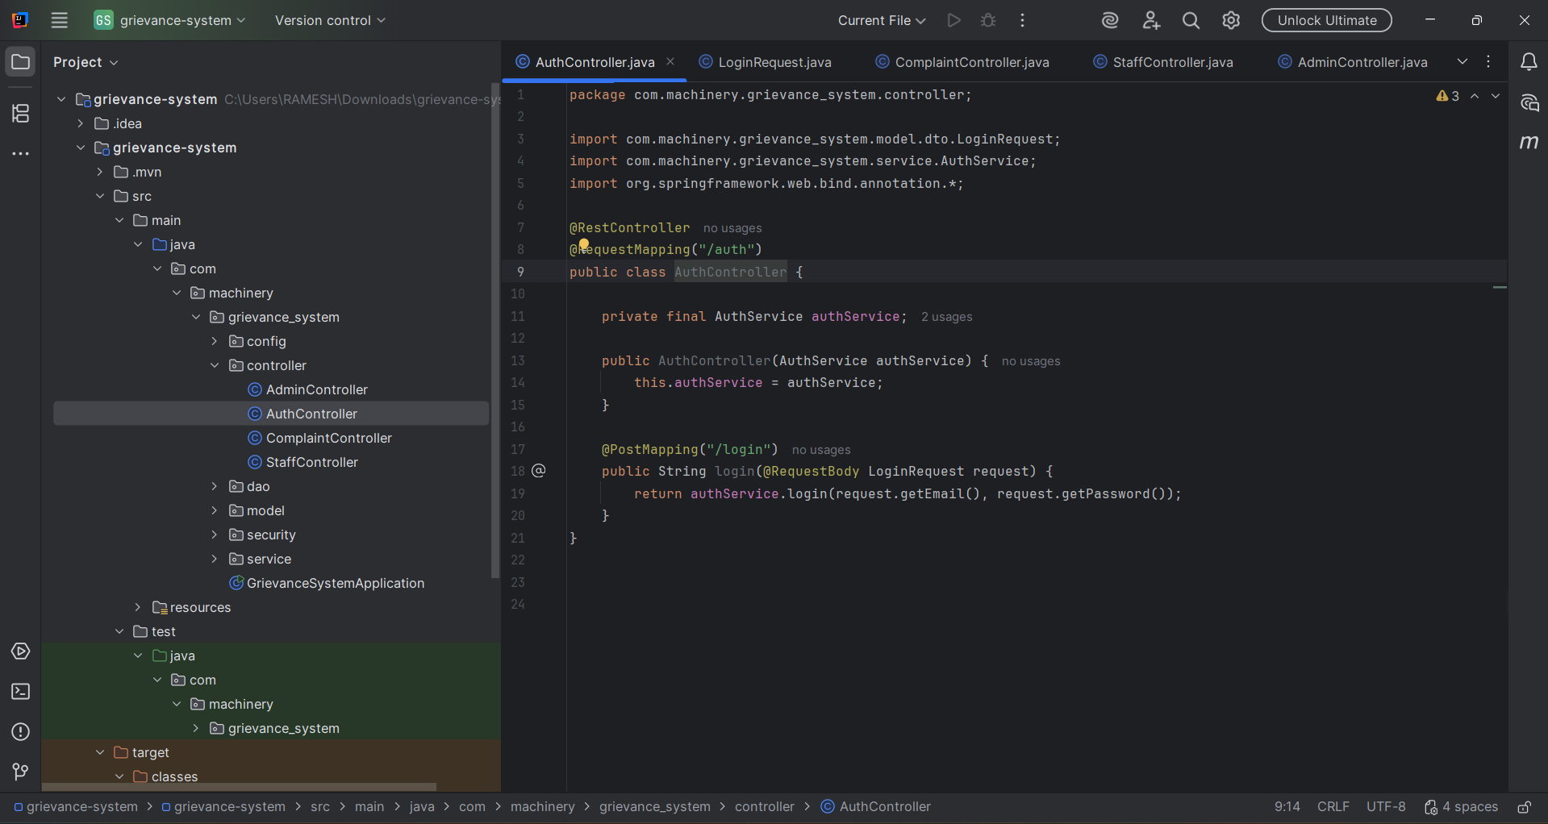
Authentication Controller

Slide 39
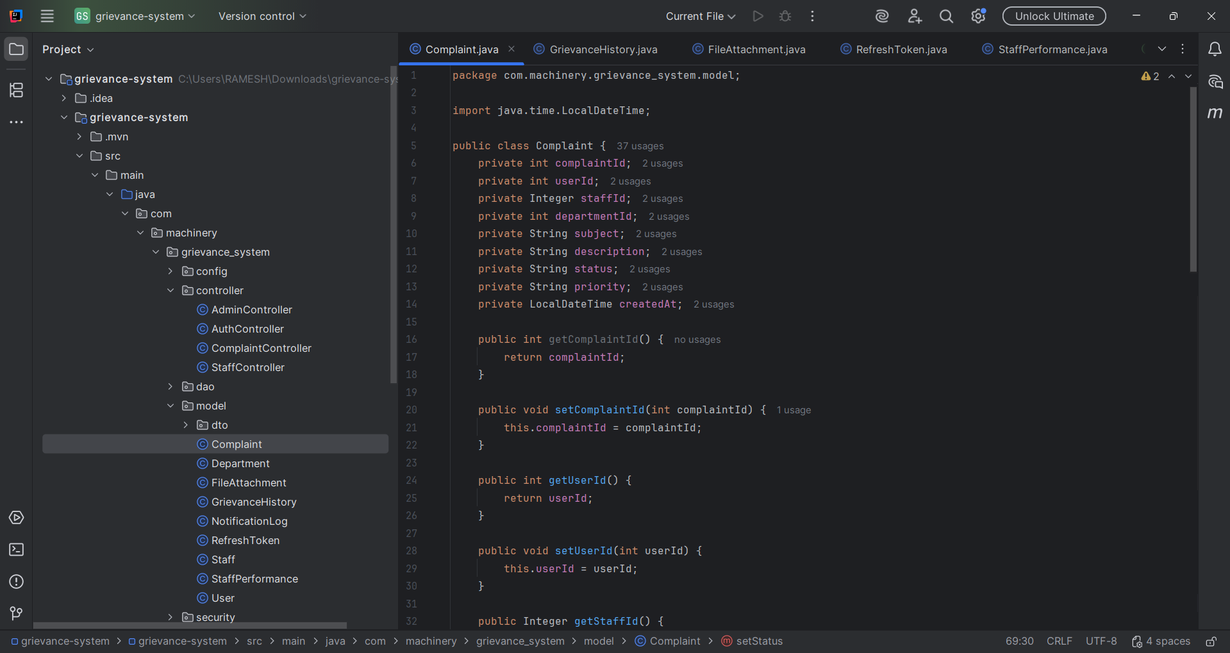
Complaint Model

Slide 40
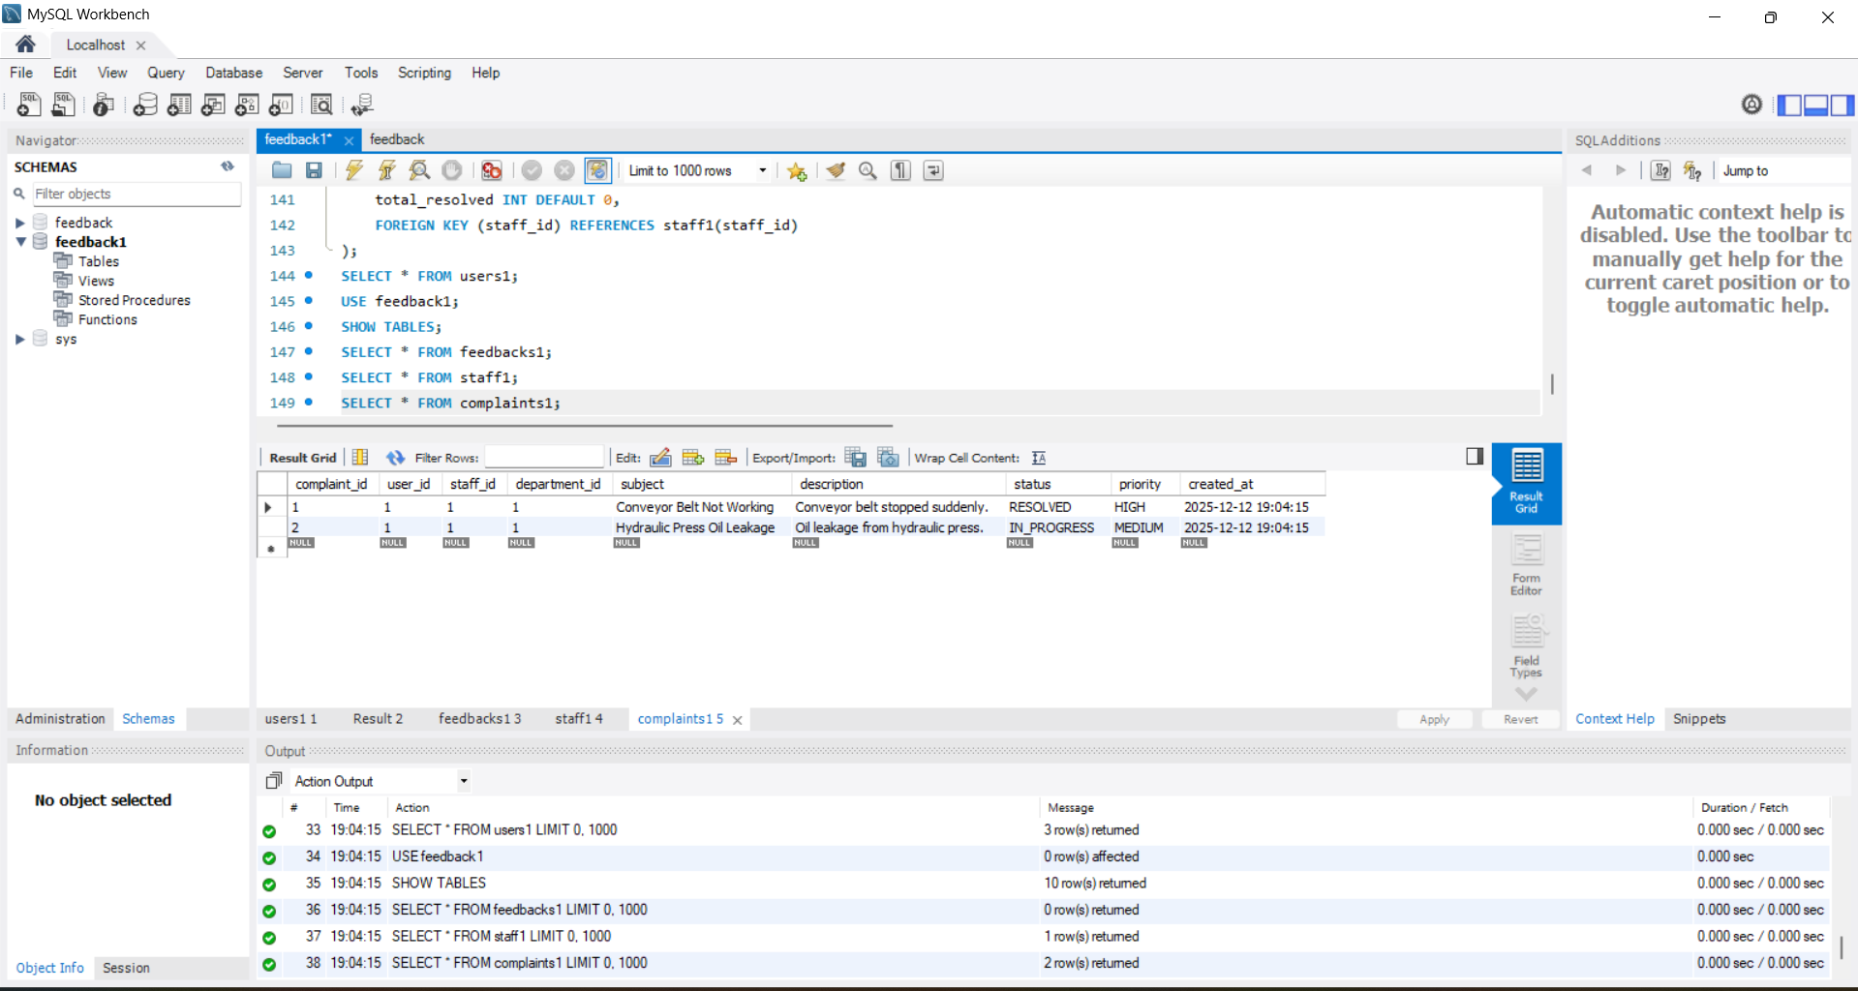
DATABASE SCHEMA

Slide 41
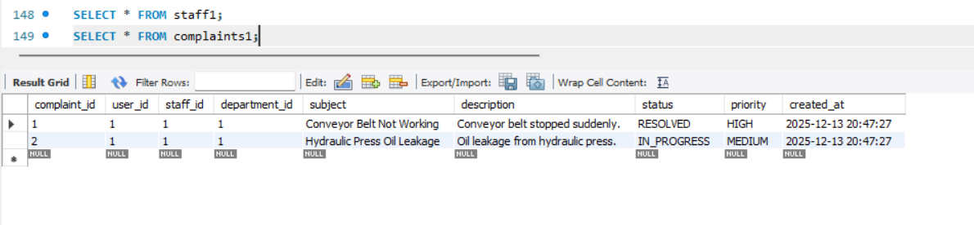
THE COMPLAINT TABLE

Slide 42
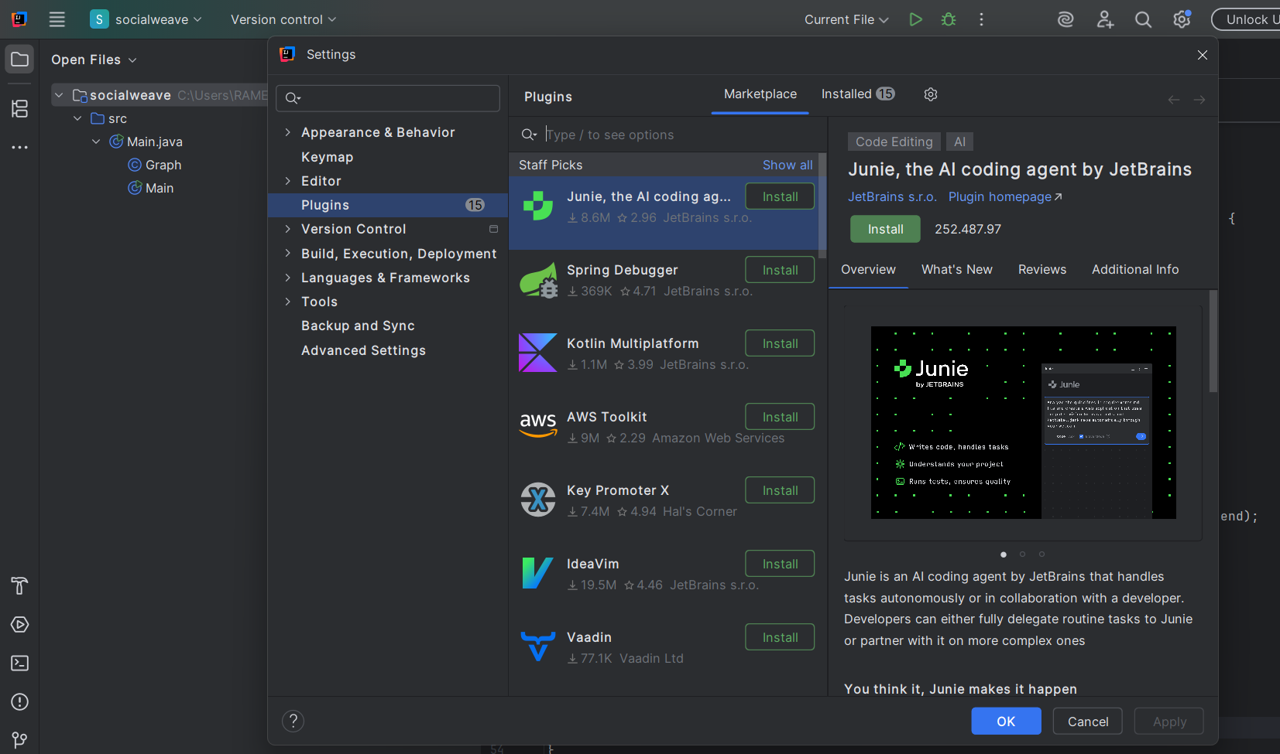
Backend in Intelli IJ

Slide 43
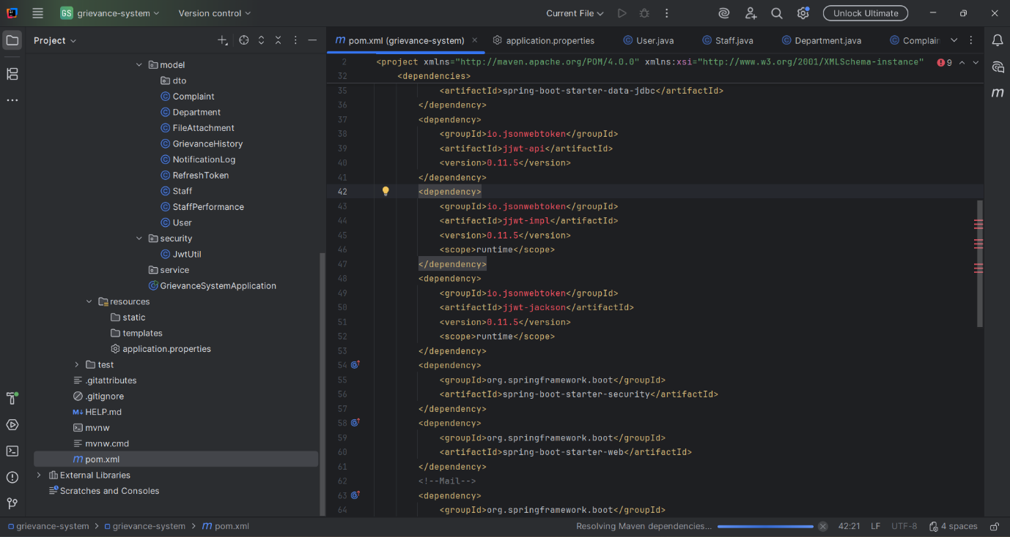
Dependencies

Slide 44
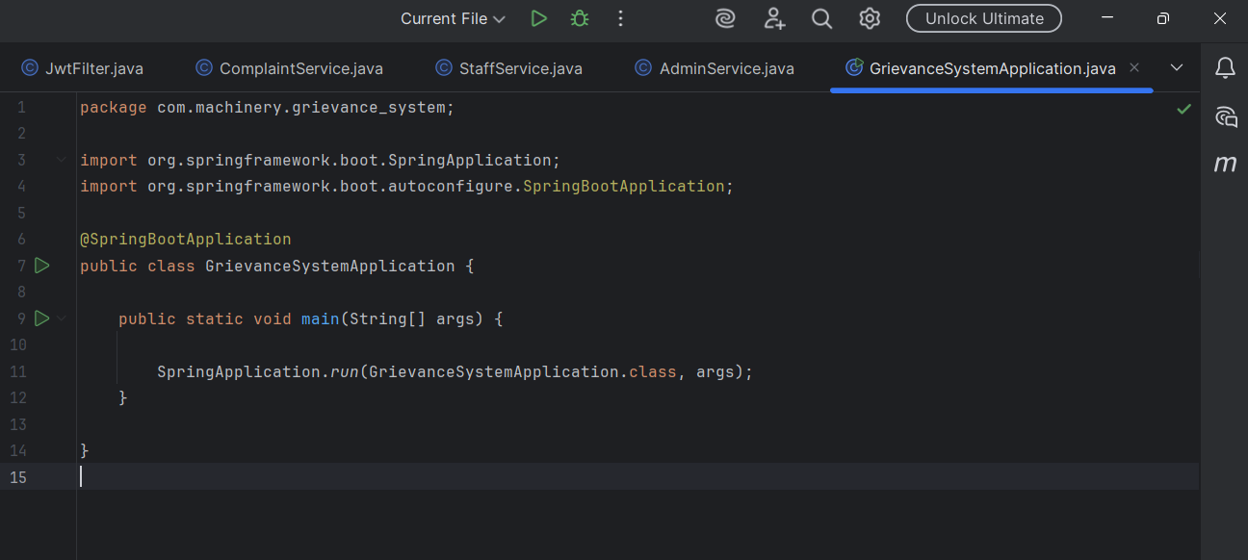
System Application

Slide 45
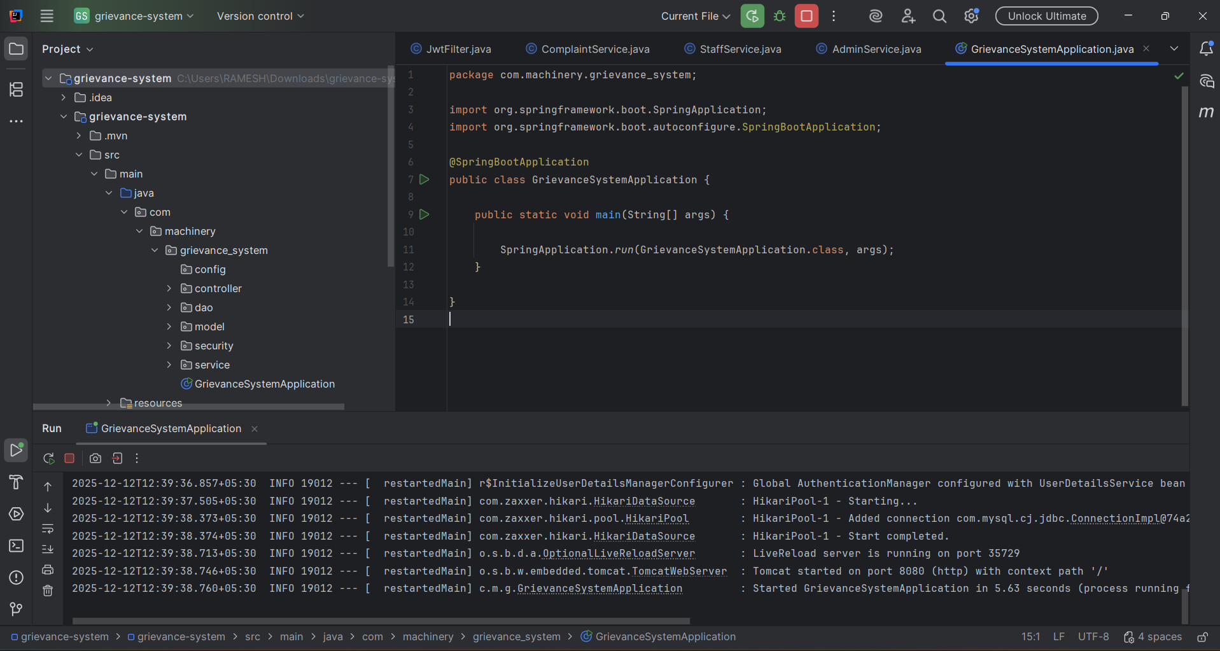
Run the code

Slide 46
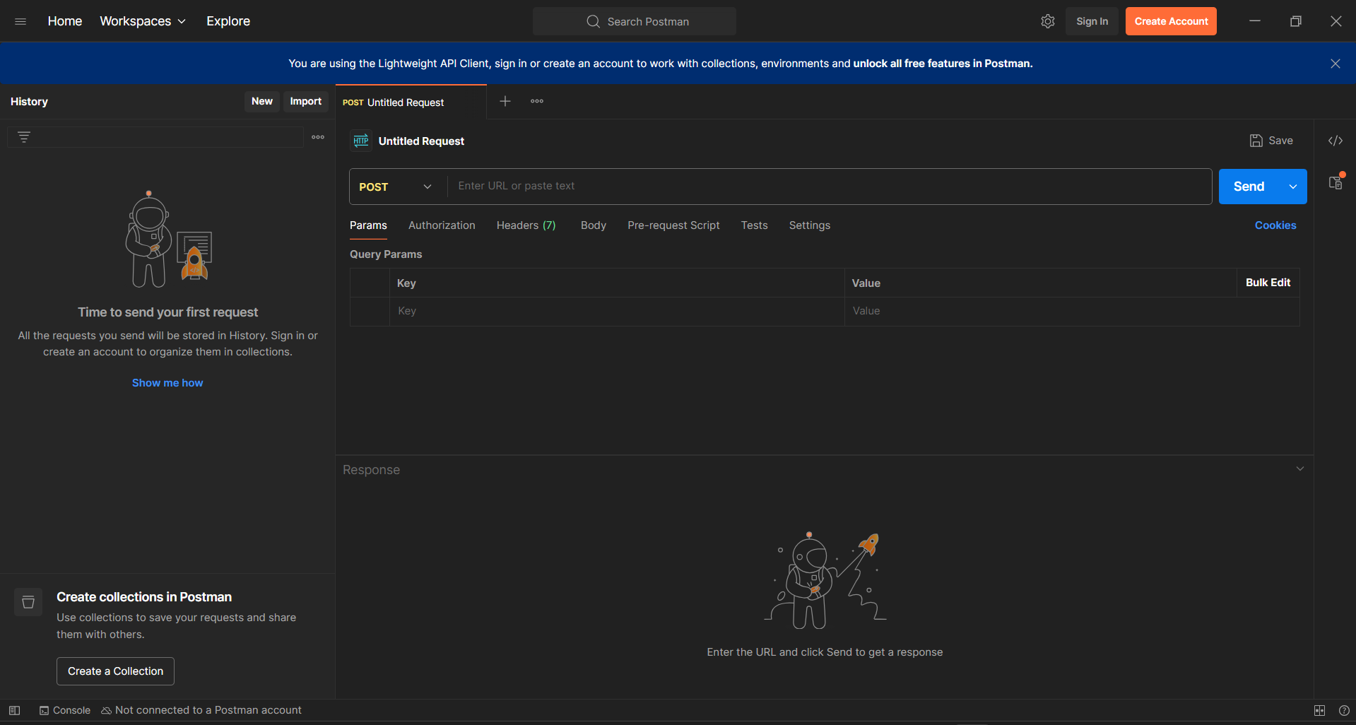
Postman

Slide 47
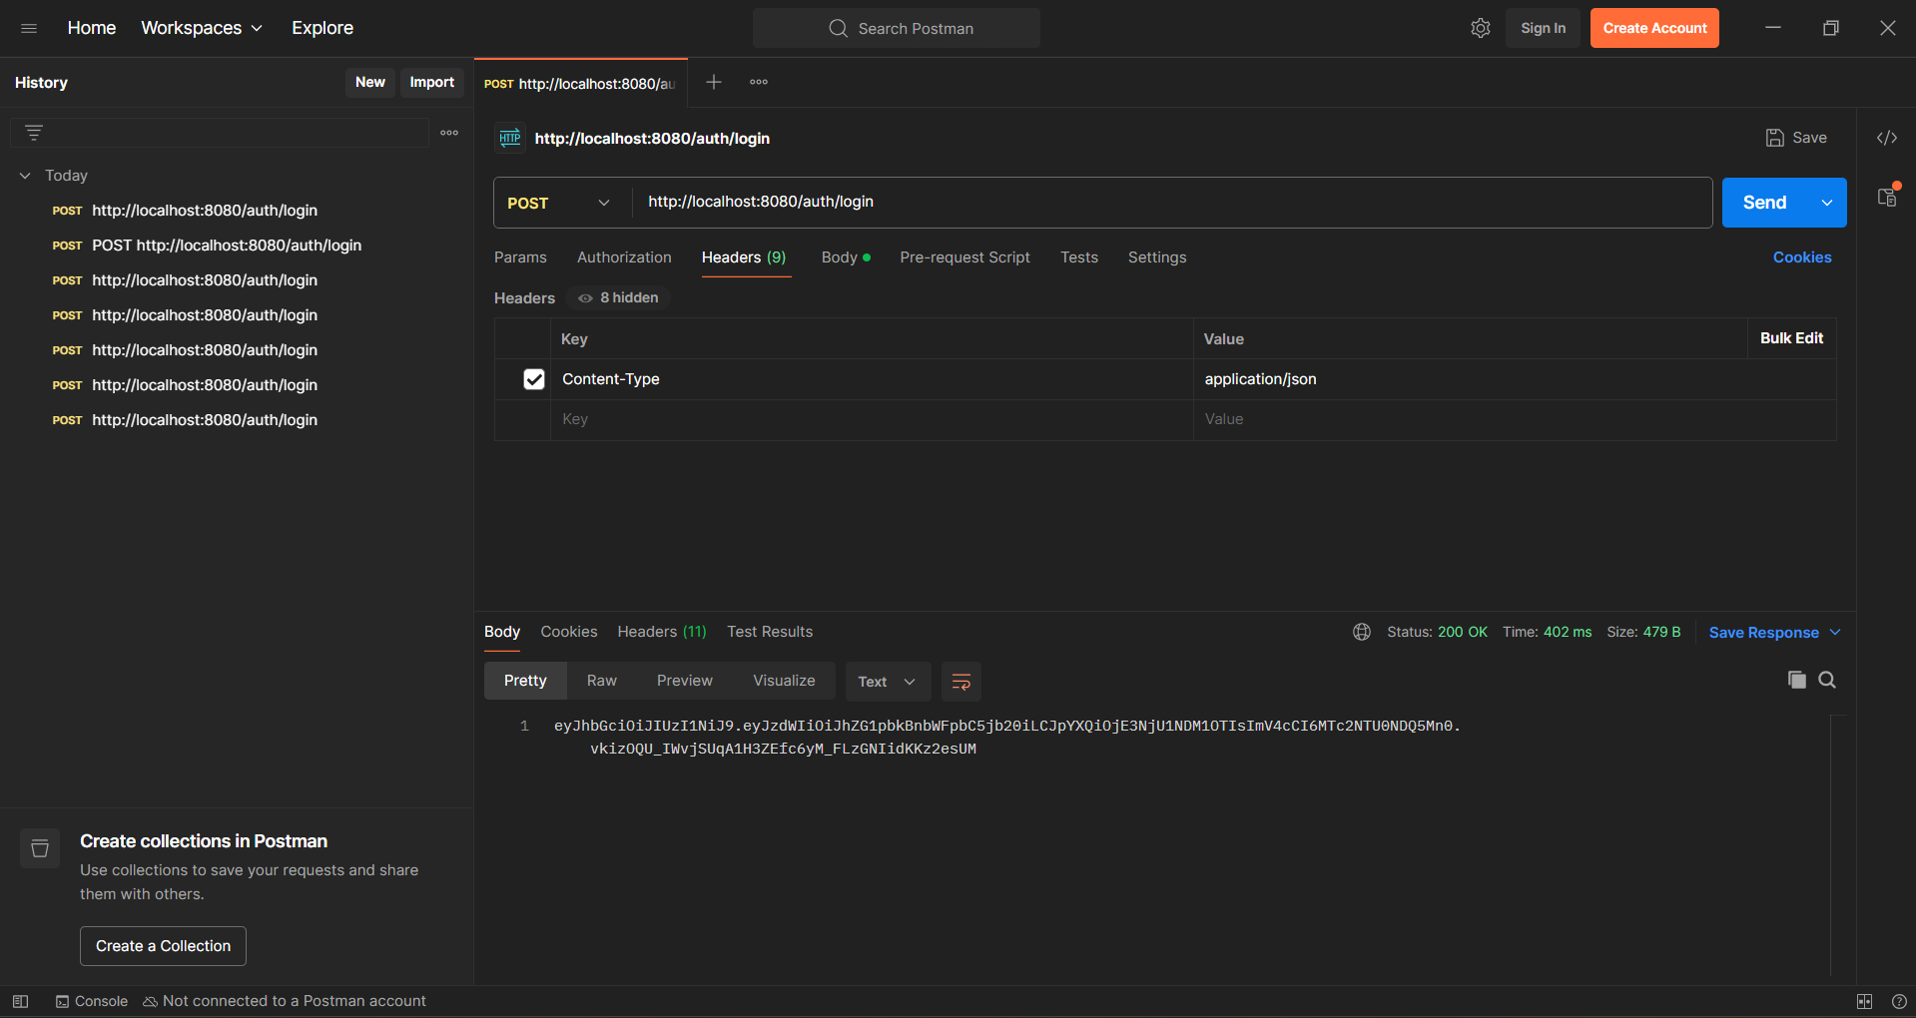
Admin Authorization

Slide 48
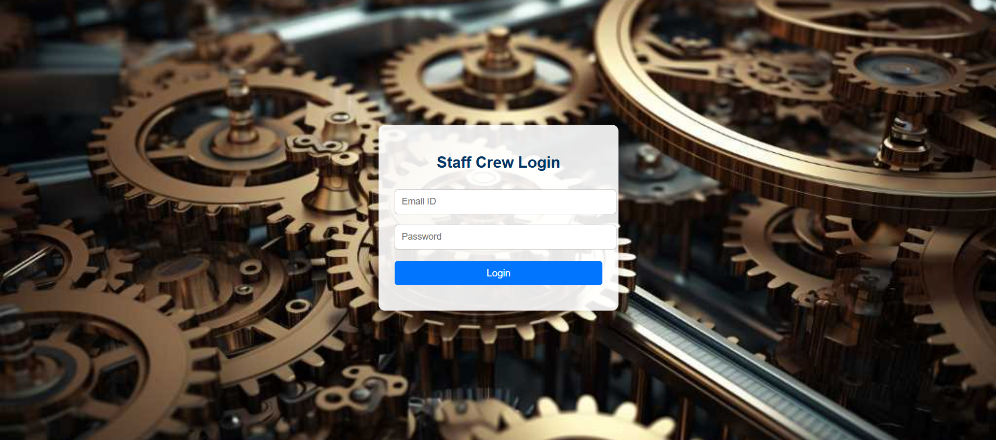
Staff Login Page

Slide 49
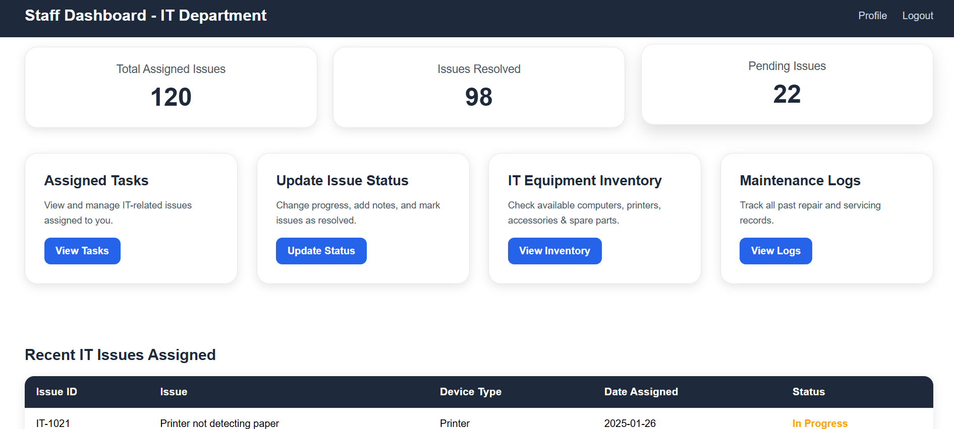
Staff Dashboard page

Slide 50
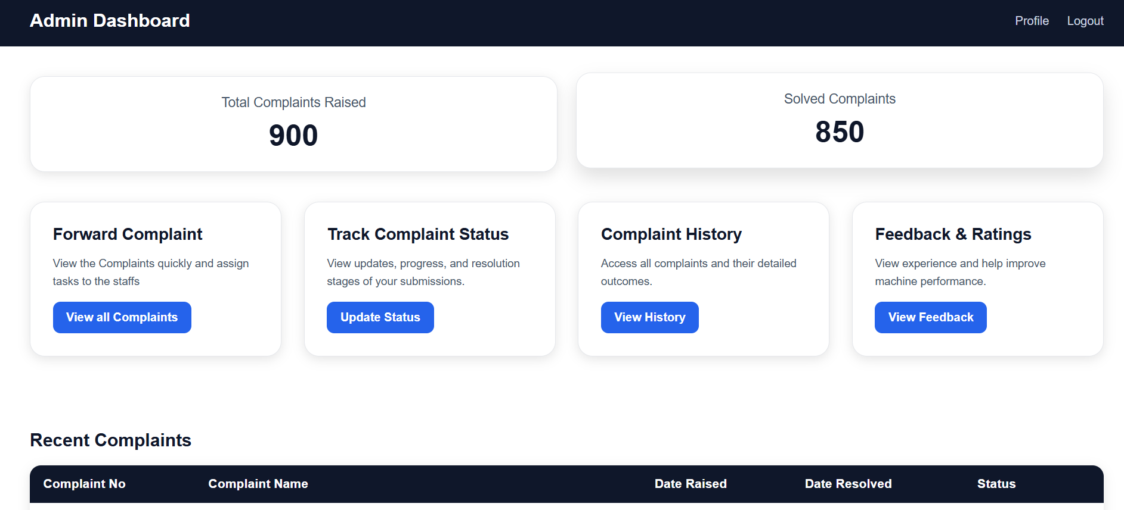
Admin Dashboard Page

Slide 51
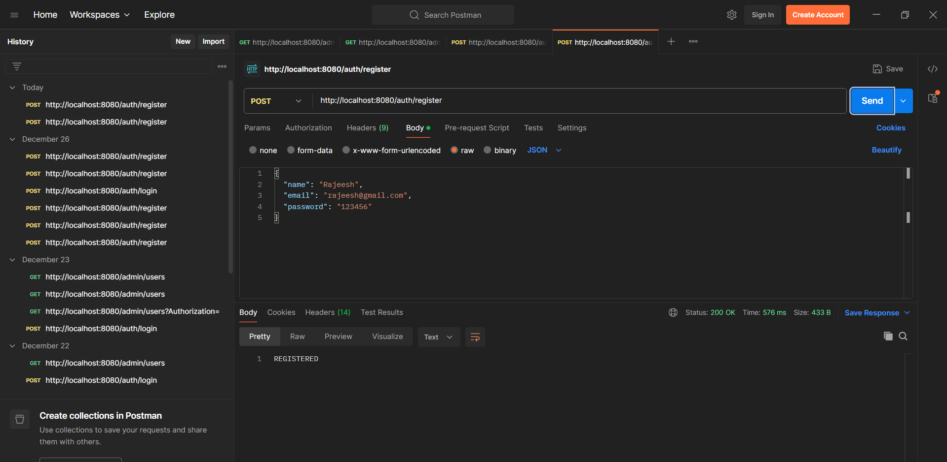
Postman in User for Login Page

Slide 52
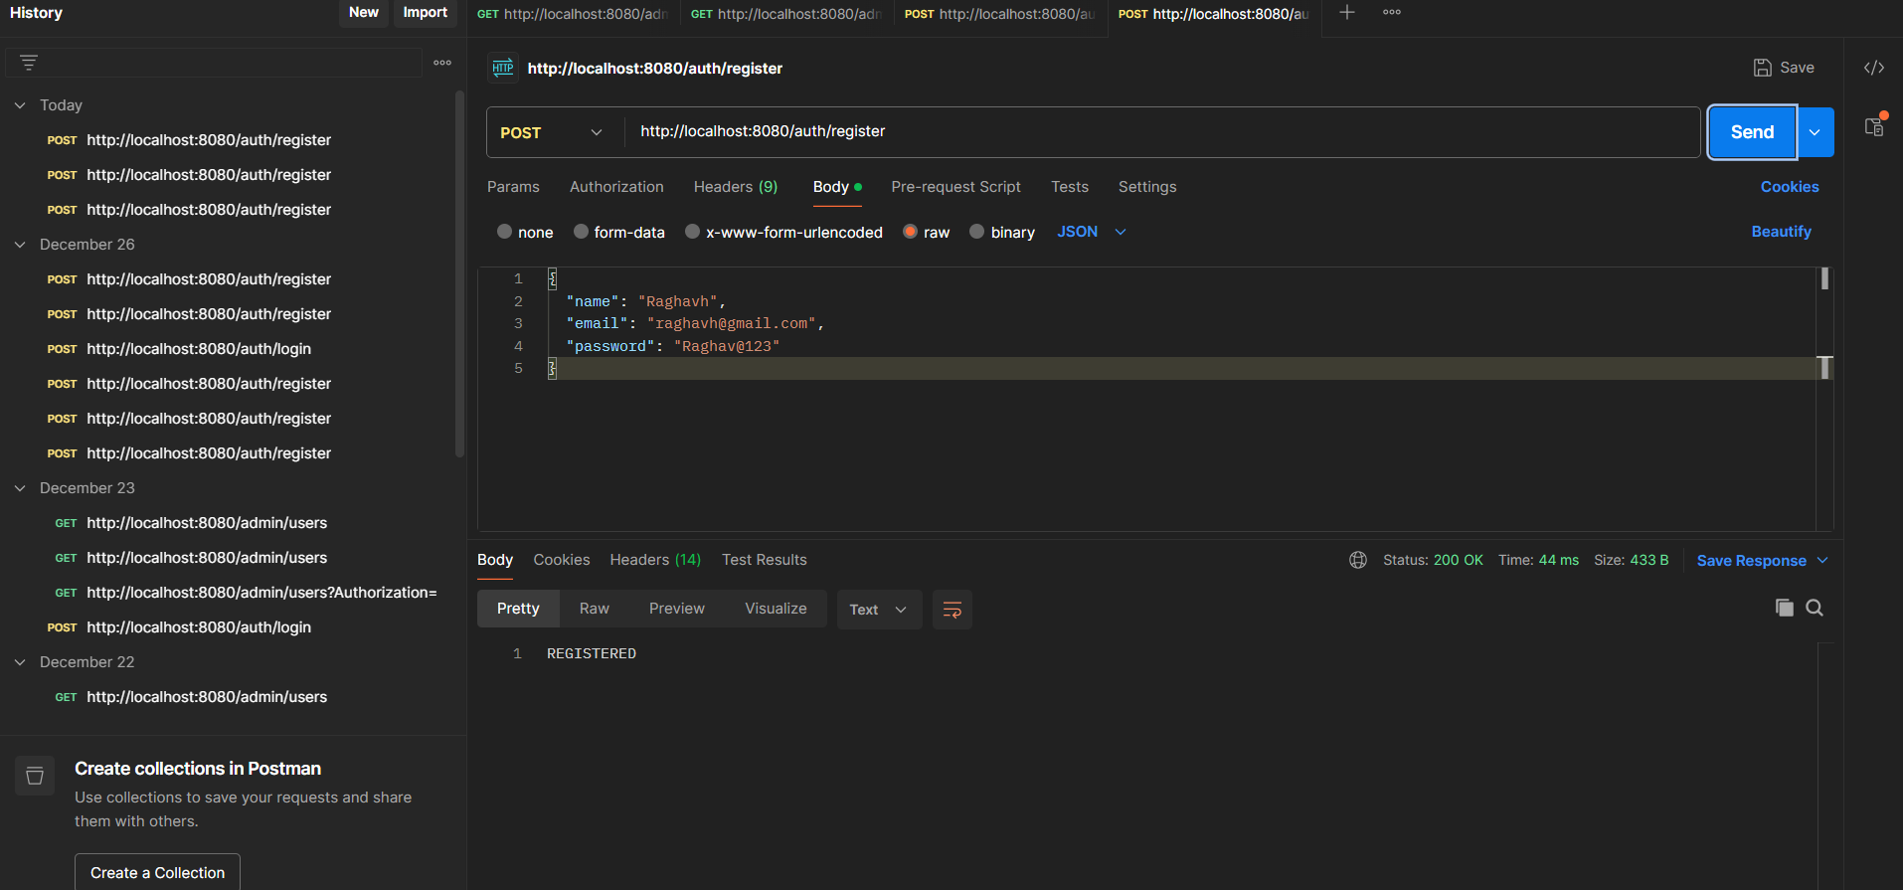
Postman for User in Login Page

Slide 53
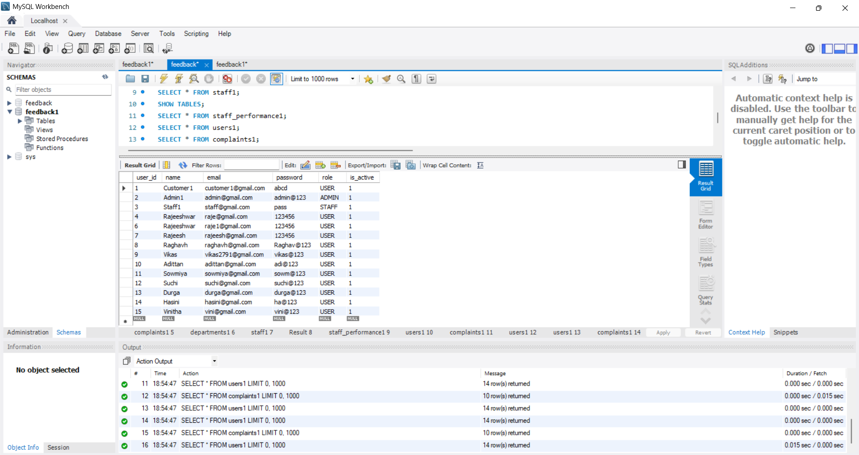
User Table

Slide 54
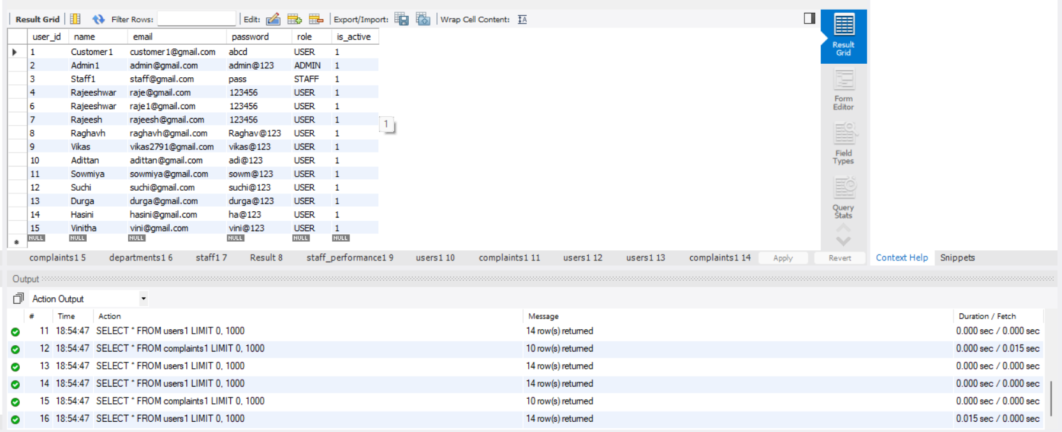
Table

Slide 55
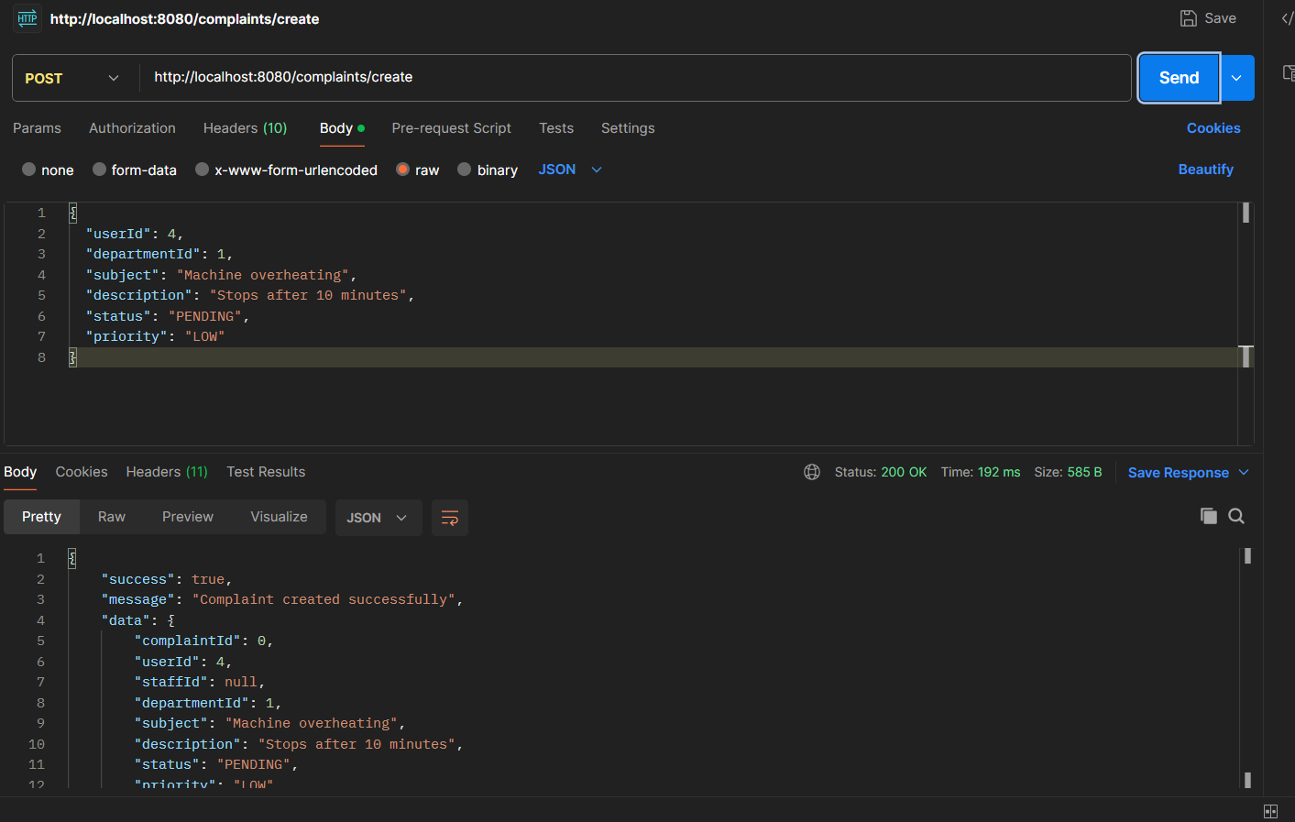
Postman for User for Complaints

Slide 56
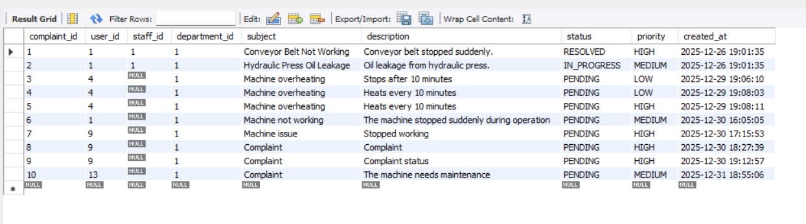
Complaint Table

Slide 57
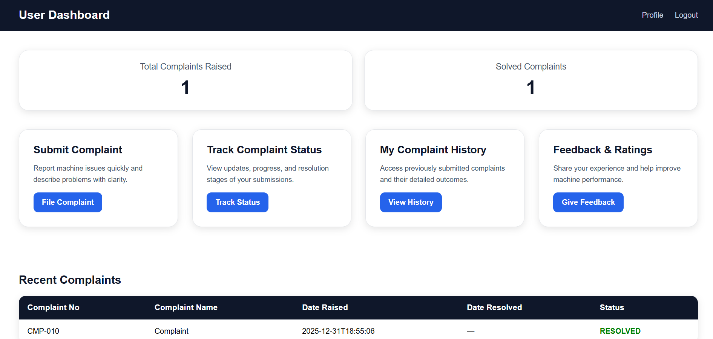
Integration

Slide 58
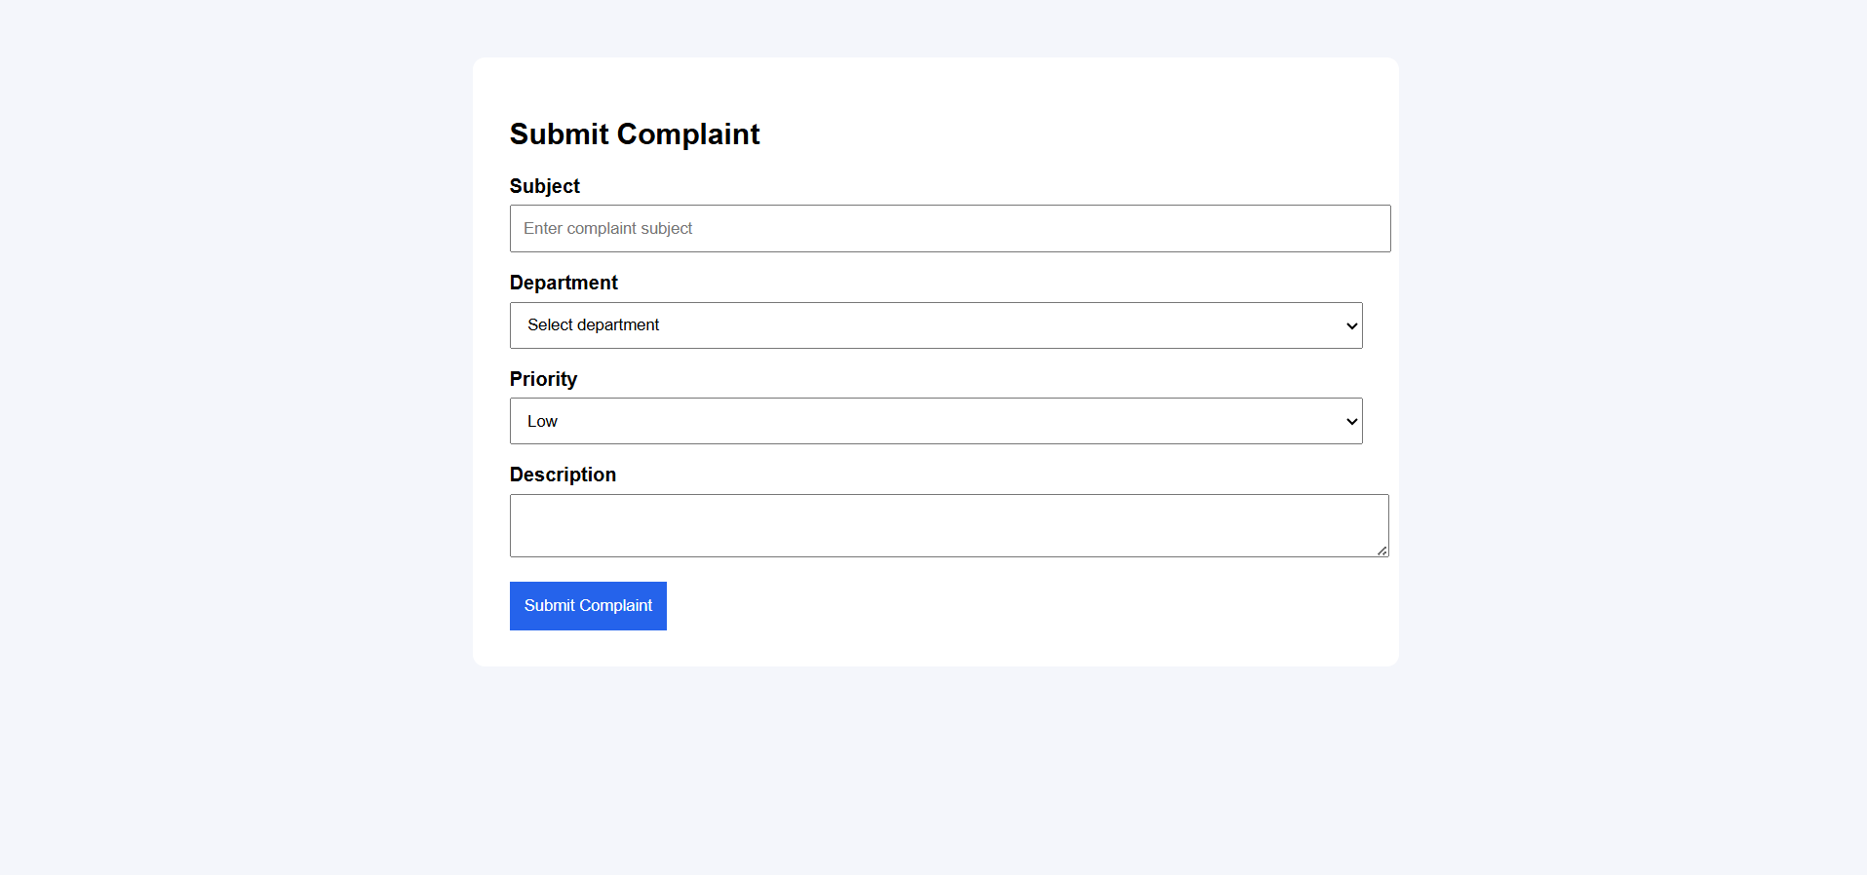
Complaint Page

Slide 59
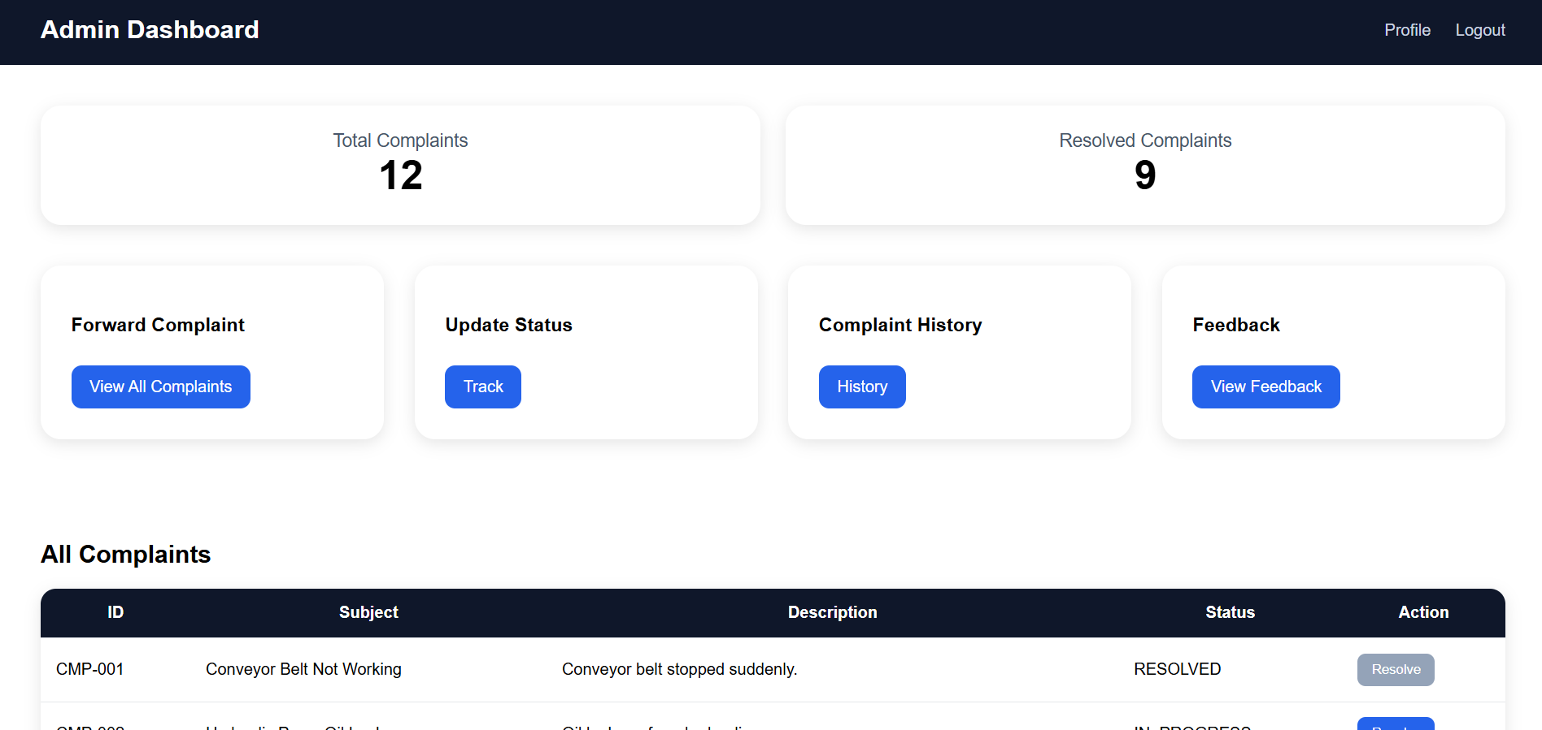
Admin Dashboard

Slide 60
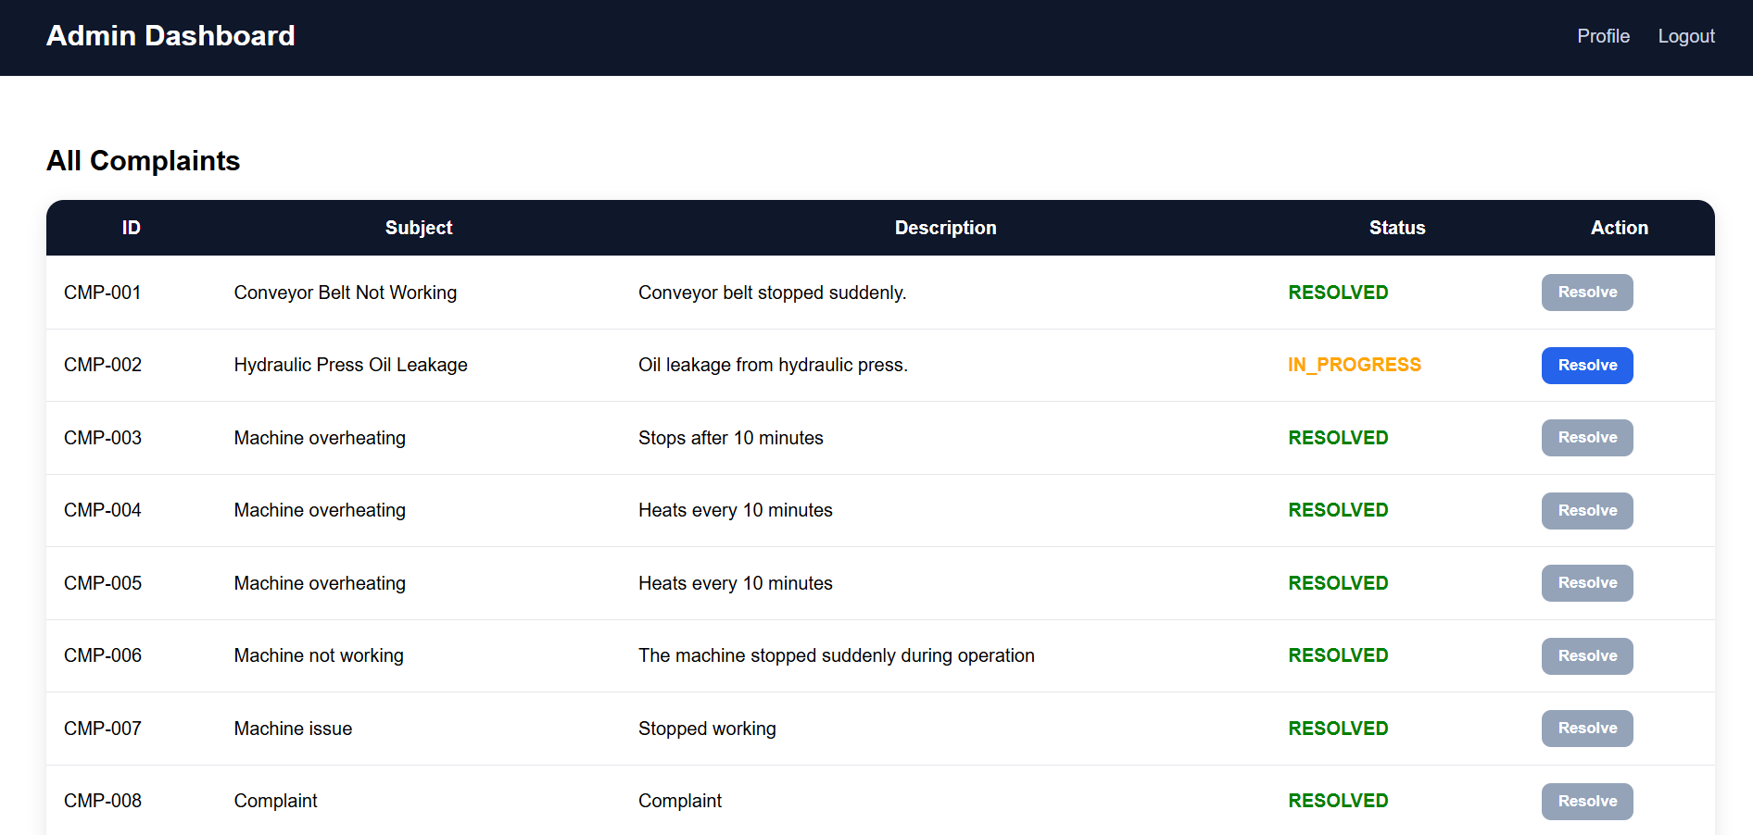
Admin Complaints

Slide 61
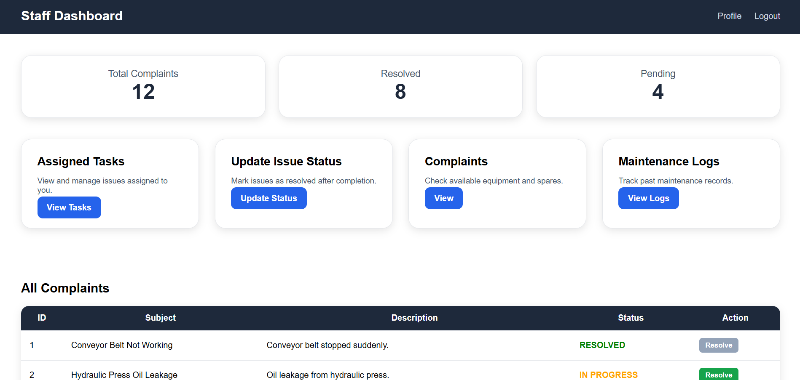
Staff Dashboard

Slide 62
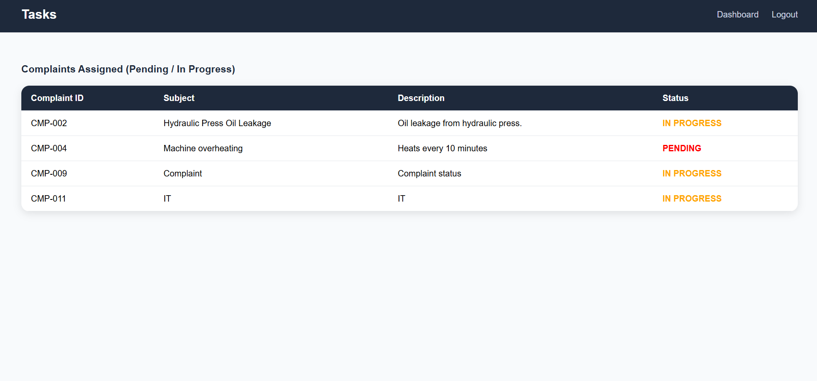
Staff Tasks

Slide 63
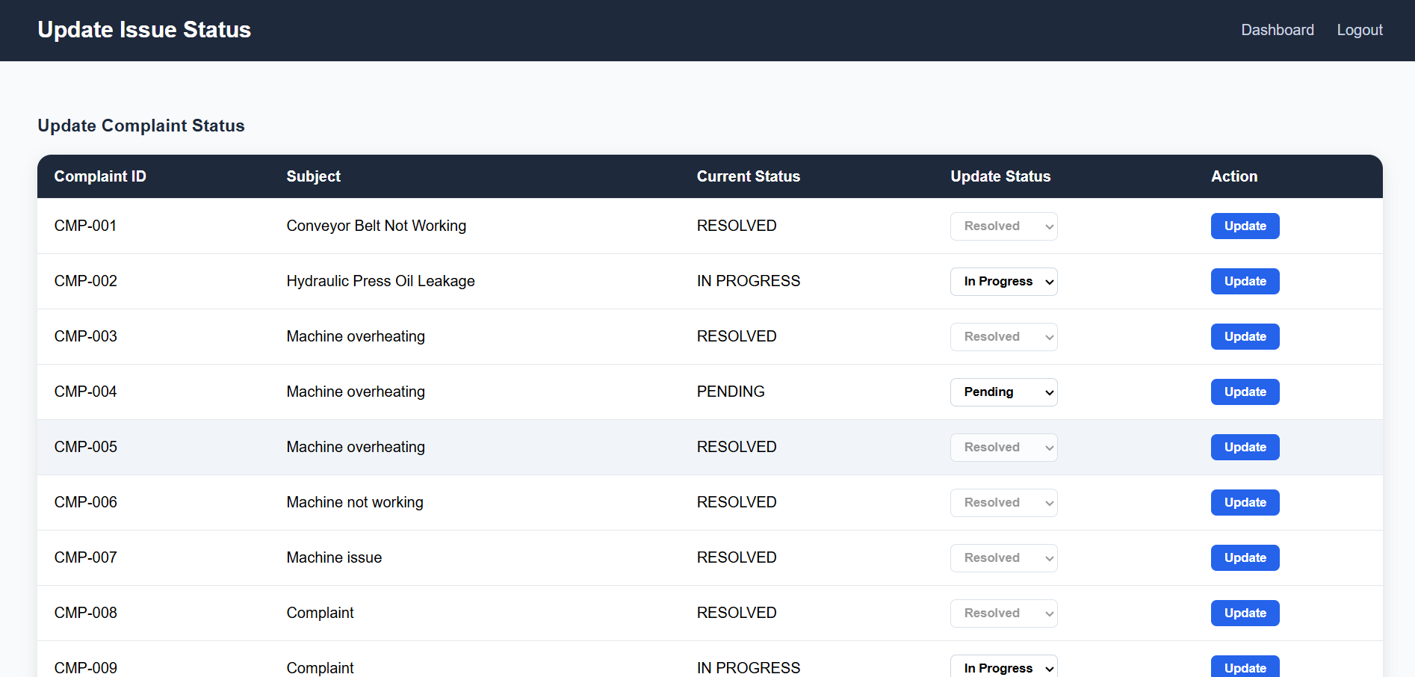
Staff Update Status

Slide 64
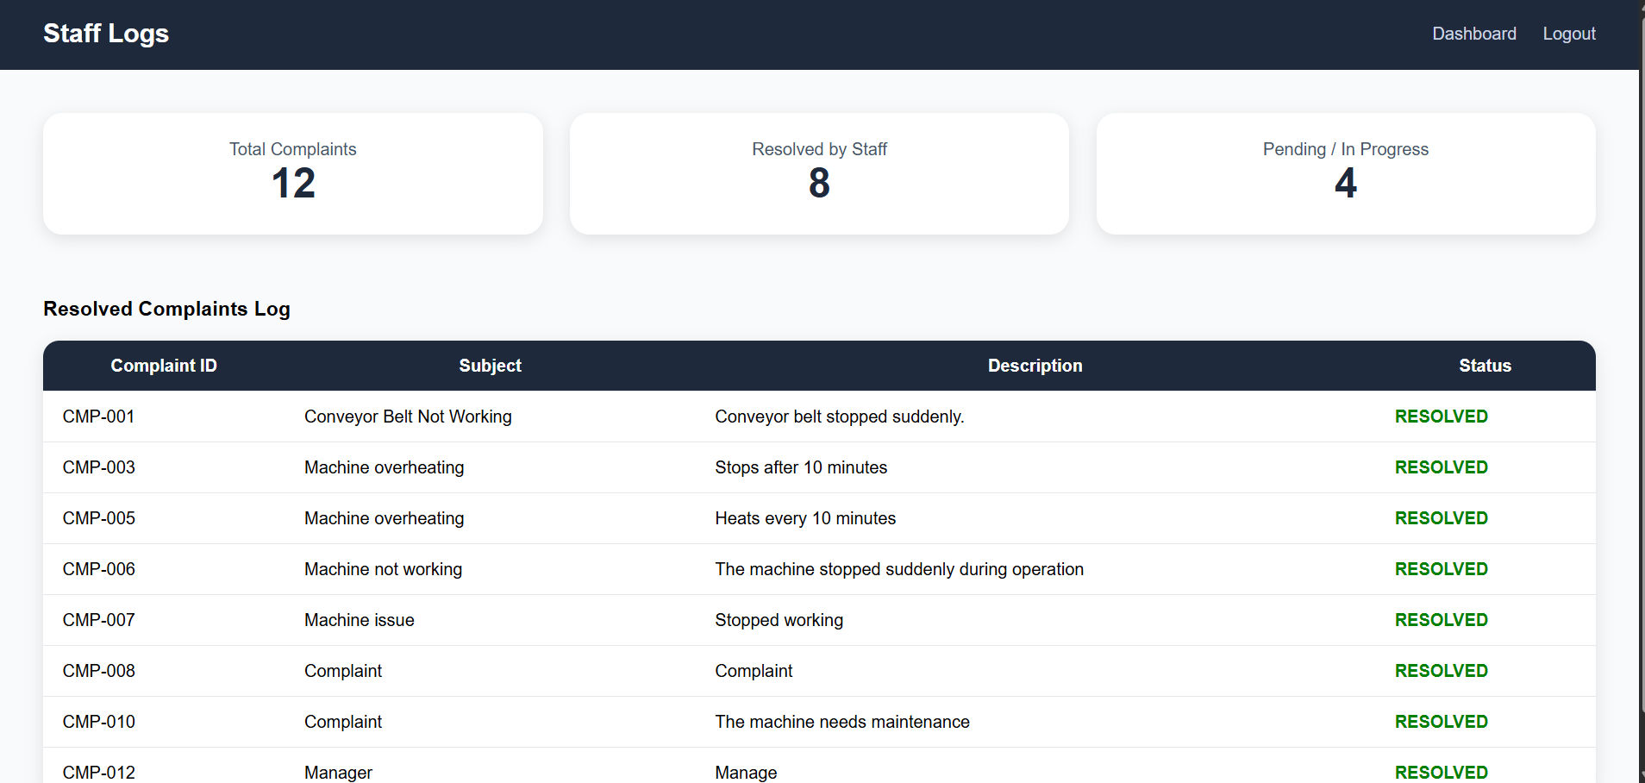
Staff Logs

Slide 65

Current Github

Slide 66
GITHUB

Slide 67
Git hub for Frontend

Slide 68

Git hub Sprint 1

Slide 69
THANK YOU

