Slide 1
Resolve IT Smart Grievance and Feedback Management System R.S.DIKSHA

Slide 2
Resolve IT Smart Grievance and Feedback Management System
PROCESS ONE: USER REGISTRATION AND LOGIN SYSTEM
PROCESS two: GRIEVANCES SELECTION AND SUBMISSION
PROCESS three: Complaint submission page
PROCESS four: Complaint transfer to respective departments
PROCESS five: RESOLVING THE COMPLAINT
PROCESS six: COLLECTING FEEDBACK

Slide 3
OBJECTIVE
THE OBJECTIVE OF THE PROJECT
A dedicated grievances and feedback management system for machinery buyers becomes essential to ensure timely support, transparent communication, and improved customer experience. Building a Smart Grievances System for a Company that works on Machineries for various Offices, Vehicles, Homes and Industries are quite challenging to manage where a feedback system would help it be more organized.

Slide 4

TOOLS AND TECH STACK USED IN PROJECT
LANGUAGES IN FRONTEND :
Html, CSS, JAVASCRIPT
BACKEND:
JAVA SPRINGBOOT
For designing:
ADOBE EXPRESS
FOR UI/UX DESIGN:
CANVA, FIGMA, ADOBE EXPRESS
DATABASE:
MySQL
REPOSITORY:
GIT AND GITHUB

Slide 5
Feature Document
Feature No. | Feature | Description | Status | Further Plans
1 | User Login | Permits the user to login into their dashboard | Completed | Verification through bill id
2 | Admin Login | Allows the Admin to login into the dashboard | Completed | Creating a crew login page
3 | User Dashboard | The User can view their history and register complaints in this page | Completed | Making the page completely functional
4 | Profile and Logout Page | The user can view their profile details and logout | Completed | Adding and editing profile details
5 | Admin Dashboard | Admin views and allocates to departments | Completed | Making a working page

Slide 6
Feature Document for Sprint 2
Feature No. | Feature | Description | Status | Further Plans
1 | Database using MySQL | Designed and created MySQL tables for users, complaints and admin & feedback | Completed | Might Require Improvisation in future
2 | Backend codes | Core backend layers including Controllers, Services, DAOs, Models | Completed | Improve performance
3 | Setting Up of the Backend | Configured Spring Boot project structure & dependencies | Completed | Add more features
4 | Authentication and Authorization | Secure login for User and Admin roles | Completed | Role-based restrictions for staff
5 | JWT Token Generation | Added JWT-based authentication to generate secure access tokens | Completed | Implement refresh tokens

Slide 7
Sprint Analysis and Requirements
DATABASE USING MYSQL
Designed and created MySQL tables for users, complaints and admin & feedback
BACKEND STRUCTURE
Configured Spring Boot project structure & dependencies
AUTHORIZATION
Secure login for User and Admin roles
BACKEND CODES USING JAVA
Core backend layers including Controllers, Services, DAOs, Models
TOKEN GENERATION
Added JWT-based authentication to generate secure access tokens
VERIFICATION USING POSTMAN
Using postman for ensuring the access

Slide 8
The tasks for the Sprint 3 coming up
A fully functional STAFF DASHBOARD
Page for selecting the type of grievances
Submit page for feedback and complaints
ADDING A STAFF ANALYSIS IN FORM OF VISUAL REPRESENTATION
Backend integration WITH FRONTEND
IMPROVE BACKEND CODE QUALITY

Slide 9
DAY WISE WORK
UNDERSTANDING THE WORKING OF SQL WORKBENCH
Writing code
DAY 23
Backend in vs code (which didn’t work)
DAY 19
Understanding the working and folders with code
DAY 21
DAY 15-17
Coding for the backend
DAY 24
DATABASE CREATION
DAY 18
Backend using IntelliJ
DAY 20
Writing codes for backend
DAY 22

Slide 10

Frontend Screenshots

Slide 11
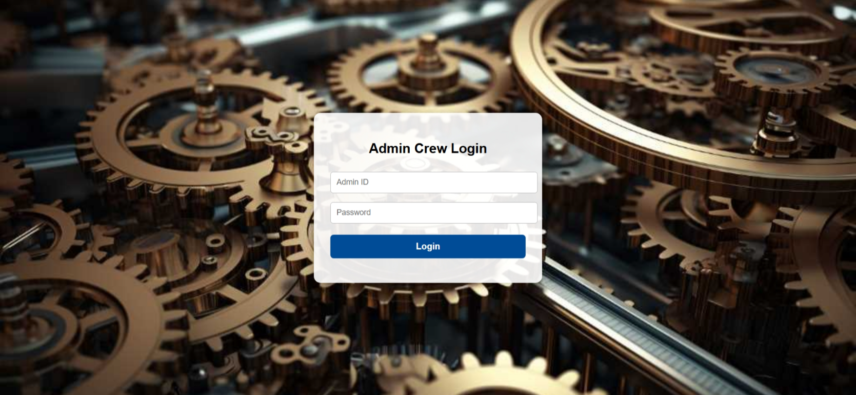
Admin Login

Slide 12
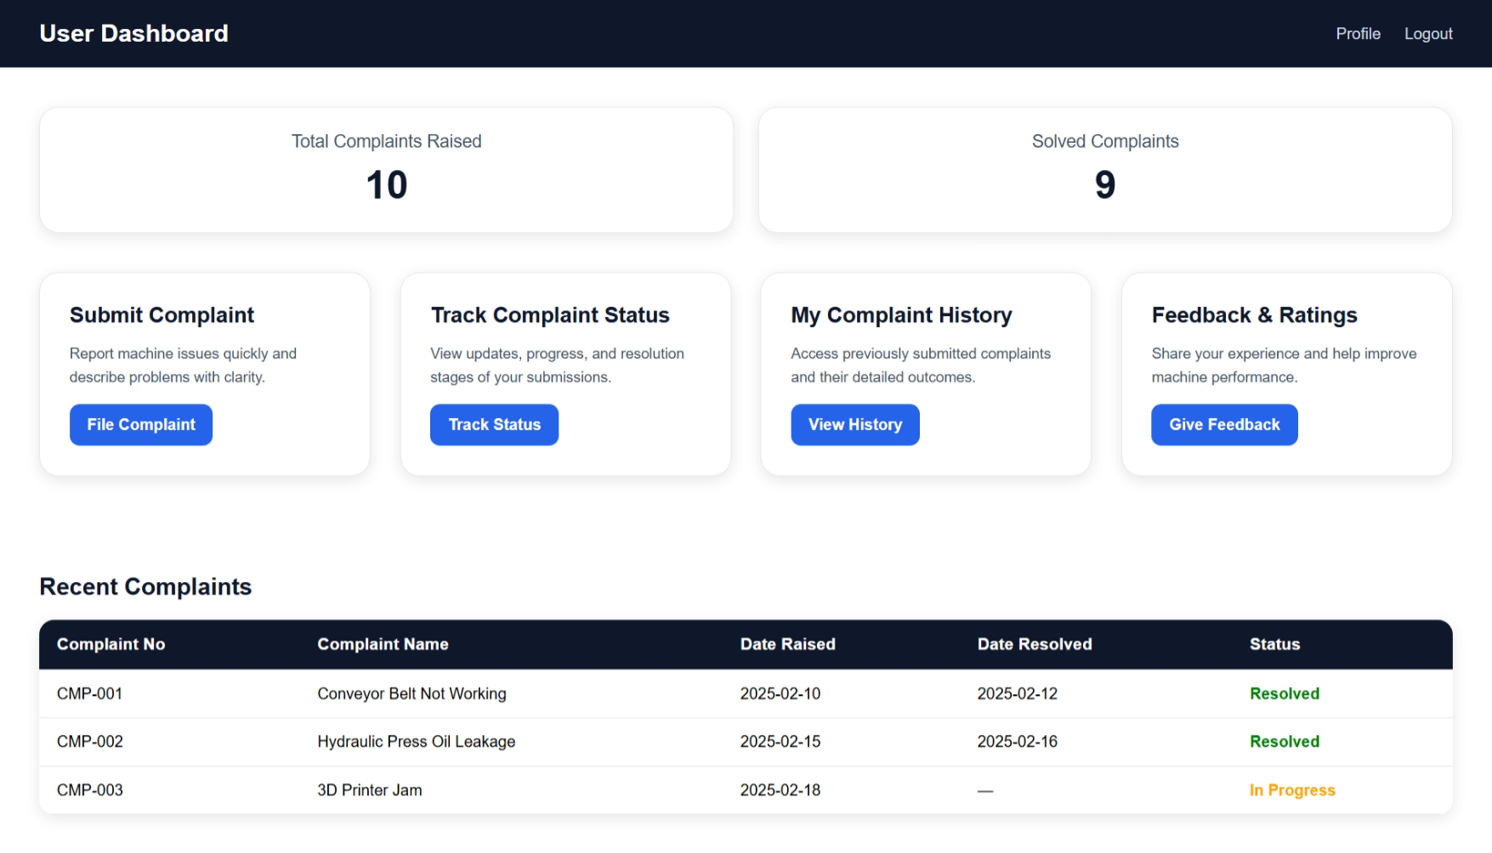
User Dashboard

Slide 13
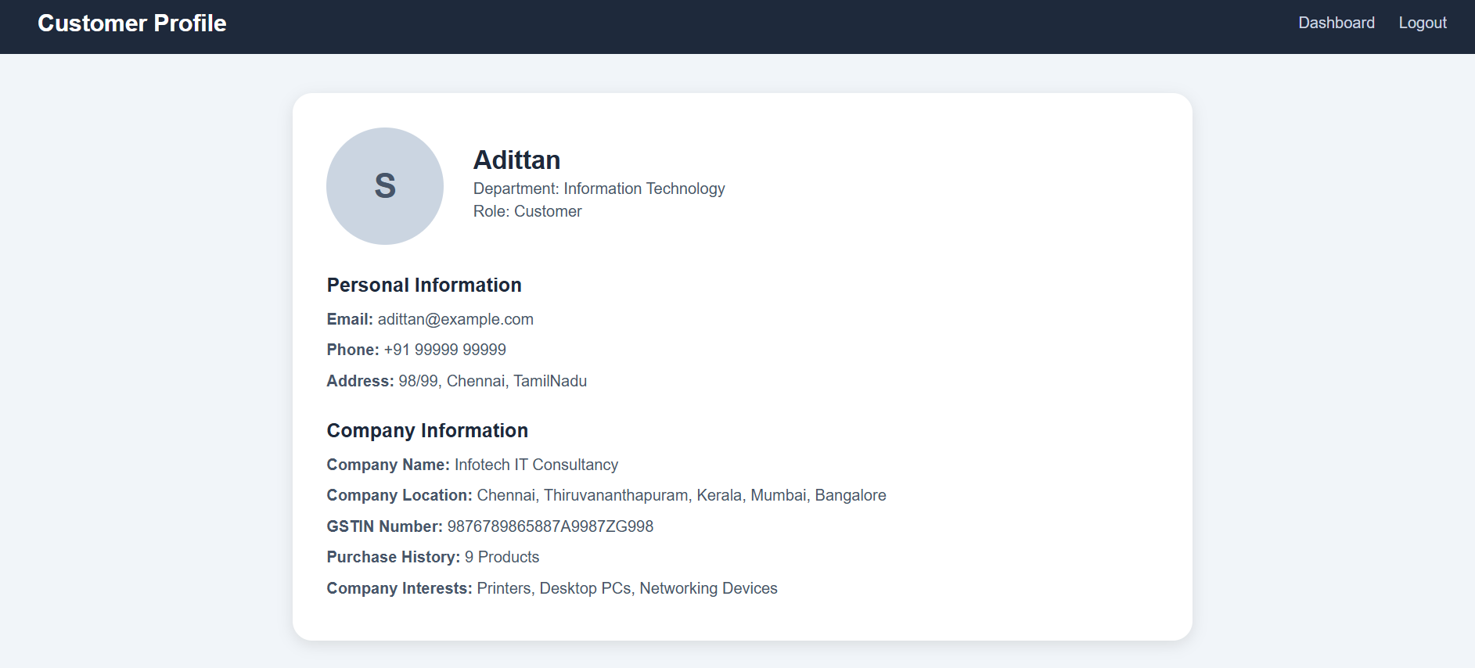
Profile Page

Slide 14
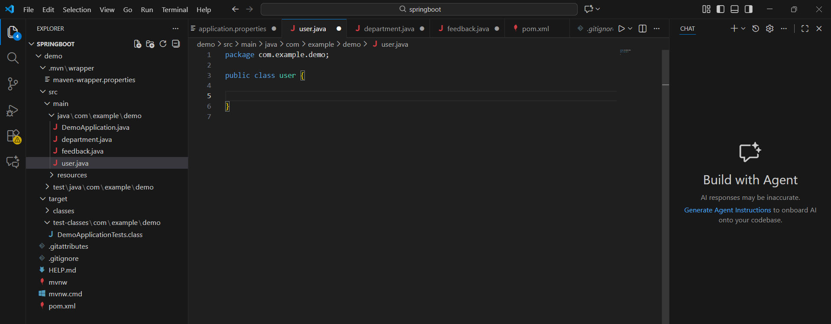
Backend in VS Code

Slide 15
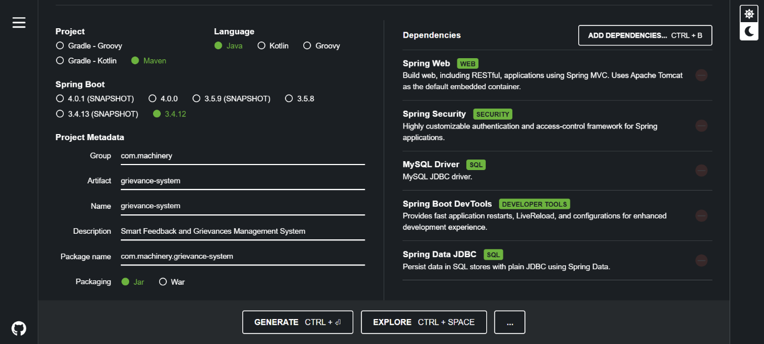
Spring Initializer

Slide 16
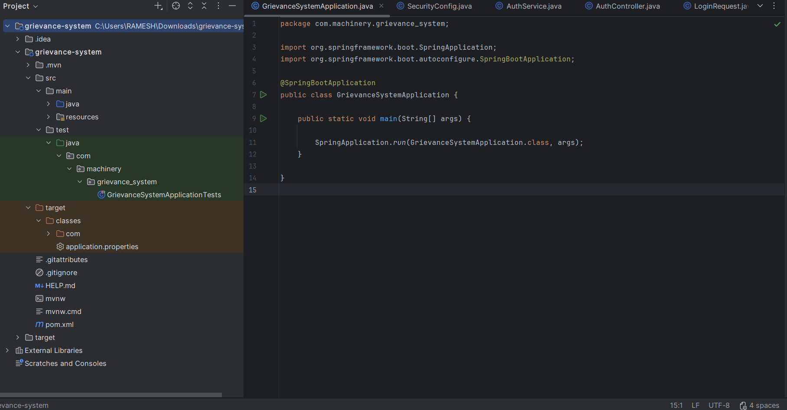
Backend architecture

Slide 17
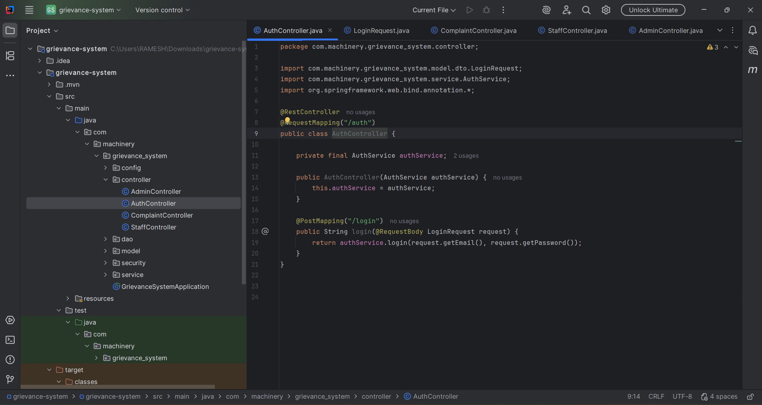
Authentication Controller

Slide 18
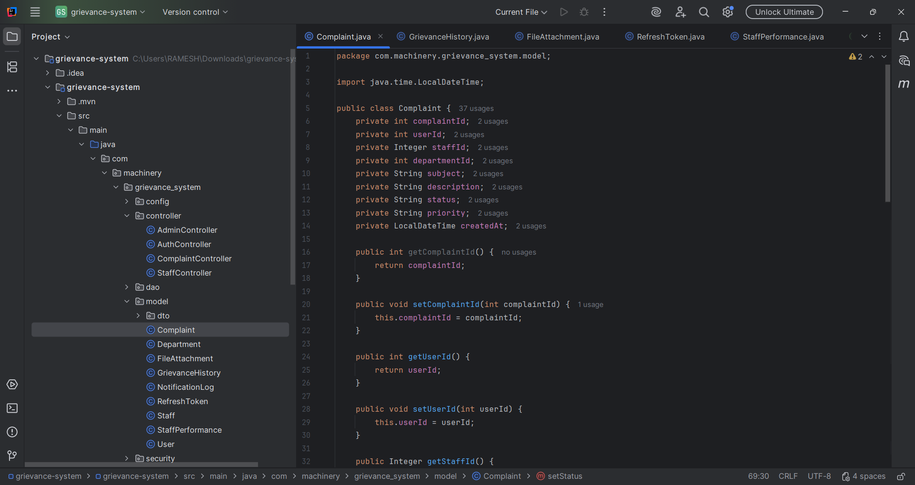
Complaint Model

Slide 19
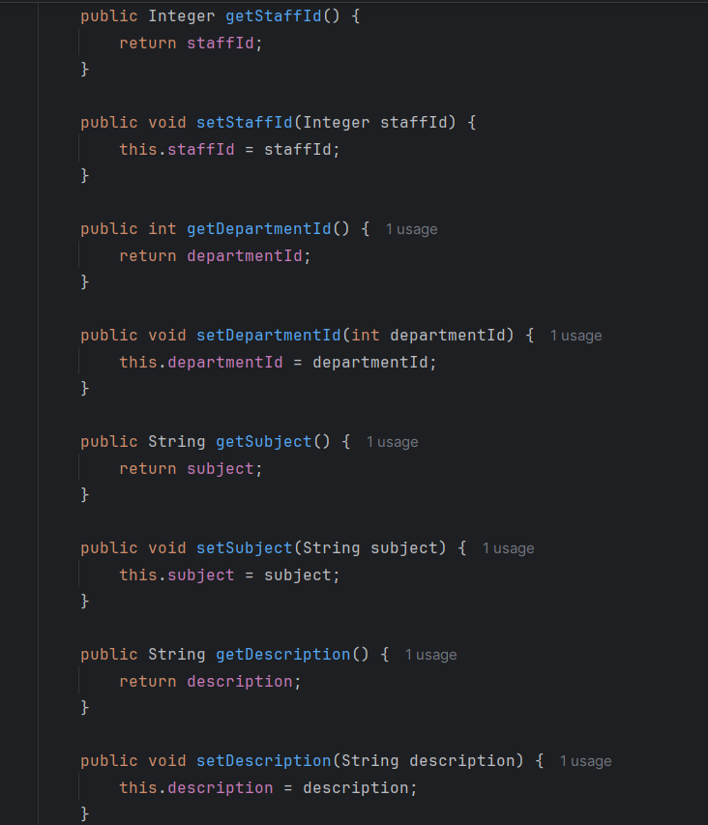
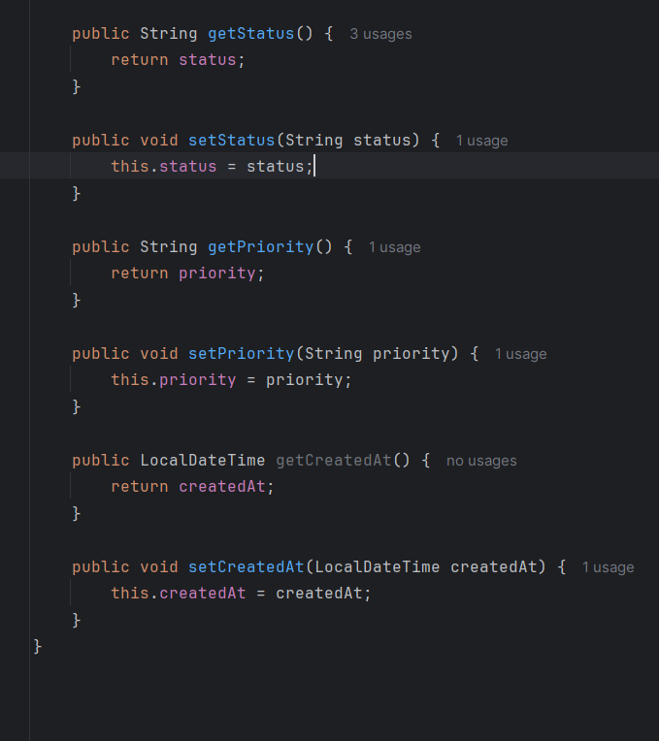
Complaint Model

Slide 20
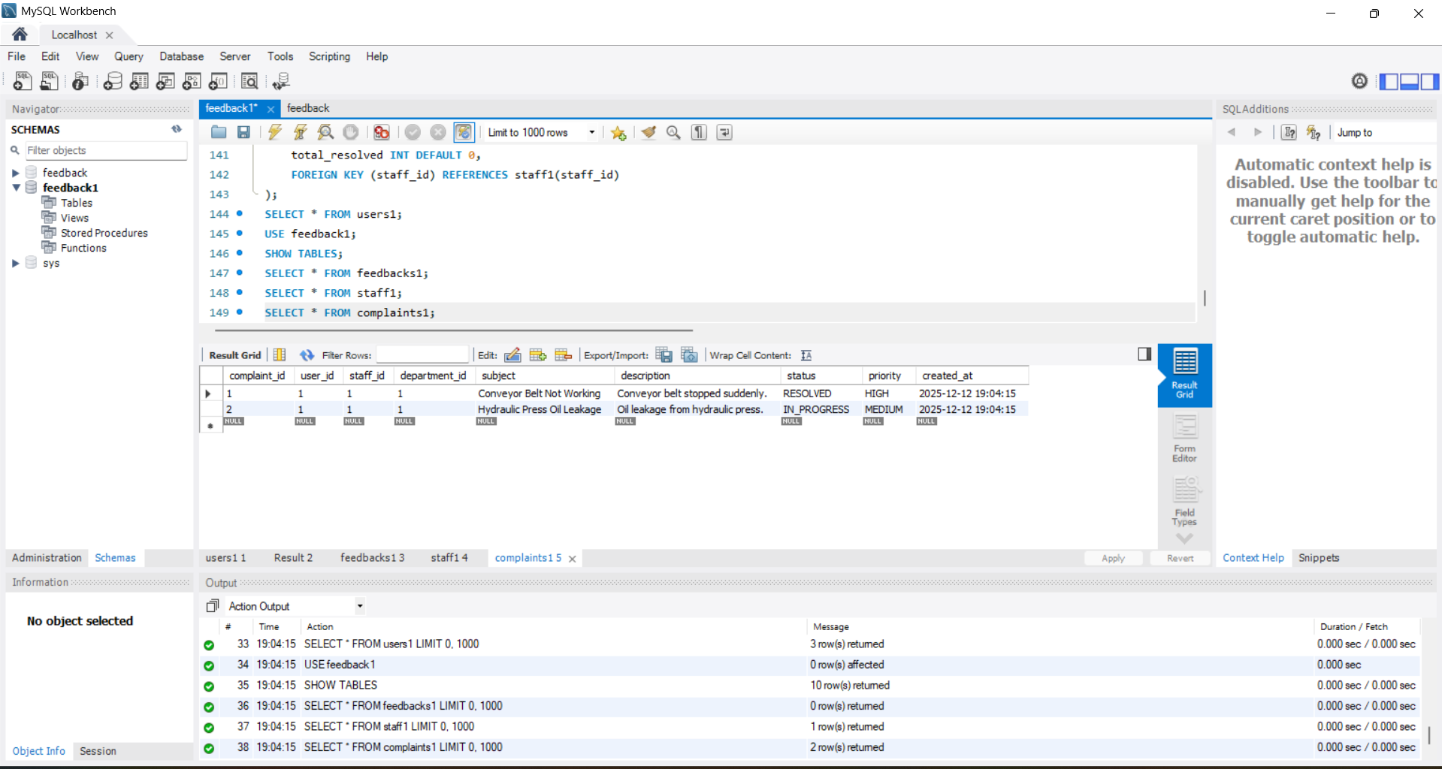
DATABASE SCHEMA

Slide 21
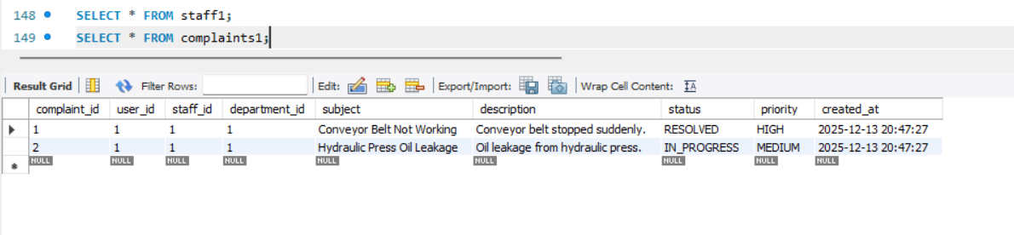
THE COMPLAINT TABLE

Slide 22
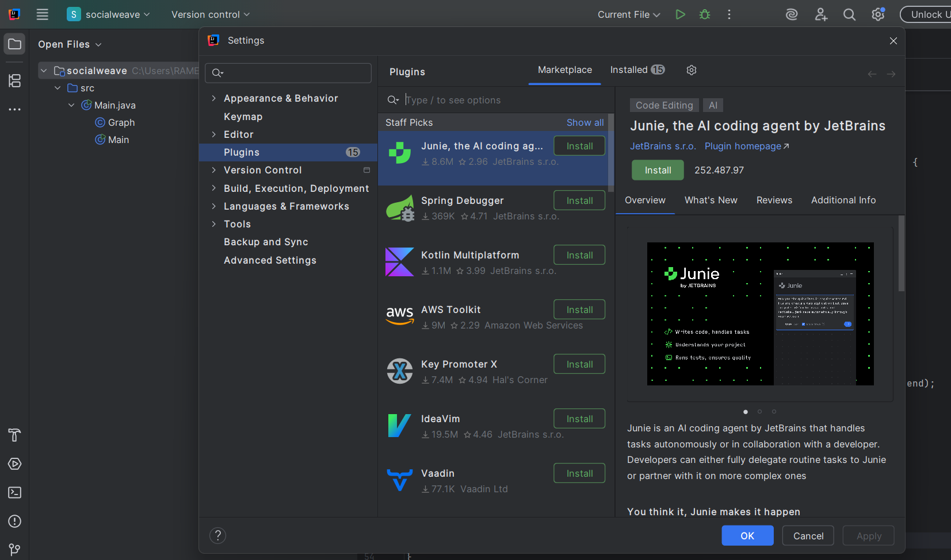
Backend in Intelli IJ

Slide 23
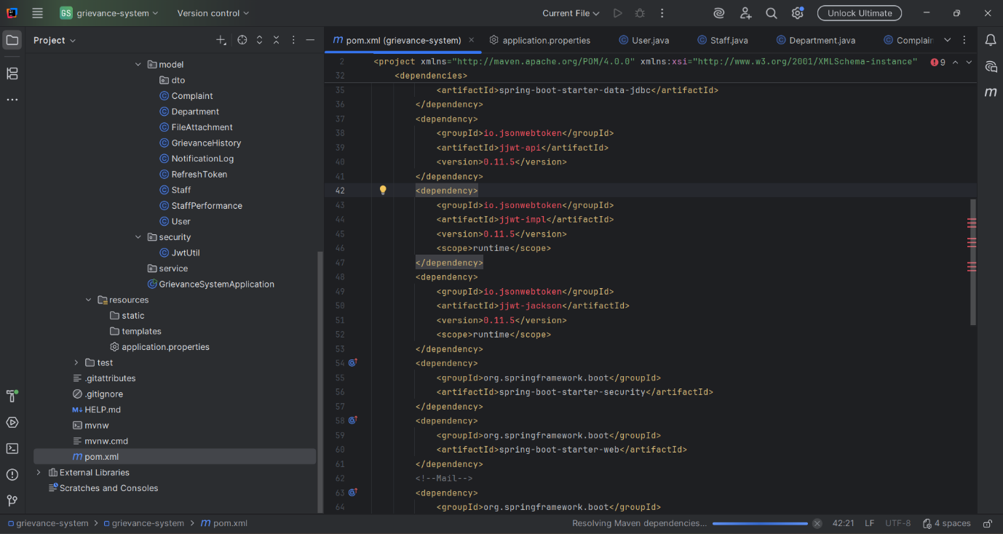
Dependencies

Slide 24
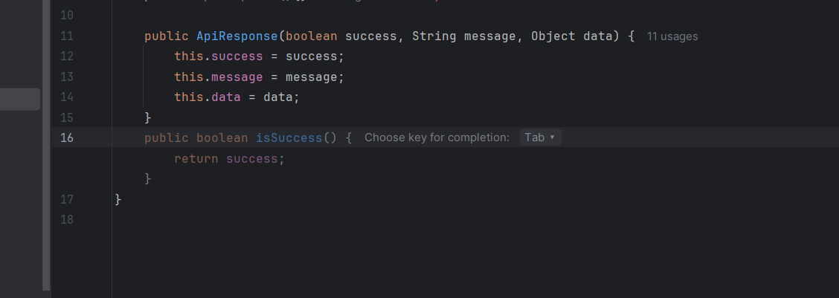
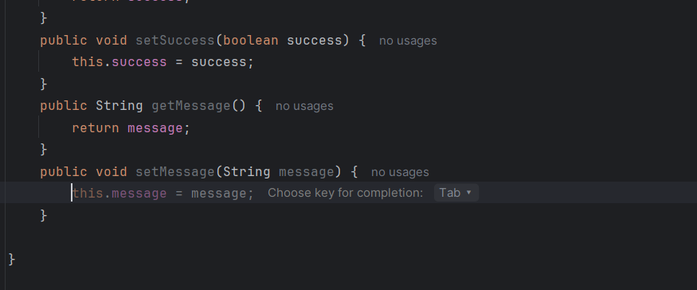
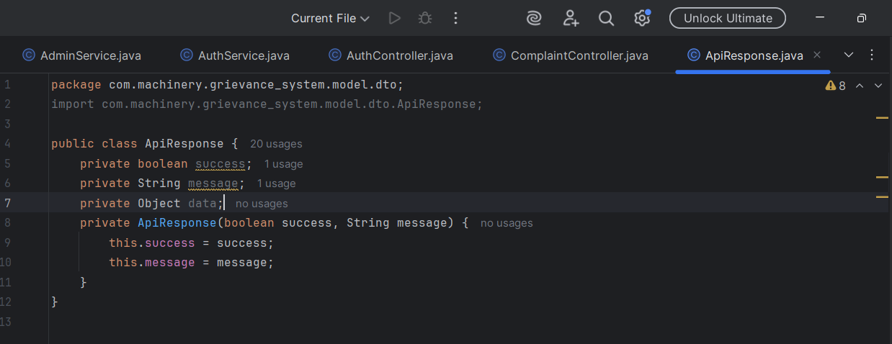
The real Magic

Slide 25
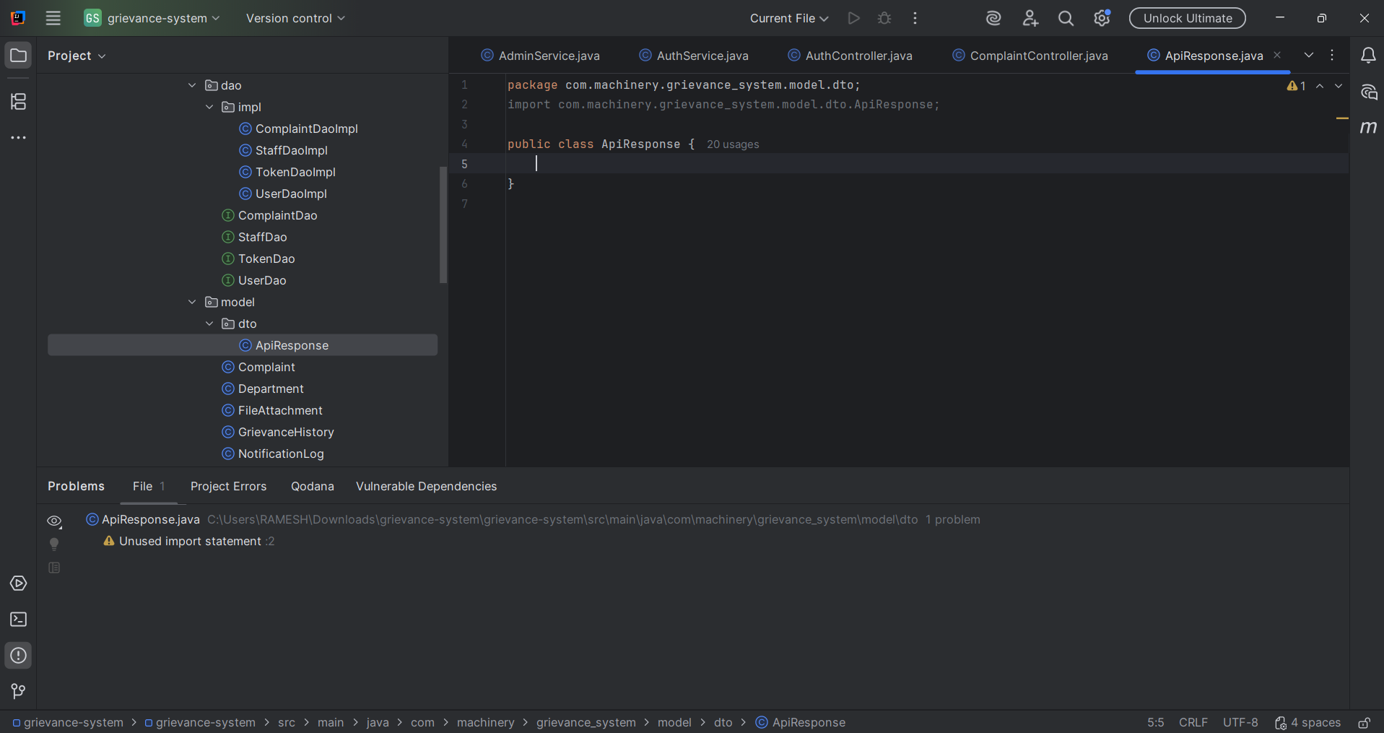
Automatic Magic

Slide 26
Testing the working of the BACKEND

Slide 27
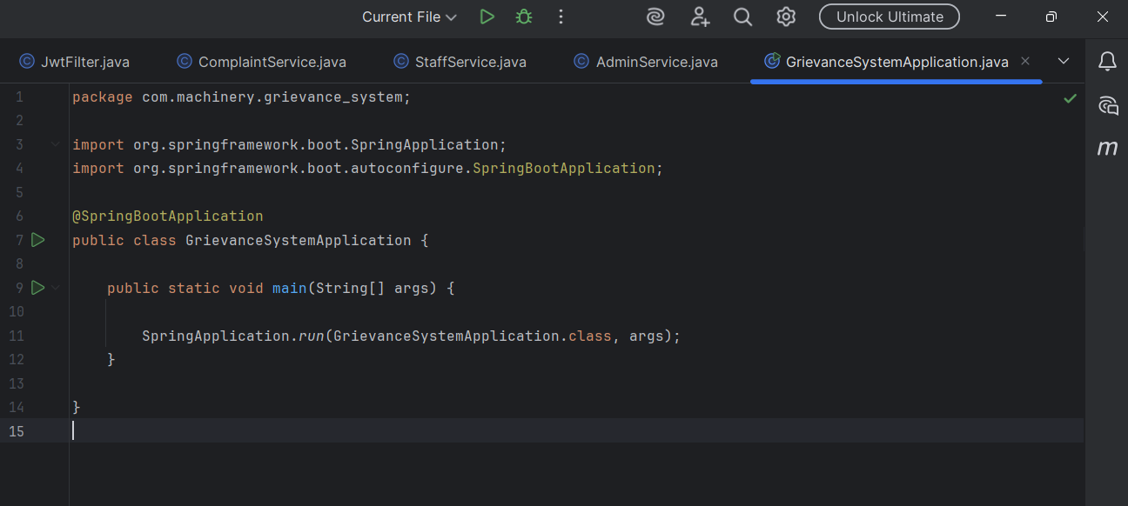
System Application

Slide 28
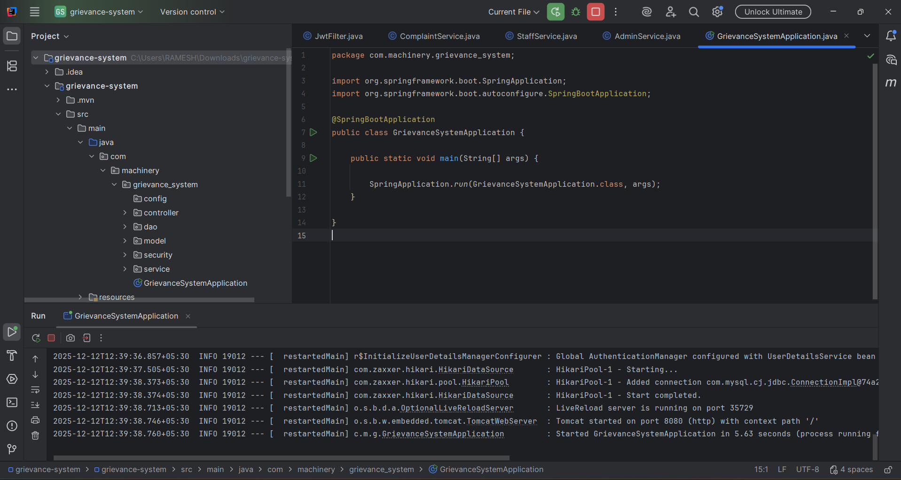
Run the code

Slide 29
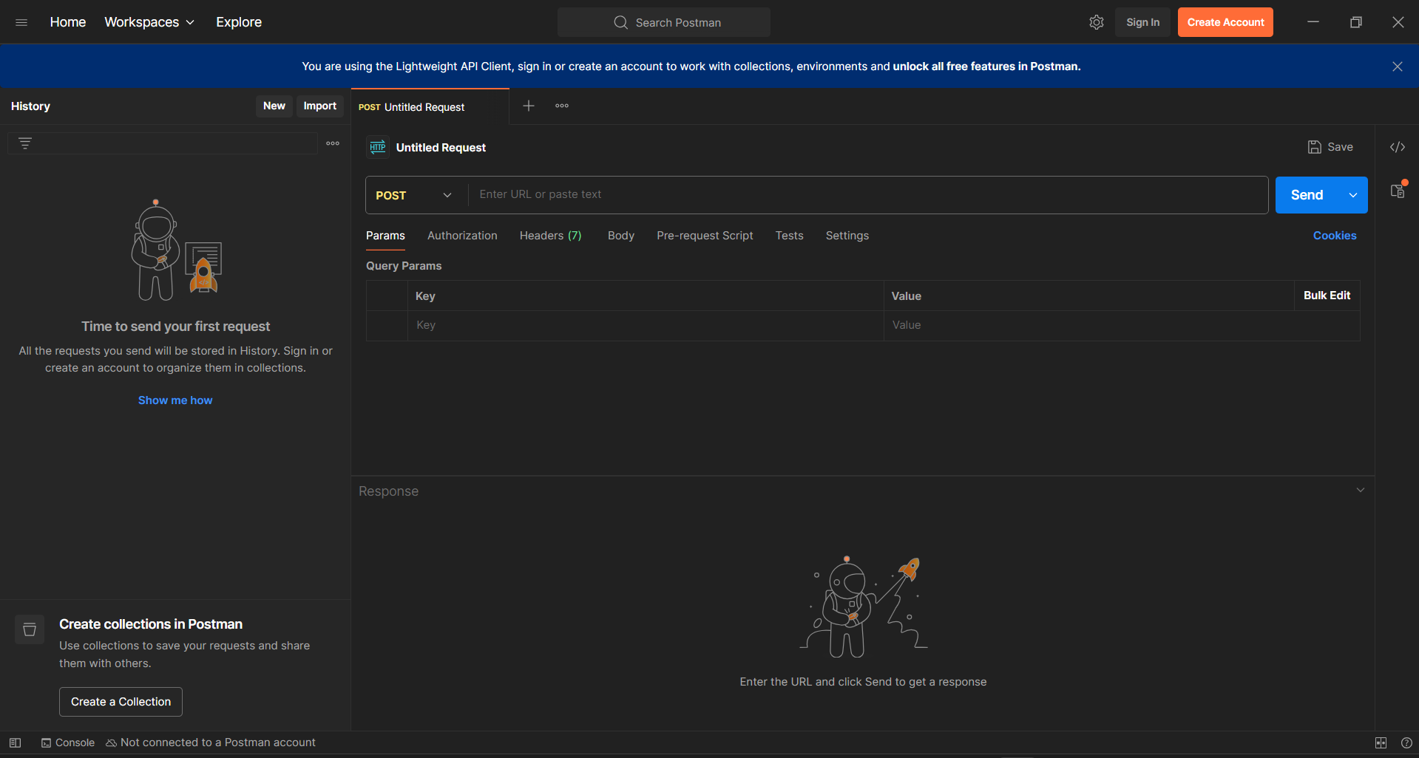
Postman

Slide 30
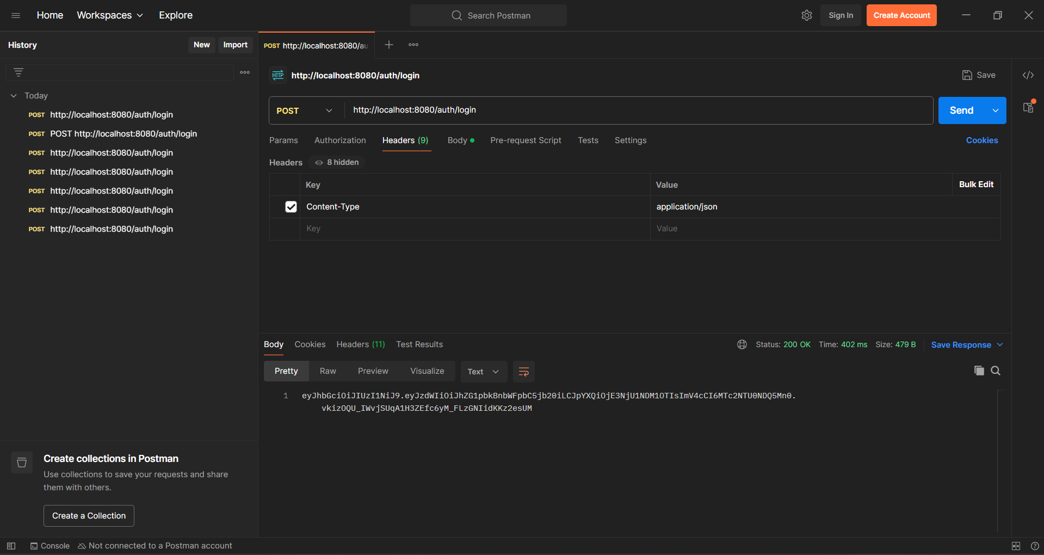
Admin Authorization

Slide 31
GITHUB

Slide 32
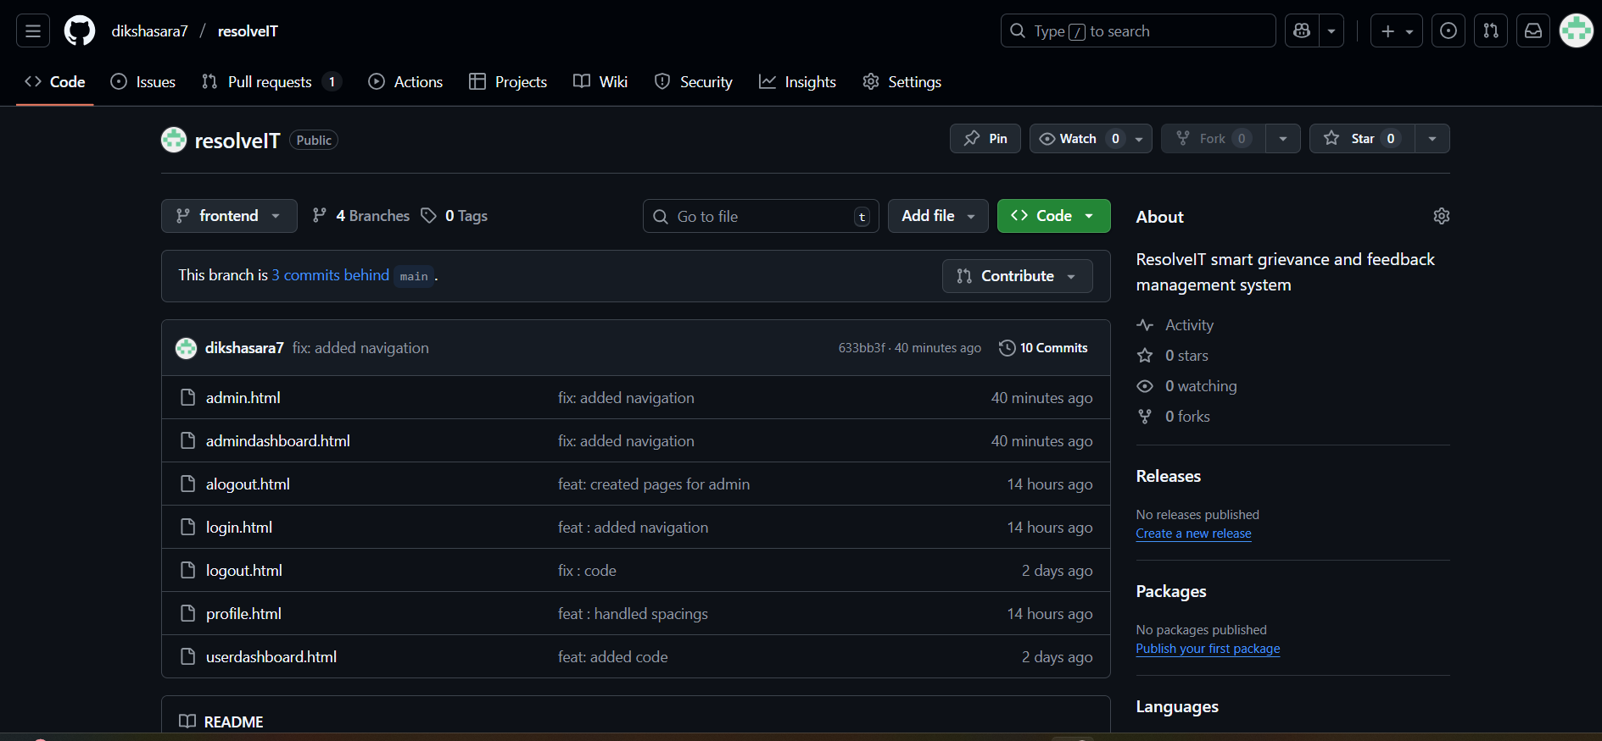
Git hub for Frontend

Slide 33
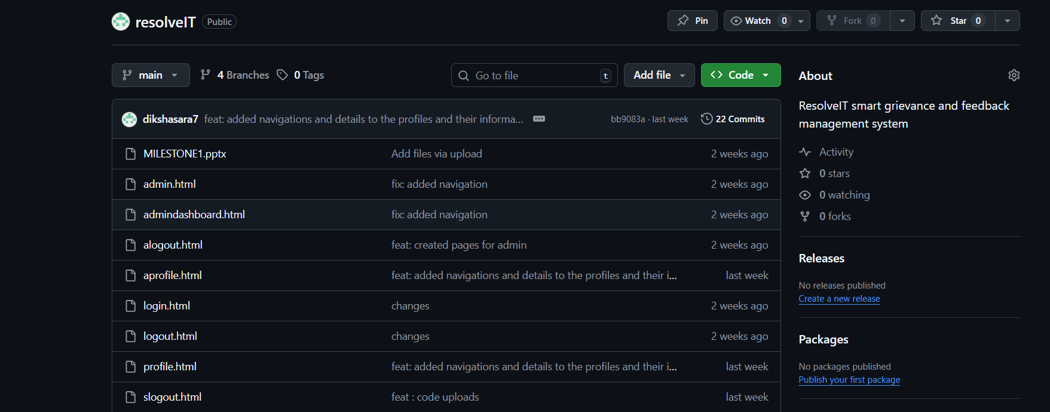
Git hub Sprint 1

Slide 34
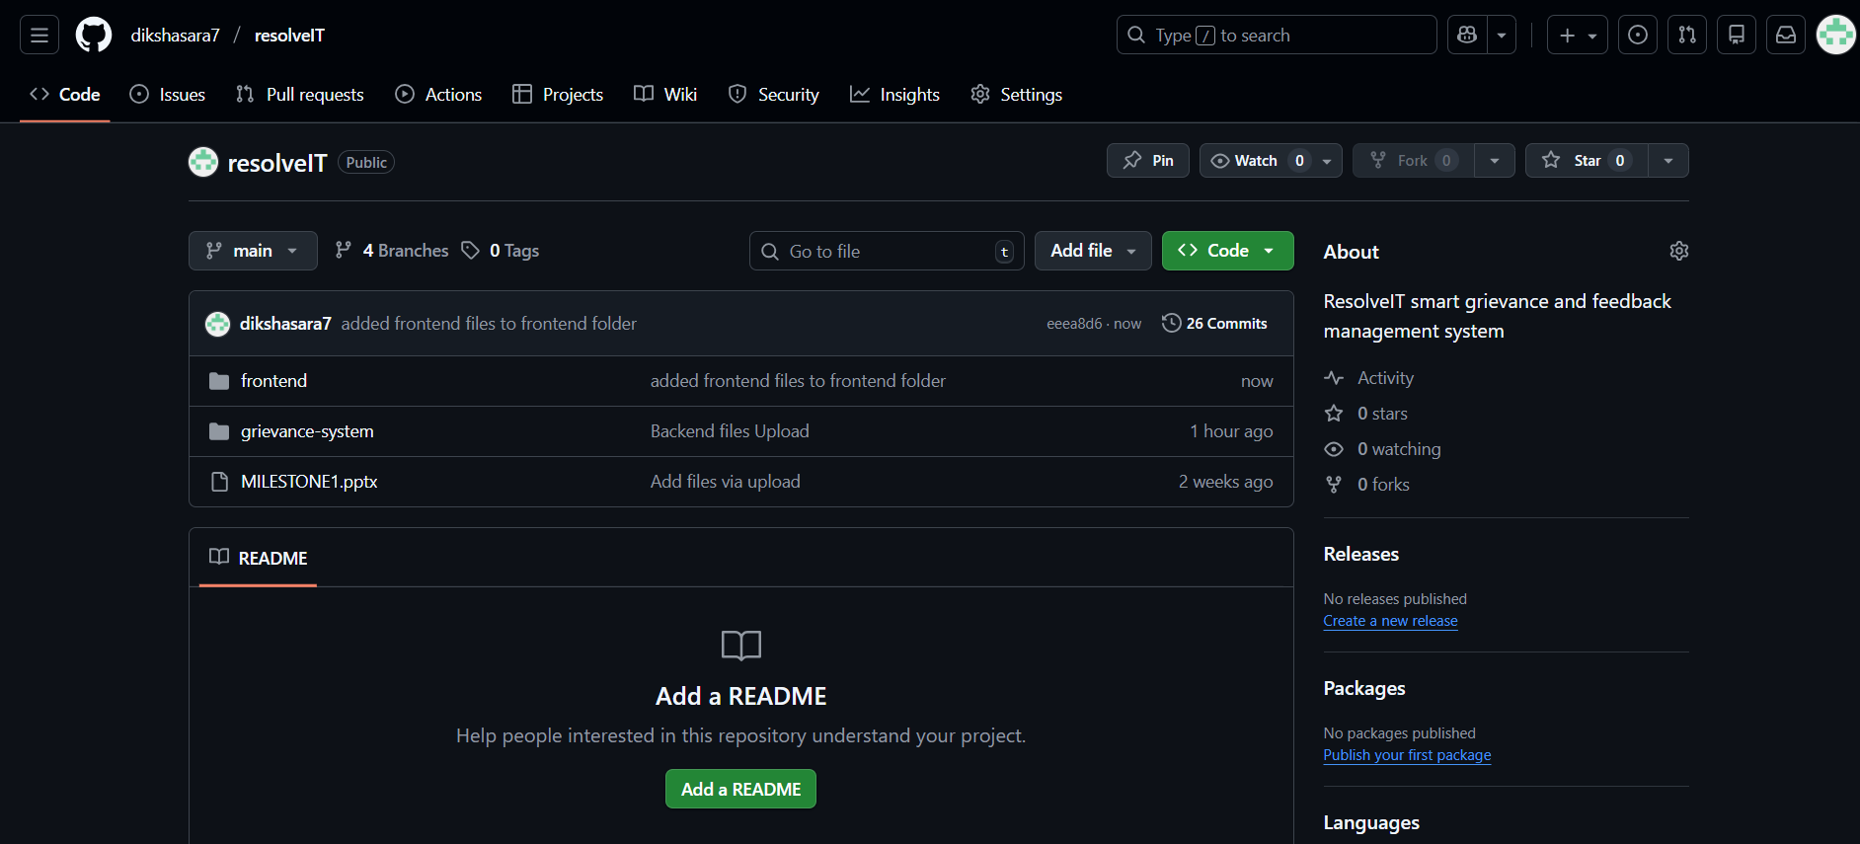
Folder Wise Organized

Slide 35
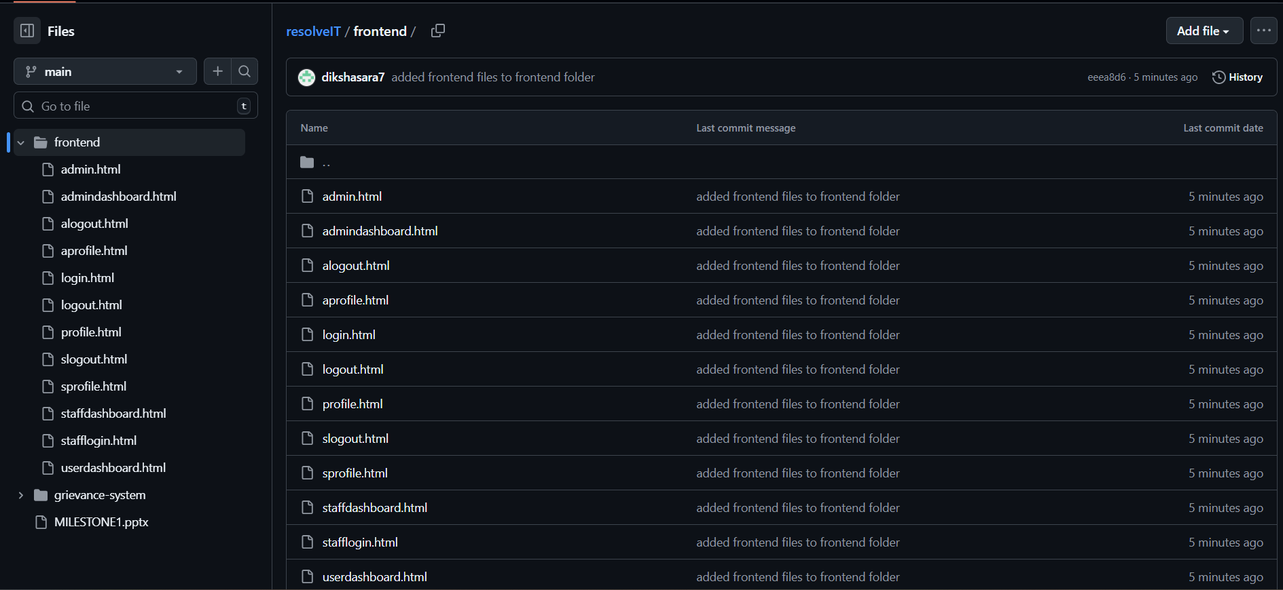
Files in resolveIT

Slide 36
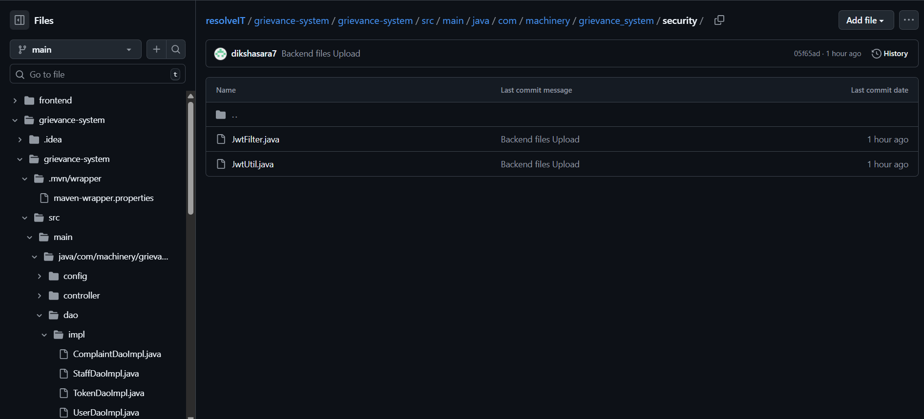
Files Structure

