Slide 1
NEXTHIKES IT SOLUTIONS
Exploratory Data Analysis of
Large-Scale Retail Transaction Data
Univariate, Bivariate and Multivariate Statistical Techniques on 100,000 Transaction Records
Submitted by
Submitted to
Diksha Saxena
NextHike
Submission Date: 25th September, 2026

Slide 2
ROADMAP
Agenda
01
Dataset & Objectives
02
Univariate Analysis
Scope, structure and business goals of the analysis
Distributions, central tendency and spread
03
Outlier Detection
04
Bivariate Analysis
IQR and Z-score methods on key variables
Correlations and category-level comparisons
05
Multivariate Analysis
06
Key Findings & Conclusion
Pivot views across three or more variables
Statistical takeaways for business decisions

Slide 3
SITUATION OVERVIEW
Dataset Overview & Objectives
100,000
18
6
0
Transaction Records
Original Variables
Product Categories
Duplicate Rows
Data spans customer demographics, order details, product & pricing fields, payment/shipping mode and return status, mixing categorical, numerical and date types.
Project Objectives
Core Tools Used
Perform univariate, bivariate and multivariate analysis
Detect and interpret outliers in pricing and delivery data
Measure correlation between key numerical variables
Analyze skewness and kurtosis of revenue distributions
Extract statistically meaningful business insights
Pandas — data manipulation and aggregation
NumPy — numerical and array computation
Matplotlib & Seaborn — statistical visualization
SciPy — hypothesis testing (t-test, ANOVA, chi-square)
NextHikes IT Solutions | Retail Transaction EDA
3

Slide 4
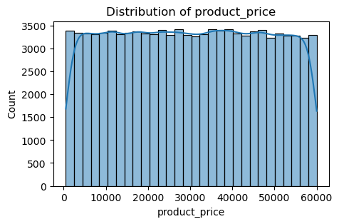
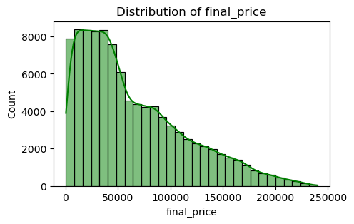
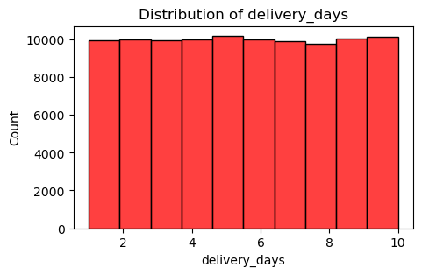
SECTION 01
Univariate Analysis — Numerical Variables
Variable | Mean | Median | Std Dev | Skewness | Kurtosis
Age | 41.56 | 42.00 | 13.85 | -0.005 | -1.20
Product Price (₹) | 30,164.5 | 30,148.0 | 17,139.7 | 0.003 | -1.20
Quantity | 2.50 | 3.00 | 1.12 | -0.003 | -1.36
Discount % | 15.01 | 15.00 | 8.95 | -0.004 | -1.20
Final Price (₹) | 64,165.7 | 49,752.4 | 49,969.3 | 0.935 | 0.17
Delivery Days | 5.51 | 5.00 | 2.87 | 0.002 | -1.22
Reading the Numbers
product_price is near-symmetric (skew ≈ 0)
final_price is right-skewed (0.935) — a long tail of high-value orders
All numerical fields show negative kurtosis except final_price, indicating flatter-than-normal spread
Distribution of product_price
Distribution of final_price
Distribution of delivery_days
NextHikes IT Solutions | Retail Transaction EDA
4

Slide 5
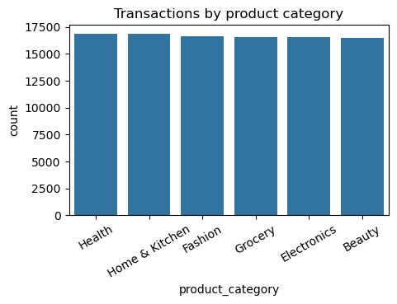
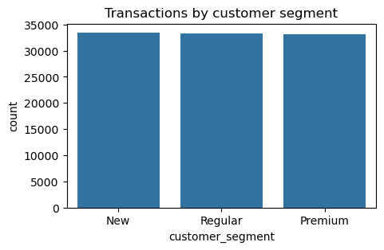
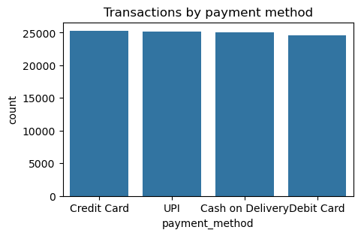
SECTION 01
Univariate Analysis — Categorical Variables
Transactions by product category
Transactions by customer segment
Transactions by payment method
Key Frequency Findings
16.5–16.9%
33.5 / 33.4 / 33.2%
25.3%
14.81%
Product categories are near-evenly split (Health highest)
New / Regular / Premium — nearly equal customer mix
Credit Card leads payment methods, closely followed by UPI
Overall return rate across all 100,000 transactions
NextHikes IT Solutions | Retail Transaction EDA
5

Slide 6
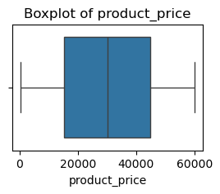
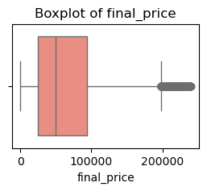
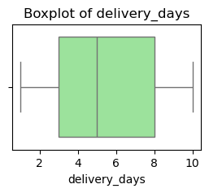
SECTION 02
Outlier Detection
IQR Method — final_price
Acceptable range: ₹ -79,306.6 to ₹ 198,057.7
1,335 outliers found (1.33% of orders)
Z-score method (|z|>3): 503 outliers
product_price
final_price
delivery_days
What the Outliers Represent
Every final_price outlier corresponds to quantity = 4, the maximum basket size
Outliers spread fairly evenly across all 6 categories (Grocery slightly highest at 247)
Outlier orders average ₹56,249 in product price vs ₹30,165 overall — nearly double
1.33%
1.9x
Orders flagged as outliers (IQR)
Higher avg. product price for outlier orders
Outliers were retained rather than removed — they represent genuine high-value, bulk-quantity transactions rather than data errors.
NextHikes IT Solutions | Retail Transaction EDA
6

Slide 7
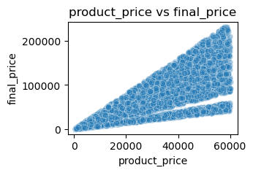
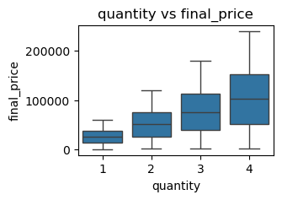
SECTION 03
Bivariate Analysis — Numerical Relationships
Pearson Correlation with final_price
Variable | r | Strength
product_price | +0.731 | Strong
quantity | +0.575 | Moderate
discount_percentage | -0.137 | Weak
age | -0.001 | None
product_price vs final_price
quantity vs final_price
Interpretation
product_price and quantity are the two strongest revenue drivers of final_price — as expected, since final_price is derived from them
discount_percentage has a mild negative relationship with final_price — deeper discounts modestly reduce revenue per order
age shows virtually no relationship with spending (r ≈ 0), and delivery_days shows no relationship with returns (r ≈ 0.0005)
NextHikes IT Solutions | Retail Transaction EDA
7

Slide 8
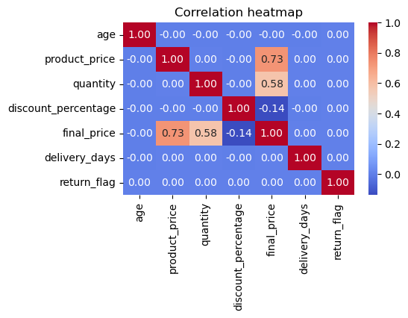
SECTION 03
Correlation Matrix & Multicollinearity
Correlation Matrix Observations
final_price correlates strongly with product_price and quantity, and negatively with discount_percentage
delivery_days shows low correlation with spending and returns
No pair of independent features shows problematic multicollinearity
Variance Inflation Factor (VIF)
Feature | VIF
age | 1.00
product_price | 1.00
quantity | 1.00
discount_percentage | 1.00
delivery_days | 1.00
Correlation heatmap — numerical variables
All VIF values ≈ 1.0 — features are effectively independent, safe for predictive modeling.
NextHikes IT Solutions | Retail Transaction EDA
8

Slide 9
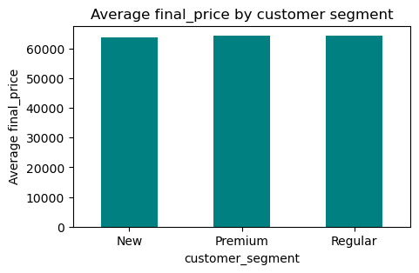
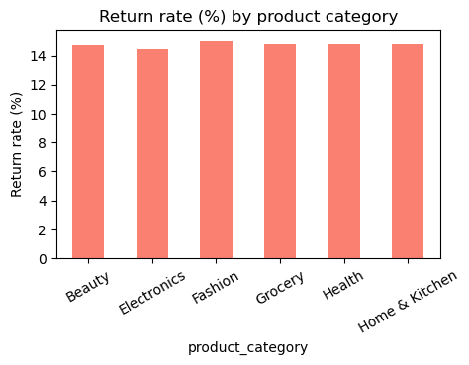
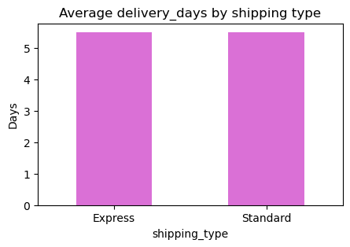
SECTION 03
Numerical vs Categorical & Significance Tests
Avg. final_price by segment
Return rate (%) by category
Avg. delivery days by shipping type
Hypothesis Test Results
Test | Comparison | p-value | Conclusion (α = 0.05)
ANOVA | Customer segment vs final_price | 0.190 | Not significant
t-test | Express vs Standard delivery days | 0.370 | Not significant
Chi-square | Product category vs return status | 0.791 | Not significant
Segment, shipping type and category show real but statistically small differences — none reach significance at the 95% confidence level on this sample.
NextHikes IT Solutions | Retail Transaction EDA
9

Slide 10
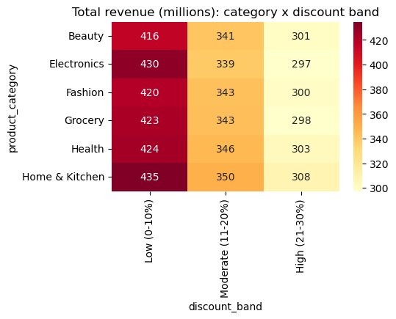
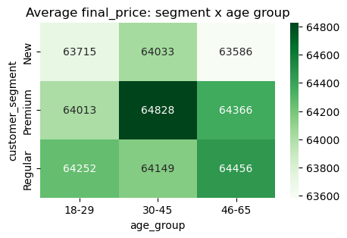
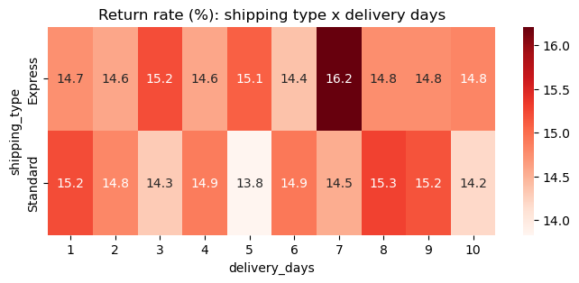
SECTION 04
Multivariate Analysis
Revenue (₹M): category × discount band
Avg. final_price: segment × age group
Return rate (%): shipping × delivery days
Combined Pattern Findings
Home & Kitchen with low discounts (0–10%) generates the highest revenue combination
Premium customers aged 30–45 show the highest average spending combination
Return rate does not vary meaningfully by shipping type or delivery-day bucket — no clear operational risk pattern emerges
NextHikes IT Solutions | Retail Transaction EDA
10

Slide 11
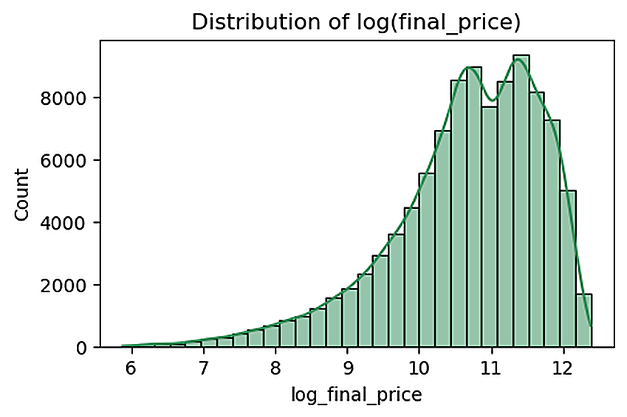
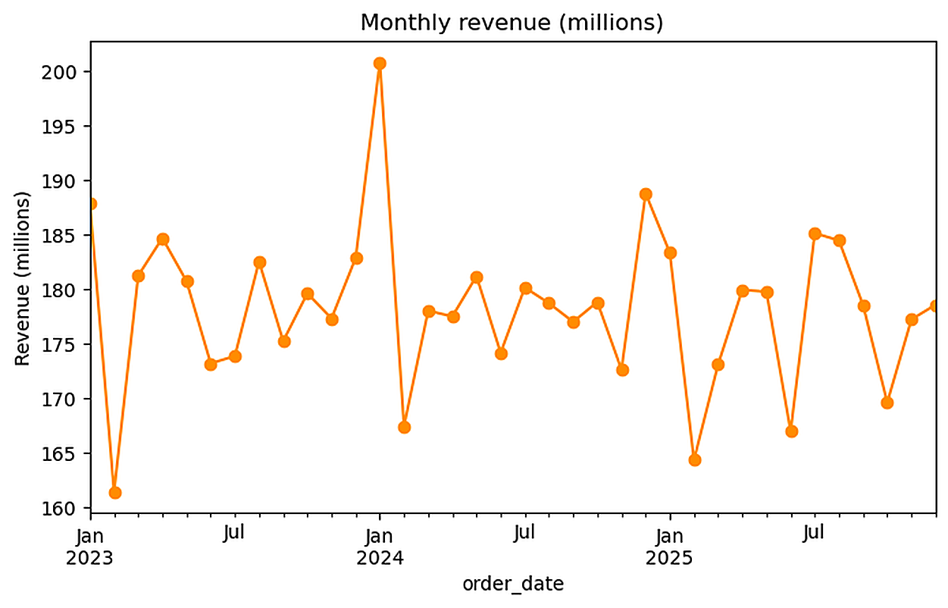
SECTION 05
Distribution Shape & Revenue Concentration
log(final_price) distribution
Monthly revenue trend (₹M)
0.935
0.169
-0.986
26.4%
final_price skewness — right-skewed
final_price kurtosis — near-normal tails
Skew after log transform (over-corrected)
Of total revenue from top 10% of orders
Revenue is right-skewed and concentrated: a small share of large transactions drives a disproportionate share of total revenue, consistent with the outlier findings.
NextHikes IT Solutions | Retail Transaction EDA
11

Slide 12
SUMMARY
Key Statistical Findings
Revenue Distribution
Price & Quantity Drive Revenue
Right-skewed with heavy influence from a limited number of high-value transactions.
product_price (r=0.73) and quantity (r=0.58) are the strongest correlates of final_price.
Discounts Trim Revenue Slightly
Outliers Are Genuine, Not Errors
Discount percentage shows a mild negative relationship with order value.
1.33% of orders are statistical outliers — large baskets and premium purchases.
Segment & Shipping Effects Are Small
Revenue Is Concentrated
ANOVA, t-test and chi-square results show no statistically significant differences.
The top 10% of orders contribute 26.4% of total revenue.
NextHikes IT Solutions | Retail Transaction EDA
12

Slide 13
CONCLUSION
From Exploration to Action
Applied univariate, bivariate and multivariate techniques across 100,000 retail transactions
Quantified correlation, skewness, kurtosis and outlier behavior in pricing and revenue
Confirmed no multicollinearity among key numerical features (VIF ≈ 1.0)
Found that price and quantity — not demographics or shipping mode — drive final revenue
Established a validated, statistically-grounded foundation for future predictive modeling
Diksha Saxena • Submitted to NextHike • 25th September, 2026

