Slide 2
Project introduction & Profile
“Earn while learn” is a web application, which connects employer and job seekers where employers are the source of the resources and the job seeker can find and apply for their targeted job.

Slide 3
The Job Portal web application can be used by any employee to apply job and any employer are post to job.

Slide 4
Drawback of Existing system
Existing system are a failing in providing quick operation
Cost is high as well.
Processing very lengthy and time consuming.
More time consume for before generation.

Slide 5
Need for new System
1. Proposed Job Portal system consists of 3 modules: Job Seeker, Employer and Administrator.
2. Online Job Portal will provide the fast operation and low cost expense than old system.
3. Easy job search, which is a job seeker need

Slide 6
SOFTWARE REQUIREMENT
Operating System : Window XP, Windows 7 Front –End : HTML, Java Script, PHP Back-End : PHP, MYSQL Supporting Server : Apache Tomcat 5.5 , WampServer

Slide 7
Hardware Requirement
Processor : Intel Pentium IV,2.4 GHz RAM : 512 MB Hard Disk Drive : 40 GB Video : 800*600,1024*768 256 colors

Slide 8
Literature survey: existing system
Case studies for Naukari.com, baba.com, shine.com. They brought the revolution of online job portals, form traditional way of job searching to technical advancement.

Slide 9
Literature survey: Proposed system
Simple and progessional GUI.
Low cost and cost effective.
E-mail facilities and notifications.
24*7 online support system for employrs and job seekers.
No duplications of jobs.

Slide 10
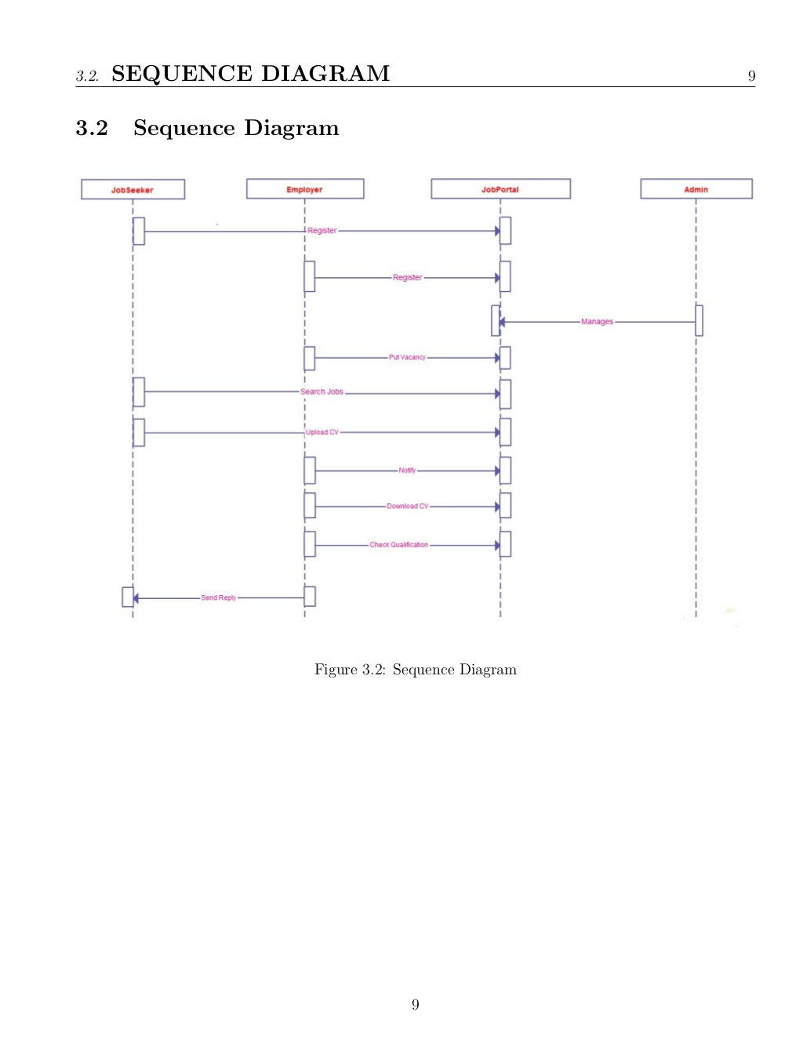
SEQUENCE DIAGRAM

Slide 11
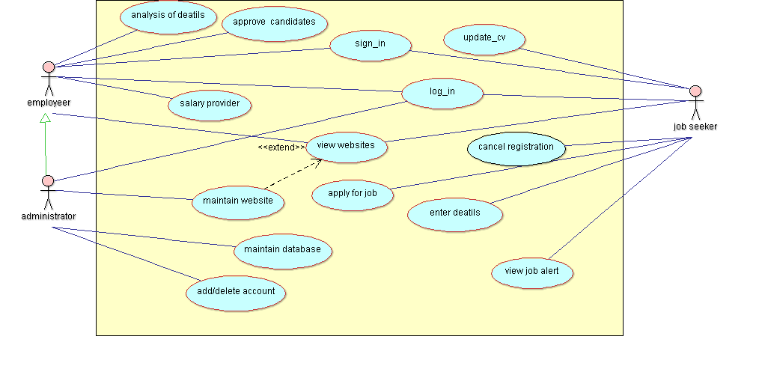
USE CASE DIAGRAM

Slide 12
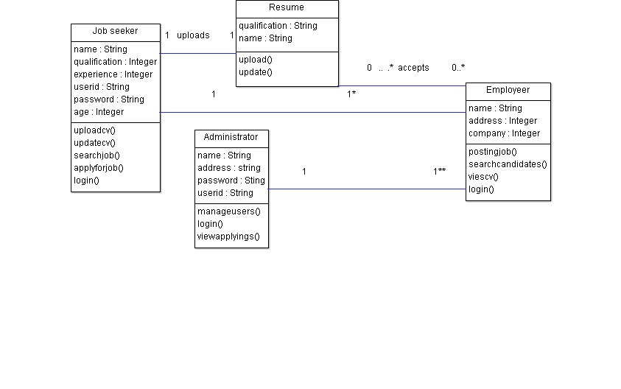
CLASS DIAGRAM

Slide 13
JOB SEEKER’S TABLE
FIELD | DATA TYPE | NULL | KEY
Ee.id | Int(4) | NO | YES
Ee_fnm | Varchar(40) | NO | NO
Ee_pwd | Varchar(10) | NO | NO
Ee_gender | Varchar(1) | NO | NO
Ee_email | Varchar(30) | NO | NO
Ee.Add | Varchar(300) | NO | NO
Ee_phno | Varchar(10) | NO | NO
Ee_mobileno | Varchar(10) | NO | NO
Ee_annual_salary | Int(10) | NO | NO
Ee_qualification | Varchar(10) | NO | NO
Ee_profile | Varchar(10) | NO | NO
Ee_dob | Varchar(20) | NO | NO
Ee_resume | Longtext | NO | NO

Slide 14
EMOPLOYEER’S TABLE
FIELD | TYPE | NULL | KEY
Er_id | Int(4) | NO | YES
Er_fnm | Varchar(30) | NO | NO
Er_pwd | Varchar(10) | NO | NO
Er_company | Varchar(30) | NO | NO
Er_add | Varchar(100) | NO | NO
Er_ph | Varchar(10) | NO | NO
Er_email | Varchar(30) | NO | NO
Er_company_profile | Varchar(300) | NO | NO
Er_dob | Varchar(20) | NO | NO

Slide 15
JOB TABLE
FIELD | TYPE | NULL | PRIMARYKEY
J_id | Int(4) | NO | YES
J_type | Varchar(40) | NO | NO
J_owner_name | Varchar(30) | NO | NO
J_title | Varchar(30) | NO | NO
J_hours | Float(3,1) | NO | NO
J_salary | Int(10) | NO | NO
J_experience | Int(3) | NO | NO
J_description | Varchar(300) | NO | NO
J_city | Varchar(20) | NO | NO
J_active | Int(1) | NO | NO

Slide 16
This system enables the jobseekers to login, to view all the vacancies and to view the applicant and vacancy details. Administrator • a. Should be able to create a new applicant. b. Should be able to change any of the editable details for the applicant. c. Should be able to search on Applicant Number and Vacancy Number. d. Attach an applicant to a vacancy - The relationship between applicant and vacancy.
6. • Job Seeker: a. Should be able to view all vacancies scheduled to be taken. b. Should be able to view the details of the company. c. Should be able to view the details of the vacancy. d. Should be able to search on vacancies, Applicant Number and Vacancy Number

Slide 17
Admin can Manage a Package or plan for Jobseeker. ➢Admin can View Register member and Manage Register Member in our site. ➢Admin Can View Jobseeker Details. ➢Admin Manage Company Details. ➢Admin can View Job alert. ➢Admin can View Apply job. ➢Admin can Manage Compose message Details. ➢Admin can View Inbox . ➢Admin can View post comment. ➢Admin can View Feedback.

Slide 18
Jobseeker can Login in our site. ➢ Jobseeker can View different different job plan. ➢Jobseeker can easily view company information. ➢Jobseeker can Update his/her profile information. ➢Jobseeker can Job alert. ➢Jobseeker can Apply for suitable job plan. ➢Jobseeker can easily Cancel member registration. ➢Jobseeker can View his/her Inbox. ➢Jobseeker can easily Post comment on our site.

Slide 19
Company can Login in our site. ➢Company can Update company profile. ➢Company can Create job criteria. ➢Company can view Compose message by Jobseeker and Admin. ➢Company can View inbox

