Slide 1
PRESTIGE INSTITUTE OF ENGINEERING MANAGEMENT AND RESEARCH ONLINE QUIZ GAME
SUBMITTED TO-
Prof. Atish Mishra
SUBMITTED BY-
Tripti Choudhary
Rashmi Sharma
Sajal Joshi

Slide 2
CONTENT
Introduction
Aims and objective
Problem definition
Existing system
Proposed system
Software requirement
Hardware requirement
Activity diagram
ER diagram
Use case diagram
Input design
conclusion

Slide 3
INTRODUCTION
We have designed this website with the purpose of allowing the students to give exams and view their results. This site is an attempt to remove the existing flaws in the manual system of conducting exams.
Student have provided flexibility to choose different types of online quiz.
Online quiz saves lots of time but also gives fast result.

Slide 4
AIMS AND OBJECTIVE
After learning subject like database management system ,networking and java in field of computer science ,we did not have much opportunity to use them to develop real life application.
These are the reason which encouraged us to take a topic like this and develop our own online quiz application which covers all the areas mentioned above.
This topic also allowed us to gain the necessary insights to develop a real world application.

Slide 5
PROBLEM DEFINATION
Existing System:
The first problem is that there are loads of hard copied documents
being generated .This bring us to the age old discussion of keeping
information form of databases versus keeping the same on sheets
of paper.
Drawback Of Existing System:
Lack of space
Filing poses a problem
Filtering is not easy
Reviewing become time consuming
Result processing

Slide 6
Proposed System
This web application provides facility to conduct online quiz
It saves time and display the results as the quiz is over ,so no need to wait for the result.
It is automatically generated by server. Administrator has a privilege to create ,modify and delete the test.

Slide 7
Features Of Proposed System
Functional capabilities
Performance level
Data structure
Reliability
Quality

Slide 8
SOFTWARE REQUIRMENT
Front end : HTML,CSS,JAVASCRIPT
Back end : My SQL,JAVA
OS : Window 7
Server : XAMPP

Slide 9
HARDWARE REQUIRMENT
RAM : 6 GB
Processor : AMD
Hard disk : 4 GB
Required Hard disk : apprx. 5mb
Keyboard : 105 keys

Slide 10
start
ACTIVITY DIAGRAM
registration
Login
password
passwordvalid
user
Types of quiz
aptitude
General knowledge
technical
result
logout

Slide 11
ER DIAGRAM
User name
Password
Name
Receiver
Father name
User
Register
Personal address
marks
Sex
Exam result
Registration
password
City
User name
User password
Result
Examination
perform
User name
General knowledge
Technical
Aptitude
Mobile no

Slide 12
Student registration
USE CASE DIAGRAM
Manage examination
Manage question bank
System login
Students
Administrator
Test
Reports

Slide 13
INPUT DESIGN

Slide 14
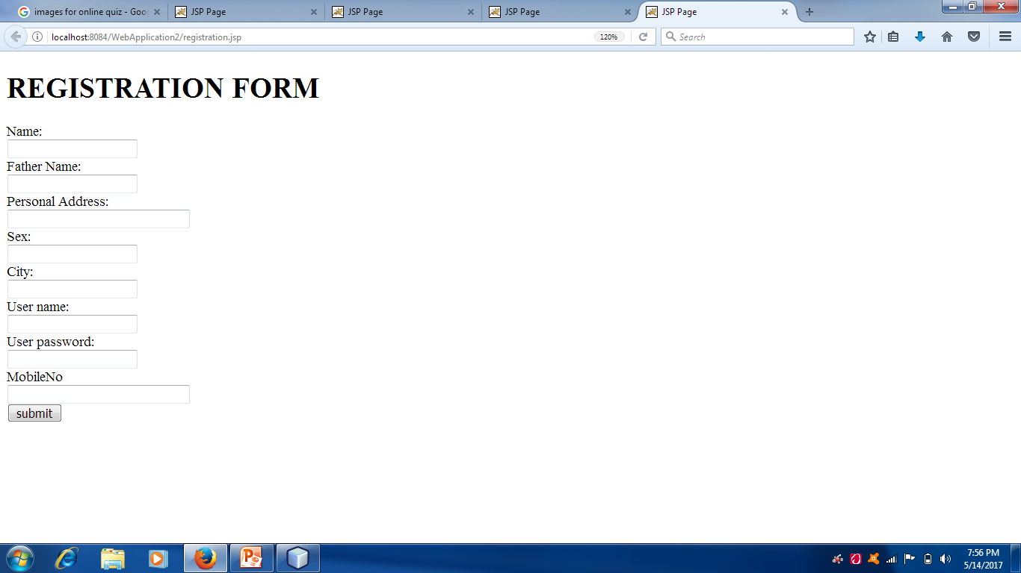

Slide 15
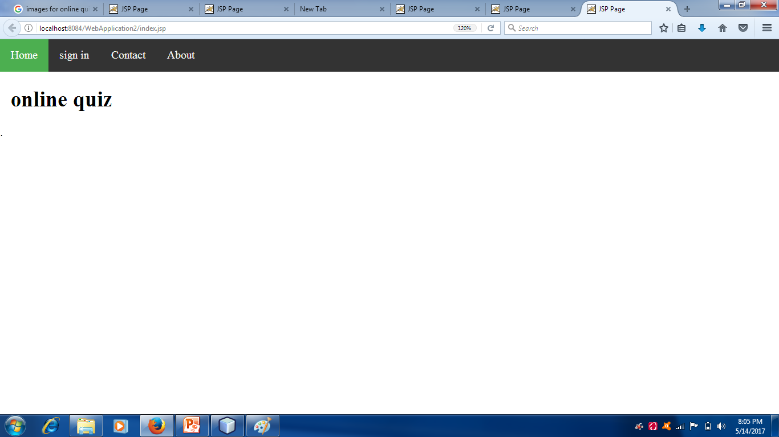

Slide 16
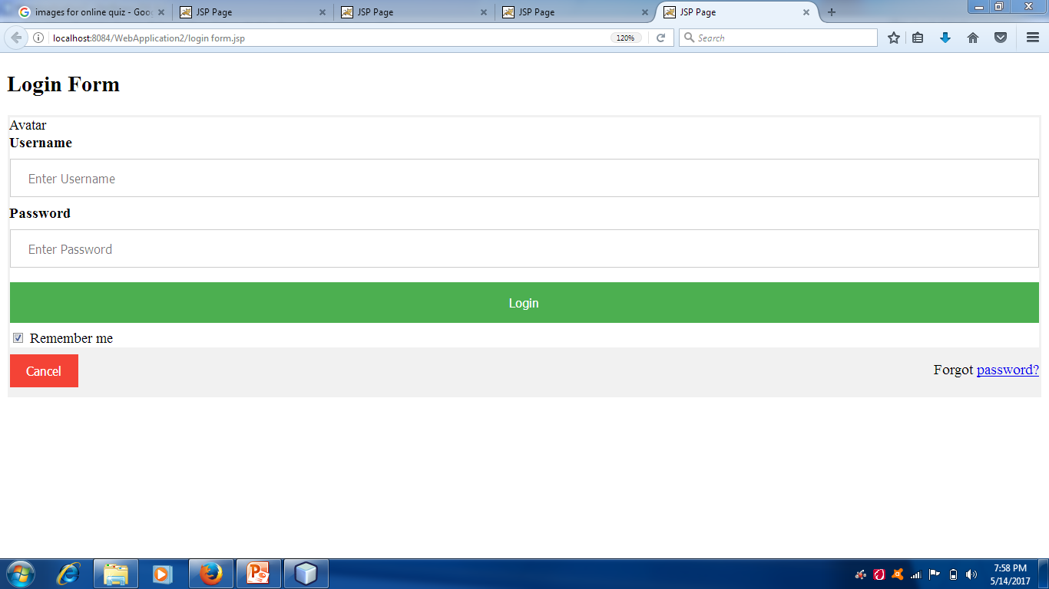

Slide 17
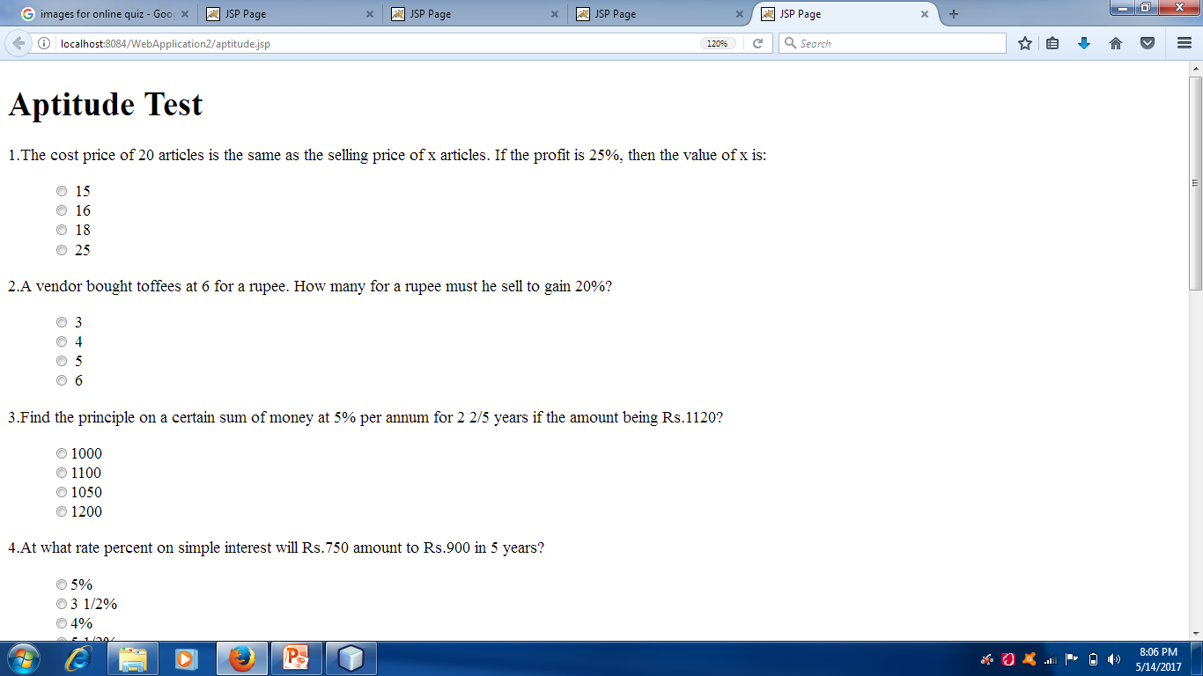

Slide 18
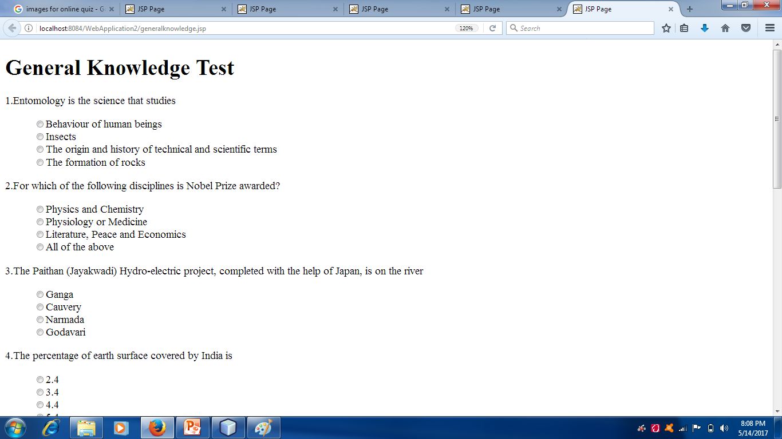

Slide 19
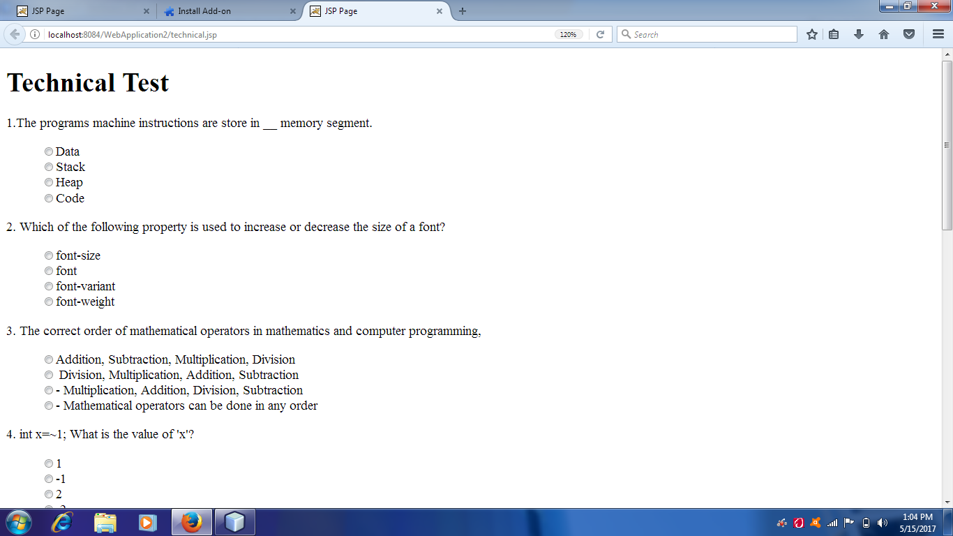

Slide 20
CONCLUSION
This project has helped us in getting a clearer understanding of real world application development.
It has provided us a deeper sight into connecting databases with servers.
The entire learning outcome of this project has proved to be immensely beneficial for our future application development.

Slide 21
THANK YOU

