Slide 1
PRESTIGE INSTITUTE OF ENGINEERING
MINOR PROJECT
TOPIC: EARN WHILE LEARN
GUIDED BY: SUBMITTED BY:
PROF. ATISH MISHRA AASTHA KATIYAR DIKSHA SHIVHARE
ARBAZ WARSI

Slide 2
Content:
Project introduction
Drawback of existing system
Need of new system
Software and hardware requirements
Front end back end
Literature survey
UML,ER,Sequence Diagram
Database design and roles of users
Screenshots and advantages
Future enhancements

Slide 3
Project Introduction & Profile
“Earn while learn” is a web application, which connects employers and job seekers where employers are the source of the resources and the job seeker can find and apply for their targeted job.

Slide 4
Drawback of Existing system
Existing system are a failing in providing quick operation
Cost is high as well.
Processing is very lengthy and time consuming.

Slide 5
Need for new System
Proposed system consists of 3 modules: Job Seeker, Employer and Administrator.
It will provide the fast operation and low cost expense than old system.
Easy job search by sitting at home , which is a job seeker need.

Slide 6
Software requirement
Operating System : Ubuntu 16
Text Editor/IDE: Sublime text 3
UML Modelling tool : ArgoUML : 0.34
ER diagram: Erdplus-diagram

Slide 7
Hardware Requirement
Processor : Intel Pentium IV,2.4 GHz RAM : 512 MB Hard Disk Drive : 40 GB Video : 800*600,1024*768 256 colors

Slide 8
Front end
HTML (Hyper Text Mark up Language): Version 5
CSS (Cascading Style Sheets) : Version 3
Bootstrap : Version 3.3.7

Slide 9
Back end
Core language : “RUBY”
Version Used : 2.5
Framework Used : “Rails”
Version Used : 5.1.4
Database Used : SQLite 3

Slide 10
Literature Survey: Existing System
Case studies for Naukari.com, baba.com, shine.com. They brought the revolution of online job portals, form traditional way of job searching to technical advancement.

Slide 11
Literature Survey: Proposed System
Simple and professional GUI.
Low cost and cost effective.
E-mail facilities and notifications.
24*7 online support system for employers and job seekers.
No duplications of jobs.

Slide 12
Steps to be followed:
Job seeker will register on the site.
Employers will post the jobs.
job seeker will go through to the site.
if he interested, he will apply for job.
Employer will view profile of jobseeker an will accept/deny him/her for job.
After getting confirmation from employer side, employer will send an email to job seeker as well as admin, and vacancy will be removed from the site.

Slide 13
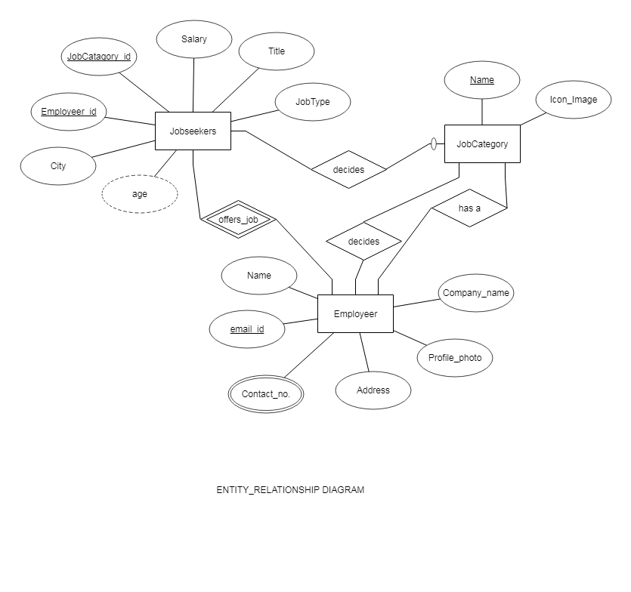

ER Diagram

Slide 14
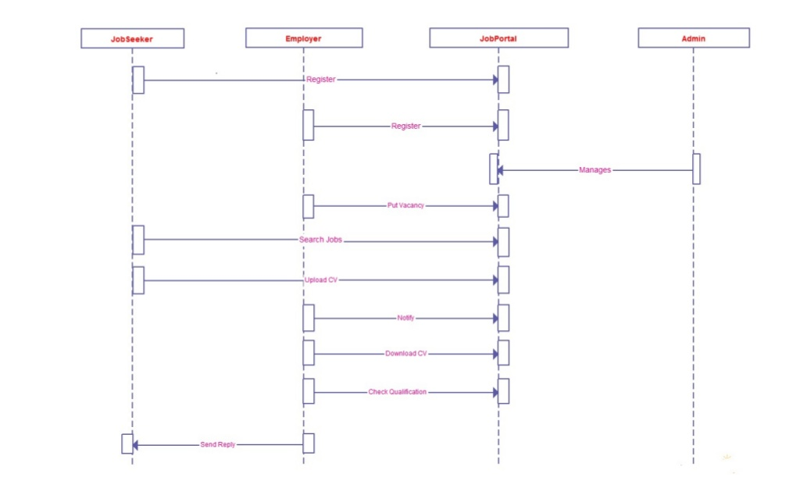
Sequence Diagram

Slide 15
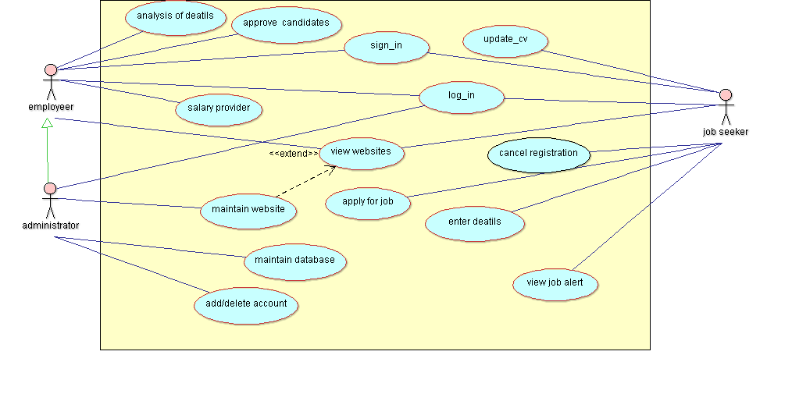
Use Case Diagram

Slide 16
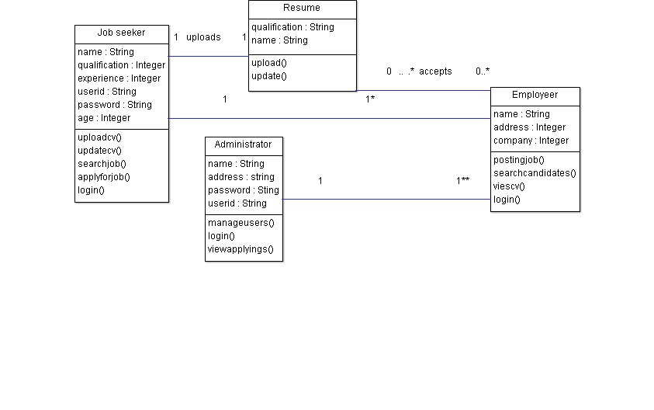
Class Diagram

Slide 17
Job Seeker’s Table
FIELD | DATA TYPE | NULL | KEY
Ee.id | Int(4) | NO | YES
Ee_fnm | Varchar(40) | NO | NO
Ee_pwd | Varchar(10) | NO | NO
Ee_gender | Varchar(1) | NO | NO
Ee_email | Varchar(30) | NO | NO
Ee.Add | Varchar(300) | NO | NO
Ee_phno | Varchar(10) | NO | NO
Ee_mobileno | Varchar(10) | NO | NO
Ee_annual_salary | Int(10) | NO | NO
Ee_qualification | Varchar(10) | NO | NO
Ee_profile | Varchar(10) | NO | NO
Ee_dob | Varchar(20) | NO | NO
Ee_resume | Longtext | NO | NO

Slide 18
Employer’s Table
FIELD | TYPE | NULL | KEY
Er_id | Int(4) | NO | YES
Er_fnm | Varchar(30) | NO | NO
Er_pwd | Varchar(10) | NO | NO
Er_company | Varchar(30) | NO | NO
Er_add | Varchar(100) | NO | NO
Er_ph | Varchar(10) | NO | NO
Er_email | Varchar(30) | NO | NO
Er_dob | Varchar(20) | NO | NO

Slide 19
Job Table
FIELD | TYPE | NULL | PRIMARYKEY
J_id | Int(4) | NO | YES
J_type | Varchar(40) | NO | NO
J_title | Varchar(30) | NO | NO
J_hours | Float(3,1) | NO | NO
J_salary | Int(10) | NO | NO
J_experience | Int(3) | NO | NO
J_description | Varchar(300) | NO | NO
J_city | Varchar(20) | NO | NO

Slide 20
Roles of users
Employer
Create the jobs and adds job seekers.
Change any of the editable details for the job seekers.
Can view vacancy and job postings.
Accept or deny candidates.

Slide 21
Job Seeker:
View all vacancies and job plans available.
View the details of the company and vacancy available.
Login in and Apply for job.
Update his/her profile information.
Can cancel member registration.
View his/her Inbox.

Slide 22
Administrator
Admin can Manage plan for Jobseeker.
Admin can View Register member and Manage Register Member.
Admin Can View Jobseeker Details, Job alerts.
Admin Manage Company Details.
Admin can View Apply jobs.
Admin can Manage Compose messages/E-mails Details.
Admin can View Inbox .

Slide 23
SCREENSHOTS FOR “EARN WHILE LEARN”

Slide 24
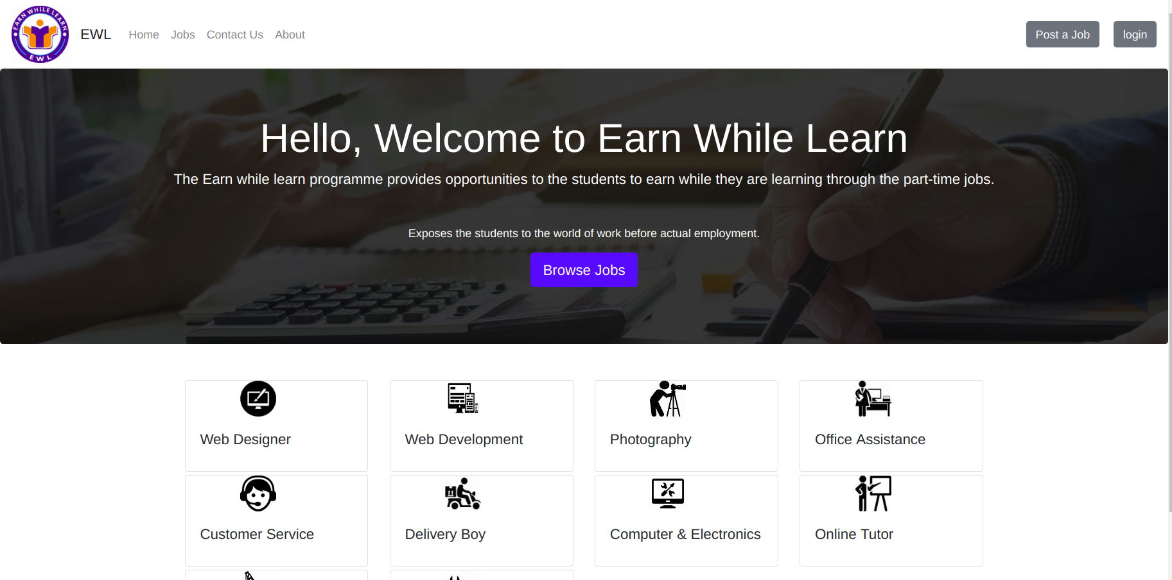
HOME PAGE

Slide 25
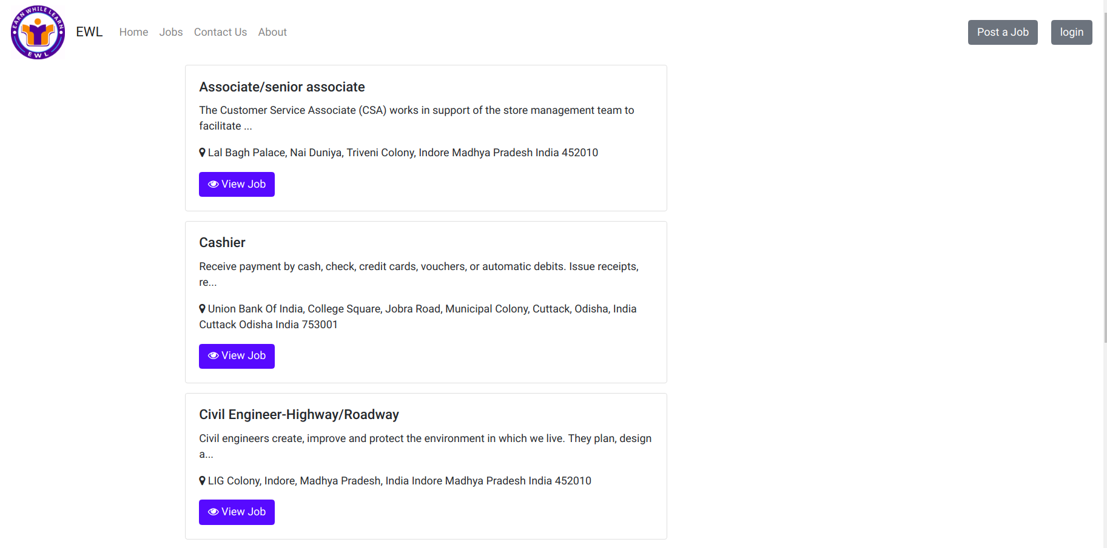
BROWSE JOBS

Slide 26
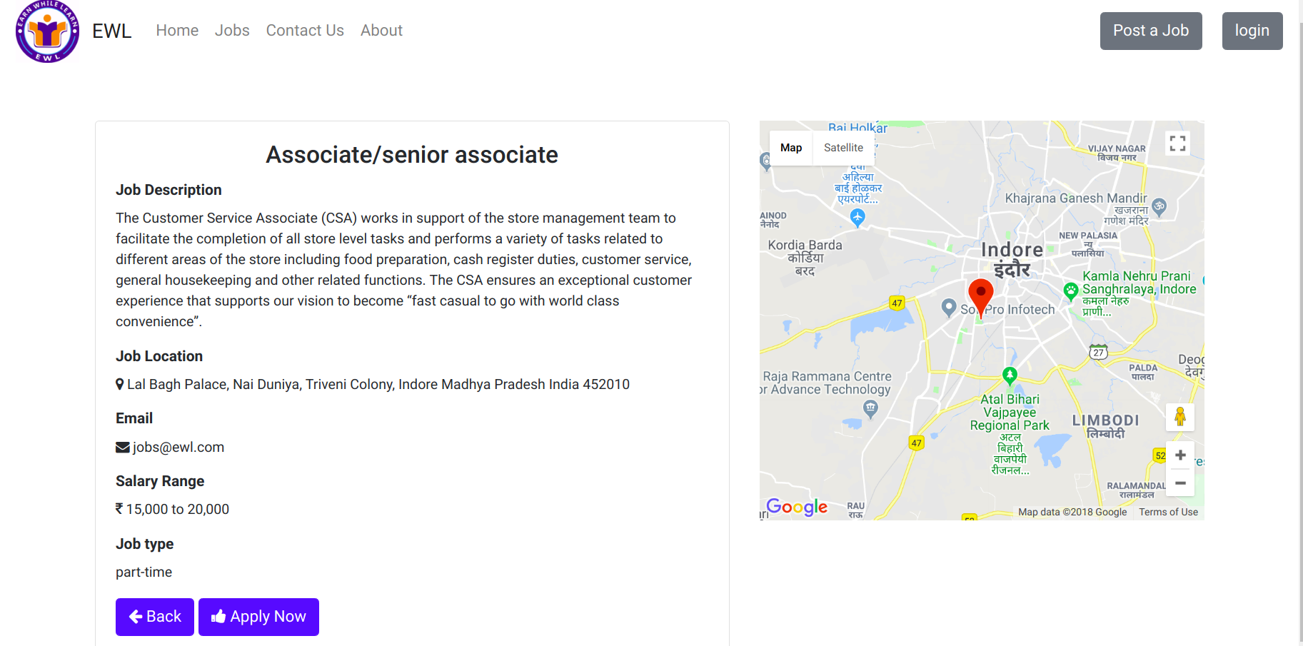
VIEW JOB

Slide 27
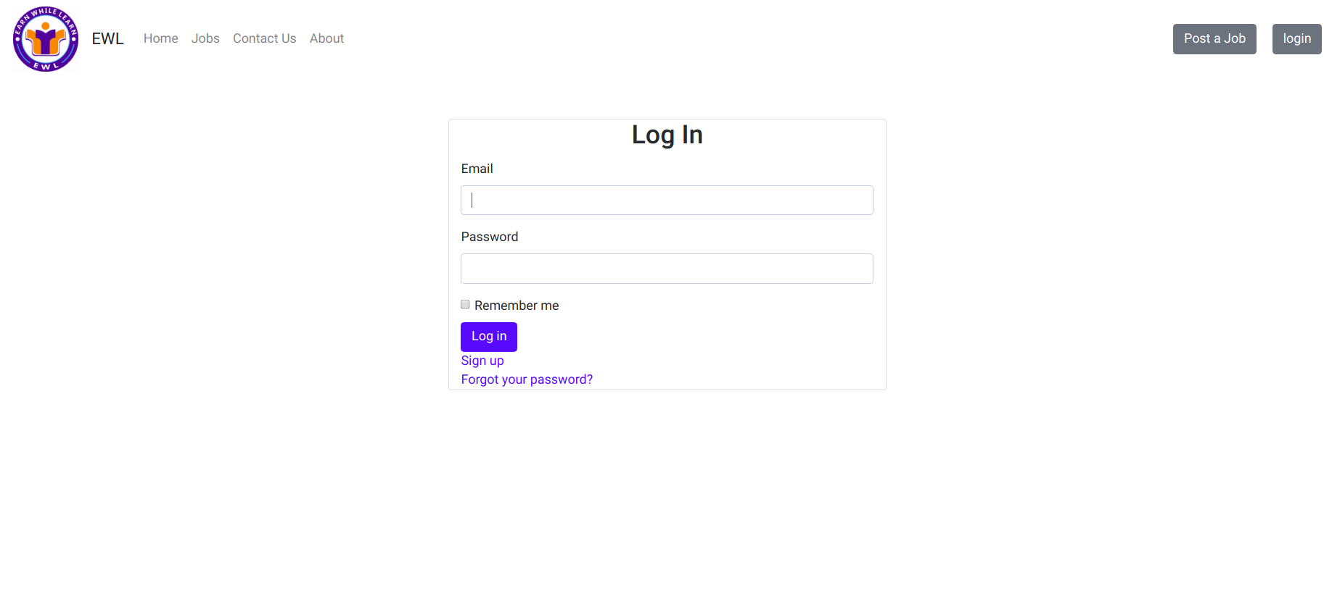
LOG IN

Slide 28
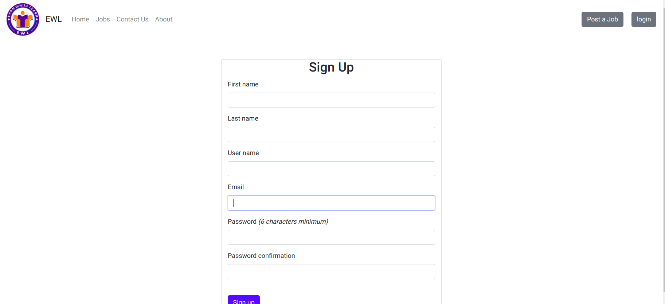
SIGN UP

Slide 29
Advantages and Usage
In getting online or offline jobs as part time and full time jobs.
Learning and self employment.
Work from home.
Less time to learn as t is GUI based application.
Variety of jobs are available.
Improve technical skills.
Comfort , flexibility and user friendly.
Security, only authorized user can use this application.
E-mail, Notification facility available.

Slide 30
Future enhancement
Online Payments.
Chat between Employer and jobseeker (text or audio).
Review and ratings for the employer’s by job seekers.

Slide 31



