Slide 1

Prestige institute of engineering
management and research
TOPIC : EARN WHILE LEARN
Guided by : Submitted by:
Prof. Atish Mishra Aastha Katiyar Diksha Shivhare Md. Arbaz Warsi

Slide 2


Slide 3

INTRODUCTION
“ Earn while learn “ , is a web application, formed with the help of rails which is the frame work of ruby programming language. By this website one can make money by part time and full time jobs also, even sitting at home at the time of learning or studying.
The Earn while learn program provides opportunities to the students to earn while they are learning through the part-time jobs and the entrepreneurial projects thus preparing them to shoulder professional assignments with relative ease.
Various part-time job opportunities are provided to the students within the campus. The part-time student employees could work as Library Assistants, Computer Service Assistants, Data entry Operators, Project/Lab Assistants, Assistant Coaches/Trainers and Career Counselors.
Also, the college provides its budding entrepreneurs with necessary guidance and resources to initiate and run their entrepreneurial ventures as well as provides for incubation of their business ideas.

Slide 4
Software Requirements
Operating System : Ubuntu 16.04 Lts
Text editor/IDE : Sublime text 3
ArgoUML : 0.34 - UML Modelling tool (USE CASE DIAGRAM)
Erdplus-diagram : ER diagram

Slide 5
BACK END:
Core language : “RUBY”
Version Used : 2.5.0p0
Framework Used : “Rails”
Version Used : 5.1.4
Database Used : SQLite 3

Slide 6

FRONT END:
HTML (Hyper Text Mark up Language): Version 5
CSS (Cascading StyleSheets) : Version 3
Bootstrap : Version 3.3.7

Slide 7
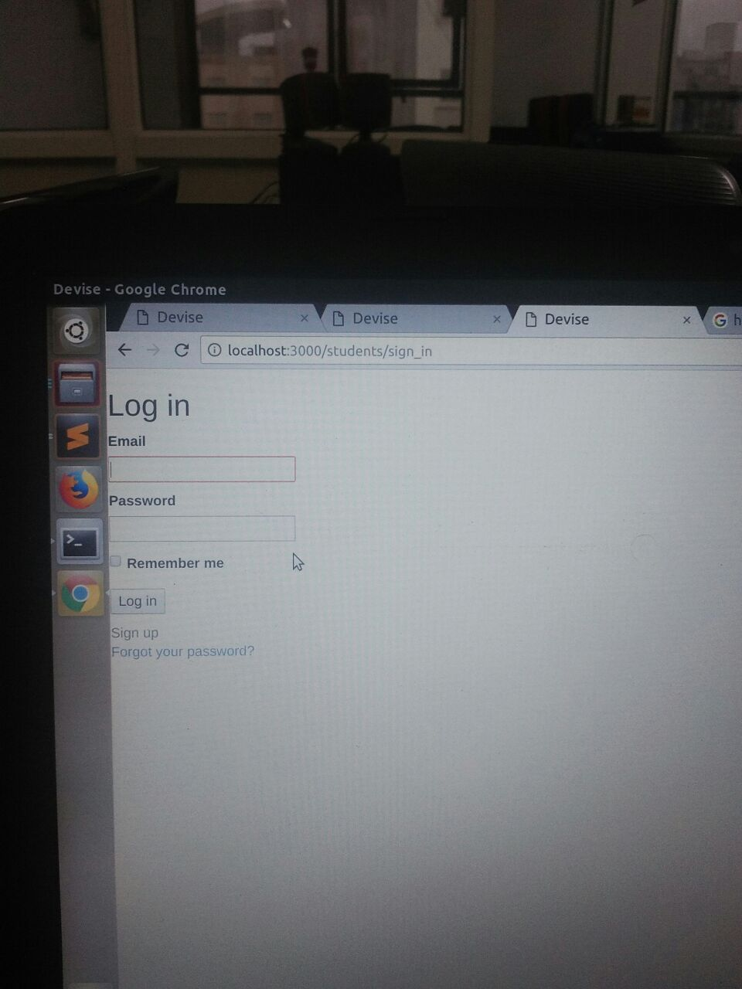
**Log in page for user log in **

Slide 8
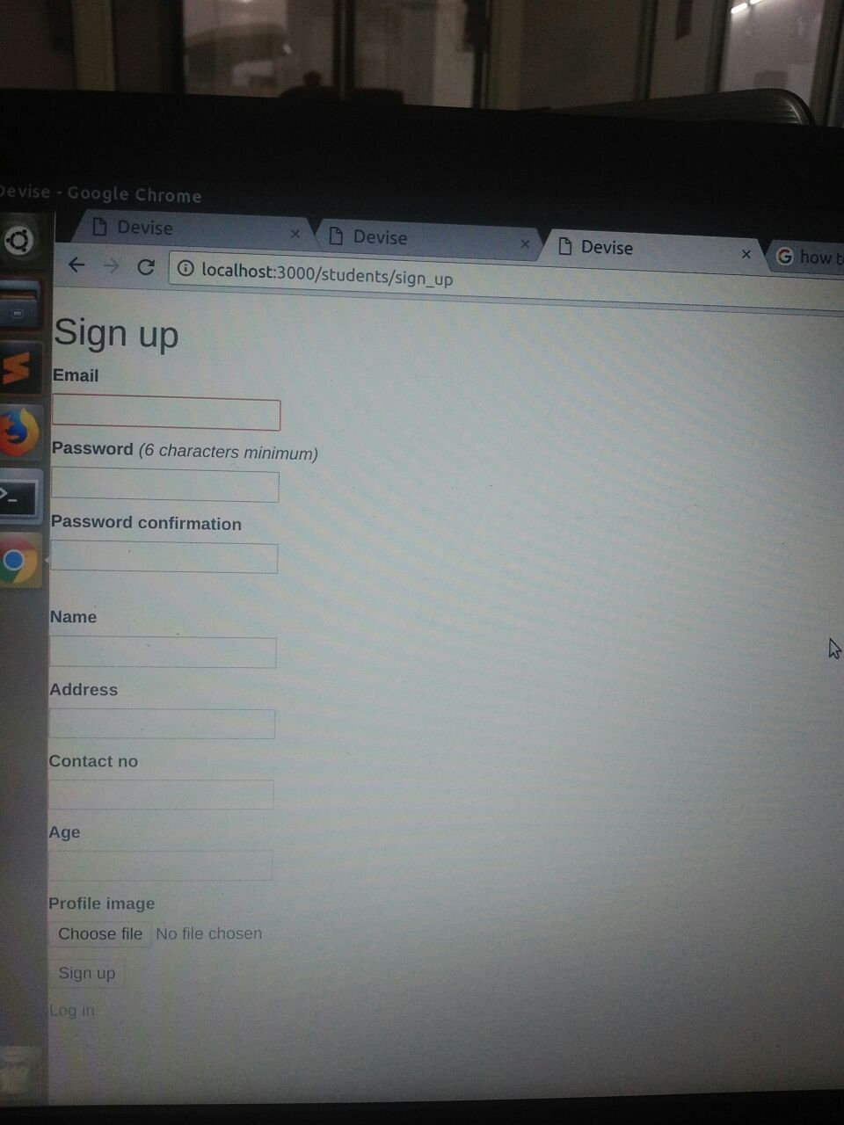
**Sign up page for the user**

Slide 9
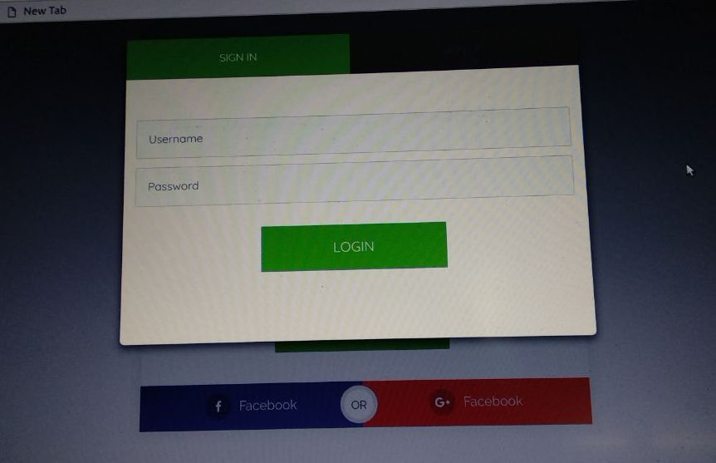
LOG IN FORM FOR FRONT END

Slide 10
User Description
In this project there will be two user : Job seeker and Employer.
Job seeker will register or log in to the system and enter his/her information on a site with its details about education and qualification.
Employer will analyse that detail and on the basis of its information ..and will conduct their interview and will appoint him/her.
Precondition for the entering in to the website is a proper “LOG IN “.

Slide 11
Steps to be followed ...
Job seeker will log in to the system .
Job seeker will fill required information for job on the basis of his/her education.
Employer will analyse that details according to the need , and will offer job based on criteria.
Online interview of the candidate will be conducted for the shortlisted candidates.
Those who have cleared interview will be selected for their job.
On the basis of their education, they will get their job .likewise:
Web designer , web developer job will be given to a computer science engineering student.
One can also get internships and training in companies.

Slide 12
Opportunities for the Job seekers
There will be some job opportunities :
Web designer
Web developer
Delivery boy
Data entry job
Billing and calculation
Typing master requirement
tutor
Other than these jobs there will be many other job for thems ,according to their education and qualification.

Slide 13

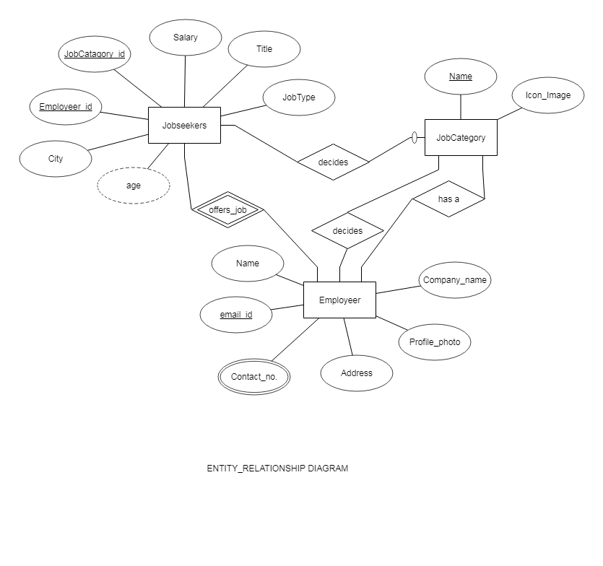

Slide 14
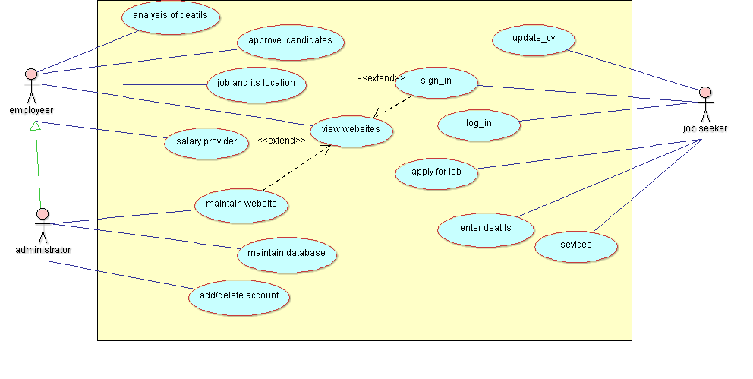

Slide 15
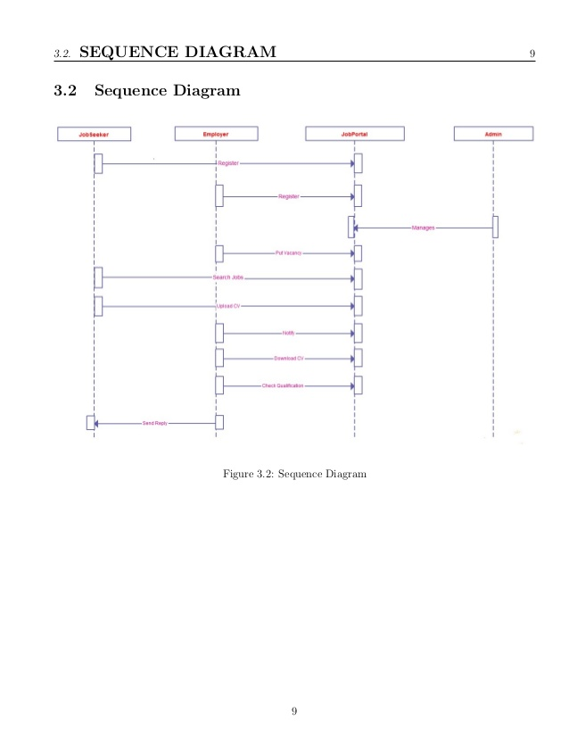

Slide 16
Advantages and Uses
1. It is used in getting online or offline jobs for job seekers as part time and full time jobs.
2. Learning and self employment.
3. Work from home.
4. Less time to learn as t is GUI based application.
5. Variety of jobs are available
6. Continue in current profession
7. Improve technical skills.
8.Comfort and flexibility and user friendly
9. only authorized user can use this application

Slide 17



