Slide 1
PRESTIGE INSTITUTE OF ENGINEERING MANAGEMENT & RESEARCH
TOPIC : EARN WHILE LEARN
Aastha Katiyar
Diksha Shivhare
Mo. Arbaaz Warsi

Slide 2


Slide 3

FRONT END:
HTML (Hyper Text Mark up Language): Version 5
CSS (Cascading StyleSheets) : Version 3
Bootstrap : Version 3.3.7

Slide 4
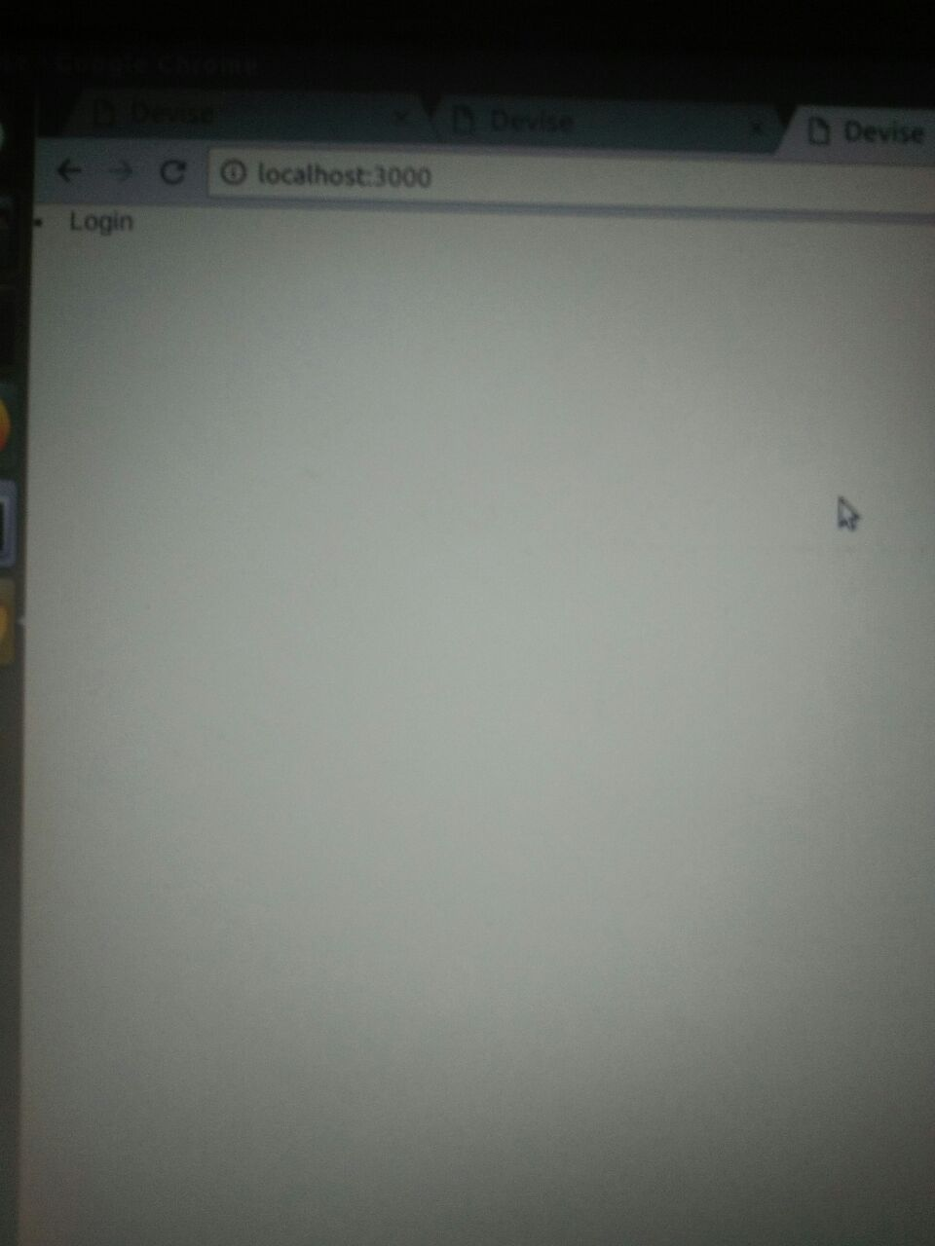
** LOG IN PAGE FOR “EARN WHILE LEARN” **

Slide 5
Software Requirements
Operating System : Ubuntu 16.04 Lts
Text editor/IDE : Sublime text 3

Slide 6
BACK END:
Core language : “RUBY”
Version Used : 2.5.0p0
Framework Used : “Rails”
Version Used : 5.1.4
Database Used : SQLite 3

Slide 7
User Description
In this project there will be two user : Student and Employer.
Student will register his/her information on a site with its details about education and qualification.
Employer will analyse that detail and on the basis of its information ..and will take its interview and will appoint him/her.
Precondition for the entering in to the website is a proper “LOG IN “.

Slide 8
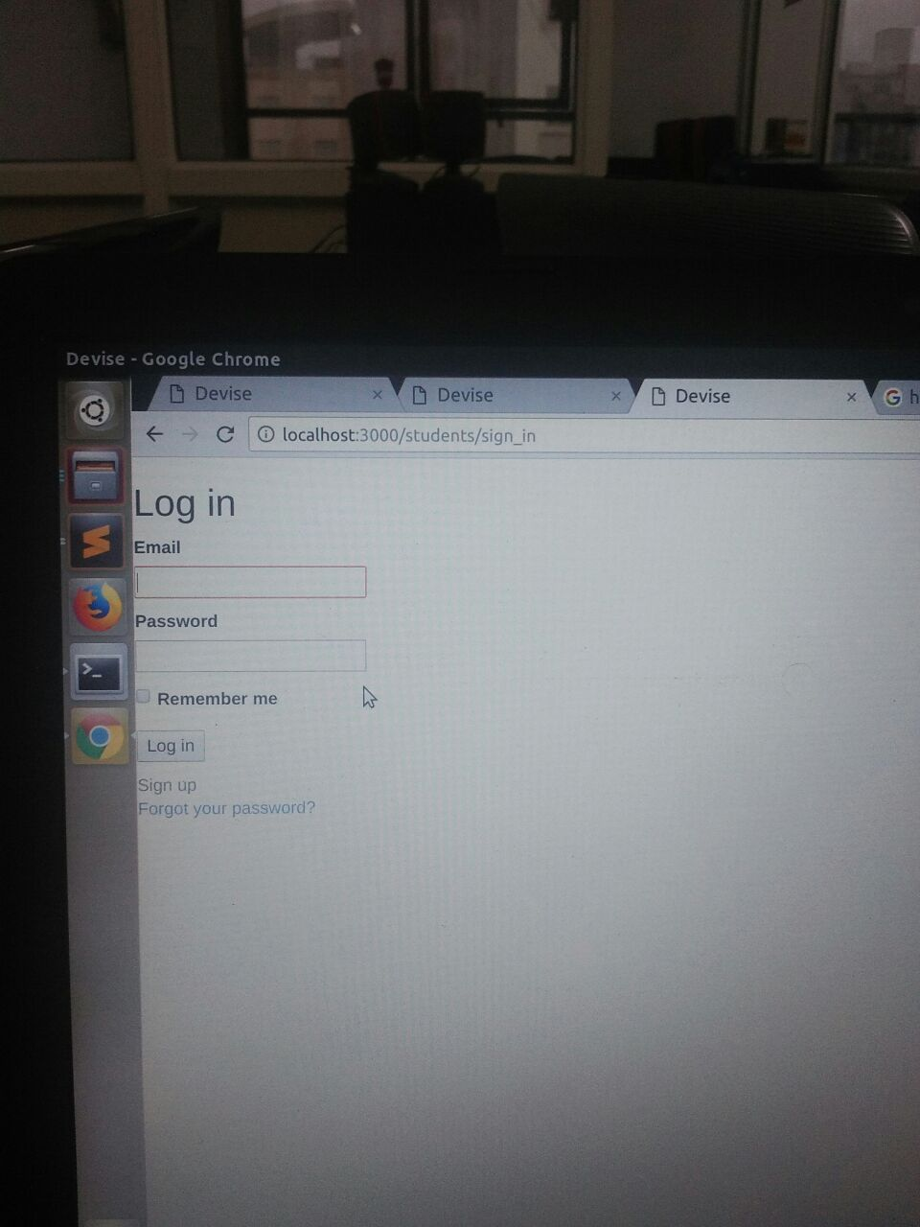
**Log in page for user log in **

Slide 9
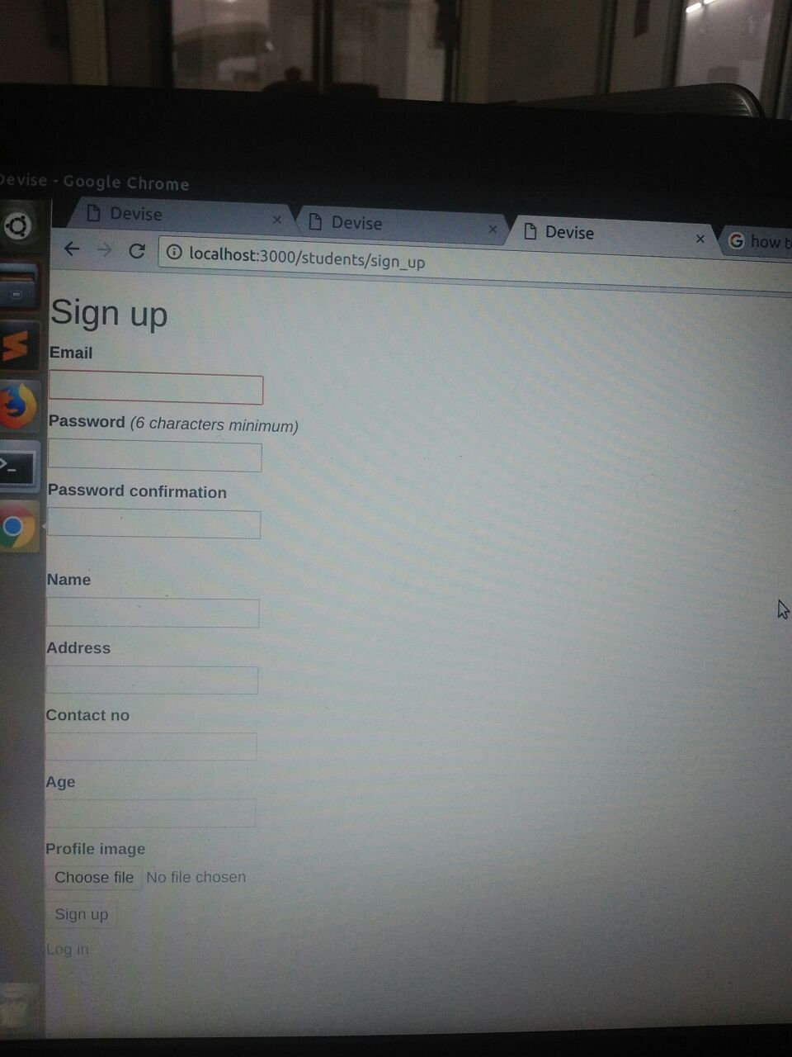
**Sign up page for the user**

Slide 10
Opportunities for the student
There will be some job opportunities for the students :
Web designer
Web developer
Delivery boy
Data entry job
Billing and calculation
Office Boy
Other than these jobs there will be many other job for the students ,according to their education and qualification.

Slide 11
Steps to be followed ...
Student will log in to the system .
Student will fill registration form with details of his/her education.
Employer will analyse that details according to the need , and will offer job based on criteria.
Online interview of the candidate will be conducted for the selected student.
Student , who have cleared interview will be selected for their job.
On the basis of their education and qualification , they will get their job .likewise:
Web designer , web developer job will be given to a computer science engineering student.

Slide 12
Advantages and use
1. It is used in getting online jobs for students for part time jobs.
2. Learning and self employment.
3. Work from home.

Slide 13


